Slide 1




Slide 2

OUTLINE
Area of operations and water supply
Overview by the Chairperson of the Board
Overview of financial performance
Overview of non-financial performance
Update on the ADM debt
Tariff proposal 2019/20
Looking forward
Acknowledgements and appreciation

Slide 3


Area of operations and water supply
01

Slide 4
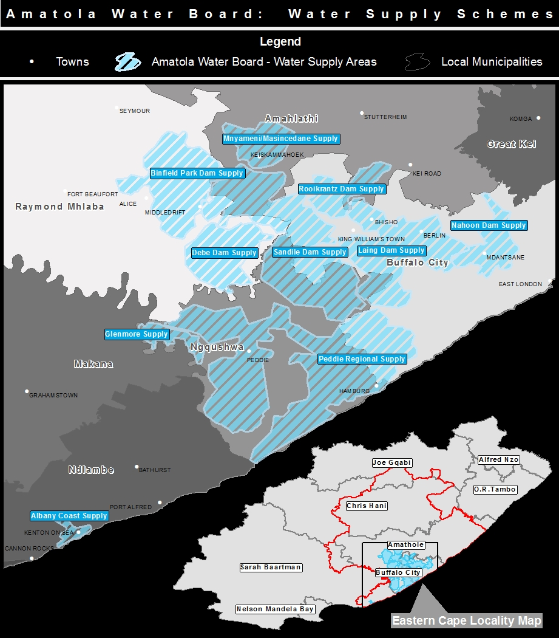
TYPE HEADING IN UPPERCASE

Slide 5
Secondary Business Activities
Amatola Water has undertaken some implementing agency work mainly for Department of Water and Sanitation, and in particular under the Regional Bulk Infrastructure Grant (RBIG) programme
Work for other clients like National Department of Public Works and Eastern Cape Department of Education has been undertaken.

Slide 6
Secondary Business Activities
Project name | Projection Description | Impact
King Sabata Dalindyebo Presidential Intervention (KSDPI) | The KSDPI Bulk Water Project aims to unlock housing and commercial development for the region as well as Mthatha. | To expand Mthatha’s existing bulk water supply system operated by the OR Tambo DM to create a regional scheme extending along five development “corridors” and serving just over one million people. Aims to unlock housing and commercial development for the region rather than Mthatha only.
King Sabata Dalindyebo: Mthatha Pipe Replacement | Replacement of failing old dilapidated pipes, associated monitoring mechanisms and rehabilitation of leaking reservoirs (10 x contracts). | Improve the level of service to the community. Reduce the number of pipe bursts.
Nooitgedagt/Coega Low Level Supply Scheme (NCLLS) | PHASE 3: Construction of WTW, 45Mℓ reservoir, and AC pipeline mitigation | NMBM currently supplies 310Ml/d of treated water to some 1.23 million consumers and smaller municipalities around the metropolitan boundaries. The new extension of the WTW will be upgraded from 70Ml/d to an average capacity of 160Ml/d (10Ml/d peak), with new associated mechanical and electrical works.

Slide 7
Secondary Business Activities
Project name | Projection Description | Impact
Department of Water and Sanitation: Dam Management | Operations and maintenance on 21 dams within the Eastern Cape province. | Safety integrity of dams managed under this contract.
National Department of Public Works: Operation and maintenance on state-owned properties | Operations and maintenance for the water care facilities on state-owned properties. | • Assurance of potable water supply that complies with SANS 241 and the Blue Drop Standard. • Safe and hygienic environment. • Safe discharge of treated effluent that complies with SANS 241 and the Green Drop Standard.
Eastern Cape Department of Education: support operations and maintenance | Assessment, refurbishment and/or upgrading of bulk water and sanitation infrastructure as well as provision of operations and maintenance services to the Eastern Cape schools, as identified from time to time (140 x schools; 223 x contracts). | • Assurance of potable water supply that complies with SANS 241 and the Blue Drop Standard. • Safe and hygienic environment. • Safe discharge of treated effluent that complies with SANS 241 and the Green Drop Standard.

Slide 8
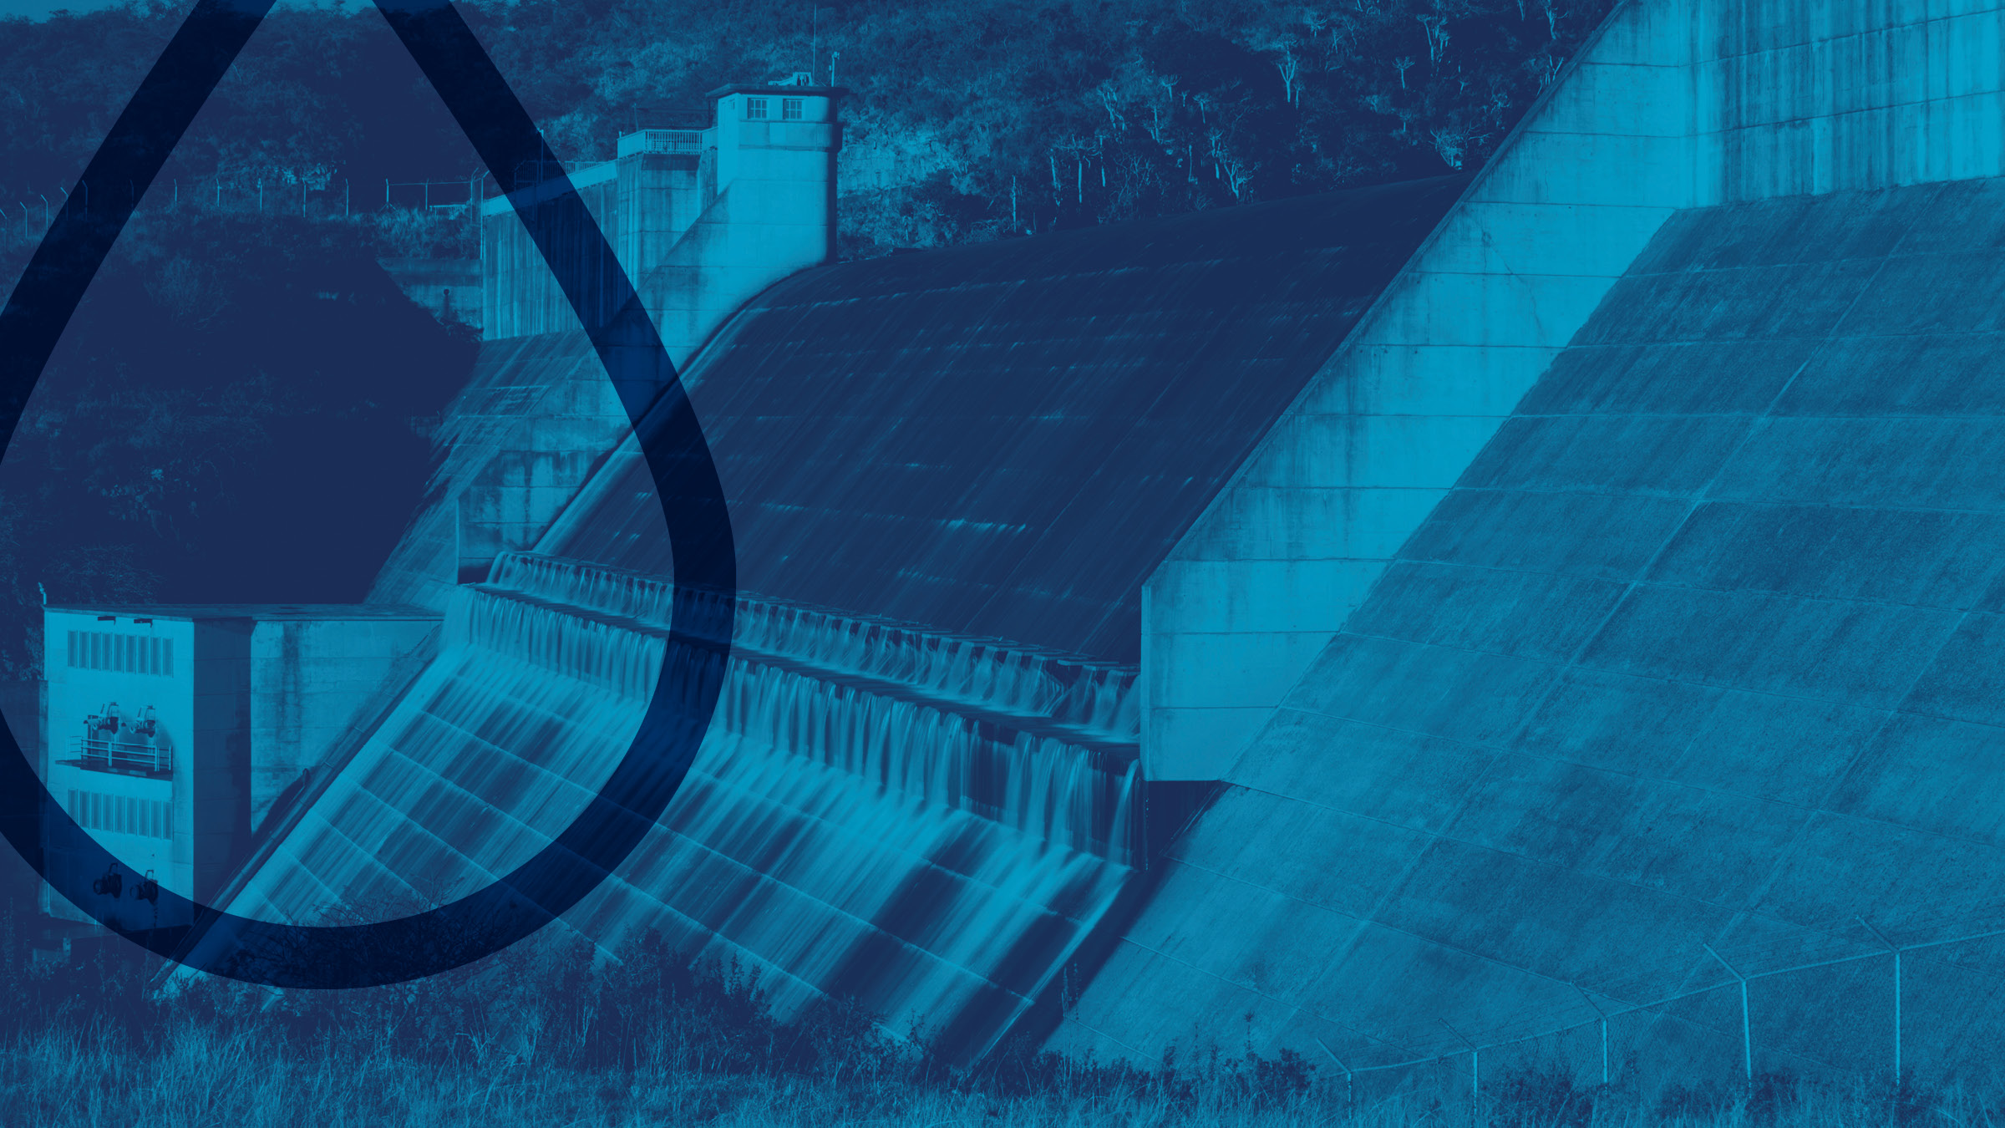
Overview by the Chairperson of the Board
02

Slide 9
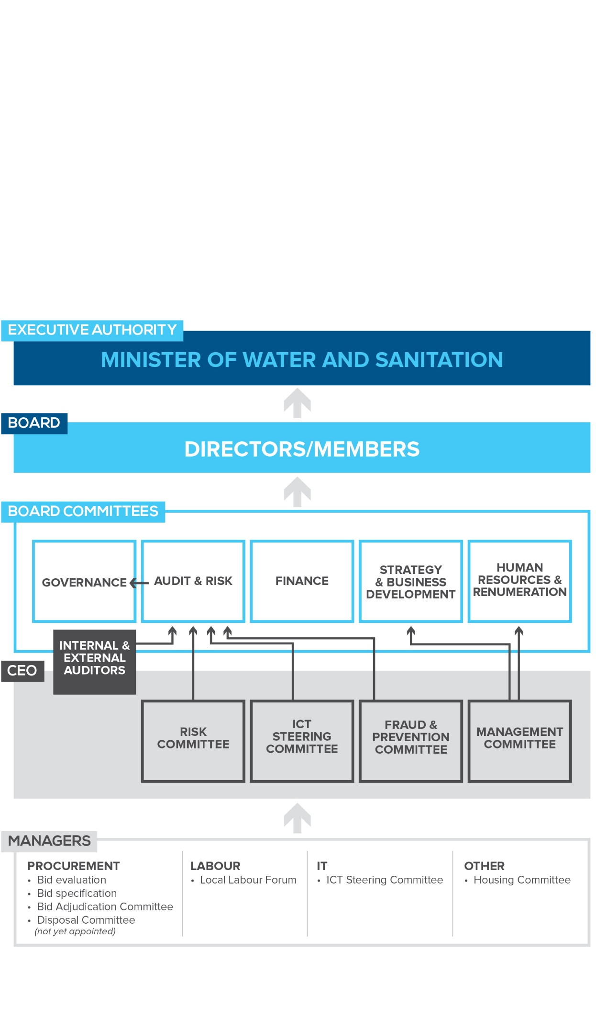
Governance Structure

Slide 10
Overview by Chairperson of the Board
State of governance in the organisation
  In six consecutive years, Amatola Water has achieved an unqualified audit outcome.
  The Board is committed to zero tolerance on fraud and corruption and has approved the revised Anti-Fraud and Corruption strategy.
Stakeholder collaboration and engagements
  Board places great deal of emphasis on accountability to its communities, customers, employees, DWS, NT and other key stakeholders.

Slide 11
Overview by Chairperson of the Board
Achievements from TAP implementation
Appointment of the permanent Chief Executive Officer and key critical staff to strengthen leadership and organisational effectiveness.
A leadership change management programme is being implemented to create support and buy-in as well as leadership cohesion and team culture.
Stakeholder and client relations are being conducted in line with the approved Stakeholder Relations and Communication Policy.
An interim structure to rebuild and support the organisational stability has been developed and is awaiting consultation and Board approval.

Slide 12
Overview by Chairperson of the Board
Achievements from TAP implementation
The Amatola Water Infrastructure Master Plan is being developed and is expected to be completed in 2018/19.
The Infrastructure Procurement Policy, which is aimed at promoting operational efficiencies, improved turnaround times and compliance with procurement legislation, has been approved by the Board.
Planning and Development (P&D) war rooms have been established to focus on improving delivery for secondary projects.
Four professional registered and experienced engineers have been appointed to augment P&D’s capacity to accelerate project implementation. One of these engineers is heading the Project Management Unit (PMU).
A Financial Recovery Plan has been developed to implement cost containment measures, and improve debt and credit management controls.
Supply Chain Management war rooms have been established to improve the effectiveness and efficiency of procurement processes and, in particular, those relating to secondary projects.

Slide 13

Overview of financial performance
03

Slide 14
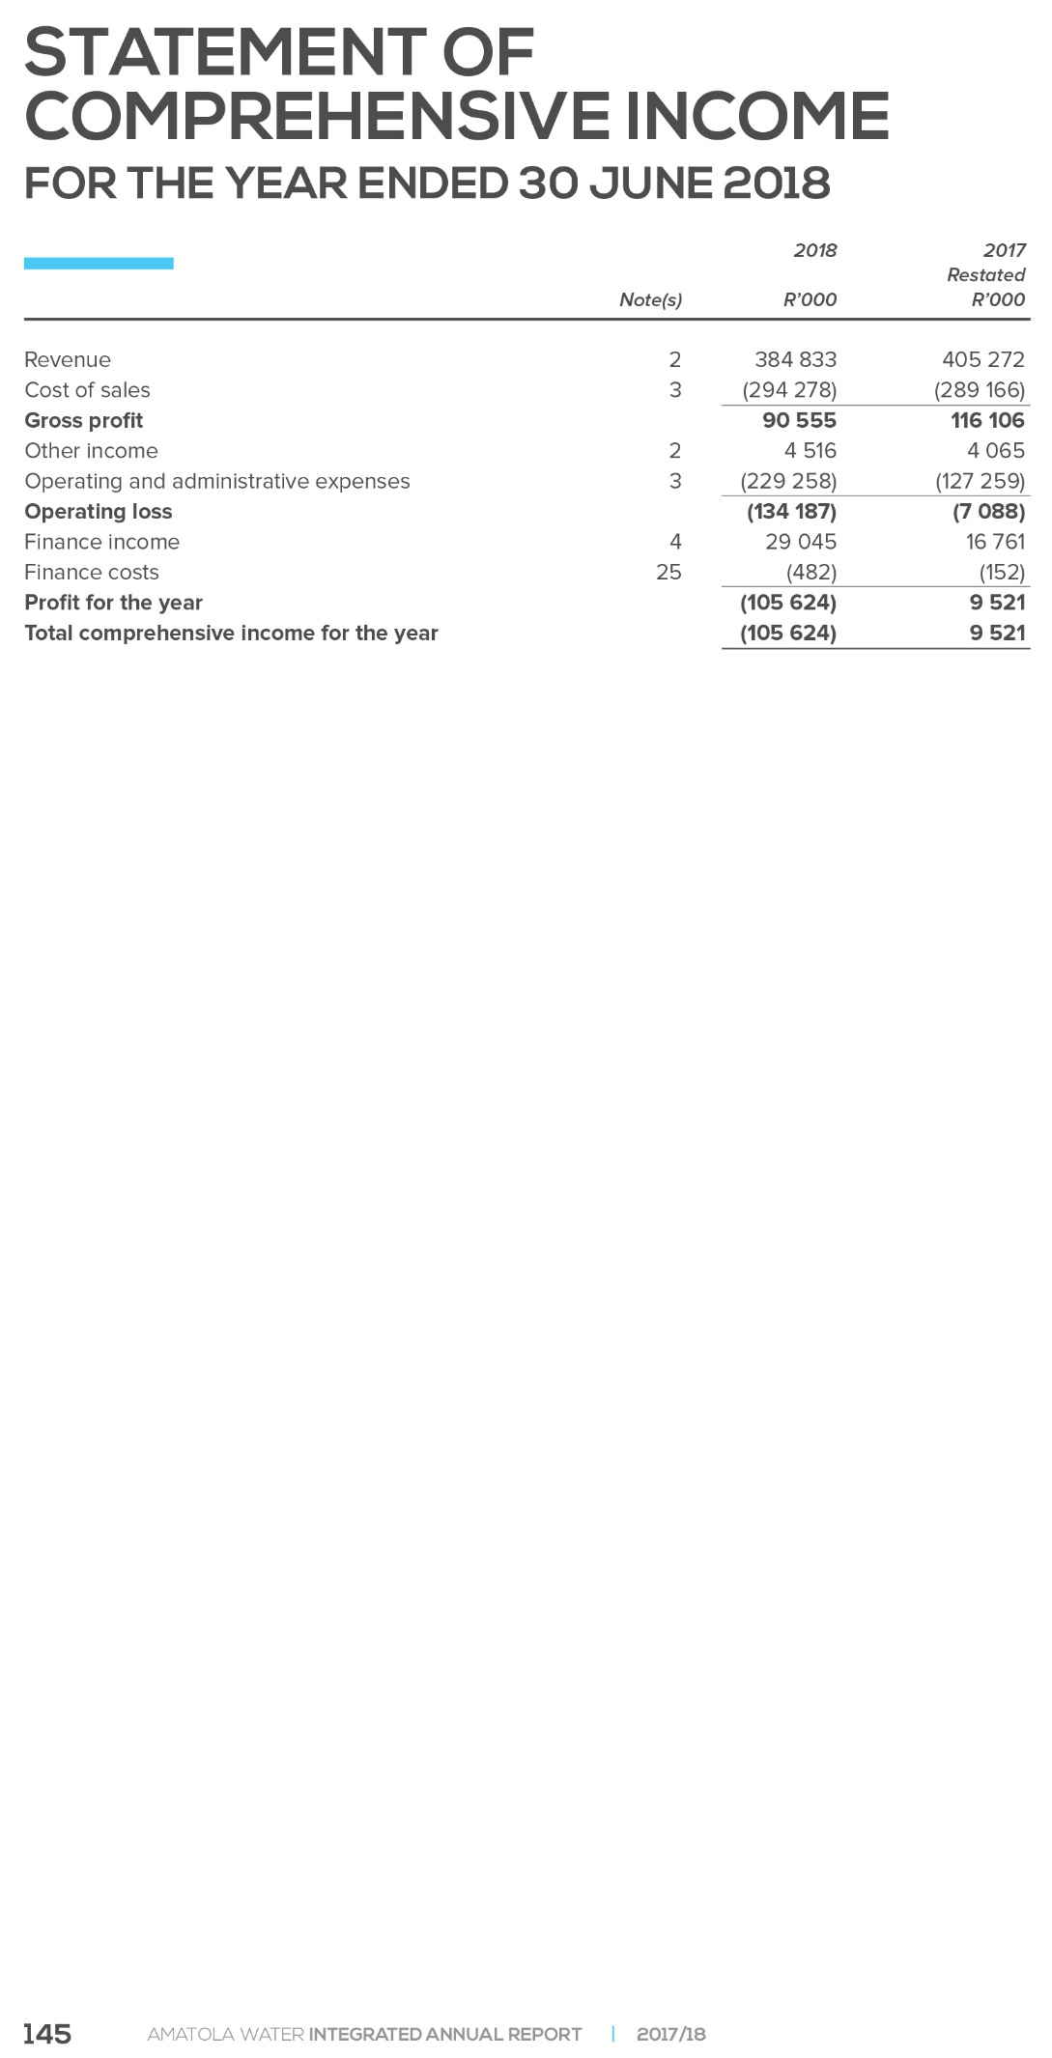
The debt impairment for ADM and other customers during 2017/18 amounted to R120 million

Slide 15
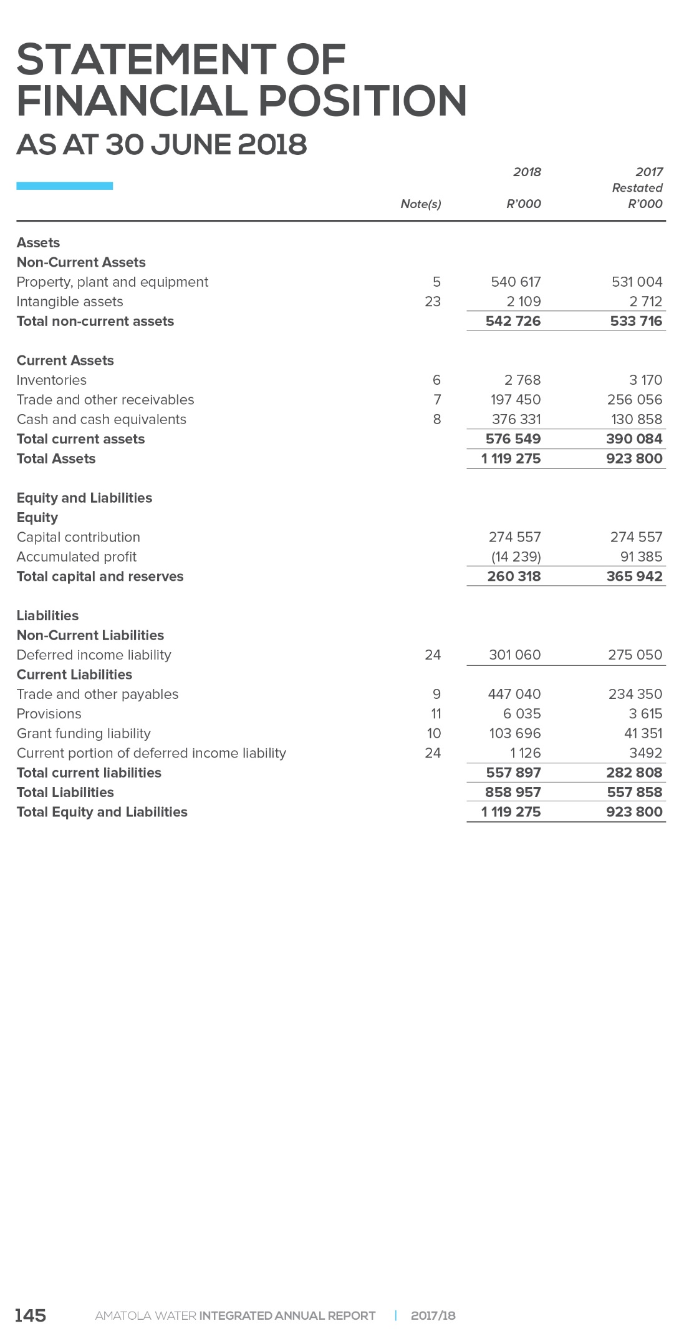

Slide 16
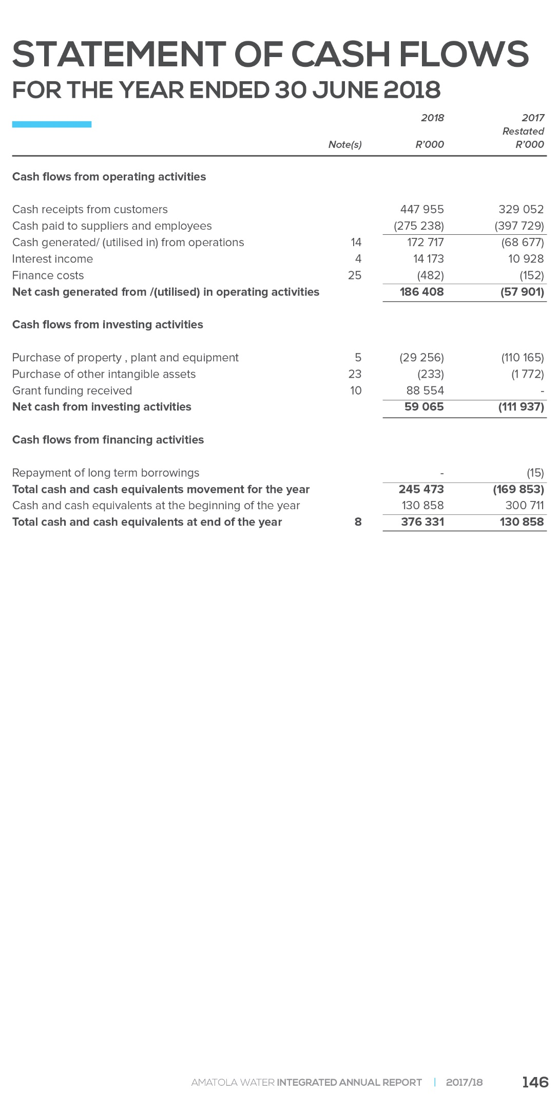

Slide 17
Analysis of current payments in operating activities

Slide 18
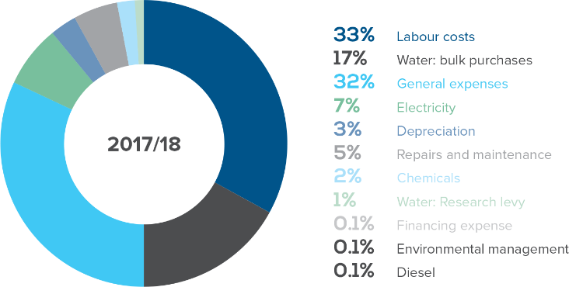
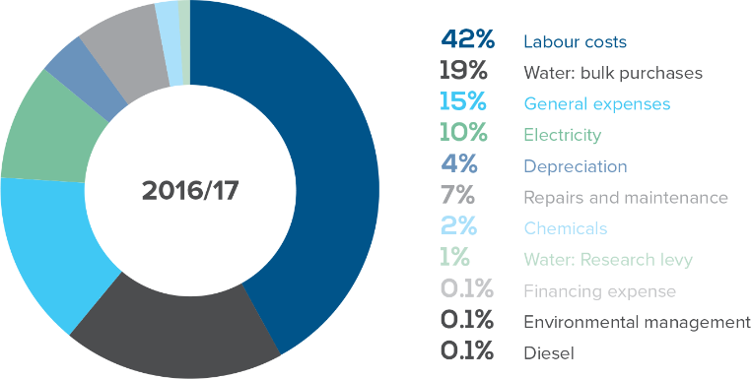
Overview of financial performance
Cost Composition

Slide 19
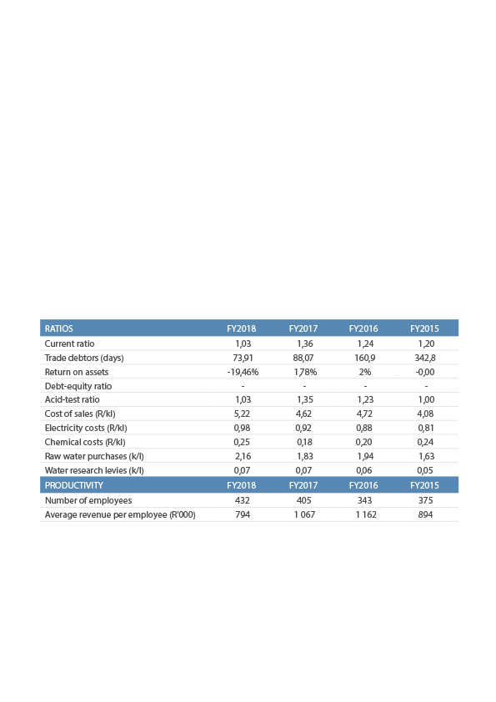
Overview of financial performance
Key Financial Ratios
The ratio analysis depicted in the table above indicates that even in the tough and volatile South African economy, Amatola Water has been able to improve its performance in some instances and keep its performance constant in others, despite the challenges which arose during the 2017/2018 financial year.
This is a testimony to the resilience and determination that exists within the organisation to continue delivering high-quality water and sanitation services to the Eastern Cape.

Slide 20
Overview of financial performance
Expenditure Outcome

Slide 21
Overview of financial performance
Programme expenditure trends
No unauthorized expenditure incurred

Slide 22
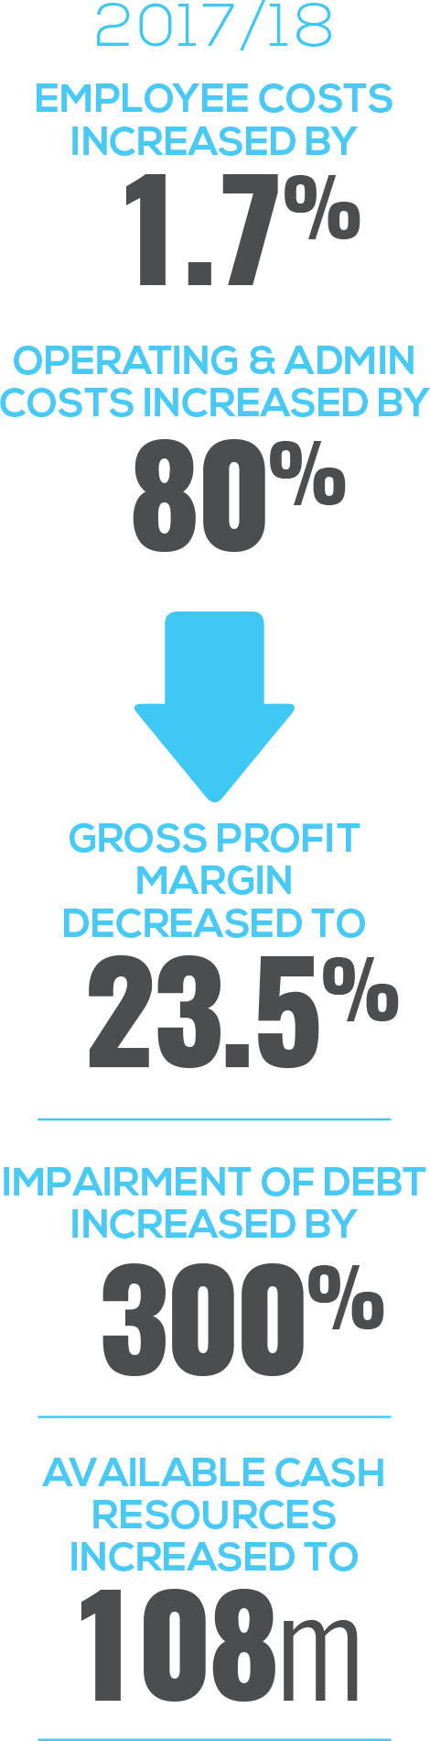
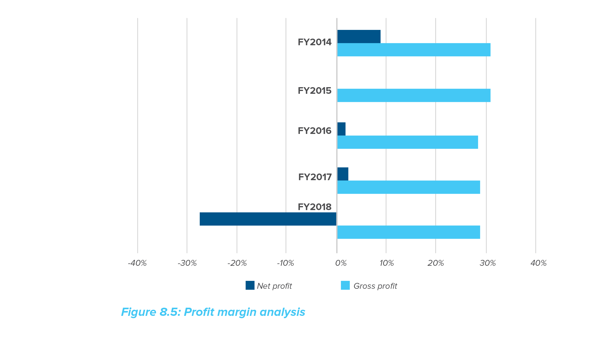
Overview of financial performance
Programme expenditure trends
The margin analysis of Amatola Water portrays a relatively stable operating business with a gross profit margin of 28.4%, averaged over the last five years.
The volatility of the net margin is largely attributed to the annual provision of doubtful debt.

Slide 23
Irregular Expenditure
RECONCILIATION OF IRREGULAR EXPENDITURE | 2018 | 2017
 | R'000 | R'000
Opening balance | 114 054 | 104 607
Current year:
- Overspending on contracts awarded | 7 249 | 7 434
- Other irregular expenditure | 9 633 | 2 013
Irregular expenditure – incurred in prior year but identified in current year | 1 774 | 0
Total | 132 710 | 114 054
In addition to the disclosure above, Amatola Water Board is investigating suspected irregular expenditure identified during the current year.
The investigation is currently still in progress and any irregular expenditure confirmed will be recognised in the financial year in which it is confirmed in line with the Guideline on Irregular Expenditure issued by National Treasury. The total value of the contracts is R7,249,610.

Slide 24
Commitments analysis
Capital commitments authorised but not contracted for are commitments relating to the infrastructure upgrades and approved capital expenditure budget. These will be contracted for in the next financial year.
The proposed capital expenditure will be funded by grant funding of R410 million (2017: R321 million) and internally generated funds of R30 million (2017: R27,9 million).

Slide 25
Fruitless and Wasteful Expenditure
 | 2018 | 2017
 | R'000 | R'000
Opening balance | 1,895 | 1,653
Fruitless and wasteful expenditure – current year | 969 | 254
Transfer to receivables for recovery |  | (12)
Total | 2,864 | 1,895
Relates to interest on late payment of invoices and other interest costs from court judgements.
Payment on adverts on cancelled bids due to delayed procurement and flawed specifications that resulted in the inability to evaluate the submitted bids.

Slide 26
Consequence Management on Irregular, Fruitless & Wasteful Expenditure
Consequence Management
Dismissed four (4) senior officials
Concluding disciplinary enquiries
Civil claims instituted and lay criminal charges
Number of investigations are currently under-way
Remedial Action
SCM policy and delegations are being reviewed
Turn-around intervention is focusing on strengthening management, improving controls in SCM and the project environment
Appointment of SCM Manager
Establishment of PMO to monitor compliance on project implementation

Slide 27

Overview of non-financial performance
04

Slide 28
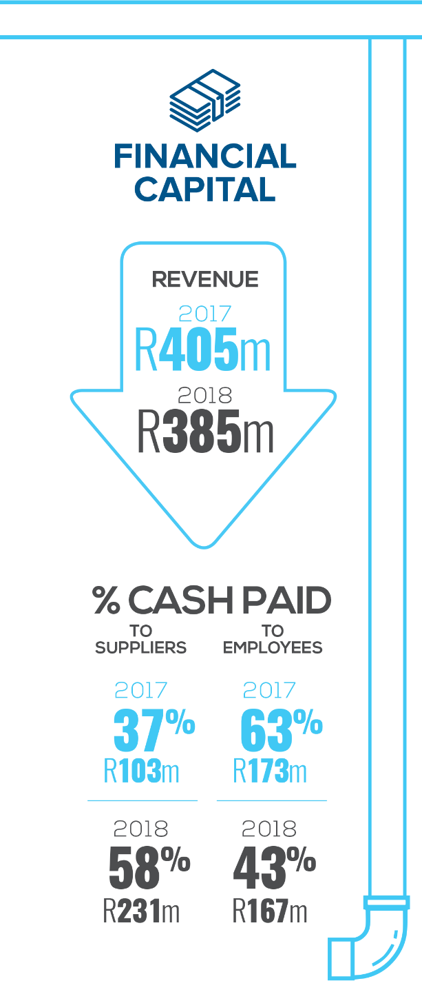
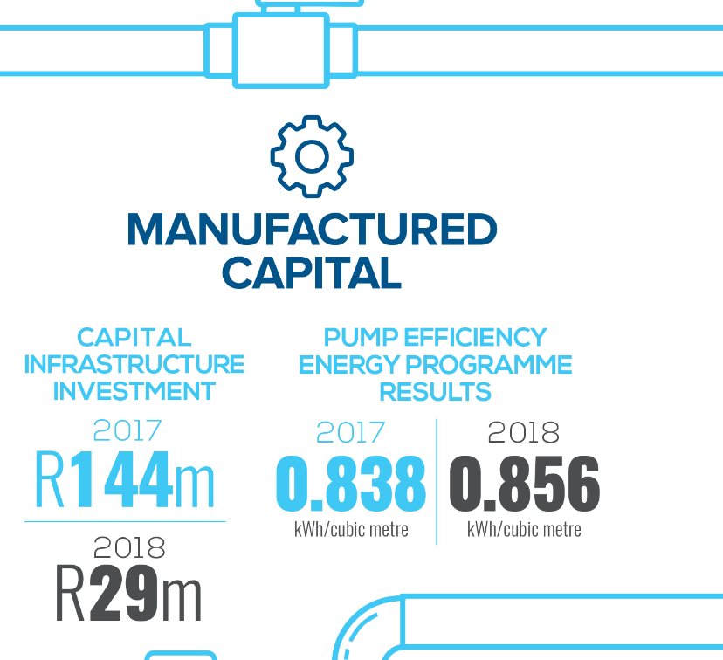
Overview of Non-Financial Performance
Key Performance Highlights

Slide 29
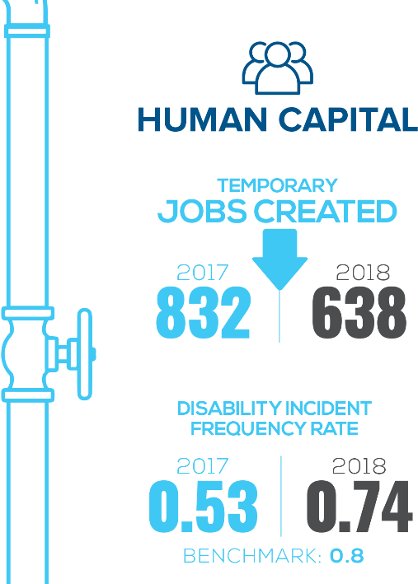
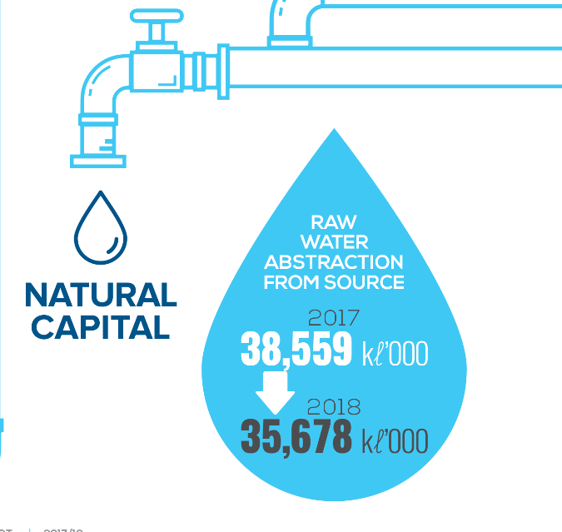
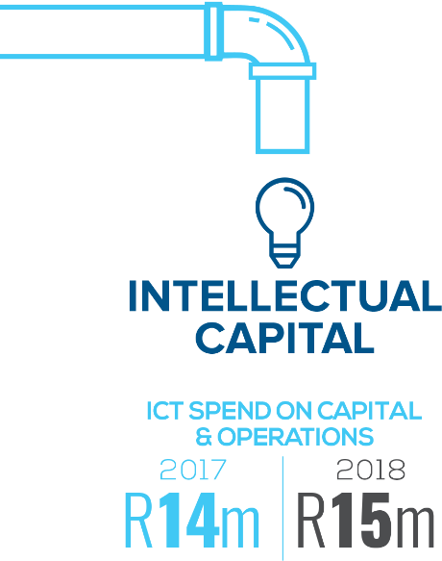
Overview of Non-Financial Performance
Key Performance Highlights

Slide 30
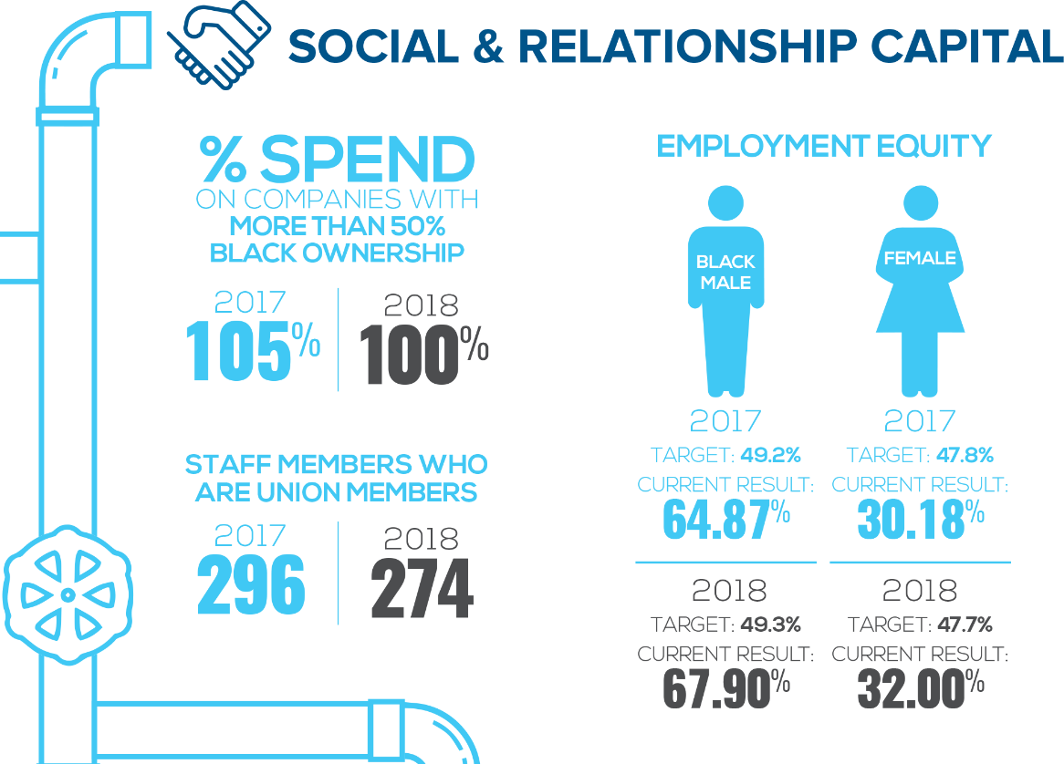
Overview of Non-Financial Performance
Key Performance Highlights

Slide 31
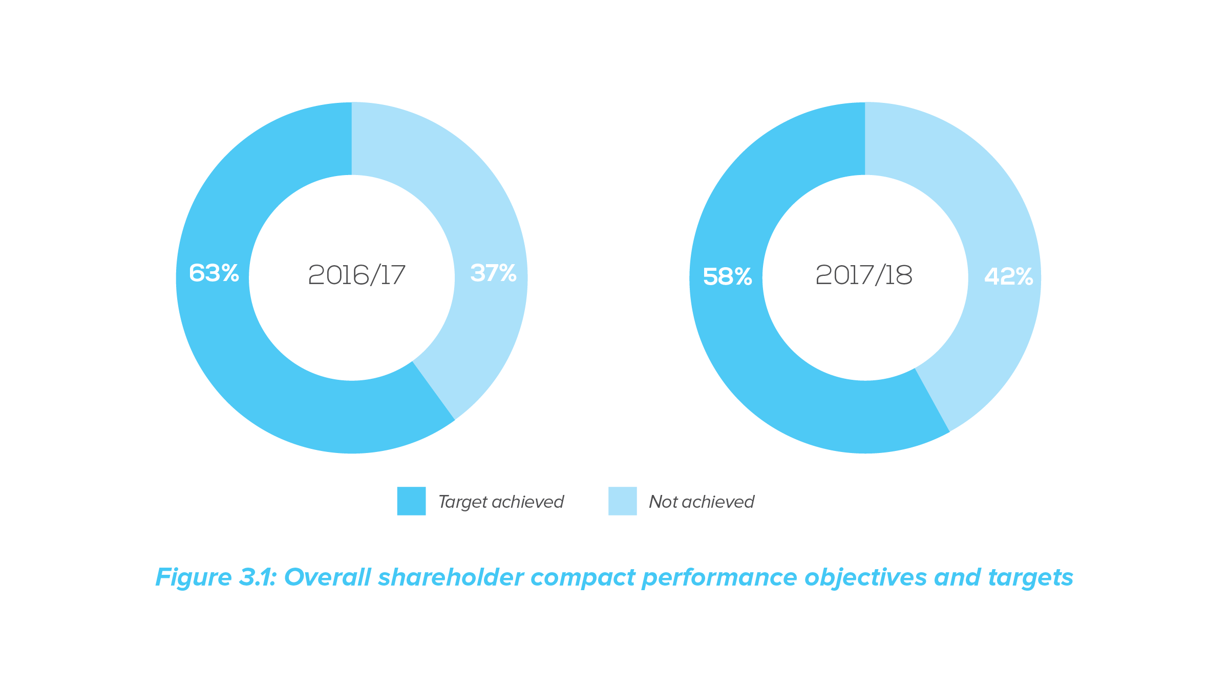
Overview of Non-Financial Performance
Overall performance against shareholder compact
Unsatisfactory performance from a financial perspective has been due to:
  The unprecedented deficit of R105,624 million; and
  Challenges in collecting outstanding debt from clients which necessitated the impairment of long-outstanding debt;
  Water sales were stagnant as restrictions were imposed on ADM. Consequently the tariff increase had no significant impact on water sales;
  The decrease in revenue from secondary business has been caused by the poor performance of contractors, contractual disputes and reprioritisation of allocated budgets.

Slide 32
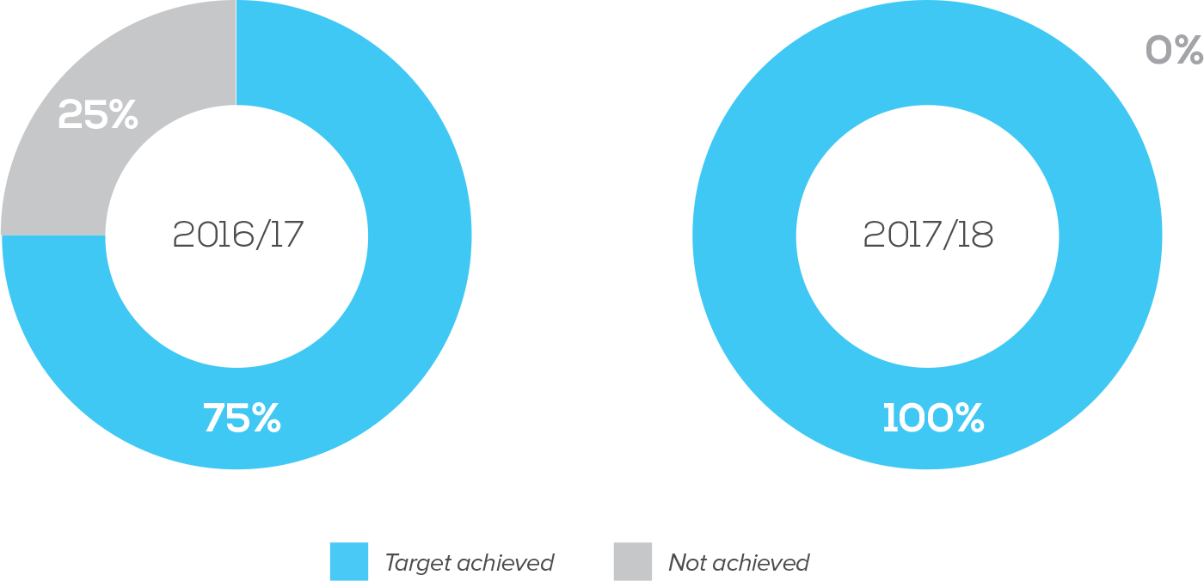
Overview of Non-Financial Performance
Organisational Efficiency and Effectiveness
There was an improvement in the management of avoidable water losses. The combined production and distribution losses were reduced from 14,2% (2016/17) down to 11,12% (2017/18) against a target of 14%.

Slide 33
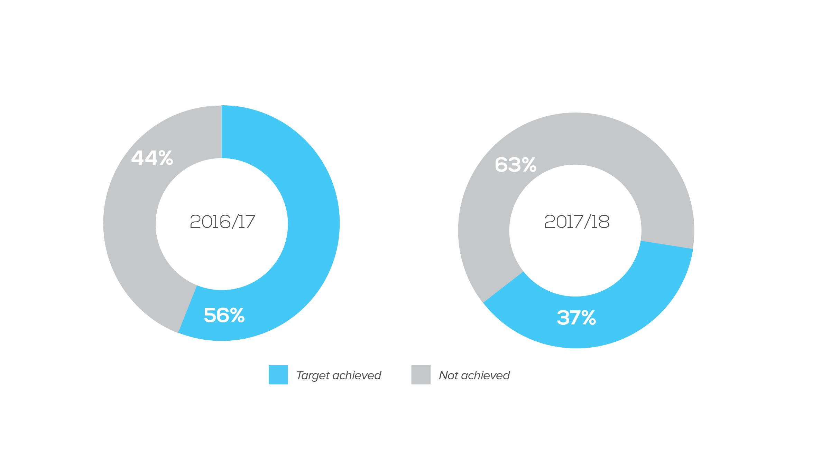
Overview of Non-Financial Performance
Financial Perspective
Unsatisfactory performance from a financial perspective has been due to:
The unprecedented deficit of R105,624 million; and
Challenges in collecting outstanding debt from clients which necessitated the impairment of long-outstanding debt;
Water sales were stagnant as restrictions were imposed on ADM. Consequently the tariff increase had no significant impact on water sales;
The decrease in revenue from secondary business has been caused by the poor performance of contractors, contractual disputes and reprioritisation of allocated budgets.

Slide 34
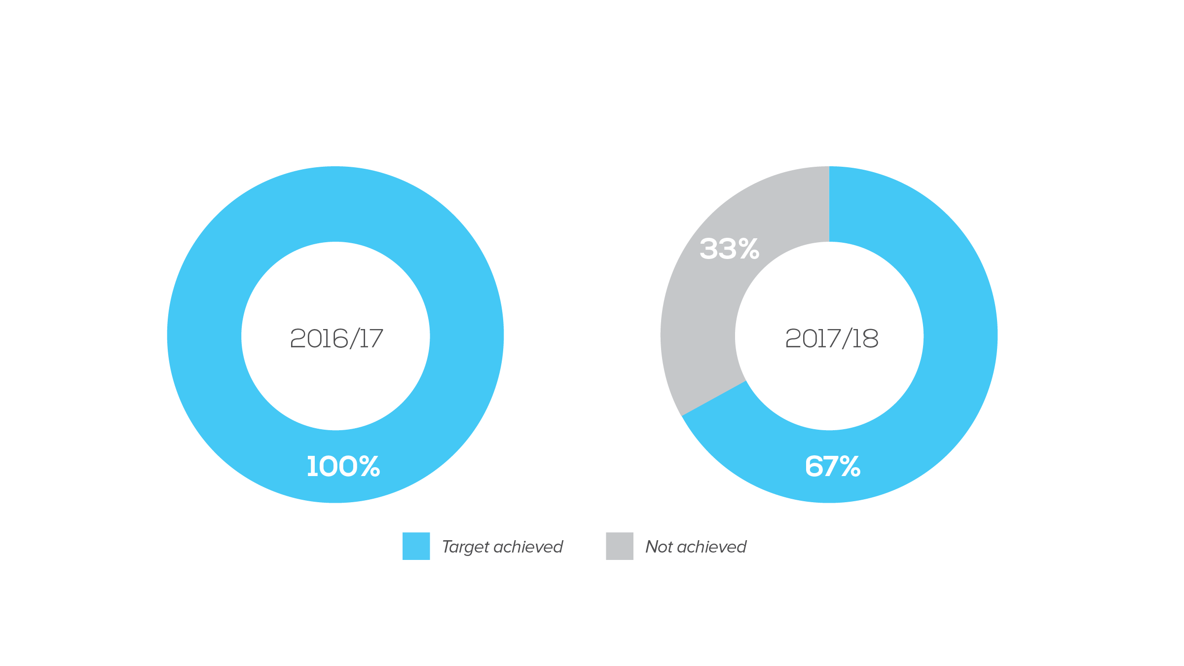
Overview of Non-Financial Performance
Organisational Capacity
% staff turnover: the was an increase in the number of voluntary resignations. The staff retention policy is being developed and vacant positions are being filled.
Number of permanent jobs created: the recruitment of critical staff is underway and will remain a priority for the implementation of the AW Turnaround Plan.

Slide 35
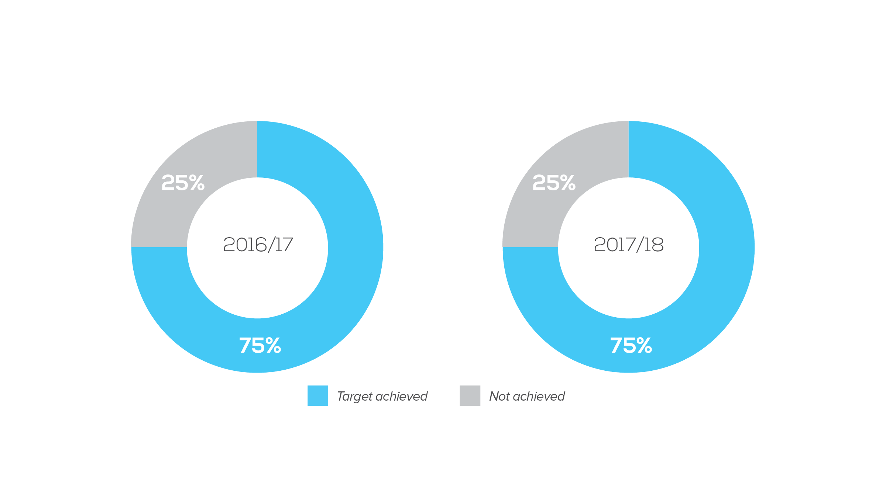
Overview of Non-Financial Performance
Customer/Stakeholder Interaction
% progress against ministerial directives implantation :
Target was not achieved due to budget cuts in the original allocation by DWS. As a result, AW and the contractor had to adjust the programme which also resulted in the suspension of work due to non-payment.
AW’s key project stakeholders are working closely to manage changes during implementation to ensure that the desired progress is achieved.

Slide 36
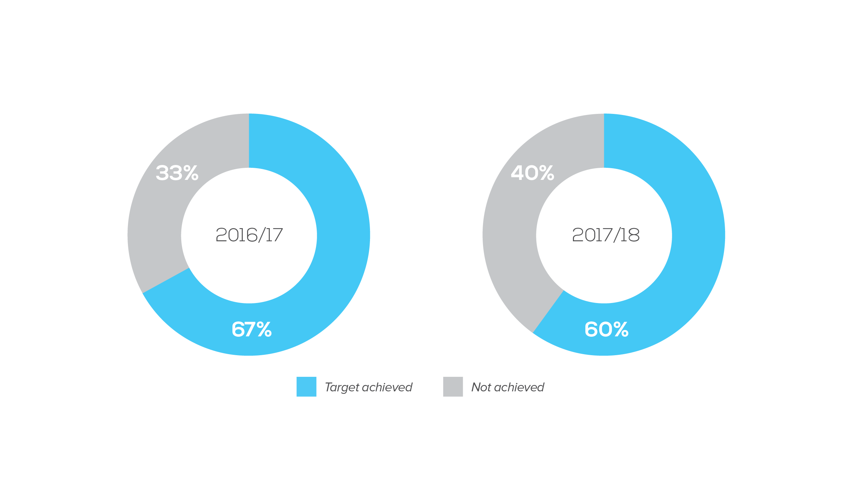
Overview of Non-Financial Performance
General Performance
% Board Member attendance of all Board/committee meetings:
Target was not achieved as some Board Members cannot make the meetings (attendance).
The remedial action plan will focus on:
  Timeous approval of the Board calendar and securing dates for approved board meetings using an electronic system such MS Outlook.
  Encouraging and committing Board Members to attendance.

Slide 37

Update on the ADM debt
05

Slide 38
Update on the ADM debt
AW has experienced 2 years of non-payment by ADM
AW Invoked the IGRFA process with communication to DWS, CoGTA and National Treasury.
Previous payment plan was only adhered to by ADM, for 3 months that is from June to September 2017, and defaulted in October 2017.
AW implemented water restrictions on ADM water supply on 1st January 2018 based on the affordability of R5.8 million. ADM applied for a court interdict for restrictions to be lifted. Restrictions were lifted on 11th January 2018, subsequent to instruction from the Minister.
Urgent meeting was convened on 12th January 2018 with Premier, Minister of Water and Sanitation and Executive Mayor of ADM, Board Chair of AW and respective officials. ADM was instructed to seek a council resolution, for the payment plan and to work with AW, to develop a restriction plan, based on affordability. ADM was also instructed to withdraw the application for interdict.
IGR processes have been explored extensively.
There have been more than 6 (six) engagements with ADM since March 2018, to date.

Slide 39
Update on the ADM debt
The legal process, to deal with the historical debt, has been explored with major delays caused deliberately by ADM
Interest is charged monthly on outstanding debt
Implemented 20% water restrictions, after ADM defaulted on current payment agreement
Current billing at approximately R8,3 million per month, after restrictions
ADM not sticking to the R5,8 million per month arrangement, which has only been paid/exceeded for 5 months, since January 2018.
A notice to effect second restrictions of another 20% has been issued on 26th November 2018.
Summons was issued to recover historical debt, up to December 2017.
National Treasury and Provincial Treasury have been engaged by AW.

Slide 40

Tariff proposal 2019/20
06

Slide 41
Proposed Tariff 2019/20:
Operational context
Cross subsidisation
Average percentage increase is applied to all the schemes
This is caused by:
Rural vs. urban scheme
  Rural schemes are social schemes
  Urban schemes are economically viable schemes
Geographical dispersion
  AW has 11 plants covering 1 District Municipality, 1 Local Municipality and 1 Metropolitan
Financing
  Challenges in terms of recovery of costs from distressed WSAs

Slide 42
Proposed Tariff 2019/20:
Anticipated Increases in Input Costs 2019/2020
CPI has been determined at 5.6%
DWS raw water increases set between 1.9% and 14.4%
Electricity tariff set to increase by 5.7%
Salary (Cost to Company) set on average of 6.6%
Other input costs increases will vary between PPI and CPI which is an average of 5.6%
Proposed tariff increases for BCMM and Ndlambe Municipality is 6.85% for potable water and 6.85% for raw water
Proposed tariff increase for ADM is 8.85% for potable and 8.85% for raw water (Incl. 2% Finance costs)

Slide 43
Proposed Tariff 2019/20:
Amathole District Municipality

Slide 44
Proposed Tariff 2019/20:
Buffalo City Metropolitan

Slide 45
Proposed Tariff 2019/20:
Ndlambe Local Municipality

Slide 46

Looking forward
07

Slide 47
Looking forward
Towards a sustainable organisation
Sustainability is at the core of AW priorities to ensure that operations are compliant with sustainable management of the environment.
Exploring innovative ways to be financial sustainable through a growth strategy and financial recovery plan.
Fast-tracking the developing of an integrated infrastructure masterplan for the province and business case to leverage funding.
Complete the infrastructure upgrades in order to realise an increase in volumes towards improving access.
Institutionalise effective risk management at strategic and operational level.
Prepare AW capability and competence towards being a regional water utility for the Eastern Cape province.
Research and invest in new technologies towards enhancing our operational efficiencies and effectiveness

Slide 48
Acknowledgements and appreciation
08

Slide 49
Acknowledgements and appreciation
Assistance requested from the Portfolio Committee:
Board thanks the Portfolio Committee for the constructive engagement in playing its oversight role and holding the Board accountable in discharging its mandate.
Support in transforming Amatola Water into a Regional Water Utility, in order to increase its financial viability and sustainability
Support IGR efforts to recover debt from ADM and other institutions of government

Slide 50

THANK YOU

