Slide 1
MANAGEMENT RESPONSE TO THE NATIONAL AUDIT OF CASP AND ILIMA/ LETSEMA
BRIEFING TO THE PORTFOLIO COMMITTEE ON AGRICULTURE, FORESTRY AND FISHERIES

Slide 2
PROVINCES VISITED DURING THE AUDIT
The internal audit has conducted the CASP audit in seven provinces namely:
Mpumalanga Province
Limpopo Province
Gauteng Province
Kwa-Zulu Natal Province
Northern Cape Province
Western Cape Province
Eastern Cape Province

Slide 3
7 MAJOR MATTERS OF CONCERN
Process of Selection and Approval of Projects
Extension Officers
Capacity In Provinces and DAFF
Accuracy and Validity of Beneficiaries
Implementation of Projects - Limited Impact of CASP, Backlog on Implementation by Provinces
Ineffective Monitoring by DAFF and Provinces
Recordkeeping & Management Information System

Slide 4
Management Response
DAFF agrees with all the 28 recommendations. The key interventions to address all areas raised are as follows:
Daff is increasing its capacity to manage, oversee and monitor the implementation of CASP by provinces. The programme will be strengthened with three Directors each responsible for three provinces and supported by the Chief Director at national and Deputy Directors per province to manage and oversee implementation.
The Branch PPME’s monitoring will be strengthened to timeously monitor and verify reports provided.
The Internal Audit (IA) report was presented to Mintech on 28 February 2019 and HOD’s made an undertaking to address all audit findings. Monitoring of corrective measures will take place during CASP quarter review meetings and Mintech meetings.

Slide 5
Management Response
The Standard Operating Procedure (SOP) of CASP is under review to address all concerns regarding standard implementation strategy and project approval processes to be followed. This review is to be concluded in the 1st quarter of 2019/20.
The prioritized projects for 2019/20 include incomplete projects from the previous financial year. Partnerships with commodity organizations entered into will increase the provincial capacity to support black producers.
DAFF is developing the farmer register which will keep record of all farmers supported, among others.
The blended funding will to a large extend ensure seamless collaboration of government departments and the financial institutions in supporting the development of black farmers.

Slide 6
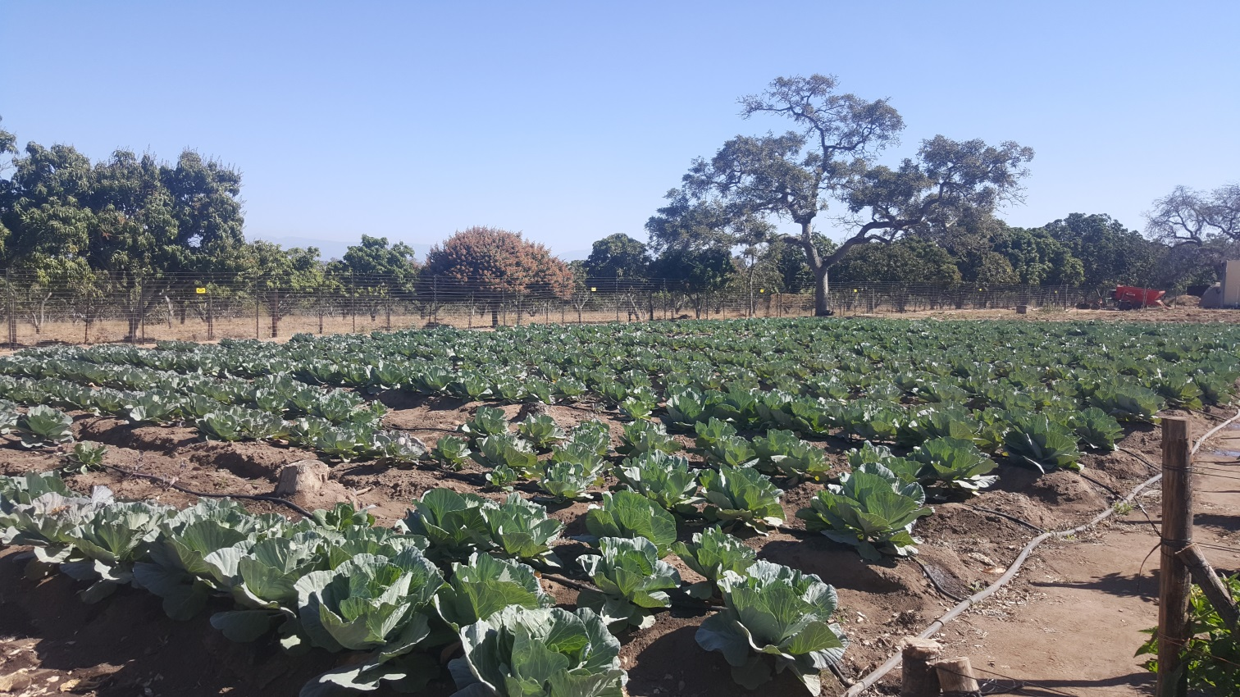
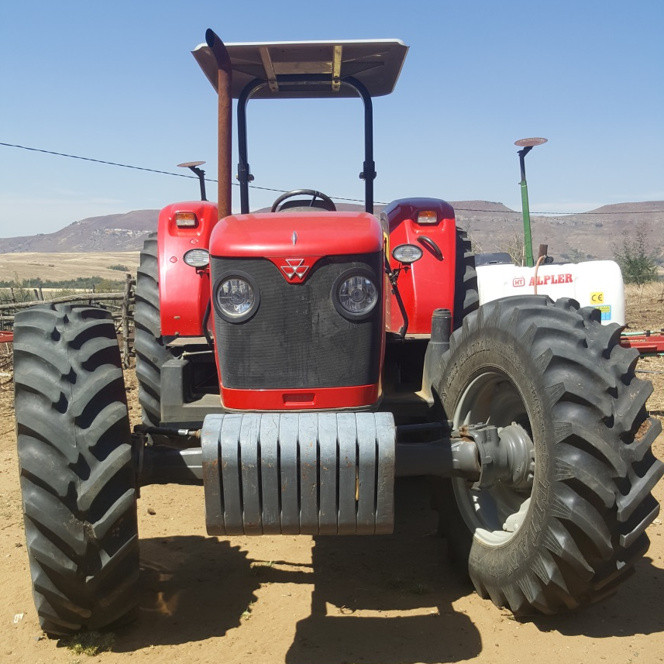
Thank you

