Slide 1


PRESENTATION TO THE
PARLIAMENTARY POTFOLIO COMMITTEE
12 March 2019

Slide 2
Contents:
  SA Connect Phase 1 progress update
    APP target and performance
    Infrastructure and service rollout
    Project expenditure
    Project management
  SA Connect socio-economic impact
  SA Connect Phase 2 progress update
2

Slide 3
Phase 1: 2018/91 APP target
 | 2018/91 APP target
 | Q1 target | Q2 target | Q3 target2 | Q4 target
Facilities to be connected | 63 | - | 194 | 313
Cumulative number of facilities to connected | 63 | 63 | 257 | 570
Budget availability | R9,7 million¹ |  | R110 million²
The annual target of providing broadband connectivity to 570 government facilities is subdivided into:
  Quarter 1: provision of broadband connectivity to 63 facilities, based on the R9,7 million budget allocation
  Quarter 2: Sustenance of the 63 facilities connected in quarter 1. No new connectivity was targeted for the quarter due to budget constraint.
  Quarter 3: provision of broadband connectivity to 194 facilities, based on the R110 million rollover funds.
  Quarter 4: provision of broadband connectivity to 313 facilities, based on the R110 million rollover funds.
¹The annual budget allocation for SA Connect was R9,7 million for FY 2018/19, which was only adequate to rollout connectivity to 63 facilities.
²The rollover amount of R110 million was approved at the end of August 2018. Consequently the bulk of the connectivity rollout to 507 facilities could only begin in September 2018.
3

Slide 4
Phase 1 Implementation Milestones
DTPS issued government orders to BBI and SITA to connect 570 SA Connect facilities
Broadband infrastructure installations to 313 was completed in line with the target.
Fast-track plan was devised to expedite service activations in line with the annual target.
Sep 2018
Dec 2018
Mar 2019
Mar 2018
Oct 2018
Jan 2019
National Treasury approved the Department’s roll-over request for R 110m in 2018/19
The first set of invoices amounting to R13.3 million were processed.
Equipment required to activate services have been delivered to respective provinces.
100 SMMEs have been trained on installations
4

Slide 5
SA CONNECT PROGRESS UPDATE
5

Slide 6

Connectivity
Core network
Internet
Access network
Broadband infrastructure
Internet service
Connectivity
Connectivity comprises the broadband infrastructure and the internet service.
Connectivity at a facility is established when the broadband infrastructure is installed and the internet service is activated.
7

Slide 7
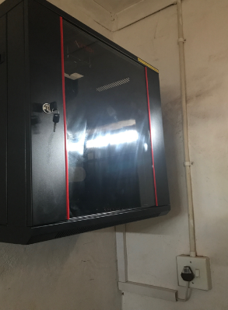
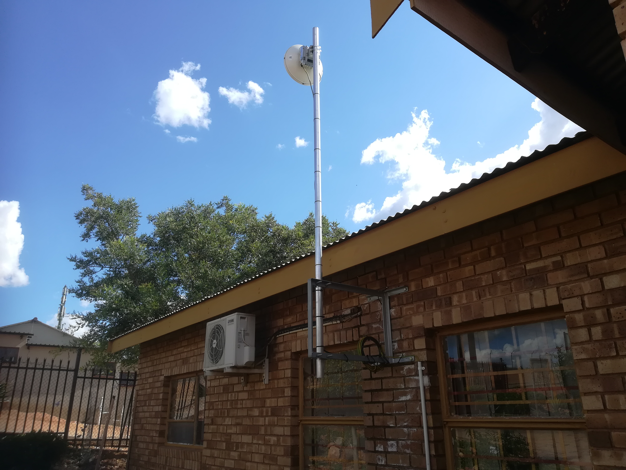

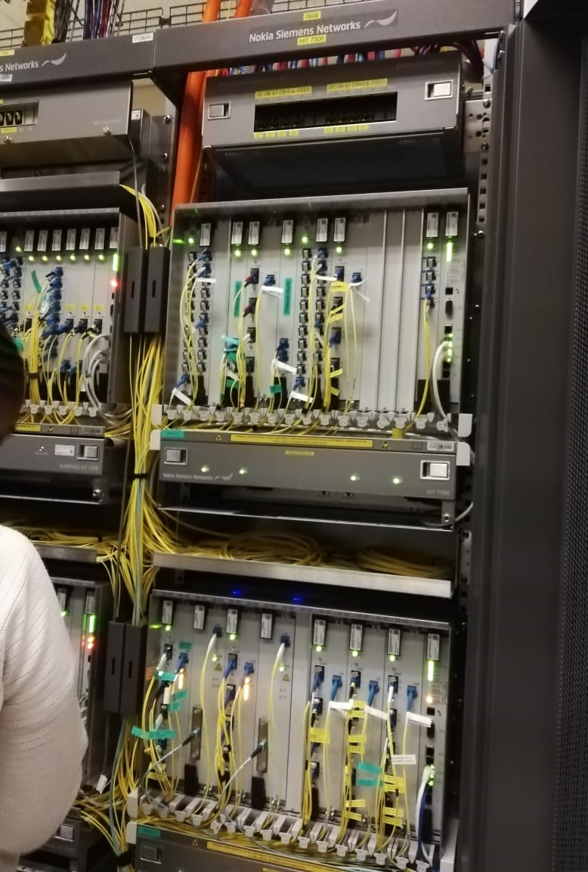

Connectivity
Indoor network cabinet
Connected facility
Access network (microwave)
Core network (fibre)
Data centre
Broadband infrastructure
Internet service
Connectivity
7

Slide 8
Performance vs APP target
Quarterly performance vs target
36 of 194 Q3 target were connected.
  Budget constraint and unforeseen infrastructure replacement placed limitation on the speed of implementation.
  2017/18 budget rollover was granted later than anticipated, resulting in delays in issuing purchase orders for connectivity.
194
63
36
15
0
0
Quarter 1
Quarter 2
Quarter 3
Cumulative quarter on quarter performance
Overall performance to date vs target
257
570
99
129
129 of 570 annual target connected to date (i.e. 441 still to be connected)
  291 of 441 infrastructure installation completed, awaiting service activations.
  150 of 441 infrastructure upgrades underway.
63
63
63
15
Quarter 1
Quarter 2
Quarter 3
Target
Target not met
Target met
6

Slide 9


Broadband infrastructure rollout
Quarterly performance vs target
There was no broadband infrastructure rollout target for Q1 and Q2 but the rollout was initiated in Q1 in order to meet Q3 target.
Q3 target of broadband infrastructure rollout to 313 facilities has been met.
  All 313 broadband infrastructure have been tested. Minor technical issues experienced at some facilities are being resolved.
  22 of the 313 have services activated (291 are awaiting service activations)
313
313
0
0
0
0
Quarter 1
Quarter 2
Quarter 3
Overall performance to date vs target
Cumulative quarter on quarter performance
313
313
313
313
310
162
0
0
Quarter 1
Quarter 2
Quarter 3
Target
Target not met
Target met
8

Slide 10
Service activations
Quarterly performance vs target
There were no new service activations in Q2 due budget constraint. However the remaining 48 services from Q1 were activated.
By end of Q3 36 of the 194 facilities targeted had internet services activated.
  Project budget constraint and unforeseen infrastructure upgrade resulted in the non achievement of the target for the quarter.
The overall 129 service activations to date trails the target of 570 due to implementation delays experienced in Q3.
A fast-track plan has been devised to bridge the implementation gap (i.e. 441) by the end of quarter four
  150 service activations for upgraded infrastructure
  291 service activations for newly installed infrastructure.
194
63
36
15
0
0
Quarter 1
Quarter 2
Quarter 3
Overall performance to date vs target
Cumulative quarter on quarter performance
257
570
99
129
63
63
63
15
Quarter 1
Quarter 2
Quarter 3
Target
Target not met
Target met
9

Slide 11
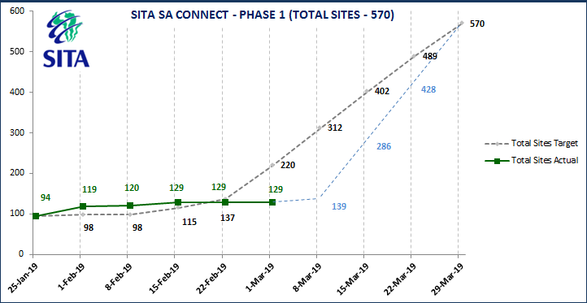
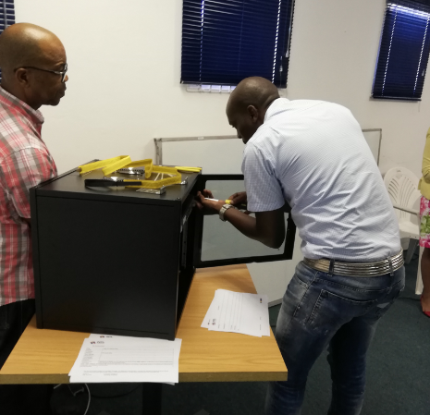
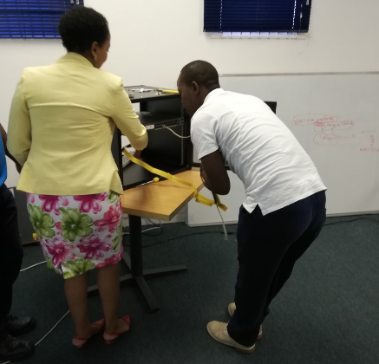
Fast-track plan for service activations
Fast-track plan
Negotiated agreement with the equipment supplier to fast track delivery
Streamlined development of bid specification
Emergency Bid Specification Committee established
Training of SMMEs (multiple SMMEs per district to expedite delivery)
Deployment of interim wireless solution (LTE /Microwave, quicker to deploy)
Installations and activations
Progress to date:
Customer premise equipment (CPE), required for service activations, have been pre-configured and delivered to respective provinces for installation.
100 SMMEs have been trained on CPE installations.
10

Slide 12
Project expenditure
For Q3 invoices amounting to R13.3 million were processed and paid. These comprised of R10.2 million for broadband infrastructure and R3.1 million for internet services.
For Q4 to date invoices amounting to R6.7 million have been processed and paid. These comprised of R4.9 million for broadband infrastructure and R1.8 million for internet services.
The total invoice amount paid to date is R19.4 million, comprising of R15.1 million for broadband infrastructure and R4.3 million for internet services
R4.3 million
R3.1 million
R1.8 million
R15.1 million
R10.2 million
R4.9 million
Quarter 3
Quarter 4*
Total*
Broadband infrastructure cost
Internet service cost
* to date
11

Slide 13
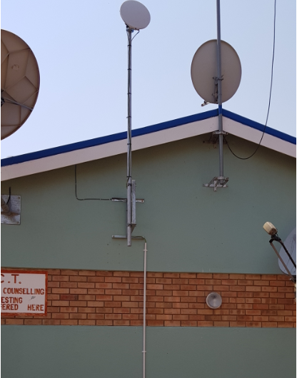
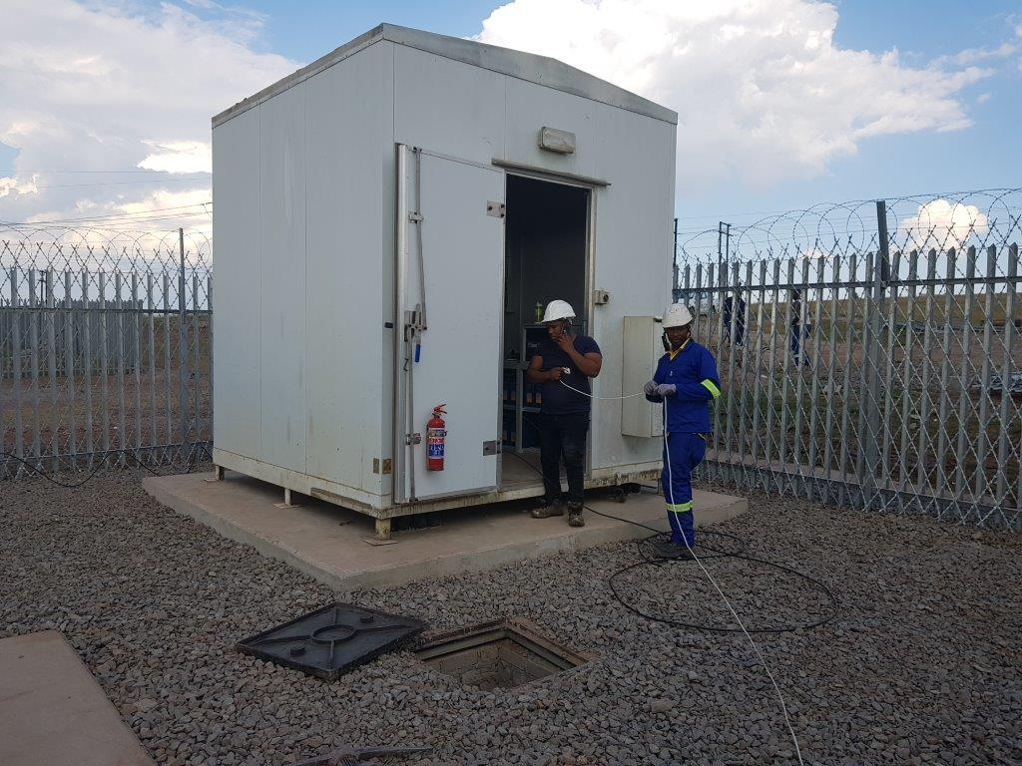
2019/20 preparatory work
In order to address implementation delays experienced in the 2018/19 rollout, proactive installations of broadband infrastructure to additional 400 facilities, where connectivity is planned for 2019/20, have commenced.
To date, broadband infrastructure installations to 137 of these 400 facilities have been completed.
Installations of customer premise equipment and service activations will commence in the 2019/20 financial year.
12

Slide 14
Project management – stakeholder engagement
Stakeholders are regularly engaged, through provincial steering committees, to provide project status update and to ensure alignment between SA Connect and provincial broadband plans.
The objectives of the engagements are to :
  Present SITA and BBI as the implementing agencies
  Provide SA Connect progress update
  Present SITA and BBI implementation approach
  Discuss support requirements from districts
  Establish district task teams
  Facilitate engagements on Rapid Deployment implementation plan
  Present the e-strategy roadmap
Representation from provinces and districts include:
  Education
  Health
  Home Affairs
  Public Works
  Community Safety and SAPS
  Social Development
  COGHSTA
  Correctional Services
  Finance
  Treasury
  Economic development
  Local Government
Districts engaged so far:
  Gert Sibande
  Dr Kenneth Kaunda
  Pixley Ka Seme
  uMzinyathi
  uMgungundlovu
  Vhembe
  Thabo Mofutsanyana
  OR Tambo
13

Slide 15
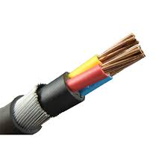
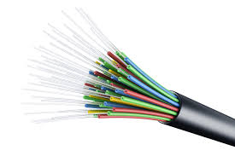
Project management – facility access authorisation
Through the project office 63 site access authorisations were facilitated, where infrastructure replacement from copper to fibre was required in order to meet SA Connect bandwidth requirements.
The work facilitated included:
  Application for permission to access building from landlords to conduct:
    Site visits and survey for planning purposes,
    Scope of work at the site.
Copper
Fibre optic
14

Slide 16
Project management – monitoring & invoicing
Project implementation monitoring
Broadband connectivity rollout to 570 facilities was project managed.
  Regular weekly programme monitoring committee, technical sub-committee and monthly project steerco meetings are being held to monitor the project, as per the project governance framework.
  337 service handover forms/certificates of completion were processed and signed.
  120 services completed and are being monitored with monthly service reports provided.
Invoice processing
Invoices amounting to R19.4 million were processed and paid.
Invoice processing entails verification (service & facility info, invoice amounts) and certification of invoices received from implementing agencies.
Resolution of invoice queries
15

Slide 17
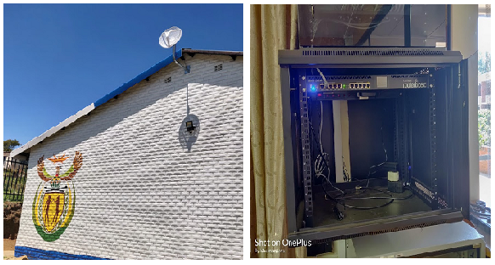
Project management – facility audits
The Department conducted ad hoc physical facility audit to verify broadband infrastructure installations and internet services assessment tests to ensure adherence to the requirements specification.
Services activated
The Department conducted the assessment on the 40 upgraded facilities as part of the sign-off and handover.
The services tested complied with the minimum technical specification of 10Mbps
Most of the newly connected facilities require local access network (LAN) to enable end-user connectivity
Infrastructure installed
The Department conducted the assessment on the 78 facilities where broadband infrastructure was installed.
The infrastructure installed at the facilities complied with minimum technical installation requirements.
There are power and security issues at some of the facilities
16

Slide 18
Project management – facility change management
The Department facilitated 58 facility change requests where requests were made to replace facilities. (nature of requests – why change and how changes we effected/resolutions)
    The following are the nature of facility change request:
        Unsuitable building (e.g. mud schools in OR Tambo)
        Facilities that are far from the available infrastructure (high site)
        Building undergoing renovations
    In line with the governance process, a change request form (with name, date, brief description of a request, proposed solution) is submitted to the project office for approval.
    Facility changes are managed in a way that the replacement facility will still be in the same District were the change is originated.
17

Slide 19
SA CONNECT SOCIO-ECONOMIC IMPACT
18

Slide 20
SMME participation in the SA Connect rollout
For service activations:
140 SMME suppliers are on a database
109 SMMEs are technically qualified for SA Connect
100 SMMEs have been trained for installations
66 SMMEs submitted bids for SA Connect
26 SMMEs are participating on SA Connect
Category of SMME | No. | %
At least 51% owned Black women | 30 | 25
At least 51% owned black youth | 30 | 25
At least 51% owned by People with disabilities | 2 | 1,7
At least 51% Military Veterans | 1 | 0,8
At least 51% owned by People living in Rural/underdeveloped area | 6 | 5
At least 51% owned by People living in Township | 17 | 14,2
SMMEs with Less than 51% Black owned | 86 | 71,7
For infrastructure installations:
8 SMMEs are participating on SA Connect
3 SMMEs are women-owned and 1 SMME is youth-owned
19

Slide 21
SA CONNECT PHASE 2 PROGRESS UPDATE
20

Slide 22
SA Connect Phase 2 - Progress Status
R1 billion has been provisionally allocated for SA Connect implementation for 2021/22 financial year subject to the Department business case and the implementation plan finalised prior to allocations being finalised in the 2020 budget process.
  To this end, the Department is working with DBSA to develop a business case and an implementation plan in line with National Treasury’s requirements.
The scoping for the feasibility study, for the remainder of Phase 2, has been concluded with the issuing of the request for proposal (RFP) for the study to open market projected for April 2019.
  The feasibility study and the business case will be delivered in a staggered approach, in line with National Treasury’s funding application window period, with the final delivery expected on 31 March 2020.
22

Slide 23
Thank You
22

