Slide 1
PRESENTATION ON THE PROGRESS MADE ON IMPLEMENTATION OF THE POULTRY TASK TEAM RECOMMENDATIONS
BRIEFING TO THE PORTFOLIO COMMITTEE ON AGRICULTURE FORESTRY AND FISHERIES
12 MARCH 2019

Slide 2
Presentation Outline
Acronyms
Acronyms
The Poultry Task Team
Poultry Master Plan
Master Plan Framework
Progress on Action Plan Items
thedti; IDC and TIPS
SAPA
SAPA and FAWU
DAFF
SPS and TBT principles
Conclusion

Slide 3
Acronyms
ALOP - Appropriate Level of Protection
APAP - Agricultural Policy Action Plan
DAFF - Department of Agriculture, Forestry and Fisheries
EU - European Union
FAO - Food and Agricultural Organisation
IDC Industrial Development Corporation
MDM - Mechanically Derived Meats
SAPA South African Poultry Association
SPS - Sanitary and Phytosanitary
TBT - Technical Barriers to Trade
TIPS - Trade and Industrial Policy
thedti - The Department of Trade and Industry
WTO - World Trade Organisation

Slide 4
The presentation gives progress on actions and activities
undertaken to address matters relating to avian dealing
with influenza, imports and African Growth and
Opportunities Act, closing down of poultry businesses and
job losses.

Slide 5
The Poultry Task Team
The Task Team is now co-chaired by the dti and DAFF; and
The Task Team met on 08th March 2019 to assess progress made on the action plan and engage on the report on the Poultry Master Plan.
The Task Team tasked:
- Trade and Industrial Strategies (TIPS) lead in crafting the Poultry Master Plan; and subsequent to the tasking:
ͦ Significant progress has been made on the development of the Master Plan for the improvement of the poultry industry.

Slide 6
Poultry master plan development
The methodology:
Collect key data on trends within the value chain;
Conduct interviews with key stakeholders (including producers, processors, feed manufacturers amongst others) at senior level across the poultry value chain to identify critical issues impacting on the value chain’s present performance, as well as emerging strategic and competitiveness issues.

Slide 7
Poultry master plan development ….
Utilize the documents from the domestic and global analysis to map the value chain;
Establish trends in the value chain and high level comparison;
Analyse trends on the domestic industry;
Identify key drivers for growth; and
Development of scenarios to build a better, competitive poultry industry.
The master plan which will be presented to stakeholders
Notes:
The legal agreements in terms of the breeds

Slide 8
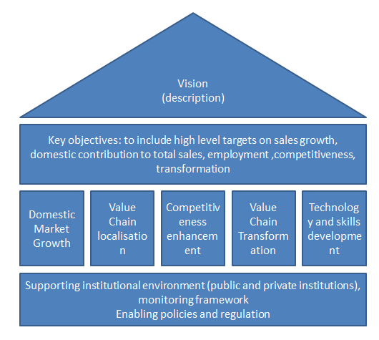
Poultry master plan development…. Masterplan Framework (still under discussion)

Slide 9
Poultry master plan development Phase 1: Global Industry Analysis
Review of Global trade data, production, investment
and employment
Prepare three successful competitor economy case studies looking at:
- The programmes and policies in place to support the development of their poultry value chains;
- The nature of firm-level competitiveness upgrading that has occurred over the last few years;
- Key lessons / factors underpinning the success of their poultry value chains.

Slide 10
Poultry master plan development Phase 2 –Domestic Poultry Value Chain
Provide the current state of activities in the domestic
poultry sector:
Review of domestic poultry production, consumption and trade;
Employment trends in each component of the value chain;
Review of the disease and chemical management framework;
Review of competitiveness of the primary broiler production; feed and poultry logistics value chains;
Review of current value addition, including challenges and opportunities both upstream and downstream; and
Assess production processes – access to technology, availability of appropriate technology, financing, skills and staffing requirements and quality of products produced and innovation.

Slide 11
Progress on Action Items assigned the dti, TIPS and IDC
Issues related to procurement, agro incentives, production of cleaner products and empowerment plans are in progress.
TIPS has completed the research on soy bean value chain and the dti completed discussions with the Land Bank on national crop funding insurance.
Industrial Development Corporation (IDC) has also completed the task of considering local tools to determine the cost of fertilizers.

Slide 12
Progress on Action Items assigned to SAPA
Issues related to maize requirements by the poultry industry, financial models to be used in the establishment of Mechanically Deboned Meat (MDM) plants and transformation plans are partially completed.

Slide 13
Progress Action on Items assigned to SAPA/FAWU
Issues related to maize requirements by the poultry industry have been completed.
Food and Allied Workers Union (FAWU) had completed the task of engaging on the local retailers on corporate citizenship.

Slide 14
Progress on Action Items assigned to DAFF
Packaging and Quality, Disease Management, Microbial Monitoring, Residue Monitoring:
It was agreed that all these issues are still important and that all has to take the approach of improving the standards of local production to give ourselves an opportunity to access international markets;
This was to ensure that while there is support for local production industries to grow, South Africa still remains compliant with World Trade Organization (WTO) rules particularly for purposes of equal treatment of imported and locally produced poultry.
An assignee has been appointed to address quality assurance inspections in terms of the Agricultural Product Standard Act, 1990.
Avian Influenza outbreaks are still experienced and a further request for compensation funding has been to National Treasury.
Notes:
Environment and welfare of poultry

Slide 15
Matters to be considered in implementation of SPS and TBT measures
Basic principles for implementation of Non Tariff measures in terms of the WTO
Least trade-restrictiveness: Measures should be no more trade restrictive than necessary to achieve the appropriate level of protection;
Scientific justification: The measures should be based on science and on an assessment of the risks involved;
Harmonization: Members are encouraged to base their Sanitary and Phytosanitary (SPS) and Technical Barriers to Trade (TBT) measures on international standards set by international standard setting bodies;
Equivalence: Members should recognize that different measures can achieve the same appropriate level of protection (ALOP);
Non-discrimination: SPS and TBT measures should be applied equally to imports and similar products produced locally. Members should not arbitrarily discriminate between trading partners where identical or similar conditions prevail;
Transparency: Reliable and accurate information on existing SPS and TBT should be made available. New or revised measures should be notified in accordance with procedures established in international bodies.

Slide 16
Conclusion
Progress has been made to address issues identified in the action plan. Furthermore a Master for the Poultry Value Chain is being developed to ensure sustainable growth of this value chain
16

Slide 17
THANK YOU

