Slide 1
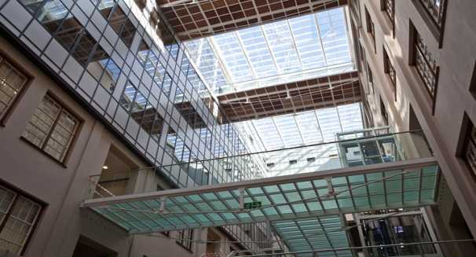
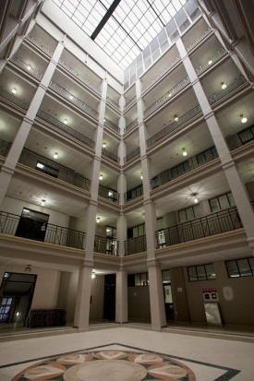
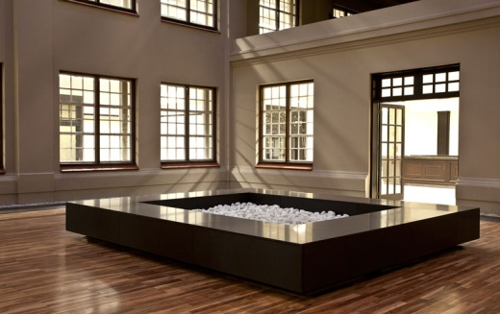
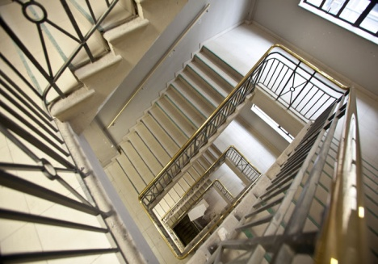
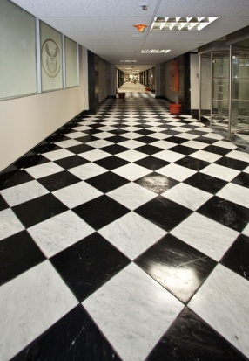
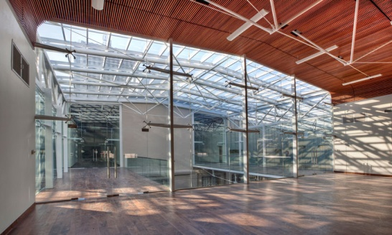
Presentation to Public Works Portfolio Committee on the management and disposal of immovable assets outside of the Republic of South Africa. 12 March 2019
Presented by Magdeline Tshabalala
12 March 2019

Slide 2
PURPOSE
The purpose of the presentation is to brief the Portfolio Committee on progress with the management and disposal of foreign properties.

Slide 3
BACKGROUND
The function to manage and procure properties abroad, including all aspects regarding leasing, purchasing, alterations, and maintenance of furniture and facilities was allocated to the Department of International Relations and Cooperation (DIRCO) on 01 May 1999 by the Minister of Public Service and Administration;
However, the authority to dispose of certain properties owned by the National Government either in the Republic of South Africa or abroad still lies with the Minister of Public Works as enshrined in the State Land Disposal Act, 1961 (Act No. 48 of 1961);
In the early 2000, DIRCO identified a number of properties in various countries as redundant and a financial burden to the State. DIRCO confirmed a number of eighteen (18) properties for disposal in various countries. The 18 properties were made up as follows: thirteen (13) properties Namibia; Two (2) properties in Bonn, Germany; one (1) property in Zurich, Switzerland; one (1) Maderia, Portugal and one (1) parking bay in Paris.

Slide 4
BACKGROUND……
In August 2008, former Minister (Ms T. Didiza) approved the disposal of all identified redundant foreign properties through public tender, with the disposal of Namibian properties being prioritised as a pilot project;
In 2009, the then Acting DG of Public Works approved for the establishment of a Joint Foreign Disposal Committee (JFDC) to facilitate the disposal of all identified foreign properties. The Director-General of DIRCO also concurred to the establishment of the committee;
In 2010, the sale of the Namibian properties was advertised on public tender. Out of the thirteen (13) Namibian properties only five (5) properties could be disposed and the remaining eight (8) properties could not be disposed as the bidders could not raise funds; and
Owing to changes of Political Office Bearers, the process to dispose all outstanding foreign properties could not be finalised;

Slide 5
PROGRESS TO DATE
In July 2018, the Public Works and International Relations Portfolio Committees undertook an oversight visit to inspect all properties in Namibia;
There are sixteen (16) properties in Windhoek. One (1) is used for office accommodation and six (6) are used for residential purposes. One (1) of the residential properties from the six is informally privately leased out;
Further, there are six (6) residential properties which are vacant and vandalized. In addition, there are three (3) residential properties which are also vacant but require maintenance.
There are four (4) properties in Walvis Bay. Three (3) of the properties are vacant and vandalised and one (1) is leased out privately

Slide 6
PROGRESS TO DATE…..
DPW has subsequently assisted DIRCO in conducting conditions assessments of the properties in Namibia. This will assist DIRCO in making an informed decision on the future use of the properties;
DPW has also assisted DIRCO with accommodation options and space planning solutions for the leased South African Mission in New York in August 2018;
At the request of DIRCO in March 2019, officials of the Department accompanied their counterparts on a two day visit to Swaziland with a view to acquainting themselves with the four (4) state-owned land parcels, the leased Chancery as well as two state-owned residences. The information gathered will inform feasibility studies on the preferred solutions for development of the Chancery as well as the Diplomatic compound and refurbishment of the official residence.

Slide 7
FOREIGN SERVICES BILL
DIRCO has tabled the Foreign Services Bill which was adopted by the National Assembly on 04 December 2018;
Section 9 of the Bill reads as follows:
(1) Notwithstanding the provisions of section 4(1)(a) of GIAMA, the Minister is the custodian of all immovable assets outside the Republic which was acquired for use by the Foreign Service.
(2) The Minister must act as caretaker of the immovable assets under his or her custodianship and must acquire and manage such immovable assets as contemplated in section 13(1) and (2) of GIAMA, in accordance with the Public Finance Management Act, 1999 (Act No. 1 of 1999), and any other applicable law.
(3) Notwithstanding the provisions of sections 4(2)(b)(i) and 13(3)(b) of GIAMA, the Minister may dispose of immovable assets under his or her custodianship in accordance with this Act and any other applicable law, after consultation with the Minister of Public Works and the Minister of Finance.
(4) A decision to dispose of any immovable asset must—
(a) be in the interest of the effective management of the Foreign Service;
(b) be to the benefit of the Republic in order to achieve the best functional, financial, economic and social return or benefit from the disposal of the immovable asset; and
(c) take into account the value of the immovable asset.

Slide 8
IMPLICATIONS OF THE FOREIGN SERVICES BILL
Should the Bill be promulgated, all life cycle asset management functions including disposals of foreign properties will be undertaken by the Department of International Relations and Cooperation.

Slide 9
RECOMMENDATIONS
It is recommended that the Portfolio Committee notes the presentation and provides feedback to enrich the inter-departmental operations on this portfolio. .

Slide 10
THANK YOU

