Slide 1
Work Villages
Ndiyeke ke kodwa ndenze nje umsebenzi wam mihla le,
Emasimini okanye endle,
Edesikeni okanye kumatshini wokwaluka,
Emarikeni ephithizelayo okanye kwigumbi elizolileyo;
Ndiyeke ke kodwa ndifumane isibindi sokuyitsho leyo,
Xa iminqweno eyabulayo indikhwebela esithubeni,
"Ngumsebenzi wam lo; iintsikelelo zam, hayi isibetho;
Kubo bonke abaphilayo, ndim oyena yena
Ukwaziyo ukuwenza ngendlela elungileyo.”
Ngoko andisayi kuwubona umkhulu kakhulu, okanye umncinci
Ukuba ungafanela umoya wam kwaye ubonisa amandla am;
Ngoko ndiza kuzihlangabeza ngolonwabo iiyure zokusebenza zam,
Ndize ndijike ngolonwabo xa izithunzi ezide zitshonile
Ekupheleni kwemini, ukuze ndidlale, ndize ndithande kwaye ndiphumle,
Kuba ndisazi ukuba kum, umsebenzi wam ngowona uphambili."
Henry van Dyke (1852–1933)

Slide 2
Sec 25: Encouraging Millions to Become Millionaires
Skills and Wisdom needed to prepare land for food and jobs!
South Africans can match the ingenuity of others once they have sec 25 access to land. By decree, the President needs to :
Grant perpetual tenures to all unregistered land users.
Demand 9M “gated, no tractor” farm subdivisions of 1000sqm paving the way for 9M life-time jobs.
Turn ZA into a world beating tax haven by replacing income taxes and vat with a 100% tax on land rents.
Launch a R2500pm Basic Income Grant (BIG) in place of BEE.
Clear out the rusty corrugated iron suburbs.

Slide 3
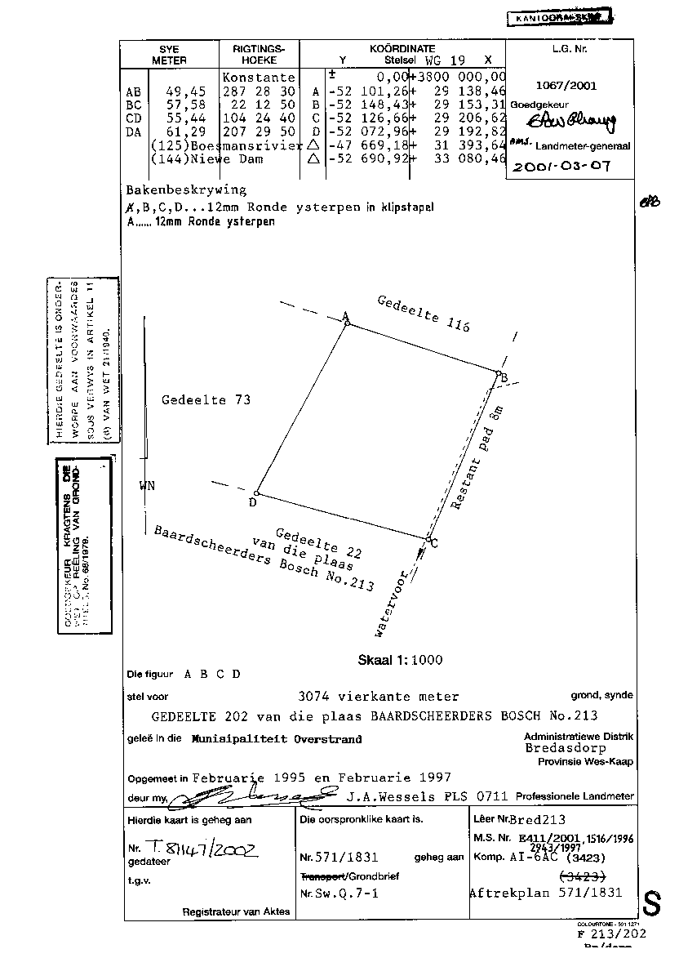
Immediately grant perpetual tenures to all unregistered land users.
Decree perpetual ownership to everyone who occupies 250sqm of land which they do not own or lease.
250sqm is the smallest size that can support a family’s vegetable and fruit needs.
Neighbours must agree the boundary pegs and sketch. Diagrams to include smart-phone co-ordinates
Present owners are to be compensated. These costs are recoverable during the first sixteen years of land tax receipts.

Slide 4
A More explicit Sec 25
SEC 25.4 (b)
says that “property is not limited to land. ” This is outside the scope of expropriations for “public purposes or in the public interest” as sec 25.2. To be explicit “property is not limited to land” needs a restrictive definition such as:
“except as a last resort, property to be expropropriated in the public interest (as sec 25.4 (a)) must be confined to unused and or vacant land with no man-made improvements.”
Unused or vacant land need to be defined as
“having lain fallow or unused for more than one consecutive year and is unoccupied or unimproved.
Arable land used as pasture for the rearing of animals is deemed to be unused or vacant because it could otherwise be used for job creation such as market gardening.

Slide 5
A More explicit Sec 25
Sec 25.5: - The state must take reasonable legislative and other measures, within its available resources, including the gradual replacement of all income taxes and vat with land rents, a rates and taxes type user-charge, excluding improvements, to foster conditions which enable citizens to gain access to unused/vacant land on an equitable basis.

Slide 6
A More explicit Sec 25
Sec 25.5 (3) d: -
The amount of the compensation and the time and manner of payment must be just and equitable, reflecting an equitable balance between the public interest and the interests of those affected, having regard to all relevant circumstances, including the extent of direct and indirect state investment and subsidy in the acquisition and beneficial capital improvement of the property;

Slide 7
The Single Land Tax: South Africa’s Constitutional Economic Power House
National Treasury and Judge Davis acknowledge the inefficiency of deadweight income taxes and vat in the 2018 MTBPS.
At a universal tax to GDP ratio of 1:1, the cost of living in 2018 was R1,1tr higher than necessary. That is an average loss of R60K for each 17m families.
In addition a Single Land Tax regime reduces the cost of land to a recurring land rent. The entry cost to an average R1m residential plot (in Southfield) becomes R5000pm (16 year P/E ratio).
Land Taxes are an expropriation of unearned land rent. Compensation is in ending the taxation of wages, salaries, interest, dividends, profit, capital gains and all man-made goods and services

Slide 8
Demand 9M “gated, no tractor” farm subdivisions of 1000sqm paving the way for 9M life-time jobs.
Give Municipalities all the professional and financial administrative back up to achieve this goal .
Institutionalise partnerships between owner-growers, horticulturists and food companies.

Slide 9
286 Work Villages and Towns
Nine million unemployed to be resettled in 286 Municipalities in five years (2019).
Average 31 000 per village.
Will use 10% of ZA’s unused arable land (Frost and Sullivan)

Slide 10
Farm JJ Fortier's 6000sqm (no tractor) Farm in Ottawa:- Disrupting the Subsistence Farming Tradition
Four growers produce vegetables and fruit for 200 families each week on 6000sqm.
That is 30sqm and one hour of work per customer per week.
Income is R10 000pm (R1000pm per family) per farmer

Slide 11
Lifetime Occupations of Work Villages and Towns (Min 500sqm plots)
Minimum 300sqm farm: sufficient to feed 10 families (R10Kpm earnings).
Constructing a solid house.
Building infrastructure + private clinics and schools + factories.
Working in village businesses and professions.

Slide 12
“Growing food is the most dangerous occupation on earth; you are in danger of becoming free” Jules Dervaes, Urban Homestead in Pasadena, California https://www.youtube.com/watch?v=7IbODJiEM5A
Grows over 3 tons of food annually on 360sqm.
Employs family of four.
Processes and or sells surplus

Slide 13
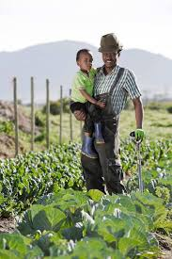
Retrenched workers land on their feet as small farmers.
1,350 were laid off at RCL Foods in 2018 due to cheap chicken imports.
Many learned to farm with chickens and vegetables. Though there was a shortage of land because of high price

Slide 14
The Generalized Henry George Principle
By Joseph Stiglitz (Nobel Prize Winner)
“One of the general principles of taxation is that one should tax factors that are inelastic in supply, since there are no adverse supply side effects. Land does not disappear when it is taxed.
“That is why it also makes sense, from an efficiency point of view, to tax natural resource rents at as close to 100% as possible.”

Slide 15
Turn ZA into a world beating tax haven by replacing income taxes and vat with a 100% tax on land rents.
Comparing the relationships between tax rates of four nations as a percentage of GDP and the average annual return in those nations’ stock market indexes over the 11-year period from 1990 to 2000.
GDP. Market data provided by http://www.pring.com/ and http://www.metastock.com.

Slide 16
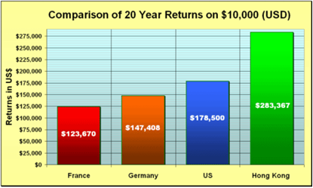
Turn ZA into a world beating tax haven by replacing income taxes and vat with a 100% tax on land rents.
Over a 20-year period, an investment in Hong Kong's Hang Seng Index would have returned more than double the same investment in France's CAC-40 and nearly double an investment in Germany's SE XTRA DAX Index.

Slide 17
Launch a R2500pm Basic Income Grant (BIG) in place of BEE
POTENTIAL BUDGET SAVINGS AND EXTRA REVENUE ON SUBSTITUTION OF INCOME TAXES and VAT with 100% TAX ON LAND RENTS PHASED IN OVER FIVE YEARS | Savings from ending deadweight taxes
RECOVERING THE DAMAGES OF INCOME TAXES and VAT
Child-support grant | R46 | bn
Job creation and labour affairs | R12 | bn
Economic regulation and infrastructure | R74 | bn
Industrialisation and exports | R17 | bn
Agriculture and rural development | R23 | bn
TOTAL 2018 BUDGET SAVINGS IN MITIGATING DEADWEIGHT TAXES | R170 | bn
EXPECTED ADDITIONAL REVENUE | Real Extra Revenue
Extra Land Rent due to GDP increase | R199 | bn
Unused (and untaxed) arable and grazing land hectares | R15 | bn
Agterscot payment by taxpayers for being relieved of punitive taxes and vat on work and capital (say 9%) | R49 | bn
Increase in land rents once land is freed of income taxes and vat (15%) | R81 | bn
EXTRA BUDGET REVENUE | R 345 | bn
TOTAL SAVINGS and EXTRA REVENUE (BASIC INCOME GRANT) | R 514 bn
Number of ZA (3,5 head) Families | 17 142 857
BASIC INCOME GRANT per FAMILY | R 30 000 pa
BASIC INCOME GRANT per FAMILY | R 2 500 | pm
BEE unfairly excludes many millions
Income taxes and vat cost R1,1tr pain deadweight taxes (2018) and destroy jobs
Government Departments have to be formed to mitigate this damage (Child support, Job Creation, Economic Regulation, Industrialisation, Agriculture),
R170bn.pa savings result when closed down
After Tax Land Rents Increase by R345bn.pa
Total extra revenue = R514bn (R2500pm per family

Slide 18
Clear out the rusty corrugated iron suburbs.
Replace rusty corrugated iron suburbs with high density social housing.
Only for Singles and Childless Couples.
Not for families who are allocated 250sqm plots, enough for food gardens
Financed by low interest Sovereign Reserve Bank Loans
or Commercial Bank Loans
Size of flat depends on loan terms

Slide 19
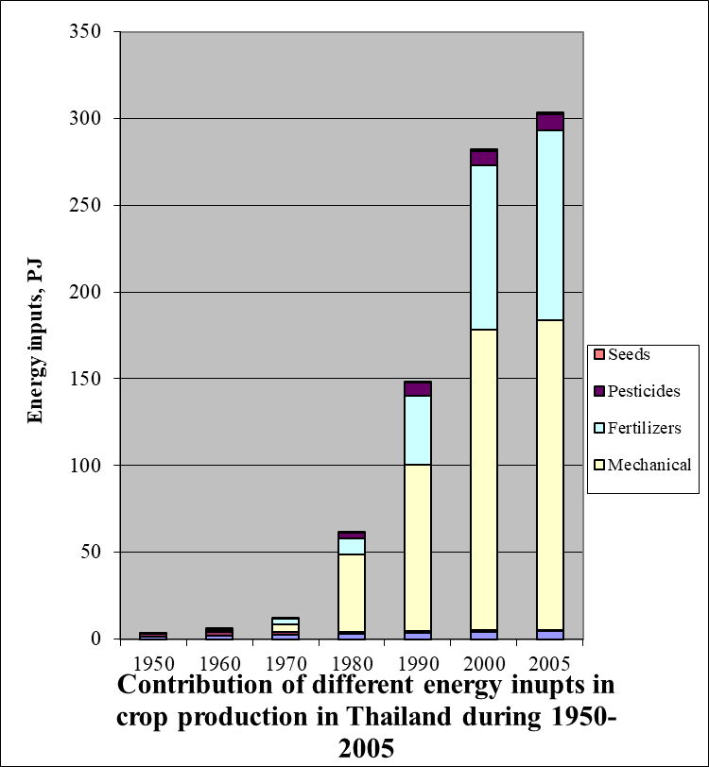
Bio-intensive farming reduces carbon emissions.
Water and Energy for Food; an interwoven linkage by Dr Peeyush Soni and Prof Athapol. Asian Institute of Technology, Bangkok (Thailand) 2009

Slide 21
House Prices are Highest When the State is Indifferent to Capturing Unearned Land Rents
Britain and South Africa are countries with the highest house price escalation; nearly twice the others.
Germany, Hong Kong, Singapore and South Korea capture a higher percentage of land rents and so prices do not rise so spectacularly

Slide 22
Non Partisan Endorsement of the Single Land Tax Leviticus (Biblical) Nobel Prize Winners (Capitalists), Joshua Nkomo (Communist)
Leviticus 25:23 New Jerusalem Bible
Land will not be sold absolutely, for the land belongs to me, and you are only strangers and guests of mine.
Three Nobel prize-winning economists Franco Modigliani, James Tobin and Robert Solow
“Users of land should not be allowed to acquire rights of indefinite duration for single payments. For efficiency, for adequate revenue and for justice, every user of land should be required to make an annual payment to the state, equal to the current rental value of the land that he or she prevents others from using.”
Now the synthesis: Capitalism, Socialism and the New Social Contract ed Richard Noyes Shepheard-Walwyn (London 1991)
Joshua Nkomo, leader of the Zimbabwe African People's Union and a past vice President of Zimbabwe:-
“We don't believe in trading land or selling land-no. And in any government that I lead, you can be certain those practices must go. That does not mean we will be taking people's land. It means that other people who haven't got money will have a chance to use land, which is the common property of everybody.
“And if they have to pay some rates or rent, that will go to a general fund of the people. In this way citizens can use as much land as they want.
Our system is this: once you use land, that land belongs to you. But you have not bought it. You cannot sell it to someone. The land belongs to the people, but everything on that land is yours. “

Slide 23
WORK
Let me but do my work from day to day,
In field or forest, at the desk or loom,
In roaring market-place or tranquil room;
Let me but find it in my heart to say,
When vagrant wishes beckon me astray,
“This is my work; my blessing, not my doom;
Of all who live, I am the one by whom
This work can best be done in the right way."
Then shall I see it not too great, nor small,
To suit my spirit and to prove my powers;
Then shall I cheerful greet the labouring hours,
And cheerful turn, when the long shadows fall
At eventide, to play and love and rest,
Because I know for me my work is best."

Slide 24
“Sec 25 must create jobs, enhance food production and not harming the economy” President Ramaphosa
My blueprint will end involuntary unemployment of all 9m able-bodied South Africans.
It will double food production (see Wandile Sihlobo BD column 6 March 2019 re exports to Saudi Arabia) with 90% less carbon emissions than commercial farming.
And ZA will become the international tax haven of choice doubling foreign direct investment and GDP growth every nine years (8%pa)
All South Africans prosper with land access in gated villages
Jobs for life are institutionalised
This Constitutional blue print is my copyright (Peter Meakin and may not be reproduced. Here are the changes which I will guarantee

