Slide 1
SAPO Status Update on SASSA and Mail Backlog
Portfolio Committee on Telecommunications and Postal Services
5 March 2019

Slide 2
Scope of Presentation
Introduction
SASSA Update
Status of Mail backlog
R2.9bn Funding Utilisation
SA Post Office – Status update on SASSA and backlogs

Slide 3
Introduction
SAPO successfully delivered on the critical SASSA grant migration and payments despite the short timelines
70.8% of beneficiaries have been paid through SAPO during February 2019
3 797 temporary jobs created by SAPO for SASSA project (2 610 for card swops and 1 187 for cash payments)
Cash payments via Cash in transit remains expensive and high risk
SAPO will continue to improve the beneficiary experience for the grant payment essential service
The mail backlog for domestic mail was cleared in December 2018 with International mail backlog for registered items still to be cleared.
The number of vehicles increased to 1 123 of the required 1 300 (86% allocation rate), thus improving deliveries.
The R2.9bn funding allocation has enabled SAPO to repay loans and reduce the creditors payment backlogs. Critical capital investment in infrastructure is in progress.
SA Post Office – Status update on SASSA and backlogs

Slide 4
The Baseline
Baseline as at April 2018 indicated that there were approximately 8.5 million beneficiaries that were paid through the old SASSA card (to be card swapped or migrated to ACB).
7,503,668 beneficiaries have been migrated to the new SAPO solution as at 3 December 2018
Over a million migrated to other banks
Remaining as at end of November 2018: approximately 400,000 to be swapped by 15 December 2018
Currently just over 150,000 beneficiaries have not presented themselves to collect their new card.
SA Post Office – Status update on SASSA and backlogs

Slide 5
The Target
What we needed to achieve?
 | Banks Payments | SASSA Card banking | Cash Payments | Merchants | SAPO | Total
March | 2 380 094 | 5 375 936 | 2 148 040 | 746 000 | 8 309 | 10 658 379
April | 2 316 659 | 5 342 376 | 2 252 175 | 900 000 | 31 448 | 10 842 658
May | 3 448 286 | 4 221 720 | 2 000 000 | 1 100 000 | 83 448 | 10 853 454
June | 7 455 486 | - | 1 000 000 |  | 1 297 968 | 10 853 454
July | 5 462 636 | - | 890 000 |  | 3 400 818 | 10 853 454
August | 4 313 256 | - | - |  | 5 540 198 | 10 853 454
Sep | 2 849 376 | 0 | - | 890 000 | 7 119 078 | 10 853 454
Primary Objective: Cash payments to be eliminated by September 2018
The October 2018 payment extraction file confirms that all cash beneficiaries effected by CPS have been migrated to SAPO and a few to other banks
SA Post Office – Status update on SASSA and backlogs

Slide 6
The Journey
Month | Activity
Nov 2017 | SASSA & SAPO sign Inter Ministerial Committee (IMC) led Implementation Protocol
Dec 2017 | SASSA & SAPO sign Services Agreement to provide Electronic Banking solution on BOT (build, operate, transfer) model
Dec/Jan 2018 | SASSA Issue RFP for Cash Payment Service Provider
Feb/Mar 2018 | SASSA suspends Cash Payment Service Provider RFP and requests SAPO to take over cash payment services in the rural areas
Mar 2018 | ConCourt extends invalidity of CPS contract to 30 September 2018 to allow SAPO time to take over
April 2018 | SAPO launces Pilot Card Swap programme in all 9 provinces
April 2018 | BOT model abandoned
May 2018 | SAPO launces full card swap programme and commences payment of SASSA grants
Aug 2018 | SAPO launches pilot cash payment solution in all 9 provinces
Sept 2018 | SAPO completes cash swap programme of all CPS paid beneficiaries
Sept 2018 | SASSA and SAPO signs new indefinite Master Services Agreement
Nov 2018 | SASSA & SAPO signs new Service Level Agreement
Dec 2018 | SAPO completes the migration form the old CPS-issued card to the new SAPO system
SA Post Office – Status update on SASSA and backlogs

Slide 7
Achievement
In terms of the February 2019 payment extraction file 11,052,684 beneficiaries are paid throughout the country.
Payments made through SAPO is reflected below:
January 2019 | Mzansi Accounts | SASSA Accounts | Total
Beneficiaries | 109,263 | 7,611,153 | 7,720,416
Grants | 122,133 | 8,234,711 | 8,356,844
Amount | R153,545,099.85 | R9,263,255,772.03 | R9,416,800,871.88
February 2019 | Mzansi Accounts | SASSA Accounts | Total
Beneficiaries | 107,741 | 7,722,967 | 7,830,708
Grants | 120,357 | 8,324,935 | 8,445,292
Amount | R150,760,558.13 | R9,314,951,776.48 | R9,465,712,334.61
SA Post Office – Status update on SASSA and backlogs

Slide 8
SASSA Withdrawal Volumes
SA Post Office – Status update on SASSA and backlogs

Slide 9
SASSA Withdrawal Values
SA Post Office – Status update on SASSA and backlogs

Slide 10
Challenges
Resource constraints – recruitment process to appoint and train a large number of additional resources to support SASSA in a short period of time and with limited resources
Implementation of IT solutions in a short period of time with significant changes in scope:
Initially SAPO were to use its Core Banking Platform with a SASSA product;
Scope change to BOT to transfer the solution to SASSA after 5 years; then
BOT abandoned
Timely procurement of appropriate equipment, eg laptops, note counters, cash protection devices, automate cash dispensing devices
Significant increase in the number of reported robberies at some of the SAPO branches requiring investment in security systems and equipment
The cash payment via CIT remains expensive and high risk – a concerted effort will be made to find alternative electronic payment facilities, ATMs, POS, Mobile Money, etc
SA Post Office – Status update on SASSA and backlogs

Slide 11
Strategic Focus
SAPO strategic focus post the termination of the CPS contract will be on the following:
Ensure continued and improved payment of social grants services
Support the repositioning and remodelling of SAPO and Postbank as the primary social grant payments partners
Addressing regulatory and contractual obligations
Improve Beneficiary experience – by insuring that payment challenges experienced by beneficiaries are adequately addressed
Improve communication and stakeholder engagements
Reduce, if not eliminate, cash payments via CIT services in the rural areas
Continue to leverage the SAPO footprint and capabilities to meet the broader Government developmental mandate to become the delivery arm of Government and its interface with Citizens
SA Post Office – Status update on SASSA and backlogs

Slide 12
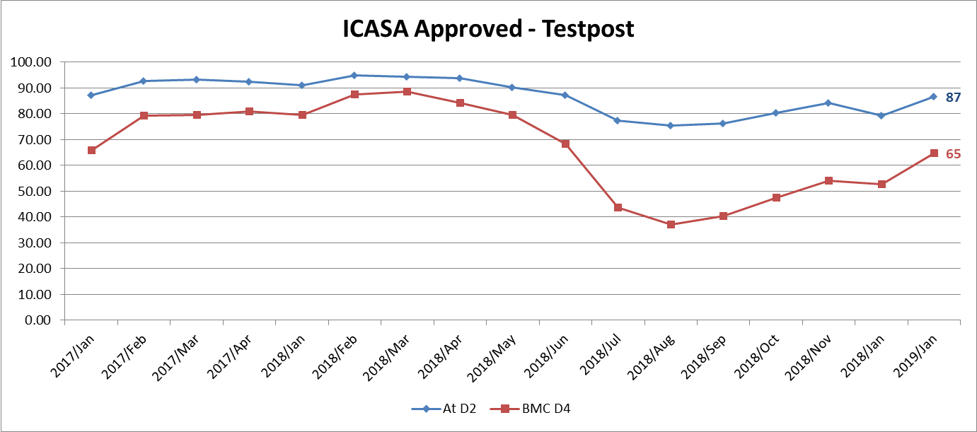
On Time Delivery: Domestic Mail
87% of Mail delivered in 2 Days Across Same Town.
65% of Mail delivered in 4 Days Between Provinces.
Almost all national mail is delivered with 8 working day (Exception rural parts of Northern Cape).
SA Post Office – Status update on SASSA and backlogs

Slide 13
International Mail Status
Outbound (Export): Mail is suppose to leave the country within 3 days
It deteriorated to 20 days in September 2018 and improved in January 2019 to less than 8 days
Inbound (Import): Mail is suppose to be delivered 2 days after arrival in the country.
In July, the mail took 30 days (2 million backlog).
In January, it improved to 13 days (half a million backlog).
There are no backlogs on the international large parcels
There are no backlogs on the Expedited Mail Services (EMS)
The backlogs is in the Registered Letters. Unfortunately, Registered Letters have goods (requiring customs clearance), whereas it was designed for documents.
SA Post Office – Status update on SASSA and backlogs

Slide 14
International Mail Actions
Increase data transmission capacity by upgrading the network to Fibre. This increases the speed of processing
Doubled the number of workstations for Customs assessment in Johannesburg Office of Exchange
Instructed other countries to send mail for KwaZulu-Natal and Eastern Cape directly to Durban Office of Exchange
Instructed other countries to send mail for Western Cape and Northern Cape directly to Cape Town Office of Exchange
Integrated the last mile delivery of EMS to the national courier leg.
After clearing the domestic mail, the national Mail Centres are sorting international parcels.
Electronic notifications are being utilised to speed up collection. Most of the parcels are in post offices
The process of procuring scanners has started. This will increase the visibility of parcels in postal system.
SA Post Office – Status update on SASSA and backlogs

Slide 15
Utilisation of R2.9bn Recapitalisation funds
Term loans with banks settled in full on 31 January 2019
R283m used for payment of critical suppliers, property rentals, VAT payment and salary top-up
R1.28bn funds available includes allocations for much need capital investment
SAPO successfully motivated for reinstatement of USO Funding – R1.5bn over the MTEF Period from 01 April 2019
R2.9bn allocation funds received on 25 January 2019
SA Post Office – Status update on SASSA and backlogs

Slide 16
End of presentation

