Slide 1
NDA ANNUAL REPORT (2017/18) SELECT COMMITTEE ON SOCIAL SERVICES 05 MARCH 2019

Slide 2
PRESENTATION OUTLINE
PURPOSE OF PRESENTATION
AUDIT OPINION BY THE AUDITOR GENERAL
LEGISLATIVE MANDATE
PERFORMANCE INFORMATION
REPORT ON GOVERNANCE
HUMAN RESOURCE PERFORMANCE REPORT
AUDITED ANNUAL FINANCIAL STATEMENTS
CHALLENGES AND RECOMMENDATIONS

Slide 3
PURPOSE OF THE PRESENTATION
To present the NDA 2017/18 Annual Report
To present the Audit Outcome on the Annual Financial Statement and Performance Information
To detail the organisational performance of the NDA and the implementation challenges experienced
To present the remedial measures to address the performance challenges
To request the approval of the NDA 2017/18 Annual Report

Slide 4
AUDITOR GENERAL (AG) AUDIT OUTCOME FOR THE NDA - 2017/18 FINANCIAL YEAR
The AG issues two audit opinions based on the two key aspects that they audit namely the Annual Financial Statements (AFS) and Performance Information.
The Audit Opinion on Annual Financial Statements remained unchanged with an Unqualified Opinion with findings. The audit outcome on AFS determines the overall audit outcome for the organisation. The NDA’s overall audit outcome was therefore an Unqualified Opinion with findings.
The Audit Opinion on Performance Information remained unchanged from 2016/17 with an Adverse Opinion with findings.
Financial health remained good by the end of the 2017/18 Financial Year.
Key initiatives have been put in place to address all issues identified by the audit per the NDA’s 2018/19 Audit Turnaround Strategy. Instances of Supply Chain non compliance that resulted in new irregular expenditure were drastically reduced in 2017/18 compared to prior years. This confirms success of the initiatives implemented by the NDA per the 2017/18 Audit turnaround strategy.

Slide 5
LEGISLATIVE MANDATE
NDA is a Schedule 3A Entity administratively reporting to DSD but operationally attached to all departments
Primary Mandate | Secondary Mandate
To contribute towards the eradication of poverty and its causes by granting funds to civil society organisations for the purpose of: | To promote consultation, dialogue and sharing of development experience between the CSOs and relevance organs of state through:
Carrying out programmes and projects aimed at meeting development needs of the poor Strengthening the institutional capacity of other civil society organisations involved in direct service provision to the poor communities | Debating development policy Undertaking research and publication aimed at proving basis for development policy
Further, the Agency is required by section 4 of the Act to implement programmes that respond to the following areas of responsibilities:
Act as a key conduit for funding from the Government of the Republic, foreign governments and other national and international donors for development work to be carried out by CSOs.
Contribute towards building the capacity of CSOs to enable them to carry out development work effectively.
Create and maintain a database of CSOs, including, but not limited to, the scope and subject matter of their work and their geographical distribution, and share the information in that database with relevant organs of state and other stakeholders.

Slide 6
NDA CSO DEVELOPMENT MODEL

Slide 7
ORGANISATIONAL STRUCTURE
MINISTER FOR SOCIAL DEVELOPMENT
NDA BOARD
CHIEF EXECUTIVE OFFICER
INTERNAL AUDIT
COMPANY SECRETARY
LEGAL AND RISK
CORPORATE PERFORMANCE
,
MANAGEMENT
PLANNING
,
MONITORING AND
REPORTING
STAKEHOLDER RELATIONS
DEVELOPMENT
,
MANAGEMENT AND
CORE OPERATIONS
FINANCE
CORPORATE SUPPORT
RESEARCH
SERVICES
DEVELOPMENT
GRANT FUNDING
,
FINANCIAL MANAGEMENT
COMMUNICATIONS AND
(
PRODUCT
RESOURCE MOBILISATION
MARKETING
DEVELOPMENT
)
AND CSO CAPACITY
BUILDING
SUPPLY CHAIN
INFORMATION
RESEARCH
MANAGEMENT
COMMUNICATION AND
OPERATIONS
TECHNOLOGY
MANAGEMENT
MONITORING
,
HUMAN CAPITAL
EVALUATION
,
MANAGEMENT
REPORTING AND
9
X PROVINCE
LEARNING
SUPPORT SERVICES
Dotted Line=
*Operationally Report to Board
*Administratively Report to CEO
9
X DISTRICT

Slide 8
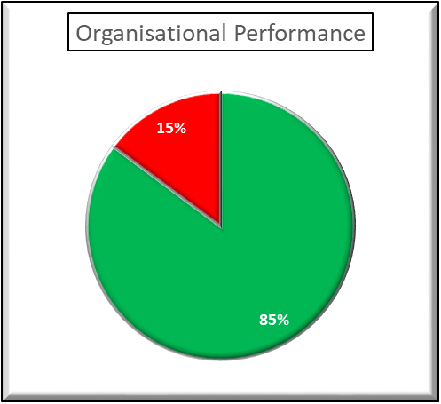
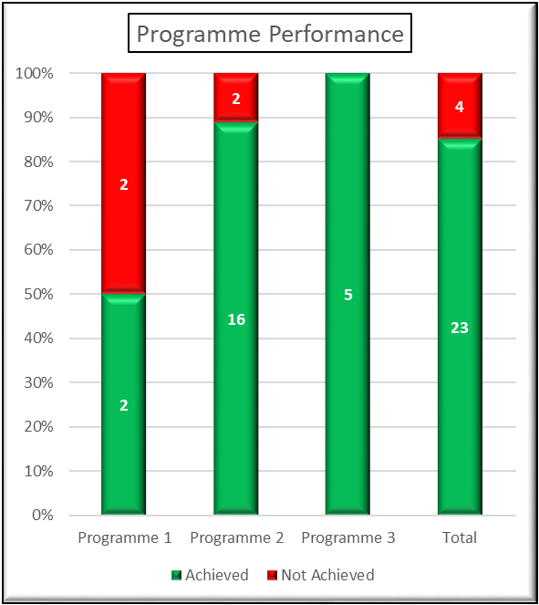
SUMMARY OF ORGANISATIONAL PERFORMANCE

Slide 9
PROGRAMME 1: GOVERNANCE AND ADMINISTRATION
# | Performance Indicator (KPI) | Planned target 2017/2018 | Actual achievement 2017/2018 | Deviation from planned target | Reasons for deviation
1.1 | % compliance to legislative /regulatory requirements including the PFMA, SCMA and Treasury Regulations and NDA policy | 100% | 99% | 1% | Delay in the finalisation of Materiality and significant framework.
1.2 | % implementation of marketing and communication plan aimed at improving NDA brand awareness. | 100% | - | 100% | Prolonged process of developing the marketing and communication strategy.
1.3 | % completion of a functional integrated information system per year | 60% | 60% | None | N/A
1.4 | % implementation of the rollout plan for establishing decentralised program delivery centres at districts | 50% | 50% | None | N/A
1.5 | % of targets achieved in the APP | 90% | 85% | 5% | Four KPIs could not be achieved due to implementation constraints

Slide 10
PROGRAMME 2: CSO DEVELOPMENT (SUB PROGRAMME 2.1 – MOBILISATION & FORMALISATION)
# | Performance Indicator (KPI) | Planned target 2017/2018 | Actual achievement 2017/2018 | Deviation from planned target | Reasons for deviation
2.1.1 | Number of CSOs participated in CSOs mobilisation engagements and consultation processes per year | 3 050 | 5 956 | 2 906 | Overachieved due to outreach programmes with Social Development department.
2.1.2 | Number of CSOs assisted to formalise their structures per year | 720 | 803 | 83 | Overachieved due to outreach programmes with Social Development department.
2.1.3 | Number of CSOs assessed to identify institutional needs and determine appropriate CSOs development support to be provided per year | 3 050 | 5 956 | 2 906 | Overachieved due to outreach programmes with Social development department.
2.1.4 | Number of CSOs assisted to register with appropriate registration authority per year | 720 | 829 | 109 | Target overachieved due to partnerships and expansion to district offices.
2.1.5 | Number of CSOs referred to other agencies for technical and/or financial support per year | 762 | 1 541 | 779 | The variance is due to the outreach programme and partnerships with other departments.

Slide 11
PROGRAMME 2: CSO DEVELOPMENT (SUB PROGRAMME 2.2 – INSTITUTIONAL CAPACITY BUILDING)
# | Performance Indicator (KPI) | Planned target 2017/2018 | Actual achievement 2017/2018 | Deviation from planned target | Reasons for deviation
2.2.1 | Number of CSOs assessed to determine institutional capacity with the aim of providing appropriate capacity building support per year | 6 250 | 7 125 | 875 | The variance is due to partnerships in six provinces (KZN, MP, LP, EC, GP and NC).
2.2.2 | Number of CSOs trained and/or mentored to comply with registration legislations per year | 3 750 | 3 953 | 203 | Extra training was conducted to support ECDs and Cooperatives in two provinces (EC and KZN)
2.2.3 | Number of civil society organisations capacitated in civil society organisational management per year | 3 000 | 4 927 | 1 927 | Increased public and private sector partnerships in six provinces (KZN, MP, LP, EC, GP and NC).
2.2.4 | Number of NPOs trained in community development practice per year | 750 | 1 341 | 591 | The target was overachieved due to collaboration with provincial Departments of Social Development.

Slide 12
PROGRAMME 2: CSO DEVELOPMENT (SUB PROGRAMME 2.3 – RESOURCE MOBILISATION)
# | Performance Indicator (KPI) | Planned target 2017/2018 | Actual achievement 2017/2018 | Deviation from planned target | Reasons for deviation
2.3.1 | Number of CSOs needs assessments conducted for resource mobilisation per year | 2 062 | 2 761 | 699 | Expansion to districts brought services closer to communities
2.3.2 | Rand Value of resources (financial and non-financial) raised to fund CSOs per year | R80 million | R61,7 million | -R18,2 million | Target not met due to partnership agreements yielding too few financial resources
2.3.3 | Number of CSOs grant funded for capacity building per year | 900 | 1 787 | 887 | Increased outreach programmes and provincial partnerships
2.3.4 | Number of individual directly benefiting from programs that have received grants from third parties through NDA per year | 2 700 | 3 488 | 788 | Increased outreach programmes and provincial partnerships
2.3.5 | Number of partnership agreements concluded and signed in the year | 21 | 21 | None | N/A

Slide 13
PROGRAMME 2: CSO DEVELOPMENT (SUB PROGRAMME 2.4 – GRANT FUNDING & SUSTAINABILITY)
# | Performance Indicator (KPI) | Planned target 2017/2018 | Actual achievement 2017/2018 | Deviation from planned target | Reasons for deviation
2.4.1 | Number of CSOs grant-funding and sustainability needs assessed per year | 2 062 | 2 144 | 82 | Expansion to districts brought services closer to communities
2.4.2 | Number of CSOs that received grant-funding per year | 200 | 162 | -38 | New CSO Development Model required new guidelines for funding which resulted in delays in the implementation and approval of grants.
2.4.3 | Number of CSOs assisted to join CSO network per year | 400 | 600 | 200 | CSO Development Model and mobilisation programme contributed to more engagements that led to the increase
2.4.4 | Number of CSOs linked to sustainable resources per year | 400 | 1328 | 928 | Partnerships with other agencies to gain access to economic opportunities led to the substantial increase

Slide 14
Program 3: - Research
# | Performance Indicator (KPI) | Planned target 2017/2018 | Actual achievement 2017/2018 | Deviation from planned target | Reasons for deviation
3.1 | Number of research and policy briefs produced per year | 18 | 18 | None | N/A
3.2 | Number of best practice publications produced per year | 9 | 9 | None | N/A
3.3 | Number of dissemination sessions for research reports, evaluation reports, policy briefs and best practice publication conducted per year | 7 | 10 | 3 | Additional request were made by CSOs on dialogues and engagements on the ECD research results in the Eastern Cape.
3.4 | Number of participants who attended research reports, evaluation reports, policy briefs and best practice dissemination sessions per year | 260 | 342 | 82 | Three additional sessions were held in the Eastern Cape on the ECD research results.
3.5 | Number of evaluation studies on NDA program conducted and results shared out with various stakeholders per year | 5 | 5 | None | N/A

Slide 15
REPORT ON GOVERNANCE
The NDA Board consists of 10 members and it operated through the following committees for the 2017/18 financial year:
Management Committee
Audit and Risk Committee
Human Resource and Remuneration Committee
Projects, Research and Development Committee
The Internal Audit Unit compiled an annual coverage plan for management of prioritised and significant strategic risks in the NDA

Slide 16
BOARD EVALUATION OF CONTROLS
The NDA Board assisted by the Audit and Risk Committee have reviewed:
The effectiveness of the internal control systems;
The operational risks covered in the scope of internal and external audit;
The adequacy, reliability and accuracy of financial information;
Any accounting and auditing concerns identified through audits;
The compliance with legal, accounting and regulatory frameworks; and
The Annual Report and discussed with the Auditor General material aspects of the report.

Slide 17
HUMAN RESOURCE
The NDA had 192 employees for the financial year 2017/18
Africans are the pre-dominant racial group, with Females being in the majority at 66%
The NDA has three (4) employees living with a disability which translates to 2% of the staff complement
The vacancy rate is 19%, whilst, the turnover rate of the NDA is at 4% following the departure of 8 employees
Three (3) employees attracted disciplinary action due to non-compliance with NDA policies and procedures
0,63% of the personnel budget has been spent on training and development

Slide 18
PERSONNEL COST PER PROGRAMME
 | Total Expenditure for the entity (R’000) | Personnel Expenditure (R’000) | Personnel exp. as a % of total exp. | No. of employees | Average personnel cost per employee (R’000)
Programme 1 | 95 660 | 42 699 | 18,56% | 57 | 749
Programme 2 | 128 601 | 71 959 | 31,27% | 128 | 562
Programme 3 | 5 830 | 4 991 | 2,17% | 7 | 713
Total | 230 091 | 119 649 | 52% | 192 | 623

Slide 19
AUDITED ANNUAL FINANCIAL STATEMENTS
AUDITED FINANCIAL STATEMENTS FOR THE YEAR ENDED 31 MARCH 2018
*All numbers are rounded off to the nearest Rand.

Slide 20
STATEMENT OF FINANCIAL PERFORMANCE FOR YEAR ENDED 31 MARCH 2018 – 2017/18 vs 2016/17
The NDA continued to operate under stringent financial constraints due to financial allocation increasing at only 3.5% year on year while CPI averaged 6%. The resources are decreasing in real terms.
Conditional Grants received from other government departments also decreased significantly, by R16,9 million, compared to prior year.
The entity is reporting an accounting deficit of R3,5 million compared to an accounting surplus of R16,6 million in the prior year.

Slide 21
NOTES TO THE STATEMENT OF FINANCIAL PERFORMANCE – REVENUE ACTUAL vs BUDGET
Total Revenue of R226,6 million is made up of three key sources as follows:
Transfer revenue from National Treasury – R200,9 million
Conditional Grants from Third Parties – R18,5 million
Third Party revenue is allocated to expenditure on behalf of Third party projects, with a nil impact to NDA’s net financial position.
Interest and Other Income (Resource mobilization / management fees) – R7,2 million
R1,2 million additional income was received compared to budget mainly due to higher than expected management fees.

Slide 22
NOTES TO THE STATEMENT OF FINANCIAL PERFORMANCE – TOTAL EXPENDITURE ACTUAL vs BUDGET
TOTAL EXPENSES:
A Total of R215,4 million was spent against an allocated budget of R241,9 million, representing 89% of the annual budget allocation.
ADMINISTRATION EXPENSES:
R99,5 million was spent on administration against a budget of R110,5 million, representing 90% of the annual budget allocation.
TOTAL MANDATE EXPENSES:
R115,9 million was spent on Mandate expenses against a budget of R131,4 million, representing 88% of the annual budget allocation.

Slide 23
NOTES TO THE STATEMENT OF FINANCIAL PERFORMANCE – ADMINISTRATION EXPENSES
ADMINISTRATION EXPENSES
R99,5 million was spent on administration against a budget of R110,5 million, representing 90% of the annual budget allocation [-R10,97 million below budget].
The 10% underspending on Administration expenses was due to the following:
Underspend on consulting and professional fees due to planned due diligence of funded projects that was only concluded and awarded in April 2018
Underspend on District Office establishment costs due to delays in procuring NDA own office space in four provinces. Tenders were issued and suitable office space could not be secured in the identified districts.
Underspend on marketing costs related to production of the corporate stationery and promotional items for the district offices. The budget could not be spent, as these planned offices were not procured by the year-end.
Underspend on IT Communication Costs due to planned implementation of the ICT master systems plan revamp project that did not materialise by the end of the financial year. Delays was attributable to the late finalisation of the ICT strategy and master system plans, which is a pre-requisite for the ICT system

Slide 24
NOTES TO THE STATEMENT OF FINANCIAL PERFORMANCE – MANDATE EXPENSES – CSO DEVELOPMENT & RESEARCH
TOTAL MANDATE EXPENSES:
R115,9 million was spent on Total Mandate expenses against a budget of R131,4 million, representing 88% of the annual budget allocation [-R15,6 million] as follows:
Programme 2 – CSO Development
R110,0 million was spent against a budget of R123,7 million, representing 89% of the annual budget allocation [-R13,6 million]
The underspend under this programme was due to slower disbursement of grants to NDA funded projects as follows:
An underspending of R4,7 million due to delays in approving grants to projects approved in the current year. The delay in approving projects was occasioned by a management decision to align the grant making policy to the new NDA service delivery model; the policy revision took longer than anticipated.
An underspending of R12,9 million was due to delays in disbursement of funds to projects funded in previous financial years, which were occasioned by challenges faced by funded organisations.
The underspend on grant funding projects was offset by overspending on Capacity Building due to more capacity building interventions conducted than was anticipated during budget re-adjustment process.
Programme 3 - Development Management and Research
R5,8 million was spent against a budget of R7,8 million, representing 75% of the annual budget allocation [-R1,9 million]
The underspending was partly attributable to delays in the finalisation of the planned evaluation of the CSO development framework that was commissioned in the third quarter of the financial year. The evaluation was finalized in the first quarter of the 2018/19 financial year. The underspend was also partly attributed to delays in the implementation of the pilot phase of the ECD study conducted in collaboration with the University of Fort Hare.

Slide 25
STATEMENT OF FINANCIAL POSITION AS AT 31 MARCH 2018 - [Balance Sheet]

Slide 26
KEY BALANCE SHEET INDICATORS
The Agency’s Assets exceeds its Liabilities by R37.6m, representing a healthy financial state.
Total Current Assets:
The entity has total current assets of R81,8 million, with cash balances to the value of R80,7 million making up 99% of total current assets.
Total Current Liabilities:
Liabilities to a total of R50.9 million are made up as follows:
Payables to Creditors (Service Providers) – 16%
Provisions and Employee Benefits (Leave provision, 13th cheque) – 23%
Provision for payments to approved grant funded projects – 5%
Unutilised Third Party funds – 56%

Slide 27
CHALLENGES
CHALLENGE | REMEDIAL MEASURE
Performance Information risks and mitigation strategies not undertaken timeously | Risk management strategy has been put in place which includes quarterly monitoring of quality of information
Shortcomings in the reporting system and the quality of performance information | A robust and automated system for quarterly reporting of performance information has been put in place for 2018/19 financial year; Training and capacity building of officials to ensure quality reporting; and Development of policies and procedures to govern performance information and reporting thereof
Fewer resources raised for funding of CSOs | Development of a focused and comprehensive strategy on resource mobilisation for grant funding
Lack of compliance to the legislation by other government departments except for DSD since 2000 | Commitment by the Portfolio Committee to assist in addressing the matter through relevant structures

Slide 28
RECOMMENDATION
It is recommended that the Select Committee approves the 2017/18 NDA Annual Report

Slide 29
Thank you
THANK YOU

