Slide 1
INTERVENTION IN TERMS OF SECTION 139(1)(b) AT ENDUMENI LOCAL MUNICIPALITY
PRESENTATION TO THE SELECT COMMITTEE ON COOPERATIVE GOVERNANCE AND TRADITIONAL AFFAIRS (YOUTH, WOMEN AND IGR MATTERS) 05 MARCH 2019 – 10H00

Slide 2
TABLE OF CONTENTS
Introduction and Background
Reasons for the Intervention
Resolutions of the Provincial Executive Council
Terms of Reference
Formalities and Conclusion

Slide 3
1. INRODUCTION AND BACKGROUND
Endumeni is a hung municipality with 13 Councillors broken down as follows: 6 from ANC, 4 from IFP, 2 from DA and 1 from the EFF.
The municipality has seen a fair share of instability over the past 12 months including instability in the management of the municipality.
On 05 December 2008, the Provincial Executive Council resolved to intervene at Endumeni Local municipality, due to the municipality’s failure in a number of areas including financial weaknesses, governance and service delivery failures.

Slide 4
2. REASONS FOR THE INTERVENTION
Dysfunctionality of the Council and its committees
Council and its Committees, with particular reference to the Executive Committee, Portfolio Committees and MPAC had not functioned optimally over the past few months due to political instability at the municipality.
The committees of council were unable to provide oversight over the administration particularly with reference to financial management and the service delivery programme of the municipality.
Following the tabling of the forensic report on the 4th of October 2018, Council had not been able to consider and process the report and, in particular, the recommendations. On the 19th of November 2018 the municipal council resolved to request the MEC to extend the 21 day period within which to develop an implementation plan and notify the MEC of such. Both the new Mayor and Speaker had committed themselves to ensuring that the recommendations of the report are implemented, speedily so. However, it became abundantly clear that due to the instability in the municipal council and municipal administration, there was no or very little appetite to implement the findings and recommendations of the report

Slide 5
2. REASONS FOR THE INTERVENTION…continued
Dysfunctionality of the Council and its committees continued..
The forensic investigation identified various instances of irregular, fruitless and wasteful expenditure, procurement irregularities, conflicts of interest, fraud, theft, maladministration and non-compliance with relevant legislation, regulations, circulars and policies.
It was normal for Endumeni Local Municipality to avoid implementing the findings of a forensic investigation, as on one occasion, the MEC had to approach the courts to compel the municipal council to comply with legislative requirements in respect of implementing consequence management, arising from the findings of the then section 106 investigation.
Following the tabling of the forensic report, the Mayor resigned while the Speaker Councillor Mbatha-Makhathini was expelled by her party. It then became abundantly clear that the municipality was on a verge of collapse, as despite support, the municipality remained unstable and challenged due to poor/absence of leadership and management.

Slide 6
2. REASONS FOR THE INTERVENTION…continued
Election of New Office Bearers
Following the resignation of the Mayor and expulsion of the Speaker, the IEC after consulting the IFP, filled the vacancies that had arisen. The Municipal Manager convened a Special Council meeting in terms of section 36 of the Municipal Structures Act to elect the Speaker. The meeting was held on the 8th of November 2018 but collapsed due to differences and disagreements within the IFP, resulting in them failing to remain in attendance at the meeting. The Municipal Manager had also contributed to the collapse of the meeting as he left and did not return to the council chambers.
Following various engagements between Cogta and the Municipal Manager he convened another Special Council meeting on the 16th of November 2018, where Cllr L Khumalo of the ANC was elected as the Speaker. Following the election of the Speaker there was confusion created by the Municipal Manager who attempted to carry on chairing the meeting even though the Speaker had been elected.

Slide 7
2. REASONS FOR THE INTERVENTION…continued
Election of New Office Bearers… continued
The Speaker took charge of the meeting. The DA, EFF and 3 IFP councillors walked out, leaving the ANC and one IFP councilor.
The meeting had sufficient number of councillors (7) to form a quorum and thus proceeded to elect Cllr Mlotshwa from the IFP as the new Mayor of Endumeni.
Following the 2016 local government elections the municipality had not elected a Deputy Mayor even though the position had been approved by the MEC. The absence of a Deputy Mayor contributed to the political uncertainty when the Mayor was incarcerated in May 2018. On 19 November 2018 the Municipal Council again met and elected a member of the Executive Committee as the Deputy Mayor. The municipality now has a Deputy Mayor, despite not having budgeted for the position in the 2018/2019 budget.

Slide 8
2. REASONS FOR THE INTERVENTION…continued
Suspension of the Municipal Manager and administrative instability
Both on the 8th and the 16th of November, the Municipal Manager conducted himself inappropriately towards councillors. He entered the political space and appeared to take sides with one of the IFP factions in council.
On the 16th the Municipal Manager purported to have received a letter from the IFP, summarily dismissing one their councillors who was suspected to have voted against his ‘party mandate’. The letter was denied by the party representatives at the meeting. The Municipal Manager openly interjected the Speaker in an effort to prevent the Municipal Council from electing a new Mayor.
The Municipal Council successfully elected the Mayor, but the Municipal Manager went on to openly defy the authority of the new Mayor. The Municipal Manager stated openly that he did not recognize the new Mayor, thus crossing the political line.

Slide 9
2. REASONS FOR THE INTERVENTION…continued
Suspension of the Municipal Manager and administrative instability…continued
Council was incensed by this kind of behavior and resolved to put the Municipal Manager on special leave, with immediate effect and appointed Mr L. Cindi, the Director Technical Services as the Acting Municipal Manager.
Cogta engaged the Speaker about the legality of forcing the Municipal Manager to go on special leave. The Speaker thus convened another Special Council meeting on the 19th of November 2018, to review the matter of the Municipal Manager and to elect a Deputy Mayor.
On 19 November 2018, the Municipal Council rescinded its decision to put the Municipal Manager on special leave and following presentation by the Mayor, resolved to give him an opportunity to respond as to why he should not be suspended.

Slide 10
2. REASONS FOR THE INTERVENTION…continued
Suspension of the Municipal Manager and administrative instability…continued
The municipal council again met on 29 November 2018 where, following the consideration of representations from the Municipal Manager, the Municipal Council resolved to suspend him, pending an investigation and possibly a disciplinary inquiry.
The municipal council appointed Mr Mthembu, the Director Corporate Services, as the Acting MM until such time as the matter of the Municipal Manager is concluded or the expiry of three months whichever comes first.
The municipality has not appointed a CFO and Director Community Services for a period longer than 6 months.
The Municipal Manager publicly exchanged insults with some of the municipality’s employees, allegedly because he had failed to address their grievances. The incident was recorded by a bystander and ended up on social media thus bringing the municipality into disrepute. This demonstrated that the administration is unstable.

Slide 11
2. REASONS FOR THE INTERVENTION…continued
Back to Basics Pillar Two – Delivering Basic Services
Human Settlements
The Endumeni Civic Association (ECA) lodged an application in the High Court against Endumeni Municipality, concerning the enforcement of access to housing. The ECA operates within Endumeni municipal area. The association had been approached by communities in wards 4 & 5 of Endumeni. The communities had accused councillors and officials alike of impropriety, fraud and corruption in the allocation of RDP houses. It was alleged by the association, that people who deserved to be allocated houses, were overlooked and people who had been allocated houses were later changed or substituted arbitrarily.
There were further allegations of fraud and corruption directed at municipal officials, relating to unjust allocations of RDP houses, including unlawful renting out of the said houses.

Slide 12
2. REASONS FOR THE INTERVENTION CONTINUED..
Back to Basics Pillar Two – Delivering Basic Services
Human Settlements…continued
The association made several attempts to engage with the municipal councillors and officials in an effort to get answers regarding the allocation of houses, all in vain. They then approached the Legal Resources Centre, which ultimately represented the association in lodging the application in the High Court, which culminated in the judgment against the municipality. The verdict gave permission to the Department of Human Settlements to take over the function, which had been delegated to the municipality. Both the municipality and the Department are opposed to the takeover of the projects and are back in court contesting the matter.
The municipality was also taken to court by disgruntled contractors over housing projects which were awarded without due process having been followed. The municipality was ordered by the court to hand over that project to the Department of Human Settlements. The municipality failed to adequately implement the court order.

Slide 13
2. REASONS FOR THE INTERVENTION CONTINUED..
Back to Basics Pillar Four – Sound Financial Management
The municipality also failed to pass its 2018/2019 budget within the prescribed timeframe, as the former Mayor had been arrested for plotting to murder the former Speaker which resulted in further instability at the municipality. The budget was subsequently passed when the Mayor was released from his incarceration.
The municipality received an unqualified audit report with other matters during the previous audit cycle (2016/17). During the last quarter, the municipality had still not addressed all the issues raised by the Auditor-General which contributed to an unfavourable 2017/2018 audit.
This also made it abundantly clear that Council had failed to exercise oversight over its administration to the detriment of the community of Endumeni.

Slide 14
3. DECISION OF THE PROVINCIAL EXECUTIVE COUNCIL
On the basis of the serious challenges prevalent at the municipality, the Provincial Executive Council resolved to intervene in terms of section 139(1)(b) of the Constitution, 1996 at Endumeni Municipality, by assuming the functions specified in sections 51 of Local Government Municipal Systems Act in order to organise the administration in a manner that would enable the municipality to achieve the objects of local government, as set out in section 152 of the Constitution.
The Provincial Executive Council authorize the MEC for Cooperative Governance and Traditional Affairs to appoint suitably qualified person(s) to implement the following terms of reference:

Slide 15
4. TERMS OF REFERENCE
Terms of reference:
preparation and implementation of a recovery plan to be approved by the municipal council;
Implementation of governance systems and procedures including oversight over the administration, ratification of decisions taken by the Municipal Council, the Executive Committee, Committees, Municipal Manager and Section 56 Managers, in terms of delegated or original authority;
Ensuring the implementation of findings arising from any investigations into fraud or maladministration or corruption; and
Ensuring implementation of remedial action plans dealing with negative findings from the Auditor General.

Slide 16
5. FORMALITIES & CONCLUSIONS
The Minister and the NCOP were informed of the resolution of the Provincial Executive Council as prescribed. The Minister has since concurred with the intervention while the decision of the NCOP is awaited.
A Ministerial Representative was also appointed to turn the situation around.
The Ministerial Representative is in the process of preparing a detailed Recovery Plan which will also be submitted to the Endumeni Council for consideration/approval and implementation. The recovery plan will focus on the three critical areas namely: Governance including Institutional Matters, Financial Recovery & Service Delivery matters.
CoGTA coordinates monthly Steering Committee meetings to monitor the implementation of the resolution of Provincial Executive Council and to coordinate support to the municipality. Members of the Steering Committee include representatives from National Department of Cooperative Governance, Provincial Treasury, SALGA amongst other representatives.
Soon after the KZN Executive Council decision to intervene at Endumeni a Notice that was published in the Government Gazette in which the Honourable President authorised an investigation into the affairs of the eNdumeni Municipality by the Special Investigations Unit. The investigation is focussed on the award made in Tender No. 21/2016-17, although the scope includes any other maladministration and unlawful conduct that may be linked to the said award. The Notice somehow reinforced the decision of the Executive Council to intervene at the municipality.

Slide 17
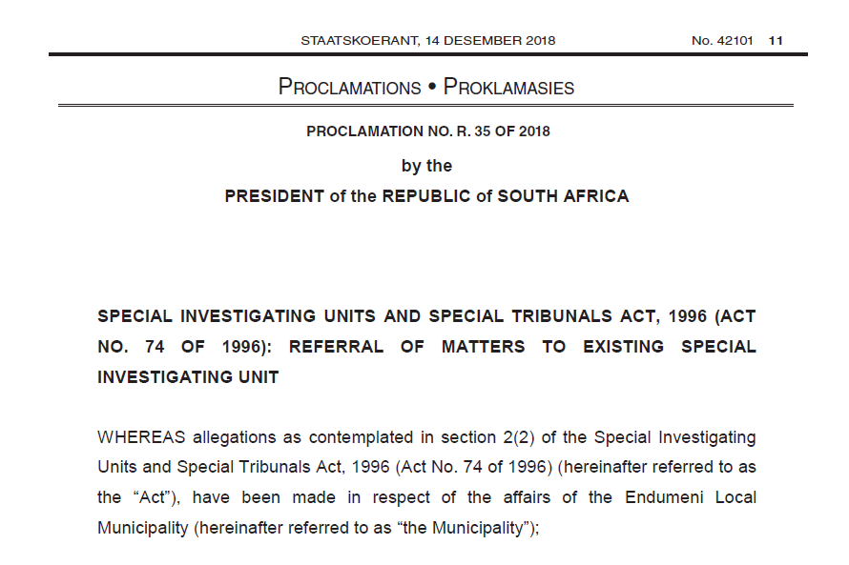
5. FORMALITIES & CONCLUSIONS Extract from Gazette

Slide 18
THANK YOU

