Slide 1
Update on South Africa’s Trade Agreements
Presentation to the Parliamentary Portfolio Committee
on Trade and Industry
Xolelwa Mlumbi-Peter Deputy Director-General
International Trade and Economic Development Division
27 February 2019

Slide 2
Outline of Presentation
SA policy context and Trade Policy and Strategy Framework
African regional economic integration & the Development Integration Approach
African Continental Free Trade Agreement (AfCFTA)
SADC
SACU
TFTA
Trade agreements with Europe
Trade agreements with BRICS countries
World Trade Organisation (WTO)
AGOA

Slide 3
SA Policy Context
SA Government’s broad national development strategy aims to accelerate growth along a path that generates sustainable development and decent jobs to address apartheid legacies.
Elaborated in the National Development Plan and New Growth Path.
National Industrial Policy Framework (NIPF) and Industrial Policy Action Plan (IPAP) are central components of this strategy and seek to encourage and upgrade value-added, labour-absorbing industrial production.
TPSF approved by Cabinet in 2012.
Strategic approach to tariff reform - Trade policy is an instrument of industrial policy and calls for developmental tariff setting Strategic approach to tariff reform.
An evidence-based, case-by-case assessment will inform changes to tariffs (no a priori position) – vital role for ITAC
Implies:
Reduce tariffs on mature upstream input industries → lower the costs for downstream, labour creating manufacturing
Raise tariffs on downstream industries with employment or value-addition potential → ensure sustainability and job creation (while observing international trade obligations)

Slide 4
Trade Strategy Priorities
Priority is to focus on African development, industrialisation and integration.
Africa needs to shift its current consumption and commodity-driven growth path onto a more sustainable industrial development path.
Pursue “development integration” in SACU, SADC, T-FTA and C-FTA: market integration; industrialisation and regional value-chains; and infrastructure development.
Maintain trade and investment relations with industrialised economies.
Work to build industrial complementarities and shift structure of trade with dynamic economies of the South, e.g. BRICS.
Work to ensure development-outcome at the WTO
Notes:
Africa Strategy: Broad strategic and policy framework to guide the dti’s support for Africa’s economic development.
Seeks to consolidate partnerships with Africa bilaterally, regionally and multilaterally and coordinate SA stakeholders to:
- Achieve Economic diversification;
- Achieve Regional (Global) integration and cooperation;
- Address supply-side constraints;
- Develop cross-border infrastructure;
- Provide technical assistance for human/institutional capacity-building;
- Balance SA’s development imperatives and commercial objectives.
Also, aim to improve intra-Africa trade

Slide 5
Regional Economic Integration in Africa (REI)

Slide 6
Approach to REI
SA advocates a developmental integration approach in all African regional economic integration initiatives.
Informed by the realization that trade integration alone does not bring sufficient economic benefit, and therefore attempts to address industrial capacity and infrastructure development.
Development integration
Market integration - FTAs
Industrial development
Infrastructure development

Slide 7
SA Strategy for Africa
Africa is the centerpiece of South Africa’s (SA’s) global economic strategy. As part of this strategy, SA has consistently championed the development integration agenda in Southern African Customs Union (SACU), the Southern African Development Community (SADC) the Tripartite Free Trade Area (T-FTA) and the African Continental Free Trade Area (AfCFTA).
The development integration agenda combines market integration, infrastructure development and industrialisation.

Slide 8
African Continental FTA (AfCFTA)

Slide 9
Background to AfCFTA
The AU Assembly launched the AfCFTA negotiations in June 2015.
Phase I of the AfCFTA negotiations includes the Protocol on Trade in Goods and the Protocol on Trade in Services; Phase II includes Competition, Intellectual Property and Investment.
The AfCFTA was launched during an Extra-Ordinary Summit in March 2018.
Creates a single market for goods and services in Africa.
Expedite continental integration and enhances intra-Africa trade and investment.
Harmonises trade regimes and establishes a single rule book for trade and investment through progressive liberalisation of tariffs and reducing barriers to services trade.
Based on development integration and recognizes different levels of development, i.e. need for Special & Differential Treatment, Flexibilities.
Preservation of the acquis – RECs and TFTA as building blocs. Negotiations will be amongst Member States/Regions that currently do not have preferential arrangements amongst themselves.
Key principles : reciprocity and variable geometry

Slide 10
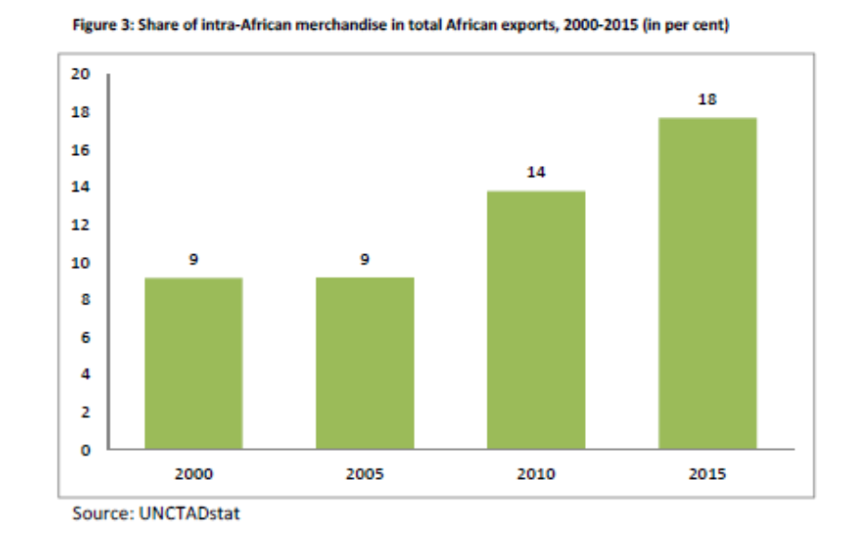
The AfCFTA: Boosting intra-Africa Trade
According to UNECA, AfCFTA promises to unlock intra-Africa trade to grow by 52% by 2022. Africa’s share of world trade estimated to be at 3%.
In 2015 WTO provided a comparative analysis of intra-regional trade as follows: intra-Africa trade at 18%; intra-Asian trade at 52%; intra-North American trade at 50%; and intra-EU trade at 70%.

Slide 11
The AfCFTA: Boosting intra-Africa Trade …
SA is the largest contributor to intra-Africa trade, accounting for over 24.9% percent, with its trade increasing by 8.6% to R478.8 billion in 2017.
SA exports are diversified with mineral products, machinery, chemicals and iron and steel products, accounting for over 50% of its total exports in 2017.
The top African destinations in 2017 were Botswana, Namibia, Mozambique, Zambia and Zimbabwe

Slide 12
Legal Architecture of AfCFTA (1)
Agreement Establishing the AfCTA – Framework Agreement and establishes a Secretariat.
Protocol on Trade in Goods –gives effect to: Schedule of Tariff Concessions; Rules of Origin, Customs Cooperation and Mutual Assistance, Trade Facilitation, Non-Tariff Barriers, Technical Barriers to Trade, Sanitary and Phytosanitary Measures, Transit and Trade Remedies.
Protocol on Trade in Services –includes provisions on general obligations and disciplines and progressive liberalisation of services.
Protocol on Rules and Procedures for the Settlement of Disputes –establishes a Dispute Settlement Mechanism aligned to the WTO Dispute Settlement Body and entails schedule and Working Procedures of the Panel, Expert Review and Code of Conduct for Arbitrators and Panelists.
Phase II negotiations include Competition, Intellectual Property and Investment.
Decisions by the Assembly are legally binding.
.

Slide 13
Strategic Importance of AfCFTA to SA
AfCFTA advances SA’s regional integration aspirations and Agenda 2063.
African market provides SA with alternative market for export of value added goods and services.
SA’s total trade with Africa amounted to R421 billion in 2017 (exports: R311 billion, imports: R109 billion).
SA had a trade surplus of R202 billion.
Manufactured goods amounted to 64% of SA exports to the Continent.
SA’s key export destination is East and Southern African region, primarily SADC.
AfCFTA presents an opportunity for expansion to new markets in West and North Africa.

Slide 14
Benefits of the AfCFTA (1)
Achieving larger economies of scale, a bigger market and improved prospects for the African continent to attract investment.
Boost intra-Africa trade and build an integrated market in Africa, that will see a market of over 1 billion people with a combined GDP of US$3.3 trillion.
New export opportunities for SA products in West Africa and North Africa.
The AfCFTA includes trade in services - important for global trade. In SA, contribution of services trade to the GDP is in excess of 60%.
Provides legal certainty and predictability of markets.
Encourages a rules based multilateral trading system.
Establishes a fair and impartial dispute resolution mechanism.
Boosts intra-Africa trade through: progressive elimination of tariffs; elimination of non-tariff barriers; facilitating cooperation on customs matters, trade facilitation and transit; enhanced cooperation in the areas of technical barriers to trade and sanitary and phytosanitary measures;
Stimulates Africa’s industrial development and employment creation.
Contributing to positive investor climate in Africa.

Slide 15
SACU

Slide 16
Southern African Customs Union (SACU) Review
SACU review underway.
Key issues include:
reviewing the architecture on tariff setting and administration
identify public policy interventions and tools to promote RVCs;
Strengthening cooperation on trade facilitation to improve border efficiencies and address behind the border issues such as SPS measures;
Exploring new ideas regarding the revenue sharing arrangement (RSA);
SA to continue to be the manager of the CRP)due to its advanced financial markets and it being the economic hub of the region.
Assessing the feasibility of establishing a regional financing mechanism (RFM) for regional industrial and infrastructure projects.

Slide 17
SADC

Slide 18
Southern African Development Community (SADC)
13 SADC MS have established a Free Trade Area (FTA) – Angola, DRC and Comoros still to join the Trade Protocol.
Focus is on consolidation of FTA, however a study being undertaken on readiness to establish a Customs Union.
Angola in the process of accession.
Zimbabwe have applied for a special dispensation on 995 and the period of 8 years should be reviewed which is still to be discussed. CMT requested Zimbabwe to review request and emphasised the importance of regional trade.
All 15 countries in SADC have signed the Services Protocol - negotiations in transport, financial, telecommunications and tourism finalised. Negotiations in energy and construction services still ongoing.
Regional Industrial Development strategy approved

Slide 19
Tripartite Free Trade Agreement between COMESA, EAC and SADC

Slide 20
Background to Tripartite Free Trade Area (TFTA)
T-FTA will combine markets of 26 countries with a population of nearly 625 million and a combined GDP of US$1.6 trillion.
Phase I – trade in goods and Phase II - trade in services negotiations, cooperation on IPR, investment, competition policy.
Based on the development integration model.
Key focus is to unlock industrial development through the RVCs and promote intra-regional investments
Role of Trade Invest Africa (TIA)
Encourage SA companies to work with the region to develop RVC in key sectors such as autos and promote complementarities.
The negotiations on the legal framework concluded
Focus is on tariff negotiations.
Modalities for tariff negotiations: 60% immediate liberalization, 25 % over 5 to 8years and 15 % sensitive but subject to negotiations.

Slide 21
SA’s Trade with TFTA countries figures in US$ 000

Slide 22
SA’s trade with the TFTA countries
South Africa’s trade with TFTA countries represents about 16 % of SA’s trade with the world.
In 2017 total trade with TFTA countries was in the tune of US $ 27,6 billion.
A bulk of the trade is with SADC countries. After SADC, Egypt, Kenya, Ethiopia and Uganda feature as export destinations of potential.
South Africa exports to Kenya account for 3,3 % of TFTA exports. South Africa in turn receives about 2% of its TFTA imports from Egypt.
Focus is on conclusion of the agreement with the East African Community and continue negotiations with Egypt.

Slide 23
Trade Agreements with countries in Europe

Slide 24
Economic Partnership Agreement (EPA) between the EU and SADC EPA Group
SA decided to join the Economic Partnership Agreement (EPA) between the EU and the SADC EPA group (Botswana, Lesotho, Namibia, Mozambique, South Africa and Eswatini) to establish a regional agreement with the EU and to secure further market access especially in agriculture.
The EPA provisionally entered into force on 10 October 2016 between SACU and the EU, except for the new negotiated agriculture market access, which entered into force on 1 November 2016.
EPA replaced the trade chapter of Trade, Development and Cooperation Agreement (TDCA),
SA achieved its objectives and improved market access beyond that under the TDCA on fisheries products as well as 32 agricultural products

Slide 25
EPA Benefits for SA
Improved market access for 32 agricultural products, with a significant improvement in our access to the EU market for wine (110 million litres duty free), sugar (150 000 tons duty free) and ethanol (80 000 tons duty free).
Improved access for our exports of flowers, some dairy, fruit and fruit products.
New market access for our fishery products.
The EPA rules of origin improve on the TDCA as they allow for extended cumulation that can facilitate intra-regional trade and industrialisation across the Southern and Eastern Africa in particular.
Several other restrictive trade rules under the TDCA, like on export taxes and standstill clause have been eased under the EPA and Automatic Specific Agricultural Safeguard agreed on list of products
Protocol on Geographical Indications (GIs) that protects 102 South African wines and three agricultural product names (Rooibos, honey bush and karoo lamb).

Slide 26
SA- EU Trade Statistics
The EU as a block remains SA’s largest trading partner.
Total trade between SA and EU has been consistently increasing over the past years; recording an increase from R449 Billion in 2013 to R 600 Billion in 2017; an increase of 34%
SA exports to EU increased from approximately R 167 Billion in 2013 to R 262 Billion in 2017, while imports increased from approximately R282 Billion to R 338 Billion in the same period
The Trade Balance remains in favour of the EU, though it has been declining over the past 5 years, recording a 35% decline from R115 Billion in 2013 to R76 Billion in 2017
SA exports to the EU are led by vehicles which contributed 26% of total exports to the EU in 2017

Slide 27
SA Trade under Exports quotas
SA’s industry benefits positively from wine and sugar quotas under EPA. Quota of raw sugar was fully utilized in 2018
South African exports of some shrimps and prawns increased by 11,7% from R 26 million in 2016 to R 29 million in 2017
Product | Treatment under the TDCA | Treatment under the EPA | Quota utilizations (2017) | Quota utilizations (2018)
Wine (Bulk and bottled) | 50 million litre bottled wine quota | 110 million litres - bottled and bulk wine quota (0% in-quota rate) | 78% | 90%
Sugar (Raw and refined) | EUR33.9 – 41.9/100kg | 150 000 tonnes quota (0% in-quota rate) | 94% | 99.81%
Ethanol | EUR 10.2 – 19.2 /hl | 80 000 tonnes quota ()% in-quota rate) | 13.8% | 15.9%

Slide 28
State of play on EPA implementation
EPA is in its 4th year of implementation
About four tariff reductions have taken place to date, the first tariff reductions took place on upon entry into force of the Agreement and the subsequent reductions took place on the 1st January every year.
As of 28 September 2018, Southern African Customs Union introduced a bilateral safeguards duty of 35.5% on bone- in chicken originating from the EU to be phased out over a period of 4 years
The 1st Joint Council is responsible for implementation of the Agreement, supported by the Trade and Development Committee (TDC).
The Joint Council adopted the ‘institutional framework’ for the EPA comprising the following: Rules of Procedure for the Joint Council, TDC and Dispute Settlement and Dispute Avoidance. As well as the Code of Conduct of Arbitrators and Mediators
The Joint Council agreed to enhance dialogue and development co-operation to diversify the economy and export basket of the SADC EPA States.

Slide 29
European Free Trade Association (EFTA) FTA
EFTA comprises of Iceland, Liechtenstein, Norway and Switzerland.
The agreement was signed in 2006 and entered into force on the 1st May 2008.
Bilateral agreements on basic agricultural products (within chapters 1 to 24, excluding processed agricultural products) are entered into with individual EFTA States.
The Agreement has been due for review since 2013. The review was launched in Geneva, Switzerland from 30 January to 02 February 2018.
The 4th Joint SACU-EFTA Review meeting will take place in March 2019

Slide 30
SA and EFTA Trade Relations
SA’s main exports are primary products.
The trade balance between South Africa and EFTA has consistently been in SA’s favour
Recently trade between South Africa and the EFTA has been fluctuating and this is attributed to the global financial crisis and other agreement been signed with other trading partners.
Total trade between SA and EFTA has been fluctuating over the past years but overall it increased from R11.02 Billion in 2007 to R25.26 billion in 2017 (129% increase compared to 2007)

Slide 31
SA and EFTA Trade Relations cont.
SA exports to EFTA increased from approximately R 9.9 billion in 2007 to R 13.89 billion in 2017, while imports increased from approximately R1.11 Billion to R 11.37 Billion in the same period.
The Trade Balance remains in favour of South Africa, though it has been declining over the past 5 years from R8.09 Billion in 2007 to R 5.3 Billion in 2017.
SA’s exports to EFTA amounted to 1.17% of the SA’s total exports to world
SA’s imports from EFTA amounted to 1.15% of the SA’s total exports to world
On the positive side SA’s motor vehicle exports increase by 26% from 2007 to 2017.

Slide 32
Way forward
The aim for SACU with the current review of the SACU-EFTA FTA is to improve access to EFTA for basic and processed agricultural products as DFQF treatment is already applied to all non-agricultural products.
EFTA’s have made offers on the SACU Market access request list on some Processed Agricultural Products (PAPs) e.g. improvement in goods covered under duty free and increases in partially elimination of duties. The individual EFTA countries have also made some additional market access in some basic agricultural products.
Negotiations are still ongoing and SACU have submitted a list of priority products were increased market access have not yet been offered but will be needed to conclude negotiations successfully.

Slide 33
Trade Agreements with BRICS countries

Slide 34
SACU-India Preferential Trade Agreement (PTA)
PTA can boost south-south trade in a targeted manner.
More focused approach to tariff preferences compared to FTA.
Also provides legal-institutional framework to manage trade.
India is now one of SA’s largest trade partners with trade in 2017 over R107 billion.
Difficulty in finalising SA/SACU offer - Concerns raised with negotiations include NTBs in the Indian market and requests by India in sensitive sectors like textiles and clothing.
Looking at reduced level of tariff exchange coverage and use the PTA as an incremental building block to enhanced trade in future.

Slide 35
SACU – MERCOSUR Preferential Trade Agreement (PTA)
MERCOSUR comprises of Argentina, Brazil, Paraguay and Uruguay. Venezuela recently became a member of MERCOSUR but has been suspended since December 2016.
The PTA is aimed at promoting trade between the two sides on on over 1000 tariff lines on both sides.
The PTA was concluded and signed in 2008.
PTA creates a legal basis for further integration and cooperation including through possible further exchanges of tariff preferences, as well as cooperation in a range of other areas.
Offers preferential margins of between 10% and a 100%.
The PTA entered into force on 1 April 2016. South Africa implemented the agreement on 10 October 2016 retrospectively to 1 April 2016.
The First Joint SACU-MERCOSUR Committee meeting under the PTA took place on 23-24 May 2017 in South Africa.

Slide 36
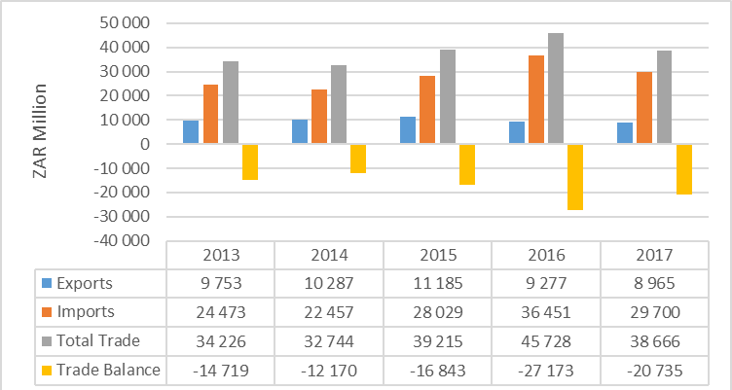
Trade between SA and MERCOSUR countries

Slide 37
Utilisation
There has been varying annual growths to exports by sector, within the top 5 sectors as follows:
In addition, Iron and Mineral fuels sector products continue to be subjected to trade remedies in Brazil in the form of Anti-dumping (AD).
Currently, there is an AD review for Iron in Brazil.

Slide 38
Way forward
MERCOSUR to convene the 2nd Joint Administration Committee (JAC)
Increase bilateral and regional trade between South Africa / SACU and MERCUSOR respectively
Foster diversification of trade baskets, i.e. increase of value added products.
Participate in each other’s trade exhibitions / fairs
Encourage outward selling missions of the private sector
Host awareness workshops as envisaged by the inaugural JAC meeting to promote the PTA.

Slide 39
World Trade Organisation (WTO)

Slide 40
WTO
Disabling of AB in WTO accompanied calls for WTO reform and modernisation mainly driven by the US and now supported by EU and Japan.
Aims to update the WTO rulebook to ‘fill in’ gaps to level the playing field.
Proposals mainly cover six issues aimed at:
Narrowing the scope and application of S&DT- S&DT will only be limited to time period but effectively same commitments;
Adjusting the principle of consensus decision making;
Regularising plurilateral agreements;
Tightening rules on industrial subsidies, SOEs and IPRs;
Strengthening rules on transparency and notification; and
Enhancing the role of the Secretariat in negotiations.
All these ultimately reduce/eliminate differentiation.

Slide 41
Africa Position
Principles
developmental objectives and principles of the DDA, including special and differential treatment and less than full reciprocity remain key;
development package must remain at the core of any negotiating outcome;
prioritize and conclude all unresolved issues in the DDA.
Agriculture
Eliminate trade distorting domestic support that constrain Africa’s full potential in agricultural production and trade.
Permanent Solution for Public Stockholding which should include new programs.
Special Safeguard Mechanism to respond to volatility in global agricultural commodity markets
Cotton
Eliminate all trade distorting policies affecting the sector and fast track the resolution expeditiously by MC11.

Slide 42
Africa Position
Fisheries subsidies
Calls for a multilateral agreement to discipline certain forms of subsidies that contribute to overfishing and overcapacity as agreed in goal 14.6 of the 2030 Agenda
Special and Differential Treatment (S&D)
S&D shall be an integral part of all WTO agreements and future multilateral outcomes and shall be embodied, in the schedules and in the rules and disciplines, so as to enable developing countries to address their development needs in line with Africa’s industrial development priorities and Agenda 2063;
Services
Reaffirm the flexibilities for developing countries as inscribed in the GATS, Annex C of the Hong Kong Ministerial Declaration and the LDC Modalities.
any outcome on GATS Article VI.4 disciplines on domestic regulation does not involve implementation of new and/or onerous administrative requirements or requirements that intrude into the domestic-policy making processes

Slide 43
Africa Position
LDCs
priority attention to be accorded to LDC issues, including showing maximum flexibility to African LDCs undergoing accession.
Trade-Related Aspects of Intellectual Property Rights (TRIPS)
amend the TRIPs Agreement to ease access to affordable medicines, introduce requirements for disclosure, prior informed consent and benefit sharing in respect of traditional knowledge so that the TRIPS Agreement and the Convention of Biological Diversity are mutually reinforcing.
Trade Facilitation Agreement (TFA)
call for the expansion of its scope to include both soft and hard infrastructure projects to facilitate full implementation of the Agreement.
Aid for trade
underline the importance of Aid for Trade initiatives in trade-related capacity-building, overcoming supply-side constraints, infrastructure development, and facilitating integration of developing economies, in particular LDCs in regional and global trade.

Slide 44
WTO cont.
SA Position:
Preserve the multilateral trading system but that supports development more decisively
Continue to advocate for progress on the outstanding Doha issues.
Any package agreed must have clear developmental character and content and should ensure trade supports inclusive growth.
Focus in e-commerce should be on cooperation, addressing the digital divide and exploring options for promoting digital industrial policy. The most we could agree to is a roll-over of the current e-commerce Work Programme and temporary moratorium on customs duties on electronic transmissions.
We will need to calibrate expectations realistically for MC12

Slide 45
SA-US Trade Relations

Slide 46
SA-US trade relation
Trade is governed by AGOA which is a unilateral preferential agreement.
Total trade between SA and US has increased from R129.9 billion in 2013 to R161.4 billion in 2017.
SA exports to the US grew from approximately R67 billion in 2013 to R88.6 billion in 2017. US exports grew from R63.0 billion to R72.8 billion in 2017.
US imposed Section 232 measures on the basis of national security provisions of the GATT – no jurisprudence in the WTO.
Section 232 duties affect SA exports of steel (25%), aluminium (10%), autos and components still subject to investigation.
Poultry TRQ of 65000 tons subject to SA still benefiting in AGOA based on the same terms - SAPA’s court case an important leverage.
US-Mexico-Canada Agreement (USMCA) an indication of a new trade agreement standard.

Slide 47
SA-US trade relations
USMCA key provisions:
Rebalances trade to support manufacturing in USA;
Strengthens product-specific rules by requiring 75% percent of auto content be made in the US and Mexico and stronger rules for other industrial products such as chemicals;
Re-shore vehicle and parts production in the US;
Creates new labor value content rule requiring that 40-45% of auto content be made by workers earning at least $16 per hour. Prohibits the importation of goods produced by forced labor;
Establishes procedures that streamline certification and verification of rules of origin and that promote strong enforcement -new cooperation and enforcement provisions that help to prevent duty evasion;
ISDS will be eliminated between Canada and the US, and scaled back between Mexico and the U.S to only claims related to direct expropriation, post-establishment national treatment and investors must also first try to resolve the disputes through domestic courts;
Prohibits use of export subsidies and WTO special agriculture safeguard;
Includes issues such as IP, services, digital trade, environment, labour.

