Slide 1
Path of hope
Budget 2019

Slide 2
Introduction
1

Slide 3
Introduction
Tough environment
Low economic growth
High unemployment
High inequality
Substantial revenue shortfalls
High budget deficit
Growing debt levels
Spending pressures (SOEs in particular)

Slide 4
Fiscal Framework
2

Slide 5
Fiscal Framework Expenditure
We welcome
The proposed conditional support for Eskom (reluctantly)
Unbundling
Cost containment
Proposals to manage the public sector wage bill
But this should not erode skills levels
And more needs to be done to actively reduce the wage expenditure
Review of configuration, number and size of national government departments

Slide 6
Fiscal Framework Revenue estimation
Consistent overestimation of revenues
Credibility of forecasts?
Concern that tax buoyancy ratios used in MTEF forecasts not achieved in recent years
Buoyancy ratios used not unreasonable against long run average
BUT, Buoyancy ratio for last 3 years is less than 1 even with substantial tax increases
Buoyancy ratio of 1 for 2019/20 would result in revenue shortfall of R29 billion (0.5% of GDP)
Significant risk that forecasts will not be met
Fiscal year | 2014/15 | 2015/16 | 2016/17 | 2017/18 | 2018/19
Budget forecast | 993,650 | 1,081,275 | 1,174,788 | 1,265,488 | 1,344,965
Actual revenues | 986,295 | 1,069,983 | 1,144,081 | 1,216,464 | 1,302,201
Shortfall | 7,355 | 11,292 | 30,707 | 49,024 | 42,764

Slide 7
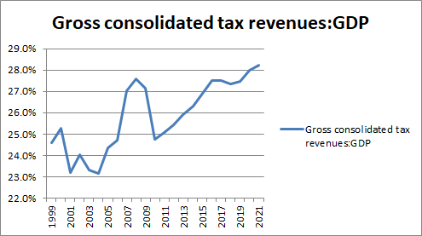
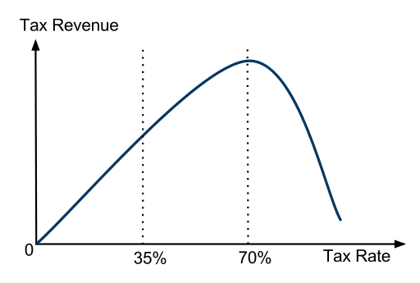
Fiscal Framework Tax structure
Proposed R15 billion of tax increases not welcomed
Concern that tax increases have become self-defeating
tax increases have not translated into additional revenues in recent years
SA has passed top of Laffer curve
Tax burden projected to reach record levels
Increasing tax burden unsustainable

Slide 8
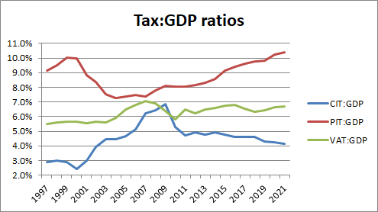
Fiscal Framework Tax mix
Trend towards increased reliance on PIT
Narrow tax base
Second most distortive tax
Contribution of CIT falling but still high by global benchmarks
Fall in CIT not due to policy measures but economic performance
Most distortive of all taxes
Most volatile source of revenue
Consumption taxes least distortive of main tax instruments
SA reliance on consumption taxes relatively low
Growth-friendly tax burden would shift tax burden to consumption
Maintain progressivity through spending

Slide 9
Fiscal Framework SACU revenue sharing formula
Combined revenue pool for sharing customs and excise duties
Revenue sharing formulae heavily weighted in favour of BLNS countries
Customs duty formula is the worst offender
Based on intra-SACU imports
SA has significant trade surpluses
BLNS heavily dependant on SACU revenues
SA taxpayers subsidising BLNS by between R30 billion and R50 billion
Unaffordable and unsustainable – SA faces a fiscal crisis!
No progress in renegotiating agreement

Slide 10
Tax proposals
3

Slide 11
Tax proposals PIT increases
Will not “minimise the negative impact on growth” as suggested
Fiscal drag no different to a rate increase
Will place taxpayers under considerable strain
Will reduce household savings and consumption
Will potentially further erode levels of tax morality and compliance
PIT tax burden forecast to reach record level at 10.2% of GDP
Increase largely proportionate across income-levels
Inevitable to raise R13.8bn
But poor will feel greatest pain
Less ability to absorb increases
Decrease in medical scheme credit in real terms highly damaging at margin of affordability

Slide 12
Tax proposals Carbon tax
1 June 2019 effective date impractical
Emissions reported for calendar year
Compliance and administration burden
Carbon tax on fuel to raise R1.8bn in revenues
But no recycling of revenues through increased expenditure
Carbon tax sold as being fiscally neutral ad recycling of revenues crucial to minimising economic impact

Slide 13
Thank you
© 2019 PwC. All rights reserved. Not for further distribution without the permission of PwC. “PwC” refers to the network of member firms of PricewaterhouseCoopers International Limited (PwCIL), or, as the context requires, individual member firms of the PwC network. Each member firm is a separate legal entity and does not act as agent of PwCIL or any other member firm. PwCIL does not provide any services to clients. PwCIL is not responsible or liable for the acts or omissions of any of its member firms nor can it control the exercise of their professional judgment or bind them in any way. No member firm is responsible or liable for the acts or omissions of any other member firm nor can it control the exercise of another member firm’s professional judgment or bind another member firm or PwCIL in any way.

