Slide 1
Briefing to the Portfolio Committee on the Mineral Resources 2nd and 3rd Quarter Report for the 2018 – 2019 Financial Year
DG – ADV T MOKOENA
DATE: 27 February 2019

Slide 2
PRESENTATION OUTLINE
Strategic overview
Structure overview
Summary of Performance (Q3)
  Financial Overview
  Pre-determined objectives
Performance Highlights per Branch / Programme
  Programme 1.1: Corporate Services
  Programme 1.1: Financial Administration
  Programme 2: Mine Health and Safety Inspectorate (MHSI)
  Programme 3: Mineral Regulation (MR)
  Programme 4: Mineral Policy and Promotion (MPP)
Concluding Remarks

Slide 3
Strategic Overview
VISION | STRATEGIC GOALS / OUTCOMES
A leader in the transformation of South Africa through economic growth and sustainable development by 2030 A global competitive, sustainable and meaningful transformed mining and mineral sector by 2019 | Increased investment in the minerals, mining and petroleum sectors Transformed minerals sector Equitable and sustainable benefit from mineral resources Efficient, effective and development-oriented Department
MANDATE
Mineral and Petroleum Resources Development Act (Act No. 28 of 2002) and the Mine Health and Safety Act (Act No. 29 of 1996) provide the regulatory framework for the promotion and regulation of the industry, as well as the equitable access to and the sustainable development of the nation’s mineral resources and related matters.
MISSION
Promote and regulate the minerals and mining sector for transformation, growth and development, and ensure that all South Africans derive sustainable benefit from the country’s mineral wealth.

Slide 4
Department Structure Overview
Minister
Hon. Gwede Mantashe
Director Generals office
Adv. Thabo Mokoena
Branch Mineral Regulations
Adv MmaDikeledi Malebe
Branch Mine health and Safety
David Msiza
Branch Financial Administration
Ditsietsi Morabe
(Acting)
Branch Corporate Services
Patricia Gamede
MHSC
Thabo Dube
(Acting)
Branch Policy and Promotion
Ntokozo Ngcwabe
CGS
Mosa Mabuza
State Diamond Trader
Stanley Mguni
MINTEK
Dr Molefi Motuku
PASA
Lindiwe Mekwe
(Acting)
State Diamond and Precious Metal Regulator
Cecil Khoza
(Acting)
Deputy Minister
Hon. Godfrey Oliphant
Notes:
Both SADPMR & MHSC CEO recruitment processes at an advanced stage!

Slide 5
Summary of Performance – Financial Overview (Quarter 3)
Programme Analysis | 2018/19 Budget Allocation | Projected Expenditure | Actual Expenditure | Variance on projected Vs Actual Expenditure | % Variance of projected expenditure | Actual Expenditure as a % of total budget | Available Budget
 | R'000 | R'000 | R'000 | R'000 | % | R'000 | R'000
Administration | 335,000 | 255,296 | 273,560 | (18,264) | -7.2% | 81.7% | 61,440
Mine Health and Safety | 205,037 | 157,353 | 158,788 | (1,435) | -0.9% | 77.4% | 46,249
Mineral Regulation | 393,606 | 304,044 | 299,537 | 4,507 | 1.5% | 76.1% | 94,069
Mineral Policy and promotion | 957,018 | 774,971 | 742,910 | 32,061 | 4.1% | 77.6% | 214,108
Totals | 1,890,661 | 1,491,664 | 1,474,795 | 16,869 | 1.1% | 78.0% | 415,866

Slide 6
Summary of Performance – Financial Overview (Quarter 3)
  The Department continues to monitor expenditure throughout the financial year on monthly basis to ensure that spending is within the acceptable variance.
  The overall expenditure up to 31 December 2018 amounts to R1.474 billion or 78% of the total allocated budget of R1.891 billion for the 2018/19 financial year resulting in an underspending of R16.8 million or 1.1% against the projected expenditure of R1.491 million.
Departmental revenue collection for the period ended 31 December 2018 (Quarter 3) amounted to R28.1 million against projected revenue of R29.9 million.The variance is mainly due to decrease in collection of prospecting fees.

Slide 7
Summary of Performance
(Pre-determined Objectives) (Quarter 3)
The overall performance attained by the department at the end of the third quarter was 73.45% which compared favorably to 64% achieved during the same period during the previous financial year.
The reported performance at the end of the third quarter remains lower than full year results from the previous financial year, and this is mainly attributable to the fact that a significant number of measures, 7% or 8 in total are only due at the end of the fourth quarter and will be measured and evaluated at the end of the financial year.
It is however worth mentioning that at the third quarter performance review, management committed to achieving measures that were reported as “Not yet Due” at the end of the fourth quarter and positively recovering on measures that were reported as “Partially Achieved” during the third quarter to bring final performance outcomes in line with past historical trends.

Slide 8
Summary of performance as at end of December 2018 (Q3)
Branches | Audited Results |  |  |  | Previous FY Comparative | Current FY
 | 31 March 2015 | 31 March 2016 | 31 March 2017 | 31 March 2018 | Q3 2017/18 % Achieved including measures not yet due | Q3 2018/19 % Achieved including measures not yet due
Departmental Performance | 84.3% | 81.7% | 84.0% | 79.6% | 64% | 73.45%

Slide 9
Programme 1.1 – Corporate Services
DDG: CORPORATE SERVICES
Ms P Gamede

Slide 10
Programme 1.1 – Corporate Services
Purpose: To enable the Department to deliver on its mandate by providing strategic support, management services and administrative support to the Department and Ministry

Slide 11
PROGRAMME 1.1: Corporate Services (1 of 12)
Branch Key Strategic Objectives
Contribution to skills development,
Sustainably develop vulnerable groups,
Communication of DMR programmes to internal and external stakeholders,
Provision of adequate facilities,
Development, review and improvement of processes,
Provision of legal support and advisory services to Ministry and Department,
Implementation of National Strategies,
Compliance with legislation,
Attraction, Development and Retention of Skills
Promotion of Corporate Governance

Slide 12
Branch – Corporate Services (2 of 12)
Vision 2019
Equitable and Sustainable Benefit from Mineral Resources
Contribute to Skills Development
Sustainably Develop Vulnerable groups
Efficient, Effective and Development Oriented Department
Develop, Review, and Improve Internal Processes and guidelines
Communicate DMR programmes with internal and external stakeholders
Provide professional legal support and advisory services to Ministry & Department
Ensure Implementation of National Strategies
Provide Adequate facilities for effective service delivery
Ensure compliance with legislations (HR & OHS)
Attract, Develop and Retain Skills
Promote Governance
Vision 2019
A global competitive, sustainable and meaningful transformed mining and mineral sector
Outcomes

Slide 13
Branch – Corporate Services (3 of 12)
Vision 2019
Equitable and Sustainable Benefit from Mineral Resources
Contribute to Skills Development
Sustainably Develop Vulnerable groups
Communicate DMR programmes with internal and external stakeholders
Number of Mining Career awareness - HRD
Number of Mining Career awareness – Special Projects
Number of identified projects facilitated for vulnerable groups
% Implement DMR Communications Strategy
Target ꞊ 8
Actual = 10
Target ꞊ 9
Actual = 12
Target ꞊ 4
Actual = 3
Target ꞊ 100%
Actual =100%
Number of bursaries acquired for studies towards mining related qualifications
Target ꞊ Not yet Due
Actual = Not yet Due
Outcome

Slide 14
Branch – Corporate Services (4 of 12)
Contribute to Skills Development
Number of Mining Career awareness – HRD
Target ꞊ 8
Actual = 10
Western Cape - University of Western Cape
Limpopo - University of Venda
Free State - Central University of Technology
Kwazulu Natal - Mangosuthu University of Technology
North-West – NW University
Gauteng – University of Johannesurg
Northern Cape – Sol Plaatjie University
Mpumalanga Cape – University of South Africa
Eastern Cape – Nelson Mandela University

Slide 15
Branch – Corporate Services (5 of 12)
Contribute to Skills Development
Number of Mining Career awareness – Special Projects
Target ꞊ 9
Actual = 12
Limpopo - Seritarita High School In Mapela, / Ebenezer High in Mahwelereng, Mokopane
Mpumalanga - Ithafa Secondary / Reggie Masuku Secondary, Ermelo,
Gauteng - Raymond Mhlaba Secondary, Tshepisong / Isaacson High School -Soweto, Johannesburg
Eastern Cape - Mandela University-Port Elizabeth / Mandela School of Science and Technology – Mvezo Village,
Northwest - Onkabetse Thuto Sec School – Mmabatho / Career Expo at Lafarge Mine – Lichtenburg / Mococe Sec School – Madimola Village,
Kwazulu-Natal Sisizakele Special School - Ingwavuma

Slide 16
Branch – Corporate Services (6 of 12)
Vision 2019
Efficient , Effective and Development Oriented Department
Provide Adequate facilities for effective service delivery
% of facilities aligned with business needs
% of Implementation of Facilities Management Strategy
Target ꞊ 100%
Actual = 100%
Target ꞊ 95%
Actual = 95%
Develop, review and Improve Internal processes, guidelines / procedures
Number of policies, guidelines reviewed
Target ꞊ 6
Actual = 7
Number of improved processes / re-engineered
Target ꞊ 11
Actual = 14
Number of Standard Operating Procedures (SOP) Developed
Target ꞊ 11
Actual = 14
Outcome

Slide 17
Branch – Corporate Services (7 of 12)
Vision 2019
Efficient, Effective and Development Oriented Department
Provide professional legal support and advisory services to Ministry & Department
% of timeous responses to opinions, appeals, inquiries, agreement s and litigation
% of Adherence to defined turnaround times
% of Adherence to Service Level Agreements (SLAs)
Target ꞊ 80%
Actual = 61%
Target ꞊ 100%
Actual = 100%
Target ꞊ 100%
Actual = 100%
Outcome

Slide 18
Branch – Corporate Services (8 of 12)
Vision 2019
Efficient, Effective and Development Oriented Department
Ensure Implementation of National Strategies
Number of files completed and submitted to State Security Agency (SSA)
% of pre-employment screening requests processed
% of service providers and contractors screening requests processed
Number of Gender Equality Strategic Plans implemented
Number of health, safety and wellness programmes implemented
Target ꞊ 100%
Actual = 100%
Target ꞊ 100%
Actual = 100%
Target ꞊ 6
Actual = 6
Target ꞊ 6
Actual = 6
Target ꞊ 75
Actual = 75
Outcome

Slide 19
Branch – Corporate Services (9 of 12)
Vision 2019
Efficient, Effective and Development Oriented Department
Ensure compliance with legislations (HR & OHS)
Attract, Develop and Retain Skills
Number of Actions implemented to ensure submission of financial disclosures
% of Human Resources Development Plans, Work Skills Plan submitted to DPSA, PSETA & MQA
Number of Actions implemented to ensure submission of performance agreements
Number of HRD initiatives aligned to National Skills Development Strategy
Maintain the vacancy rate at an acceptable level ≤ 10%
Target ꞊ 5
Actual = 5
Target ꞊ 100%
Actual = 100%
Target ꞊ 4
Actual = 4
Target ꞊ 14
Actual = 14
Target ꞊ ≤ 10%
Actual = ≤ 12.16%
Outcome

Slide 20
Branch – Corporate Services (10 of 12)
SUMMARY ON APPROVED VACANT POSTS
Advertised | 10
Waiting competency results | 0
Waiting PSC Results | 16
Shortlisting | 18
To be advertised | 25
To be interviewed | 05
Submission en route | 08
TOTAL | 82

Slide 21
Branch – Corporate Services (11 of 12)
Promote Corporate Governance
Efficient, Effective and Development Oriented Department
% of Implementation of Management Action Plan
(Internal Audit)
% of Implementation of Management Action Plan
(External Audit)
% Adherence to Compliance Framework
% of Risk Management Plans
Vision 2019
Target ꞊ 100%
Actual = 100%
Target ꞊ 100%
Actual = 100%
Target ꞊ 100%
Actual = 100%
Target ꞊ 100%
Actual = 50%
Outcome

Slide 22
PROGRAMME 1.1: Corporate Services (CS) (12 of 12)
Highlights for Q3
The following were the branch highlights for the third quarter of the financial year (2018/19):
International Day of Persons with Disabilities at Toekomsrus Community Hall in Randwest City Municipality, on 3 December 2018.
16 Days of Activism Campaign for No Violence Against Women and Children at Diepkloof Welfare Centre in Soweto on 5 December 2018.
Ten (10) career awareness initiatives were conducted against a target of eight (8) (This is a cumulative measure)
Fourteen (14) business processes were improved and Standard Operating Procedure (SOPs) developed for each process in order to improve service delivery. The target was eleven (11).

Slide 23
Programme 1.2 – Financial Administration
ACTING CHIEF FINANCIAL OFFICER
Ms D Morabe

Slide 24
PROGRAMME 1.2: Financial Administration
Branch Objectives
Provision of efficient services to internal and external customers,
Management of financial resources
Implementation of processes and systems
Promotion of Corporate Governance

Slide 25
Branch – Financial Administration (1 of 7)
Provide efficient services to internal and external customers
Implement processes and systems
Manage Financial Resources
Efficient, Effective and Development Oriented Department
Promote Corporate Governance
VISION 2019
Vision 2019
A global competitive, sustainable and meaningful transformed mining and mineral sector
Outcome

Slide 26
Branch – Financial Administration (2 of 7)
Provide efficient services to internal and external customers
Efficient, Effective and Development Oriented Department
Implement processes and systems
% of Implementation of Master Systems Plan (MSP)
% of Systems Availability
% of Achievement of SLA
Customer Satisfaction Index (1-5)
% of Financial Reports delivered on schedule
% of Suppliers paid within 30 days
Vision 2019
Target ꞊ 95%
Actual = 95.31
Target ꞊ 95%
Actual = 95%
Target ꞊ Deferred to Q4
Actual = Deferred to Q4
Target ꞊ 100%
Actual = 100%
Target ꞊ 100%
Actual = 100%
Target ꞊ Not yet Due
Actual = Not yet Due
Outcome

Slide 27
Branch – Financial Administration (3 of 7)
Manage Financial Resources
Efficient, Effective and Development Oriented Department
% of variance on allocated Budget
% Implementation of the Integrated Budget Plan
Number of Incidents of Irregular Expenditure
% of Implementation of Asset Management Plan
Vision 2019
Target ꞊ ≤ 2%
Actual = ≤ 1.1%
Target ꞊ 100%
Actual = 100%
Target ꞊ 0
Actual = 1
Target ꞊ 67%
Actual = 67%
Outcome

Slide 28
Summary of Performance – Financial Overview (Q3) 2018/2019
(4 of 8)
Programme | Budget | Quarter 3 Projection vs Expenditure (YTD) |  |  | Projections Jan - Mar 2019
 |  | Projected Expenditure | Actual Expenditure | Variance
Corporate Services | 238 207 | 181 394 | 203 622 | -22 228 | 49 561
Financial Administration | 96 793 | 73 902 | 69 938 | 3 964 | 25 420
Mine Health and Safety | 205 037 | 157 353 | 158 788 | -1 435 | 47 684
Mineral Regulation | 393 606 | 304 044 | 299 537 | 4 507 | 94 069
Mineral Poliy and promotion | 957 018 | 774 971 | 742 910 | 32 061 | 198 085
Total Budget | 1 890 661 | 1 491 664 | 1 474 795 | 16 869 | 414 819
Important to note:
Corporate Services and Mine Health and Safety spent above the target on leased accommodation and unplanned audits and inspections resulting from disasters
The shortfall will be addressed before the end of the financial year MPP and FA will release funding to cover the deficit in CS (R14,9m) and MHS (R1,4m), respectively
R1,047 ring-fenced for EPWP will be surrendered to NT since the agreed targets were not met

Slide 29
Summary of Performance – Financial Overview (Q3) 2018/2019
(5 of 8)
Economic classification | Budget | Quarter 3 Projections vs Expenditure (YTD) |  |  | Projections Jan - Mar 2019
 |  | Projected Expenditure | Actual Expenditure | Variance
Compensation of Employees | 617 628 | 465 492 | 460 063 | 5 429 | 157 565
Goods and Services | 253 430 | 192 907 | 212 436 | (19 529) | 55 318
Payments for Capital Assets | 12 350 | 9 125 | 2 912 | 6 213 | 9 438
Payments for Financial Assets | - | - | 652 | (652) | -
Transfers and Subsidies | 1 007 253 | 824 140 | 798 732 | 25 408 | 192 498
Total Budget | 1 890 661 | 1 491 664 | 1 474 795 | 16 869 | 414 819
Important to note
Compensation of employees: The variance is attributed to delays in filling of vacant posts, the funds will be used to pay sms bonuses and pay progression
Goods and services: the shortfall on leased accommodation at the end of the financial year will be R14,9m will be funded from transfer payments
Transfer payments: R1,047m will be surrendered to NT at the end of the financial year due to dissatisfactory progress in implementing the EPWP projects
(Q3) 2018/2019
(5 of 9)

Slide 30
Financial Overview (Quarter 3) (6 of 7)
Items that are committed under payments for capital asset
  Computer equipment refresh for Head office and Regional Offices
  Replacement of worn-out/irreparable furniture CT and Durban Regional Offices
  Walk-through metal detectors for Limpopo, Klerksdorp, Rustenburg, Durban and Gauteng Regional Offices
  Surveillance and access control systems for Welkom Regional Office
  Switches for servers
Orders have been issued for all assets except for computer equipment
Delivery of all assets will be concluded by mid March 2019
Payments are anticipated before 31 March 2019

Slide 31
Branch – Financial Administration (7 of 7)
Promote Corporate Governance
Efficient, Effective and Development Oriented Department
% of Implementation of Management Action Plan
(Internal Audit)
% of Implementation of Management Action Plan
(External Audit)
% Adherence to Compliance Framework
% of Risk Management Plans
Vision 2019
Target ꞊ 100%
Actual = 100%
Target ꞊ 100%
Actual = 100%
Target ꞊ 100%
Actual = 100%
Target ꞊ 100%
Actual = 100%
% of Implementation of ICT Governance Initiatives
Target ꞊ Not yet Due
Actual = Not yet Due
Outcome

Slide 32
Programme 2: Mine health and Safety Inspectorate
Chief Inspector of Mines
Mr D Msiza (represented by Mr X Mbonambi)

Slide 33
PROGRAMME 2: Mine Health and Safety Inspectorate
(1 of 12)
Branch Objectives
Promote health and Safety,
Contribute to skills development,
Implement SLA’s
Develop and review internal processes,
Improve turnaround times,
Promote Corporate Governance,

Slide 34
Branch – Mine Health and Safety (2 of 12)
Vision 2019
A global competitive, sustainable and meaningful transformed mining and mineral sector
Promote health and Safety
Contribute to Skills Development
Implement SLAs
Transformed Minerals Sector
Develop and Review internal processes
VISION 2019
Improve turnaround times
Promote Corporate Governance
Outcome

Slide 35
Branch – Mine Health and Safety (3 of 12)
Promote health and Safety
Transformed Minerals Sector
Number of Inspections conducted
Number of Audits conducted (individual audits included)
% MHS Annual report Submitted
Number of Tripartide workshops conducted
Vision 2019
Target ꞊ 6 000
Actual = 6 544
Target ꞊ 297
Actual = 354
Target ꞊ 1
Actual = 1 (submitted: Sept’18)
Target ꞊ 45
Actual = 58
Outcome

Slide 36
Branch – Mine Health and Safety (4 of 12)
Promote health and Safety
Transformed Minerals Sector
% reduction in Occupational Fatalities
% reduction in Occupational Diseases
% of Investigations initiated vs Completed
% of Inquiries initiated vs Completed
Vision 2019
Target ꞊ 20%
Actual = 14%
Target ꞊ 10%
Actual = 30%
Target ꞊ 80%
Actual = 94%
Target ꞊ 80%
Actual = 64%
% reduction in Occupational Injuries
Target ꞊ 20%
Actual = 9%
Outcome

Slide 37
Branch – Mine Health and Safety (5 of 12)
Strategic Objective : Promote health and Safety
Measure Title : % reduction in Occupational Fatalities
The number of fatal accidents reported 2017 were 65 versus 59 fatal accidents in 2018

Slide 38
Branch – Mine Health and Safety (6 of 12)
Strategic Objective : Promote health and Safety
Measure Title : % of Investigations initiated vs Completed
The number of investigations initiated is 451 and the number completed is 424 which made the inspectorate over achieved by 94% of its 80% target.

Slide 39
Branch – Mine Health and Safety (7 of 12)
Strategic Objective : Promote health and Safety
Measure Title : % of Inquiries initiated vs Completed
The number of inquiries initiated is 42 and 27 were completed which resulted in the inspectorate achieving 64%. The reason for under achievement is unavailability of witnesses and awaiting responses from legal representatives on inquiry dates.

Slide 40
Branch – Mine Health and Safety (8 of 12)
Contribute to Skills Development
Sufficient and relevant skills in the mining sector
% of adherence to Government Certificate of Competency (GCC) Exams policy
Vision 2019
Target ꞊ 100%
Actual = 100%
2018 | 2017
Mine Engineering Certificate of Competency
1st Qrt = 31 3rd Qrt = 37 68 | 1st Qrt = 26 3rd Qrt = 27 53
Mine Managers Certificate of Competency
1st Qrt = 29 3rd Qrt = 20 49 | 1st Qrt = 17 3rd Qrt = 10 27
Outcome

Slide 41
Branch – Mine Health and Safety (9 of 12)
Implement SLAs
Efficient, Effective and Development Oriented Department
% adherence to SLAs
Vision 2019
Develop and review internal processes
% of identified internal processes developed or reviewed
Target ꞊ 100%
Actual = 100%
Improve Turnaround times
% of adherence to prescribed timeframes for medical appeals
Target ꞊ 80%
Actual = 90%
% of adherence to prescribed timeframes for CIOM appeals
% of adherence to prescribed timeframes for MPRDA Applications
Target ꞊ 100%
Actual = 100%
Target ꞊ 100%
Actual = 97%
Target ꞊ 80%
Actual = 89%
% of adherence to prescribed timeframes for Administrative tasks
Target ꞊ 100%
Actual = 100%
Outcome

Slide 42
Branch – Mine Health and Safety (10 of 12)
Promote Corporate Governance
Efficient, Effective and Development Oriented Department
% of Implementation of Management Action Plan (Internal Audit)
% of Implementation of Management Action Plan (External Audit)
% Adherence to Compliance Framework
% of Risk Management Plans
Vision 2019
Target ꞊ 100%
Actual = 90%
Target ꞊ 100%
Actual = 100%
Target ꞊ 100%
Actual = 100%
Target ꞊ 100%
Actual = 100%
Outcome

Slide 43
PROGRAMME 2: Min Health and Safety Inspectorate (MHSI)
(11 of 12)
Highlights for Q2
SUCCESSFUL GOLD ONE MINE RESCUE OPERATION
A successful rescue operation took place in the early hours of the morning (26 July 2018) at the Gold One’s Modder East operations, following a fire which broke out underground.
At the time of the accident, 644 employees were underground. All the employees evacuated to the mine's refuge bays wherein they were rescued from and brought to surface.
All the rescue teams involved, DMR officials, the mine employees and management, took swift actions in ensuring that a potential disaster is averted.

Slide 44
PROGRAMME 2: Min Health and Safety Inspectorate (MHSI)
(12 of 12)
Highlights for Q3
THE 2018 MINE OCCUPATIONAL HEALTH AND SAFETY SUMMIT
The Department in partnership with Mine Health and Safety Council (MHSC) hosted the Mine Occupational Health and Safety (OHS) Summit on the 18th to the 19th October 2018. The Summit is in line in Section 43 (e) of the Mine Health and Safety Act (MHSA), which states that at least every two years, we must arrange and coordinate a tripartite Summit to review the state of OHS at mines. The Summit was held under the theme of “every mineworker returning form work unharmed every day”.
COMMEMORATIONS OF WORLD AIDS DAY
In support of the Minister of Health’s initiatives, of addressing the scourge of HIV and AIDS including TB, the Department in partnership with MHSC hosted the World AIDS Day Commemoration at the Olympia Park Stadium in Rustenburg. The event took place on the 7th of December 2018 in collaboration with the platinum mines that are in Rustenburg, local Department of Health and local Government bodies, under the theme ‘’Cheka Mmpilo, Know Your Status’’

Slide 45
Programme 3 – Mineral Regulation
DDG: Mineral Regulation
Adv M Malebe

Slide 46
PROGRAMME 3: Mineral Regulation (1 of 9)
Branch Objectives
Promote Job creation,
Promote sustainable resource use and management,
Reduce state environmental liability and financial risks
Implement transformation Policies / legislation,
Monitor and enforce compliance,
Promote Corporate Governance,

Slide 47
Branch – Mineral Regulation (2 of 9)
Promote Job creation
Promote sustainable resources use and management
Reduce state liability and financial risks
Equitable and sustainable benefit from Mineral Resources
VISION 2019
Transformed Minerals Sector
Implement transformation policies / legislation
Efficient, Effective and Development oriented Department
Monitor and Enforce Compliance
Promote Corporate Governance
Vision 2019
A global competitive, sustainable and meaningful transformed mining and mineral sector
Outcomes

Slide 48
Branch – Mineral Regulation (3 of 9)
Promote Job creation
Equitable and sustainable benefit from Mineral Resources
Number of SLPs development projects completed
% of approved SLPs published
Number of Black Industrialist created through procurement
Number of Jobs created through mining
Vision 2019
Target ꞊ 90
Actual = 83
Target ꞊ 100%
Actual = 0%
Target ꞊ 7
Actual = 8
Target ꞊ 5 250
Actual = 3 694
Promote sustainable resource use and management
% of evaluated Work programmes relative to rights issued considering elements of sustainable development
Target ꞊ 100%
Actual = 100%
Outcome

Slide 49
Branch – Mineral Regulation (4 of 9)
Reduce state environmental liability and financial risk
Equitable and sustainable benefit from Mineral Resources
% of statutory notices/orders issued to remedy Inadequate Financial Provision
% of statutory notices/orders issued to remedy Environmental Non-Compliance
% of closure certificates issued in line with the regulatory framework
% of complaints received vs inspected
Vision 2019
Target ꞊ 100%
Actual = 100%
Target ꞊ 100%
Actual = 100%
Target ꞊ 100%
Actual = 100%
Target ꞊ 100%
Actual = 120%
Outcome

Slide 50
Branch – Mineral Regulation (5 of 9)
Reduce state environmental liability and financial risk
Equitable and sustainable benefit from Mineral Resources
% of statutory notices/directives issued
% of Admin Fines Issued
% of complaints Closed vs Received
Vision 2019
Target ꞊ 100%
Actual = 143%
Target ꞊ 100%
Actual = 100%
Target ꞊ 100%
Actual = 42%
% of cases opened
Target ꞊ 100%
Actual = 100%
Outcome

Slide 51
Branch – Mineral Regulation (6 of 9)
Implement Transformation Policies and Legislation
Transformed Minerals Sector
Number of rights and permits granted tor issued to HDSA controlled entities
Number of consultations/engagements and conflict management with communities/stakeholders and mining industry
% Compliance by Mining Industry
Number of Industry Workshops conducted
Vision 2019
Target ꞊ 90
Actual = 142
Target ꞊ 112
Actual = 387
Target ꞊ Deferred to Q4
Actual = Deferred to Q4
Target ꞊ 6
Actual = 8
Number of SLP inspections conducted
Target ꞊ 159
Actual = 203
Number of legal compliance (MLA & SLP) verification inspections conducted
Target ꞊ 113
Actual = 128
Outcome

Slide 52
Branch – Mineral Regulation (7 of 9)
Efficient, Effective and Development Oriented Department
Vision 2019
Monitor and Enforce Compliance
% Enforcement of procedures to collect arrear prospecting fees
Number of Environmental Compliance Inspections Conducted
Target ꞊ 100%
Actual = 100%
Target ꞊ 957
Actual = 1 156
Target ꞊ 70%
Actual = 19.64%
% of adherence to prescribed timeframes committed to DPME
Outcome

Slide 53
Branch – Mineral Regulation (8 of 9)
Promote Corporate Governance
Efficient, Effective and Development Oriented Department
% of Implementation of Management Action Plan
(Internal Audit)
% of Implementation of Management Action Plan
(External Audit)
% Adherence to Compliance Framework
% of Risk Management Plans
Vision 2019
Target ꞊ 100%
Actual = 100%
Target ꞊ 100%
Actual = 100%
Target ꞊ 100%
Actual = 100%
Target ꞊ 100%
Actual = 100%
Outcome

Slide 54
Mineral Regulation (MR) Highlights for Q3 (9 of 9)
Highlights for Q3
The following SLP Projects were delivered during the third quarter of the financial year:
Province | Company | Project | Category | Investment Amount | Potential Jobs
Northern Cape | Assmang limited | Mcviger Enterprise Project in Kathu | Economic/Business | R 4 million | 22
Mpumalanga | Seriti mining (pty) ltd | Refuse Trucks donated to Lekwa local Municipality | Environment | R 5 million | N/A
Limpopo | Sishen iron ore (pty) ltd | Business hub in Thabazimbi | Economic/Business | R 1.5 million | 5
Gauteng | Anglogold ashanti ltd | Wedela Agricultural project in Carltonville | Agriculture | R 6.9 million | 15
FreeState | Coppersunset (pty) ltd | Construction of Early Child Development Centre in Denysville | Education | R 2.8 million | 44

Slide 55
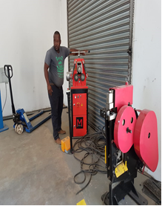
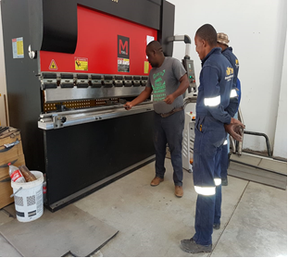
Mineral Regulation (MR) Highlights for Q3 (9 of 9)
ASSMANG LIMITED: MCVIGER ENTERPRISE PROJECT IN KATHU (NC)

Slide 56
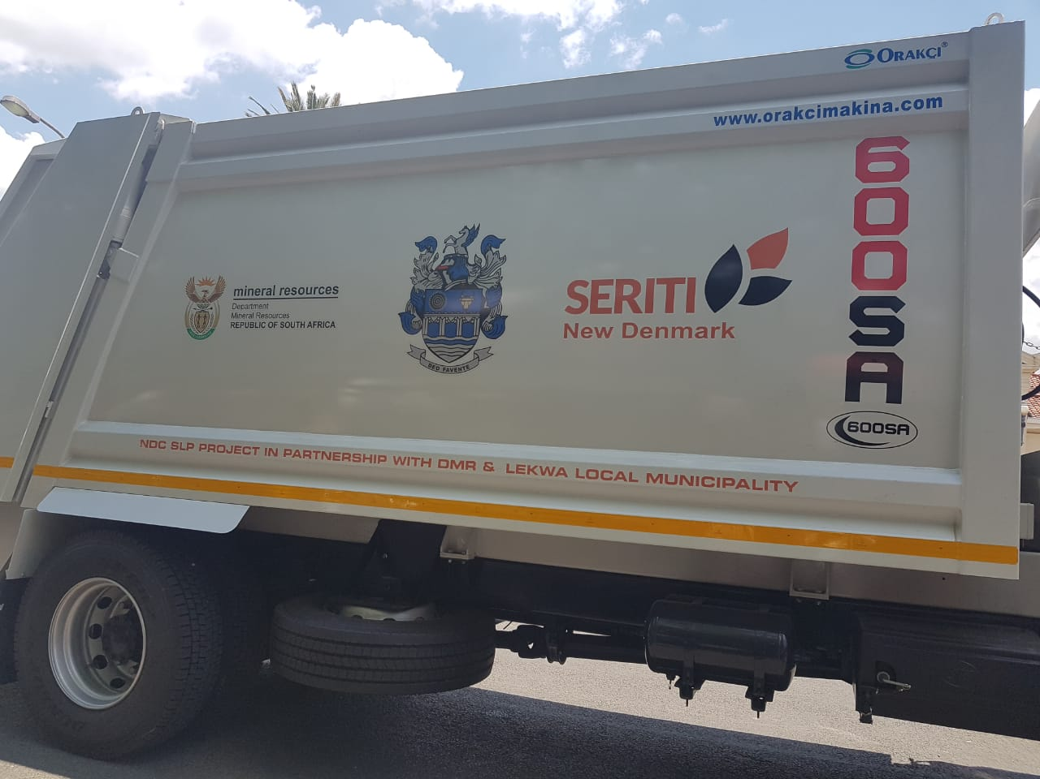
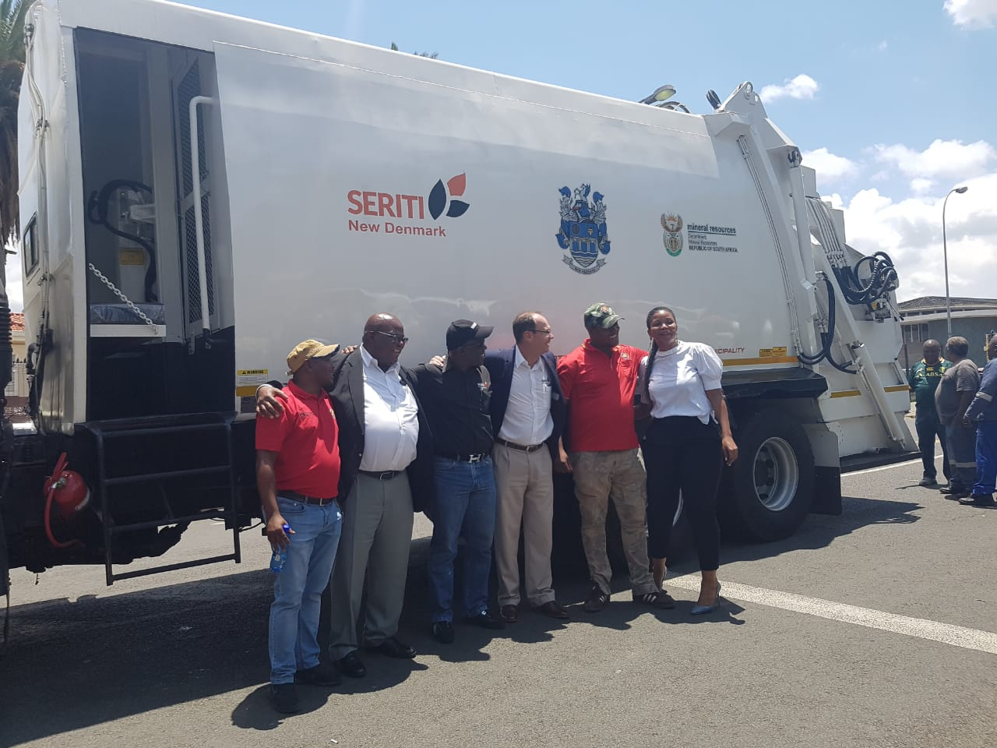
Mineral Regulation (MR) Highlights for Q3 (9 of 9)
SERITI MINING (PTY) LTD: REFUSE TRUCKS DONATED TO LEKWA LOCAL MUNICIPALITY (MP)

Slide 57
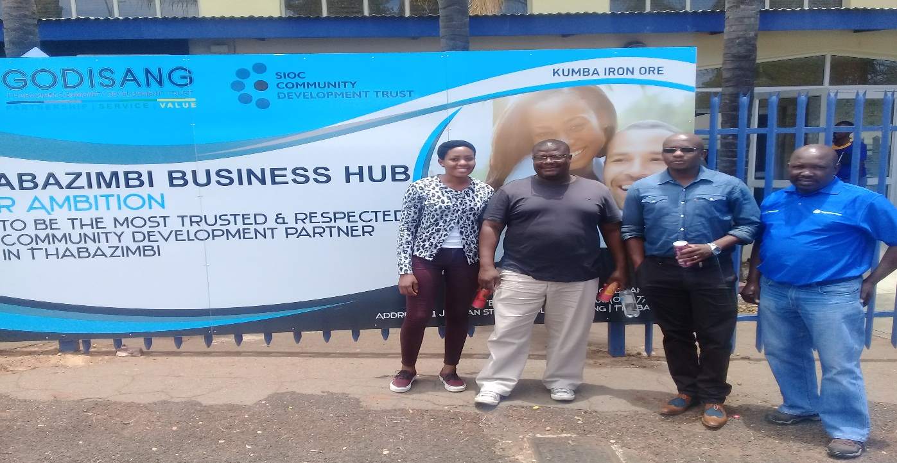
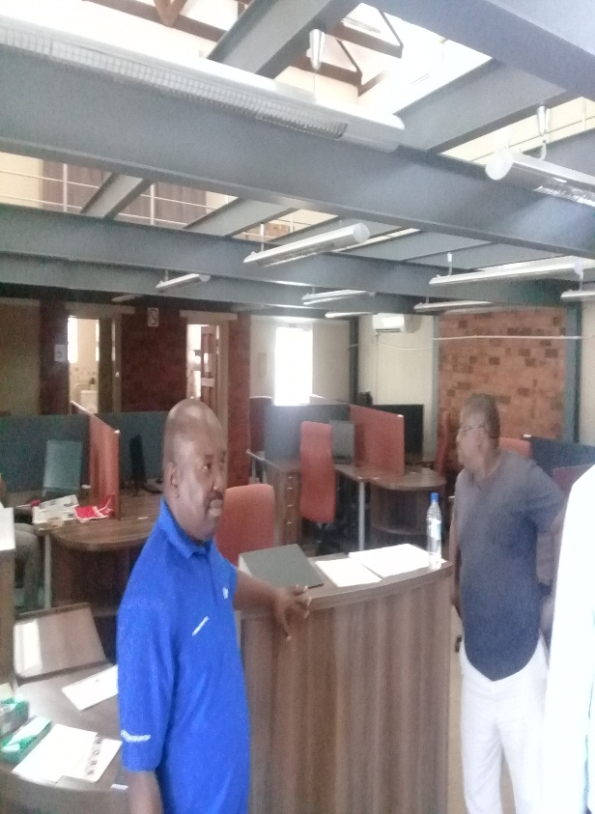
Mineral Regulation (MR) Highlights for Q3 (9 of 9)
SISHEN IRON ORE (PTY) LTD: BUSINESS HUB IN THABAZIMBI (LP)

Slide 58
Mineral Regulation (MR) Highlights for Q3 (9 of 9)
ANGLOGOLD ASHANTI LTD: WEDELA AGRICULTURAL PROJECT IN CARLTONVILLE (GP)

Slide 59
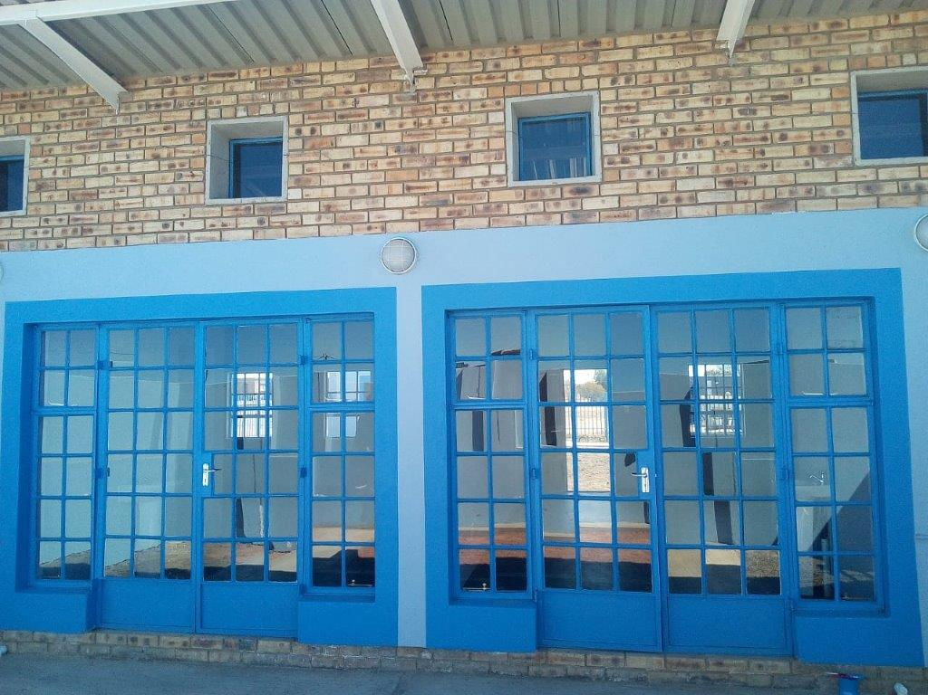
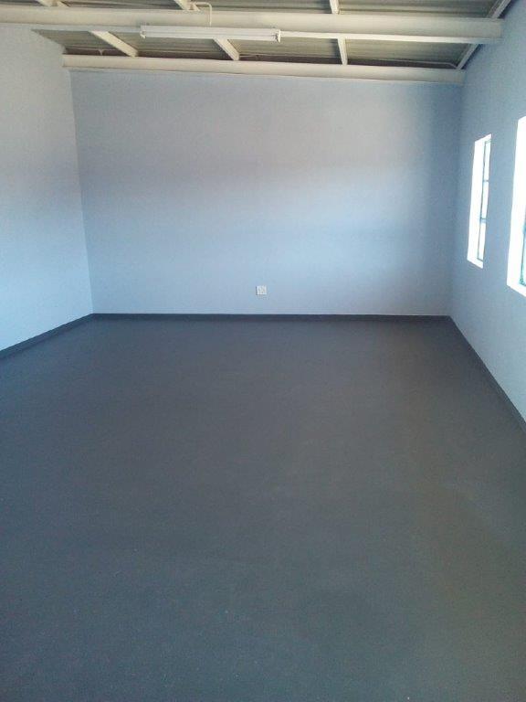
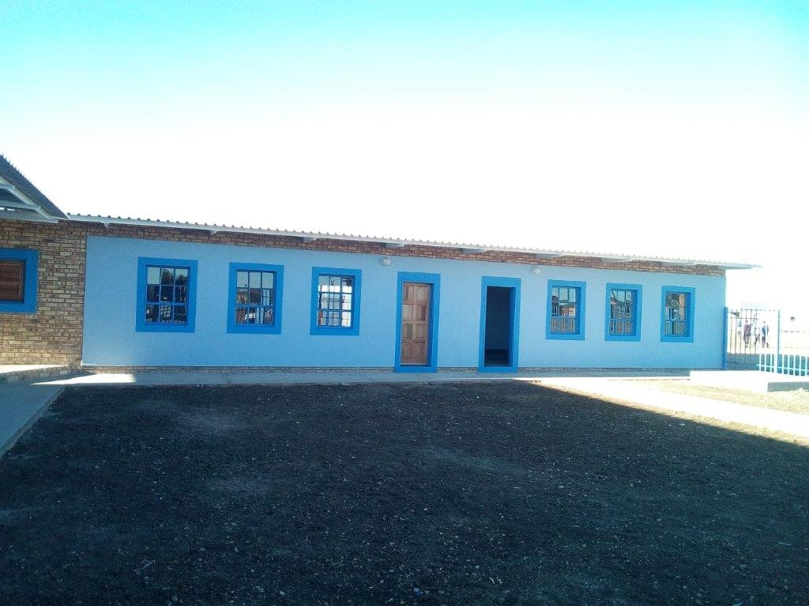
Mineral Regulation (MR) Highlights for Q3 (9 of 9)
COPPERSUNSET (PTY) LTD: CONSTRUCTION OF EARLY CHILD DEVELOPMENT CENTRE IN DENYSVILLE (FS)

Slide 60
Programme 4 – Mineral Policy and Promotion
DDG: Mineral Policy and Promotion
Mrs F Ngcwabe

Slide 61
PROGRAMME 4: Mineral Policy and Promotion
Branch Objectives
Contribute to Economic Growth through Mining and Upstream Petroleum,
Promote Investment into the Mining and Upstream Petroleum sectors of South Africa,
Promote Sustainable Mining,
Continue to Transform the Mining and Upstream Petroleum Industries through development & review of legislation

Slide 62
Branch – Mineral Policy & Promotion (1 of 10)
Promote Investment in the mining, minerals and upstream petroleum sectors
Manage and manage Mineral Resources Diplomacy
Increased Investment in the Mineral and Mining Petroleum Sectors
VISION 2019
Equitable and sustainable Benefit from Mineral Resources
Promote sustainable resources use and management
Transformed Minerals Sector
Facilitate transformation in the mining and minerals sector
Efficient, Effective and Development oriented Department
Integrated and aligned environmental efforts
Develop and review internal processes
Improve Turnaround Times
Promote Corporate Governance
Vision 2019
A global competitive, sustainable and meaningful transformed mining and mineral sector
Outcomes

Slide 63
Branch – Mineral Policy & Promotion (2 of 10)
Promote Investment in the Mining, Minerals and Upstream Petroleum Sectors
Increased Investment in the Mineral and Mining Petroleum Sectors
Number of Publications
Number of Investment promotion events/forums/workshops
% of Implementation of Oceans Economy Operation Phakisa Plan
Number of SMMEs Supported
Vision 2019
Target ꞊ 7
Actual = 11
Target ꞊ 33
Actual = 32
Target ꞊ 100%
Actual = 100%
Target ꞊ 60
Actual = 75
Number of social dialogues with Stakeholders
Target ꞊ 2
Actual = 1
Outcome
Notes:
Number of Publications
Over achieved due to reprioritisation of work.
Number of Investment Promotional Activities
A meeting was deferred due to unavailability of stakeholders. This meeting will be held in Q4.
Number of SMMEs
Over achieved due to requests from the public for assistance.
Number of Social Dialogues
Over-achieved due to several engagements in preparation for the social compact and Mining Vision Strategy 2030.

Slide 64
Number of SMME’s Supported (3 of 10)
Promotion of Investments in Mining, Minerals and Upstream Petroleum

Slide 65
Branch – Mineral Policy & Promotion (4 of 10)
Promote Investment in the Mining, Minerals and Upstream Petroleum Sectors
Increased Investment in the Mineral and Mining Petroleum Sectors
% of Implementation of Shale Gas action plan instruments
Number of reports reviewing the identification of Minerals Critical for National Developmental imperatives and designation of the quantities and qualities required
Vision 2019
Target ꞊ 100%
Actual = 100%
Target ꞊ Not yet Due
Actual = Not yet Due
Manage and Implement Mineral Resources Diplomacy
Number of International strategic Partnerships implemented
Target ꞊ 4
Actual = 1
Outcome
Notes:
International Strategic Partnerships
PGM Conference & ITEC. It has not been possible to implement other MOUs due to unavailability of the relevant countries, such as Nigeria, China and India.
The Branch has since met with these countries and reports will be provided by end of financial year.

Slide 66
PROGRAMME 4: Mineral Policy and Promotion (5 of 10)
Update on Implementation of Shale Gas Activities
The project concluded the drilling of the two monitoring boreholes, R01-BW and R02-BW, which were drilled to depths of 517 and 1402m, respectively.
Geological logging, sampling of percussion chips, downhole geophysical surveys and hydrogeological tests were conducted on these respective boreholes.
The technical specifications for the 2-D seismic survey have been concluded and submitted in preparation for tender publication.
A drilling consultant has been appointed to oversee the technical specifications, the bid evaluation, contraction and technical auditing for the 3 500m ultra deep borehole and a specifications document has been produced.

Slide 67
Branch – Mineral Policy & Promotion (6 of 10)
Promote Sustainable Resources Use and Management
Equitable and Sustainable benefit from Mineral Resources
Number of technical partnerships implemented with SOEs & Govt organisations
A review of Departmental Environmental Management Plan
Number of reports developed on mine closure and D&O mines
Number of derelict and ownerless mine sites Rehabilitated
Vision 2019
Target ꞊ 3
Actual = 3
Target ꞊ Not yet Due
Actual = Not yet Due
Target ꞊ 1
Actual = 1
Target ꞊ 35
Actual = 20
Number of mine Environmental Management Tools developed
Target ꞊ 1
Actual = 1
Outcome
Notes:
Number of technical partnerships
CGS on water management; CGS on rehabilitation; Mintek on rehabilitation
Number of Derelict and Ownerless Mines
The service provider (Council for Geoscience) reported that they had experienced some challenges with the appointment of contractors for the rehabilitation work. This led to the delay in the rehabilitation work. All sites will be rehabilitated by financial year end.

Slide 68
Branch – Mineral Policy & Promotion (7 of 10)
Integrated and Aligned environmental efforts
Increased Investment in the Mineral and Mining Petroleum Sectors
Number of engagements with relevant departments
Vision 2019
Target ꞊ 3
Actual = 3
Facilitate Transformation in the Mining sector
Number of legislative instruments developed, reviewed and amended
Target ꞊ 1
Actual = 1
Outcome
Notes:
Number of engagements with relevant departments
- Engagements held with DEA/ DWS/ NT on issues that affect mining and minerals

Slide 69
Branch – Mineral Policy & Promotion (8 of 10)
Efficient, Effective and Development Oriented Department
Vision 2019
Develop and Review Internal Processes
Number of internal business processes developed / reviewed
Target ꞊ Not yet Due
Actual = Not yet Due
Improve Turnaround times
% adherence to timeframes
Target ꞊ 95%
Actual = 100%
Outcome

Slide 70
Branch – Mineral Policy & Promotion (9 of 10)
Promote Corporate Governance
Efficient, Effective and Development Oriented Department
% of Implementation of Management Action Plan
(Internal Audit)
% of Implementation of Management Action Plan
(External Audit)
% Adherence to Compliance Framework
% of Risk Management Plans
Vision 2019
Target ꞊ 100%
Actual = 100%
Target ꞊ 100%
Actual = 100%
Target ꞊ 100%
Actual = 100%
Target ꞊ 100%
Actual = 100%
Outcome
Notes:
% Implementation of Audit (Internal and External)
The Branch has no internal and external findings to implement.
% of Risk Management Plans
The Branch had no risk action plans to implement in Q3.

Slide 71
PROGRAMME 4: Mineral Policy and Promotion (MPP)
(10 of 10)
Highlights for Q3
The Branch gazetted the Mining Charter Guidelines
Minister hosted an Oil and Gas Breakfast Session.
At the 15th ITEC held in Russia, in November 2018, the Implementation Plan on Cooperation on PGMs was finalised.
As South Africa was selected as the Chair of the Kimberley Process Monitoring Working Group – Ambassador Nhlapho has been appointed on contract to assist as the Chairperson.
  South Africa as Chair hosted the KPCS WGM in October 2018.
  South Africa attended and participated at the KP Plenary in November 2018

Slide 72
THANK YOU

