Slide 1
BUDGETING IN AN ERA OF AUSTERITY AND STATE CAPTURE: A FIVE-YEAR REVIEW OF BUDGET POLICIES AND OUTCOMES
SUBMISSION BY BUDGET JUSTICE COALITION
TO THE SELECT AND STANDING COMMITTEES ON FINANCE
26 February 2019
Notes:
Daniel (but we each introduce ourselves)

Slide 2
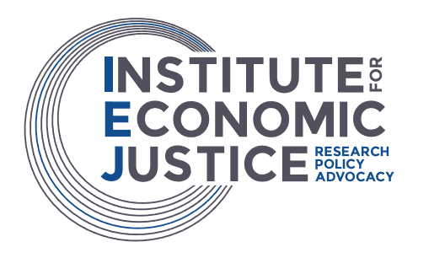
The Budget Justice Coalition
Alternative Information and Development Centre (AIDC), the Children’s Institute at UCT, the Dullah Omar Institute (DOI), Equal Education (EE), Equal Education Law Centre (EELC), the Institute for Economic Justice (IEJ), the National Shelter Movement, OxfamSA, Pietermaritzburg Economic Justice and Dignity (PMEJD), the Public Service Accountability Monitor (PSAM),the Rural Health Advocacy Project (RHAP), SECTION27 and the Studies in Poverty and Inequality Institute (SPII)
Notes:
Daniel

Slide 3
One Step Forward, Two Steps Back
BJC 5-year review
Three arguments:
1. Austerity has been implemented over the past five years
2. This has had regressive, discriminatory and counter-productive impacts
3. There are alternative ways of raising revenue and managing debt that need to be explored
Notes:
Daniel

Slide 4
Fiscal Framework
BJC 5-year review
Government has been implementing austerity since at least 2014/15
Larger pool of available resources has not translated into larger allocations to government departments, but to deficit reduction and bailouts to SOEs
Austerity is self-defeating during recessionary times
Table 1: Consolidated revenue, non-interest expenditure and population growth
 | 2014/15 | 2015/16 | 2016/17 | 2017/18 | 2018/19 | Average growth
Revenue growth | 2.7% | 5.1% | 0.6% | -1.0% | 2.7% | 2.0%
Non-interest expenditure growth | 1.7% | 4.6% | -0.2% | 0.3% | 2.6% | 1.8%
Population growth | 1,6% | 1,6% | 1,6% | 1,6% | 1.6% | 1.6%
Source: Consolidated budget revenue, National Treasury 2017-2019 Budget Review and own calculations. StatsSA Mid-Year Population Estimates.
Notes:
Busi

Slide 5
One Step Forward, Two Steps Back
BJC 5-year review
Per capita GDP has fallen for four years in a row
Public debt has grown as a share of total GDP
Widening socio-economic inequality
Rise of precarious work
1/3 labour force out of work
Among the most unequal countries in the world
Notes:
Busi

Slide 6
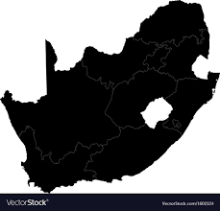
Impacts of Austerity on:
BJC 5-year review
Capacity of the state
Worsened the performance of government
“Austere expenditure ceilings are affecting local, provincial and national government departments across the country, and every service area from water to electricity to housing and social development’’
Tax policy
Increase in the VAT rate from 14% to 15%
Retrogressive and discriminatory impacts
Notes:
Daniel

Slide 7
Departmental Impacts of Austerity on:
BJC 5-year review
Health
Real per capita decline in health care funding
R700 million less will be spent on health in 2019/20*
Critical staff shortages
Increase in medico legal claims
Education
Per learner spending has actually declined by 10% since 2010
Disproportionately impacts on poor schools with infrastructure backlogs
*compared to the 2018 MTBPS estimate
Notes:
Daniel

Slide 8
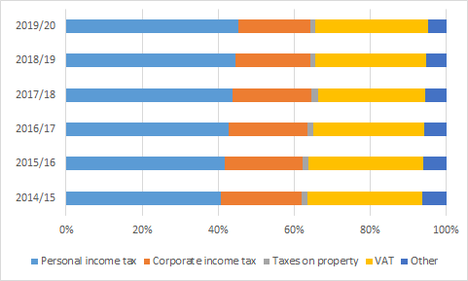
Tax Mix Alternatives
BJC 5-year review
Revenue:
Personal income tax (PIT) effective rates have fallen since 1997.
Corporate income tax (CIT) rates have also fallen dramatically, from 50% in 1990 to 28% in 2018.
The VAT change from 14% to 15%
Annual increases in the fuel levy (a tax paid on petrol and diesel that are otherwise VAT exempt)
Wealth tax taxed at levels below the appropriate PIT bracket
Tax credit benefits (particularly medical) which are costly and problematic
Source: National Treasury 2019 Budget data
Notes:
Busi

Slide 9
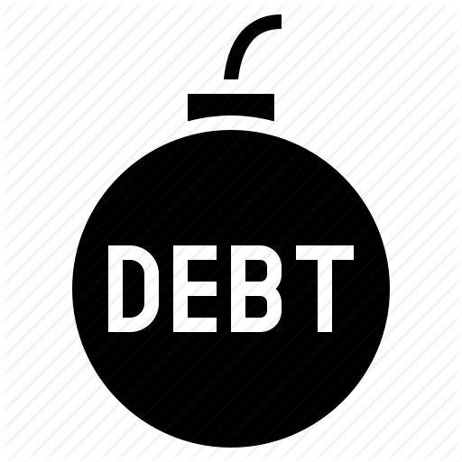
Alternatives to Managing Debt
BJC 5-year review
Eskom is the only real debt crisis in the country
Increasing the debt threshold
that debt (at moderate levels) can have substantially positive benefits.
The redrafting of the mandate of the Government Employee Pension Fund
The modification of private pension and provident funds investment obligations
The mobilisation of the Government Employee Pension Fund
Public audit of debt
Notes:
Erwan

Slide 10
Impacts of Corruption & Mismanagement
BJC 5-year review
Threaten the progressive realisation of constitutional rights
High costs
South Africa no less than R27 billion per year, while 76,000 jobs which could have been created are being lost through corruption**
Rising number of adverse audits
Bailouts for mismanaged and corrupt SOEs
**Department of Economic Development , 2017
Notes:
Erwan

Slide 11
Ensuring a credible budgeting process
BJC 5-year review
There have been six changes of Finance Minister since 2014
During the 5th term, budget proposals and policy statements have become less and less convincing – Treasury needs re-strengthening
Money Bills Amendment Procedure and Related Matters Amendment Act amendments have made it even more difficult for the public to participate
Notes:
Daniel

Slide 12
Recommendations
BJC 5-year review
Macroeconomic Policy
More awareness of the ‘quality’ of the economic growth that is aimed for
Greater focus on employment and economic growth in monetary policy
Better policy coherence and collaboration between the National Treasury with the Departments of Trade and Industry, Economic Development, Labour, Social Development and the Reserve Bank.
Fiscal Policy
Adoption of UN Committee Recommendations to the Government of South Africa on fiscal policy
Take action to end austerity by:
Ensuring real per capita annual increases in non-interest government
Measure the impact of previous and existing budget cuts on rights enjoyment
Institute, where necessary, cost-containment measures that comply with the human rights standards
Notes:
Daniel

Slide 13
Recommendations
BJC 5-year review
Revenue and Debt Management Policy
Increase tax rates on PIT, CIT and wealth
Institute a permanent annual net wealth tax
Raise the capital gains tax inclusion rate to 100%
Significantly raise the estate duty tax and close loopholes
Reduce the rate of increase for the fuel and road accident fund levies
Reverse the VAT hike
Explore heterodox strategies of public debt management
Reduce tax breaks for higher-income households
Notes:
Erwan

Slide 14
Recommendations
BJC 5-year review
State Capacity
Transparency on policy directive for reducing the size of the state
Undertake public service employment rationalisation (not simple headcount reductions)
Put an end to corruption and State Capture, by:
Provide full budgetary support to the SAPS, SIU, NPA, Hawks and other crime fighting units
Upgrade procurement policy and publish all contracts entered into by the state
The Budget Process
Co-construction of budgets with social movements and community organisations
Strengthen capacity within the Parliamentary Budget Office (PBO)
Support the vulekamali.gov.za budget portal project
Notes:
Daniel

