Slide 1


THE COMPENSATION FUND
PORTFOLIO COMMITTEE MEETING
February 2019

Slide 2
INTRODUCTION
INTRODUCTION
- The Constitutional Mandate of the CF
- The Policy Mandate of the CF

Slide 3
INTRODUCTION: THE MANDATE OF THE CF
Constitutional Mandate
The mandate of the Compensation Fund is derived from Section 27 (1) (c) of the Constitution of the Republic of South Africa. In terms of this Act, specifically the mentioned Section, all South Africans have a right to social security. The Compensation Fund is mandated to provide social security to all injured and diseased employees.
Legislative Mandate
The Compensation Fund is established in terms of section 15 of the Compensation for Occupational Injuries and Diseases Act as amended. The main objective of the Act is to provide compensation for disablement caused by occupational injuries or diseases sustained or contracted by employees or for death resulting from such injuries or diseases and provide for matters connected therewith.

Slide 4
VISION AND MISSION
  VISION
  To be a world class provider of sustainable compensation for occupational injuries and diseases, rehabilitation and reintegration services
  MISSION
The Mission of the Compensation Fund is to:
  Provide efficient, quality, client centric and accessible COID service
  Sustain financial viability
  Ensure an organisation which takes care of the needs of its staff for effective service delivery

Slide 5




STRATEGIC PLAN OF THE FUND
The Strategy of the Fund is comprised of two strategic priorities or objectives:
 | Quality Medical Care | Client Centered Care | People | Performance
Strategic Objectives | To provide faster, reliable and accessible COID Services by 2020 |  | To provide an effective and efficient client oriented support services
Contribution to the National Development Plan | Our services contribute to the achievement of the National Development Plan by: Providing a social security system covering all working people with social protection for workers who suffer workplace injuries and occupational diseases in the work place. This includes the their surviving beneficiaries in an event of injuries or diseases that result in death.

Slide 6
STRATEGIC PLAN FOCUS
GOVERNANCE
Compensation and Pension Benefits
Medical Services
Disability Care
COMPLIANCE
CORPORATE SUPPORT

Slide 7
LINK TO OUTCOMES
Government Service Delivery Outcomes | DOL Strategic Objectives | CF Strategic Outcomes | CF Strategic Objectives
Outcome 4: Decent Employment through inclusive economic growth | KRA 3: Protecting vulnerable workers, | Strengthening of Social Security through compensating for occupational injuries and diseases | Provide faster, reliable and accessible COID Services by 2020
 | KRA 5: Strengthening social protection
Outcome 13: A comprehensive, responsive and sustainable social protection system
Outcome 12: An efficient, effective and development oriented public service | KRA 8: Strengthening the institutional capacity of the Department | Strengthening the institutional capacity of the Fund | Provide an effective and efficient client oriented support services.

Slide 8
LEGEND
Implication: ACHIEVED
Performance Indicator is on track or reflects complete implementation. Target achieved
100% + Complete
Implication: NOT ACHIEVED
Performance Indicator behind schedule. Target not achieved
0% - 99% Complete

Slide 9
QUARTER 2 OVERALL PERFORMANCE
Overall achievement per Strategic Objective and per Programme during QUARTER 2
July to September 2018-19
Cumulative Performance from Quarter 1.

Slide 10
QUARTER 2 PERFORMANCE PER STRATEGIC OBJECTIVE 2018/19
Strategic Objectives | Annual Planned Indictors | Indicators with targets reporting in Q2 | Achieved | Not Achieved | Overall Achievement %
Provide an effective and efficient client oriented support services. | 3 | 1 | 1 | 0 | 100%
Provide faster, reliable and accessible COID Services by 2020. | 6 | 6 | 5 | 1 | 83%
Total number of Indicators | 9 | 7 | 6 | 1 | 86%
Overall Performance |  |  | 86% | 14%

Slide 11
QUARTER 2 PERFORMANCE PER PROGRAMME 2018/19
Programme | Annual Planned Indicators | Indicators with targets reporting in Quarter 2 | Achieved | Not Achieved | Overall % Achievement
Programme 1: Administration | 3 | 1 | 1 | 0 | 100%
Programme 2: Compensation for occupational injuries and diseases Services operations | 3 | 3 | 2 | 1 | 67%
Programme 3: Medical Services | 2 | 2 | 2 | 0 | 100%
Programme 4: Orthotic and Rehabilitation | 1 | 1 | 1 | 0 | 100%
Total number of Indicators | 9 | 7 | 6 | 1 | 86%
Overall Performance |  |  | 86% | 14%

Slide 12
COMPARATIVE ANALYSIS PER PROGRAMME FOR Q1 & Q2 2018/19
Programmes | QUARTER 1 2018/19 |  |  | QUARTER 2 2018/19
 | Quarter1 Planned targets | Overall Achieved | % | Quarter2 Planned targets |  | Overall Achieved
Programme 1: Administration | 2 | 1 | 100% | 2 | 1 | 100%
Programme 2: Compensation for occupational injuries and diseases Services operations | 3 | 2 | 67% | 3 | 2 | 67%
Programme 3: Medical Services | 2 | 2 | 100% | 2 | 2 | 100%
Programme 4: Orthotic and Rehabilitation | 1 | 1 | 100% | 1 | 1 | 100%
Total | 7 | 6 | 86% | 7 | 6 | 86%
The Programmes during 2017/18 Financial Year were prior to the Review of the CF Structure

Slide 13
PERFORMANCE TRENDS

Slide 14

QUARTER 1 & 2
PERFORMANCE PER INDICATOR
Number | PERFORMANCE INDICATORS FOR THE FINANCIAL YEAR 2018/19 | Annual Target | Quarter 1 Target | Q1 Achievement | Quarter 2 Target | Q2 Achievement | LEGEND | TREND
1.2 | Percentage implementation of the approved annual risk-based audit plan | 85% | 15% | 25% | 45% | 60%
2.1 | Percentage of approved benefits paid within 5 working days | 98% | 98% | 100% | 98% | 100%
2.2 | Percentage of active registered employers assessed annually by 31 March 2019 (excl exempted employers) | 75% | 40% | 35% | 55% | 38%
**2.3 | Percentage of claims adjudicated within 40 working days of receipt | 90% | 90% | 92% | 90% | 95%
**3.1 | Percentage of medical invoices finalised within 60 working days of receipt | 85% | 85% | 99% | 85% | 94%
**3.2 | Percentage of pre-authorisation requests responded to within 10 working days | 85% | 85% | 87% | 85% | 90%
**4.1 | Percentage of compliant requests for assistive devices responded to within 15 working days of receipt | 85% | 85% | 91% | 85% | 89%
5%
17%
**Indicators with Provincial Performance breakdown

Slide 15


QUARTER 2
PROGRAMME 2 PERFORMANCE PER PROVINCE
90% of registered compensation claims adjudicated within 40 working days
Province | Total claims registered | Total claims adjudicated | Percentage of Total claims adjudicated | Claims adjudicated within 40 working day | Percentage of Total claims adjudicated within 40 working days
Eastern Cape | 4365 | 4147 | 95% | 4064 | 93%
Free State | 2087 | 2054 | 98% | 2032 | 97%
Gauteng | 16467 | 15726 | 96% | 15200 | 92%
Kwa-Zulu Natal | 7130 | 6867 | 96% | 6794 | 95%
Limpopo | 12305 | 12120 | 98% | 11844 | 96%
Mpumalanga | 2800 | 2754 | 98% | 2734 | 98%
North West | 3324 | 3240 | 97% | 3199 | 96%
Northern Cape | 900 | 890 | 99% | 882 | 98%
Western Cape | 20836 | 20503 | 98% | 20227 | 97%
Grand Total Q2 | 70214 | 68301 | 97% | 66976 | 95%
Grand Total Q1 | 31076 | 28946 | 93% | 28737 | 92%

Slide 16
QUARTER 2
PROGRAMME 3 PERFORMANCE PER PROVINCE
85% of medical invoices finalised within 60 working days of receipt
Province | Total Received | Total Finalised | Percentage of Total Finalised | Finalised within 60 working days | Percentage of Total Finalised within 60 working days
Eastern Cape | 21952 | 21128 | 96% | 20919 | 95.29%
Freestate | 11594 | 10454 | 90% | 10296 | 88.80%
Gauteng | 201930 | 193337 | 96% | 189750 | 93.97%
Kwa-Zulu Natal | 11075 | 10495 | 95% | 9874 | 89.16%
Limpopo | 27304 | 26437 | 97% | 25806 | 94.51%
Mpumalanga | 11943 | 11595 | 97% | 11436 | 95.75%
North West | 12269 | 11626 | 95% | 11435 | 93.20%
Northern Cape | 4178 | 3996 | 96% | 3885 | 92.99%
Western Cape | 28840 | 27554 | 96% | 26751 | 92.76%
Systems Generated | 1357 | 924 | 68% | 917 | 67.58%
Grand Total – Q2 | 332442 | 317546 | 96% | 311069 | 93.57%
Grand Total – Q1 | 146154 | 145281 | 99% | 145232 | 99.00%

Slide 17
QUARTER 2
PROGRAMME 3 PERFORMANCE PER PROVINCE
85% of pre-authorisations responded to within 10 working days on previously finalised cases
Province | Received | Achieved | Percentage
EC | 65 | 52 | 80%
FS | 36 | 34 | 94%
GP | 195 | 172 | 88%
KZN | 60 | 51 | 85%
LP | 61 | 59 | 97%
MP | 42 | 38 | 90%
NC | 6 | 6 | 100%
NW | 4 | 3 | 75%
WC | 80 | 75 | 94%
Total Pre-Authorization's
 |  | Q1 |  | Q2
Received |  | 473 |  | 549
Achieved |  | 412 |  | 490
Percentage |  | 87% |  | 89%

Slide 18

QUARTER 2
PROGRAMME 4 PERFORMANCE PER PROVINCE
85% of compliant requests for assistive devices responded within 15 working days
Province | Received | Achieved | Percentage
Eastern Cape | 23 | 14 | 61%
Free State | 59 | 57 | 97%
Gauteng | 204 | 195 | 96%
Kwa-Zulu Natal | 115 | 109 | 95%
Limpopo | 74 | 64 | 86%
Mpumalanga | 86 | 83 | 97%
North West | 42 | 32 | 76%
Northern Cape | 32 | 22 | 69%
Western Cape | 15 | 5 | 33%
Total – Q2 | 650 | 581 | 89%
Total – Q1 | 231 | 210 | 91%

Slide 19
ANNUAL PERFORMANCE PLAN (APP) 2018/19
QUARTER 2
JULY 2018 – SEPTEMBER 2018
PROGRESS AND MAJOR PERFORMANCE CHALLENGES ENCOUNTERED DURING REPORTING PERIOD
With a special focus on NOT ACHIEVED Targets

Slide 20
PROGRAMME 2
PROGRAMME PERFORMANCE INDICATOR | QUARTER 2 TARGET | ACTUAL PERFORMANCE | REASON FOR VARIANCE | REMEDIAL ACTION
STRATEGIC GOAL 8: STRENGTHENING SOCIAL PROTECTION (MTSF OUTCOME 13: A COMPREHENSIVE, RESPONSIVE AND SUSTAINABLE SOCIAL PROTECTION SYSTEM)
1.1 Percentage of active registered employers assessed annually by 31 March 2019 (excl exempted employers) | 55% of active registered employers assessed by 30 September 2018 | NOT ACHIEVED 38% of active registered employers were assessed by 30 September 2018 As at the end of March 2018, there were a total of 401 536 active registered employers on the database. Of the total active registered employers, 153 749 (38%) were assessed by 30 September 2018 (2018/19 Q2). 38% is lower than the planned 40%. | 17%: Employer’s non submission of ROE’s The recruitment process of appointing Employers Compliance and Statutory Services not finalised to ensure employers' compliance and enforcement | Issue final reminder for submission of outstanding returns of earnings Referral of non-submitting employers to IES Review of 2019/20 APP to support full implementation of the definition of Active Registered Employers Estimation of non-submitted ROE’s by Q4.

Slide 21
2018/19 Q2 PERFORMANCE LINKED TO BUDGET
PROGRAMMES | Planned Indictors | Achieved | Not Achieved | Overall Performance | Budget | Actual Spent | Variance | % Spent
 |  |  |  |  | R'000 | R'000 | R'000 | R'000
Programme 1: Administration | 1 | 1 | 0 | 100% | 2 403 477 | 549 218 | 1 854 259 | 23%
Programme 2: COID Services | 3 | 2 | 1 | 67% | 1 025 917 | 144 724 | 881 193 | 14%
Programme 3: Medical Benefits | 2 | 2 | 0 | 100% | 3 106 081 | 1 382 540 | 1 723 541 | 45%
Programme 4: Orthotic & Rehabilitation Services | 1 | 1 | 0 | 100% | 2 450 | 54 | 2 396 | 2%
OVERALL PERFORMANCE | 7 | 6 | 1 | 86% | 6 537 925 | 2 076 536 | 4 461 389 | 32%

Slide 22
2018-19 REVENUE SUMMARY

Slide 23
ECONOMIC CLASSIFICATION

Slide 24
2018-19 EXEPENDITURE PER PROGRAMME

Slide 25
2018-19 REVENUE AND EXPENDITURE SUMMARY

Slide 26
VARIANCES
Compensation of Employees:
Compensation of employees is at 46% spending , which reflect a normal spending for the period under review.
Goods and Services:
A contract for the new claims system was signed end of August 2018 , the project started on the third September 2018 and this will impact positively on the expenditure movements for the following reporting period.
Phase 2 of the CF filing project has been delayed due to lack of SAP resources.
Case ware software licence is still pending supply chain processes and therefore affecting the expenditure movements for the period under review.

Slide 27
VARIANCES
An amount of R17.2 million that was allocated for projects under Directorate Organisational Effectiveness has been set aside to be surrendered due to the plans to have those projects to commence in the next financial year (2019/2020).
The unwinding of interests also contribute to slow movement of expenditure as it will only actuaries have made their year end valuation.
Expenditure on travelling activities that occurred for various purposes within the current reporting period will only reflect in the expenditure information for October 2018 due to outstanding invoices.
Due to cost cutting measures there were numerous meetings that took place internally which affect venues and facilities and catering expenditure item for the period under review .
Plans are under way to have provincial strategic workshop during the 3rd quarter (Oct-Dec 2018)and this will contribute on expenditure movement during that period

Slide 28
VARIANCES
The process for budgeting for medical and compensation benefits has been reviewed based on prior period actual expenditure. This has resulted in the compensation benefits budget amount being significantly reduced.
The pension payments are not reflecting on the actual expenditure as the amounts are set off against the current liabilities.
What is outstanding is the actuarial valuations which will affect the benefits expenditure. These valuations will be finalised with the interim financials by end of November 2018.

Slide 29
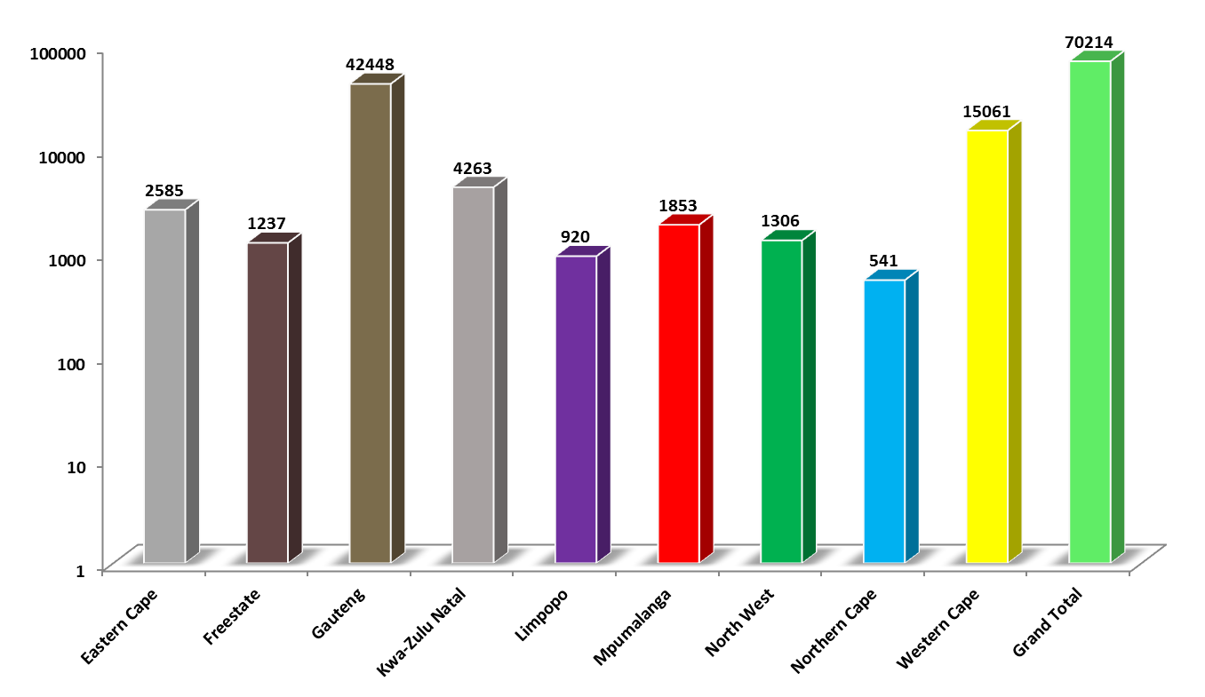
INJURIES PER PROVINCE
60%
21%

Slide 30
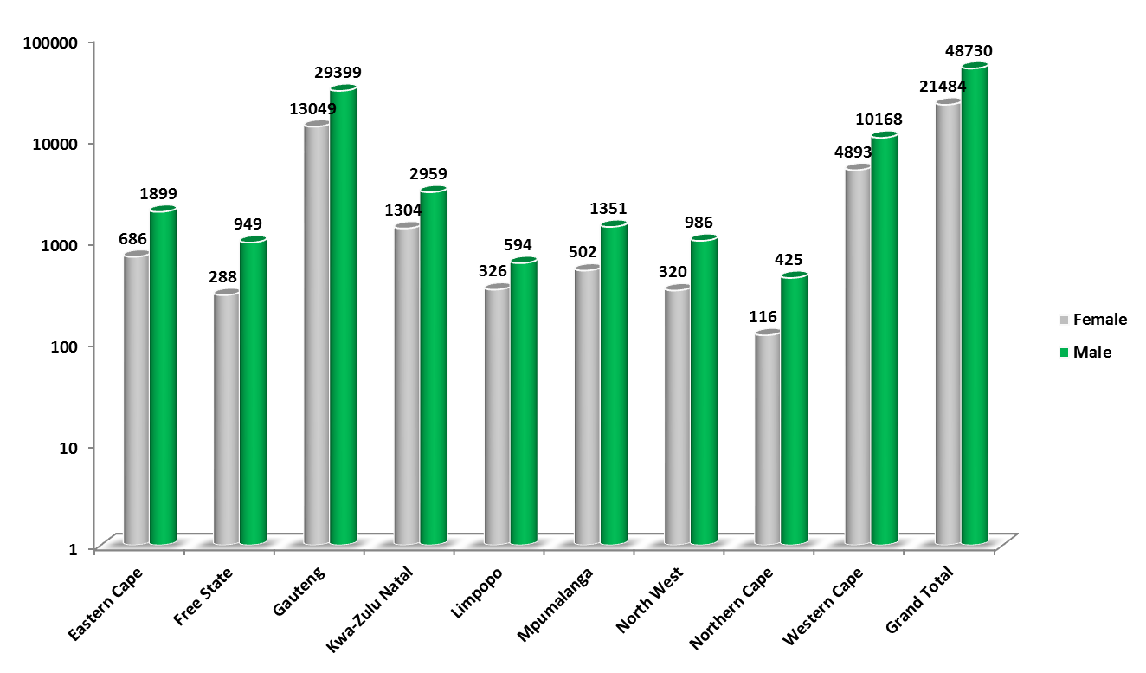

MALES AND FEMALES
21%
69%

Slide 31
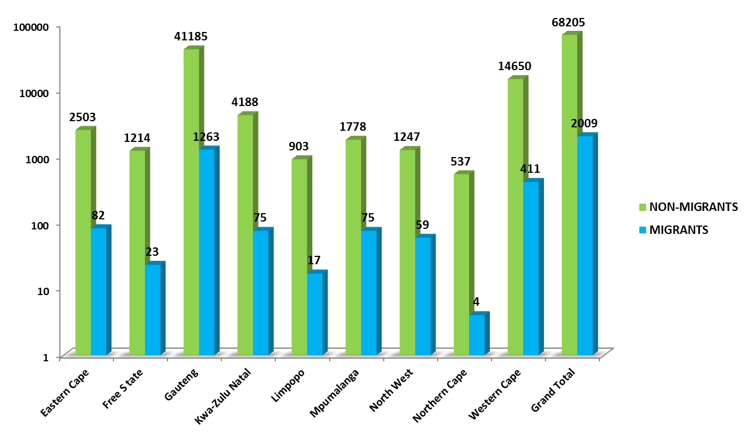
MIGRANTS AND NON MIGRANTS
97%

Slide 32
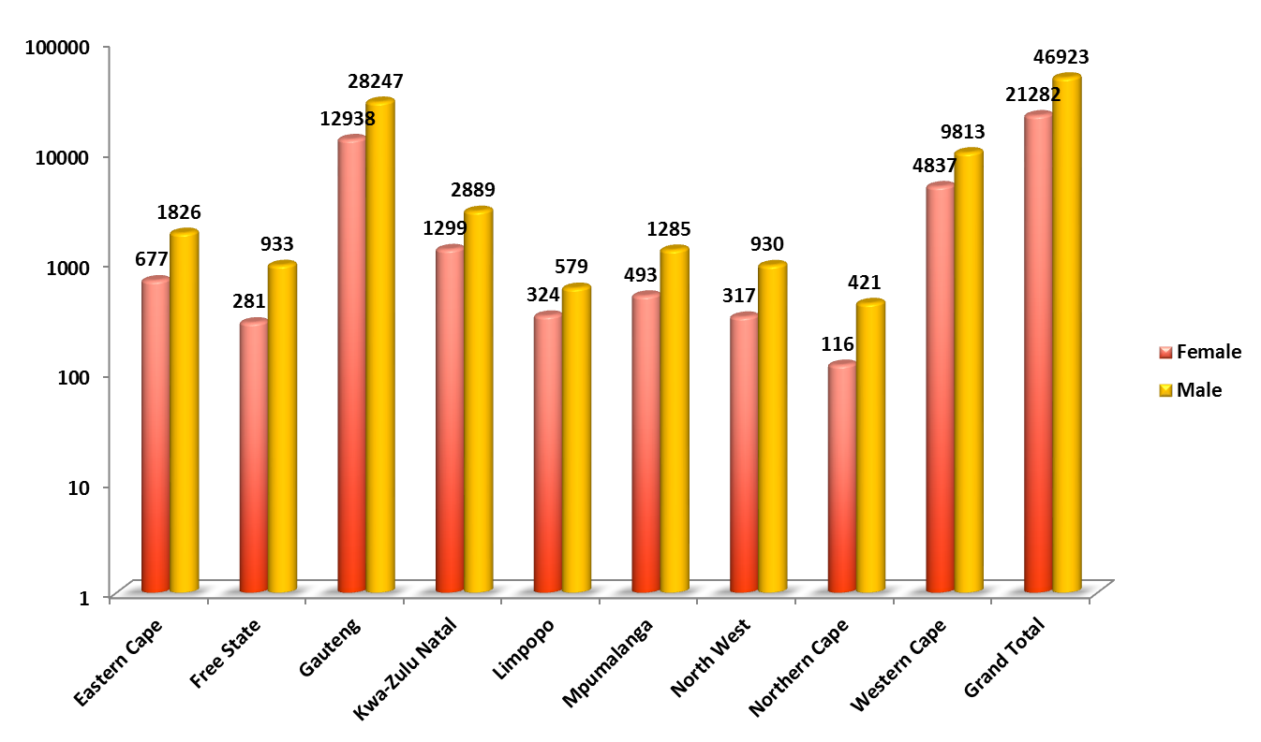
NON MIGRANTS: GENDER

Slide 33
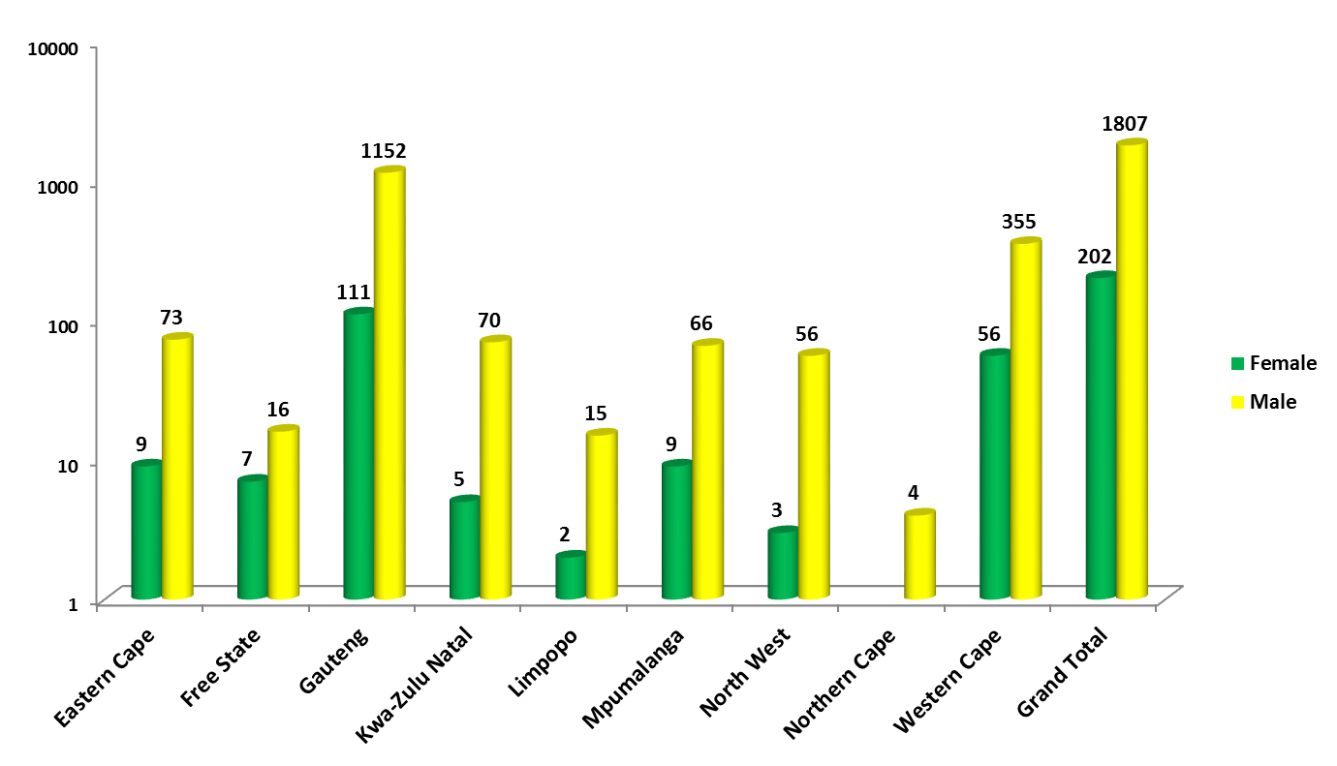

Slide 34
TOP 20 INJURIES, INDUSTRY SECTOR AND COMPANIES
The report shows top 20 injuries and in which industry sector and company the injuries are mostly incurred.
The report reflects Multiple Superficial Injuries as the most suffered injury by workers at workplace.
The nature of injury contemplate that the working class of citizens are working at food and retail sector (at Shoprite checkers and Pick N Pay).
The report will assist in reducing number of injuries suffered by workers by:
  Visiting the companies with higher number of injuries.
  Reinforce compliance with OHS.
  Promote safety measures with specific focus for target audience being identified and the type of industries they work in.

Slide 35
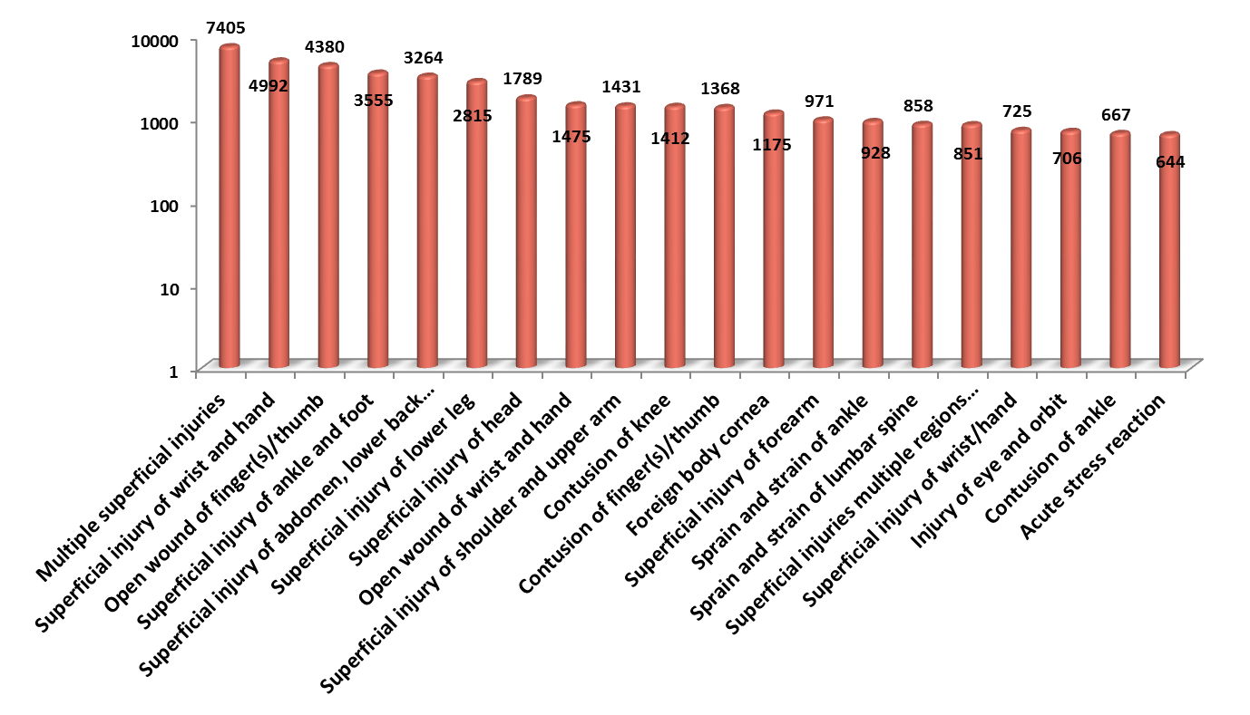
TOP 20 INJURIES

Slide 36
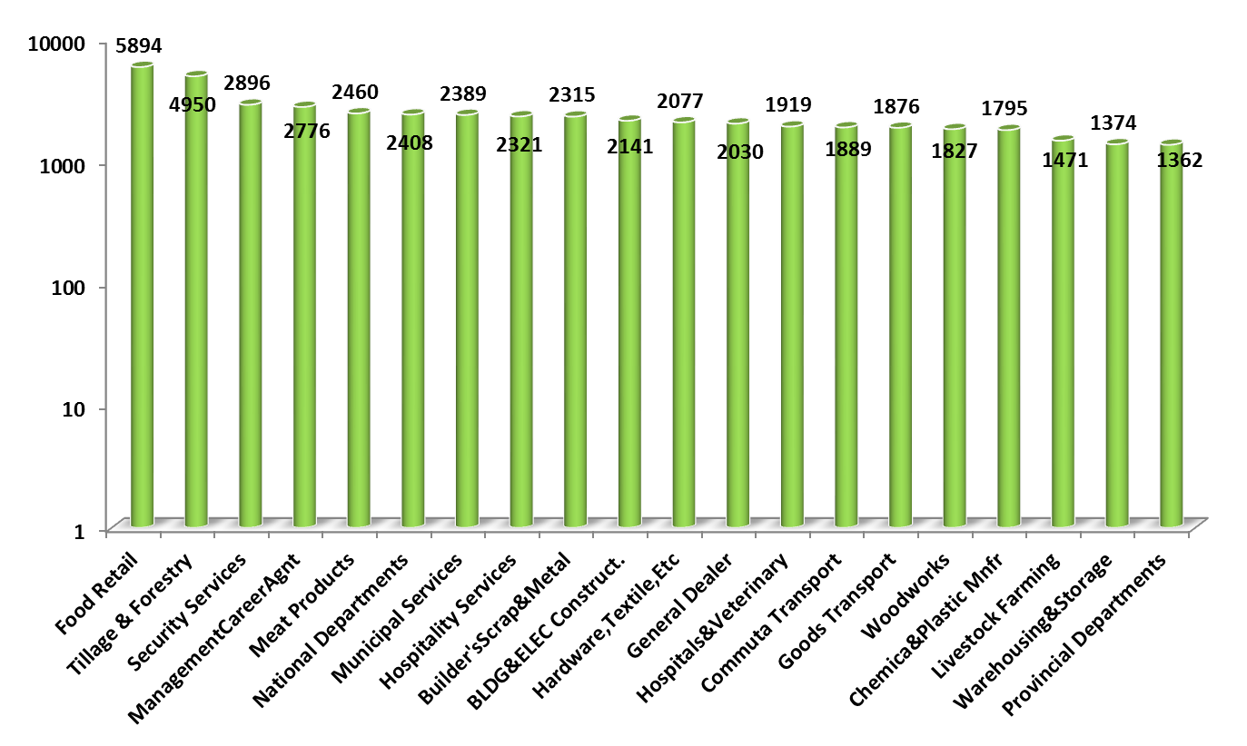
TOP 20 INDUSTRY SECTOR

Slide 37
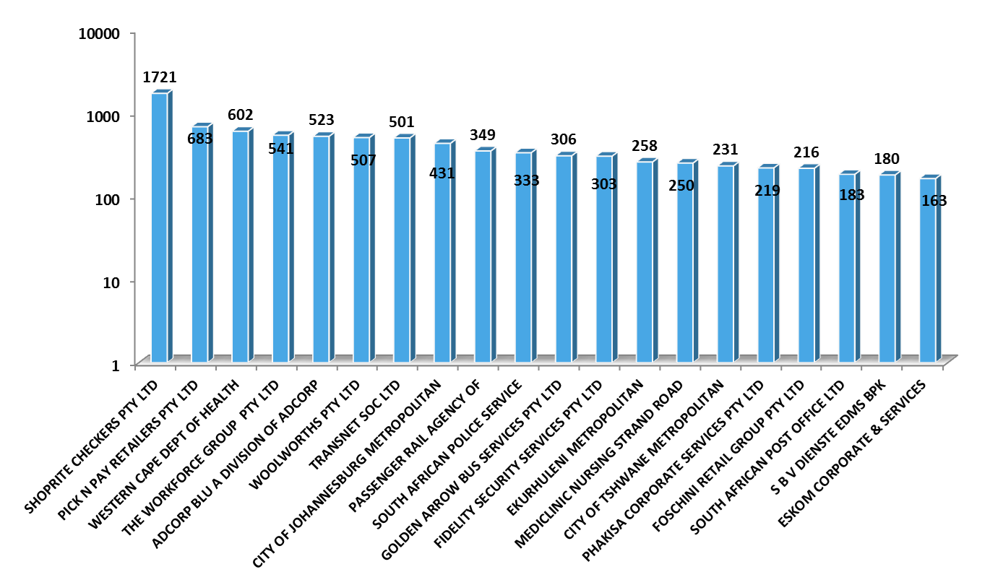
TOP 20 COMPANIES

Slide 38
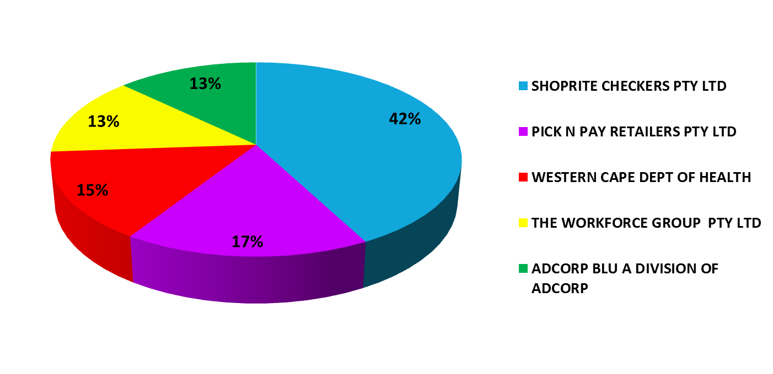
TOP 5 COMPANIES
The pie chats shows Shoprite Checkers contributing 42%

Slide 39
  PROGRESS ON BUDGET REVIEW AND RECOMMENDATION REPORT – 2017/18
RECOMMENDATION | PROGRESS
The performance information provided to the Portfolio Committee on Labour on a quarterly basis has been verified by Internal Audit and Audit Committee for credibility and completeness. | The Performance Information is verified by Internal Audit on a quarterly basis and the report is communicated to EXCO, Audit Committee as well as the Board.
The action plans to address challenges identified by the auditors are adequately implemented and regularly monitored, as well as holding staff accountable for poor performance and non-implementation or inadequate implementation of the action plans so as to prevent repeat findings. Internal audit and risk need to monitor the action plans and give regular feedback to the leadership on the progress of implementation and the adequacy thereof. | Internal Audit conducts the verification of Portfolio of Evidence submitted to support progress made in implementing actions in the CF Action Plan Phase 2 and the AGSA Audit Action Plan on a quarterly basis. The report generated from this high level verification will be reported to EXCO accordingly for corrective action and improvement where necessary.

Slide 40
  PROGRESS ON BUDGET REVIEW AND RECOMMENDATION REPORT – 2017/18
RECOMMENDATION | PROGRESS
The human resource capacitation project shifts focus from senior management services level to operational level so as to improve service delivery. | Capacity is addressed both through training interventions as well as creation and filling of posts necessary for fulfilment of the mandate of the Compensation Fund. Training interventions for employees below SMS from April - September 2018: A new organisational structure has been developed and implemented which addresses the capacity constraints on the core business areas of the Fund both at Head Office and at provincial office. In addition the recommendations of the Skills Audit are being implemented to train existing staff in areas where skills gaps were identified.
The Unemployment Insurance Fund and the Compensation Fund develop proper accounting systems and processes to accurately report on investments in terms of the required accounting standards. | The Compensation Fund has developed an SOP to ensure accurate reporting and consolidation of investments in terms of GRAP standards.

Slide 41
  PROGRESS ON BUDGET REVIEW AND RECOMMENDATION REPORT – 2017/18
RECOMMENDATION | PROGRESS
The Department regularly provides feedback on progress with cases referred to the South African Police Services (SAPS). | The Fund prepares an Investigations report on a monthly basis and this report is presented to the Risk Committee and the Audit Committee. It will be included in the presentations made to the Portfolio Committee on a quarterly basis.
The Department briefs the Committee on progress regarding the appointment of additional Client Service Officers (CSO) with special focus on UIF activities as well as CF focused CSOs. | The new CF Organisational Structure is catering for 268 CSO’s across all provinces. The process of recruiting the posts is dependent on the placement of the current CSO in provinces, followed by the advertisement of the vacant CSO’s posts that are outstanding.
The Department report back to the Committee on progress with the stabilisation of IT systems. | A new Online Claim system is being developed on SAP and the project commenced on 03 September 2018. It will take 52 weeks (until 31 August 2019) to complete the project. There are ongoing enhancements for the current claims system (Umehluko) claim system and SAP which are managed in the weekly operational meetings.

Slide 42

Compensation Commissioner
Thank You…

