Slide 1
INFRASTRUCTURE PROGRAMME
MEASURES TO DEAL WITH LOAD SHEDDING AT ENTITIES
Presented by: The Director-General
Date: 19 February 2019

Slide 2
OUTLINE OF THE PRESENTATION
PURPOSE OF THE PRESENTATION
BACKGROUND
LIST OF ENTITIES WITH/WITHOUT GENERATORS
CONCLUSION

Slide 3
PURPOSE OF THE PRESENTATION
The purpose of the submission is to outline the measures to deal with load shedding at the public entities of the Department.

Slide 4
BACKGROUND
The Department of Arts and Culture (DAC) has made funding available for the acquisition and installation of generators as a measure to deal with load shedding at entities.
The newly acquired generators function as the back up generators i.e. they kick-in during power outages and provide electricity for the lights, productions, etc.
Funds were also made available for upgrading existing emergency generators which provide only lighting during power outages, to back up generators .
In some cases, emergency generators require replacement rather than upgrading due to their condition.
It should also be noted that, in most cases, funding included fees to appoint an Engineer to check the suitable location to place the generator, design the structure to install the generator, draft the specifications according to the needs of the entity and monitor the service provider who will be responsible for the acquisition and installation.
The detail of which entities were funded, the amounts, financial years and the future commitments are outlined in the slides to follow.

Slide 5
LIST OF ENTITIES WITH/WITHOUT GENERATORS

Slide 6
Name of the Entity | Transferred funding for the generator/ and other projects | Financial Year Transferred | Commitment for the generator/ and other projects | Comments
Arts Cape Theatre | 14,000,000 | 2017/18 | - | Two back-up Generators were installed for the lights, Air-conditioning and productions and kicks-in during a power outage.
The Market Theatre Foundation | 3,658,000 | 2016/17 | - | There is an emergency generator for lights. For productions the City of Johannesburg provides the theatre with a temporary back-up generator. The Market Theatre Foundation is in the process of installing back-up generators.
PACOFS | 30,0000 | 2016/17 | - | The Theatre has an emergency generator for lights which needs replacement. Installation of a back-up generator will be part of the funded installation of the Heat Ventilation and Air-conditioning system project.

Slide 7
Name of the Entity | Transferred funding for the generator/ and other projects | Financial Year Transferred | Commitment for the generator/ and other projects | Comments
Play House Company | 17,488,406 | 2015/16,2016/17 and 2017/18 | - | Back-up generator was installed at the theatre and kicks-in during a power outages.
South African State Theatre | 2,500,000 | 2016/17 | - | Emergency generator was installed to cover emergency lighting and water pumps during a power outage. Funding was transferred to the entity to upgrade the existing emergency generator as a back-up
Afrikaans Taal Museum | 0 | - | 2019/20 R 581,000 | There is an emergency generator for lighting at the Historium building. Installation of an emergency generator for the monument is part of their 2019/20 Financial Year allocation

Slide 8
Name of the Entity | Transferred funding for the generator/ and other projects | Financial Year Transferred | Commitment for the generator/ and other projects | Comments
Iziko Museums of South Africa | - | 2012/13 | - | Generator was installed as part of the construction of the courtyard project and kicks-in during a power outage.
National English Literary Museum | - | 2014/15 | - | Generator was installed as part of the construction of new National English Literary Museum building and kicks-in during power outages. It was funded as part of the building.
Luthuli Museum | 0 | - | - | Back-up generator for lighting was funded and installed by the Department of Public Works (DPW) and kicks-in during power outages.

Slide 9
Name of the Entity | Transferred funding for the generator/ and other projects | Financial Year Transferred | Commitment for the generator/ and other projects | Comments
Kwa Zulu Natal Museum | 2,356,027 | 2014/15 | - | Back-up generator for lighting was installed by the Department of Public Works and kicks-in during power outages.
Msunduzi Museum | 10,000,000 | 2016/17 | 2019/20 R2,700,000 | Currently there is no generator, however, installation of a back-up generator is part of the restoration and upgrading of all buildings at the complex and security upgrade project that is underway.
National Museum | 500,000 | 2014/15 | - | Generator was installed and kicks in during power outages.

Slide 10
Name of the Entity | Transferred funding for the generator/ and other projects | Financial Year Transferred | Commitment for the generator/ and other projects | Comments
Nelson Mandela Museum | - | 2006/07 2013/14 | - | Generator was installed at Qunu building during construction and at the Bhunga building during the upgrading . Both generators kicks-in during power outages.
Ditsong Museums of South Africa | 5,000,000 | 2018/19 | - | Procurement of back-up generators is underway.
Robben Island Museum | 12,000,000 | 2015/16 and 2016/17 | - | 5 Generators were installed and kick-in during power outages. Electricity is generated on the Island and in addition there was a Solar system installed.

Slide 11
Name of the Entity | Transferred funding for the generator/ and other projects | Financial Year Transferred | Commitment for the generator/ and other projects | Comments
War Museum of Boer Republics | 500,000 | 2018/19 | 2019-2020 R4,380,000; R6,000,000 and R6,330,000 | Currently there is no generator, however, installation of a back-up generator is part of the replacement of the Fire suppression and Heat Ventilation and Air-conditioning system project that is underway.
William Humphrey Museum | 4,103,000 | 2018/19 | 2019/20 R17,000,000 | Currently there is no generator, however, installation of a back-up generator is part of the replacement of the Heat Ventilation and Air-conditioning system project that is underway.
South African Library for the Blind | - | 2010/11 | - | Generator was installed by Department of Public Works.

Slide 12
Name of the Entity | Transferred funding for the generator/ and other projects | Financial Year Transferred | Commitment for the generator/ and other projects | Comments
National Library of South Africa | - | 2008/09 | - | Pretoria Campus :Generator was installed as part of the construction of the National Library project and still Functional. Cape Town Campus Generator was installed by Department of Public Works.
Freedom Park | - | 2015/16 | - | Generator was installed during construction of Freedom Park and kicks in during power outages
National Arts Council | 400,000 | 2015/16 | - | Generator was installed and still Functional

Slide 13
Name of the Entity | Transferred funding for the generator/ and other projects | Financial Year Transferred | Commitment for the generator/ and other projects | Comments
National Film and Video Foundation | 0 | - | - | Generator was installed by the landlord , entity is occupying a leased building.
National Heritage Council | 0 | - | - | They don’t have a generator, entity is occupying a leased building.
South African Heritage Resources Agency | 0 | - | - | They don’t have a generator. Investigations to upgrade or relocate the entity are underway.
PANSALB | 0 | - | - | They don’t have a generator, entity is occupying a leased building.

Slide 14
PICTURES

Slide 15
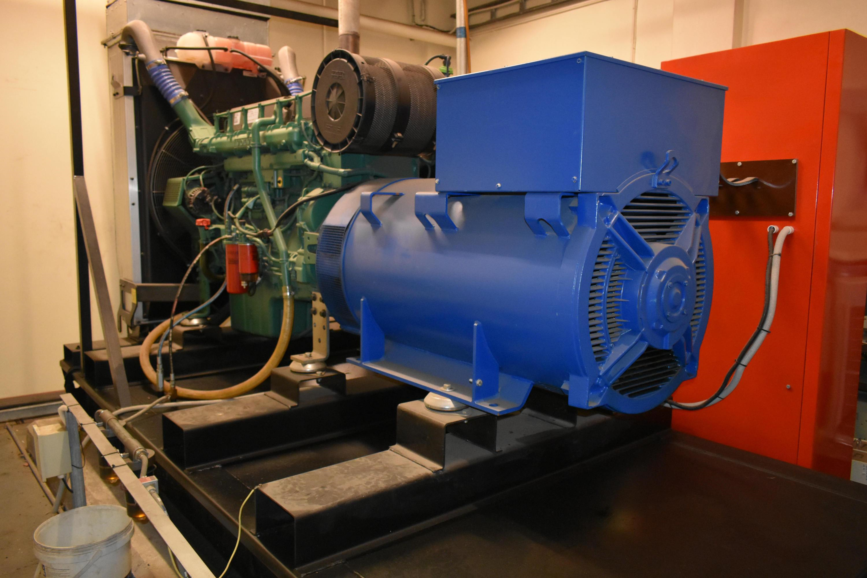
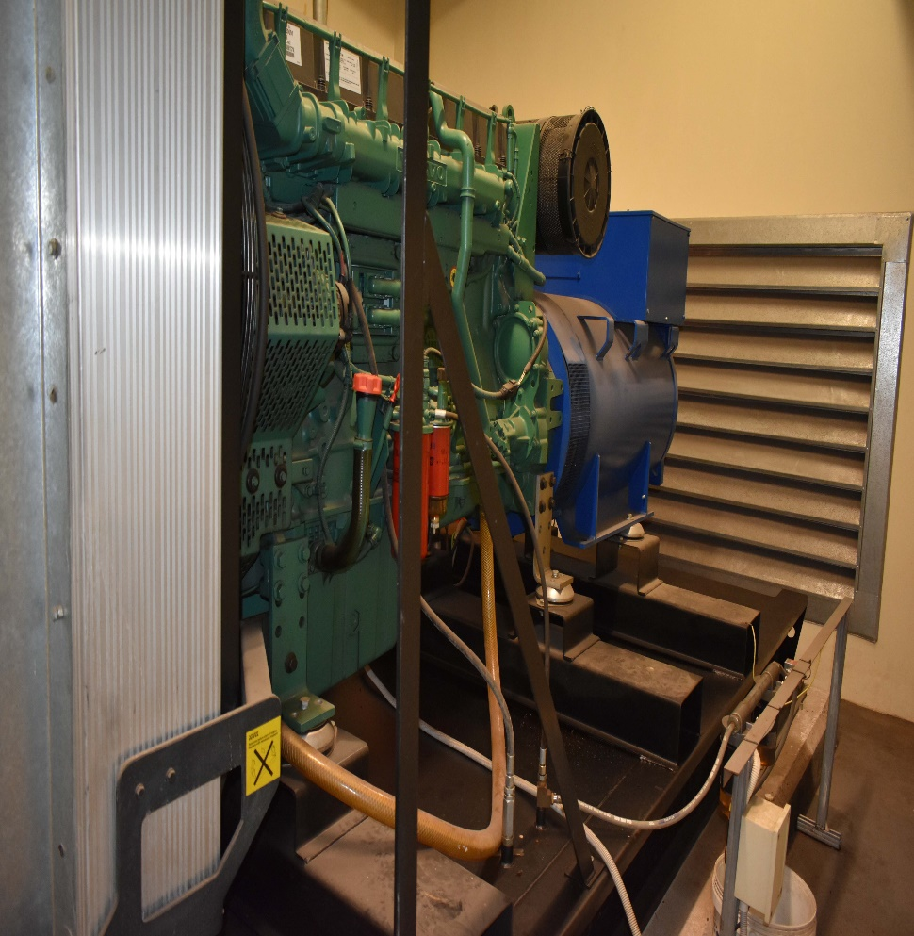
KZN MUSEUM

Slide 16
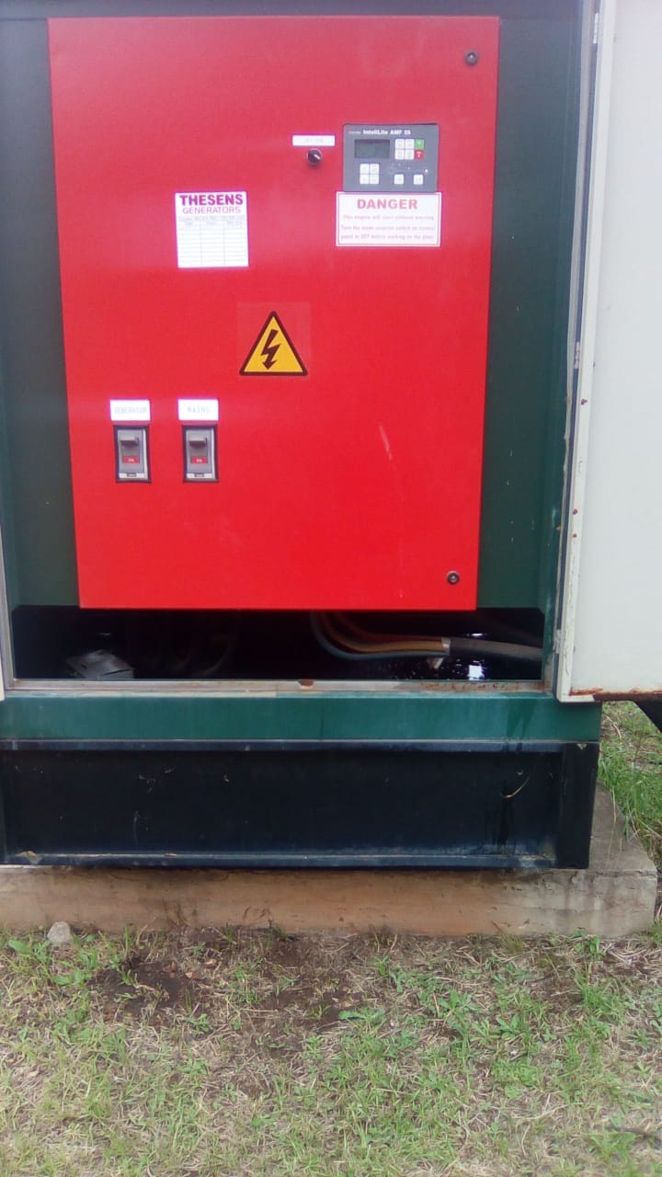
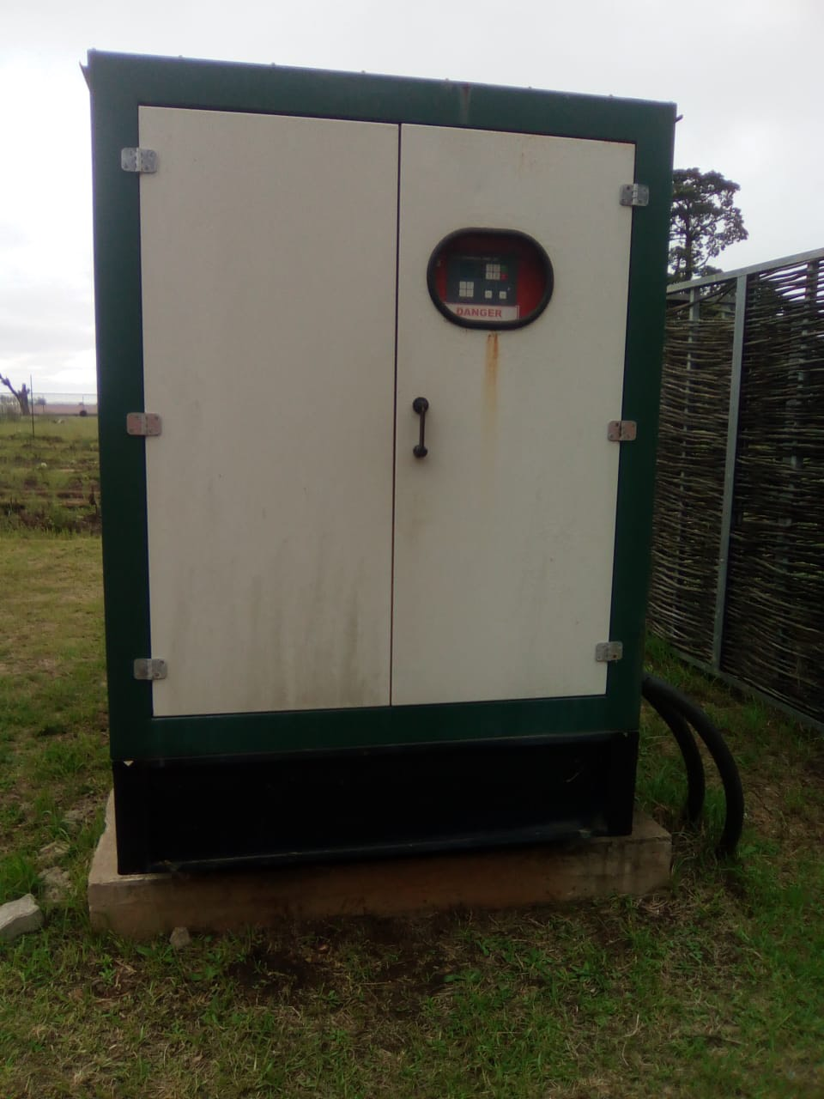
Nelson mandela museum

Slide 17
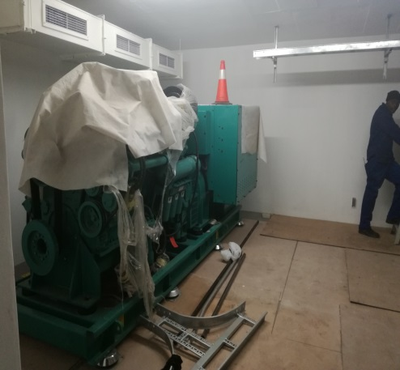
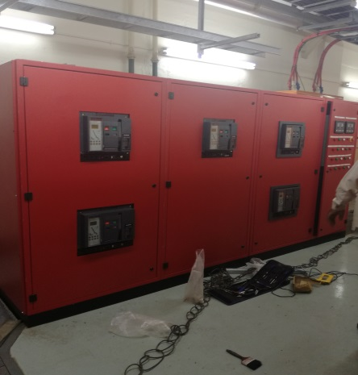
PLAYHOUSE COMPANY

Slide 18
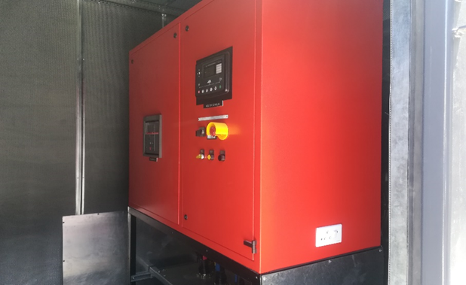
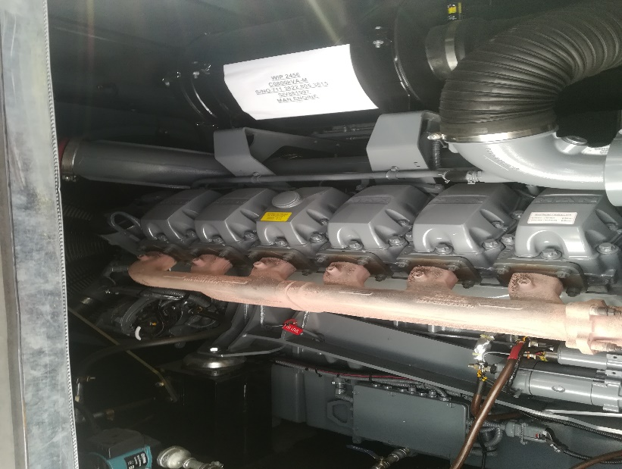
ARTSCAPE THEATRE

Slide 19
CONCLUSION
The funding of the upgrading, acquisition and installation of the back up generators is an ongoing process.
In some entities the generator forms part of the scope of work for bigger projects, especially in cases where there is a challenge of limited space and a need of services of a Structural Engineer.
It should be noted that the funding varies based on the size and the needs of the entity.

Slide 20
Thank you

