Slide 1
Public Service Graduate Recruitment Scheme Framework (GRSF) and Developmental Programmes
Public Service Portfolio Committee
13 February 2019

Slide 2
OUTLINE OF THE PRESENTATION
Problem Statement
Pre 2018 Implementation Context
Factors influencing the GRSF
Key Principles and Objectives
Overview of the GRSF
Definitions
Funding and Budgeting
Recruitment Remuneration and Duration
Monitoring and Evaluation
Challenges and Resources

Slide 3
PROBLEM STATEMENT (1)
The National Development Plan (NDP)-Vision 2030 made the following observations:
the public service faces a severe shortage of staff and specialised skills, especially in health, policing, infrastructure planning, engineering, finance and information technology. This adversely impacts not only front-line service delivery, but also the long-term planning and co-ordination.
The NDP observed that graduates and youth with potential struggle to identify how they can embark on a career in the Public Service, at the same time the Public Service struggles to fill junior positions in scarce occupations and critical areas of service delivery.
The NDP further observed that there is fragmentation, programmes are not widely known, weak coordination and poor reporting impeding a consolidated picture of the capacity of the state and measurement of the government spending on these programmes.
The NDP proposed a strategy to make the Public Service a career of choice by:
Attracting highly skilled graduates and young persons with potential, retaining and binding them,
Cultivating a sense of professional common purpose and commitment to working towards developmental goals.

Slide 4
PROBLEM STATEMENT (2)
To achieve the foregoing, the NDP recommends that the State:
Introduce a Formal Graduate Recruitment Scheme focused on:
Addressing challenges faced in implementation rather than at high-level policy formulation.
Co-existing with, rather than replacing, other recruitment routes in the public service.
Strengthening the talent pipeline for the Public Service’s future capacity, and be coordinated centrally.
The expected outcome was for the Public Service to have a well defined, transparent and shared strategy for recruiting dedicated young people and ensuring that their skills are developed and accompanied with career progression to ensure that they are retained in the service, … in the specialised areas they are primarily qualified in.

Slide 5
PRE-GRADUATE RECRUITMENT SCHEME FRAMEWORK 2014-2018
PRE-GRADUATE RECRUITMENT SCHEME FRAMEWORK DATA
2014-2018

Slide 6
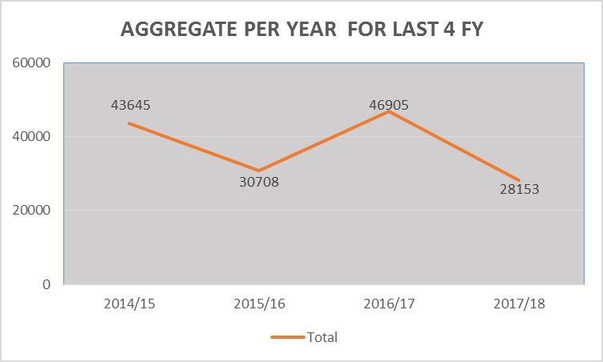
Overview of Public Service Implementation Data 2014/15 -2017/18

Slide 7
NUMBER OF CANDIDATES IN PROGRAMMES PER YEAR
Provincial/ National Departments | 2014/15 | 2015/16 | 2016/17 | 2017/18 | Total: 2014/15 –2017/18
Eastern Cape | 2 502 | 561 | 2 352 | 1 922 | 7 337
Free State | 2 243 | 2 275 | 1 364 | 2 370 | 8 252
Gauteng | 575 | 10 443 | 12 434 | 4 648 | 28 100
KwaZulu-Natal | 1 976 | 415 | 2 483 | 3 053 | 7 927
Limpopo | 2 849 | 2 835 | 3 281 | 3 193 | 12 158
Mpumalanga | 993 | 1 230 | 914 | 823 | 3 960
National | 9 658 | 6 241 | 13 189 | 9 165 | 38 253
Northern Cape | 217 | 289 | 496 | 327 | 1 329
North-West | 908 | 1 074 | 938 | 1 021 | 3 941
Western Cape | 1 368 | 2 482 | 3 211 | 1 631 | 8 692
NARYSEC | 20 356 | 2 863 | 6 243 | 0 | 29 462
Total | 43 645 | 30 708 | 46 905 | 28 153 | 149 411

Slide 8
KEY SECTOR IMPLEMENTATION OVERVIEW

Slide 9
FACTORS INFLUENCING THE DESIGN OF THE GRSF
Response to recommendations to increase the duration of the programmes to align with typical period required for appointment into permanent positions in the public service.
Increasing the chances of retention of talent and ensuring value for money.
Expanding the scope to include artisan development programmes and graduates recruitment schemes and Cadet programmes.
Elucidating some conditions of service applicable to participants in developmental programmes.
Giving effect to the objectives of the Strategy to turn the Public Sector Workplaces into a Training Space by accommodating the increased demand for work-integrated learning opportunities especially from the TVET Colleges System.
Aligning to the periods of internship requirements for the purposes of acquiring statutory professional registration.

Slide 10
KEY PRINCIPLES INFORMING THE DEVELOPMENT AND IMPLEMENTATION OF A GRADUATE RECRUITMENT SCHEME
Intends to build the capacity of the state ( specialist professionals, technical skills) which are scarce to find and produce.
Linked to demand – for retention capacity;
Based on an empirical need assessment (Demand and Supply Forecasting Model);
Affordable (no additional financial implications on the departments except for already planned costs of development and employment)
Has less legal implications (that which require amendments to legislation except for issuing of Directives/Determinations which are already provided for within the existing laws)
Has a considerable potential to respond to the developmental agenda of the country
Reduce unemployment, especially among designated groups, including youth, women and PWD
Eradicate poverty,
Reduce inequality, and
Improve service delivery

Slide 11
OVERVIEW OF THE DEVELOPMENT OF THE GRSF
G&A Working Session Feedback
At least 3 consultation sessions were held with the G&A Cluster Working Sessions at which the proposed Options were presented between June 2015 and August 2016
Stakeholder Consultations
13 Consultations Sessions held with National and Provincial departments and other relevant formations (April 2015 – February 2016)
Framework Approach Decision
Feasibility Study & the 3 Options
Three Options:
Option 1: Coordination of Departmental Scheme
Option 2:Centralised Recruitment, Decentralised Selection
Option 3: Central Graduate Recruitment Scheme
Decision adopted was a Framework approach focusing on creating an enabling environment, minimum norms, enhanced coordination, reporting, autonomy and accountability of departments.
Approval
Cabinet Approval December 2017;
Launch by the MPSA July 2018
Approval by MPSA December 2018;
Issued to departments in January 2019;
Implementation Phase Commenced in January 2019.

Slide 12
OVERVIEW OF LINKAGES AND RELATIONSHIPS
The Public Service Developmental Programmes and Graduate Recruitment Scheme Framework co-exist and contribute to other programmes of government and its social partners, which are intended to empower and create employment opportunities for the youth.
Youth Employment Accord (2013) Economic Development Department
Decade for Artisan (2013) Department of Higher Education & Training
Youth Employment Service (YES) Initiative (2018) Presidency/BUSA/DHET
National Youth Development Strategic Framework (2017) (NYDA/Presidency)
National Rural Youth Service Co-orp (NARYSEC) (2009) DRDLR
The Public Service Programmes deliver the single largest number in contribution to the national figures for youth development and employment creation as coordinated by the DHET; they are better coordinated and show continuous improvement year-on-year (data quality and impact), and they are supported a by legislated policy framework.

Slide 13
THE STRATEGIC OBJECTIVES OF PROGRAMME
To promote investment in strengthening departments’ talent pipeline for their future skills needs;
To encourage the contribution of the public service departments to the country’s youth developmental agenda;
To bring to effect the objectives of Skills Development Act and the National Skills Development Strategies.
The Skills Development Act, 1998, seeks to encourage employers, including the public service:
to use the workplace as an active learning environment;
to provide opportunities for new entrants to the labour market to gain work experience; and
to employ persons who find it difficult to be employed.
Encourage workers to participate in learnership and other training programmes; and
Improve the employment prospects of persons previously disadvantaged by unfair discrimination and to redress those disadvantages through training and education.

Slide 14
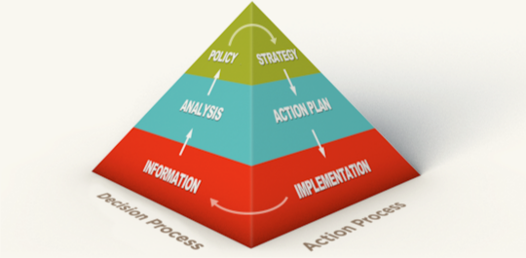
Objectives of the Framework
 | Provide a well-defined, transparent and shared approach with minimum norms to recruiting dedicated young people.
 | Strengthen the talent pipeline for the Public Service’s future capacity especially in Scarce occupations and critical areas of service delivery (Technical Skills and Specialist Professions).
 | Provide best-practice on existing graduate Schemes in the public service and the principles for implementation across the public service must be pursued. Enhanced coordination, governance and reporting, while maintaining the individual departments’ autonomy and accountability.
Enhance the image and competitiveness of public employment in the labour market and to improve professionalism in the Public Service

Slide 15
DEFINITION OF A GRADUATE
A Graduate means “A person who has successfully completed a course of study or training, especially a person who has been awarded an undergraduate or first academic degree or a diploma registered in terms of the National Qualifications Framework Act 67 of 2008.
OTHER CONSIDERATIONS:
The development pathway to an occupation is not always linear and it can follow different routes.
The public service occupies a unique position where it has no option, but to ensure maintenance of qualified and experienced personnel in its ranks at all times. It is in its best interest not only to recognise various occupational qualifying routes and stages and to wait for the market forces to produce the skills it requires, but seek to strategically influence the skills pipeline for its benefit.
School
Theory
Practical
Workplace
Assessment
Expertise

Slide 16
OTHER CATEGORIES AND DEFINITIONS
Graduate Internship | programme offered to a person who has completed a qualification and is unemployed but requires workplace experience in order to enhance future employment opportunities.
Internship programmes | a workplace or practical component that is required in addition to a general theoretical knowledge based qualification (offered by an institutional provider) in order to obtain registration as a professional or (be) licensed to practice upon completion of the programme.
Pre-service training (Work Integrated Learning - WIL) | programme offered to a person who is currently studying towards a higher education qualification and must undertake a period of work experience in order to fulfil the requirements of the qualification.
Candidacy Development Support Programmes | an internship linked to professional development, which is a requirement for professional registration with Professional Bodies or Councils.
Learnership Programme | a structured learning programme that combines theoretical learning with practical work experience which leads to a qualification registered on the NQF.
Learner | a person who is employed in the public service in terms of a learnership agreement or an unemployed youth who does not have any work experience in the field in which he or she is studying
Apprenticeship programme | a learning programme in respect of an officially listed trade, which includes a trade-test in respect of that trade.
Structured Youth Development Programme | a developmental programme for youth who have completed school-leaving certificate level (Grade 9 - Grade 12), seeking to be exposed to a workplace to be equipped a with the skills, attitudes, competencies and values needed to successfully carve a career in the public service or elsewhere in the economy.

Slide 17
THE PUBLIC SERVICE GRADUATE RECRUITMENT SCHEME FRAMEWORK: CONTEXTUAL CONSIDERATIONS
Bearing in mind that the mechanism to effectively deliver either of the GRSF options would depend on the creation of a centrally operated agency, however such would run against the decentralised human resource management approach of the public service. Secondly, the constrained economic position the public service finds itself in currently renders it unaffordable to pursue a centrally operated scheme.
For the selected option to be feasible the approach must be within the DPSA mandate for determining norms and standards for the development and implementation of department based Graduate Recruitment Scheme.
Graduate Recruitment Scheme: A programme to recruit and train graduates for specific roles or a programme to recruit and train graduates through a broader development programme, with assignment to specific roles on completion.

Slide 18
INTEGRATED TALENT DEVELOPMENT & MANAGEMENT STRATEGY SUPPORTING THE GRSF
Public Service
HRD Strategic Framework
Integrated Talent Development Management (HR Planning, Recruitment Policy = HRD Strategy)
Responsibility
Role
Quota allocation based on the vacancy rate within related occupations
Top Management
Decision on the Career Planning, Talent Development & Recruitment Strategy options
HRM (Recruitments)
Open recruitment
e.g. 80%
HRM (Planning & Recruitment) & HRD
Career Planning & Talent Management: maintaining constancy in the supply of skills by grooming and promoting talent internally
e.g. not exceeding 10% of the vacancy rate within related occupational category
Human Resource Development & HRM (Planning Recruitments)
Promoting Developmental Programmes including Learnerships, Internships, Traineeships & Graduates Recruitments Programmes
e.g.. not exceeding 10% of the vacancy rate within related occupational category

Slide 19
INTEGRATION OF CAPACITY BUILDING PROGRAMMES
Capacity for Technical Skills & Specialist Professions
Investing in the development of talent pipeline for current and future skills needs for government and the economy at large
Creating Employment
Graduate Recruitment Scheme
Directive/Circular on the waiver of Minimum Work Experience for appointment into entry level posts in the Public Service
Directive on the appointment of persons into Developmental Programmes in the Public Service

Slide 20
PROCESS FOR IMPLEMENTING AND ROUTES TO GRADUATE RECRUITMENT SCHEME
The Public Service Human Resource Development Strategic Framework underpins the Integrated Talent Development and Management, encompassing all Developmental Programmes and Graduates Recruitment Scheme
Graduate Recruitment Framework
(this document provides minimum generic elements of the scheme )
Minimum Generic Elements of Graduate Recruitment Scheme
Recruitment
Career Fairs
Campus Visits
Advertisements
Open manual & online applications
Screening
Psychometric & Aptitude assessments
Language, numeracy assessments
Selection
Information Sessions
Group Interventions
1-on-1 Interviews
Final Selection
Placement
Induction
Offer of employment
Training
Job Rotation
Mentoring & Coaching
Department A
Department B
Department C
Department D
Department E
GRS
GRS
Cadet Programmes
Bursaries
Learnership
Bursaries
Learnership
Apprenticeship
Internship
Internship
GRS
Internship
Apprenticeship
Bursaries
Cadet Programme
Traineeship

Slide 21
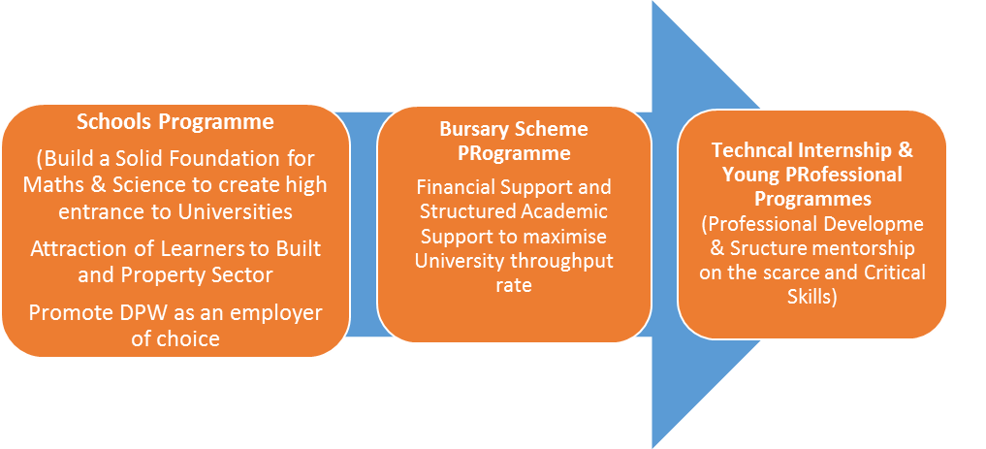
EXAMPLE OF A DEPARTMENTAL SKILLS PIPELINE INTERVENTION STRATEGY

Slide 22
THE GRSF PROFESSIONAL PIPELINE
School
Workplace
Assessment
Experts
Theory
Management
Retired-Active
School
(MSE)
Higher
Education
Candidacy
Retired Inactive
Registered
Experienced
Expert
Education and Training
Professional Practice
Basic Education
Professional Formation
Professional Practice
Complete Basic Education with relevant subjects Math, Natural Science/Geography, Life Science Accounting Economics & English
Stage 1:
Complete Relevant Tertiary Education Stream/
Faculty
Stage 2:
Complete Registration Requirements
Experienced for International Registers
Expert:
Shows Leadership in field
Management
Manages enterprise dependent on technical/skills
Practitioners contribute after normal retirement
Entry Level & Foundation
Entry Level & Focus of the GRS In the Public Service
Career Progression , Retention & Mentorship Capacity
Mentorship Capacity

Slide 23
FUNDING & DURATION OF THE GRADUATE RECRUITMENT SCHEME
A Head of Department shall ensure that sufficient funds are available to implement a departmental Graduate Recruitment Scheme including its associated costs.
Where a national department initiates and leads a Graduate Recruitment Scheme targeting a sectoral and/or occupational category, budgetary arrangements shall be made in consultation with each of the affected executive authorities prior to the implementation of the scheme.
Where available and appropriate, the department may utilise the skills levy from a Sector Education and Training Authority (SETA) or donor funds to establish and operate a Graduate Recruitment Scheme.
The duration shall not exceed forty-eight (48) months : this shall include training component, orientation, assistance with preparation for professional registration (where applicable) to a point where the candidate meets the minimum requirements to be appointed to the entry level position in terms of the occupation involved.

Slide 24
BUDGETING CONSIDERATIONS
In preparing a budget for implementing the developmental programmes, the department shall take into account the following costs:
Monthly stipend or allowances;
Targeted training for candidates offered by National School of Government and other institutions;
Personal and/or Further Development Programmes;
Reasonable Accommodation as regulated by the Policy and the Determination on Reasonable Accommodation and Assistive Devices for employees with disabilities in the Public Service (2015);
Pre-employment verification as prescribed in Section 57 (3) of the Public Service Regulations 2016;
Possible extension of contracts as a result of approved leave taken during the internship contract due to incapacity and/or leave for occupational injuries and diseases, paternity and maternity leave.

Slide 25
RECRUITMENT & SELECTION OF CANDIDATES INTO A GRS AND RETENTION INTO PERMANENT POSITIONS WITHIN THE DEPARTMENT
The intention is to retain these candidates in the public service, for the medium to long term.
An executive authority shall ensure that all opportunities for developmental programmes within his/her department are advertised in terms Regulation 65 and the Selection thereof shall be in terms of Regulation 67 of the PSR 2016 respectively.
Unsolicited (ad hoc) applications for developmental programmes may only be accepted without following the above procedure under the following conditions:
The duration of the programme does not exceed six (6) consecutive months;
The applicant submits a verifiable and valid proof that he/she requires the work-integrated learning (WIL) opportunity as part of a recognised learning programme and/or for a professional body assessment purposes;
the terms and conditions as agreed between the participant and the department is recorded in writing;
At the completion of the training and orientation components of the graduate recruitment and development programme, and the expiry of the regulated period of the programme, the candidate must be exited and retained into another employment capacity.

Slide 26
DURATION OF THE EMPLOYMENT
PROGRAMME | DURATION
GRADUATE INTERNSHIP PROGRAMME:
for acquiring experience only | Pre-determined fixed timeframe not exceeding twenty four (24) months
for meeting statutory requirements for professional registration | As per the requirements of the relevant recognised body, but not exceeding forty-eight (48) month Where the additional once –off opportunity to re-write or meet the council examination/ requirements falls outside the regulated period, the HOD shall extend the contract, on the same conditions of service as existed before, by not more than one (1) year
for structured programmes such as departmental graduate recruitment schemes /cadet programmes | A period not exceeding forty-eight (48) months
Student internship programme | Pre- determined period not exceeding 24 months
Learnership programme | Specified period exceeding 24 months i.e. linked to the Qualification
Apprenticeship programme | Period specified in the apprenticeship registration documents as per the Skills Development Act 2008 as amended.
No Extensions of contract, except where it is to accommodate leave of absence taken for purposes of paternity, adoption, maternity, incapacity and occupational injuries and diseases and/or where the provision of reasonable accommodation and assistive devices were delayed.

Slide 27
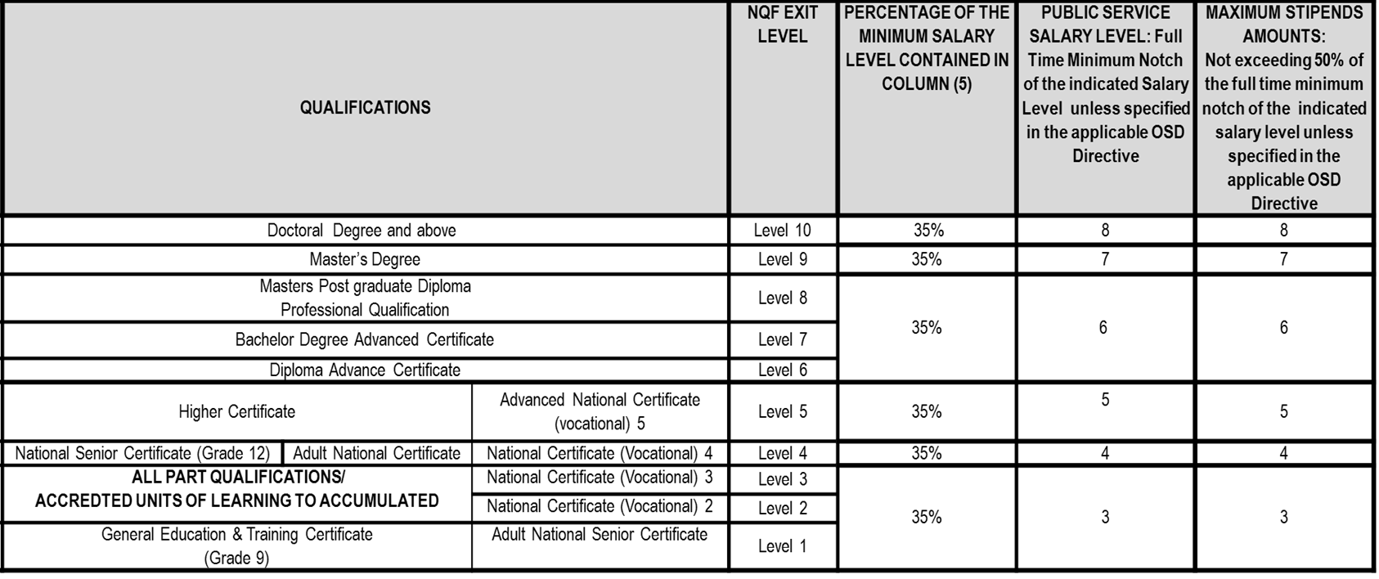
REMUNERATION

Slide 28
EXIT MANAGEMENT
For the purposes of enhancing the work of the department and to respond to the demand for scarce and critical skills, the head of department may retain a suitable candidate/s into an entry level vacant permanent position/s or contract with due consideration to the department`s approved Human Resource Plan.
A vacant entry level post shall be advertised at least internally within the department for fair, open and equitable competition among existing employees, in posts at lower levels and candidates involved in the programme.

Slide 29
MONITORING, EVALUATION AND REPORTING (1)
The Department of Public Service and Administration shall monitor:
the number of Schemes established and operating in the Public Service;
the occupational categories these Schemes are recruiting,
the number of beneficiaries participating in the programme during each financial year;
the rate of retention into the departments and/or the entire system,
the cost of the programme, and
the accessibility and methods used in communicating the programme to the general public.
The reporting on all graduate recruitment Scheme shall be in terms of the Public Service Regulations (2016) Chapter 3, Part 1, Section 28 on the Human resource Development Plan.

Slide 30
MONITORING, EVALUATION AND REPORTING (2)
The DPSA shall:
monitor implementation and compliance of the programme on a quarterly and annual basis;
evaluate the efficiency, effectiveness and the impact of the programme every three years, with recommendations and improvement plans submitted to departments
Persons on experiential learning shall maintain a logbook approved by the institution of learning at which the individual is registered.
Persons on a developmental programme linked to statutory requirements for professional registration purposes, shall present to the employer the requirements from the relevant professional body.
The pre-employment verifications as prescribed in terms of Regulations 57(3) and 57(1)(c), PSR 2016 must be conducted prior to the appointment of all persons into these development programmes.
Departments shall capture and report details of the persons on development programmes using the requisite fields in PERSAL.
Departments shall use prescribed reporting templates issued by the DPSA.

Slide 31
GRS IMPLEMENTATION ROAD MAP: Moving forward
Test the efficacy of the provisions of the Graduate Recruitment Scheme Framework in the Public Service departments and some Local Government Institutions.
Envisaged Target Groups:
Graduates meeting minimum requirements for employment into the public service areas of service delivery;
Candidates with potential, but who do not have minimum requirements for appointment, especially into regulated occupations, are supported to meet the requirement through the necessary programmes, including candidacy support programmes.
Partnership Approach with Departments and institutions that:
employ large number of homogeneous occupations,
have labour intensive operations,
that require specialised skills and specialist professions, a
a mandate to build capacity in the municipalities.

Slide 32
ROLL OUT IMPLEMENTATION PARTNERS
The following departments have shown interest in implementing the GRS Framework:
National Treasury;
KZN Provincial Treasury;
Western Cape Provincial Treasury;
National Department of Public Works;
KZN Provincial Department of Human Settlements;
Mpumalanga COGTA & MISA;
Mpumalanga Department of Public Works, Roads and Transport;
Northern Cape Provincial Treasury;
Mpumalanga Provincial Department of Health;
Limpopo Provincial Treasury;
South African Police Services; and
Department of Water and Sanitation.

Slide 33
CURRENT AND PLANNED PROJECTS OF PARTNERS (1)
Department | Current (2018-19) | Budget (Million) | Planned intake (2019-20) | Budget | Other partners
National Treasury | 66 | R6m | 120 | R18,069,881 | KZN Treasury, Northern Cape, Western Cape, Eastern Cape Treasury and associated municipalities within the respective provinces. Accounting Technician, General Internal Auditor and Professional Accountancy.
National Department of Public Works | 418 | R66,3m | 239 | R11,5M | Nationwide (incl. female only electrical engineers programme – KZN)
KZN Department of Human Settlements | 49 | R12,132,109 | 11 | R2, 019,138 | Built Environment
Mpumalanga COGTA & MISA | 47 | R1,536M | 13 | R1M | Town & Regional Planning
Mpumalanga Department of Public Works, Roads and Transport | 184 | R4,951M | 34 | R1M | Gert Sibande, Kangala, Bohlabelo & Ehlanzeni Municipalities.

Slide 34
CURRENT AND PLANNED PROJECTS OF PARTNERS (2)
Department | Current (2018-19) | Budget (Million) | Planned intake (2019-20) | Budget | Other partners/Comments
Water and Sanitation | 162 | R61M | 40 | R15M | Dams, Laboratories nationwide Engineering, Water Economics, Water related Sciences(Hydrology, Surveying & QS)
KZN Department of Public Works | 32 | R1,440M | 37 | R1,755M | Built Environment
Limpopo Treasury | 48 | R3,3M | 45 | R3,3M | Vhembe, Molemole & Capricorn Municipalities.
Mpumalanga Department of Health | 271 | R72M | 366 | R100M
Total | 1528 | R168,989,109 | 1127 | R151,644,021

Slide 35
CHALLENGES
The removal of annual implementation targets (5% of fixed staff establishment per annum) in the amendment of the PSR (2016);
Cuts in Compensation budgets leading to reduction of intake;
Under-reporting by departments. Focus on support rather than core areas;
Lack of electronic reporting systems;
Inability in departments to align with/incorporate HRD interventions in departmental overall recruitment strategy and lack of talent development and retention strategies;
The barriers between spheres of government. National and provincial departments do not always have physical space to accommodate and absorb persons on developmental programmes, whereas municipalities often have space, and too often are found to be unable to attract and retain talent. So partnerships could be established;
Departments with direct front line service delivery centres could be better utilised in accommodating persons on developmental programmes, since there are challenges in many areas, i.e. administration of patient files in health care facilities

Slide 36
RESOURCE ALLOCATION
In comparison to some of the examples of similar programmes listed below, the PS programmes has less budgetary allocation to undertake these programmes.
Against this context the role of the DPSA, is limited to advice, policy making and monitoring and evaluation.
NAME | ORGANISATIONAL CONFIGURATION | FUNDING
YES Secretariat | Independent organisation | R6,3m seeding amount
NYDA | Independent organisation
Youth Employment Accord Secretariat (EDD) | Chief Directorate
NARYSEC | Chief Directorate
DPSA HRD Chief Directorate | Chief Directorate Responsible for overall Public Service HRD Strategic Framework and policy of which GRS & Youth Development programmes are but just 2 of 17 other areas. | R800,000.00 p.a

