Slide 1
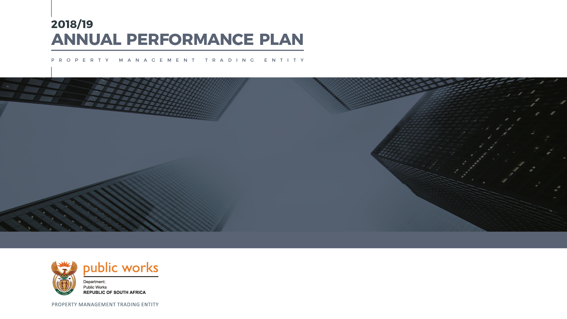
Date: 06/02/2019
HON TW NXESI, MP
Minister of Public Works
Presentation to Select Committee on Petitions and Executive Undertakings

Slide 2
CONTENTS
DEPLOYMENT OF VACANT STATE LAND AND BUILDINGS IN THE PROVISION OF STUDENT ACCOMMODATION
LETTING OUT AND ECONOMIC EMPOWERMENT
MAINTENANCE STRATEGY

Slide 3
“We have now started serious talks with the Minister Nzimande (Minister of DHET at the time) and which the various landlords around how they can utilise their properties. How can we make them utilise our empty buildings in order to accommodate the students at the various universities? It is a very huge project and we think that it will work”
A: DEPLOYMENT OF VACANT STATE LAND AND BUILDINGS IN THE PROVISION OF STUDENT ACCOMMODATION
SECTION A

Slide 4
1. PMTE BUSINESS MODEL
REAL ESTATE INFORMATION
&
REGISTRY
DETERMINE
IMMOVABLE ASSET MANAGEMENT STRATEGY
REAL ESTATE
INVESTMENT
PLAN / ACQUIRE / DISPOSE
CONSTRUCTION PROJECT MANAGEMENT
PROPERTY
MANAGEMENT
REAL ESTATE MANAGEMENT
OPERATE
(LEASES)
FACILITIES MANAGEMENT
MAINTAIN
EXECUTE:
PROVIDE ACCOMMODATION
Finance
Supply Chain Management
PMTE Operationalization through Business Process Review

Slide 5
2. REMS OPERATING ENVIRONMENT
State: R4,3 billion
Other: ±R20/30 million
DISPOSALS
Letting OUT
Our mandate
ACQUISITIONS
Lease to own
Short term leasing
Out-right purchase
BoT
PROPERTY PAYMENTS AND ADMINISTRATION
Utilisation
Client Billing
Property Payments
R4,5 billion
The REMS balance sheet
Rates and taxes: R1,3 billion
Lights/ water and utilities: R4,3 billion
REMS
total leased in | 2566
Total valid | 1846
Total expired | 720
Total vacant state owned | 5720
Total occupied by user deps. | 88 300
Total let out privately | 1270
Total illegally occupied | 1300
Debit | Credit
User Charges R4,5 billion | Rates and Taxes R1,3 billion
Leasing reimbursement from users R4,5 billion | Landlords (creditors) R4,5 billion
Lights and Water R1,3 billion | Lights and Water R1,3 billion
Letting OUT(revenue) R31 million
R10, 331 billion | R7,1 billion
 | Surplus R3,231 billion
The extent of our work

Slide 6
3. REMS OPERATIONS
Acquisitions and leasing IN
Provision of suitable functional accommodation for client departments Leasing in (Short-term) Build Operate and Transfer (Permanent solution) Out-right purchase (Permanent solution) Lease to own (Permanent solution) Ensure the efficiency in acquiring properties Acquisition Framework Implementation of the Property Empowerment Policy Establishment of a panel of landlords Establishment of proper governance processes 4. Expedited lease renewal and negotiation
State Owned and Disposals and Letting OUT
Management of state owned property occupied by: Private tenants User departments Management of vacant state owned properties Letting OUT Other forms of disposal Marketing of vacant state owned properties
Property Administration and Payments
Administration and payments of the following services: Rates, Municipal services, Lease rentals, Shared Savings, Day to day maintenance, Cleaning & Gardening; and Security services Resolve disputes and disconnection of services by suppliers such as municipalities, Eskom General administration Management of illegally occupied properties 4. Property ownership verification REMS operations and manages an estimated R9 Billion in collections (receivable) and R7 Billion in payments

Slide 7
4. VACANT SURPLUS PROPERTY
 | Vacant Land/Farms | Office | Residential | Airstrip
Bloemfontein | 401 | 95 | 107 | 0
Durban | 786 | 3 | 56 | 0
Cape Town | 2103 | 7 | 47 | 0
Johannesburg | 142 | 4 | 12 | 0
Kimberly | 1233 | 16 | 3 | 0
Nelspruit | 153 | 0 | 3 | 0
Port Elizabeth | 289 | 9 | 105 | 1
Polokwane | 8 | 0 | 23 | 1
Pretoria | 52 | 1 | 10 | 0
Mmabatho | 17 | 0 | 0 | 2
Umtata | 3 | 7 | 21 | 0
TOTAL: | 5187 | 142 | 387 | 4
GRAND TOTAL: |  |  |  | 5720
NOTE:
Verification of surplus properties remains a continuous exercise;
The number of surplus properties might increase as verification unfolds;
Reconciliation and migration of data between PMIS and Master database continues;
REMS is instituting systems and measures to identify Bona Vacantia properties.

Slide 8
5. BACKGROUND AND SUMMARY
  Based on discussions in 2016, the Department engaged the Department of Higher Education and Training (DHET) with the intention of supporting the drive to resolve the crisis relating to insufficient student accommodation throughout the country.
  This would focus specifically on the Post School Education and Training (PSET) sector and institutions.
  Vacant state land and property portfolio was identified as an instrument that might be put to good use towards meeting the accommodation requirement whist stimulating the economy insofar and construction and refurbishment of facilities was concerned.
  Under governance of an interdepartmental Memorandum of Agreement, it was also resolved that a Joint Task Team (JTT) of officials from both Departments would be established to be responsible to coordinate the process of the “acquisition” of immovable state-owned assets for the PSET Institutions.

Slide 9
6. THE DHET SCOPE REQUIREMENT
  The country has a total of 24 universities situated on 223 campuses.
  For the Technical and Vocational Education and Training College (TVET) sector, there are also 60 colleges situated on 250 campuses.
  The total requirement determined by DHET, as principal custodian for the project, is for a total of 300 000 beds i.e. accommodation for 300 000 students, aggregated as follows:
    Universities: accommodation for 200 000 beds: and
    TVET colleges: accommodation for 100 000 beds
  The first phase of the project, has been identified as comprising of 12 institutions situated on 66 campuses, namely University of the Free State, University of Johannesburg, University of the North West, University of Venda, University of the Western Cape, University of the Vaal, University of Tshwane, University of Zululand, University of Nelson Mandela, King Hintsa TVET, Sefako Makgatho Health Science University and Motheo TVET College.

Slide 10
7. WHAT HAS BEEN DONE?
2016 - An interdepartmental task team was established to facilitate the process of availing vacant, surplus state owned properties.
2017 – a draft MoU was finalised and signed by DPW
2017 – DPW identified properties in (burning) areas where the DHET indicated a need for student accommodation.
  The list of properties was handed over to DHET for consideration.
  Of the 68 DPW properties, approximately 25 are vacant land and the remainder are vacant apartment buildings and stand-alone houses mainly vacated by government departments. These are illustrated per Province as follows:
No | Province | Properties | No | Province | Properties
1 | Eastern Cape | 13 | 2 | Gauteng (JHB) | 1 Apartment block
3 | Kwa-Zulu Natal | 21 | 4 | Gauteng (PTA) | 1 Apartment block
5 | Limpopo | 8 | 6 | Free State | 1 Apartment block
7 | Western Cape | 2 | 8 | Mpumalanga | 4
9 | North West | 17

Slide 11
7. WHAT HAS BEEN DONE?
  Site visits to the sites identified by DHET and those identified DPW have been finalised for 7 of the 12 prioritised institutions.
  17 feasibility studies are due for completion by March 2019 informing the viability of solutions.
Delays:
Change in administration both DPW and DHET: 2017
Focus shifted towards the transfer of land for human settlement, developing forest villages (through inter governmental partnerships on bulk services, infrastructure and other basic services) and rural development)
Finance and sustainability model (including compensation framework) to inform the basis on which State assets are deployed to the programme is not yet fully developed impacting on the implementing of quick-win projects.

Slide 12
8. METHODS TO ADDRESS STUDENT ACCOMMODATION
State Intervention:
Re-establishment of inter-departmental task team: February 2019
Confirmation of properties required by DHET: February 2019
Finalisation of Memorandum of Understanding with DHET: March 2019
Discussion of funding options for the refurbishment, renovation, property and facilities management of securing of identified property: Student Accommodation Task Team, DPW, DHET and NT
  PPP
  Build Operate and Transfer
  Outright purchase

Slide 13
8. METHODS TO ADDRESS STUDENT ACCOMMODATION
Technical capacity:
The departments’ professional services has a basket of technical skills including, but not limited to:
Architects,
Town Planners,
Quantity Surveyors,
Project Managers,
Trained artisans,
Engineers and Managers etc.
These professionals can be availed to perform the required functions for all refurbishment, renovation or development projects.

Slide 14
8. METHODS TO ADDRESS STUDENT ACCOMMODATION
Private sector investment:
Letting out of surplus state owned properties for redevelopment and development into student accommodation
  Advertising: February 2019
  Award: June-August 2019
In consideration of the urgent need for student accommodation, the department will prioritise proposals for the development of student accommodation in areas near higher education institutions;
These proposals will be evaluated based on their value add in relations to the provision of student accommodation.

Slide 15
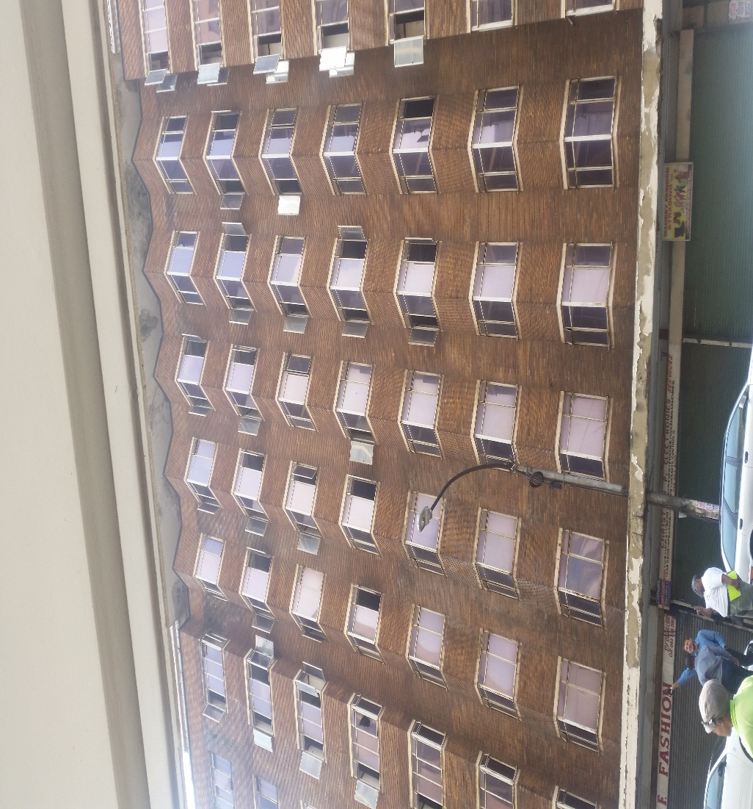
9. DESIRED IMPACT
Braamfontein: close proximity to WITS, UJ
Impact | NDP 2030: Chapter 9 - 61
Contribution the provision of safe, secure, affordable and functional accommodation for students | Complete the construction of two new universities in Mpumalanga and the Northern Cape; new medical schools in Limpopo and a number of academic hospitals; expand the infrastructure of existing institutions and allow all universities to use of distance education to reach more learners.
Revenue generation through letting out
Securing vacant surplus state owned properties

Slide 16
“The PMTE will also provide opportunities for letting some of the vacant properties to the public and private sectors, in particular, availing properties to emerging black and female entrepreneurs”.
B. LETTING OUT AND ECONOMIC EMPOWERMENT
SECTION B

Slide 17
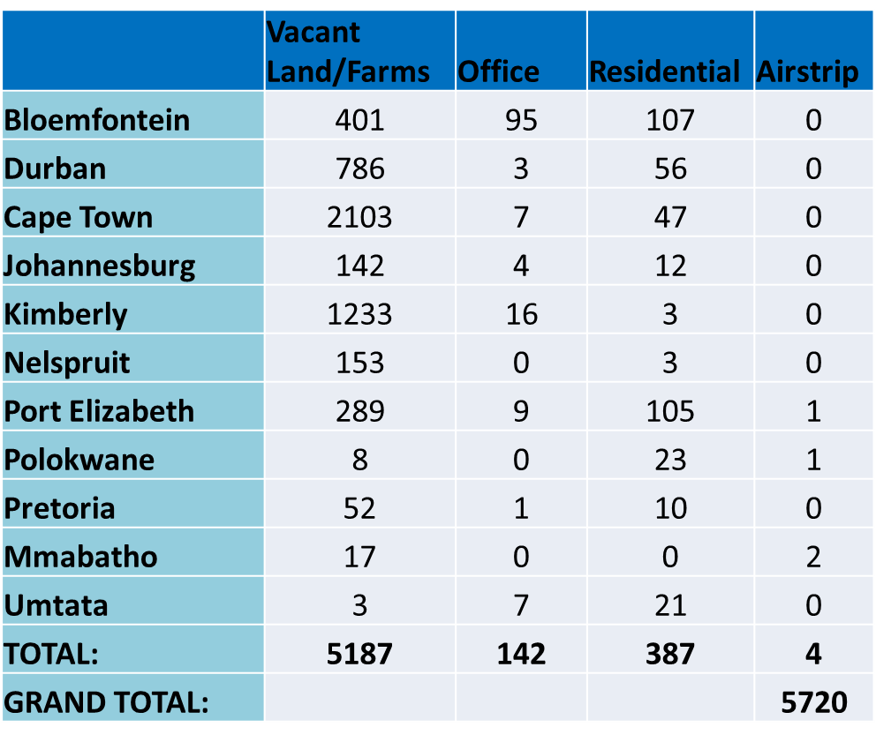
1. VACANT SURPLUS PROPERTY

Slide 18
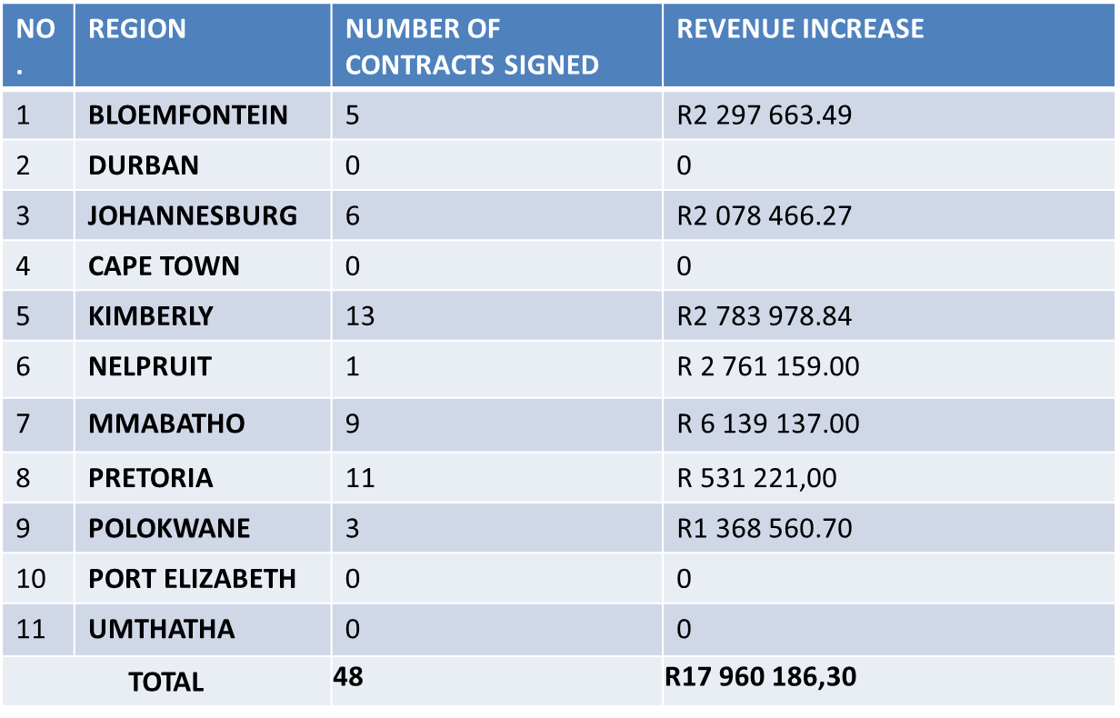
2. WHAT HAS BEEN DONE?
TOTAL OF 757 PROPERTIES LET OUT 48 LEASES CONCLUDED IN 2018/19
REGION | NUMBER OF LET-OUT
Bloemfontein | 47
Durban | 125
Cape Town | 145
Johannesburg | 54
Kimberly | 151
Nelspruit | 48
Port Elizabeth | 36
Polokwane | 36
Pretoria | 67
Mmabatho | 39
Umtata | 9
Total | 757
INCREASE IN REVENUE

Slide 19
3. WHAT HAS BEEN DONE?
LETTING OUT:
A list of surplus properties has been finalised for letting out
The department is in the final stages of internal and final approval of the Disposal Framework, by our DG and NT respectively
provincial workshops have been conducted to prepare for the advertising of surplus property
An Interim internal circular has been drafted to ensure that the approval process does not affect the planned activities to advertise properties to the public.
PERMANENT DISPOSAL:
The department is in discussion with the Provincial Department of Public Works to determine the process it followed in approving a permanent disposal process for surplus residential properties

Slide 20
3. WHAT HAS BEEN DONE?
  DISPOSAL FRAMEWORK: LETTING OUT
  Principles are aligned with the section 217 of the Constitution of RSA
  Framework covers:
    Renewal, renegotiation and review of the existing leases
    Evaluation and adjudication of the backlog applications
    Advertisement of the surplus properties
    Standardisation of the letting out process;
    Issuing long term leases appropriate for different types of businesses; and
    Empowerment of black owned and local businesses through radical economic transformation measures and set-asides.

Slide 21
3. WHAT HAS BEEN DONE?
CATEGORISATION OF APPLICATION TYPES:
EXISTING TENANTS
A special once off dispensation to clear the backlog of applications to be put in place;
A request for proposal (RFP) shall be published to invite existing tenants to apply for the renewal of lease contracts;
Invitation to renewal of lease will apply to the following tenants:
PREVIOUS APPLICANTS
A special once off dispensation to clear the backlog of applications to be put in place;
A request for proposal (RFP) shall be published to invite previous tenants to re-submit their applications as the specifications of the RFP;
NEW APPLICANTS/ INTERESTED INVESTORS/TENANTS
An invitation to submit RFP shall be published through an open tender process;
Invitation will be applicable to listed properties on National Public Works Website (www.publicworks.gov.za) and other mediums of communication.

Slide 22
2. COMMERCIAL DEVELOPMENT AND LETTING OUT PROGRAMME
4. PREPARATION FOR THE LETTING OUT OF STATE OWNED SURPLUS PROPERTIES
NEW LETTING OUT FRAMEWORK
Investor / Tenant Classification (Based on Annual Turnover):
Micro Enterprises: Tenant/Investor with an Annual Turnover of Less than R1m;
Very Small Enterprises: Tenant/Investor with an Annual Turn-over of ≥R1m and < R10m;
Small Enterprises: Tenant/Investor with an Annual Turn-over of ≥R10m and < R50m;
Medium & Large Enterprises: Tenant/Investor with an Annual Turn-over of >R50m.
Proposals will be evaluated according to the size of the business to ensure a fair and equitable process

Slide 23
4. PREPARATION FOR THE LETTING OUT OF STATE OWNED SURPLUS PROPERTIES
DISPOSAL FRAMEWORK: LETTING OUT
TENANT RENTAL CALCULATIONS ALIGNED WITH RFP
  Micro Enterprises (Annual Turnover Less than R1m): Fixed monthly rental amount to be not less than the base rental rate. An annual escalation rate which is equal to prime rate plus 4% shall apply to these Tenants.
  Rentals for Towers, Billboards and Servitudes: Fixed monthly rental amount to be not less than the base rental rate. An annual escalation rate which is equal to prime rate plus 4% will shall apply to these Tenants
  All Other Tenants: A rental payment model based on a base rental rate plus a Revenue Share Model (% of Revenue) shall apply to these Tenants.

Slide 24
2. COMMERCIAL DEVELOPMENT AND LETTING OUT PROGRAMME
4. PREPARATION FOR THE LETTING OUT OF STATE OWNED SURPLUS PROPERTIES
NEW LETTING OUT FRAMEWORK: RADICAL SOCIO-ECONOMIC TRANSFORMATION
An empowerment strategy focussing on creating business opportunities for women, persons with disabilities, youth and employment potential for the disadvantaged local communities
Job creation, demands of localization, use of SMME suppliers and employment of local communities has been included as requirements for all new proposals
There will be specific concessions for the informal businesses, NPO (NSRI), micro enterprises and cooperatives whereby the rental to be charged will be limited to the basic rates and taxes levied on the property by the municipality concerned plus a 20% administration fee

Slide 25
5. EVALUATION PROCESS: OVERVIEW
Step 1
Administrative Compliance Evaluation
Eliminate non-responsive proposals
Step 2
Credit, Risk & Affordability Assessment
Eliminate proposals with a very poor and poor Rating
Step 3
Evaluate Financial, Investment and Transformation Proposal
No minimum Score apply
Proposals rated as Fair – REC reserves right to investigate further
Evaluation is Scorecard based
Tenant / Investor with highest Total Score recommended to RAC

Slide 26
2. COMMERCIAL DEVELOPMENT AND LETTING OUT PROGRAMME
6. NEW LETTING OUT FRAMEWORK: IMPLEMENTATION PLAN
Approval of the disposal framework and the RFP for the new letting out framework
January 2019
Extension and renewal of existing leases
ongoing
(53 have been concluded)
Publishing of RFP
February 2019
Closing of bid
April 2019
Evaluation and adjudication of received bids
May 2019
Contracting
June 2019
Contract management and property development
Ongoing
Property marketing conference
April 2019
Provincial property marketing events
August to October 2018
Draft business process on letting out sent to DG, HEAD PMTE, DDG: SCM and EXCO
25/01/2019
List of surplus properties to be published on DPW and NT websites and tender bulletin
15/02/2019
Development of strategy on permanent disposal of residential properties
01/03/2019

Slide 27
  7. INTERIM CIRCULAR ON LETTING OUT OF SURPLUS PROPERTIES
  IMMEDIATE ACTION REQUIRED:
  Establishment of Disposal Committees;
  PMTE to open an interest bearing account for administration of deposit receipts;
  Letting –out Circular to be approved by the Director General;
  IMPACT:
  Reduction of holding costs on vacant state owned properties (Rates, taxes, security, water, electricity)
  Reduction of opportunities for illegal occupation of state owned properties (currently an estimated 112 illegally occupied properties)
  Increase revenue

Slide 28
““A challenge that we are still faced with, however, is that numerous state properties are vacant, leaving them susceptible to theft, vandalism, and illegal occupation. To address this, the PMTE is developing capacity to implement our maintenance strategy. This approach will also reduce the incidence and cost of unplanned maintenance, and preserve the longevity and condition of the department’s immovable assets”
C. MAINTENANCE STRATEGY
SECTION C

Slide 29
1. STATE OF THE PORTFOLIO - problem statement
CHALLENGES UNDERMINING ADEQUATE MAINTENANCE
Budget allocations inadequate / absent / not ring-fenced
Failure to institutionalise technical competence
New projects without maintenance plans, and not quantified or budgeted for
Lack of asset management plans and/or accountability where it exists
STRUCTURAL WEAKNESSES AFFECTING THE PORTFOLIO
Ageing portfolio and high maintenance backlog
Baseline budgets for maintenance is not commensurate with the extent of portfolio
Weak controls, exacerbated by manual and fragmented systems
Poor compliance to OHS requirements
Decentralised decision making
Little correlation between timing of raising capital, project execution and asset condition
Lack of complete asset lifecycle management
Lack of technical competence to engage technical issues adequately

Slide 30
2. KNOCK-ON EFFECT - impact
MODE OF DELIVERY: REACTIVE OR EMERGENCY MAINTENANCE (Day-to-Day)
Currently operating in run-to-failure mode where relief is provided only after failure
In response, corrective maintenance is initiated through the procurement of services from external contractors – at excessive costs
Considering extent of portfolio, maintenance requests translates into DPW call centre processing over fifty thousand calls per year
User Departments are responsible for emergency maintenance below R100 000, but few have the capability to execute which leads to increasing pressure on DPW
OHS COMPLIANCE ISSUES
DPW capacity to perform inspections is limited to approx. 2600 facilities per year
Of late, numerous crisis points have exposed the state of compliance in some State-owned and leased Head Office facilities
Lack of in-depth knowledge of the condition of all facilities, and risk of growing number of OHS non-compliance, poses the risk of serious disruption of service delivery

Slide 31
3. WHERE DO WE WANT TO GO?
Planned Maintenance
TFM
Term Contracts
Emergency Mode / Fire Fighting

Slide 32
4. WHAT HAS BEEN DONE?
The Facilities Management division was formally established in January 2016
  To respond to the maintenance challenges of state owned facilities
PROGRESS INCLUDES:
A detailed overview of the operational and capital expenditure patterns were completed showing development areas and operational inefficiencies that were contained in the value chain of maintenance execution.
The options for maintenance approach were explored through the development of the Top 300 programme. In this programme, new delivery models were explored and several pilot programmes were executed that included:
  Conditions Assessment pilot
  Real-time monitoring of property performance pilot
  Real time monitoring of water and energy savings
  Asset register optimisation and schedule maintenance framework pilot
  Critical component maintenance framework developed – Boilers, HVAC, Lifts, Water Systems
  Total Facilities Maintenance framework developed
The pilot studies were concluded and are now currently being developed into a comprehensive maintenance strategy in alignment with NIMS.

Slide 33
5. MAINTENANCE STRATEGY
MAINTENANCE
Critical Components
Maintenance Type
PLANNED /PREVENTANTIVE MAINTEANCE
Corrective Maintenance (breakdown/failures)
Maintenance Approach
Term / Interval
Based
Conditions Based
Planned
Emergency
Maintenance Actions
Servicing and Maintenance actions (prescribed frequency)
Inspections, Testing &
Monitoring
Inspections/
customer complaints
Inspections/
customer complaints
MAINTENANCE PROGRAMMES & PROJECTS

Slide 34
6. SHORT TERM INTERVENTIONS
OHS INTERVENTIONS
OHS dispensation – Develop proper protocols and frameworks with the DoL and Local Municipalities
Development of a Compliance Index for PMTE and to pilot compliance Indexing of the prioritized facilities 19/20
Digitization of compliance certificates
Maintenance Contracts Reform
  Implement a national roll-out of the Original Equipment Manufacturer (OEM) for lifts
  Increase the coverage of Term Contracts for maintenance
Capital
  Reprioritize capital projects within the PMTE baseline to address high risk areas
  Explore alternative funding mechanisms to address high risk areas which cannot be funded in the baseline e.g. Boilers, Water Systems

Slide 35
6. SHORT TERM INTERVENTIONS (CONT)
LIFTS:
All Lifts of the Department have enumerated and assessed
  Approximately a 1000 Lifts Nation wide
  JHB RO being worst off. Half of their Lifts out of commission
The DPW requested deviation from normal procurement process and follow a negotiated with lifts manufactures in various government buildings
The reason for deviation is that the manufacturers are the one that draw up the maintenance plan and the manuals of the equipment. The Original Equipment Manufacturers (OEMs). The OEMs know the process and the reason for the methods used in the manufacturing of the equipment
Strategy and deviations being implemented in JHB, PE and Pretoria.
Engagements with other regions for national roll-out to include the replacement of the lifts and utilising economies of scale to negotiate strategic benefits is being considered (National Treasury to be involved)

Slide 36
6. SHORT TERM INTERVENTIONS (CONT)
BOILERS:
Conditions Assessments have been conducted and final reports were received in Dec 2018
We now know the number (90) and the conditions of the 56 boilers were assessed.
Reports currently being analysed (assisted by Mechanical Engineers in CPM) to identify and cost the urgent boilers for repairs, refurbishment and replacements. Reports and costed plans will be finalised by end January 2019. Priority is given to the most critical boilers
National Boiler Technical Committee is working on the strategy including aligning the information from regions and replicate the best practice

Slide 37
6. SHORT TERM INTERVENTIONS (CONT)
HEATING VENTILATION AND AIR-CONDITIONING SYSTEMS (HVACS):
Developing a plan to identify and quantify all HVAC status in all regions. Project to be implemented in the next financial year.
Once quantification has been completed including conditions assessment, costed plans will be developed and a Strategy to address the challenges developed.
Depending on the conditions various strategies can be adopted:
  For Repairs and Refurbishments - nominated procurement strategy using OEMs will be implemented (National Treasury Involved)
  For Replacements – A different Strategy will be followed (PPP’s or Own Budget)

Slide 38
7. MEDIUM TERM INTERVENTIONS
MAINTENANCE REFORMS
Introduction of TFM for priority facilities.
Institutionalisation of conditions assessment and maintenance planning competency within the sector (NIMS):
  Engagements have commenced with provincial structures to standardise this competence through the Public Works Sector Infrastructure Forum (subcommittee of Technical MINMEC)
TECHNOLOGY:
Phased introduction of Maintenance ERP System (Archibus) for all facilities
Real-Time-Remote monitoring of priority facilities and critical components e.g. (water systems, boilers, hvac, lifts)
DATA
ACQUISITION – Sensors, BMSs
WORKFLOW MANAGEMENT – ARCHIBUS ;
Technology Tools (Platforms)
Maintenance
REPORTS VISUALISATION
CRITICAL COMPONENT MONITORING

Slide 39
8. LONG TERM INTERVENTIONS
COMPONENTISATION IAR
GRAP compliant IAR has been developed
Enhancements to enable comprehensive asset management planning have been initiated. This will enable:
  Maintenance planning
  Capital Planning
  Complete Portfolio understanding down to component level
Integrated asset lifecycle management is being introduced on current active projects. Including understanding maintenance costing and ensuring that Users commit to appropriate user charges for the whole lifecycle of these assets.
GRAP Compliant IAR
Land Parcels
Facility
Building
Lift
Assets and system of assets
Sub Assets
Conveyor
CURRENT
IAR at
component
Level enables operational decisions to enhance efficiencies
TO BE

Slide 40
9. DESIRED IMPACT
Improving the condition of the portfolio to enable client departments to better discharge their service delivery mandates
Improved OHS compliance on all facilities
Mitigation of the risk of shutdown of key facilities without any prior knowledge
Improve Asset Life Cycle Management, costing and planning

Slide 41
CONCLUSION
It is recommended that the Select Committee on Petitions and Executive Undertakings notes:
The overview of progress on the deployment of:
  vacant State land and buildings in the provision of student accommodation
  Letting out for Economic Empowerment
  Maintenance Strategy to improve condition of the portfolio to enable client departments to better discharge their service delivery mandates
The plans and interventions in which these undertakings will be implemented going forward

Slide 42

END
National Department of Public Works (NDPW)
Head Office: Public Works
CGO Building
Cnr Bosman and Madiba
Pretoria Central
Private Bag
X65
Pretoria
0001
Website: http://www.publicworks.gov.za

