Slide 1
Community benefits from trophy hunting: Realities vs Pretence
Dr Louise de Waal

Slide 2
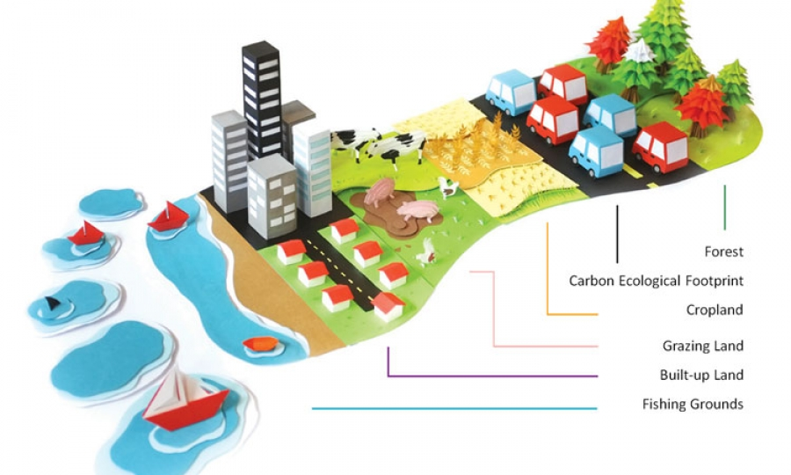
Human Footprint

Slide 3
Concerns around Trophy Hunting
Weak governance
Corruption
Lack of transparency
Lack of critical mass of scientific data
Illegal activities
Poor monitoring and enforcement

Slide 4
APNR history of non-compliance
Some examples:
Early 2005, an elephant was shot 21 times before it succumbed (Klaserie).
June 2005, an elephant was wounded and only killed 24 hrs later (Balule).
March 2006, a lion was wounded and killed by rangers following morning (Umbabat).
March 2006, an elephant was wounded, fled into KNP and never found since (Umbabat).
March 2013, an elephant was shot 20+ times in close proximity to Motswari Lodge (Umbabat).
June 2018, a pride male lion of approximately 6 years old was killed (Umbabat).
August 2018, a collared elephant was killed illegally. MTPA laid criminal charges and the warden was subsequently convicted (Balule).
December 2018, a young elephant was shot multiple times in front of photographic safari tourists (Balule).

Slide 5
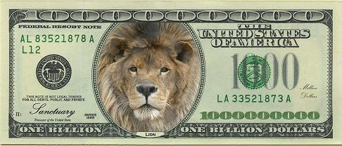
Trophy hunting in South Africa
Lack of compelling empirical data
Lack of reliable data sources
Lack of consensus on value of industry
Gross Annual Revenue | Year | Source
US$ 68 million | 2012 | Di Minin, et al., 2016
US$ 100 million | 2005 | Lindsey, et al., 2006
US$ 120 million | 2015 | DEA, 2018
US$ 130 million | 2015 | PHASA, 2017
US$ 206 million | 2014 | Southwick Associates, 2015 on behalf of SCI

Slide 6
Economic insignificance of trophy hunting
Tourism stats for 2017 - South Africa
Total contribution US$31 billion (direct & indirect)
8.9% of GDP
726,500 jobs (direct)
1.5 million jobs (direct & indirect) or 9.5% of total employment
10.4 million foreign tourists per year
(Source: World Travel & Tourism Council)
Income trophy hunting ≈ 1.3% of total tourism income
For every trophy hunter, RSA receives 1,300 ordinary tourists

Slide 7
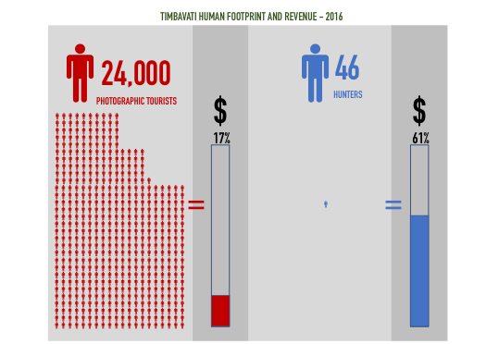
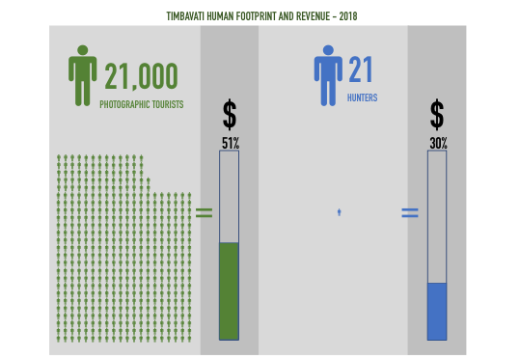
Generating revenue for operating budgets
2016: Conservation fee R160 pp per stay
2018: Conservation fee R328 pp per day
Source: Timbavati website

Slide 8
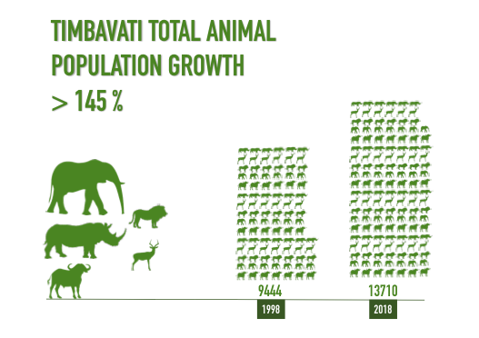
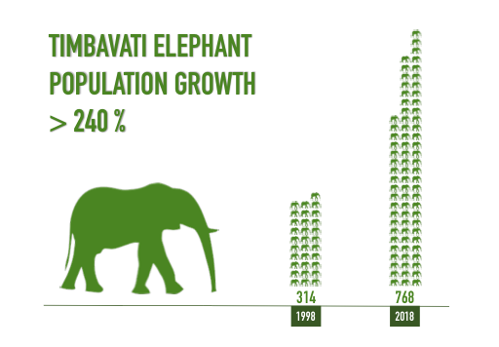
Wildlife population trends
Source: Timbavati website

Slide 9
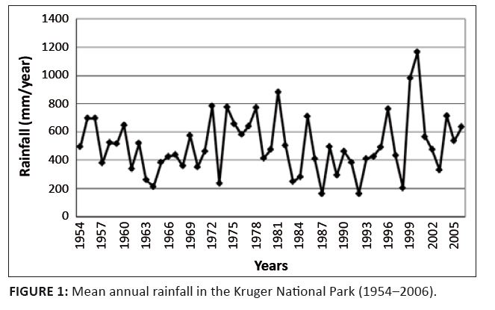
Rainfall data for Kruger NP
Northern arid bushveld zone receives 300 - 500 mm of rain per year
Southern lowveld bushveld zone receives 500 - 700 mm of rain per year
Source: Seydack et al., 2012

Slide 10
Why cherry pick 1998?
Source: Timbavati website

Slide 11
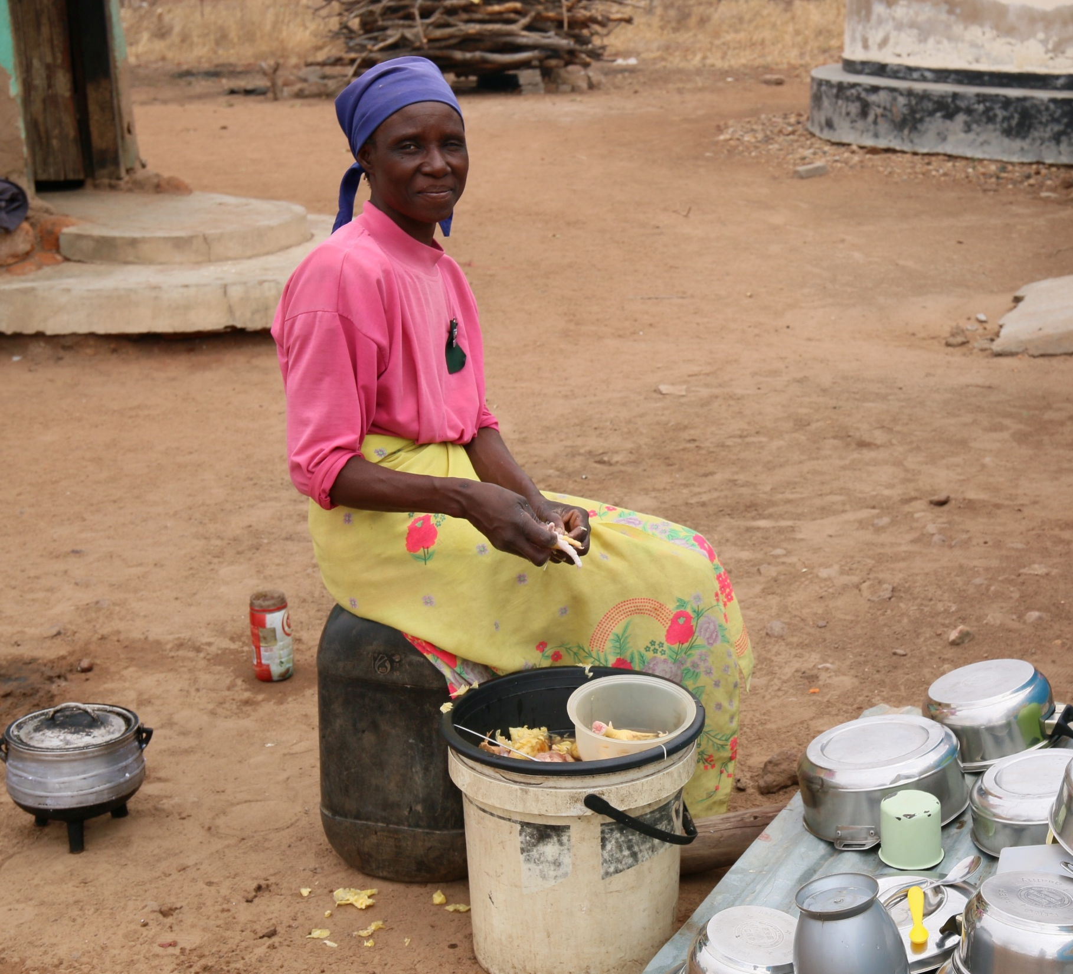
Benefits from tourism to local communities

Slide 12
Greater Kruger Hunting Protocol
One of the objectives for trophy hunting is “to support social investment initiatives within communities as per reserve specific programmes”.
“Hunting within the GKNP reserves are guided through the following principles….”, including “the commitment to local community involvement and empowerment, contributing a percentage of proceeds to identified community development programmes”.

Slide 13
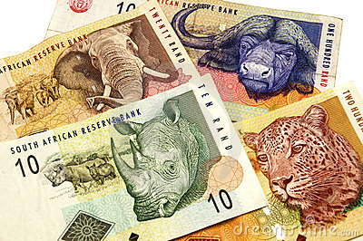
Trophy hunting revenue in APNR
2018
4 APNR x 20 hunters per year = 80 hunters
9,000 trophy hunters per year in SA (DEA)
Trophy hunting revenue in APNRs
<1% of SA gross trophy hunting revenue
Approx. US$ 1.2 million annually

Slide 14
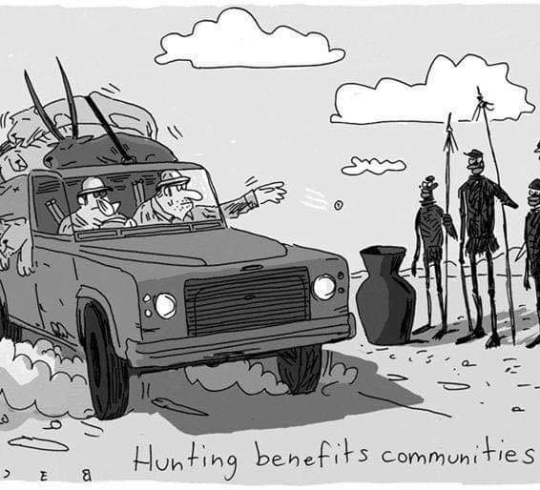
Does Trophy Hunting in APNRs Benefit Communities?

Slide 15
Missing the Mark
Consumptive and non-consumptive combined economic impact on local communities from APNRs is estimated at ZAR 2.1 million (2016).
Some socio-economic projects include:
Timbavati Environmental School
Balule Black Mambas
Balule Bush Babies
Klaserie Eco-Children

Slide 16
Missing the Mark
Source: House Committee on Natural Resources, 2016

Slide 17
Comments from SANParks in letters to APNRs
“Report on how revenue generated through off-takes was spent.
KNP cannot comment on the revenue report received, since it is not clear from the report how the various [APNR] sub-regions, or the [APNR] as an entity, regulate and monitor income generated as result of the animal off-takes. It is also not clear towards which conservation, management and socio-economic activities the revenue generated is being directed.”

Slide 18
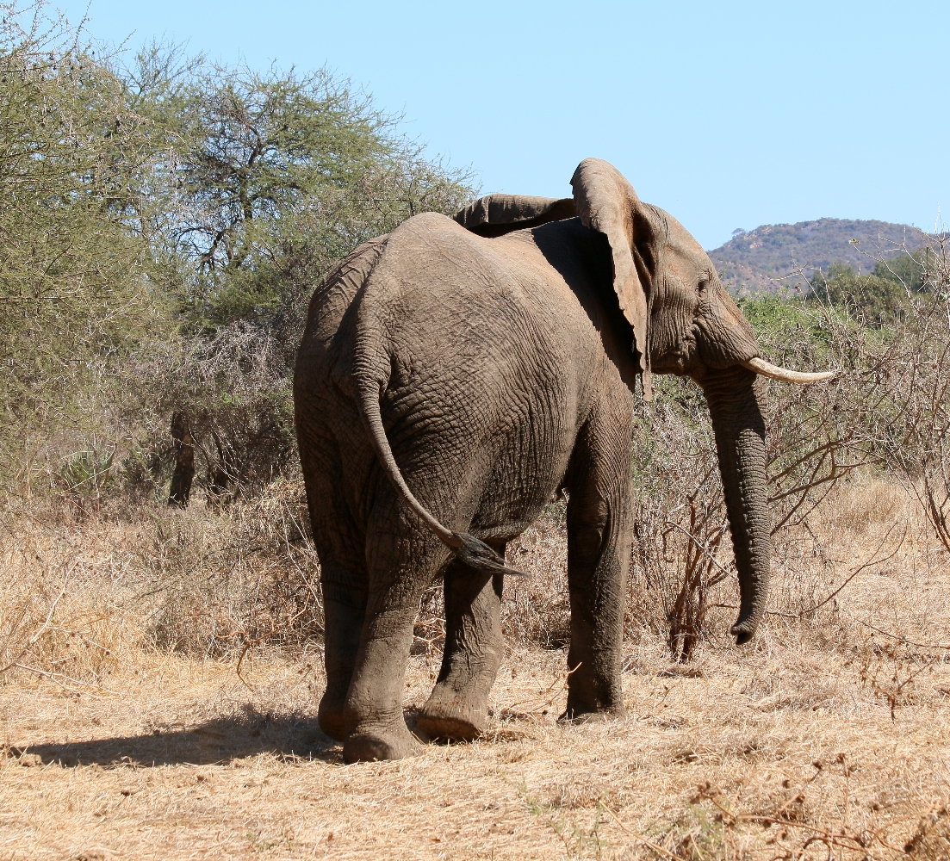
Realistically, a marginal industry like trophy hunting can never make a meaningful contribution to a 2.3 million large local population, which continues to grow.

Slide 19
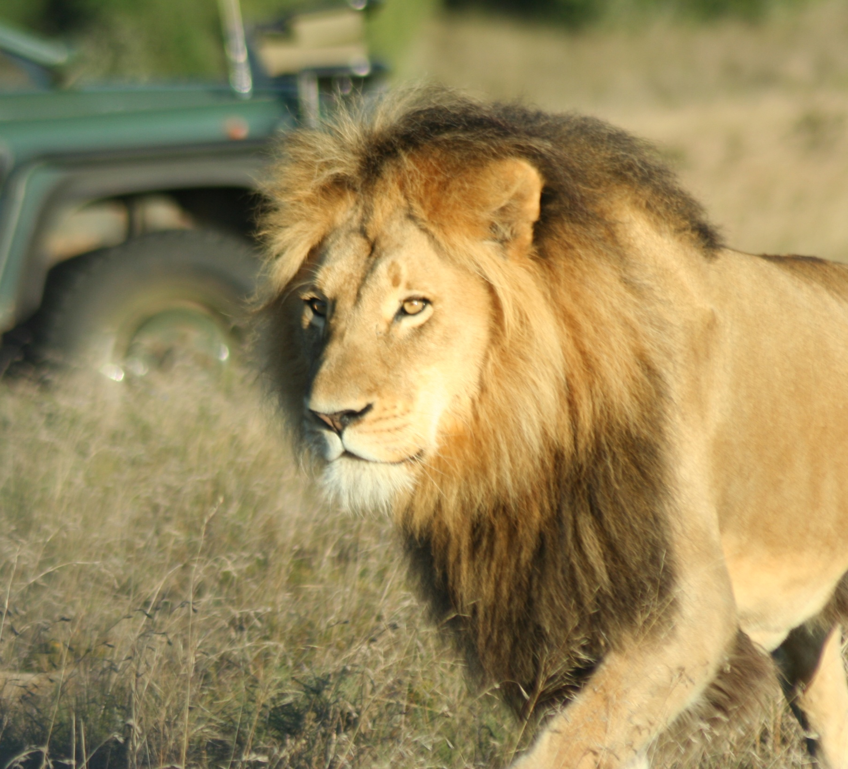
Eco-tourism

Slide 20
Community initiatives in Greater Kruger
Tourism Conservation Fund is set up to address non-inclusion of South Africa’s rural neighbouring communities into the tourism and wildlife economies
Singita Community Culinary School that offers commis chef training for graduates from the local community
SANParks charges a 1% community levy to uplift communities in and around the Greater Kruger

Slide 21
Jobs in eco-tourism vs trophy hunting
Source: IUCN/PACO, 2009

Slide 22
Reputational damage to Brand SA
Ross Harvey on potential damage to Brand SA, as a result of the captive predator breeding industry:
“The opportunity costs and negative externalities associated with the predator breeding industry may, along with other threats facing wild lion survival, undermine South Africa’s brand attractiveness as a tourism destination by up to R54.5 billion over the next decade.”

Slide 23
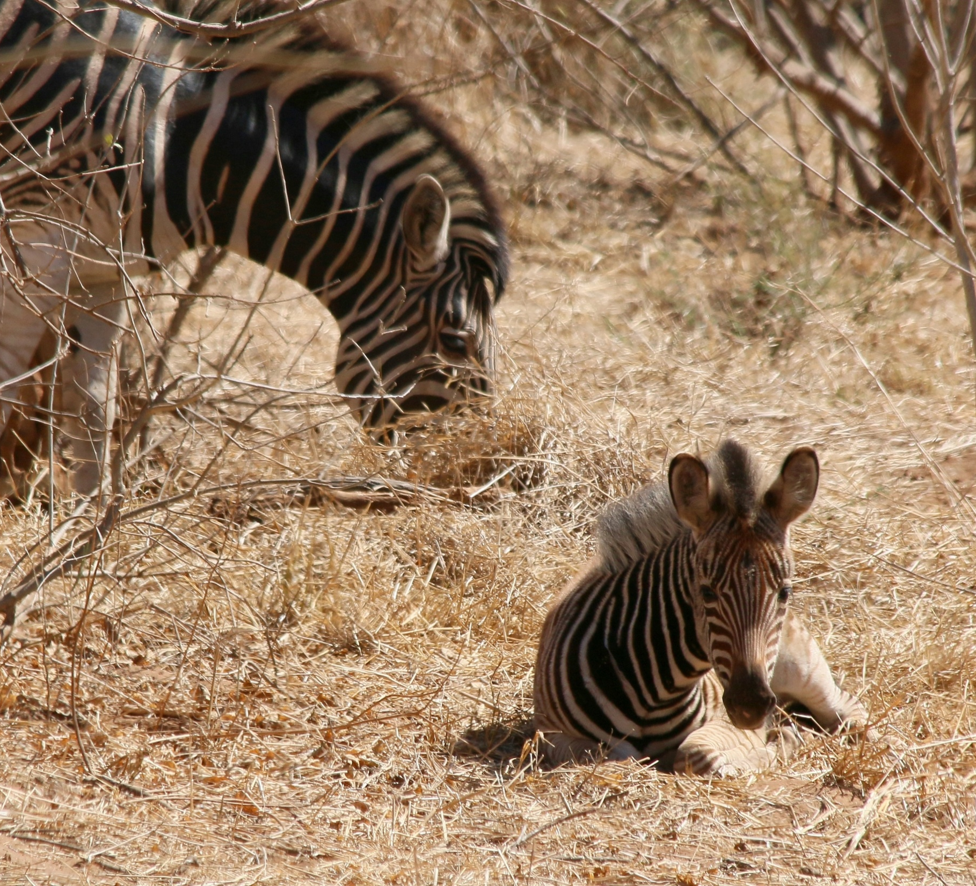
Reputational damage from trophy hunting

Slide 24
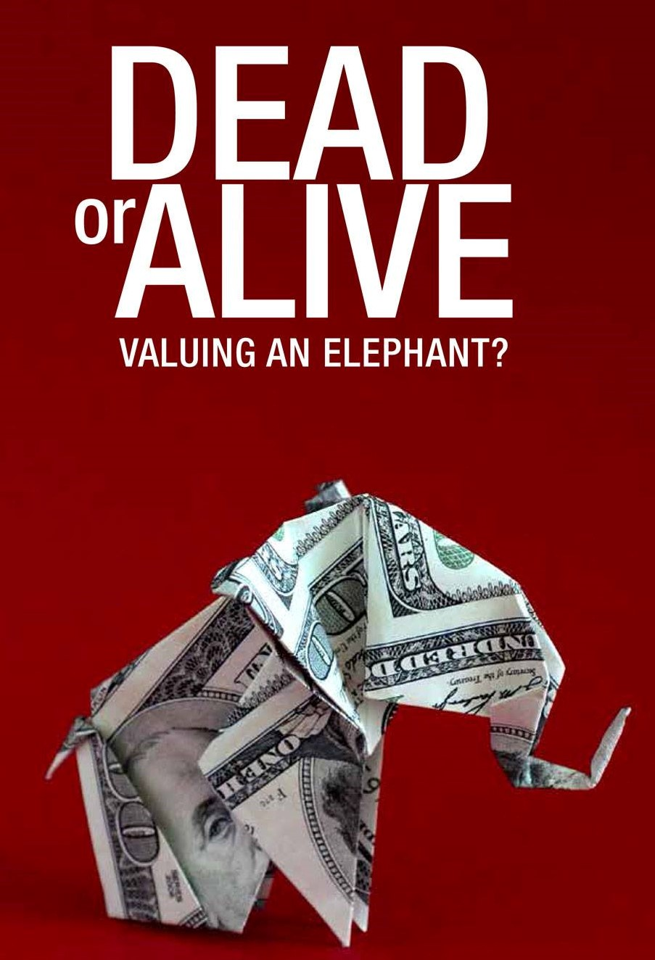
Dereck Joubert - value of a lion:
Trophy = US$15,000
Eco-tourism an entire life = US$ 2 million
Sheldrick Wildlife Trust - value of an elephant:
Poached for ivory = US$21,000 (raw value)
Eco-tourism an entire life = US$ 1.6 million

Slide 25
Why would we risk our well-established, successful, growing and highly valuable eco-tourism sector on the western boundary of Kruger for trophy hunting, which is worth a fraction of the overall tourism sector?

