Slide 1
DHA PREPARATION FOR THE ID CAMPAIGN DISTRIBUTION : 2019 ELECTIONS
PRESENTATION:
PORTFOLIO COMMITTEE
DATE: 5 DECEMBER 2018

Slide 2
Presentation Layout
Purpose
Background
Identity Document & Smart Card Issuance
Uncollected Identity Document & Smart Card
Strategic Approach for ID distribution
Channels for delivering services
Action Plan for ID Campaign
8. Recommendation(s)

Slide 3
Purpose
To brief the Portfolio Committee about the preparation plans and the state of readiness for the distribution of ID’s for the 2019 elections

Slide 4
Background
.
The Department of Home Affairs is responsible for population registration, determination of citizenship, issuing of enabling documents( ID’s, passports, Birth, Marriage and Death certificates) and other related services.
The Department is in terms of the provisions of the Identification Act, 1997 (Act No 68 of 1997), responsible for the processing of Identity documents to all South African citizens. These documents are issued on application and enable holders thereof to identify themselves for general purposes, day to day activities in society including for voting purposes.
The purpose of the branch is to ensure secure, efficient and accessible services and documents for citizens and lawful residents through the execution of the following core functions:
Management of the National Population Register

Slide 5
Background (contin….)
.
Management of SA identity documents and Home Affairs National Identification System (HANIS)
Management of passports and travel documents
Determination of the status of citizens
Management of births, marriages and death records

Slide 6
2013
SMART ID CARD ROLLOUT ROADMAP
2013/14
70 Offices connected
2014/15
Additional 70 Offices connected
2015/16
38 offices connected
2016/17
1 office connected
2017/18
5 offices connected
Grand Total: 184 offices connected
2013/14
.
2014
APP TARGET : 100 000
125 112 Smart Cards issued
APP TARGET:1 600 000]
1 638 387 Smart Cards Issued
2015
2015/16
APP Target: 2 200 000
2 320 972 Smart Cards
2016/17
2 200 000 Smart ID
2 649 950 Smart Cards
2016
2017/18
Target: 3 000 000
2 864 111 Smart Cards
2017
Total of 14 banks conected to eHome Affairs
2017 and beyond
Smart ID Card issuance,
inception todate: 11 495 434

Slide 7
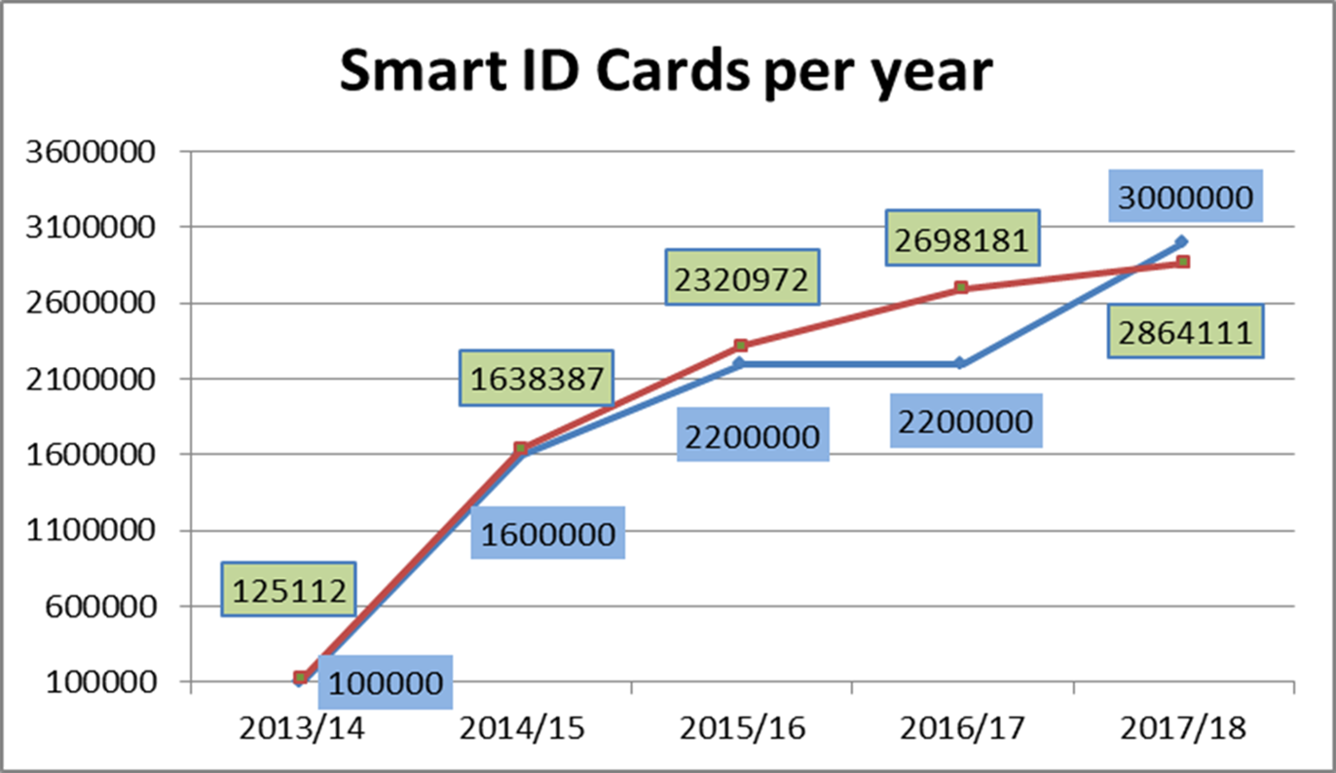

Slide 8
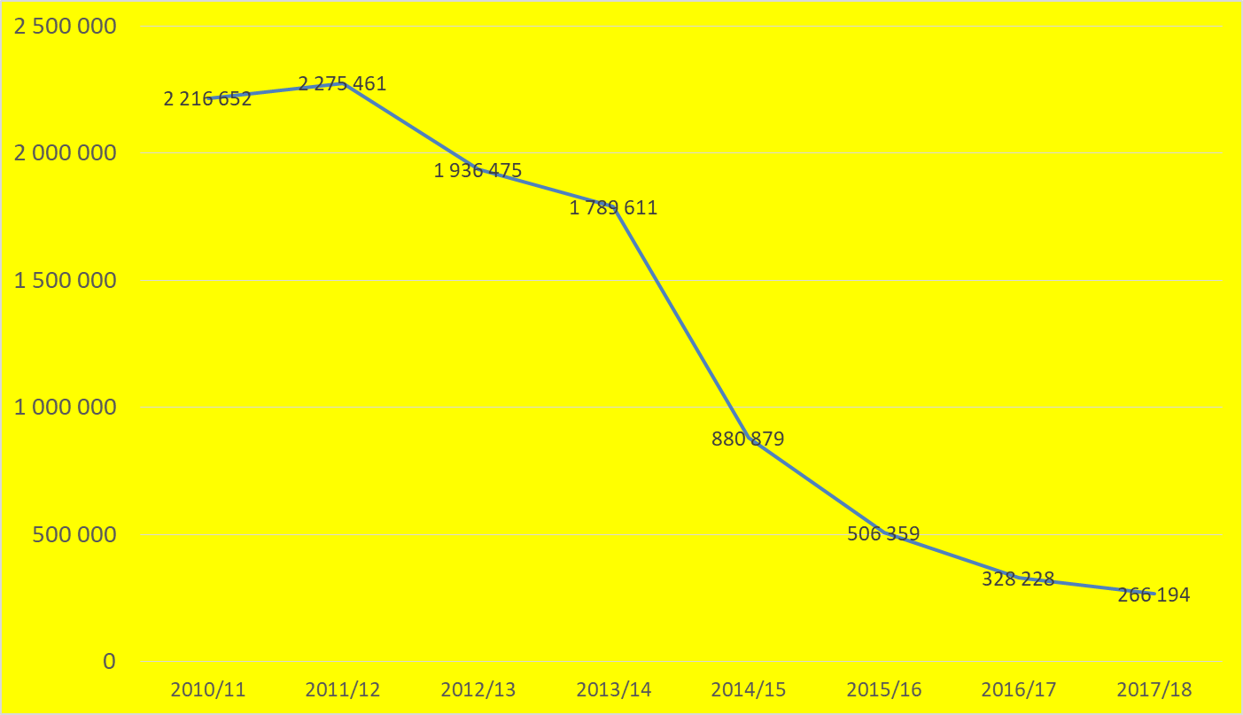
Green Barcoded ID Books

Slide 9
Uncollected Smart ID Cards
.

Slide 10
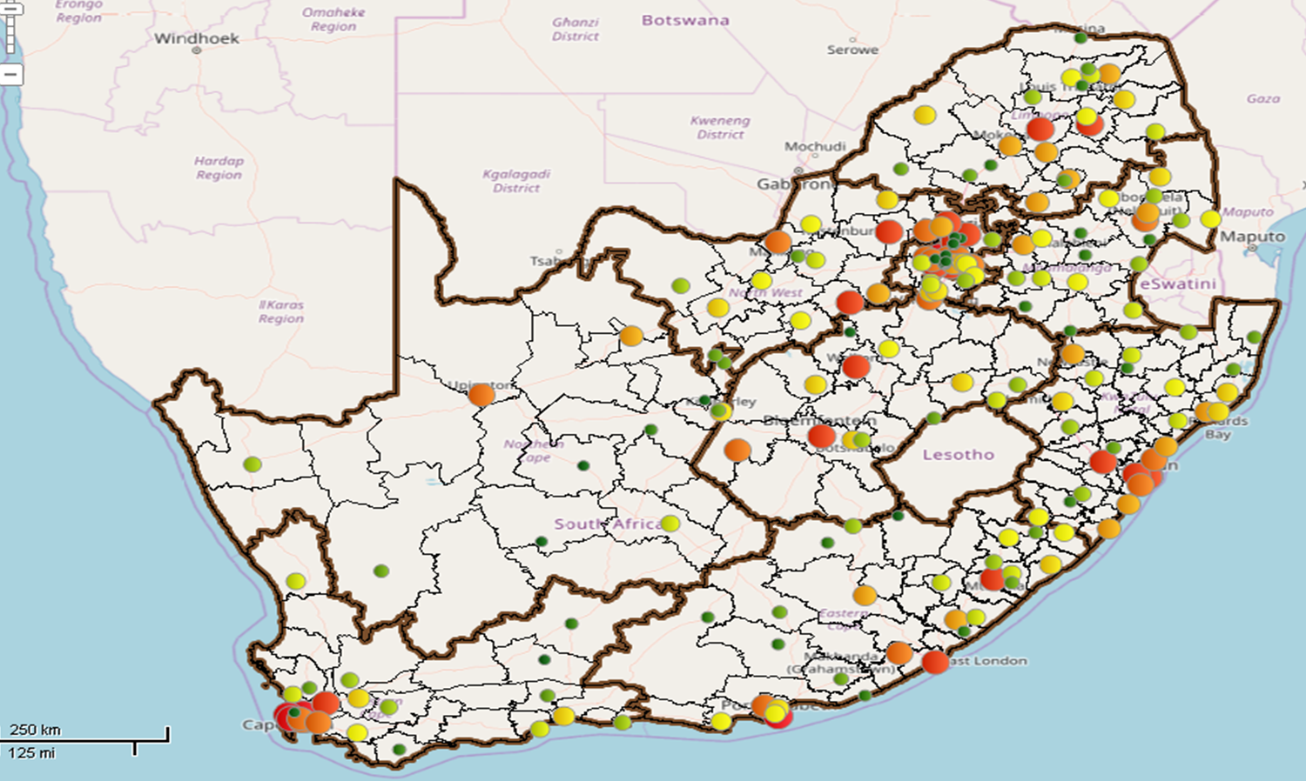
.

Slide 11
Uncollected green ID book s at province as at 3/8/18
PROVINCE | 0-30 DAYS | < 6MONTHS | > 6MONTHS | TOTAL
FS | 364 | 118 | 639 | 1 121
NC | 79 | 15 | 13 | 107
NW | 312 | 147 | 776 | 1 235
GP | 2 363 | 867 | 1 990 | 5 220
EC | 3 348 | 928 | 1 919 | 6 195
WC | 1 256 | 885 | 1 795 | 3 936
LP | 1 488 | 292 | 827 | 2 607
MP | 2 241 | 755 | 971 | 3 967
KZN | 6 348 | 3 227 | 3 894 | 13 469
GRAND TOTAL | 17 799 | 7 234 | 12 824 | 37 857
.

Slide 12
Strategic Approach for ID Distribution
Identification of areas with uncollected ID’s and Smart ID Cards
Provinces to work with stakeholder fora to deploy mobile units for people to collect their green barcoded ID books
To enlist services of CDW’s and compile lists with schedule visit where people must collect their ID’s
The door to door distribution of list for uncollected identity document lying in offices
Through outreach programs, joint programs with other departments, imbizos, posters, pamphlets and social media
Working closely with Communication branch and GCIS

Slide 13
Strategic Approach for ID Distribution (cont…)
Facebook pages used to promote clients to collect their ID books,
Use of Community Radio Stations to encourage clients to collect their IDs,
Loud hailing in rural communities – during outreach programs,
Arrange mobile to distribute ID to inmates at prison as well as call clients to collect
Head Office to re-release short message system [SMS] notifications to clients

Slide 14
Channels for Delivering Services

Slide 15
DHA Footprint
Front Offices
 | LOCAL OFFICE LARGE |  | LOCAL OFFICE MEDIUM |  | LOCAL OFFICE SMALL (PSP) |  | LOCAL OFFICE SMALL (TSC) |  | Grand Total
PROVINCE | RURAL | URBAN | RURAL | URBAN | RURAL | URBAN | RURAL | URBAN
EC | 0 | 6 | 15 | 9 | 22 | 1 | 6 | 0 | 59
FS | 0 | 3 | 3 | 6 | 11 | 0 | 5 | 2 | 30
GAUTENG | 0 | 8 | 2 | 21 | 0 | 6 | 2 | 22 | 62
KZN | 1 | 7 | 6 | 12 | 29 | 3 | 17 | 2 | 77
LP | 0 | 5 | 14 | 6 | 19 | 2 | 12 | 0 | 58
MP | 0 | 3 | 11 | 10 | 18 | 1 | 15 | 0 | 58
NC | 0 | 3 | 6 | 1 | 4 | 1 | 1 | 2 | 18
NW | 0 | 3 | 8 | 5 | 2 | 0 | 4 | 0 | 22
WC | 0 | 5 | 5 | 7 | 1 | 0 | 9 | 1 | 28
Grand Total | 1 | 43 | 70 | 77 | 106 | 14 | 71 | 29 | 412
Table above: 411 DHA Offices, per province, office size and geographical split
Table above: Graphical display of the Urban vs Rural split

Slide 16
DHA Footprint & Live Capture Offices
PROVINCE | RURAL | URBAN | Grand Total
EC | 14 | 13 | 27
FS | 4 | 9 | 13
GP | 0 | 29 | 29
KZN | 10 | 17 | 27
LP | 11 | 10 | 21
MP | 10 | 9 | 19
NC | 8 | 5 | 13
NW | 6 | 7 | 13
WC | 10 | 12 | 22
Grand Total | 73 | 111 | 184

Slide 17
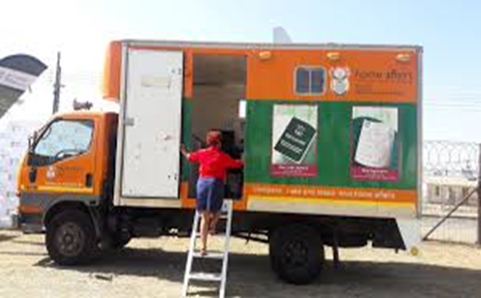
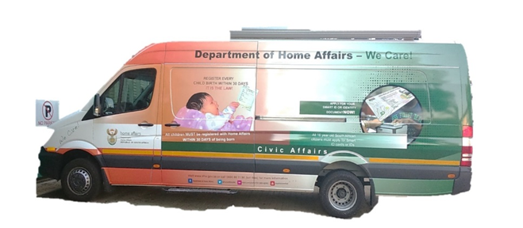
Mobile Units – Old & New Generation
Old Generation
New Generation
The old existing fleet current capabilities
The Mobile can process and print Birth, Marriage and Death Certificates
The Mobile can process green ID book applications
The Mobile can update Birth record and amendment applications
There is no Smart ID card system capabilities
The old fleet has 114 existing units
There are 19 new mobile units of which 3 are functional
The new generation mobiles have been installed with the new live capture system (Smart ID Cards)
Currently there are 3 mobile units that are used as proto-types

Slide 18
BANKS WITH LIVE CAPTURE
NAMES OF BANKS WITH LIFE CAPTURE SYSTEM
 | Province | City | Bank
1 | Gauteng | Centurion | ABSA LIFESTYLE CENTURION
2 | Gauteng | Johannesburg | ABSA TOWERS NORTH
3 | Gauteng | Johannesburg | ABSA GANDI SQUARE
4 | Gauteng | Centurion | FNB LIFESTYLE CENTURION
5 | Gauteng | Tshwane | FNB LYNWOOD
6 | Gauteng | Sandton | FNB MERCHANT PLACE
7 | Gauteng | Johannesburg | FNB TOWERS
8 | Gauteng | Tshwane | NEDBANK ARCADIA
9 | Gauteng | Rivonia | NEDBANK RIVONIA
10 | Gauteng | Roodepoort | NEDBANK ROODEPOORT
11 | Gauteng | Centurion | STANDARD BANK CENTURION
12 | Gauteng | Rosebank | STANDARD BANK KILLARNEY ROSEBANK
13 | Gauteng | Johannesburg | STANDARD BANK SIMMONDS STREET JHB
14 | Western Cape | Cape Town | STANDARD BANK CANAL WALK

Slide 19
DHA 2019 Elections Communication Plan Schedule

Slide 20
DHA 2019 Election Communication: Implementation Schedule
Outcome | Activity | Responsible
Direct Promotion of DHA services offered to the public when applying for and collecting Smart IDs Establish Stakeholder partnerships Note: Align to Phase 1 of GCIS Communications Plan January 2019 to May 2019 | Identify regions with high number of uncollected IDs in each Province Conduct Road Shows Ministerial Imbizo Partnership with community based media Partnership with Provincial and Local Government | Communications Civic Services Provincial Managers DMOs

Slide 21
Implementation Schedule (Cont.)
Outcome | Activity | Responsible
Implement a high impact advertising plan Prompt SA citizens to apply for and collect IDs Theme: Be Smart Apply, Collect Your ID Note: Align implementation to Phase 1 of GCIS Communications Plan January to May 2019 | Placement of Radio and Print advertisements Electronic billboards at transport transit points (Taxi, Bus terminals, Airport) Provide information of DHA operations during Voter registration weekend (26-27 January 2019) | Communications Civic Services Provincial Managers

Slide 22
Recommendation
Portfolio Committee to take note of the ID distribution and campaign strategy in preparation for the 2019 elections.

Slide 23
Ke ya leboga
Ndiyabulela
Ngiyabonga
Thank you
Inkomu
Ndi khou livhuha
Notes:
BULLET 1: Duran - The Indaba Close out Report should be obtained for evidence.
BULLET 2: Duran - Obtain the finalized MOU.
BULLET 3: James - provide the statistics of children born over weekend and public
BULLET 4: LP (40) & NW (1) - Secondment letters from the North West and Limpopo
BULLET 5: KZN & GP - Certificates for the Ladysmith and Legae health facilities
Reasons before amendment to Saturdays only:
A Birth Registration Indaba was conducted to create awareness.
The MOU with the Department of Health was finalized.
Birth registration on Saturdays and Sundays at high volume offices.
Secondment of provincial personnel to health facilities on a permanent basis.
Two new health facilities were connected.

