Slide 1
Vodacom’s response to the 2018 ECA Amendment Bill
November 2018

Slide 2
Vodacom in Africa
South Africa
Population: 57.4m
Market penetration: 66.34%
GDP: $432.5bn
# Customers: 41.6m
Market position: 1st
Kenya
Population: 51.0m
Market penetration: 50.64%
GDP: $61.0bn
# Customers: 28m
Market position: 1st
DRC
Kenya
Tanzania
Tanzania
Population: 59.1m
Market penetration: 40.56%
GDP: $51.8bn
# Customers: 12.9m
Market position: 1st
DRC
Population: 84.0m
Market penetration: 37.22%
GDP: $34.0bn
# Customers: 11.8m
Market position: 1st
Vodafone
Mozambique
Vodacom
South Africa
Lesotho
 | Vodacom | % of Africa
Population(m) | 284.3 | 22%
Real GDP($bn) | 598.4 | 24%
Mozambique
Population: 30.5m
Market penetration: 43.5%
GDP: $15.8bn
# Customers: 6.1m
Market position: 1st
Lesotho
Population: 2.3m
Market penetration: 63.5%
GDP: $3.3bn
# Customers: 1.4m
Market position: 1st
Notes:
1, Macro data based on Business Monitor International databases, 2018
2. Revenue mix as per Vodacom FY2018 reporting
3. Share price data as at 10.09.2018
4. Market penetration based on GSMA Intelligence, 2018

Slide 3


Key transformational milestones
BEE deal
Transforming the sector
R16.4 billion deal
Committed to transformation
R3.3 billion returned to investors
special dividend
Diversified portfolio as part of Vodacom Group
C20% effective black ownership
Most empowered telco
Most empowered company on JSE 2016
Top black managed company on JSE 2017
R31bn procured from BEE Level 4 & above in 2018
R10.6bn spent with >51% black owned suppliers
In 2018
R9bn spent with >30% black women owned
suppliers in 2018
R443m spent on skills development in 2018

Slide 4
Vodacom is committed to South Africa
OTHER ARCHIEVEMENTS | March 2018
Connected schools | 3 000
Trained teachers | 250 000
Teacher centres | 92
Youth development centres | 10
Youth who benefitted through Youth Academy | 966
SMMEs that benefited from Innovator Trust | 53
Universities with zero rated access to curriculum content | 19
Learners with free access to quality digital educational content | 550 000
Beneficiaries of bursaries program | 1200

Slide 5
South Africa’s ICT objectives
Vodacom supports Government ambitious objectives for the sector, including:
  Promoting broadband coverage in rural areas and underserviced areas
  Ensuring that as many people as possible can benefit from affordable broadband
  Promoting innovation that addresses national developmental challenges and goals
  Transforming the sector through broad-based black economic empowerment
The Government's overall objectives for the telecoms sector as generally expressed over a number of years from the 2012 National Development Plan right through to the 2016 White Paper and most recently in the Memorandum on the objects of the Bill

Slide 6
Government’s more recent investment focus for the ICT sector
  “We have placed economic growth and job creation at the centre of our national agenda.”
  “We have finalized consultations with the telecoms industry and other stakeholders to ensure allocation of spectrum reduces barriers to entry, promotes competition and reduce costs to consumers”
  “We launched an ambitious and, in the history of our country, unprecedented, drive to raise at least $100 billion in new investment over five years”
  “Our independent communications regulator is now preparing to license available high demand spectrum”
Excerpts from President Ramaphosa’s address at the Investment Conference, October 2018
Vodacom participated at the Investment Conference and pledged to invest R50bn in network infrastructure over a five year period

Slide 7
Key drivers of mobile market outcomes in S.A.

Slide 8

ICT Ecosystem
Invest
Vodacom’s continued commitment to…
Invest and ROI
Spectrum
Coverage & Quality
Customer Needs
Price Reduction
Usage Growth
Increase customers using data
Appeal to
award spectrum and
complete digital migration
Reduce prices and find ways to make service affordable for all
Connect all
and maintain quality network
Ensuring customer needs are met
8

Slide 9
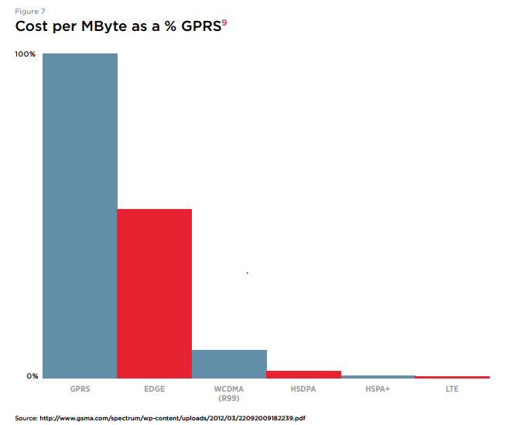
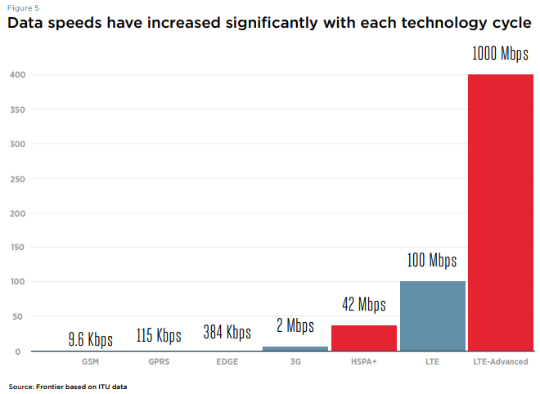


Invest and ROI
Spectrum
Coverage & Quality
Customer Needs
Price Reduction
Usage Growth
ICT ecosystem – investment to improve network is critical
>R40 billion
Vodacom plans to invest ZAR50bn over next five years (assuming existing legislative and regulatory framework remain in place).
Unit costs fall
with each new technology
Whilst speed increase
Notes:
MNOs deploy more efficient network equipment (3G/4G) to serve demand more efficiently

Slide 10
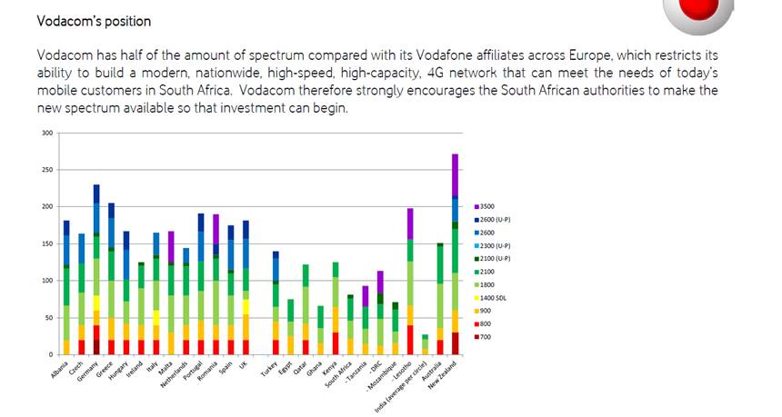
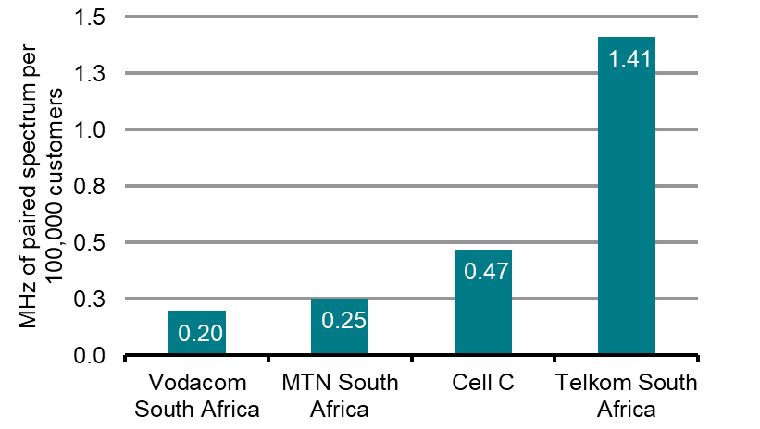
Invest and ROI
Spectrum
Coverage & Quality
Customer Needs
Price Reduction
Usage Growth
ICT ecosystem – spectrum is also critical to improve network
Capacity constraints stemming from a lack of high demand spectrum
Availability of spectrum affects network coverage and capacity that can be delivered in a cost efficient way
Operators can manage capacity constraints to some extent based on how they set prices: will not further reduce prices if this would cause unacceptable network congestion and reduced QoS.
Spectrum holdings for Vodafone/Vodacom across different countries
SA is seriously spectrum constrained: particularly larger operators (Vodacom and MTN)
Spectrum per 100,000 customers

Slide 11

ICT ecosystem – various options to get the best price
Invest and ROI
Spectrum
Coverage & Quality
Customer Needs
Price Reduction
Usage Growth
₀₁ BUNDLE SIZE ₀₂ VALIDITY PERIOD
₀₃ COMMITMENT
DATA
R/MB
R/MB
R/MB

Slide 12






Invest and ROI
Spectrum
Coverage & Quality
Customer Needs
Price Reduction
Usage Growth
ICT ecosystem – various options to get the best price
1GB
1 GB plus 1 GB (night owl)
R per bundle
30 Days
14 Days
7 Days
1 Day
1 Hour
Price per
bundle
R149
R99
R79
R29
R12
1GB
R per inclusive MB
R0,08
30 Days
14 Days
14 Days
1 Day
1 Hour
7 Days
Price/
Inclusive MB
R0,15
R0,10
R0,08
R0,03
R0,01
R0,08
R0,03

Slide 13
>80% of prepaid subscribers buy hourly, daily & weekly bundles
Invest and ROI
Spectrum
Coverage & Quality
Customer Needs
Price Reduction
Usage Growth
ICT ecosystem – data bundles
>25% of contract subscribers buy hourly, daily & weekly bundles

Slide 14
ICT ecosystem – different pricing models for different needs
Effective
price / MB index
1
-2%
-29%
-51%
% bundle sales for validity of day, week and fortnight
24%
27%
42%
59%

Slide 15
Invest and ROI
Spectrum
Coverage & Quality
Customer Needs
Price Reduction
Usage Growth
ICT ecosystem – effective price per MB and data usage
CAGR
-21.4%
Data traffic
-31%
-24%
-13%
-16%
-22%
CAGR 52.1%
Effective price per MB
Vodacom price per MB has fallen YoY

Slide 16

Invest and ROI
Spectrum
Coverage & Quality
Customer Needs
Price Reduction
Usage Growth
Notes:
Story to be included: Gary

Slide 17
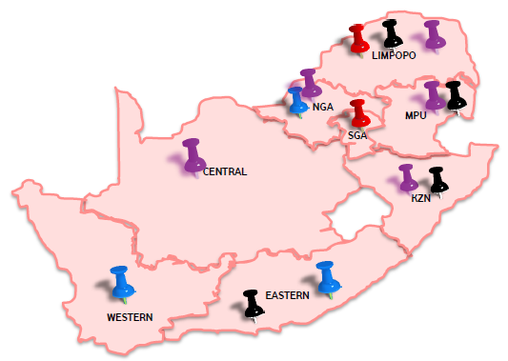


ICT ecosystem – deep rural and SMME commitment
Business Opportunity
SMME’s become business partners in deploying deep rural coverage sites
SMME’s build the “deep rural coverage site” on behalf of Vodacom and leases back to Vodacom for minimum of 5 years and with a “buy-out” option after 9 years and 11 months
Business Drivers:
Access to the same type of network, similar quality and speeds as urban areas
To promote equal digital participation for all segments of society.
Alignment to Government’s National Integrated ICT Plans.
Supporting SMME Development
Vendors invited to RFP:
➢ 14 SMME’s were invited to respond to the RFP
➢ 9 responses received, 5 declined
➢ 7 SMME’s were shortlisted and 4 were successful
An initial 118 sites were allocated to 4 successful SMME’s: Target (Live): Mar’2019
Geographical distribution of SMME’s for the “initial” allocation of 118 deep rural coverage sites – “leasing model”
We can do more and sooner!!!
Vodacom’s “deep rural” rollout plans (1150 sites – 31 March 2023 )
Challenges:
Power
Security
Infrastructure (Road Access)
31 Mar-18 | 31-Mar-19 | 31-Mar-20 | 31-Mar-21 | 31-Mar-22 | 31-Mar23 | Total
101 | 249 | 200 | 200 | 200 | 200 | 1120

Slide 18
2018 Bill Proposals

Slide 19
Vodacom proposes a competitive WOAN
WOAN
MNO1
MNO2
MNO3
MNO4
Vodacom proposes that…
Spectrum blocks - equal allocation of HDS to five blocks
Feasibility - MNOs’ committed to but capacity from the WOAN
Transformation – based on the ICT sector code
MNO block’s either awarded via auction and/or with obligations (coverage obligations)
The alternative as per the Bill will…
Create uncertainty with investors
Stifle investment
High risk of failure

Slide 20
The 2018 Bill addressed some problematic elements of the previous Draft Bill
Issues partly addressed under the 2018 Bill
No requirement to return existing spectrum nor to renew spectrum licences annually
The MNOs should get access to unassigned HD spectrum immediately, i.e. before WOAN is fully functional
The WOAN envisaged to exist and compete with the MNOs with network competition preserved – lower risk of market monopolisation

Slide 21
But the 2018 Bill and Policy Directive are inconsistent
Policy Direction | Bill
Capacity commitment Each licensee assigned currently unassigned high demand spectrum procure a minimum of 30% WOAN capacity for a period of not more than three years where-after Authority may determine minimum of 30% WOAN capacity procured collectively | Each radio frequency spectrum licensee that is assigned currently unassigned high demand spectrum procures a minimum of 30% capacity or such higher capacity as determined by the Authority.
WOAN consortium ownership Must include diversity of ownership to ensure meaningful participation of all entities involved including SMMEs, and to prevent monopolistic behaviour. | Must include diversity of ownership and control to ensure meaningful participation of all entities involved and may not be dominated or controlled by any single entity
Terms and conditions Shall remain in force for the duration of the spectrum licence issued | Authority must impose USO obligations on existing and new spectrum licences

Slide 22




The 2018 Bill still contains radical changes
All assignments of spectrum will be subject to the principles of open access and non-exclusivity.
Coverage
The WOAN
Access
Spectrum
All mobile operators have to provide cost-based wholesale access to their networks and services. This can no longer be refused on the grounds of reasonableness (economically viable).
MNOs will be subject to inefficient coverage obligations requiring to roll out in rural and underserviced areas before being able to deploy spectrum in urban areas
A Wholesale Open Access Network (WOAN) will be established. The WOAN is expected to be assigned a disproportionately large amount of unassigned spectrum, and granted advantages currently unavailable to other licensees.
ICASA independence
Important decisions move to Ministerial decision making (eg amount of spectrum to be assigned to the WOAN) and reduced ICASA independence (eg Policy Directions to become binding for ICASA)
…and which cumulatively can be expected to have a chilling impact on investment

Slide 23
By way of context - mobile operators make significant long term investments
Mobile operators make significant investments with uncertainty about future returns
Mobile operators invest for the long term
Vodacom alone has invested more than Rand 40 bn in last 5 years
It plans to invest Rand 50bn in next 5 years
Investment into 5G significant and returns uncertain
Mobile licences typically for 15 to 20 years
Lifetime of mobile network equipment from 8-15 years
In recognition of this, important policy aim to provide certainty

Slide 24

Access - Cost based wholesale open access will chill investment
All MNOs obliged to give access to facilities and networks at cost
Impact of mandated access at cost
Mobile operators expected returns lower
Returns more uncertain
Reduce ability to differentiate form rivals – eg from better coverage
Reduced incentive to invest first
Open access to all networks without considering technical and economic feasibility
Introduction of a unique and unprecedented Deemed Entity regime – and all MNOs will qualify
Blanket set of intrusive remedies for Deemed Entities
E.g. Cost to Upgrade RAN
R550k per site x 13 000 sites = R7.150 billion
Notes:
Give practical costs of upgrade R550k per site x 13 000 sites = R7.150 billion

Slide 25
Spectrum - Open access & non-exclusive use exacerbates investment chill
Open access to and non exclusive use of spectrum
Impact of assigning spectrum on the basis of open access and non-exclusive use
Harmful interference
MNOs not able to control and improve quality of service
Erode the value of spectrum
Non-exclusive rights to spectrum
Open access to spectrum

Slide 26
Coverage – rural first will delay availability of high speed broadband services
MNOs required to roll out in rural and underserviced areas before deploying spectrum in urban areas
Impact of ‘outside in’ roll-out obligation
Delayed deployment of high speed mobile broadband in urban and suburban areas
‘Parallel roll-out’ can achieve coverage objectives without consumer detriment in urban/suburban areas
No int’l precedent for Bill proposal
Low frequency spectrum (700/800Mhz) needed for efficient rural roll-out not available until 2021/2022
High frequency spectrum suitable for roll out of 4G (2.6 GHz) available immediately
‘Outside-in’ roll out obligation prevents/delays deployment in urban and semi-urban areas, where congestion already occurring

Slide 27
WOAN - preferential treatment increase uncertainty & risks competitive distortions
WOAN is expected to be assigned a disproportionately large amount of unassigned spectrum, and advantages unavailable to others
Impact of the creation of such WOAN
WOAN has significant cost advantages which could give it material but unfair advantage in w/s market:
  distortion of competition in retail market
  Lower incentive for MNOS to invest
  Risk of monopolisation lower but remains
WOAN faces no demand risk, removing incentives to be efficient
WOAN could take time to be functional, leaving significant amounts of spectrum unused
CSIR study proposes 45% of unassigned HDS spectrum for the WOAN
MNOs to guarantee purchasing of 90% of
WOAN capacity
WOAN exempted from spectrum payments
WOAN to have access to urban networks of MNOS at preferential rates

Slide 28
ICASA - Interference increases regulatory uncertainty and risks of ‘politicization’
A number of Bill provisions move decision making powers from ICASA to the Ministry and reduce ICASA’s independence
Impact of dampening of ICASA’s independence
Prof Martin Cave summarises it as:
“… This amounts to a substantial ‘hollowing out’ of ICASA’s functions. Accordingly, my conclusion from this section is that the Bill contains provisions for the redistribution of decision-making authority among the legislature, the Minister and regulator (ICASA), which depart from international practice which itself is designed to introduce certainty into the environment in which major investment decisions are made. The resulting greater uncertainty runs the risk of chilling firms’ incentives to invest.”
Amount of spectrum to be assigned to the WOAN
Policy directions from the Ministry become binding for ICASA
New catch-all provisions for Minister, including power to decide what constitutes high demand spectrum and setting the terms and conditions for renewal of spectrum licences

Slide 29
Moreover, the changes in the Bill falls short of the Constitution
  it violates the rule of law and the doctrine of legality – the Bill is irrational, arbitrary and materially vague in many important respects.
  it infringes the constitutionality guaranteed independence of ICASA
  it violates Vodacom’s property rights – arbitrary deprivation of Vodacom’s existing rights to spectrum; arbitrary deprivation of Vodacom’s existing rights to property in its facilities

Slide 30
Economic impact of the 2018 Bill

Slide 31





2018 Bill proposals affect investment in short and long term
Short to medium term effects
WOAN IS ESTABLISHED AND FULLY FUNCTIONAL
Long run effects
Cost-oriented WOA and non-exclusive spectrum will chill MNO investment
5-7 years
Lower MNO investment not offset by WOAN investments as WOA & non-exclusive spectrum remain
Under the 2018 Bill it could still take time for WOAN to become fully functional and deploy spectrum to effectively serve SA market
Rural first roll-out will delay efficient roll-out in other areas
Network competition negatively affected by the preferential treatment of WOAN
Uncertainties around WOAN and interference with ICASA’s independence undermine investment
Material uncertainty about future returns on investment will ‘chill’ investment leading to worse outcomes in SA mobile sector

Slide 32






Lower investment & slower transition to new technologies affect mobile users
Frontier estimate:
The 2018 Bill will result in slower migration to newer technologies
Higher prices
Mobile data prices would be up to ca. 15% higher with the 2018 Bill
Which will result in higher unit costs…
Lower quality
Average data speeds would be up to 35% lower with the Bill
which affects consumers through:
Consumer outcomes
Consumers would be worse off by ZAR45bn
Higher prices result in lower data usage:
Notes:
¹Compared to a no Bill scenario with continued improvement in mobile market under current framework
²Mobile data prices under 2018 Bill estimated 6%-16% higher over period 2021-2030
³Data speeds under the 2018 Bill estimated 9%-37% lower over period 2018-2025
⁴In NPV terms, over 20 years (2020-2040)

Slide 33






… and there will be further negative effects on the wider economy
Frontier estimate based on Deloitte and SA connect methodologies:
Lower GDP
Lower data usage and digitization imply lower productivity increases, thus leading to lower GDP
GDP would be lower by ZAR 12-28bn with the Bill
The Bill will result in less investment in the mobile sector
Lower employment
Fewer direct jobs related to network expansion and fewer indirect and induced jobs resulting from lower productivity increases and lower GDP
16-36,000 fewer jobs with the Bill
which affects the wider economy through:
Lower tax revenues
Lower GDP with the bill also means lower tax revenues
Tax revenues would be lower by ZAR 3-8bn with the Bill
Notes:
¹Compared to a no Bill scenario, but continued improvement in the functioning of mobile market
²NPV of GDP over 5 years (2020-2025). Tax figure is also NPV.
³Reduction in the impact on GDP, employment and tax under 2018 bill versus the previous draft bill is smaller than the impact on consumer outcomes. Because impacts are calculated over 5 years, and therefore do not reflect that the longer term impact under the 2018 Bill is smaller due to the preservation of network competition.

Slide 34
Technical impact of the 2018 Bill

Slide 35



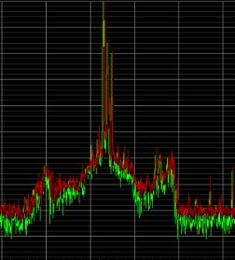
Impact of the Bill on technical viability
Infrastructure costs and mast loading
Spectrum Efficiency
Network Resiliency
Non-exclusive Access to Spectrum
Removal of the “technical and economical” feasibility criteria for access to ECNS facilities will result in additional costs and risk to the access provider
It will also result in inefficient use of ECNS facilities
Spectrum re-farming should NOT be subject to approval by the Authority
It’s a daily necessity for mobile operators to manage network capacity requirements between all technologies
Real-time spectrum database – not practical to implement
It will result in outages, dropped calls and detrimental to the overall end-user experience
Interference challenges and limits proper network planning & RF optimisation
No investment incentive and certainty for licencees
Negatively impacts QoS on end user experience

Slide 36
Vodacom proposals

Slide 37
Vodacom proposes a competitive WOAN
Although Vodacom does not believe that a Wireless Open Access Network (WOAN) as prescribed in the Bill is necessary to meet the Government’s objectives, we can envisage a competitive WOAN as a means to open the market to new players.
A competitive WOAN would be a new type of company.
Owns an advanced mobile network (LTE) and
allows other licensees to use the network
It would be a sustainable business, succeeding on its own merits
operating in a competitive environment, and
a broad-based black economic empowerment vehicle

Slide 38
A competitive WOAN …
The Policy Direction, under the existing Act, should be allowed to proceed and the Bill should not be rushed through Parliament
…should be based on the ICT Sector Code when determining the qualification criteria for the award of the licenses to ensure that operators’ transformation programmes are not negatively impacted
… would:
Preserve
the fundamental principles of market-based competition, innovation and investment
Operate within
the regulatory framework in the current Act
Contribute meaningfully to
the transformation
of the
ICT sector

Slide 39

Vodacom’s positions on key matters in the Bill
Access
Spectrum
Coverage
The WOAN
Access and sharing based on commercial agreements
Economically and technically feasible, and achieve efficiencies
Renewal of existing spectrum licenses should be preserved as long as its conditions remain fulfilled and the relevant fees are paid
New spectrum via ITA by ICASA
MNOs will be subject to inefficient coverage obligations requiring to roll out in rural and underserviced areas before being able to deploy spectrum in urban areas
Envisaged a competitive WOAN
Committed to support the WOAN (buy capacity)
The WOAN should have favourable spectrum payment terms
Commercial rates to be charged for its services
The WOAN should not have coverage obligations
ICASA independence
Independent capacitated regulator

Slide 40
Thank You

