Slide 1
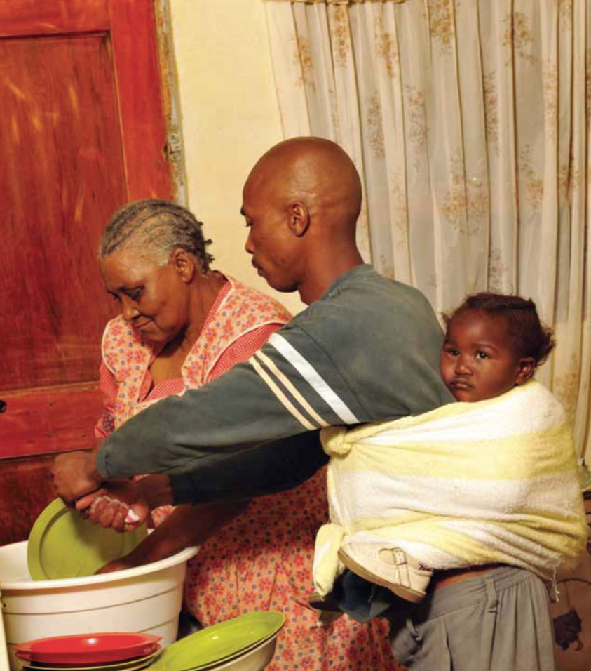
Eric Miller
Notes:
> This is the first State of South Africa’s Fathers report, and has been produced as a collaboration between Sonke Gender Justice and the Human Sciences Research Council, with support from the National Research Foundation ( NRF ) through the Centres of Excellence in Human Development at Wits University, and DG Murray Trust.

Slide 2
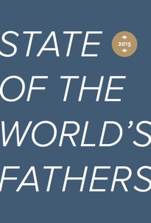
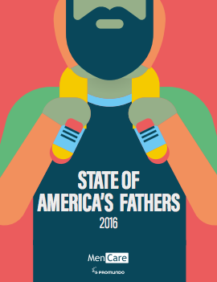
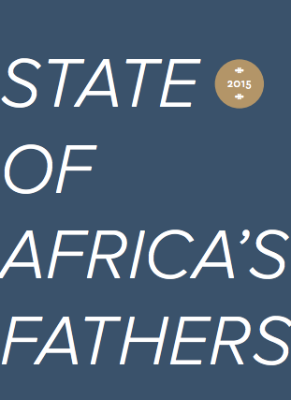
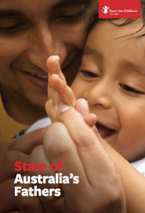
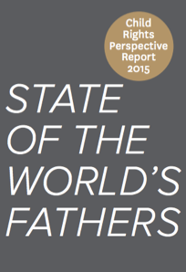
First ever State of the World’s Fathers 2015
Analyzed global research on why men’s participation as fathers and caregivers matters
For women, children, men themselves and societies
Affirmed that we do not adequately measure men’s participation in caregiving
Contributed to new paternity and parental leave policies and bills in 3 countries
Notes:
The report is published as a MenCare Global Fatherhood Campaign publication, and joins the family of State of the World’s Fathers reports.
These have been published in 2015 and 2017, and join the State of the World’s Mothers report produced by Save the Children, and the State of the World’s Children report produced by UNICEF.
The fathers’ reports have inspired various country partners to produce national reports in Brazil, Australia and the Netherlands.
This report is the first national report in Africa.

Slide 3
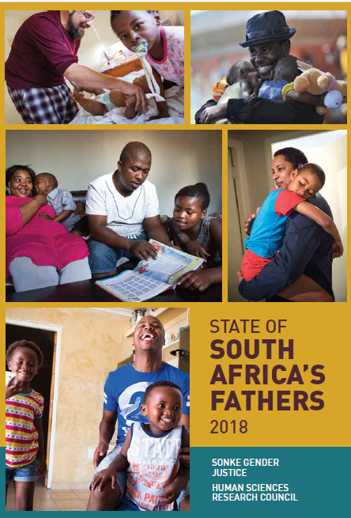
The State of South Africa’s Fathers report 2018
A facilitator of a broader narrative on fatherhood in SA.
An advocacy document, to improve policies and programmes that support father’s involvement.
To track parents’ use of parental leave
Notes:
The report inspires a broader perspective on fatherhood, beyond the narrow focus on the co-residence of a child with their biological father. In short there are more kinds of fatherhood than co-resident biological fatherhood and we need to start documenting these.
As an advocacy document, the report will provide regular updates to policy makers on fatherhood in South Africa, for example whether parents use the new parental leave provisions as intended.

Slide 4
What percentage of men are fathers?
About 53% of the total adult male population aged 18 – 59 years (17,527,315).
Just over half of the number of adult men in the country are likely to be biological fathers.
Notes:
> This is not an accurate number, but a loose calculation, and the number lies somewhere between 40 and 60 %.

Slide 5
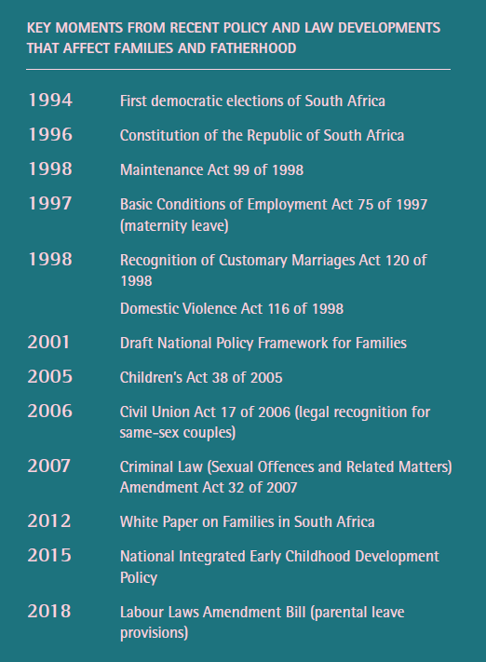
Policy timeline for Fatherhood in South Africa
Notes:
> This table presents key policy documents since 1994. We did not go to the policies preceding 1994 since it was hard to gauge when we should start.

Slide 6
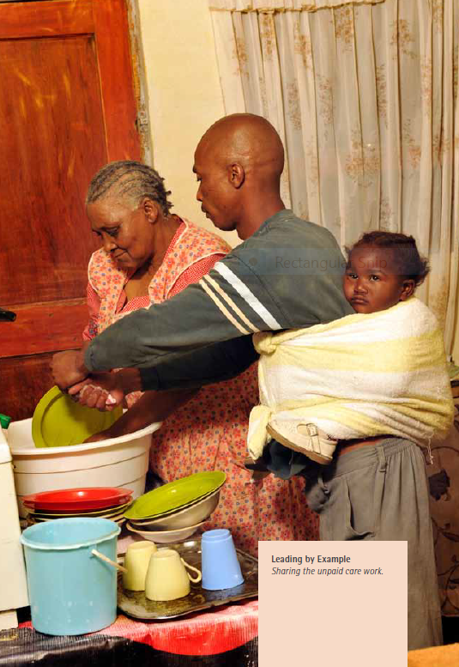
Grandmother Alice Mdaka, supports the ten people living in her small three bedroom Khayelitsha township house on her monthly R1200 pension.
This is supplemented by an additional R400 monthly she earns by selling items she knits, and another R400 contribution from her daughter who receives a state medical grant.
The entire family subsists on this total R2000 monthly. (2009)
A day in the life of Alice Mdaka
Notes:
> This is a picture taken by photographer Eric Miller and the notes are his. It reflects the type of household that i smore likely to be representative of SA than the nuclear family.

Slide 7
Children’s residency by household
Notes:
> Extended household = parents, children and members RELATED to household head.

Slide 8
Notes:
71% of children share a household with an adult man who may or may not be their biological father.
The 35% of men do not necessarily play a caregiving role, and may unfortunately pose a risk to the child.
It does however highlight the potential caregiving that another man may provide if we can get social fatherhood to be encouraged.

Slide 9
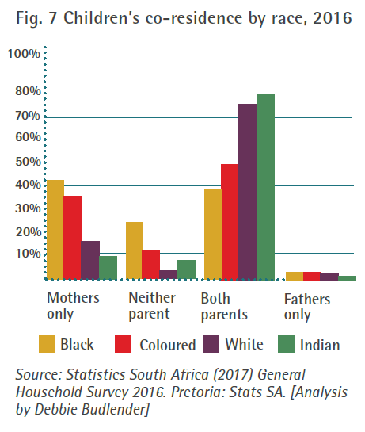
Notes:
> The co-residence by race is still a symptom of the migrant labour system’s legacy, where Black men were purposefully removed from their homes to provide cheap labour.

Slide 10
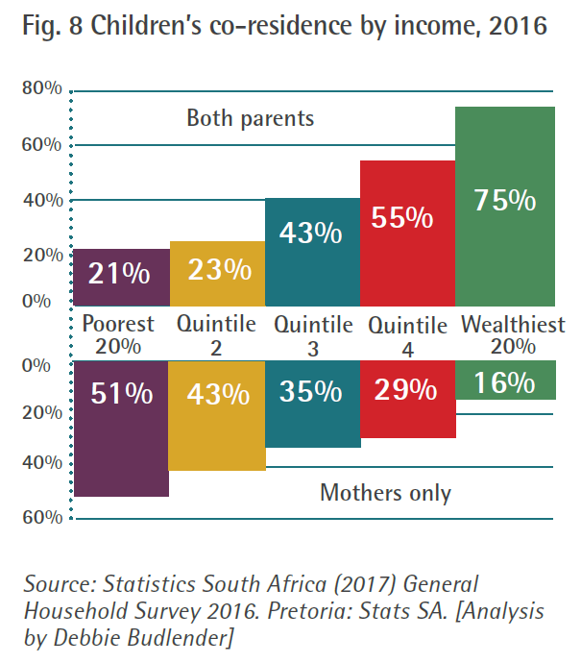
Notes:
Co-residence is not influenced by race or culture as much as it’s influenced by income.
For the top quintile (75%) the race categories are quite close to each other, for example Black families in this quintile show co-residence of 68%.

Slide 11
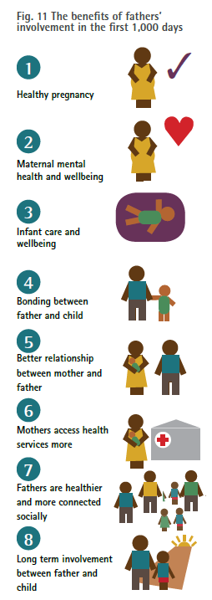
Fatherhood in the first 1000 days
Notes:
The first 1000 days in a person’s life is the most important period for brain development for the person’s whole life. It’s from conception up to the second birthday.
This chapter was written by Dr Tawanda Makusha and Dr Linda Richter
These benefits are possible when fathers are involved in caregiving in the first two years of the child’s life.

Slide 12
Men and the Child Support Grant
Men don’t use the CSG any differently
When men receive the CSG, their households are not more likely to spend money on alcohol, tobacco and gambling compared to households where women receive the CSG.
The education level and emotional health of caregivers, as well as the province of residence, are more influential than the gender of the caregiver in determining household spending on these items.
Notes:
> This was an analysis of a group of fathers who were the primary caregivers of children and the recipients of the CSG. Done by Dr Zoheb Khan at University of Johannesburg.

Slide 13
Labour Laws Amendment Bill:
Maternity leave remains, with slight increase in maximum allocation to 66% of standard leave for parents.
Paid Parental leave of 10 days for parents that do not qualify for maternity leave. The largest group of parents that fall in this category are fathers, so in effect we will now have paternity leave available.

Slide 14
Labour Laws Amendment Bill:
Language Gender neutral i.e. ‘parental leave’. Allows for all genders and sexual orientations.
Adoption leave of 10 weeks for adoptive parents and parents who commission a surrogacy, from the day of placement.

Slide 15
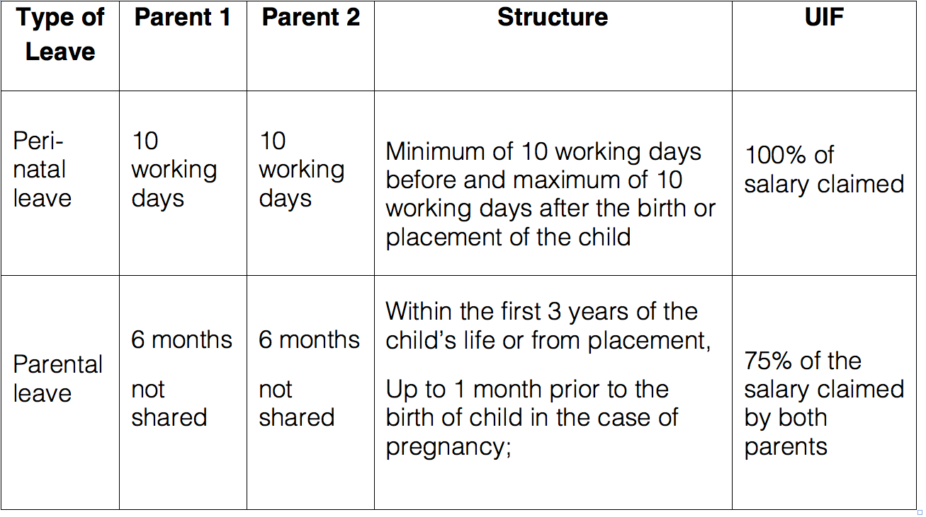
RECOMMENDED LEAVE STRUCTURE

Slide 16
Policy implementation suggestions
Enact parental leave provisions, and track parents’ use of leave.
Continue and expand men’s use of CSG.
Link maintenance system and family plan for separating couples better, to offer more options than money.
Improve health facility norms and standards to support men’s involvement in maternal and infant health.
Notes:
> These are the advocacy suggestions that follow in Chapter 6.

Slide 17
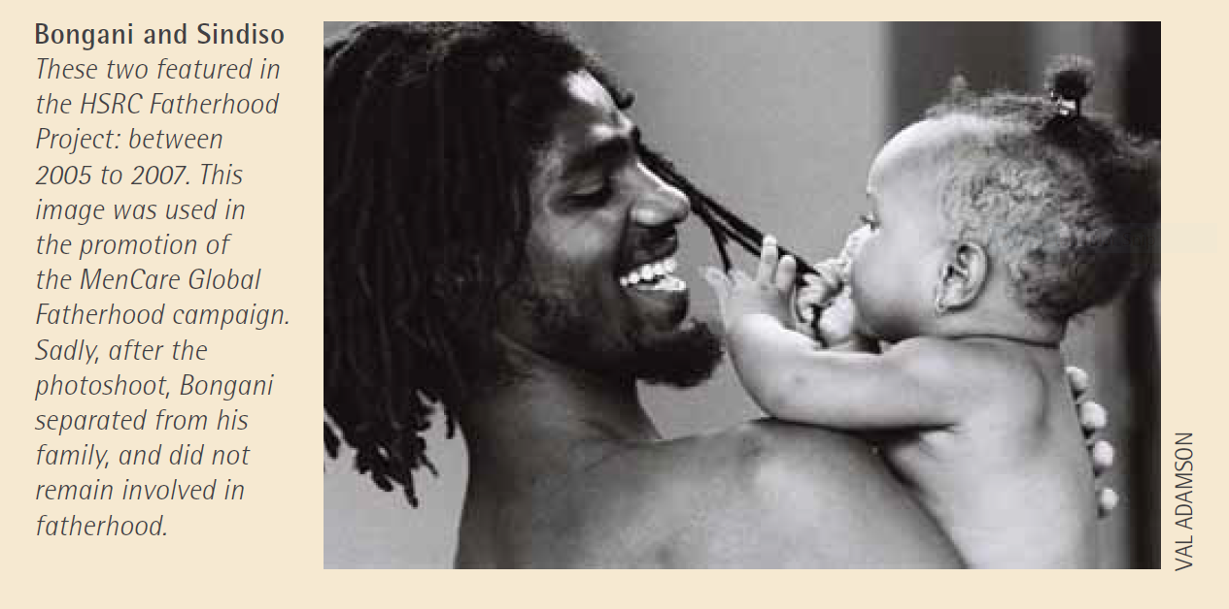
Thank you
andre@genderjustice.org.za
suleiman@hsrc.ac.za

