Slide 1
Digital Inequality in South Africa
A context in which to consider the Electronic Communications Act and an update on South Africa’s cost to communicate
Prof. Alison Gillwald
Executive Director: Research ICT Africa
University of Cape Town, Nelson Mandela School of Public Governance
Electronic Communications Bill Amendment public hearing
Parliamentary Portfolio Committee on Telecommunications and Postal Services
26 November 2018

Slide 2
Context
South Africa’s digital economy growing despite policy and regulatory environment not because of it.
We congratulate President Ramaphosa’s recent effort to urgently address obstacles in the sector such as the licensing of high-demand spectrum by ICASA and the reintegration of the two Ministries
Institutional incapacity, policy uncertainty and regulatory inefficiency have, among others shackled potential of sector to contribute to digital economy.
Long green and white process holding up rapid deployment, high demand spectrum release and institutional rationalisation only introduce amendments to three Act.
Still require policy and implementation that cuts across sectors – digital economy vision

Slide 3
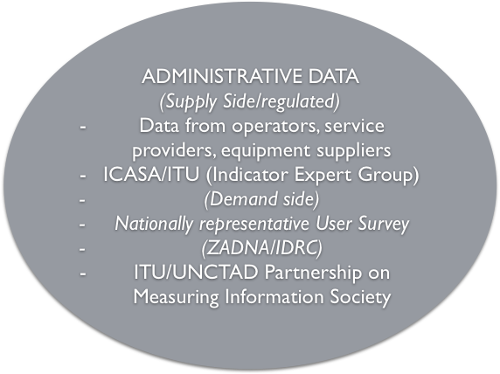
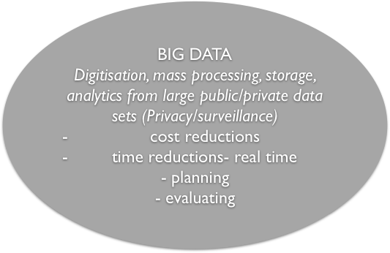
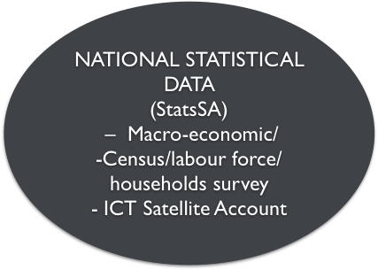
Research ICT Africa- Evidence based policy
Welcome requirements on regulator to collect data but requires integrated national effort to produce quality evidence

Slide 4

7 ICT indicators, 6 targets under SDG Goals 4, 5, 9,17
Target 4a: Proportion of schools with access to computers for pedagogical purposes
Target 4.4: Proportion of youth/adults with ICT skills, by type of skills
Target 5b: Proportion of individuals who own a mobile telephone, by sex (ITU)
Target 9c: Percentage of the population covered by a mobile network, broken down by technology (ITU)
Target 17.6: Fixed Internet broadband subscriptions, broken down by speed (ITU)
Target 17.8: Proportion of individuals using the Internet (ITU)

Slide 5
We do not have the official data to know our progress
We do not have the official data to know where we are or progress to SDG targets…

Slide 6
Supply vs demand-side indicators: What’s the story?
Active SIMS vs Unique subscribers.
Disaggregation by gender, income, education, location.

Slide 7
DEMAND SIDE ANALYSIS
Issues of digital inequality

Slide 8
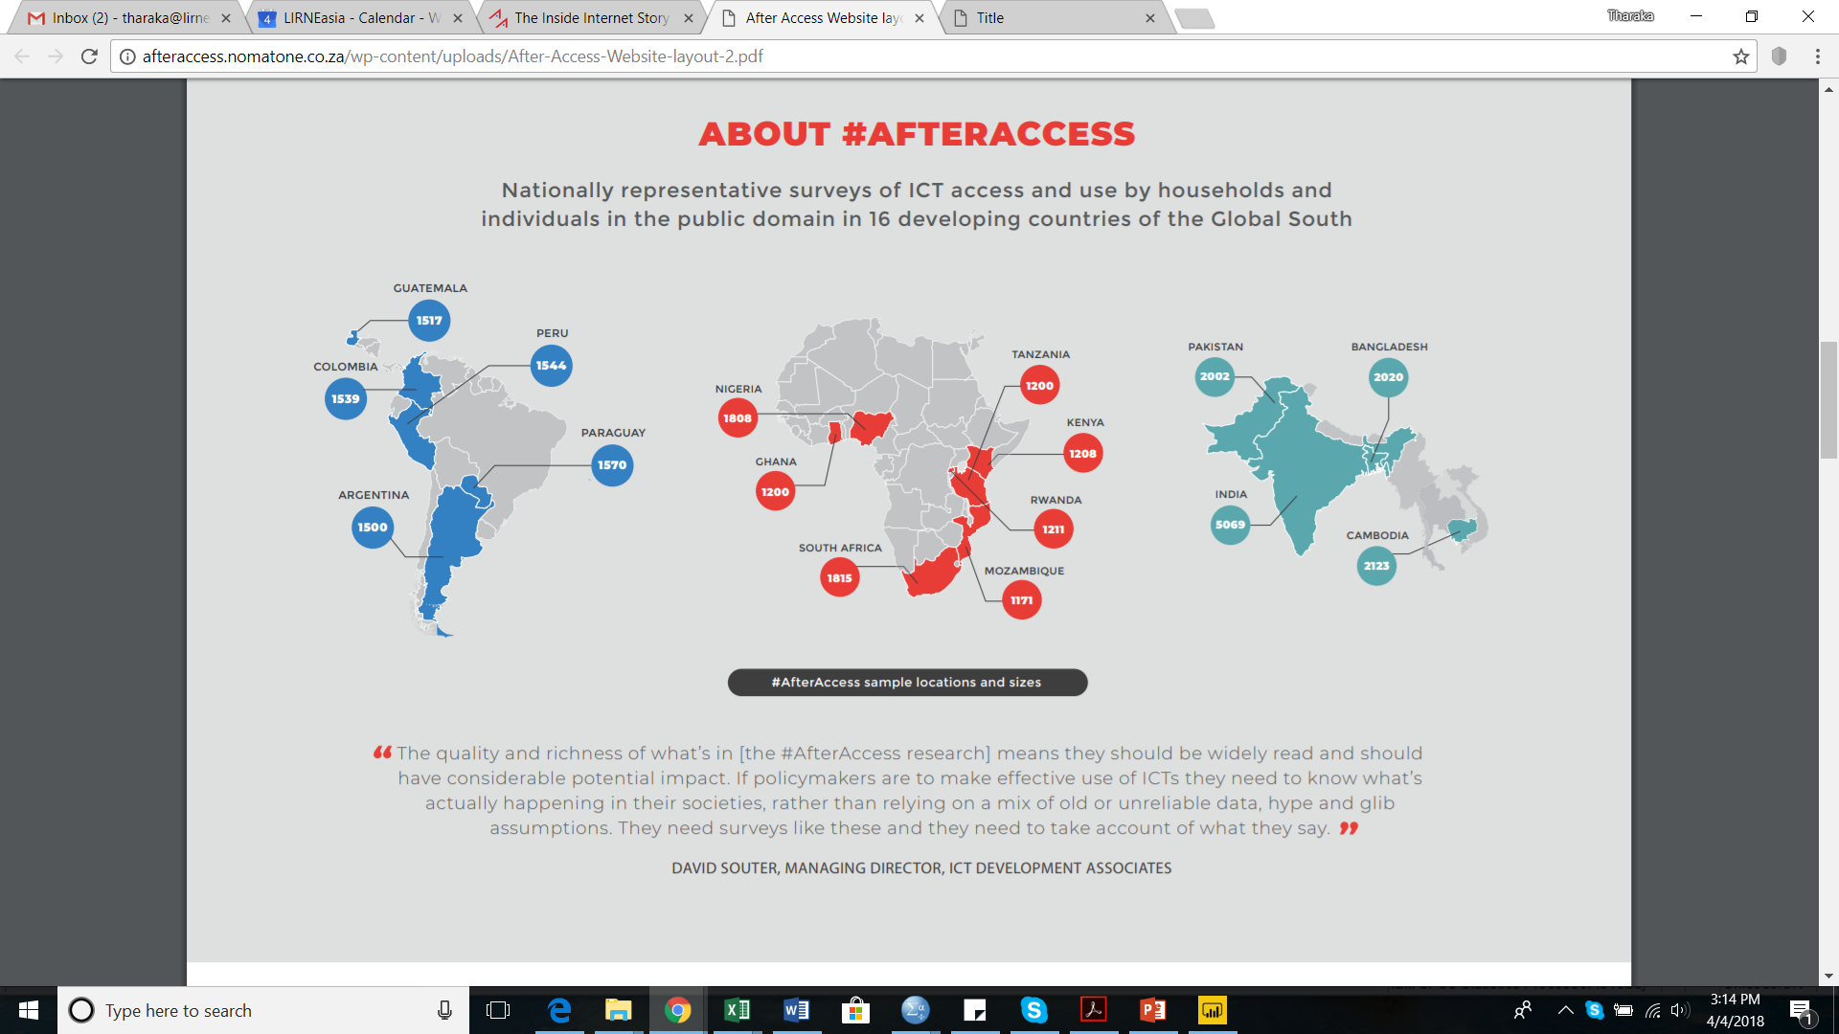
Nationally representative surveys of ICT access and use by households & individuals aged 15-65; In 16 developing countries; Data represents 30% of the global population; 28,900 face-to-face interviews; +/-3 margin of error

Slide 9
Sample
Two sampling frames were available for South Africa based on the 2011 census: Enumerator Areas (EAs) and Small Layers (SAL).
Out of 90, 425 EAs, a total of 75 EAs were sampled using SRS 47 urban areas and 32 rural areas were sampled ( 60% urban : 40% rural split).
The target sample of 1800 was spilt in to 60% urban and 40% rural, yielding a target of 720 rural and 1080 urban households.
Household and individual weights were then constructed based on the census and world data on urban and rural, male and female proportions.

Slide 10
Mobile phone ownership, Internet use tracks GNI per capita

Slide 11
Gender gap in mobile phone ownership
As markets become saturate greater parity in ownership
Smaller gap than Internet
      But other cultural, demographic, urbanisation, factors at play

Slide 12
Major barrier to adoption in rest of Africa is lack of power
South Africa performs very well compared to global south

Slide 13

Gender gap in Internet use also track GNI

Slide 14
Gender gap in Internet use also track GNI

Slide 15
Urban-rural Internet divide than gender divide (but overlapping)

Slide 16
ICT ownership
Despite lack of policy implementation and effective regulation ICT take-up strong, but those offline face same affordability and skills challenges as those off line anywhere else on the continent.

Slide 17
Ownership and use of ICTs by income
Affordability is the main obstacle to South Africans trying to get online

Slide 18
Financial inclusion
Transition from voice to data supported by other revenue streams such as mobile money

Slide 19

Internet access and social media penetration
 | 15+ that use the Internet |  |  |  | Where did you first access the Internet
 | 2008 | 2012 | 2017 | Diff (2017-2012) | Computer or Laptop | Mobile phone | Tablet | Social Media penetration
Ghana | 6% | 13% | 28% | 15% | 29% | 70% | 1% | 27%
Kenya | 15% | 26% | 27% | 1% | 25% | 75% |  | 25%
Mozambique |  |  | 10% | 10% | 20% | 77% | 3% | 9%
Nigeria |  | 18% | 29% | 11% | 29% | 71% |  | 27%
Rwanda | 2% | 6% | 9% | 3% | 49% | 51% |  | 6%
South Africa | 15% | 34% | 53% | 19% | 25% | 73% | 2% | 42%
Tanzania | 2% | 4% | 14% | 10% | 28% | 71% | 1% | 12%

Slide 20
Reasons for not using the Internet

Slide 21
SUPPLY-SIDE ANALYSIS
Pricing, quality and coverage as outcome of regulated competition

Slide 22
Cost drivers
High rand-dollar exchange rate- Which affects equipment import required for the constant upgrading of mobile network.
Increasing costs of key inputs - power in particular has inflationary effects on data prices
In the absence of high-demand spectrum being released to operators for 4G: high bandwidth services are also not being deployed in the cost-effective manner which further exacerbate the high cost of data.
Regulatory issues: failure of ICASA to complete market review to determine dominance in wholesale markets, which is highly imperfect by nature, does not produce the intended competitive results – wholesale facilities and IP transit costs result in high telecom input costs for service providers and corporates

Slide 23
International bandwidth and national transmission
South Africa is connected to six submarine cables.
Telkom, Liquid Telecom South Africa (previously Neotel) and Broadband Infraco have made considerable backbone and backhaul investment over the past decade, giving South Africa the most extensive coverage in the continent
Supplemented by recent expansion of fibre networks in larger metropolitan areas and complementary investments in secondary intercity routes (high levels of redundancy)

Slide 24
Mobile Market Share
The south African mobile market is dominated by two players: Vodacom and MTN.
Using the HHI the market is found to be highly concentrated which n index higher than 2500.
Despite smaller players (Cell C and Telkom) adopting a number of competitive strategies they have failed to gain substantial market share.

Slide 25
Mobile operator investments
Mobile operators have made significant network infrastructure investment to be able to carry vast volumes of data.
Vodacom coverage- 3G - 99.97%, 4G (80%)
MTN coverage- 3G - 98%, 4G (80%)
Competition in the mobile market is no longer about pricing only, quality is more critical especially in the data market.
Big operators are likely to win this battle as they are able to re-invest revenues gained from their large market shares
Figure 6: Operators’ capital expenditures (ZAR billions) in 2017/18
Source: Operators’ annual reports, 2017

Slide 26
Are data prices in South Africa high?
The cost of cheapest of 1 GB of data (international standard indicator) is used to compare prices in South Africa with other African countries
South Africa performs poorly in the RAMP index, coming 35th of out of 49 African countries
The cost of cheapest 1 GB of data in South Africa is USD 8.28 (ZAR 99) seven times higher the cost of 1 GB in Egypt (USD 1.13) and nearly three times the cost of same data in Ghana, Kenya and Nigeria
Though this is not how data is used in pre-paid markets – very high value low cost products that make ‘effective’ price much lower
But best value in >10GB products and post paid products that are the best value but not affordable to majority of citizens – ‘poverty premium’

Slide 27
SA’s Cheapest 1GB data Compared to Africa’s cheapest countries
Source: RAMP Index, 2018

Slide 28
Pricing strategy and competition
MTN offers the cheapest 500 MB data bundles for daily (ZAR 50) and weekly (ZAR 55) periods, but Telkom again offers the cheapest 500 MB monthly bundle at ZAR 69. Similarly, MTN offers the cheapest 1 GB weekly bundle (ZAR 70) but does not compare well in the 1 GB monthly comparison. Vodacom’s ZAR 149 promotional package (2 GB) offers the most value with an effective rate of ZAR 74.50 per GB, but Telkom’s 1 GB is still the cheapest at a nominal price of ZAR 99.
Rain now offers the cheapest tariffs across the board: a 100 MB bundle will cost a customer ZAR 5, significantly less expensive than the previously lowest ZAR 29 100 MB offering of Cell C, MTN and Telkom. Rain’s 500 MB costs less than half that of Telkom’s 500 MB bundle and also out-competes its 1 GB bundle price by being just about half the cost (ZAR 50).

Slide 29
Prices vs quality of service
In a regulated data environment a number of other important factors that have to be considered when comparing price
Licensee obligations – coverage, quality of service
And progress towards policy objectives - policy outcomes
QoS – increasingly important in broadband environment - QOS flip side of price.
  Penetration (access)
  Usage (intensity of use)
  Quality of service
Even price sensitive users choosing to pay premium for quality services (or just to get signal in their area).

Slide 30
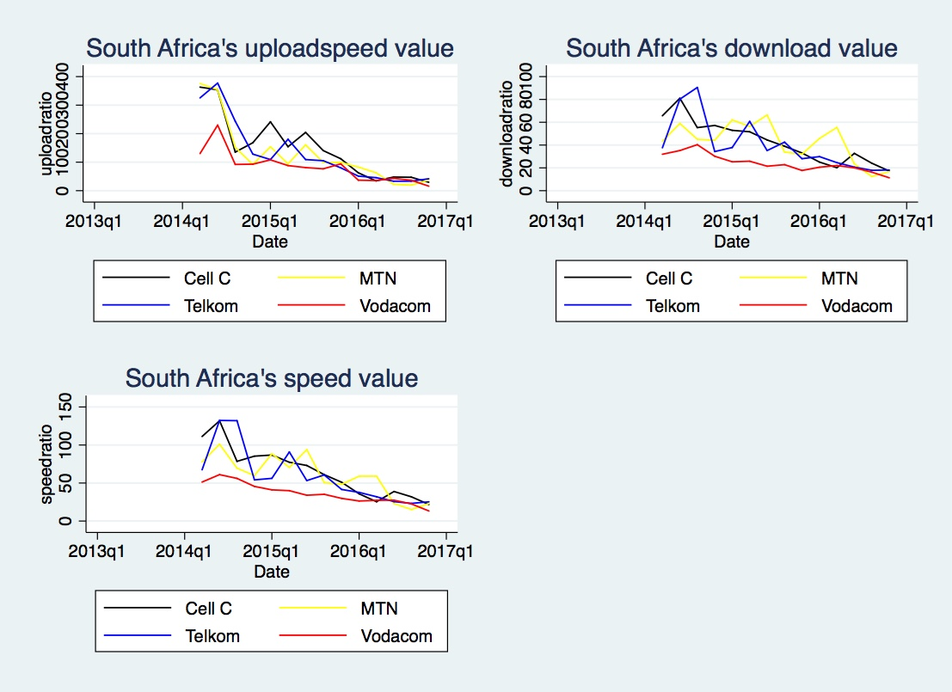
Quality adjusted prices
Represents the ratio between the 1GB data basket and the average download and upload speeds, shows that the two dominant operators Vodacom and MTN offer higher quality, respectively.
In the same period Telkom’s quality was the lowest. However, since Q1 2016, it seems that smaller operators improved their quality, catching up with dominant operators in Q2 2016 (in line with increased network investments). Vodacom SA’s high prices are accompanied by higher Internet speeds, compared to MTN SA and Cell C, which are performing less well on the measure based on average download/upload speed (in Mbps) divided by 1GB basket costs.

Slide 31
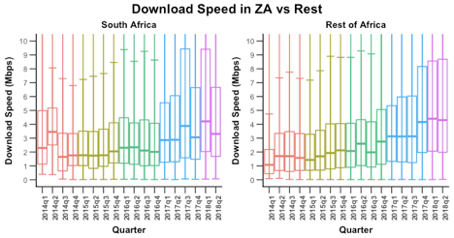
Download speed in ZA vs Rest of the World (Speedchecker)
South Africa performs well in comparison to other African countries.
download speeds in South Africa have been improving due to innovations and technological developments.
A development which can be associated with investments by telecommunication

Slide 32
…coverage too
Map shows five major operators: Broadband Infraco SOC Limited, FibreCO Telecommunications, Dark Fibre Africa, Liquid South Africa and Telkom South Africa. From the map, Telkom South Africa has the most comprehensive fibre coverage, reaching most parts of the country, while other operators like Dark Fibre Africa only provide services in major towns/cities.
Source: Steve Song

Slide 33
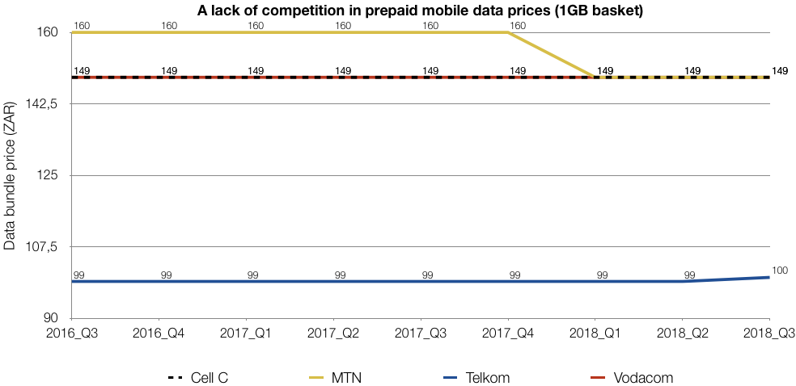
RIA’S Africa Mobile Pricing Index
The RAMP Index ranks the cheapest prepaid mobile voice, data and bundled products in 49 African countries

Slide 34
Some implications for ECA Amendment and beyond

Slide 35
Digital paradox
Digital paradox that more people come online greater inequality there is
Even though we do see significant investments in South African networks that have resulted in the extension of mobile and fibre networks across the country the After Access survey data illustrates how the socially and economically marginalised – particularly those at the intersections of class, gender, race, or ethnicity – are unable to harness the Internet to enhance their social and economic wellbeing.
Although lack of affordability of devices is the primary barrier to South Africans coming online and lack of affordability of data the major factors limiting intensity of use modelling of the data shows that the main factors determining determine the degree of digital inclusion are education and income.
Development of relevant local content and applications in local languages, along with the enhancement of citizens’ digital literacy skills, are all important demand stimulants.
Additional supply-side focused policy interventions which fail to address demand-side challenges will simply perpetuate the existing structural inequalities.
Until fundamental inequalities offline are addressed they will be replicated and even amplified online.

Slide 36
Efficiency, innovations vs consumer welfare
What is clear is that we need even greater regulatory agility and insight to manage tensions between the certain policy objectives of competitive efficiency, innovation and consumer welfare.
With prices of various services high by various benchmarks and more effective regulation of wholesale access in market in which operators are dominant could also reduce the cost of broadband not only for individual users but as a critical input into other sectors of the economy.
It is clear that even cost-based prices based on existing business models, licensing frameworks and spectrum valuing and use are not going to be affordable for half the population in South African that is currently offline.
Interventions that would reduce prices, enhance quality, improved e-literacy and develop local content would all bring online those who are currently marginalised from services, women being in the majority.

Slide 37
Agile policy & regulation for digital economy & society
Greater state coordination, harnessing of private sector and civil society resources
Adopt wider, integrated digital economy approach;
remove all excise duties on feature and entry level smart phones;
avoid instrumental competition regulation (static efficiency) in platform markets (dynamic inefficiency) which may inhibit innovation;
create open data, access to big data – transparency, accountability, entrepreneurial opportunity;
localisation – content/apps development;
create safe and secure Internet (cyberpolicy – data protection, to stimulate productive use, e-commerce, e-government, e-trade, while constraining global monopoly ensuing protection of citizens, and ensuring fair tax regimes; and
adopt short and longer term strategies to overcome human development constraints on digital inclusion - not only to enable consumption but also production.

Slide 38
Implement, adapt, implement…
NDP, SA Connect, adaptive regulation…
Implement SA Connect to drive investment into underserviced areas through public demand aggregation and creation of incentives through anchor tenancies (focusing on schools).
Connect public Wi-Fi to all public buildings.
implement critical competition elements of ECA, particularly Chapter 10 market review to enable more price sensitive users to use the Internet.
ICASA must regulate wholesale prices in markets where there is dominance as this is critical to creating the fair and competitive environment required to produce lower prices, better quality and range of services.
Review wholesale regulation in data market of facilities and bandwidth will reduce input costs for service providers and private networks.

Slide 39
WOAN
Cost of not releasing 4G spectrum for more than six years has been high requirement to refarm spectrum and use suboptimal spectrum for 4G has contributed to operator costs.
Had policy been effectively implemented the requirements and intended outcomes of the WOAN could have been far more effectively achieved through assessment of market dominance and asymmetrical regulation of it.
WOAN (of digital dividend spectrum only) only considered in markets with far more extreme dominance than South Africa (Kenya over 80% at the time and Mexico 75% - where the introduction of asymmetrical regulation permitted by the same constitutional changes has reduced América Móvil/Telcel to 60%.)
Tension between objectives universal access, SMME/BBEE, and competition pressures, investment.
While this will enable market entry and expansion of some existing smaller service providers a disparate competitive pressure will not discipline market behaviour of the incumbents and may weaken position of late, smaller network operators ,through market fragmentation 9in face of global trend towards greater concentration.
Ensuring underserved areas are beneficiaries of high demand assignments can be addressed through requirements on the winning bidders to provide mobile broadband coverage in those areas before the operator is permitted to deploy the new spectrum in areas already serviced.
High demand spectrum should be competitive assigned without creating artificial scarcity to drive up prices, with rules to avoid speculation, spectrum trading to correct valuation errors should bee permitted.

Slide 40
Alternative access strategies
Even if there was effective regulation and prices were cost based largely numbers of people
Review all national licensing, spectrum and USF models and strategies – develop alternatives based on realities of extreme inequality;
create incentives for infrastructure-sharing and support complementary investments in broadband networks;
enable public and private extension of free public Wi-Fi to towns and rural with the connection of all public buildings;
more optimal co-existence of licensed and unlicensed spectrum that will optimise spectrum for diverse needs in the country;
secondary use of spectrum should be made available which can be delivered at a fraction of the price of GSM technologies;
ICASA must assign licensed spectrum required for the evolution of existing services at a competitively determined (efficient use) price to ensure the build-out of capital-intensive networks (with spectrum trading to correct value/use errors);
nationally allocated spectrum not in use in should be made available through low cost or licence-exempt spectrum for communities, non-profit providers or micro-networks; and
create incentives for infrastructure-sharing and support complementary investments in broadband networks.

Slide 41
Institutional failure
Many of the failures attributable to institutional arrangements and incapacitated institutions.
It is in the national public policy that the transformative potential lies.
The institutions and the individuals in them require the technocratic capability to implement the policy effectively.
Shifting competitive assessment functions to the competition commission (which are intrinsic to ex ante regulation to enhance consumer welfare.
Claw back implementation powers into equally (arguably more incapacitated) Ministry/Department or additional implementation agencies (with skills challenges and duplication of administrative costs) as proposed does not enable the implementation of the public interest (independent of undue state or industry influence and with Parliamentary oversight) necessary for effective regulation.
Also need more stringent appointment processes for Chapter 9 institutions that have higher technical expertise thresholds.

Slide 42


Research made possible through the support of
See Gillwald, Mothobi & Rademan. 2018. State of ICT in South Africa, available at www.researchictafrica.net, or electronically here

