Slide 1
BUDGET JUSTICE COALITION SUBMISSION 2018 MTBPS AND ADJUSTMENTS APPROPRIATION BILL
Parliament, Cape Town
23 November 2018 Public Hearing of The Standing Committee on Appropriations

Slide 2
Preamble
This submission is informed by a range of civil society organisations ,the Budget Justice Coalition (BJC). The BJC is a coalition of about twenty progressive civil society organisations who acknowledge that working to ensure substantive equality in our society is not possible without active engagement with, and transformation of, the budget.
The primary purpose of this submission is to highlight areas within the selected programmes that are in need of concerted interventions in relation to budgeting, and planning following the tabling of the Medium Term Budget and Policy Statement (MTBPS), Adjustments Estimates and Adjustment Appropriations Bill by the Minister of Finance, Tito Mboweni, on 24 October 2018.

Slide 3
Presentation Structure
INTRODUCTION
IMPLEMENTING RECOMMENDATIONS OF UN
FINDINGS AND RECOMMENDATIONS:
Basic Education
Post-School Education and Training
Health
Social Development
Environmental Governance
Human Settlements
Rural Development & Land Reform

Slide 4
Introduction
The MTBPS states a commitment to keeping government expenditure within previously stated expenditure ceilings
This signals a certain level of control over national government expenditure, but could also reflect the absence of political will to cut ‘fat’ in the system in the face of a looming crisis
It is unacceptable that the financial consequences of poor governance and corruption are being transferred to the citizenry
After 2 Years of engagement between Civil Society , National Government and the United Nations Committee on Economic Social and Cultural Rights has released its concluding observations in October 2018
While social expenditure has maintained inflation level increases and South Africa has been implementing austerity measures for some time .
The Committee recommendations on in respect of South Africa’s performance provide an introduction to our submission

Slide 5
ICESR Recommendations to South Africa
Review Fiscal Policy to improve its capacity to mobilize domestic resources required to bridge existing gaps in realising the socio economic rights
Revise the Provincial and Local Government Equitable Share Formulas to improve equity in the allocation of resources towards the attainment of covenant rights
Assess the impact of the vat increase on low income households and implement mitigating actions where needed
Re-examine growth model in order to move towards a more inclusive development pathway
Intensify efforts to combat illicit financial flows including measures to combat trade mispricing within multi national corporations
Austerity Measures often unavoidable but when implemented they should be temporary , only cover the period of the crisis , necessary and proportionate and not result in discrimination and increased inequalities

Slide 6
Basic Education
The 2018 Medium Term Budget Policy Statement (MTBPS) boasts that “[a]fter debt-service costs, education is the fastest-growing area of expenditure”, however this statement is misleading. The basic education budget is actually growing slower than a number of other budget priorities and has been continuously revised downward.
The basic education government expenditure according to the budget review for the 2018/19 financial year was R230,4 billion; almost R20,3 billion less than what we had projected to be spending two years ago.
A look at the previous MTBP statements reveals that there will be far less funding available to basic education than was previously budgeted for
This decrease in projected allocations is particularly concerning given the 1% VAT increase which came into effect in April this year. This has meant that the cost of textbooks and materials for building schools, amongst other items, have increased, while the sector has less funds to make provision for education resources

Slide 7
Spending Projections on Basic Education: MTBPS 2016-2018
 | Projected Basic Education Spending in the 2018/19 Financial Year
MTBPS 2016 | R250,7 billion
MTBPS 2017 | R249,8 billion
MTBPS 2018 | R247,4 billion (revised estimate)

Slide 8
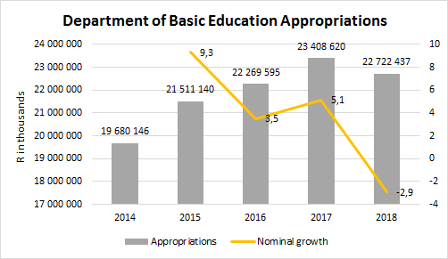
Department of Basic Education Appropriations

Slide 9
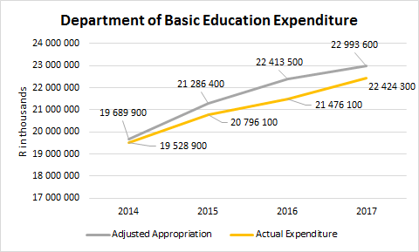
Department of Basic Education Expenditure

Slide 10
School Infrastructure Backlogs Grant Underspending
R’ 000 | Allocated | Spending | Underspending
2013/14 | R 1 956 000 | R 1 370 100 | R 585 900
2014/15 | R 2 513 600 | R 2 407 900 | R 105 700
2015/16 | R 2 024 300 | R 1 368 300 | R 656 000
2016/17 | R 1 979 800 | R 1 049 500 | R 930 300
2017/18 | R 2 179 698 | R 1 786 396 | R 393 302

Slide 11
ASIDI Targets versus Performance
 | 2016/17 |  | 2017/18 |  | 2018/19
 | Target | Performance | Target | Performance | Target | Performance
Schools Built | 136 | 16 - (12%) | 115 | 12 - (10%) | 50 | 9 - (18%)
Sanitation | 265 | 9 - (3%) | 257 | 29 - (11%) | 285 | 64 - (23%)
Water | 459 | 10 - (2%) | 344 | 43 - (13%) | 325 | 64 - (20%)
Electricity | 620 | 0 - (0%) | 134 | 17 - (13%) | - | -

Slide 12
Findings
While allocations to the Department of Basic Education have been increasing, the annual percentage growth is slowing down
Where the Department has been allocated funds, it has struggled to use its entire budget
Spending patterns of the SIBG for the last 5 years show a continuous trend of under-spending on the ASIDI programme
For the past three years the DBE has not met a single target and for a project which should have concluded after a three year period, seven years later, the programme has still not completed its work

Slide 13
Recommendations
The Standing Committee on Appropriations, National Treasury and the Department of Basic Education need to work together to determine which programmes contribute to the underspending of allocated budgets and how to mitigate further underspending in the current and next financial year.
Provide financial management support to the Department of Basic Education and provincial education departments to encourage output driven expenditure, particularly on infrastructure grants.
Increased oversight on the ASIDI programme to ensure efficient budget expenditure, as well as monitoring performance to see that delivery targets are reached before the 2020 Norms and Standards second deadline.
National Treasury should reverse the almost R7 billion cuts to school infrastructure grants announced in the February budget speech.

Slide 14
Post-School Education & Training
Similar to the 2017/18 financial year, post-school education and training remains the second fastest growing expenditure item, after debt service costs. This line item will grow by approximately 10% over the medium-term.
Former President Jacob Zuma announced last year that higher education studies would be free (starting in 2018) for poor and working-class first-year students. This announcement undoubtedly had an impact on the country’s fiscus resulting in former Minister of Finance, Malusi Gigaba, asserting in his 2018 Budget Speech that R57 billion would be re-allocated to fund fee-free higher education for poor and working class students over the medium term.
The National Student Financial Aid Scheme (NSFAS) is the primary vehicle through which fee-free tertiary education is rolled out. As such, there has been a massive increase towards the higher education budget and a substantial amount of these funds are pooled into Programme 3 – under which NSFAS is housed.

Slide 15
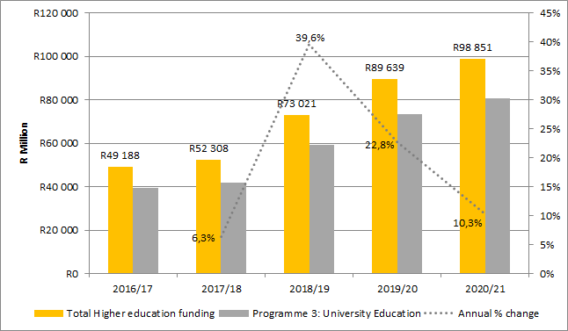
Post-school Education & Training

Slide 16
Findings
The 2018 Adjusted Estimates of National Expenditure (AENE) indicate that an additional amount of approximately R103 million was allocated to Programme 3 (University Education), increasing the allocation from R59.14 billion to R59.25 billion.
Unfortunately the consequence of these increases on other social spending budgets, have been dire. The 2018/19 national budget revealed baseline reductions across a number of sectors, including budget cuts to municipal, housing and education infrastructure.
Questions remain on how the state intends to address these competing priorities, therefore, sustaining the funding of fee free higher education and ensuring that other social needs are met through appropriate budget allocations.

Slide 17
Recommendations
The development by the Department of Higher Education and Training, in consultation with the relevant stakeholders, including National Treasury, of a policy that speaks to the roll-out of fee-free higher education is imperative. In the absence of a guiding document the sustainability of this proposal falls into question.
The realisation of fee-free higher education must not compromise the provision of other social services, such as basic education – particularly in relation to budget allocations.
With the support of DHET, governance challenges within NSFAS must be addressed as a matter of urgency. The consequences of the disarray within the funding scheme impacts those in need of financial assistance most of all.

Slide 18
Health
Current allocations insufficient to transform health care delivery as proposed in the recently tabled NHI Bill let alone address immediate priorities immediate challenges
There is no health system without health workers , estimates of vacancies range from 37000 – 40 000 vacancies . The 350 million allocated for critical posts is unlikely to address the staffing crisis.
Well trained , adequately remunerated community health workers can contribute significantly to improving service delivery. Beyond bringing forward the transition to the minimum wage , investments in providing community health workers with the necessary training to fully integrate them into the health workforce must be accelerated.
Poor leadership and governance in the management of health resources have resulted in significant under resourcing of health care manifesting in growing accruals amounting to R 14 billion per annum , growing wasteful and irregular expenditure .
Medico Legal Claims continue to weigh heavily on the system. Total claims in excess of R56 Billion . The continued underinvestment in the service delivery could result in further growth in these provisions

Slide 19
Health
Health infrastructure spending continue to disappoint with significant under performance .While financed through a nationally held conditional grant , provinces manage funds in line with local priorities . Centrally held funds in the NHI Facility Revitalization grant has also also under performed with over R820 million reprioritized in the 2018 Budget .
The tabling of the NHI BILL in June this year is a significant advancement on the road to universal health coverage but the lack of a comprehensive financing to support its implementation weakens prospects of its eventual implementation

Slide 20
Recommendations
Require a NDOH to compile a comprehensive HRH distribution analysis of Health Workforce at facility , district and provincial level
Require NDOH along National Treasury to develop a funding plan for the filling of critical frontline health posts
Address the leadership and governance challenges in provincial departments to ensure that allocation for health are spent on health
Require NDOH to develop a plan to address challenges in the NHI indirect grant that addresses underspending
Require NDOH to implement the National Community Health Worker policy and the recommendations of the CHW investment case

Slide 21
Social Development
Increasing and expansion of social grants should be at the centre of any inclusive pro poor economic stimulus package as beyond benefitting poor households directly but also increases aggregate consumption through increased spending
There is a concern that potential beneficiaries of the Child Support Grant are being administratively excluded with under spending of over R630 million over the last two years due to “ greater efficiency in assessment” and “lower than expected take up”
Despite being a signatory to the International Covenant on Socio Economic Rights South Africa provides no commitment to social assistance for vulnerable poor people between 18 and 59
Recent VAT increases have significantly impacted on food security of poor people. Its alarming that despite budget allocation in the Food Relief Program to support 413 000 vulnerable people only 112 806 vulnerable individuals were able to access this support

Slide 22
Recommendations
Require National Treasury to fully integrate pro poor social assistance into economic recovery plans
Investigate the administrative exclusion of potential beneficiaries of the child support grant by requiring the department of social development to provide insights into its reported efficiencies in assessment as well as the lower than expected demand despite anecdotal evidence to the contrary
Require National Treasury along with the department of social development to investigate the progressive implementation of a Basic Income Grant and prioritise the review of comprehensive social security
Investigate measures to assist Parliament in prioritising the passing of the Social Assistance Amendment Bill to create a CSG top up for orphans in line with the High Court Order

Slide 23
Environmental Governance
The 4,5 increase in the allocation to the department of environmental affairs is lauded however analysis of the budget mix indicate that over 54% of the departments budget is allocated to an expanded public works program
While investment in green projects and expanded public works are important the administrative burden of these projects likely impact on the departments core work of overseeing and fulfilling a host of legal responsibilities emanating from South Africa Environmental Statutes
Less than a third of the budget (30%) is directed to fulfilling these obligations which places significant risk to the departments ability to fulfil its constitutional obligation to protect the environment for the benefit of present and future generations
In light of significant environmental risks presents by climate change , the allocation of a mere .9 percent of the total budget is alarming

Slide 24
Recommendations
There is a need to reorganise the current budget mix to support the departments core work
Consideration should be given to moving current EPW programs housed within the department to the expanded public works programs which promote more efficient implementation
Request the department of planning monitoring and evaluation to investigate current mandate of the department and report on the extent to which the department budget is sufficient to deliver its mandate

Slide 25
Human Settlements
The right to housing is one of the most contested and litigated socio-economic rights in South Africa
The right to housing is central to fulfilment of a number of fundamental rights including the right to health and the right to dignity
Housing delivery is taking place in a context where it will take the City of Cape Town about 60 years to get through its waiting list
Over 3,1 million people living informal settlements
As we move towards our 25th year as a democracy continued failure in this program is longer acceptable .

Slide 26
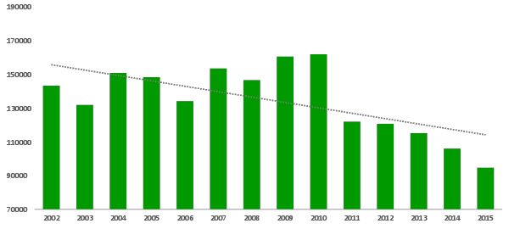
Number of Houses/Units Completed per Year,
2002 – 2015
Notes:
This graph illustrates the department’s progress with regard to housing delivery.
It looks at the total number of separate houses and residential units developed across all of the governments housing programmes, including affordable rental and Community Residential Units (CRU).
WATCH TREND SINCE 2011

Slide 27
Recommendations
Request an analysis of the extent to which current intergovernmental fiscal arrangements is impacting on the delivery of this right
Investigate the extent constraints on the delivery of subsidy units with mere 33% of targeted units reached
Request the department to submit plans to address weaknesses in informal settlement upgrading plans
Investigate the withholding of the Human Settlements Development Grant to Limpopo
Request treasury to investigate the introduction of new funding conditions to improve the performance of Urban Settlements Grants

Slide 28
Rural Development and Land Reform
Despite the dominance of the land issue in political discourse it is concerning that the MTBPS offers little guidance on the extent to which the deficiencies in the current program will addressed over the medium term.
Instead an ready miniscule land reform budget is reduced by 35 %
No new measures or programs are introduced to address serious problems in the program highlighted in our written submission

Slide 29
-Thank you -
For further information contact:
Zukiswa Kota z.kota@ru.ac.za (PSAM)
Daniel McLaren mclaren@section27.org.za (Section 27)
Russell Rensburg russell@rhap.org.za (RHAP)
Sacha Knox sacha@spii.org.za (SPII)
Sibabalwe Gcilitshana sibabalwe@equaleducation.org.za (EE)

