Slide 1
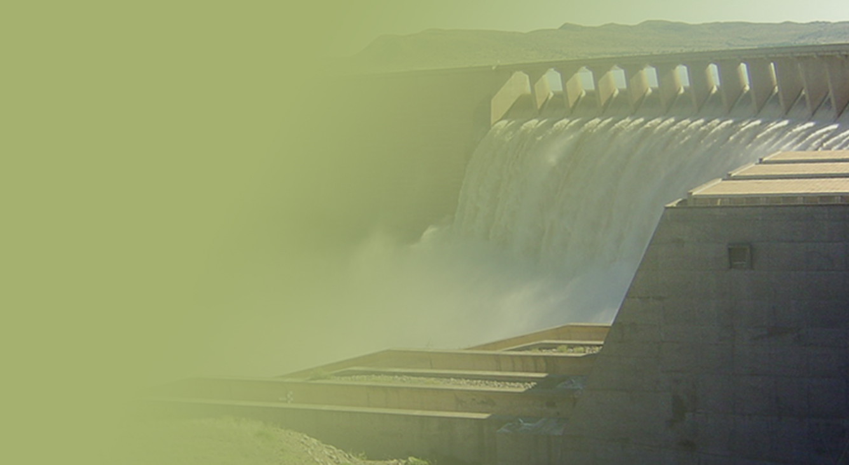
PRESENTATION TITLE
Presented by:
Name Surname
Directorate
Date
VOTE 36: ADJUSTMENT APPROPRIATION BILL FOR THE 2018/19 FINANCIAL YEAR
Date: 22 November 2018

Slide 2
Contents
Part A: Overview 2018/19 second quarter performance
Non-financial performance
Financial performance
Part B: Overview of 2018/19 adjusted budget
Overview of adjusted budget per programme and economic classification
Readiness to spend additional allocation

Slide 3
Part A: overview 2018/19 second quarter performance

Slide 4
Overview: Main Account 2018/19 original budget
Analysis of original budget | Amount in R’000
Un-earmarked funds | 2 770 366
Earmarked funds | 2 153 894
Specifically and exclusively appropriated | 10 647 358
Total | 15 571 518
Notes:
Details
Un-earmarked funds: 2 770 366
Un-earmarked funds (excluding ring-fenced allocation): 2 208 250
Ring-fenced allocation for infrastructure and planning services: 122 936
Ring-fenced allocation for office accommodation: 439 180
Earmarked funds: 2 153 894
Transfers to Water Trading: 2 083 894
Water resource management in 9 WMAs: 70 000
Specifically and exclusively appropriated: 10 647 358
Compensation of employees: 1 720 205
Regional Bulk Infrastructure Grant (Indirect): 2 880 922
Water Services Infrastructure Grant (Indirect): 608 175
Conditional Grants to Local Government: 5 438 056
Total: 15 571 518

Slide 5
Analysis of Q2 final performance
Non-financial performance
Financial performance

Slide 6
Analysis of non-financial performance per budget programme
Achieved
(100%)
Partially achieved
(50 – 99%)
Not achieved
(<50%)

Slide 7
Financial performance per budget programme & economic classification
Programme | Total budget |  |  |  | Quarter 2
 | Total appropriated | Actual spending | Variance | % spent | Budget / drawings | Actual spending | Variance | % spent
 | ‘000 | ‘000 | ‘000 |  | ‘000 | ‘000 | ‘000
Administration | 1,714,639 | 1,432,691 | 281,948 | 84% | 869,405 | 1,432,691 | (563,286) | 165%
Water Planning & Info Management | 862,122 | 364,608 | 497,514 | 42% | 396,248 | 364,608 | 31,640 | 92%
Water Infrastructure Dev | 12,496,165 | 5,204,329 | 7,291,836 | 42% | 6,476,947 | 5,204,329 | 1,272,618 | 80%
Water Sector Regulation | 498,592 | 140,774 | 357,818 | 28% | 225,050 | 140,774 | 84,276 | 63%
Total | 15,571,518 | 7,142,402 | 8,429,116 | 46% | 7,967,650 | 7,142,402 | 825,248 | 90%
Economic Classification
Current payments | 3,293,839 | 2,048,411 | 1,245,428 | 62% | 1,585,798 | 2,048,411 | (462,613) | 129%
Compensation of Employees | 1,720,205 | 771,952 | 948,253 | 45% | 843,595 | 771,952 | 71,643 | 92%
Goods and Services | 1,573,634 | 1,276,456 | 297,178 | 81% | 742,203 | 1,276,456 | (534,253) | 172%
Interest and Rent on Land | - | 3 | (3) | 0% | - | 3 | (3) | 0%
Transfers and Subsidies | 8,633,286 | 3,822,760 | 4,810,526 | 44% | 4,214,856 | 3,822,760 | 392,096 | 91%
Payment for Capital Assets | 3,619,984 | 1,271,231 | 2,373,162 | 35% | 2,166,996 | 1,271,231 | 895,765 | 59%
Total | 15,571,518 | 7,142,402 | 8,429,116 | 46% | 7,967,650 | 7,142,402 | 825,248 | 90%

Slide 8
Summary: notes to the financial performance
Economic classification | Notes
Compensation of Employees (Under-spending) | Vacant posts across all four programmes: The recruitment processes are underway for the filling of posts which are mainly critical and/or core in nature and vacant due to natural attrition
Goods and Services (Over-spending) | The over spending was largely due to the amounts (R610.286 million) paid to the Implementing Agents (IAs) for the War on Leaks (WoL) National Strategic Programme, paid without budget
Interest and Rent on Land (Over-spending) | The incurred amount relates to interest attributed mainly to penalties charged on the accommodation/ transportation no shows, interest charged on overdue accounts and cancellation of courses
Transfers and Subsidies (Under-spending) | The under spending was attributable to the following outstanding transfers: RBIG 5B: R268.380 million: Amount withheld due to non-compliance with the provisions the Division of Revenue Act, 2018 (Act No. 1 of 2018) (DoRA).
Notes:
The country loses seven billion rand a year to water losses
Rural municipalities have a non-revenue water rate of 72.5%, while metropolitan municipalities are averaging around 34.3% water loss
The cost of the WoL project to reduce these water losses is a lot less compared to building new infrastructure to make these quantities of water available and will enhance the return on existing infrastructure
The project is currently training ten thousand artisans and or plumbers who will fix leaking taps in their local communities and falls within the Government set of goals and commitments to advance youth development
The learners are gradually completing their training (i.e. 910 water agents have completed, 482 artisans completed, 446 artisans are preparing to sit for their trade test before the calendar year).
Should this project be stopped at this stage all the costs incurred to date would be considered to be fruitless & wasteful
The cancelling of the WoL project at this stage could result in youth revolts

Slide 9
Summary: notes to the financial performance
Economic classification | Notes
Transfers and Subsidies (Under-spending) cont… | WSIG 5B: R14 million: Amount withheld due to non-compliance with the provisions the Division of Revenue Act, 2018 (Act No. 1 of 2018) (DoRA). Amatola WB: R65 million - The WB spending has been slow on the 2017/18 financial year transferred allocation. The Department held bilateral meetings with the entity, and it was decided that the WB must submit a turn-around plan before the Department transfers the delayed allocation. Magalies WB: R23.846 million - The project namely Pilanesberg BWS phase 2 is completed and commitment for the phase has been reached. Phase 3 is still at a planning stage, there is a potential risk that transferring the allocation will mean that the funds will not be spent for the intended purpose, which is construction work. Sedibeng WB: R60.200 million - The delayed allocation will be transferred once the Department has received the necessary documentation from the entity.
Payments for Capital Assets (Under-spending) | The under spending is attributable to the invoices still to be certified, verified and approved for payment of work done on the Indirect (Schedule 6B) Regional Bulk Infrastructure and Water Services Infrastructure Grants.

Slide 10
Overview: Water Trading Q2 final performance
Overall non-financial performance
Analysis per budget programme
Achieved
(100%)
Partially achieved
(50 – 99%)
Not achieved
(<50%)

Slide 11
Overview: Water Trading 2018/19 income and expenditure
Economic classification In R’000 | Annual budget | Actual | % spent
Revenue from exchange transactions | 8,866,476 | 4,978,586 | 56%
Revenue from non-exchange transactions | 2,031,590 | 1,695,068 | 83%
Total income | 10,898,066 | 6,673,655 | 61%
Operating expenditure | 9,062,301 | 6,289,470 | 69%
Projects expenditure | 1,835,764 | 192,714 | 10%
Total expenditure | 10,898,066 | 6,482,184 | 59%
Surplus / (deficit) | 0 | 191,471
Notes:
Details
Un-earmarked funds: 2 770 366
Un-earmarked funds (excluding ring-fenced allocation): 2 208 250
Ring-fenced allocation for infrastructure and planning services: 122 936
Ring-fenced allocation for office accommodation: 439 180
Earmarked funds: 2 153 894
Transfers to Water Trading: 2 083 894
Water resource management in 9 WMAs: 70 000
Specifically and exclusively appropriated: 10 647 358
Compensation of employees: 1 720 205
Regional Bulk Infrastructure Grant (Indirect): 2 880 922
Water Services Infrastructure Grant (Indirect): 608 175
Conditional Grants to Local Government: 5 438 056
Total: 15 571 518

Slide 12
Summary of operational expenditure
Objective | Annual budget | Actual | % spent
 | R’000 | R’000
Administration | 815,827 | 667,249 | 82%
Implementation of water resources management activities | 805,058 | 166,328 | 21%
Operations, maintenance and refurbishment of national water resource schemes | 493,261 | 245,563 | 50%
Financing and investment in raw water infrastructure | 6,223,417 | 4,932,066 | 79%
Bulk water supply to strategic users | 724,739 | 278,264 | 38%
Total operational expenditure | 9,062,301 | 6,289,470 | 69%
Notes:
Administration: mainly relates to the non recoverable construction costs (i.e. CoE and G & S) which amounted to R209 million by 30 September 2018 that could not be capitalised against a project.
Financing and investment in raw water infrastructure: relates to additional payment made to the TCTA (i.e. R 4, 9 billion) to enable them to pay the R9.3 billion bond redemption by 01 Aug 2018.

Slide 13
Summary: notes to the financial performance
Economic classification | Notes
Operational expenditure | A spending of 69% against the annual budget and can be attributed to the payment made to TCTA for the financing and investment in raw water infrastructure and also the non-recoverable costs for construction sites (included as part of Administration programme)
Projects expenditure | A spending of 10% against the annual budget of R1.8 billion. Augmentation projects budget for the financial year amount to R1.2 billion excl. of VAT and only R97 million was spent to date. Refurbishment and Rehabilitation of existing raw water infrastructure reflect a spending of R25 million against the annual budget of R500 million. The budget allocation for the refurbishment and rehabilitation will be revised down in order to cover the projected overspending on operation and maintenance. There is no spending on rehabilitation of conveyance system due to the late approval of the budget allocation and suspension procurement process.

Slide 14
Part b: overview of 2018/19 adjusted budget

Slide 15
Overview of adjusted budget per programme and economic classification
Programmes | Main Appropriation | Unforeseeable/ Unavoidable | Virements | Other adjustments | Total Adjustments | Adjusted Budget
 | R`000 | R`000 | R`000 | R`000 | R`000 | R`000
Administration | 1 714 639 | - | (53 485) | - | (53 485) | 1 661 154
Water Planning & Info Mgt. | 862 122 | - | (172 492) | - | (172 492) | 689 630
Water Infra Mgt. | 12 496 165 | - | 405 874 | 1 302 211 | 1 708 085 | 14 204 250
Water Sector Reg. | 498 592 | - | (179 897) | - | (179 897) | 318 695
Total | 15 571 518 | - | - | 1 302 211 | 1 302 211 | 16 873 729
Economic Classification
Compensation of Employees | 1 720 205 | - | (2 223) | - | (2 223) | 1 717 982
Goods & Services | 1 573 634 | - | (10 540) | - | (10 540) | 1 563 094
Transfers and Subsidies | 8 633 286 | - | 6 169 | 288 083 | 294 252 | 8 927 538
Payments for Capital Assets | 3 644 393 | - | 6 594 | 1 014 128 | 1 020 722 | 4 666 115
Payments for Financial Assets |  | - | - | -
Total | 15 571 518 | - | - | 1 302 211 | 1 302 211 | 16 873 729
Notes:
Transfers and Subsidies: R 288.083 million (i.e. schedule 5B – direct transfers to municipalities)
Payments for Capital Assets: R 1 014 billion (i.e. schedule 6B – indirect transfers to municipalities)
Virements: The amount reprioritised to partly address budgetary shortfalls with respect to excess expenditure incurred to date on War on Leaks National Strategic Training Programme

Slide 16
Readiness to spend additional allocation
Allocation letter received on 20 September 2018
Province | Budget allocation | No of projects | Business plan | Appointment of implementing agents | Implementation plans received
 | R’000
Eastern Cape | 647 214 | 35 | √ | In progress:- procurement process will be finalised over the next 2 weeks | √
KwaZulu-Natal | 122 366 | 7 | √ |  | √
Limpopo | 97 475 | 6 | √ |  | √
Mpumalanga | 56 800 | 4 | √ |  | √
Northern Cape | 9 788 | 1 | √ |  | √
North West | 309 649 | 16 | √ |  | √
Western Cape | 58 919 | 2 | √ |  | √
Total | 1 302 211 | 71
Notes:
Include transfer dates:
Three regions (EC, NW and WC [viz. Theewaterskloof]): the construction unit will be used for some projects
EC :– The 6 implementing agents are:
Amathole DM [viz. Mnquma LM, Mbhashe LM] ,
Chris Hani DM [viz. Enoch Mgijima LM, Inxuba Yethemba LM, Emalahleni LM, Sakisizwe LM, Intsika Yethu LM and Engcobo LM] ,
Joe Gqabi DM [viz. Joe Gqabi DM],
Koukamma LM [viz. Ndlambe LM],
OR Tambo DM [viz. Port St. Johns, Mohlonto LM, King Sabata Dalindyebo LM, Ingquza LM & Nyandeni LM, O. R. Tambo DM] ,
Sarah Baartman [viz. Kouga LM, Koukamma LM, Ndlhambe LM,Sunday Rivier Valley LM , Makena LM and Dr Beyers Naude, Blue Crane LM , Koukamma LM and Kouga LM]
KN :– The 7 implementing agents are: Harry Gwala DM, King Cetshwayo DM, UMsunduzi DM, uMzinyathi DM, UMgungundlovu DM, UMkhanyakude DM &
Uthukela DM
LP :– The 2 implementing agents are:
Mopani DM [viz. Greater Tzaneen LM, Greater Letaba LM, Greater Giyani LM, Maruleng LM, Ba-Phalaborwa LM]
Mogalakwena LM [viz. Mogalakwena LM]
MP:– The 4 implementing agents and projects are: Dr JS Moroka, Emakhazeni, Steve Tshwete & Thembisile
NC:– The implementing agent and project is Nama koi LM
NW:– The 7 implementing agents and projects are: Greater Mamusa LM, Greater Taung LM, Ngaka Modiri Molema DM, Kgetlengrivier LM, Rustenburg LM,
Moses Kotane LM & Madibeng LM
WC:– The 2 implementing agents and projects are: Oudtshoorn LM & Theewaterskloof LM

Slide 17
End

