Slide 1




the dti’s SECOND QUARTER REPORT 2018-19
PORTFOLIO COMMITTEE ON
TRADE AND INDUSTRY
21 NOVEMBER 2018

Slide 2
PRESENTATION OUTLINE
ECONOMIC OVERVIEW
STRATEGIC OBJECTIVES
SUMMARY OF DEPARTMENTAL PERFORMANCE
FINANCIAL PERFORMANCE 2017/18

Slide 3

ECONOMIC OVERVIEW
The global economy is projected to grow by 3.7 % in both 2018 and 2019 - 0.2 per centage point lower from April 2018 forecast (IMF:WEO, October 2018).
Downward revision of growth projections is across all regions:
  Growth in advanced economies will remain at 2.4% in 2018 and will soften to 2.1% in 2019.
  The Euro Area, from 2.4 % in 2017 to 2.0 % in 2018 and 1.9 % in 2019 due to tighter financial conditions in Italy and down revision for Germany.
  Emerging Market and Developing Economies growth rates for both 2018 and 2019 were revised downward from 4.9% to 4.7 % and 4.7 % respectively.
  Sub-Saharan Africa is projected to be 3.1 % in 2018 0.3 percentage point lower than previous projections.
GLOBAL GROWTH FORECAST
3.8%
2017
3.7%
2018
3.7%
2019
IMF WORLD ECONOMIC OUTLOOK:2018

Slide 4
Economic activity remains under pressure
ECONOMIC OVERVIEW
Notes:
Q-o-Q economic activities contracted by 0.7% compared to the decline of 2.6 % in Q1 of 2018. However, Y-o-Y data show that the economy was 0.4% bigger in Q2 of 2018 compared to Q2 of 2017.

Slide 5
Unemployment Rate Increases
ECONOMIC OVERVIEW
Notes:
The unemployment rate rose to 27.5 % in Q3 2018 compared to 27.2 % in Q2 of 2018.
This was due to an increase in the number of unemployed people. The number of unemployed grew by 127 000 reaching a total of 6.21 million.
The industries that recorded larger declines in employment were Private households (30 000), Mining (29 000) and Manufacturing (25 000).
While Finance and other business services recorded employment gains of about 102 000, followed by Trade 86 000 and Construction 27 000.
The employment gains offsite the jobs lost by the mining, manufacturing and household.
As a result a net increase of 92 000 jobs in the Q3 of 2018 was recorded.
This brought Total employment to 16.4 million at the end of Q3 of 2018.

Slide 6
Manufacturing Trade Deficit Narrows Sharply
ECONOMIC OVERVIEW
Notes:
However in Q2 of 2018 (after two successive quarters of positive growth in employment), in line with the decline in manufacturing production, the sector lost 105 000 jobs;
Job losses are a result of lack of demand in the sector which led some companies to shut down or ration employment.
According to industry associations (Polasa and SAISC):
Babcock Ntuthuko Powerlines closed down in 2018 Q2, citing lack of work/projects for the company, leaving 1850 people without jobs.
The four big companies: Tubular Construction, Genric, Cosira and DCD Doybel retrenched their workers in 2018 Q2 due to the lack of work/projects.
Due to a depressed economy and demand, other small fabricators are rationalising or restructuring in order to survive.
According to SEIFSA:
Input costs (including fuel and energy costs) have been increasing, negatively affecting profitability in the sector.
The demand for machinery is also very low. If there is no demand for manufactured products, productive efficiency gets affected negatively, eventually tapering off. This affects job numbers.
Job loss in Food and Beverage sector could be attributed to:
Tiger Brands closing down 3 of its production sites due to listeriosis outbreak around February/March 2018
This shut down by Tiger Brands could also have a ripple effect up and down stream of the value chain.
Drought in the Western Cape affected some of the wine production.
Sugar products facing competition from imports as local production costs rose due to the recently imposed tax on sugar.
The South African Sugar Association (Sasa) has been calling for an increase in import tariffs for sugar products and that has just been imposed by ITAC in the form of an increase in the dollar-based reference price to $680.

Slide 7
South Africa’s Trade balance with Africa remains positive
ECONOMIC OVERVIEW
South Africa’s trade balance with the rest of Africa remains positive.
Total exports to Africa increased by R6 billion to reach R87 billion in Q2 of 2018 from R81 billion in Q1 of 2018.
Notes:
Imports increased from R31 billion in Q1 of 2018 to R34 billion in Q2 of 2018;
Trade surplus rose by R4 billion to reach R46 billion in Q2 of 2018 from R41 billion in Q1 of 2018.
The US has granted South Africa tariff exemption on 161 aluminum and 36 steel products.
Although SA has been granted the exemption, regional integration remains key in the face of unilateralism and threatening trade wars.

Slide 8
ECONOMIC OVERVIEW
SA Trade Deficit with BRICS Narrows
South Africa’s exports with its BRICS counterparts has increased by R5 billion to reach R46 billion in Q2 of 2018 from R41 billion in Q1 of 2018;
Total imports decreased by R3 billion in Q2 of 2018 to reach R68 billion from R71 billion in Q1 of 2018 while the trade balance narrowed by R7 billion to reach -R23 billion in Q2 of 2018 from -R30 billion at the end of Q1 2018.

Slide 9
ECONOMIC OVERVIEW
South Africa’s Trade with the World
South Africa’s trade balance with the rest of the world remained positive in 2nd of 2018.
Total exports to the World increased by R35 billion to reach R303 billion in Q of 2018 from R268 billion in Q1 of 2018.
Imports declined from R287 billion in Q1 of 2018 to R284 billion in Q2 of 2018; and
The trade surplus at the end of Q2 of 2018 amounted to R18 billion from a deficit of R19 billion in Q1 of 2018.

Slide 10
STRATEGIC IMPERATIVES
Objectives
Goals
To facilitate transformation of the economy to promote industrial development, investment, competitiveness and employment creation
Grow the manufacturing sector to promote industrial development, job creation, investment and exports
Vision
A dynamic industrial, globally competitive South African economy, characterised by inclusive growth and development, decent employment and equity, built on the full potential of all citizens.
2. Build mutually beneficial regional and global relations to advance South Africa’s trade, industrial policy and economic development objectives;
Improved conditions for consumers, artists and opening up of markets for new patents players
3. Facilitate broad-based economic participation through targeted interventions to achieve more inclusive growth;
4. Create a fair regulatory environment that enables investment, trade and enterprise development in an equitable and socially responsible manner;
Strengthened capacity to deliver on the dti mandate
5. Promote a professional, ethical, dynamic, competitive and customer-focused working environment that ensures effective and efficient service delivery.

Slide 11

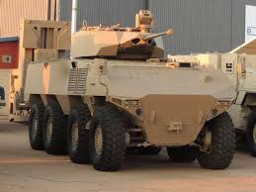
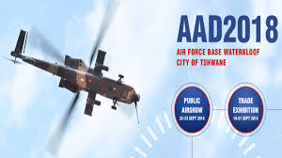
Key Achievements
INDUSTRIAL DEVELOPMENT
SG 1: Facilitate transformation of the economy to promote industrial development, investment, competitiveness and employment creation
  Aerospace and Defence:
  Denel announced the successful completion of the guided missile qualification test series for the A-Darter infrared (IR) homing short range air-to-air missile system.
  The Africa Aerospace and Defence (AAD) exhibition kicked off in Tshwane in September 2018.
  Agro Processing:
  Amendments to the regulatory framework for the sugar industry to allow more PDI participants in the industry have been finalised.
Notes:
The A-Darter is a fifth generation missile that uses an imaging IR seeker system.
Agro Processing
Finalized amendments to the regulatory framework for the sugar industry to allow more PDI participants in the industry
South African Sugar Association in collaboration with the dti, has developed a Draft Sugar Transformation Plan including amendments to the Sugar Industry Regulations (Sasa Constitution and Sugar Industry Agreement).

Slide 12

Key Achievements
INDUSTRIAL DEVELOPMENT
SG 1: Facilitate transformation of the economy to promote industrial development, investment, competitiveness and employment creation
Agro Processing:
  Amendments to the regulatory framework for the sugar industry to allow more PDI participants in the industry finalised.
Industrial Policy:
  Training of 19 students for level 2 boatbuilding is underway at False Bay College .
  Composite Training Academy has enrolled 13 students who completed the level 2 theoretical training and are currently completing their practical training in composite materials at Nautic Africa.
Notes:
South African Sugar Association in collaboration with the dti, has developed a Draft Sugar Transformation Plan including amendments to the Sugar Industry Regulations (Sasa Constitution and Sugar Industry Agreement).
Training of 19 students for level 2 boatbuilding is underway at False Bay College and a further 11 students are expected to start in January 2019.
Composite Training Academy has enrolled 13 students who completed the level 2 theoretical training and are currently completing their practical training in composite materials at Nautic Africa. 25 students have also started their level 2 theoretical training in September 2018, bringing it to 38 students in the programme.

Slide 13
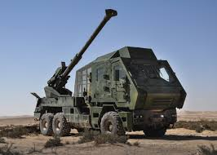
Key Achievements
INDUSTRIAL DEVELOPMENT
SG 1: Facilitate transformation of the economy to promote industrial development, investment, competitiveness and employment creation
Technical Infrastructure: The African Continental Free Trade Agreement was signed by South Africa in July 2018, making it the 46th country to sign.
Industrial Procurement
  The local content of the T5-52 Howitzer gun is estimated at 65%. The cost of the development, design and industrialisation will be amortised over the first 72 units to be supplied to Asia countries.
Notes:
The export promotion project relates to the supply of 72 units of the newly developed 155mm 52 calibre Truck-mounted Gun-Howitzer to the Pakistan Army. This is a totally new development artillery system that has not been sold to any defence force in the world.
Certain modifications will be made to the T5-52 system to suit the unique requirements of the Pakistan Army. The proposed supply agreement of T5-52 guns to Pakistan Army will build on the DLS current suppliers which have been developed during the Hoefyster Programme and thereby ensure sustainability for the local manufacturing companies as the Hoefyster program that will come to an end in seven years. It is anticipated that R2.6 billion forex will be earned over two years for 72 T5-52 export units to Pakistan.
Technical Infrastructure
The African Continental Free Trade Agreement was signed by South Africa in July 2018, making it the 46th country to sign. The department led the Technical Barriers to Trade (TBT) and Non-tarriff Barriers (NTB) chapters of this agreement, supported by the Technical Infrastructure (TI) entities.

Slide 14
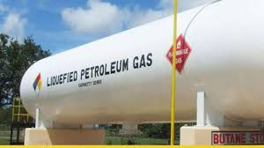
Key Achievements
INDUSTRIAL DEVELOPMENT
SG 1: Facilitate transformation of the economy to promote industrial development, investment, competitiveness and employment creation
Primary Minerals Processing and Construction:
  the dti tabled the Liquefied Petroleum Gas (LPG) industrial strategy and the Golfinho Liquefied Natural Gas (LNG) project in Mozambique at Nedlac.
  The Export Credit Insurance Corporation (ECIC) has underwritten $ 1 - 1.2 billion USD in the Golfinho project. the dti has written to the ECIC to obtain the work packages.
Notes:
the dti tabled the Liquefied Petroleum Gas (LPG) industrial strategy and the Golfinho Liquefied Natural Gas (LNG) project in Mozambique at Nedlac. These projects/strategies were accepted by Nedlac, for inclusion in the President of South Africa’s Job Summit agenda.
An awareness campaign throughout the provinces has been on-going for the Agro-Processing Support Scheme (APSS), which has yielded positive results i.e. approval of some of the businesses we have engaged with;
Onshore LNG projects (Golfinho & Mamba) that are to be developed in the North of Mozambique over the next 3 - 15 years, are currently the biggest opportunities for South Africa. The Golfinho onshore LNG project is a $ 23 billion United State Dollar (USD) project and is expected to reach a final investment decision (FID) by the second half of 2019. Construction will begin in earnest once the FID has been taken

Slide 15


Key Achievements
INDUSTRIAL DEVELOPMENT
SG 1: Facilitate transformation of the economy to promote industrial development, investment, competitiveness and employment creation
Metals:
  International Trade Administration Commission (ITAC) has imposed a preliminary safeguard duty of 42.09% on steel Hexagon screws (HS:73181539) with effect from 03 August 2018 to restore industry sustainability through dti intervention.
  In August 2018, Gibela launched an enterprise development programme to help new and established businesses in South Africa’s rail sector achieve growth and create jobs.
Notes:
Through the intervention of the department, International Trade Administration Commission (ITAC) has imposed a preliminary safeguard duty of 42.09% on steel Hexagon screws (HS:73181539) with effect from 03 August 2018 to restore industry sustainability. The department has also participated in the Public Hearing engagement on the matter in September 2018.
Engagements with South African Revenue Services (SARS) on a reference price for various steel downstream subsectors , have led to the activation of the Risk Engine, effective from 01 August 2018.
Following the delivery of 20 train sets made in Brazil, Gibela has commenced with the local assembly of train 21, 22 and 23. The plan is to have train sets number 21 completed by end of 2018. At the back of this contract, local companies are benefiting from the transfer of technology. This includes Ubunye on traction motor, Global Composites on cab structures.

Slide 16
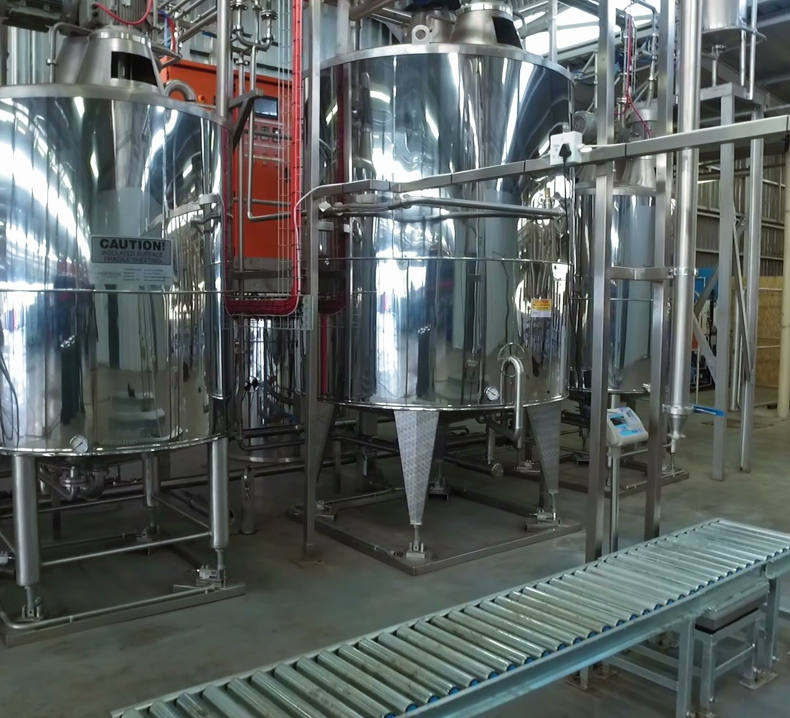
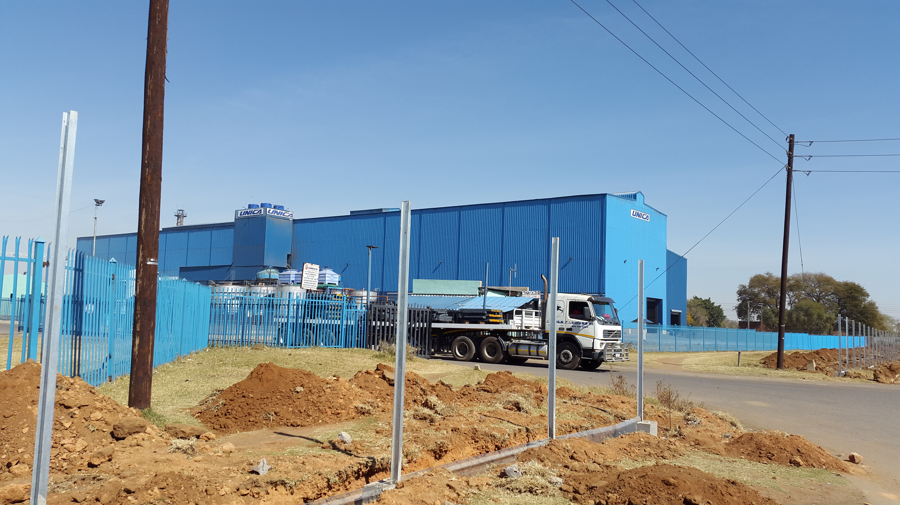
Key Achievements
INDUSTRIAL DEVELOPMENT
SG 1: Facilitate transformation of the economy to promote industrial development, investment, competitiveness and employment creation
209 enterprises financially supported across all incentives and that will result in over 7 000 jobs projected to be retained and over 3 000 new jobs projected to be created through these approvals.
Over R10 billion of private sector investment was leveraged across all incentives.
20 interventions to support BIs in the IPAP sectors
The first Black Industrialists Steering Committee on Market Access and Procurement Opportunities with SOEs and National Treasury looking at market access opportunities within the Public Sector was held in August 2018 at Denel Dynamics in Irene

Slide 17
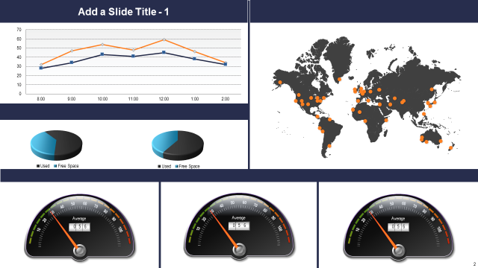
TRADE, INVESTMENT AND EXPORT
SG 2: Build mutually beneficial regional & global relations to advance South Africa’s trade, industrial policy & economic development objective
African Continental Free Trade Area (AfCFTA) Agreement signed by South Africa during the 31st Ordinary Session of the African Union Heads of State and Government on 1 July 2018.
South Africa technical team visit to Iran in August 2018 to discuss concrete interventions to deepen trade and investment relations.
The Department successfully hosted the 8th Brazil, Russia, India, China and South Africa (BRICS) Trade Ministers Meeting and 19th meeting of the BRICS Contact Group on Economic and Trade issues in July 2018
Notes:
Mission to Saudi Arabia in July 2018, among other things, to present investment projects for the $10 billion Saudi investment pledge.
The Department successfully hosted the 8th Brazil, Russia, India, China and South Africa (BRICS) Trade Ministers Meeting and 19th meeting of the BRICS Contact Group on Economic and Trade issues in July 2018.
Successful participation of the dti at the 73rd session of United Nations General Assembly (UNGA) 2018 in New York City in September 2018.
the dti undertook the 4th Trade Mission to Peru which took place in Lima, Peru. The South African business delegation comprised 17 exporters and the targeted sectors for this mission were: Agro processing, mining equipment and mining services.

Slide 18

TRADE, INVESTMENT AND EXPORT
SG 2: Build mutually beneficial regional & global relations to advance South Africa’s trade, industrial policy & economic development objective
The Study on Policy Options for a Future Trade and Investment Relationship between South Africa and USA was completed. A Cabinet Memorandum on the Study and its recommendations was submitted to Cabinet.
Export sales of R1,475 billion recorded against a target of R1,2 billion.
A total of 304 companies assisted under EMIA
Achieved investment pipeline of R17,329 bn.
Successful Outward Selling and Investment Mission (OSIM) to Australia in August to September 2018 whereby 22 companies were in attendance with anticipated export sales of R714 million in the next six months.
Notes:
Successful Participation at Wire and Tube whereby exhibitors reported a total of R2,925,000 actual export orders signed during the event and projected export sales of R105,4 million within six months after the event. The exhibitors reported obtaining a total of 135 trade leads.
Successful participation in SA-UK Business forum in Cape Town during the official visit to RSA of UK Prime Minister.
45 trade leads were generated as per the delegation evaluation feedback. Export sales to be generated 6 months after the event amounts to R 306 million.

Slide 19
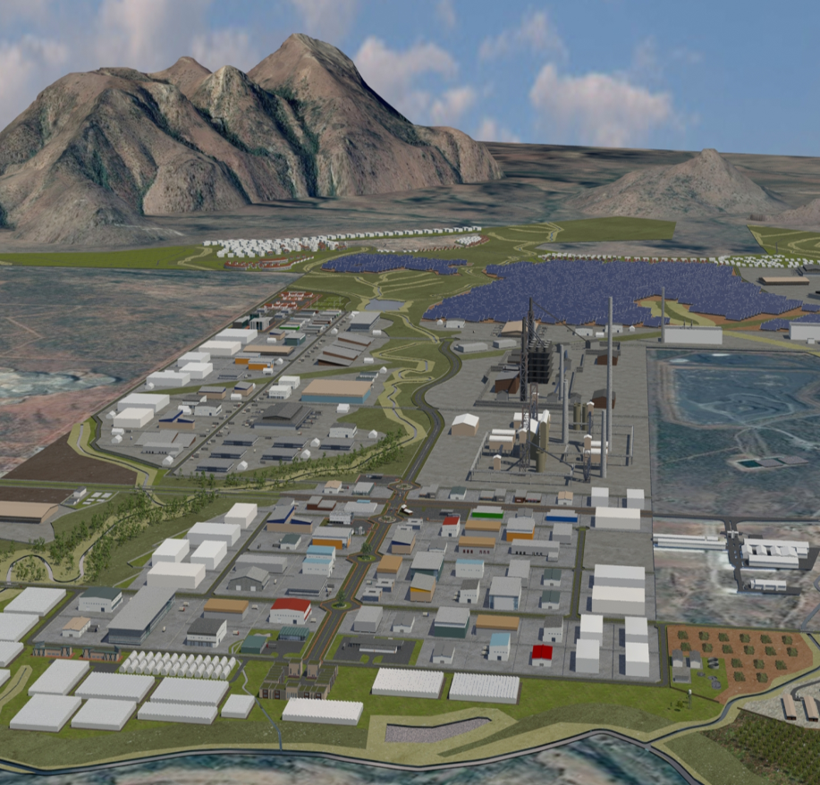
SPECIAL ECONOMIC ZONES & ECONOMIC TRANSFORMATION
SG3: Facilitate broad-based economic participation through targeted interventions to achieve more inclusive growth
SEZ General Performance
  A Framework Agreement between the dti and Bank of China was signed at the State Visit in China in September 2018. Bank of China made a commitment to assist the dti with industrial project up to R15 billion.
Partnerships
  Framework Agreement signed between the dti and The National Development Reform Commission (NDRC) for partnership in the undertaking industrial development projects in South Africa with a special focus on Musina- Makhado SEZ.
  The partnership between the dti, Trade Investment Kwa-Zulu Natal (TIKZN), iThala Bank, Growth Fund, Richards Bay Special Economic Zone (RBIDZ) and Economic Development, Tourism & Environmental Affairs (edtea) has seen the conclusion of the agreement between the Development Bank of Belarus, Ithala, Minsk Automobile and Mzanzi Maz.
Notes:
This project will culminate to the establishment of an 80% BI factory in Richards Bay KZN that will manufacture trucks and buses in the country with an estimated investment value of R1.7 billion being completed for the first phase.

Slide 20
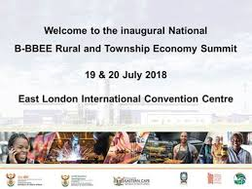
SPECIAL ECONOMIC ZONES & ECONOMIC TRANSFORMATION
SG3: Facilitate broad-based economic participation through targeted interventions to achieve more inclusive growth
Rural & Township Economy
  The National B-BBEE Rural and Township Economy Summit was held in July 2018.
  the dti hosted a group of 10 beneficiary companies at the Innovation Summit in Cape Town in September 2018.

Slide 21
Key Achievements
LEGISLATION AND REGULATION
SG 4: Create a fair regulatory environment that enables investment, trade and enterprise development in an equitable and socially responsible manner
Liquor abuse community awareness session was conducted in Mpumalanga(Moloto) in June 2018. 300 people targeted and attended the session. The National Liquor Authority (NLA) successfully launched the online Case Management System (Renewal Module) in May 2018 that will ensure that registrants and consultants enhance their ability to make use of the system for liquor license applications and renewals. Three (3) training session on the online renewal conducted in GP (18), KZN (10) and EC (13). A total of 41 consultants and registrants attended the sessions.

Slide 22
ADMINISTRATION AND CO-ORDINATION
SG 5: Promote a professional, ethical, dynamic and competitive and customer–focused working environment that ensures effective and efficient services delivery
All eligible creditor payments processed well within 30 days.
Female SMS
  Women in SMS at 52% against quarterly target of 49%.
⬆
  The number of people with disabilities employed was at 3.61% against annual target of 3.42%.
People with Disabilities

Slide 23
FINANCIAL PERFORMANCE 30 September 2018
R3,4 billion or 79,3% YTD spent against the YTD budget
R9,5 billion adjusted budget
R6,1 million or 64,2% available budget
R4,3 billion YTD budget
Notes:
At the end of the second quarter of the 2018/19 financial year, expenditure compared with the year-to-date projections of R4.3 billion is R3.4 billion or 79.3%. There has been a slight improvement from the 2017/18 financial year, same period, which recorded expenditure of 75.5% against the projected budget.
Of the R3.4 billion spent by the department, transfer payments to departmental agencies, foreign governments and international organisations as well as others accounted for 41%; followed by transfers to beneficiaries across the various incentive scheme programmes at 36%. Compensation of Employees as well as Goods and Services were 14% and 9% respectively.

Slide 24
FINANCIAL PERFORMANCE
Financial performance per programme
Programme | Budget 2018/19 | Year-to-date (YTD) |  |  |  | Available budget | % budget available
 |  | YTD Cash flow projections | YTD Expenditure | Variance (Budget less expenditure) | % variance
 | R’000 | R’000 | R’000 | R’000 | % | R’000 | %
Administration | 837,280 | 383,836 | 378,860 | 4,976 | 1.30% | 458,420 | 54.75%
International Trade and Economic Development | 124,773 | 48,665 | 51,859 | (3,194) | (6.56%) | 72,914 | 58.44%
Special Economic Zones and Economic Transformation | 146,276 | 88,368 | 51,713 | 36,655 | 41.48% | 94,563 | 64.65%
Industrial Development | 2,029,777 | 1,109,854 | 1,096,172 | 13,682 | 1.23% | 933,605 | 46.00%
Consumer and Corporate Regulation | 330,347 | 208,382 | 204,895 | 3,487 | 1.67% | 125,452 | 37.98%
Incentive Development Administration | 5,567,857 | 2,142,793 | 1,296,749 | 846,044 | 39.48% | 4,271,108 | 76.71%
Trade and Investment South Africa | 411,602 | 298,648 | 307,935 | (9,287) | (3.11%) | 103,667 | 25.19%
Investment South Africa | 83,846 | 25,100 | 25,796 | (696) | (2.77%) | 58,050 | 69.23%
Total | 9,531,758 | 4,305,646 | 3,413,979 | 891,667 | 20.71% | 6,117,779 | 64.18%
Notes:
Incentives performance
The spending on incentives as at 30 September 2018 was R1.2 billion or 59.2% of the YTD projections of R2.1 billion.
A lag in the projections is mainly due to non-compliant claims which were agreed at application and formed part of the approval, but not met when the claims were received from claimants.
Another reason is outstanding compliance documentation (i.e. BEE and tax clearance certificates) from claimants.
On a brighter note, the reprioritization of funds to performing incentive programmes, was carried out as part of the mid-term budget review.
This will result in increased support for the clothing, textile, footwear, leather and leather goods manufacturing industries as well as the film industry in its contribution towards employment opportunities in South Africa.
Managed through the Investment South Africa (ISA) division, funding has been provided for the implementation of 3 additional provincial One Stop Shops in Mpumalanga, Free State and Eastern Cape.
On the front of department’s entities, support was provided for the NRCS, NCC, SABS and NCT for activities planned to be delivered by March 2019.
In line with the budget processes, these adjustments will come into effect once the Adjusted Appropriation Act is assented to by the President.

Slide 25
Thank you
Ngiyathokoza
Ke a leboha
Ke a leboga
Siyabonga
Inkomu
Ndo livhuwa
Enkosi
Ngiyabonga
Dankie

