Slide 1



sefa 1st Quarter Performance Report
Financial Year 2018/19
Portfolio Committee Small Business
21 November 2018

Slide 2
Presentation Outline
Introduction
Loan book performance
  Approvals
  Disbursements
Development impact
  SMMEs financed and jobs facilitated
  Support to targeted groups
Post-Investment Monitoring
  Portfolio at risk
  Collections
Financial performance
Recommendations

Slide 3
Q1 Performance Dashboard
LOAN BOOK
PERFORMANCE
Approvals
Target: R171m
Q1 Achieved: R86m
50%
Disbursements
Target: R147m
Q1 Achieved: R287m
171%
Approvals: Productive Sectors
Target: R87m
Q1 Achieved: R16m
19%
NUMBER OF SMMEs
FINANCED
& JOBS FACILITATED
#of SMMEs Financed
Target: 14 463
Q1 Achieved: 21 149
146%
Jobs Facilitated
Target: 14 899
Q1 Achieved: 24 323
163%

Slide 4
Q1 Performance Dashboard
Black-owned Enterprises
Q1 Target: R103,7m
Q1 Achieved: R207m
200%
Youth-owned Enterprises
Q1 Target: R44m
Q1 Achieved: R49m
112%
Women-owned Enterprises
Q1 Target: R66m
Q1 Achieved: R126m
190%
Enterprises in Priority Provinces
Q1 Target: R66m
Q1 Achieved: R130m
196%
DEVELOPMENT
IMPACT
Township
Q1 Target: 40m
Q1 Achieved: 14m
35%
No of Facilities (≤ R500k)
Q1 Target: 14 380
Q1 Achieved: 21 098
147%
Disabilities
Q1 Target: R3,6m
Q1 Achieved: R515k
14%
FINANCIAL
PERSPECTIVE
Cost-to-income*
Target: 100%
Q1 Achieved: 76%
132%
Impairments
Target: 26%
Q1 Achieved: 36%
72%
Personnel Expenses
Target: 29%
Q1 Achieved: 2%
1450%
BUSINESS PROCESSES
Turnaround times DL
Q1 Target: 20 days
Q1 Achieved: 18 days
111%
Turnaround times DL
Q1 Target: 30 days
Q1 Achieved: 32 days
94%
Turnaround times: WL
Q1 Target: 45 days
Q1 Achieved: 31 days
143%

Slide 5
Introduction

Slide 6
INTRODUCTION
An overview of the 1st quarter organisational performance of the Small Enterprise Finance Agency (sefa) against its approved corporate plan for the financial year 2018/19.
sefa’s amortised Total Loan Book at the 30 June 2018 was R 2billion
  R1,2 billion Wholesale Loan Facilities and R800 million Direct Loan Facilities.
A total of R86 million loan facilities was approved, representing 50% of the quarterly target and 10% of the annual target.
Total disbursements for the quarter was R287 million representing 171% of the quarterly target and 34% annual target.
The tough economic conditions and issues relating to the broader SMME operating environment exerted on going pressure on the performance of the loan book.
The Portfolio at Risk (PAR) at the end of June 2018 was 57% of the total loan book.
Majority of organisational activity focused on year-end activity for the 2017/18 financial year.
The internal organisational environment remains stable.

Slide 7
Loan book performance

Slide 8
LOAN BOOK PERFORMANCE
The total approvals for the quarter was R86 million against the target of R171 million which represent 50% of the quarterly target.
  R26 million from Direct Lending (DL)
  R60 million through Khula Credit Guarantee (KCG) programme.
The loan programmes could not meet their quarterly approvals target
  DL: the low quality of deals received and the strict lending conditions which is aimed at improving the quality of the loan book.
  Microfinance: delays experienced during the diligence and financial viability of small microfinance institutions.
  Co-operatives lending program underperformance was due to resignation of the key staff.

Slide 10
Development impact

Slide 11
Development impact: SMMEs financed and jobs facilitated
The Q1 performance against target is as follows:
  No of SMMEs and Co-operatives financed – 146% of target achieved
  Jobs facilitated - 163% of target achieved
The majority of SMMEs and Jobs facilitated was contributed by the Microenterprise sector.

Slide 12
Development Impact: Targeted Groups
Youth-owned enterprises received R36 million, Priority rural provinces received R55 million and R4,9 million was disbursed to township enterprises and R502 thousand was to enterprises with people with disability.
The women-owned enterprises disbursements was R55 million and R116 million for black-owned enterprises.

Slide 13
Development Impact: Provinces

Slide 14
Post-investment monitoring

Slide 15
Post investment monitoring: Total Portfolio At Risk (PAR)
The Portfolio At Risk represents outstanding loan balance account ( 60 days+ in arrears).
Total PAR is 57%
The total sefa loan book is worth R2 Billion comprising of WL- R1,2 billion & DL- R800 million.
The Bridging Loan book risk percentage is at 89% worth about R116 million.
The Term Loan book risk percentage is at 66% worth R762 million

Slide 16
Post investment monitoring: Impairments
The total portfolio impairments as 30 June was 46%, a 6% increase from the previous year.
  Due to the non- performance in the cooperative loan book and microfinance.

Slide 17
Total sefa collections Q1
Total collections for the quarter under review is R76 million (92% of the quarterly target).
Direct Lending R42 million and Wholesale loan R34 million

Slide 18
DL loan book collections
The diagram provides a quarterly comparison for DL 2017/18 and 2018.
During Q1 FY2018/19 90% of target was achieved compared to Q1 FY2017/18 where 68% of collections target was achieved.

Slide 19
WL loan book collections
The diagram provides a quarterly comparison for WL 2017/18 and 2018.
During Q1 FY2018/19 113% of target was achieved compared to Q1 FY2017/18 where 117% of collections target was achieved.

Slide 20
Financial performance

Slide 21
Financial Performance
sefa Group
Consolidated Statement of Comprehensive Income | 2019 | 2019 | 2019 |  | 2018 |  | 2019 |  | 2018
For the period ended 30 June 2018 | YTD | YTD | YTD |  | YTD |  | Full Year |  | Year End
 | Actual | Budget | Variance |  | Actual |  | Budget |  | Actual
 | R'000 | R'000 | % |  | R'000 |  | R'000 |  | R'000
Income | 44 813 | 51 934 | -13% |  | 62 051 |  | 260 734 |  | 220 299
Movement on impairments & Bad debt Written-off | (7 289) | (26 114) | 72% |  | (43 543) |  | (97 832) |  | (109 727)
Personnel expenses | (39 540) | (49 791) | 21% |  | (46 346) |  | (211 534) |  | (178 778)
Investment property expenses | (14 069) | (21 368) | 33% |  | (37 949) |  | (64 445) |  | (91 598)
Interest shareholder's loan | (8 976) | - | -100% |  | (8 354) |  | (5 735) |  | (34 325)
Other operating expenses | (16 527) | (27 359) | 51% |  | (19 025) |  | (90 248) |  | (72 669)
Operating income/(loss) | (41 589) | (72 697) |  |  | (93 166) |  | (209 060) |  | (266 798)
MTEF Allocation received | 57 209 | 57 209 |  |  | 55 945 |  | 228 837 |  | 223 780
Net operating income /(loss) + MTEF Allocation | 15 620 | (15 488) |  |  | (37 221) |  | 19 777 |  | (43 018)
Cost to income (all inclusive) | 85% | 114% |  |  | 132% |  | 100% |  | 110%
Cost to income (excl Interest on shareholder's loan) | 76% | 114% |  |  | 124% |  | 100% |  | 102%
Personnel expenses as a percentage of total loan book (loans and equities). | 2% | 3% |  |  | 3% |  | 29% |  | 11%
Personnel costs as a percentage of net loans and advances | 7% | 7% |  |  | 8% |  | 25% |  | 31%
Accumulated impairment provision as a percentage of loans and advances at cost | 52% | 30% |  |  | 49% |  | 26% |  | 37%

Slide 22
2018/19 Q1 FINANCIAL HIGHLIGHTS
 | 2019 | 2019 | 2019 |  | 2018 |  | 2018
 | YTD | YTD | YTD |  | YTD |  | Year End
 | Actual | Budget | Variance |  | Actual |  | Actual
 | R'000 | R'000 | % |  | R'000 |  | R'000
Income details
Interest from lending operations | 21 669 | 27 904 | -22% |  | 39 905 |  | 94 521
Investment income | 7 721 | 3 429 | 125% |  | 6 638 |  | 29 015
Fee income from loans and indemnities | 1 913 | 3 666 | -48% |  | 709 |  | 6 086
Investment property rental income | 7 029 | 9 527 | -22% |  | 10 316 |  | 27 749
Other income | 6 480 | 7 408 | -13% |  | 4 482 |  | 16 647
Other comprehensive income from equity accounted investments | - | - | 0% |  | - |  | 46 281
Total | 44 813 | 51 934 | -13% |  | 62 051 |  | 220 299
Income for the Q1 OF 2018/9 FY slightly lower than budget by 14% but much lower than prior year same period by 26% mainly due higher interest generated from lending.
Fee income was also lower than budgeted due to lower disbursements.
The other components of the Income are above budget with exception of “Other Income”.

Slide 23
2018/19 FINANCIAL YEAR HIGHLIGHTS (CONT.)
 | 2019 YTD | 2019 YTD | YTD |  | 2018 YTD |  | Year End
 | Actual | Budget | Variance |  | Actual |  | Actual
 | R'000 | R'000 | % |  | R'000 |  | R'0
Personnel expenses | (39 540) | (49 791) | 21% |  | (46 346) |  | (178 778)
Investment property expenses | (14 069) | (20 897) | 33% |  | (37 949) |  | (91 598)
Other operating expenses | (16 527) | (27 359) | 40% |  | (19 025) |  | (72 669)
Costs containment
Personnel costs are 21% lower than budget as the salary increases are yet to be effected.
Other operating expenses are 29% lower than budget due to the continued tight costs containment initiatives that were put in place including delay in IT capital expenses that which would have resulted in higher depreciation.
Property portfolio expenses are 33% (R9m) lower than budget and are 63% (R24m) lower than prior year.
Costs to Income
Costs to income ratio for FY is 76% compared to 100% target

Slide 24
Balance Scorecard

Slide 25
Balance Scorecard

Slide 26
Case Studies of Funded Clients
from approvals during Quarter 1 of 2018/19

Slide 27
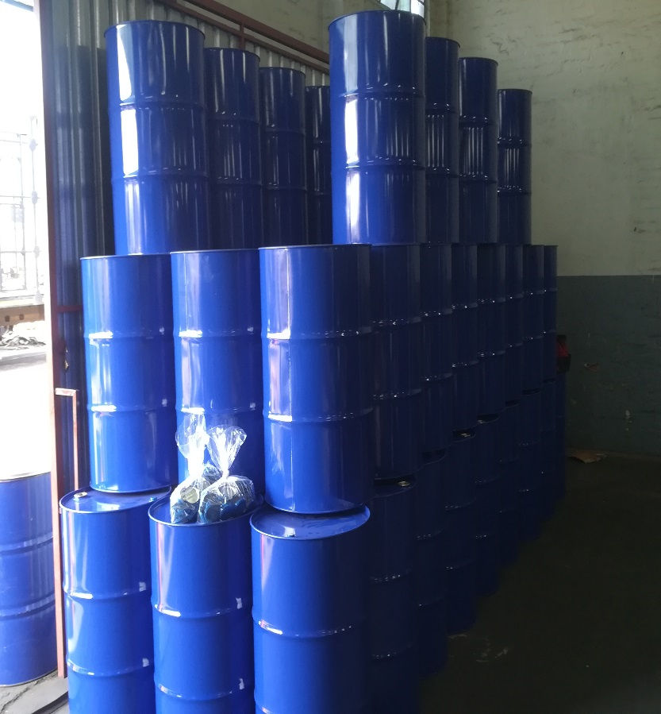
Butterfly Industrial Packaging And Contracting CC
Butterfly Industrial Packaging & Contracting CC is a close corporation that was registered in 2005.The business sole member is Gonaseelan Shunmugam. The member is classified as disabled due to a speech impairment which limits his communication and impacts on his quality of life.
The member had approached sefa for the setup of a new plastic washing and waste removal operation. He has negotiated long term contracts with customers in need of this service. The entrepreneur has 17 years experience within the industry and is well networked to suppliers and customers.
sefa approved a Term Loan of R279 278.17 and ISA of R173 009.99 . The funds to be utilized towards vehicle, stock, small equipment, Protective gear and overhead costs .
Through sefa funding 5 new jobs will be created and sefa will be funding a disabled black male.
The project is good for sefa as this type of project is in the waste recycling industry. sefa will be funding a disabled individual which falls within the priority target group of sefa.
Key information
Location: KZN – Durban
Jobs facilitated: 5
Funding amount: R452 288.16
Sector: Recycling

Slide 28
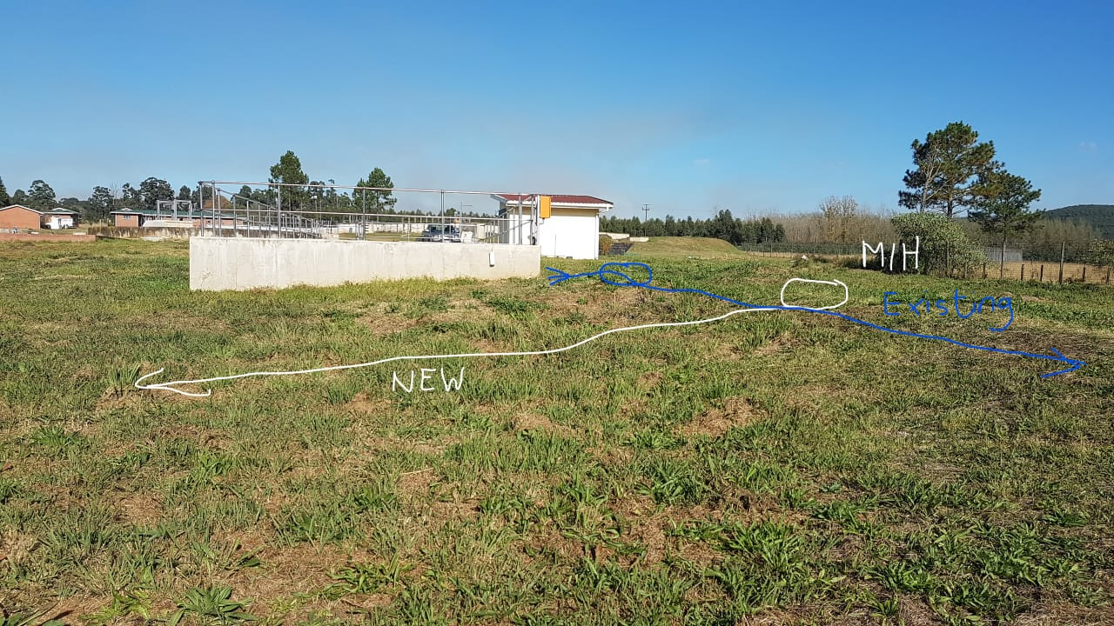
Diomedea Projects (Pty) Ltd
Diomedea Projects was established in 2015 by Mr Coetzee (49%), Mr Nondaba (11%) and Mr Mtshali (40%). The company has not traded from 2015, this is the first order awarded to Diomedea Projects (Pty) Ltd. The company is a level 2 BEE company aims to tender for government contracts mainly in construction and civil environment. The company location is Port Shepstone which falls under the Ugu Municipality.
Diomedea Projects (Pty) Ltd has been awarded a Purchase Order from Ugu Municipality for an amount of R142 553.70. The project involves the supply, delivery and installation of 250mm UPVC pipe for a distance of 265m.
sefa approved a Bridging Loan of R95 015 over 3 months. The funds to be utilized towards projects costs (Material, Labour and travelling expenses).
Through sefa funding 14 new jobs will be created and sefa will be funding a black owned company.
The project is good for sefa as this type of project will be assisting in the current water crises at Ugu. This is the first application approved from the Ugu area and sefa wants to establish a footprint in the area.
Key information
Location: KZN – Harding
Jobs facilitated: 14
Funding amount: R95 105
Sector: Construction

Slide 29
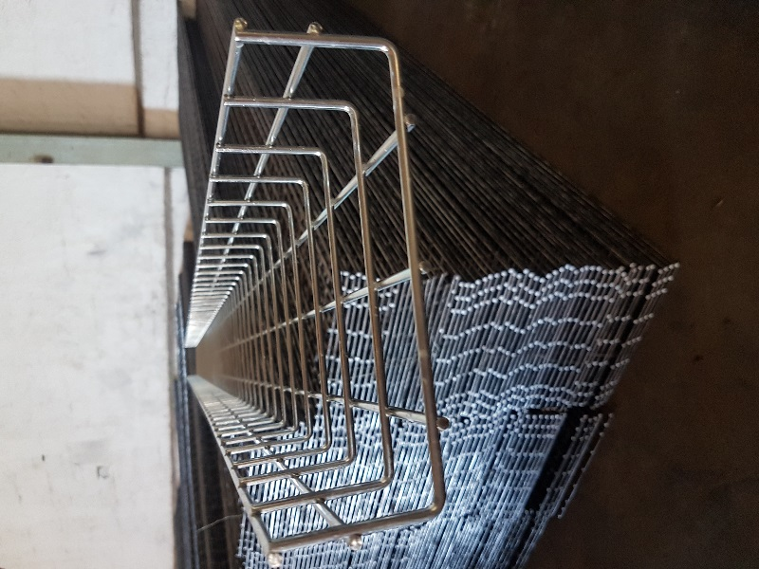
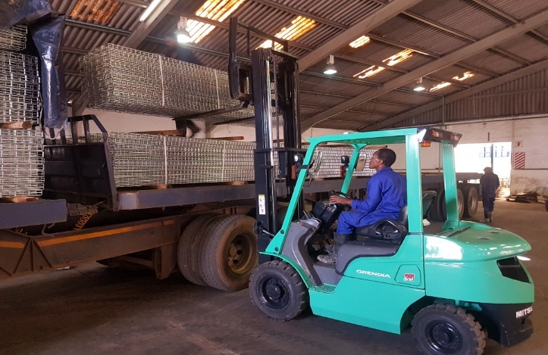
Strut Systems Africa (Pty) Ltd
Strut Systems Africa (Pty) Ltd is an existing business which has been in operation for over two years. The business is owned and operated by Mr Garth Phillip Landsberg, a talented entrepreneur with over 20 years of experience in the fastener, bolts and metal trays industry
Strut Systems Africa’s key focus is the forming, electroplating, supply and delivery of completed wire mesh metal cable trays and electroplating and supply of threaded rods, spring nuts and clamps to customers countrywide
The business is based in an industrial park within the township of Hammarsdale
The client was referred to sefa by word of mouth
sefa has funded R3 596 015 which went toward the purchase of raw materials (metal and chemicals)
Key information
Location: Hammarsdale
Jobs facilitated: 9
Funding amount: R3 596 015
Sector: Manufacturing

Slide 30
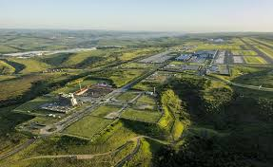
Lwethu Spotlight cc
Lwethu Spotlight CC was established in March 2007 (Registration number: 2007/049631/23) by Mr Hloniphani Jackson Ngcobo. This is a 100% black owned and managed company with a head office located in Pietermaritzburg, KwaZulu Natal. The business was registered in 2007 but started operating two years ago. The business is in its infancy stage but was formed with the objective of tapping into procurement opportunities in public sector.
Lwethu Spotlight CC has been awarded a Purchase Order, Reference No. 6/90370 for which the University Of KwaZulu Natal has requested 10 fridges, 40 tables, 40 chairs which are required to be delivered on 30 June 2018. The applicant will fund 40 tables and requires funding from sefa for the fridges and chairs only. The purchase order relates to insurance payout that University of KwaZulu Natal received in order to replace property that was damaged by students during riots in 2017.
sefa approved a Bridging Loan of R 65 040.The funds were to be utilized towards cost of purchasing and delivering of the chairs and fridges.
The project is good for sefa as this type of project will enable Mr. Ngcobo to establish some financial independence and empowerment. This deal will open up the possibility for further deals with University of KwaZulu Natal
Key information
Location: KZN – University of KwaZulu natal
Job facilitated: 1
Funding amount: R65 040
Sector: Services

Slide 31
Direct Lending
Free State

Slide 32

Titius Holdings (Pty) Ltd
Titius Holdings (Pty) Ltd has been in business since December 2017.
The business is 100 % black youth owned and operates in the priority province of Free State.
Titius Holdings (Pty) Ltd supplies various goods and services to private and public sector entities in the Free State Province and beyond.
The client was referred to sefa through word of mouth.
sefa approved and disbursed R 136 805.00 which went towards funding a Purchase Order for the supply and delivery of computer hardware to Free State Development Corporation in Bloemfontein.
Key development impact information
Location: Bloemfontein, Free State
Jobs facilitated: 1
Funding amount: R 136 805.00
Sector: Services

Slide 33
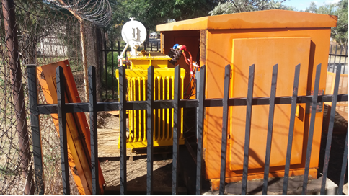
Mezisat (Pty) Ltd
Mezisat Holdings (Pty) Ltd has been in business since July 2014.
The business is 100 % black youth and female owned operating in the priority province of Free State.
Mezisat (Pty) Ltd supplies various electrical goods and service to private and public sector entities in the Free State Province and beyond.
The client was referred to sefa through word of mouth.
sefa approved and disbursed R 239 260.00 which went towards funding a Purchase Order for the supply, delivery and installation of Electrical Transformers to Free State Development Corporation in Botshabelo industrial area.
Township development.
Key development impact information
Location: Dewetsdorp, Free State
Job facilitated: 5
Funding amount: R 239 260.00
Sector: Services

Slide 34
Direct Lending
Mpumalanga

Slide 35
Mhliki Consulting & Projects cc
Mahliki Consulting is owner by a woman by the name of Thobile Maureen Zulu.
Mahliki Consulting And Projects CC has been awarded a purchase order by Eskom to source and supply :
5 x Izumi Rec6630 (these are battery operated hand held dieless crimping tools used to compress Anderson type connectors up to 500KCM)
10 x Fluke 177 (these are instruments used to measure electrical values- principally voltage (volts), current (amps) and resistance (ohms).
Mahliki Consulting needed R197 868 to deliver on this purchase order.
Mahliki approached sefa for a financial assisted to in order to execute the above purchase order.
sefa approved the loan and made it possible for Mahliki Consulting to deliver on the above purchase order successfully.
Key information
Location: Daantjie Trust, Mpumalanga Province.
Jobs facilitated: 2
Funding amount: R 197 868
Sector: Services

Slide 36
Zumile Trading 321 cc
The company is 100% black owned by Mr Selby Smangaliso Ntuli. The business is in the supply and delivery of services through the tendering process by the government. The company is based in Tekwane North, in Mbombela Local Municipality, in Mpumalanga.
The company was awarded a Purchase Order by the Department of Health-Embhuleni Hospital to supply and deliver Uniform for workers. The value of the Purchase Order was R149 960.00.
sefa approved a loan amounting to R 118 565.00 for the client to deliver on the purchase order.
The funds are partially paid-out, the remaining funds will be paid before delivery of the Uniform.
Key information
Location: Tekwane North
Job facilitated: 1
Funding amount: R149 960.00
Sector: Services

Slide 37
Mgwambe Project (Pty) Ltd
The company is 100% black youth owned by Mr Muzi Moses Mabuza. The business is in the supply and delivery of services through the tendering process by the government and other public and private institutions.
The company is based in Tekwane South, in Mbombela Local Municipality, in Mpumalanga.
The company was awarded a Purchase Order by the South African Police Service in Lydenburg to supply an Industrial washing machine and a tumble dryer. The value of the Purchase Order is R218 000.00.
sefa approved a loan amounting to R171 695.00 for the client to deliver on the purchase order.
Key information
Location: Tekwane South
Job facilitated: 1
Funding amount: R171 695.00 Sector: Services

Slide 38
Ndamasi Transport & Projects (Pty) Ltd
Ndamasi Transport And Projects is 100% owned Gastinah Mahlangu, a black female.
Ndamasi Transport And Projects (Pty) Ltd has been awarded a purchase order by Eskom to source and supply Blade Paddle with the following dimensions:
1. Width 555 x length 415 X thick 15mm.
2. STL Ash Conditioner with 20mm wide Tungsten tips on the working face and end face.
Ndamasi needed R123 487 in order to deliver on the above order.
sefa approved the loan for Ndamasi to deliver on the purchase order.
Key information
Location: Standerton, Mpumalanga Province.
Jobs facilitated: 2
Funding amount: R 123 487
Sector: Services

Slide 39
Direct Lending
Limpopo

Slide 40
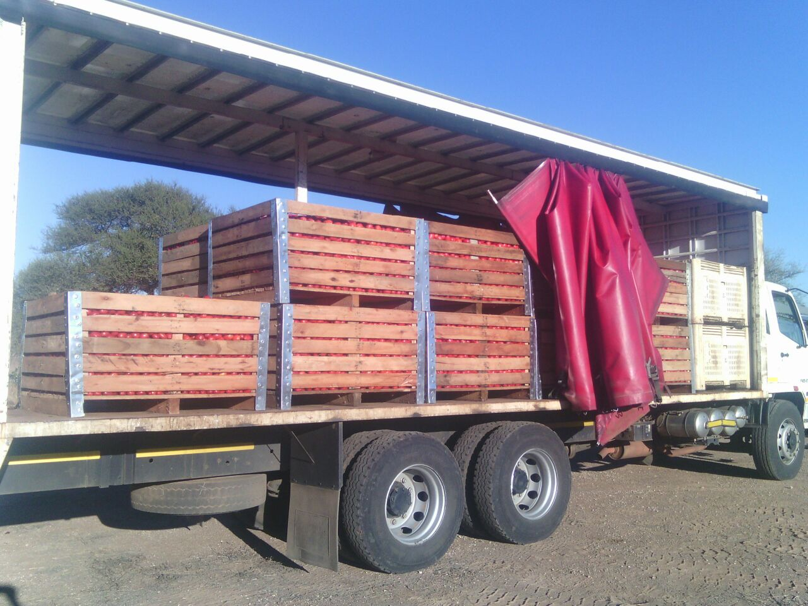
U-Move Farming (Pty) Ltd
U-Move Farming (Pty) Ltd is a company involved in the cultivation of tomatoes.
The company approached sefa through its managing director Mr. Khathu Mashau for a bridging loan amounting to R3 364 270.00 to be utilised for the purchase of a tractor, drip irrigation system and the provision of production inputs such as fertilizers and pesticides.
The farming project is taking place under the jurisdiction of Musina Local Municipality.
The above request emanated from a contract obtained from Eastern Trading Company Ltd t/a Darsot Food Corporation, the controlling shareholder of JSE - listed AH – Vest, which produces All-Joy products.
The contract is for the cultivation of tomatoes on a 200 hectare with an estimated yield of 60 tons per ha at a price of R1 790.00 per metric ton inclusive of delivery costs.
Key Information
Location: Nwanedi, Limpopo
Jobs facilitated: 830
Funding amount: R3 364 270.00
Sector: Agriculture – Crop Production

Slide 41
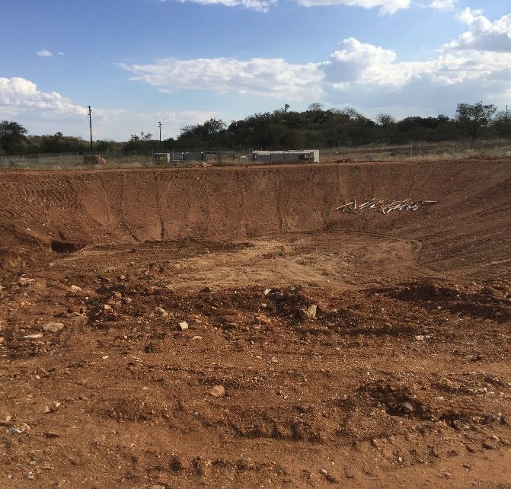
Ukukhomba Holdings (Pty) Ltd
Ukukhomba Holdings (Pty) Ltd is owned by Mr. Serve Nieberth Mabasa.
Ukukhomba Holdings (Pty) Ltd was awarded a contract by Musina Local Municipality for Landfill Operations and Management of Musina Solid Waste Site for a period of three (3) years until 31st December 2020.
The contract of Waste Management emanated from the current Landfill Site, which was developed 20 years ago and the commencement of the construction on the N1 which will now transverse on the northern site of the current landfill.
The estimated construction waste is 75 000m³, which will cover the remainder of the Landfill to full capacity, hence a development of new landfill area.
sefa approved a term loan amounting to R1 784 512.50 purchase the Landfill Compactor and two 10 m³ Tipper Truck to be utilised at the Dumping Site under Musina Local Municipality.
Key Information
Location: Musina
Jobs facilitated: 14
Funding amount: R 1 784 512.50
Sector: Waste Management

Slide 42
Direct Lending
Eastern Cape

Slide 43
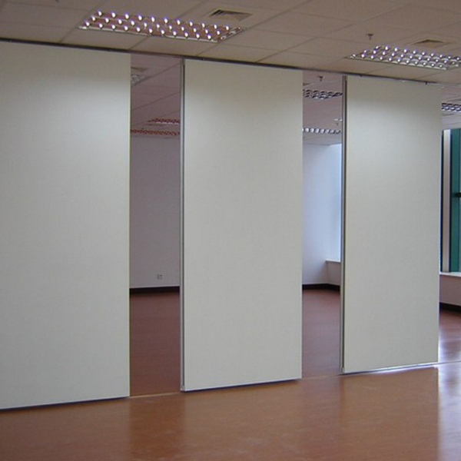
Bukhulu Consulting and Suppliers
Bukhulu Consulting and Supplies is a business owned by Putuma De Klerk.
The company was awarded a purchase order by King Sabatha Dalindyebo Municipality in Mthatha to the value of R174,067 to supply and deliver partition material.
sefa funded the business for its project costs of R135,005.
Sefa received a cession of payment from the municipality.
The client learnt about sefa from print media.
Key Information
Location: Mthata
Jobs facilitated: 1
Funding amount: R 135 005
Sector: Construction & Material

Slide 44
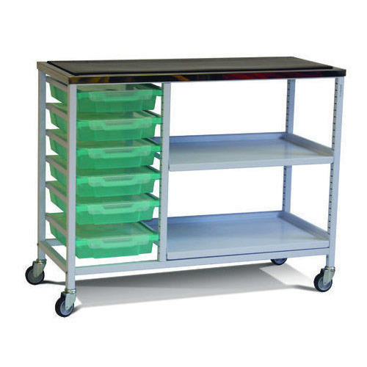
Zenkcubeko General Trading (Pty) Ltd
The business is 100% black woman owned registered in 2011 by Mrs. Novakele Rose Maarman. The business operates in East London, Eastern Cape.
The entrepreneur registered the business with the intend of focusing on supply of medical equipment and targeting public and private hospitals.
The business has delivered on numerous orders successfully and had built a good track record with the various departments and hospitals delivered on.
The client was awarded a supply and deliver order by Frere Hospital, to deliver medical examination trolleys. The contract value amounting to R 188 825.00.
sefa loan assisted the client with procuring the examination trolleys and making sure that they maintain the good relationship built with the contract providers.
Key information
Location : East London
Jobs facilitated : 1
Funding amount: R 136 058. 23
Sector: Medical supplies

Slide 45
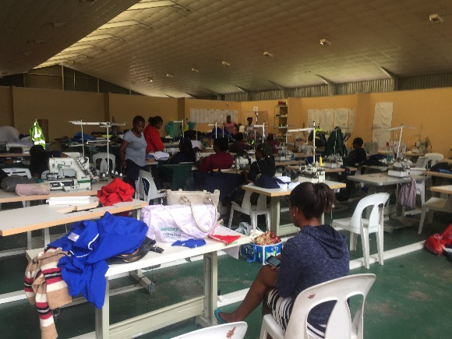
Zamulwazi Co-operative
Zamulwazi Clothing Manufacturers (“Zamulwazi”) is an existing majority black owned co-operative with 5 members that manufactures and distributes clothing in Mthatha in the Eastern Cape. The co-op has been in existence for more than 8 years and has been operating at a small scale.
The entity was awarded a tender to manufacture and supply traffic officer uniforms to the Eastern Cape Department of Transport.
The contract is valued at R25 million spread over a 3 year period with an order of R7.2 million having already been issued by the Eastern Cape Department of Transport for the first year.
Zamulwazi approached sefa for funding to assist in executing the contract. The loan amounting to R3 804 454 was used to purchase of material, backup generator and labour costs.
The business is 20% youth owned. The project maintained 40 jobs and create 20 jobs.
Key information
Location: Mthatha
Job facilitated: 60
Funding amount: R3 804 454
Sector : Manufacturing and Textiles

Slide 46
Direct Lending
Gauteng North

Slide 47

NILOTIQA (PTY) LTD
Nilotiqa (Pty) Ltd is a company that offers ethnic hair care products. The business was established in 2014 by sole-shareholder Ms. Thokozile Mangwiro.
The product range currently offers Deep Moisture Butter, Detangling Cream, Replenishing Conditioner, Nourishing Hair Oil and Cleansing Shampoo. Until recently, the applicant has been selling all the products online.
The company’s business activities are to manufacture of Ethnic Hair Products.
The client heard of sefa through the word of mouth
sefa funded the client for an amount of R2 710 678
The business is owned a woman and it is involved in manufacturing. The business secured an indefinite contract from Clicks to supply them with ethnic hair products.
Key information
Location: GP – Bryanston
Jobs facilitated: 2
Funding amount: R2 710 678
Sector: Manufacturing

Slide 48
Direct Lending
Northern Cape

Slide 49
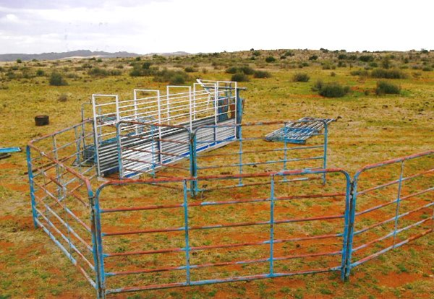
Megalanyane Solutions (Pty) Ltd
Megalanyane Solutions (Pty) Ltd is 100% owner managed by Rodney Tebogo Megalanyane .
Business was established and registered on the 26th June 2014 and 100% black owned .
Business is operating a general trader. I has been focusing supply and delivery of groceries, agricultural goods.
Business was awarded a purchase order by the Northern Cape Department Agriculture, Land Reform and Rural Development to supply and deliver mobile handling facilities for sheep and cattles at the Dawid Kruiper Farms.
Business approached sefa to assist with a bridging finance facility to purchase the mobile handling facilities.
Key information
Location : Kimberley
Jobs facilitated: 1
Funding amount: R 372 375.75
Sector: Services

Slide 50
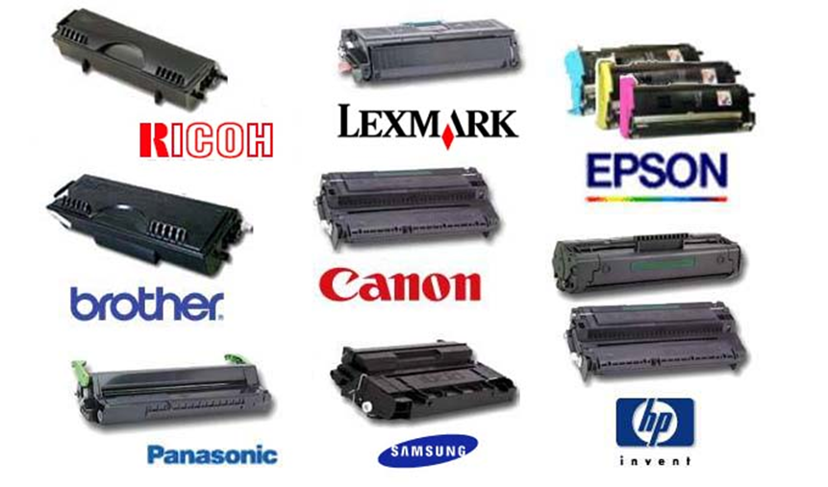
N Gazans Construction Trading supplier and other activities (Pty) Ltd
Business is a 100% black, male owned logistics entity, established and managed by Mr Letlhogonolo Motsikoe
Business was established and registered on the February 2018.
Business received a contract from South African Police Service (SAPS) Northern Cape Provincial office Kimberley to supply and deliver Cartridges.
Business approached sefa to assist with a bridging finance facility to purchase the cartridges.
Key information
Location : Kimberley
Jobs facilitated: 1
Funding amount: R 71 156.00
Sector: Services

Slide 51
Direct Lending
Western Cape

Slide 52
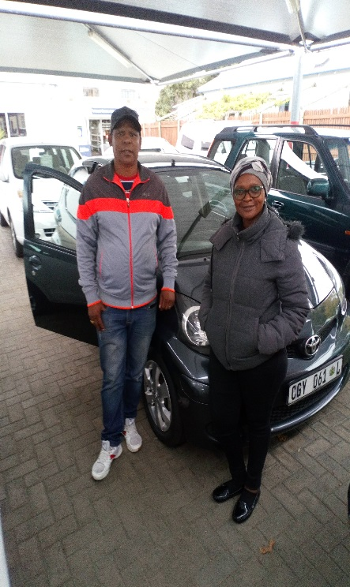
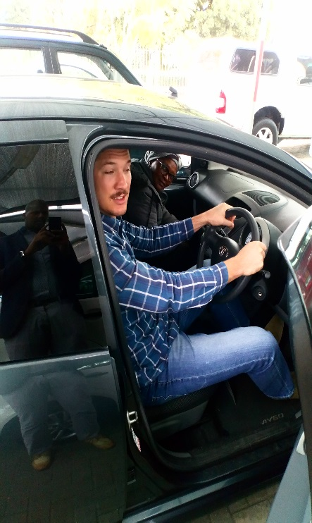
Lee- Nash Trading CC
Lee- Nash Trading CC trading as Phoenix Driving School was founded in 2017 by Melony and Peter Louw, (a husband and wife team).
They originally managed a driving school on behalf of the owner, however, in September 2017, they decided to start their own driving school business.
Due to the lack of vehicles, they entered into arrangements with two Service Providers (Cross Road Driving School and Eric's Driving School) for the use of their vehicles subject to availability. They entered into an arrangement with two service providers for the use of their vehicles when available.
With only their skill, expertise and a reputable reputation, they managed to build a sustainable business.
sefa assisted the entrepreneurs by approving funding to purchase 2 vehicles.
Key information
Location: George, Western Cape
Job facilitated: 2
Funding amount: R483 880-36
Sector: Services
PHOTOS

Slide 53
Direct Lending
Gauteng South

Slide 54
Unagundo Projects (Pty) Ltd
Unagundo Projects (Pty) Ltd is an existing business owned by Mpho Nemavhulani and Vutshilo Nemukula. The core activities of the business incorporates General maintenance of office and industrial buildings; Renovations specialist and supplier of all materials (within the building, maintenance, design and partitioning space); Electrical work; Cleaning of offices and buildings; Rubble removal.
The business is 50% youth owned and the business township based.
Unagundo Projects (Pty) Ltd secured R250 000-00 funding to execute a purchase Order awarded by NYDA (National Youth Development Agency).
The loan amount required was for material and working capital
The project entails office space planning and partitioning of the NYDA offices in the West rand.
Key information
Location : Soweto, Gauteng
Job maintained: 4
Funding amount: R250 000-00
Sector: Construction and building maintenance

