Slide 1
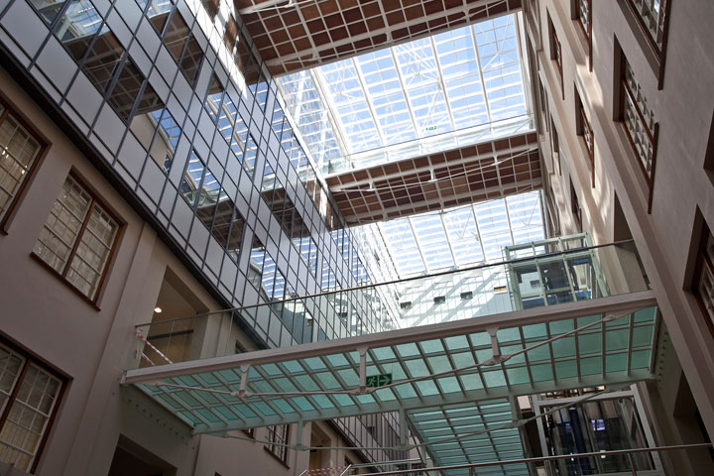
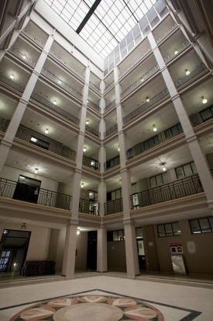
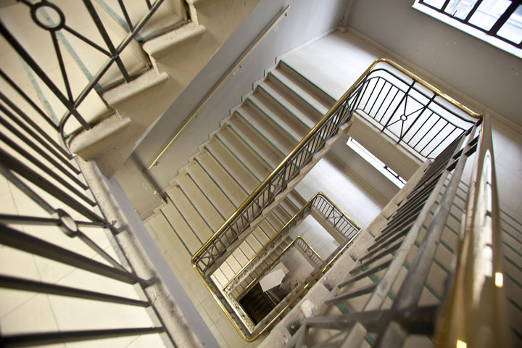
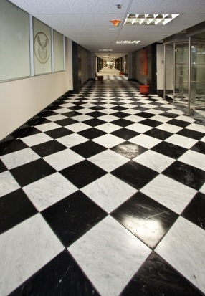
Presentation to the Portfolio Committee 20 November 2018
SPATIALLY ENHANCED ASSET INFORMATION

Slide 2
CONTENTS
NO | ITEM | SLIDE
1 | Table of contents | 2
2 | Purpose | 3
3 | DPW Immovable Asset Register (IAR) | 4
4 | Significance of the Immovable Asset Register (IAR) | 5
5 | Significance of the IAR cont… | 6
6 | Background | 7
7 | Background cont…. IAR Compilation Process – High Level Overview | 8
NO | ITEM | SLIDE
8 | Physical Verification Process Utilisation of Technology - Hardware & Software Tools | 9
9 | Capability to Build Asset Footprints: Created to determine the extent of improvements | 10
10 | Land Parcels represented Spatially | 11
11 | Improvements represented spatially | 12
12 | Component & Infrastructure Assets | 13
13 | Data can be represented by User Department | 14
14 | Spatial representation of Assets as per request | 15
NO | ITEM | SLIDE
15 | Alignment of IAR to GIAMA Life cycle management of immovable assets | 16
16 | Archibus Functionality overview | 17
17 | Business Processes and alignment to Archibus | 18
18 | Practical steps of migrating data to Archibus | 19
19 | Demo (Archibus) | 20

Slide 3
PURPOSE
The presentation seeks to:
inform the Portfolio Committee of the practical steps taken to move the Immovable Asset Register (IAR) from Excel to ARCHIBUS format towards full compliance with the Government Immovable Asset Register Act (19 of 2007)
highlight the process of collecting and saving core data of the IAR using technology
confirm the continued use of Excel spreadsheets for importing and exporting data from DPW IT Systems for reporting purposes i.e. Interim Financial Statements and Annual Financial Statements to various Stakeholders including the Auditor General (AG)

Slide 4
DPW IMMOVABLE ASSET REGISTER (IAR)
The Department of Public works (DPW) manages an extensive property portfolio that comprises of 29 644 land parcels on which 89 626 improvements are located across 52 client departments countrywide in order to make a contribution towards the State’s service delivery objectives
DPW releases suitable vacant land parcels to the Department of Rural Development and Land Reform and the Department of Human Settlements for the land reform programme and to address the housing backlog in the country
The IAR serves as the primary source of data for all property related activities or transactions. The PMTE has initiated the migration of the rebuilt IAR data into an integrated asset management solution

Slide 5
SIGNIFICANCE OF THE IMMOVABLE ASSET REGISTER (IAR)
The IAR is of a strategic importance in the State’s drive to obtain the best functional, social & economical returns from its property portfolio in line with the National Development Plan’s socio-economic objectives (for example, the disposal of land for human settlements and land reform)
IAR is the core tool for the PMTE to effectively carry out its mandate in order to meet the service delivery objectives of the State
A complete and accurate IAR underpins the successful implementation of GIAMA, compliance to PFMA, applicable GRAP standards, National Treasury regulations/guidelines and PMTE Immovable Asset Management Policy

Slide 6
SIGNIFICANCE OF THE IAR cont…
DPW made a significant contribution to the G20 Balance Sheet Project (Deemed Cost Valuation model eliminated assets recorded at R1 values, assets valued at R126 billion as at 31 March 2018)
The extent of the land and buildings under the custodianship of DPW is 5,4 million hectares and 36,8 million sqm respectively
The PFMA requires the Accounting Officer to manage and safeguard assets to prevent fraud or misappropriation of assets

Slide 7
BACKGROUND
1995 - 1999 first major exercise in respect of the IAR was undertaken by the first democratic Government of RSA and by 1999 an IAR was compiled. This was a catalyst that resulted in the development of the Property Management Information System (PMIS)
DPW is currently paying Municipal Services, Rates & Taxes and Sundry Payments through PMIS
IAR not a static inventory => continuous enhancements on DPW’s IAR is required to ensure:
Compliance with Section 13 (d) of the Government Immovable Asset Management Act (GIAMA) (conduct condition assessment on immovable assets over a five-year cycle);
Provision of reliable immovable asset information in order to meet the business requirements of the PMTE and service delivery objectives of the State
Proper accounting of immovable assets in line with the PFMA; and
Compliance with the applicable GRAP standards and National Treasury guidelines

Slide 8
BACKGROUND CONT…. IAR COMPILATION PROCESS – HIGH LEVEL OVERVIEW
In 2013 DPW appointed Professional Mobile Mapping to develop a mobile application for data collection which include a Geographic Spatial representation of the assets on the ground
The software tool and mobile solution was used to verify land, buildings, significant components & infrastructure assets
The collected data went through the quality assurance process involving Service Providers, IAR Project Managers, Regional Property Management staff and Asset Registry staff at Head Office
Once all the above activities were completed the data was saved on the Oracle database located at SITA
Physical verification and spatial representation of the immovable assets are made possible by Geographic Information Systems (GIS) as per the diagrams below:

Slide 9
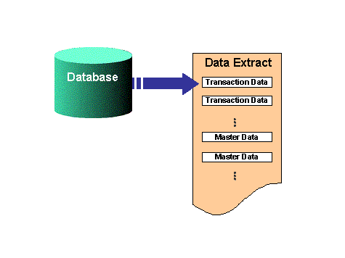
PHYSICAL VERIFICATION PROCESS Utilisation of technology - hardware & software tools
Ready for field work
QA 1
SSP
QA 2
SSP
QA
Regional Office
Desktop GIS mapping
and loading of footprints
Failed records were returned for correction
Progress reported at Head Office
Migrate to Archibus SQL Database
Head Office QA
Reports from Archibus
Approved records saved to Oracle Database @ SITA
Export to Excel and Prepare for migration

Slide 10
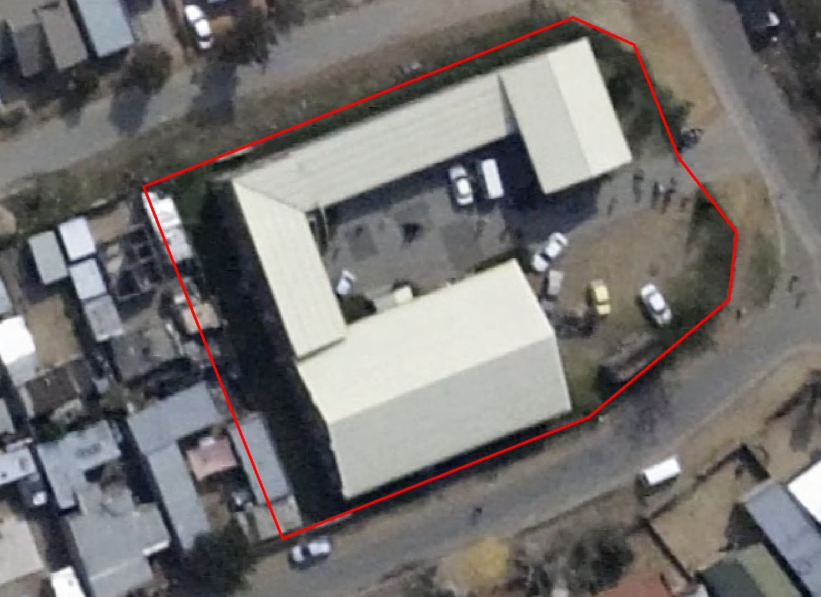
CAPABILITY TO BUILD ASSET FOOTPRINTS: CREATED TO DETERMINE THE EXTENT OF IMPROVEMENTS
13.98 m
40.82 m
17.3 m
23.82 m
10.16 m
866.72 m²
12.68 m
18.89 m
17.08 m
36.32 m
25.821 m

Slide 11
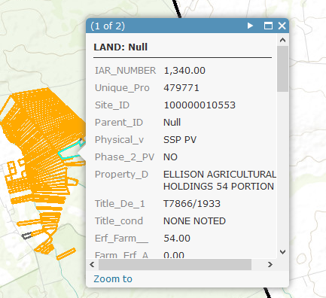
LAND PARCELS REPRESENTED SPATIALLY
All Land are stored as parcel boundaries
All land parcels have attribute data attached and viewable from the spatial representation

Slide 12
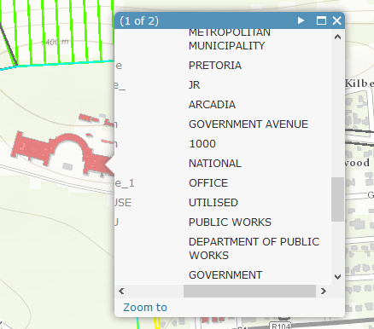
IMPROVEMENTS REPRESENTED SPATIALLY
All Improvements are stored as polygons
All Improvements have attribute data attached and viewable from the spatial representation

Slide 13
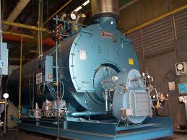
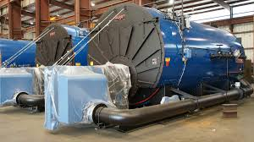
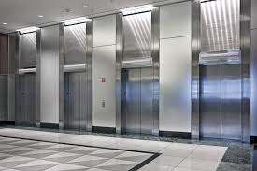
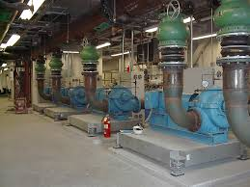
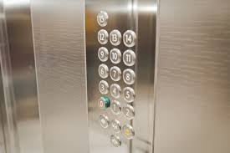
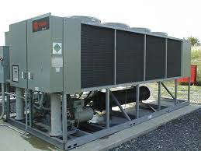
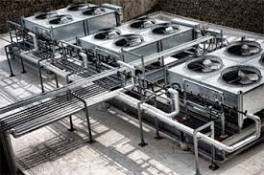
COMPONENT & INFRASTRUCTURE ASSETS
BOILERS
ELEVATORS
GENERATORS
HVAC

Slide 14
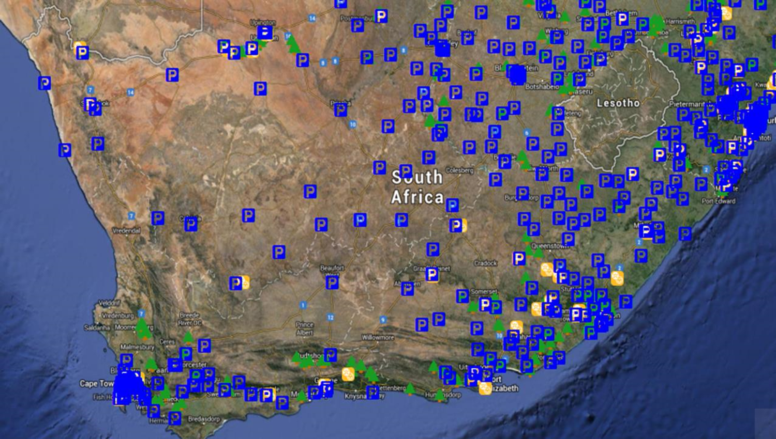
DATA CAN BE REPRESENTED BY USER DEPARTMENT
This is the IAR only representing the SAPS Land parcels as points across South Africa
Can be filtered to specific User Department

Slide 15
SPATIAL REPRESENTATION OF ASSETS AS PER REQUEST

Slide 16
Alignment of IAR to GIAMA Life cycle management of Immovable Assets
U-AMP
C-AMP

Slide 17
ARCHIBUS FUNCTIONALITY OVERVIEW
U-AMP
C-AMP
Vesting
GRAP
Reports
Lease Out
Revenue
Portfolio Analysis
IAR
SAGE
Rates & Taxes
Condition Assessment
Expenditure
Maintenance
Capital Projects
Facilities
Management
Maintenance Costs

Slide 18
BUSINESS PROCESSES AND ALIGNMENT TO ARCHIBUS
Planning (DPW Family)
Acquisition & Disposal
Capital Projects & Budgeting
Portfolio/ Investment Management
Real Estate Portfolio Management
REMS (Leases)
Real Estate Portfolio Management
Real Estate Portfolio Management
Real Estate Portfolio Management
Capital Budgeting Projects
Building Operations
Space Management
Environmental & Risk
Facility Management
Demand Management
REIRS (Asset Register)
Asset Management
Work Place Management
Asset Management
Asset Management
Capital Budgeting
Asset Management
Capital Budgeting
Real Estate Portfolio Management
Asset Management
Asset Management
Asset Management
SAGE
INFORMATION COMMUNICATION TECHNOLOGY (ICT)
Legal and Regulatory Framework (GRAP, IDMS, GIAMA, PFMA etc.)
Risk Management and Quality Assurance

Slide 19
PRACTICAL STEPS TAKEN TO MIGRATE DATA TO ARCHIBUS
1) Project Inception
Decision taken to Acquire new ERP solution as per the mobilization of the PMTE and the requirement to be GRAP compliant
2) DPW Requirement Specification
DPW developed a requirement specification which detailed minimum requirements for an Immovable Asset Register (IAR) to comply with PFMA, GIAMA and GRAP
3) ARCHIBUS Inception
Archibus was the software of choice after a critical review process
4) URS/FRS Preparation
User Requirements Specification and Functional Requirement Specification (FRS) was developed
5) System Configuration and User Acceptance Testing
System Configured and Conducted User acceptance testing for functionality
6) Migration of IAR data from Oracle server to Archibus
Exported IAR data from Oracle database to Excel
7) Data Testing and Training
Background verification of migrated records to test completeness
8) Production/Live
Moved data from Test to Production/Live Environment
Data mapped and migration to Archibus (SQL)
Data verified on the system for correctness
Updated exceptions on the system
Training of Users
Immovable Asset Data Maintenance
Call centre (Unscheduled Maintenance)
Movable Asset Maintenance

Slide 20
DEMO

Slide 21
END
National Department of Public Works (NDPW)
Head Office: Public Works CGO Building Cnr Bosman and Madiba Pretoria Central Private Bag X65 Pretoria 0001
Website: http://www.publicworks.gov.za
THANK YOU

