Slide 1
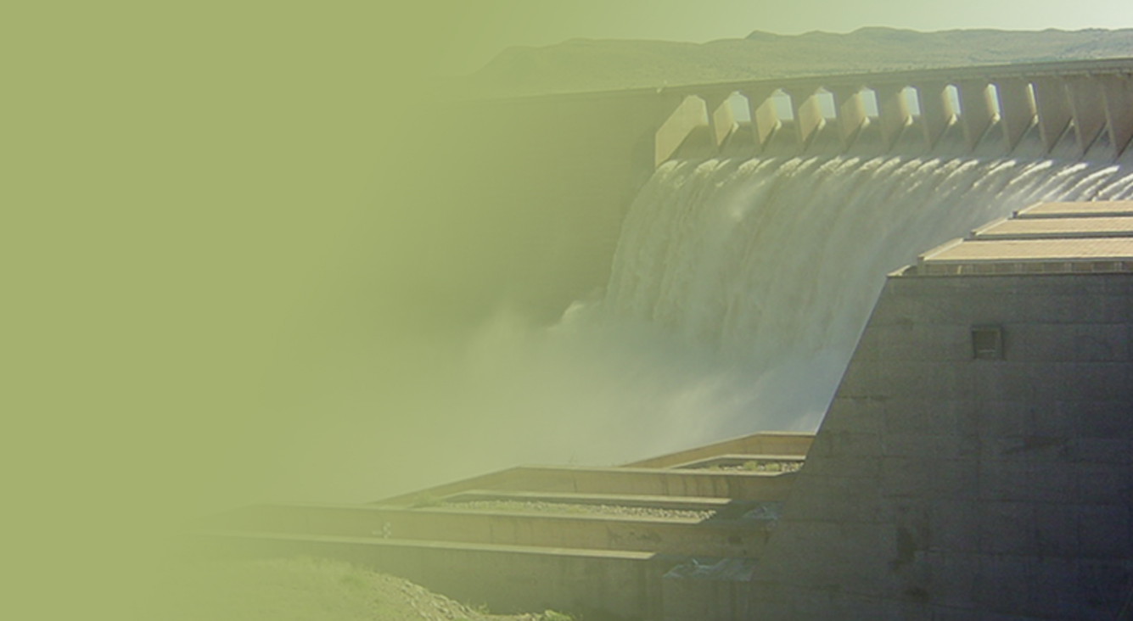
PLAN TO RESOVE THE OUTSTANDING DEBT OWED BY MUNICIPALITIES
Presented by Frans Moatshe Act CFO
14 November 2018
PRESENTATION TITLE
Presented by:
Name Surname
Directorate
Date

Slide 2
Content
PFMA requirements
Legal action taken to collect outstanding Municipal Water debt
Participation in IMTT
Restriction of water
Withholding equitable share
Revoking water use authority licenses of defaulting Municipalities

Slide 3
Collection steps and Strategies
In terms of the Public Finance Management Act (PFMA), 1 of 1999, the Accounting Officer:
3.1.3 Must take effective and appropriate steps to collect all money due to the department
[section 38(1)(c)(i)];

Slide 4
Collection steps and Strategies
Sending final demand letters
Arranging meetings with municipalities,
Meetings with COGTA, Provincial Treasuries and NT
Query resolution
Hand over to the debt collector
Hand over debt to legal
63 summons issued
7 court judgments granted ( Phumelela, Seme, OR Tambo, Mangaung, Emfulweni, Nketoana and Siyathemba )
135 not handed-over
47 paying their accounts

Slide 5
Collection steps and Strategies
The Water debt has been included in the IMTT on Electricity reticulation and monies owed to the Water Trading Entity and Water Boards
A Advisory Panel was appointed to look at the problems facing Municipalities
The report was biased towards problems Eskom were facing and did not adequately address the Water Boards and the WTE debt
An separate Advisory Panel will be appointed or the scope of the existing Advisory Panel will be extended to look at the debt to Water Boards and the Water Trading Entity
The members of the new/revised Panel should include members with experience in water related activities and include water engineers and water scientists
The Municipal debt has increased by R1,7 billion from 31 March 2018 to 30 September 2018

Slide 6
Collection steps and Strategies
Should the participation in the IMTT not achieve any significant results:
Water restrictions to be made on defaulting municipalities
Section 59 (3) (b) of the National Water Act allows the DWS to restrict or suspend the flow of water to defaulting municipalities. These needs to be implemented to those municipalities/entities that are not servicing their debt as part of the credit control mechanisms
Restriction letters have already been sent to: Msukaligwa Local Municipality, Maluti-A-Phofung Local Municipality, Mafube Local Municipality, Madibeng Local Municipality

Slide 7
Collection steps and Strategies
Once water has been restricted and has no positive effect, individual letters will be sent to National Treasury (NT) for each Municipally requesting that the equitable share be withheld until:
The Municipality has made a payment to cover the last invoice received (current debt)
A payment arrangement has been entered into showing how the old debt will be repaid
Once the payment arrangement has been concluded, NT is to pay a portion of the equitable share covering the latest invoice of the municipality and the first payment per the payment arrangement.
Once theses payments have been made and confirmed by WTE, the remainder of the equitable share to be paid to the Municipalities by NT
National Treasury are of the opinion that this is a short term solution and does not address the root cause

Slide 8
Collection steps and Strategies
Should the above-mentioned actions not yield positive results the following will be considered:
Revoking the water use authority licenses of defaulting Municipalities
Withholding RBIG and WSIG grants

Slide 9
THANK YOU

