Slide 2
TABLE OF CONTENTS
EXECUTIVE SUMMARY
SHOWCASING OUR PLATFORMS
FY2017/18 PERFORMANCE
Financial Results and Audit Outcome
Content and Platforms
Human Capital
Governance
Achievements and Awards
Social Responsibility
Looking Forward

Slide 3
EXECUTIVE SUMMARY
SABC is one of the key institutional pillars of our democracy, delivering essential content to millions of South Africans on multiple platforms and in 14 different languages, on a daily basis.
2017/18 financial year was a demanding one for the SABC, the Board, its employees and many of its stakeholders.
Had to overcome many daunting challenges and the pattern might continue with even greater severity in the year ahead. However, these challenges will also be overcome.
Salient points for the 2017/18 financial year’s performance include:
Appointment of permanent SABC Board.
Improved leadership stability with the appointment of COO and four (4) Group Executive positions (GCEO and CFO appointed in FY2018/19).

Slide 4
EXECUTIVE SUMMARY
Exceeded ICASA local content and genre quotas on television and over performance on local music quotas on radio.
Coverage of numerous News, Current Affairs and Sporting events nationally and internationally – many of them live.
Review of SABC’s Editorial Policies.
Culture and climate survey to obtain a view of SABC’s working conditions.
Implementation of performance management and reduction of disciplinary cases and grievances in the Corporation.
Focussed efforts to reduce internal and external audit findings.

Slide 5
EXECUTIVE SUMMARY (cont)
SABC had a demanding financial year with cash resources stretch to the maximum to ensure continued business operations:
Total revenue was R6.6 billion against a budget of R7.3 billion - underperformance of R709 million (10%). Year-on-year performance showed an improvement of R56 million (1%).
Expenditure was R7.269 billion compared to budget of R7.279 billion - R11 million (1%) underspend.
SABC’s performance resulted in a total net loss of R622 million.
At 31 March 2018, the SABC’s cash position was R131 million.
Auditor General issued a disclaimer audit opinion mainly attributable to following core areas:
Uncertainty regarding the SABC’s going concern assumptions;
Property, Plant and Equipment;
Irregular Expenditure.

Slide 6
SHOWCASING OUR PLATFORMS

Slide 7
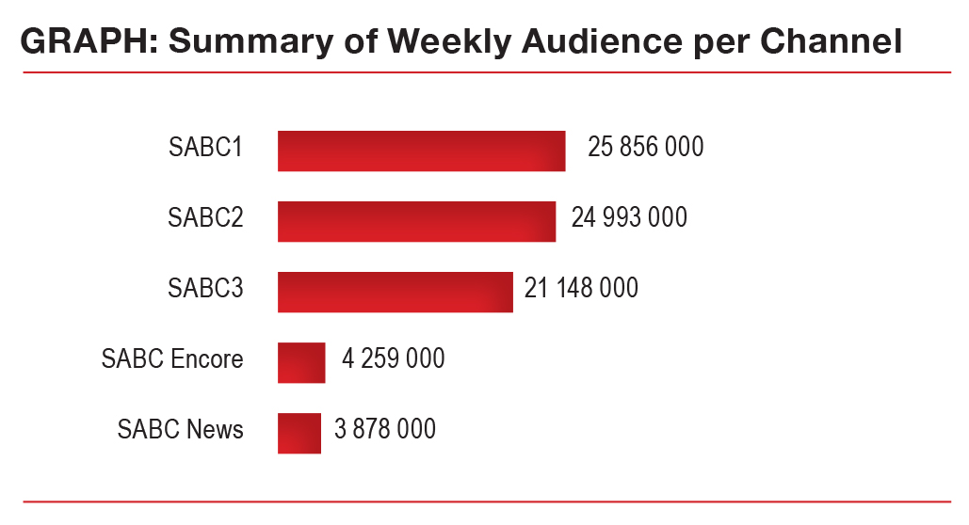
SHOWCASING OUR PLATFORMS - TELEVISION
SABC TV consists of three free-to-air channels and two other channels carried on a subscription digital satellite network. The channels deliver top-quality local and international content in all South Africa’s languages through-out the nation. SABC1, SABC2 and SABC3 attract on average 28 million South African viewers in a typical month.

Slide 8
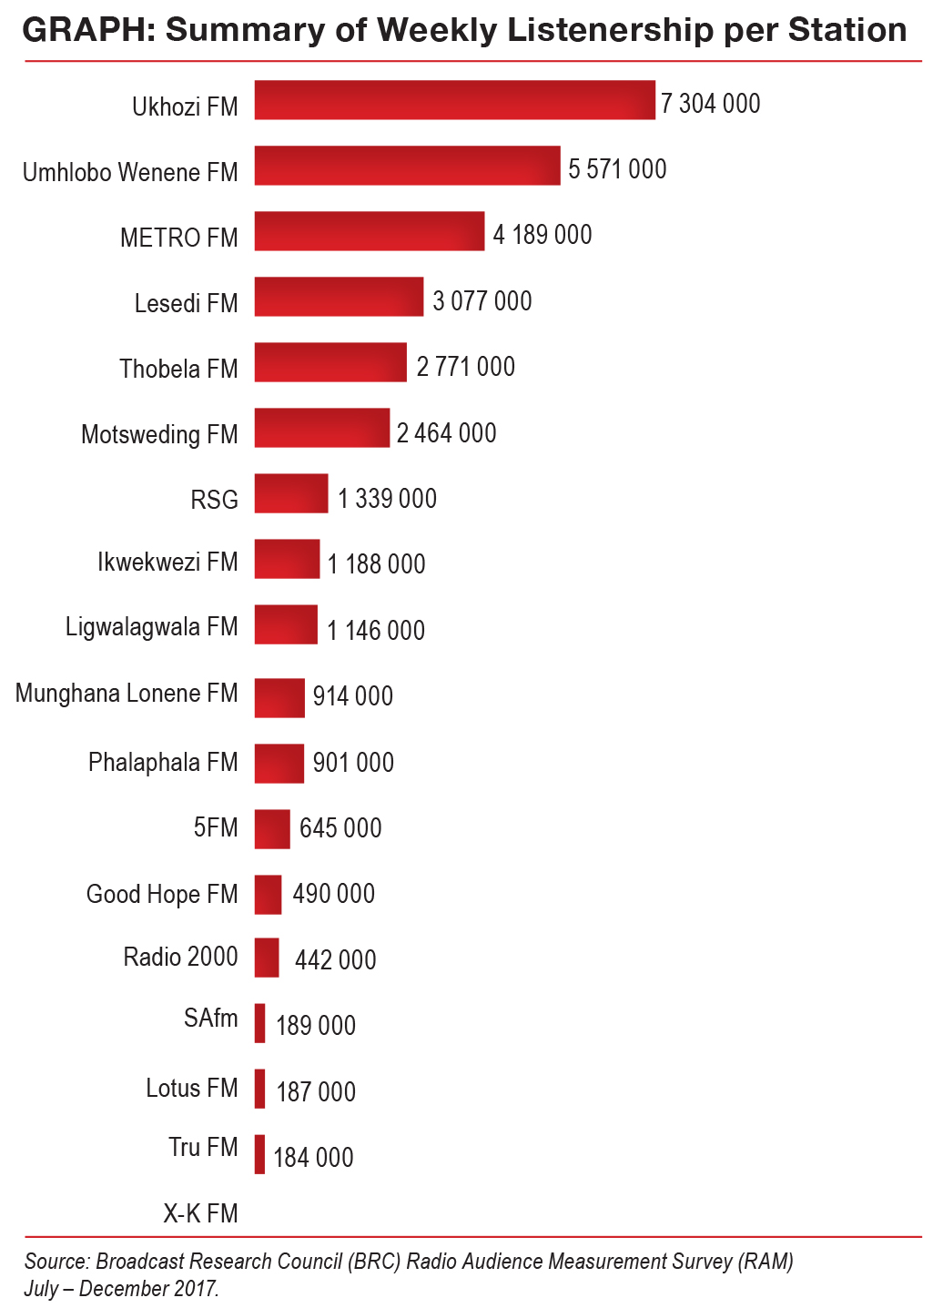
SHOWCASING OUR PLATFORMS - RADIO
SABC radio stations have remained relevant, widely accessible, and are a core platform for the Public Broadcaster to deliver on its public service mandate.
SABC Radio commands a healthy all-adult share (15years+) of 70.5% which translates to 28 328 million South Africans.
The graph indicates weekly listenership numbers per station.

Slide 9
FY2017/18 PERFORMANCE

Slide 10
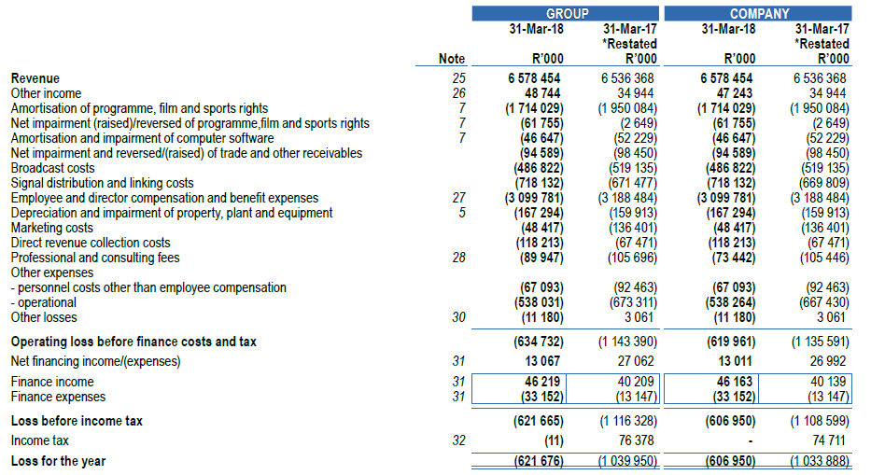
FY2017/18 PERFORMANCE – FINANCIAL RESULTS
STATEMENT OF PROFIT OR LOSS

Slide 11
FY2017/18 PERFORMANCE – FINANCIAL RESULTS
As at 31 March 2018, the SABC’s cash position was R131 million. Net cash inflow of R49 million was generated since the beginning of the financial year. This was an improvement of 60% compared to the previous fiscal.

Slide 12
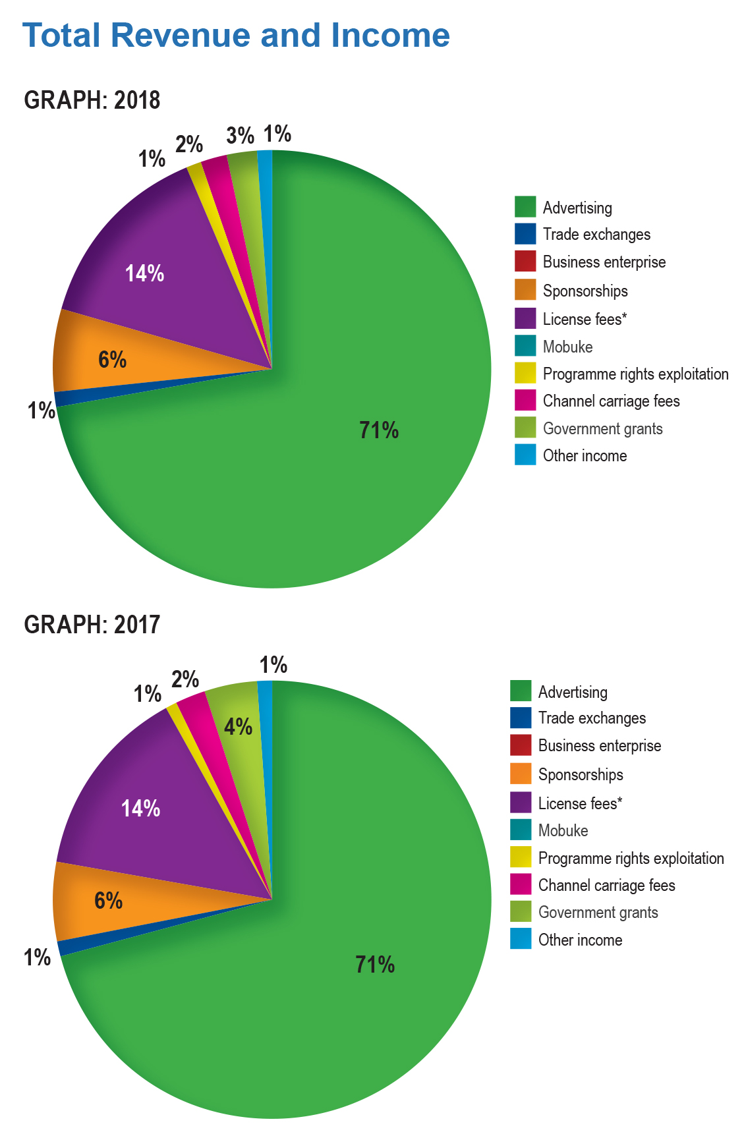
FY2017/18 PERFORMANCE – FINANCIAL RESULTS
REVENUE PERFORMANCE
Total revenue for the full financial year was R6.6 billion against a budget of R7.3 billion resulting in an underperformance of R709 million (10%).
However, a year-on-year performance showed an improvement of R56 million (1%) driven mainly by commercial revenue.
The graphs depicts the various revenue streams of the SABC as percentages and also indicate the variances between the two years (albeit small).

Slide 13
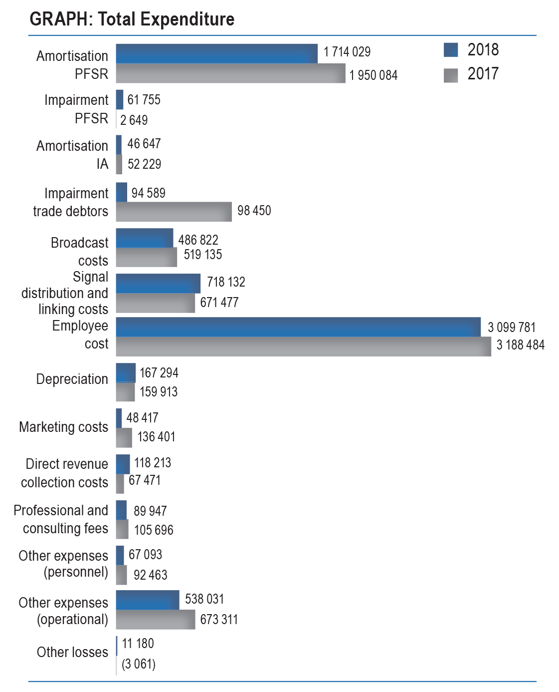
FY2017/18 PERFORMANCE – FINANCIAL RESULTS
Total EXPENDITURE incurred for the 2017/18 financial year amounted to R7.269 billion compared to the budget of R7.279 billion.
The R11 million (1%) underspend is mainly owing to amortisation of content and other expenses.
Employee costs of R3 billion is the highest expenditure item.

Slide 14
FY2017/18 PERFORMANCE – FINANCIAL RESULTS
TRADE AND OTHER PAYABLES
TRADE PAYABLES | 2018 | 2017
 | R'000 | R'000
- local | 388 048 | 225 335
- foreign | 13 158 | 890
Other payables | 191 310 | 152 338
Accruals | 416 055 | 210 316
Programme, film and sports rights related trade accruals | 109 174 | 117 738
Total | 1,117,746 | 706,617

Slide 15
FY2017/18 PERFORMANCE – AUDITOR GENERAL AUDIT OUTCOME
Uncertainty on Going Concern assumption
- current net losses
- net current liability
- Projections / forecasts of cash flows could not be satisfied
Property, plant & equipment
- existence & completeness of AUC
- late submission of estimated useful lives & impairment
- prior year qualification
Irregular expenditure
- poor internal control systems to prevent & detect irregular expenditure
Trade & other payables (prior year qualification)
Programme, Film & Sports Rights reassessment of useful lives)
Taxation (linked to assets & content qualification)
DISCLAIMER OF AUDIT OPINION

Slide 16
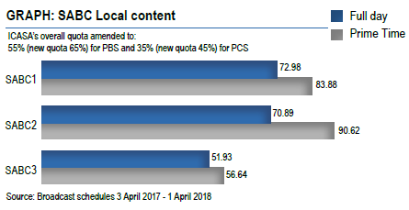
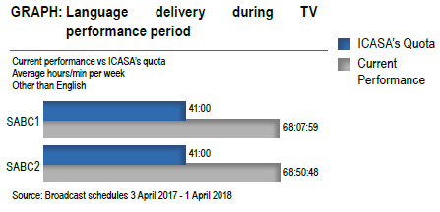
FY2017/18 PERFORMANCE – CONTENT AND PLATFORMS
The SABC performed very well in its objective of contributing to nation building by acquiring and scheduling content that reflects the South African story. Local content quotas on all three television channels were exceeded.
PBS radio stations also exceeded all their genre quotas in terms of news, current affairs, informal knowledge building education, children and drama ensuring that the nation is informed, educated and entertained in the language of their choice. SABC’s PBS TV Network exceeded in delivering on its language quotas (languages other than English).

Slide 17
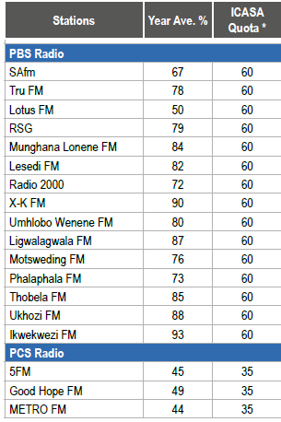
FY2017/18 PERFORMANCE – CONTENT AND PLATFORMS (cont)
The SABC has the top 5 most listened to Radio Stations in the country. These are:
The SABC radio stations also far exceeded ICASA’s minimum requirements for South African music as can be seen below:
1. Ukhozi FM: 16.7%;
2. Umhlobo Wenene FM: 13.6%;
3. Lesedi FM: 7.4%;
4. Thobela FM: 7.2%; and
5. METRO FM: 5.3%.
SABC radio stations delivered public value by broadcasting innovative programming that advocates for social cohesion, nation building, promotion of democracy and empowerment of South African citizens.
To observe these themes, stations utilised a variety of public service programming genres that incorporated drama, talk-back show format, pre-recorded inserts, interviews and magazines as well as highly entertaining but informative commercial programming and content.

Slide 18
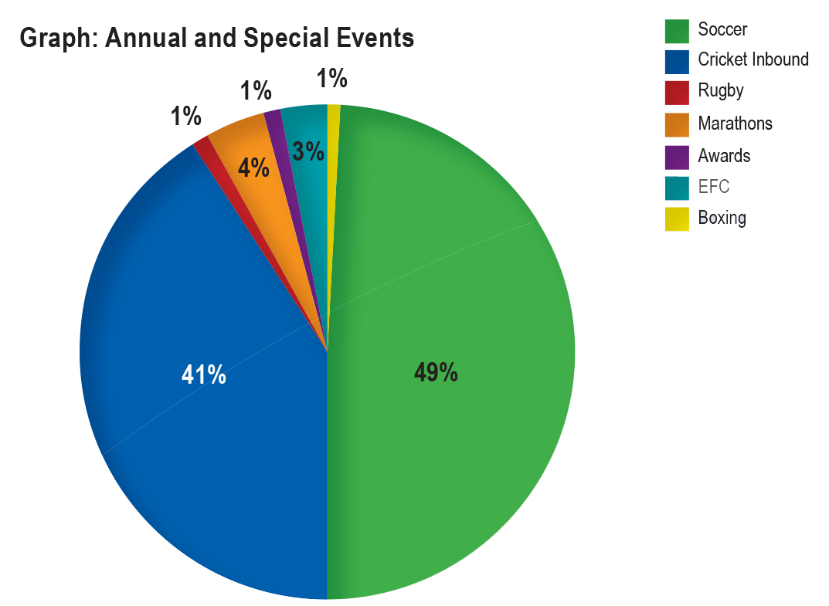
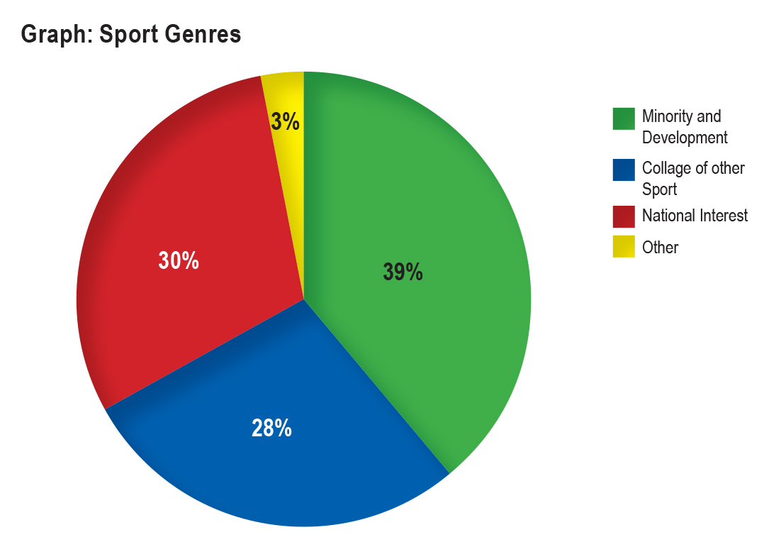
FY2017/18 PERFORMANCE – CONTENT AND PLATFORMS (cont)
News and Current Affairs forms an integral part of the Public Broadcaster’s mandate to inform and educate its audiences. Numerous national and international stories and events were covered, many of them live.
SABC News digital platform performed very well with the News YouTube channel reaching 10 million views in March 2018 from an average monthly performance of 5 million views.
The SABC’s mandate to broadcast sports of national interest was realised with the continued coverage of a wide range of sporting events on radio and television – soccer, athletics, rugby, cricket, marathons, boxing, basketball, extreme fighting championships, sport awards etc. This was delivered despite the rising cost of Sports Rights and lack of a dedicated Sports channel.
The graphs below depicts the number of minutes afforded to each sport/genre as well as the percentages dedicated to Sports of National Interest and Minority and Developmental Sport.

Slide 19
FY2017/18 PERFORMANCE – HUMAN CAPITAL
As the broadcasting landscape evolves employee skills are becoming more specialised, making engagement and culture priorities for HR. Every organisation’s culture should support technology and the ensuing digital transformation.
During 2017/18, the SABC conducted a culture and climate survey to provide employees with an opportunity to voice their opinions regarding important aspects of the SABC’s working environment. The results of the survey are currently being implemented in the organisation.
With digitisation becoming a priority, a new set of skills is required. This is not simply one of reskilling, instead, HR is looking at leadership, operating models and structures. During the period under review, various executive vacancies were filled. These vacancies included:
Chief Operations Officer (COO);
GE: Radio;
GE: News and Current Affairs;
Chief Audit Executive (CAE); and
GE: Human Resources.
(The positions of CFO and GCEO were filled during June and July 2018 respectively).

Slide 20
FY2017/18 PERFORMANCE – HUMAN CAPITAL (cont)
HR Priorities for the Year under Review included:
Career Progression
An integrated Career Progression framework and policy was developed and presented to the relevant stakeholders for approval. Planning is currently underway to conduct a pilot exercise within HR.
Performance Management
Performance contracting only took place at management level. Further contracting will take place during the new financial year.
Workplace Skills Plan (WSP)
Delivery on the WSP was slow due to financial constraints. However, during the year under review, new ways of training were developed and this yielded cost savings within this environment whilst addressing the skills needs of the organisation.

Slide 21
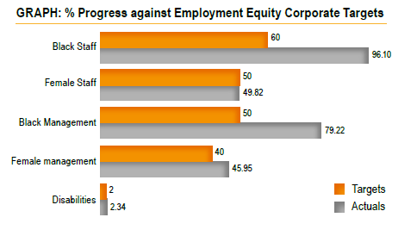
FY2017/18 PERFORMANCE – HUMAN CAPITAL (cont)
Other HR Priorities included Employment Equity and Employee Relations.
As seen below the SABC reflected a strong employment equity profile when measured against its employment equity targets during the period under review.
Amongst priorities of the SABC Board was to reduce the number of disciplinary cases and grievances within the Corporation. HR focused on the finalisation of outstanding disciplinary cases and also reduced the number of disciplinary cases within the organisation to a manageable number.

Slide 22
FY2017/18 PERFORMANCE – GOVERNANCE
SABC’s aim was to deliver on the highest standards of compliance with not only the letter, but also the spirit of relevant governance codes. To achieve this, processes and practices were reviewed to ensure compliance with relevant legal requirements.
There was a renewed focus on the use of funds, to ensure spending in an efficient and cost-effective manner, as well as adherence to good corporate governance practices that are continually benchmarked against the risk management framework issued by National Treasury.
Additional effort went into clearing previous internal and external audit findings. Significant progress was made on both these deliverables, however, it should be noted that this is an on-going process that will continue in the new financial year.
The identification, assessment and mitigation of strategic, compliance, operational and fraud risks form the core of the SABC’s enterprise-wide risk management. During the period under review, 76 risk management plans were completed for identified risks. The plans are monitored and evaluated on an on-going basis.

Slide 23
FY2017/18 PERFORMANCE – GOVERNANCE (cont)
IRREGULAR EXPENDITURE | GROUP AND COMPANY
 | 2018 | 2017 | 2016
 | R'000 | R'000 | R'000
Opening balance | 4 405 804 | 5 148 526 | 4 385 138
Irregulae Expenditure not validated | - | (1 429 645) | 322 282
Add: Irregular expenditure - identified in the current year relating to the prior years | - | - | -
Balance as restated | 4 405 804 | 3 718 881 | 4 707 420
Add: Irregular expenditure - identified in the current year | 571 496 | 686 923 | 441 222
Less: Irregular Expenditure recovered |  |  | (117)
Irregular Expenditure awaiting condonation subject to further investigation | 4 977 300 | 4 405 804 | 5 148 526
Analysis of expenditure awaiting condonation per age classification
Current year | 571 496 | 686 923 | 441 222
Prior years | 4 405 804 | 3 718 881 | 4 707 420
 | 4 977 300 | 4 405 804 | 5 148 642

Slide 24
FY2017/18 PERFORMANCE – GOVERNANCE (cont)
FRUITLESS AND WASTEFUL EXPENDITURE | 2018 R'000 | 2017 R'000 | 2016 R'000
Opening balance | 145 994 | 92 461 | 58 299
Less: Reversal of incorrectly disclosed prior year amount | - | (21 139)
Restated opening balance | 145 994 | 71 322 | 58 299
Current year movements | 50 174 | 74 672 | 34 678
Add: Fruitless and wasteful expenditure - incurred in the current year | 20 715 | 70 006 | 34 678
Add: Fruitless and wasteful expenditure - relating to prior years identified in the current year | 29 459 | 4 666
Less: Amounts condoned
Fruitless and wasteful expenditure not condoned | 196 168 | 145 994 | 92 977
Less: Amounts recoverable | - | - | -
Less: Amounts recovered |  |  | (516)
Less: Amounts not recoverable (not condoned)
Fruitless and wasteful expenditure awaiting condonation | 196 168 | 145 994 | 92 461

Slide 25
ACHIEVEMENTS AND AWARDS

Slide 26
ACHIEVEMENTS AND AWARDS
Awards, achievements and recognition received by SABC platforms, programmes and individuals are fully detailed in its Annual Report. A summary thereof includes:
Radio – 24 Awards
Television – 22 Awards
News and Current Affairs – 36 Awards
Sports – 2 Awards

Slide 27
SOCIAL RESPONSIBILITY

Slide 28
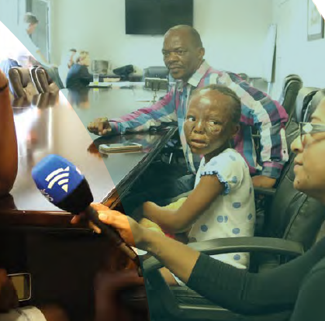
SOCIAL RESPONSIBILITY
During the period under review, SABC platforms in partnership with the SABC Foundation participated in various nation building initiatives. These include but are not limited to:
Wanga from Burns to Beauty
People Living with Cancer: Cancervive Ride
Quellin Manillier, Strabismus Procedure
South African National Youth Orchestra Concert
Christmas Hampers
Talk Sign Day
SABC Disability 360 Awards
Disability Dialogue
SABC1 Gives Back campaign
Mandela Month
1000 Woman 1 Voice Lunch
GoodHope FM United in Hope Benefit Concert
SAfm / Gift of the Givers - Western Cape fires
Abaphole Baphile Outreach Programme
METRO FM and McCain Cooking classes
Ri a Luvha’ Road shows
Mandela Day in partnership with Habitat for Humanity, Orange Farm

Slide 29
LOOKING FORWARD

Slide 30
WAY FORWARD
The SABC is in a process of rehabilitation and renewal - must be carefully managed and restored to ensure fulfilment of its unique public mandate.
Good progress made in stabilising the SABC, strengthening governance and regaining integrity. However, current financial position remains dire.
Developed a new strategic Roadmap. Is aimed at ensuring that the SABC operates competitively in evolving media and digital landscape and provide informative, educational and entertaining content to all South Africans. Main objective is to ensure financial sustainability.
Focus is also on reducing operating costs. Review of the SABC’s operating model will assist to ensure that the organisation is properly aligned for future operations and is fit for purpose.

Slide 31
SABC STRATEGIC ROADMAP 2023
RESPECT TRUST INTEGRITY QUALITY
VISION
To become the leading, credible voice and face of the nation and the continent
MISSION
A high performing, financially viable, digitised national public broadcaster that provides compelling informative, educational and entertaining content via all platforms
STRATEGIC POSITIONING
PREFERRED BROADCASTER
- Accessibility - Plurality
- Regulations - Relevance
COMMUNITIES
PREFERRED EMPLOYER
- Engagement - Trust
- Performance - Development
EMPLOYEES
PREFERRED PROVIDER
- Product - Content
- Cost - Efficiency
CLIENTS
PREFERRED BRANDS
- Value - Quality
- Trusted - Innovation
AUDIENCES
PILLARS AND GOALS
Our business strategy is premised on 6 strategic pillars and goals:
Financial Sustainability: A financially stable organisation
Content & Platforms: Offer a competitive innovative multi-tier portfolio
Digital: SABC Everywhere for everyone
Human Capital: A competent, dynamic workforce that is fit for purpose
Governance: Compliant governance practices, risk management and internal controls
Partnerships: Strategic and sustainable partnerships
KEY PERFORMANCE AREAS
1. Revenue 2. Expenditure 3. Working Capital 4. Audience Share 5. Operational Efficiencies 6. Corporate & Brand Image 7. Org. Climate 8. Compliance
BEHAVIOURS
Responsibility Attitude Competitiveness Execution

Slide 32
WAY FORWARD (cont)
Profitable growth is critical for long-term financial sustainability. In order to achieve this the SABC will have to address the challenges with its funding model, cost base and operational inefficiencies.
Negotiations with third parties to ensure that maximum value is obtained, maintaining and monitoring capital utilisation, identification of and investment into new revenue growth areas, and driving cost-efficiencies throughout all operations are crucial elements to reach profitability levels in the current competitive landscape and economic climate.
The SABC will work hard to ensure that the organisation is run efficiently and effectively, and to redirect spending and simplify procedures in a way that supports a more sustainable and creative public broadcaster.

