Slide 1



2018 Medium-term Budget Policy Statement
7 November 2018 | Standing Committee on Appropriations

Slide 2
“It was the best of times, it was the worst of times, it was the age of wisdom, it was the age of foolishness, it was the epoch of belief, it was the epoch of incredulity… we were all going direct to Heaven, we were all going direct the other way...” So too is the present time. As a country, we stand at a crossroads. We can choose a path of hope; or a path of despair. We can go directly to Heaven, or as Dickens so politely puts it, we can go the other way. For ordinary South Africans, it has become a difficult time.”
Minister of Finance, TT Mboweni, MTBPS speech, 24 October 2018


Slide 3
Overview
Accelerated economic growth
1
Infrastructure investment
2
Education &
Skills
3
Health
4
Government and Public Services
5
Green R&D
6

Slide 4
Accelerating economic growth

Slide 5
Economic malaise
Downward revision of 2018 growth forecasts (from 1.5% to 0.7%)
  Recession in 1st half of 2018
  Economic growth average 1.8% p.a. since 2008
  Well below NDP target - 5.4% GDP growth p.a.
  Latest (narrow) unemployment rate up to 27.5% (October 2018)
  Falling GDP per capita
Tax revenues down by R27bn in 2018/19 as a result
  Low growth undermines the fiscal framework
  Reduces spending and requires selective tax increases
Sectoral weaknesses – Agriculture, Mining and Manufacturing
30.4 million living below the poverty line

Slide 6
Budget deficit rising above the target – 3.6% of GDP to 4.0% for 2018/19 and rising to 4.2% in 2019/20

Slide 7
Higher government borrowing: Debt-to-GDP ratio continuing to rise. Will only stabilise (at 59.6%) in 2023/24

Slide 8
Debt-service costs/tax revenue = 13.9% (2018/19) rising to 15.1% (2021/22)
“Debt-service costs are the fastest-growing category of expenditure, crowding out social and economic spending.”
Debt-service costs rising at 10.9% a year, compared with 7.2% for rest of government spending

Slide 9
Spending priorities
1/3 of spending is on wages “crowds out other spending”
1/3 is for transfers to households and other entities
Public investment on infrastructure is being squeezed
Spending priorities are: reducing poverty and inequality, increasing employment and inclusive growth
In fact: basic education (15%), public health (12%), social grants (12%), basic services (all rising slowly in real terms)
Also improving spending efficiency, government capacity and governance

Slide 10
Salary creep within public sector

Slide 11
Salary creep within public sector

Slide 12
Infrastructure investment

Slide 13
Decline in public and private investment

Slide 14
Public Investment in Infrastructure
Infrastructure investment will amount to R855 billion over the next three years (5% of GDP)
Special fund to improve quality of government spend
  Project planning and implementation
Effort to fix poor governance of SOEs
More emphasis on attracting private investment – “blended finance” = partnership and/or privatisation?
Some extra support for cities
  Integrated city development grant
  Integrated Urban Development Framework
  Cities Support Programme

Slide 15
Short-term policy priorities
Policy certainty and investor confidence
  E.g. Mining Charter, Renewable energy, Public Procurement Bill (for SMEs and township/rural enterprises, Panel on land reform, tourism visas
Strengthening public institutions and SOEs
Creating partnerships for growth
  Business support for local procurement, employment tax incentive, youth employment service, small business and innovation fund, infrastructure fund
Structural reforms?

Slide 16
Eduction and Skills: Beyond the budget

Slide 17
Education and Skills: Beyond the budget
In an environment of low economic growth and competing resource
demands we examine internal efficiencies and better planning.
The budget needs to balance multiple education and skills imperatives:
Supporting excellence and/or equity
Supporting higher end skills or foundational skills
Creating high skilled or low skilled jobs
Managing technology development and automation vs labour intensive growth to absorb high numbers of the low skilled unemployed.
You can’t have one without the other

Slide 18
From the MTBPS speech we comment on
Adjustments for school infrastructure backlogs (‘eradicating pit latrines at schools’)
School safety also requires attitudinal and behaviour change(‘no child should be in a school that is unsafe’)
Overcrowded skills policy environment (‘policies must be clear and consistent’)
Silence on skills development to support the technologically driven fourth industrial revolution sector (‘supporting growth and job creation’).
Notes:
4. Speech speaks about industrialisaation,not technological growth and agriculture (labour intensive growth)

Slide 19
Basic School and Home Infrastructure
SCHOOLS | 2011 | 2013 | 2016 | 2017
No running water | 2401 | 1772 | 171 | 45
No electricity | 3544 | 2925 | 569 | 72
No toilets | 913 | 822 | 68 | 401
Using pit toilets | 11450 | 10915 | 9203 | 4624
HOUSEHOLDS | 2003 | 2011 no-fee | 2011 fee paying | 2015 no-fee | 2015 fee paying
With Electricity | 80 | 82 | 95 | 88 | 96
With Running tap water | 64 | 63 | 87 | 64 | 92
With Water flush toilets | 48 | 40 | 84 | 44 | 90

Slide 20
Accelerated Schools Infrastructure Development Initiative
ASIDI is to support the school infrastructure project for safe schools.
Been a difficult project for DBE to manage. Should this be managed by Department of Public Works or Basic Education?
Managing contractors: Story of school building project at Duffs Road Primary. 6 contractors in 6 years – each left with the money but no building.

Slide 21
School Safety: Math Achievement and Bullying
Elements of School climate
Math achievement by bullying
Parents' Engaging
Students are safe and welcome at school
Character development
Developing the leadership
School safety and health
Equality and social inclusion
The voice of students
Respect
Care
Safety
Inclusion

Slide 22
Policies and regulations impeding delivery
Conversations in South Africa are about policy coherence, co-ordination, alignments and over-regulation maybe impeding rather than facilitating skills delivery.
OECD Economic Surveys (2015) highlights that regulatory barriers to trade and investment are high.

Slide 23
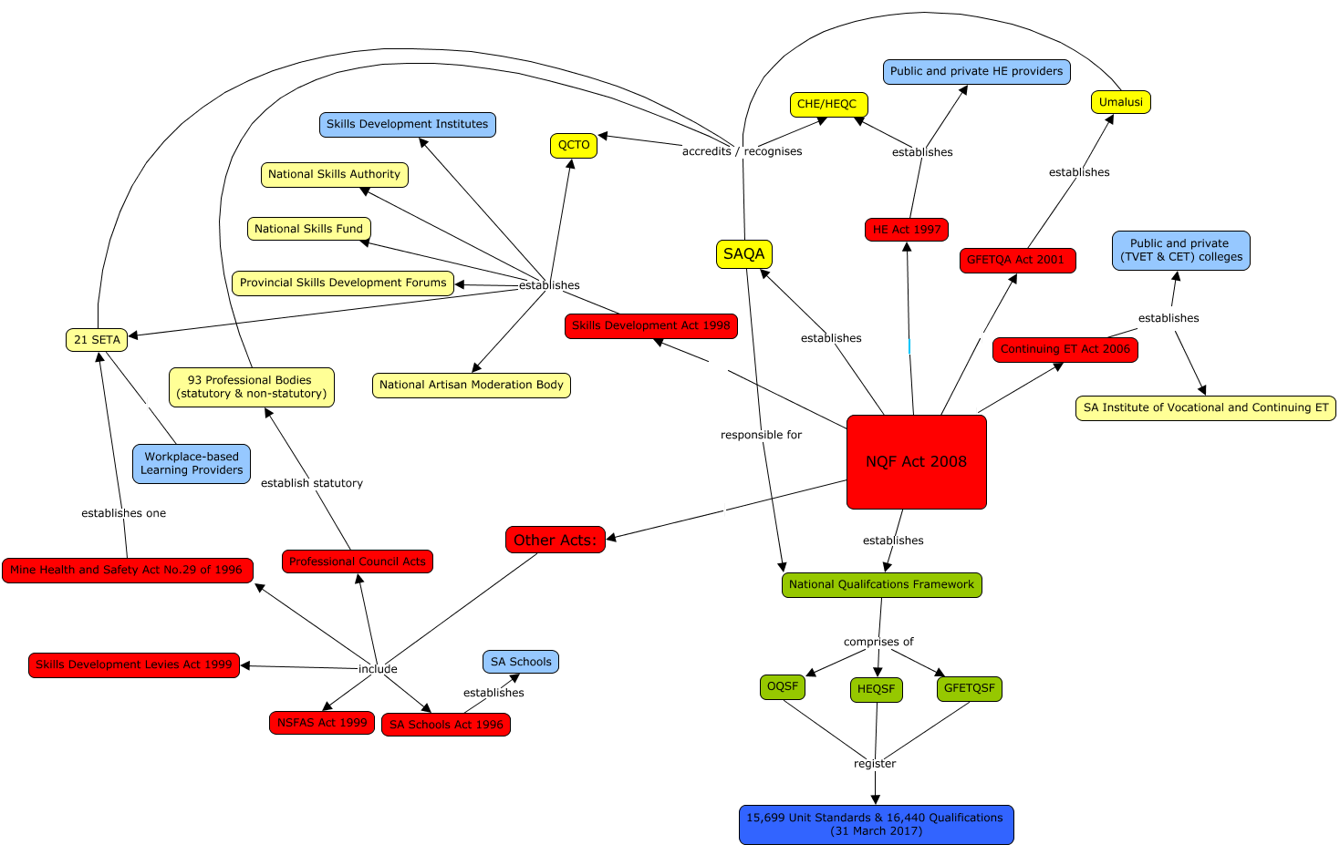
The Institutional Sprawl of the National Qualification Framework, Skills Development and Continuing Education and Training Acts in PSET context
Notes:
The institutional sprawl may have led to implementation crawl and the very slow pace of change. The over regulation and bureaucratisation of the system may be impeding rather than facilitating skills delivery. Two stories: The NQF as ‘overarching’ enabling framework and The NQF as technocratic, overregulating disabling.

Slide 24
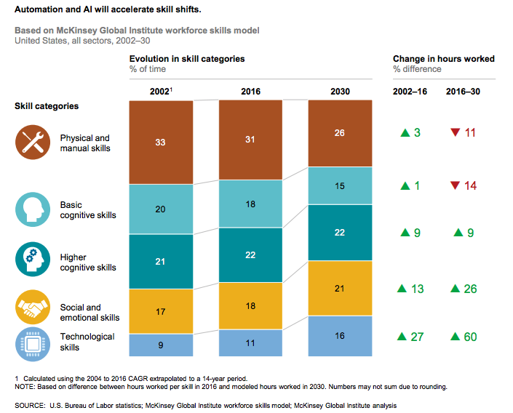
Skills for growth industries of the future
Examples: Green & Blue Economy, Square Kilometre Array Telescope, Information Communication Technologies, AI machine learning and Fourth Industrial Revolution.
New industries depends on high Science & Tech skills.
Reading, Writing, Numeracy, Reasoning are still the core skills to build from.
These industries will lead to increased inequalities - challenge is to manage a dual economy.

Slide 25
The 4IR economy: Skills, Jobs and Sectors
Top Skills needed | Most in Demand Jobs | Sectors that would grow
Complex problem solving | Data Analysts and Scientists | Information & communications technology
Critical thinking | AI & Machine Learning Specialists | Engineering
Creativity | Big Data Specialists | Biotechnology
People Management | Digital Transformation Specialists | Global health and healthcare
Co-ordinating with others | Sales and Marketing Professionals | Infrastructure
Emotional intelligence | Software and Applications Developers and Analysts | Financial services and investors
Judgement and Decision Making | Information Technology Services | Aviation, travel and tourism
Service orientation | Process Automation Specialists | Supply chain
Negotiation | Innovation Professionals | Energy utilities and technology
Creative Flexibility | Information Security Analysts | Mining and metals
 | E-commerce & Social Media Specialists

Slide 26
Changing Skills Requirements for 4IR economy
The skills requirements of the 4IR are:
  not yet extensively researched in South Africa, so we rely on international models
  highly dynamic due to accelerating technological change (and therefore difficult to predict)
  needing to be underpinned by strengthened basic STEM skills
  biased towards high-skills domains within ICTs, engineering, and biotechnology (while at the same time heightening the need for more ‘human’ skills)
Education, skills development, and the development of 4IR innovation capabilities are intertwined. Optimizing capability development will require
understanding the nature of changes to skills supply and demand, and
resources for skills development.

Slide 27
Health
HIV/AIDS, Tuberculosis, non-communicable diseases and other public health ailments in South Africa
−

Slide 28
Halting & reversing the spread of HIV and TB
7,9 million
The estimated number of people living with HIV in South Africa in 2017
This is 14% of people in South Africa
1,6 million more when compared to 2012
44%
11%
Overall incidence
Young males
15 – 24 years

Slide 29
Halting & reversing the spread of HIV and TB continued
The small gains achieved by putting people on treatment are sadly being reversed by the stubborn HIV incidence among youth mostly males whose HIV prevalence has also increased compared to all years since we started tracking HIV epidemic in the country.
SA has one of the world’s worst TB epidemics driven by HIV, with an estimated 349,582 (1% of population) new cases in 2012 or 1,003/100,000 population in 2012
The results of the first national TB prevalence survey expected early 2019

Slide 30
HIV/AIDS and TB
As in previous years, the government must again be commended for continuing to provide the bulk of the funding of up to 80% of the cost of the national HIV response
This is one of the highest levels of national contribution among the high priority countries for HIV/AIDS which is in line with our national goal of providing “A long and healthy life for all South Africans”.
1
The observed improvements in life expectancy is partly a result of these interventions and thus with consistent investments the average life expectancy of 70 years targeted by 2030 is not beyond reach
2
3
Indeed, if we are to win the war against HIV/AIDS, STIs and TB we need to increase funding to NDOH, DSD, SANAC, DHET and DST as donor funding continues to dwindle due to the middle income status of the country
4
There should be a bigger shift towards funding intervention programs that deal with the structural drivers of HIV epidemic such as prevention of teenage pregnancies, keeping girls at school and reproductive health education among school going age children.
Notes:
2 clicks for complete content

Slide 31
Health allocation
The health allocation increase was 2% higher for 2019/2020 than the previous year increase of 7%.
However, this increase is associated with infrastructure, NHI, health workers including allocation towards post for medical graduates.
With HIV mostly being a chronic illness, there is now a great need to invest more resources in emerging other NCDs that are among the top causes of death among South Africans, including diabetes.
Notes:
The total allocation to health in the Appropriation Bill is R47.1 billion. The bulk of public expenditure on healthcare is allocated to programmes 3 and 5, namely HIV/AIDS, TB and Maternal and Child Health, and Hospitals, Tertiary Health Services and Human Resources Development. Each of these two programmes receive approximately R25 billion. These two programmes receive 44% and 47% respectively of the total allocation, i.e. 92% in total. Only R1 billion or 3.5% of the appropriation is allocated to the implementation of national health insurance, a figure that will rise to R3 billion or 5.5% of the budget by 2020/21. The overall increase in allocation is modest when taking away inflation and other tax increases. It should be noted the biggest year on year increase in the allocation for program 2 averaging 46%.

Slide 32
Health inequalities across the continuum of healthcare access
-0.043
-0.152
+0.435
+0.063
The Concentration Index Metric
-1
all of ill-health is concentrated in the poor
0
equality
+1
all of ill-health is concentrated in the rich
Poor self-reported health
Postponement of care
Medical aid
Satisfied with health care services
-0.124
-0.031
-0.164
+0.064
Immobility
Unmet need
Difficulty in affording costs
Satisfied with health care provider
-0.032
+0.254
-0.177
Mental ill health
Private care
Difficulty in affording medicines
Source: SANHANES-I (2012)
-0.010
-0.241
+0.079
Post Traumatic Stress Disorder
Public care
Satisfied with quality of outpatient care
Notes:
The concentration index is a key and well established metric in the study of inequalities in health. The index takes on a value between -1 and +1. Higher negative values mean that the particular measure is more prevalent among the poor, while higher positive values mean that the measure is more prevalent among the rich. Zero values denote equality or the absence of inequality. These indices can be calculated for any number of health- and health-related outcomes, including variables representing each of the various dimensions of access to health care.
Across the continuum of access to healthcare, all the ‘negative’ outcomes have negative concentration indices (i.e. being more prevalent amongst the poor), while the ‘positive’ ones have positive outcomes (i.e. being more prevalent among the rich). In terms of health care need, all four measures of need, represented here by the WHODAS disability assessment schedule, the Kessler psychological distress scale, and an index of post-traumatic stress disorder, take on negative values, i.e. the prevalence of need is greater among the poor than the rich. Those perceiving a need for care, moreover, do not necessarily access care. The poor are more likely to have postponed seeking medical care or to have not received care. The index values for public and private care and for medical aid reflect the long entrenched inequity in the health care sector, with the affluent being more likely to have access to medical aid and private care and the poor being reliant on public health care services. As expected, problems with ability to pay for care and medicine is also more pronounced among the poor. In terms of the consequences of care, the affluent are more satisfied with the services rendered in the health care system, likely because they have access to private rather than public care. Note Education plays an important role. Health needs to be seen as a investment.

Slide 33
National Health Insurance
These socioeconomic gradients that exist across the different dimensions of healthcare access provide evidence of the continued inequitable state of South Africa’s healthcare system
The transition therefore to NHI is imperative in light of The National Development Plan’s aim to achieve a significant shift in equity, efficiency and quality of healthcare service provision by 2030
However, constraints in fiscal space asks serious questions as to how exactly the country needs to pursue the quest for universal health care (UHC) in the short-, medium- and longer-term
Notes:
Health inequalities in South Africa therefore remain stark and is extensive. Ultimately, the inequalities in health and health care faced by the poor are compounded as one moves across the various dimensions of access to health care. The poor are at a disadvantage across the continuum of access to health care, from health care needs, to health care seeking and utilisation, to affordability and satisfaction, thus compounding and ensconcing the degree of inequality. These inequalities in access to health care and to quality health care calls for efforts to ensure universal health coverage (UHC). In South Africa’s case, the main policy response in this domain is the implementation of national health insurance (NHI). The transition therefore to NHI is imperative in light of The National Development Plan’s aim to achieve a significant shift in equity, efficiency and quality of healthcare service provision by 2030. However, constraints in fiscal space asks serious questions as to how exactly the country needs to pursue the quest for universal health care (UHC) in the short-, medium- and longer-term.

Slide 34
Required Social Investment
While many important healthcare programmes are being implemented and scaled up, there are in some instances is a lack of funding for large-scale prospective impact assessments, examples being the
    integrated school health programme (ISHP), the implementation of the sugar tax, and proposed changes in tobacco control
    Investment on social drivers of HIV epidemic especially among adolescent girls and young women, but not at the expense of young boys and strengthening sexual and reproductive health among youth
Notes:
Government has implemented many important health care programmes in the last few years and will in the next few year proceed to implement and scale-up these and other programmes. A few examples of such initiatives include the integrated school health programme (ISHP), the pending implementation of the sugar tax, public awareness campaign to complement the health promotion levy on sugary beverages and to establish health technology assessment unit, and proposed changes in tobacco control and legislation regarding alcohol. It is imperative that adequate funding be invested in extensive prospective evaluations of these and other health care programmes rather than in the limited retrospective assessment of programme impacts and implementation.

Slide 35
Government and Public Service

Public Satisfaction (SASAS 2003-2017)
South African perception of service delivery
Trust in the political system
Corruption as a societal problem
Repositioning and Professionalising Local Government
Reconfiguring SOEs landscape

Slide 36

Public satisfaction with different areas of government performance (SASAS 2003 – 2017)
1
3
5
Social grants: highest public approval rating at 72% in 2017. However, the level of satisfaction shows a decline of 5% since 2010.
Satisfaction with water and sanitation has received fairly consistent ratings between 2003 and 2015; however, since 2010 the approval ratings are down by 7%.
Areas of greatest public concern are job creation (6% down from 2010), crime reduction (8% change since 2010), and low-cost housing (3% down since 2010).
.
◻



❑
2
4
6
In late 2010 about 70% of all adult South Africans registered satisfaction with the management of education. 58% was recorded for 2017 - a 12% drop in satisfaction since 2010.
Satisfaction with access to health care is slowly on a downward trend. Between 2014 (59%) and 2017 (51%) it went down by 8%.
Land reform has received low levels of public approval. In 2017 only 21% of South Africans were satisfied or very satisfied with land reform; a 12% drop from 2010.
.

Slide 37
South Africans’ perceptions of service delivery
(SASAS 2017)
Those living in Limpopo (53), Mpumalanga (52), Western Cape (52) and Gauteng (51) are more satisfied with access to basic services than those in North West (46), and Eastern Cape (44).
Satisfaction with access to service delivery is measured by the Service Delivery Index. The index score ranges from 0 – 100 with higher values indicating higher satisfaction levels.
1
Those living in formal urban areas (51) and formal rural areas (51) are more satisfied than those living in traditional areas (48) and in urban informal settlements (37).
2
3
The wealthy (56) and reasonably comfortable (53) are more satisfied than the poor (47) and the very poor (39).
4
White (54) and Coloured (50) are marginally more satisfied than Africans (49%).
Notes:
2 clicks for complete content

Slide 38
Trust in the political system (SASAS 2003 – 2017)
For the period 2004-2017 we observe a general decline in public confidence in Parliament, national government, and local government.
Trust in Parliament dropped from 65% (2004) to 25% in 2017 – 40% decline.
Trust in national government declined from 69% in 2004 to 28% in 2017 - decline of 41%.
About 28% of the South African adult population trusted their local government in 2017. This is down from 55% in 2004 representing a decline of 27%.
The 2017 SASAS survey indicate that fewer South Africans trust political parties (17%) and politicians (13%).
Trust in local government by province shows that the Western Cape (44%) recorded the highest level of trust with Free State (16%) scoring the lowest.

Slide 39
Corruption as a societal problem (SASAS 2003 – 2016)
31%...
the share of the adult population that viewed corruption as a ‘most important’ challenge
This number grew by 21% between 2003 and 2016, rising from 9% to 31%.
Concern about corruption increased more among formal urban dwellers (11% in 2003 to 37% in 2016), while those living in rural, traditional authority areas, the rate of growth was from 6% to 21%.
A higher proportion of respondents with tertiary education (45%) mentioned corruption as a challenge compared to those with primary or no formal schooling (22%).
The disaggregated results reveal that Indian and white respondents continued to be more vocal when compared to black African and coloured respondents
Notes:
3 clicks for complete content

Slide 40
Address capacity constraints and weaknesses in municipalities
1
According to 2018 MTBPS, municipalities owe more than R23 billion in arrears, including to Eskom and water boards – they are vulnerable to liquidation.
2
The R2.5 billion allocated every year to provide extensive support to build municipal capacity is welcomed but there is an urgent need to monitor skills capacity and its impact in all municipalities during the 25 years review of local government.
3
There is also a need to conduct a skills and capacity audit to understand the capacity realities and support requirements of entry-level, mid-level and senior-level municipal officials to inform training and capacity-building interventions.

Slide 41
Service delivery challenges – powers and functions of the Minister of COGTA and MECs
The local government sphere remains the coal face of service delivery in South Africa, yet it is wrought with electricity, roadworks, water and sanitation challenges among others.
The growing scope of government functions and a declining institutional capacity of the municipalities provides an opportunity for the review of powers and functions as set out in sect 84 and 85 of the Municipal Structures Act (MSA), 1998.
Ascertain how amendments to the MSA could facilitate a differentiated approach to the structure and functions of two-tier local government to enable the creation of single-tier local government to optimise service delivery.

Slide 42



Repositioning and Professionalising Local Government
1
Dynamic strategy to enhance capacity and thus responsiveness of developmental local government
2
Blueprint for best practice: implementation guidelines and roadmap that responds to NDP Vision 2030 and the domestication of the SDGs.
3
Effective delivery on IDPs and inclusive, sustainable and developmental local government.
4
Report to Cabinet to guide implementation protocols towards responsive developmental local government to improve service delivery through phased-in approach.

Slide 43
Reconfiguring SOEs
Revisit the research already conducted to track the implementation of the 31 short and long term recommendations of the PRC
Recommendations 8, 31, 27 and 28 are critical given the current concerns raised by the 2018 MTBPS
RECOMMENDATION 8 The mandates of SOEs should be subject to critical strategic review every five years, and the requirement thereof should be factored into an SOE Act.
RECOMMENDATION 27
A transitional SOEs Reforms Committee [Execution Management and Monitoring Task Team] must be established to drive the implementation of the PRC’s recommendations
RECOMMENDATION 28 The proposed SOE Council of Ministers and the Central SOEs Authorities should develop customised human capacity building programmes
RECOMMENDATION 31 The Government should develop an integrated reporting, monitoring and evaluation capacity for SOEs across all spheres of Government

Slide 44
Green Research & Development in South Africa

Slide 45


Slide 46
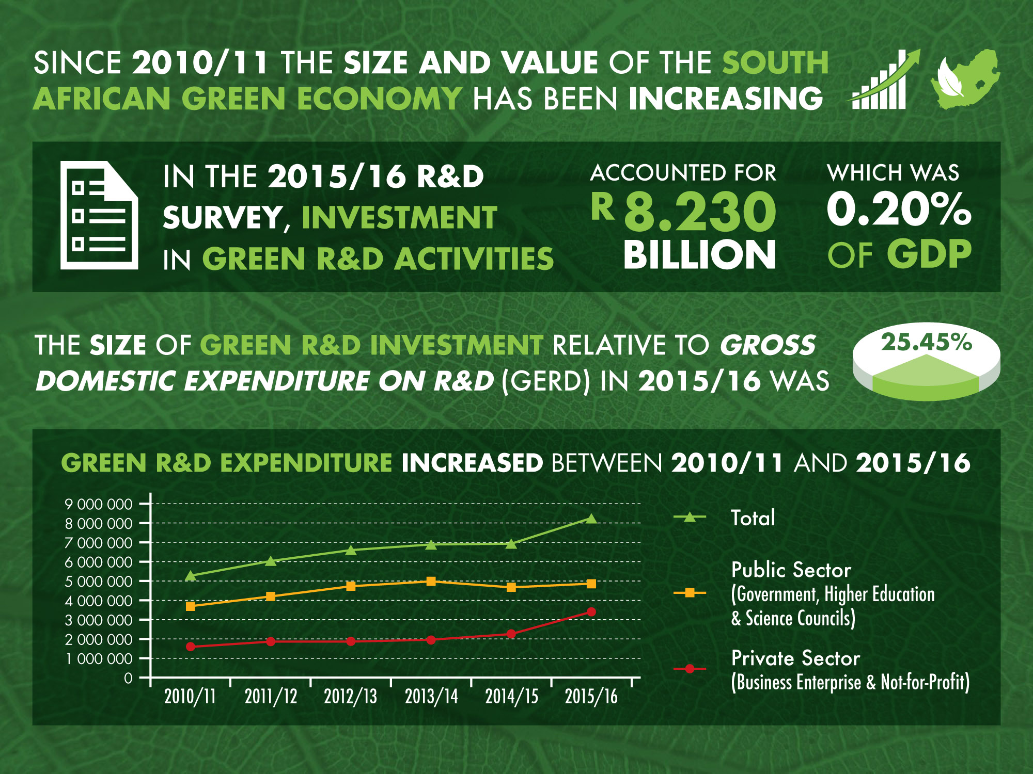

Slide 47
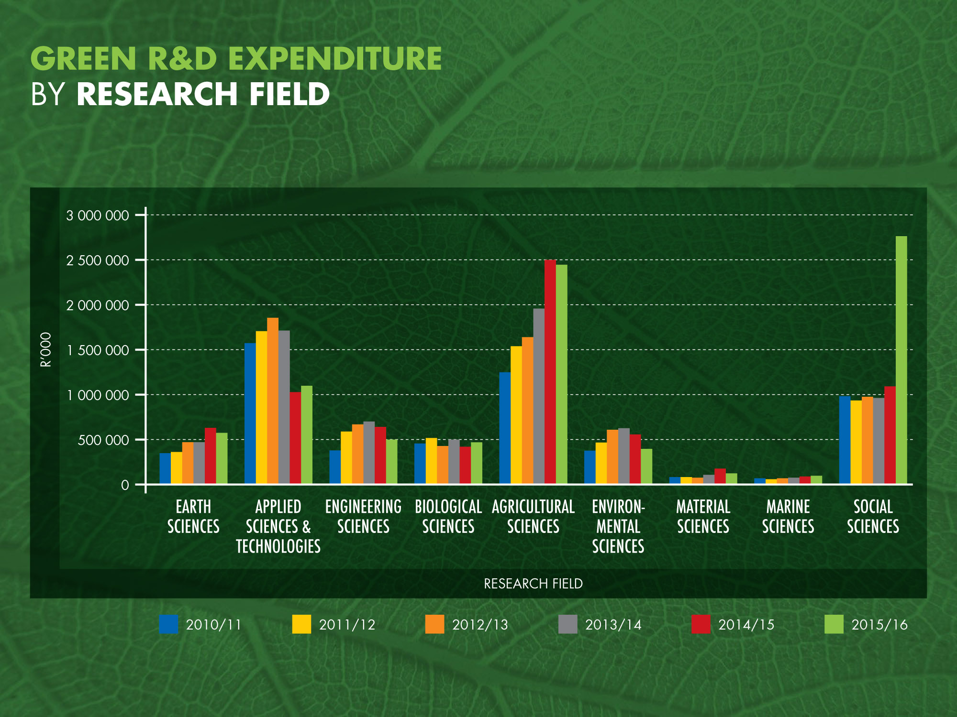

Slide 48
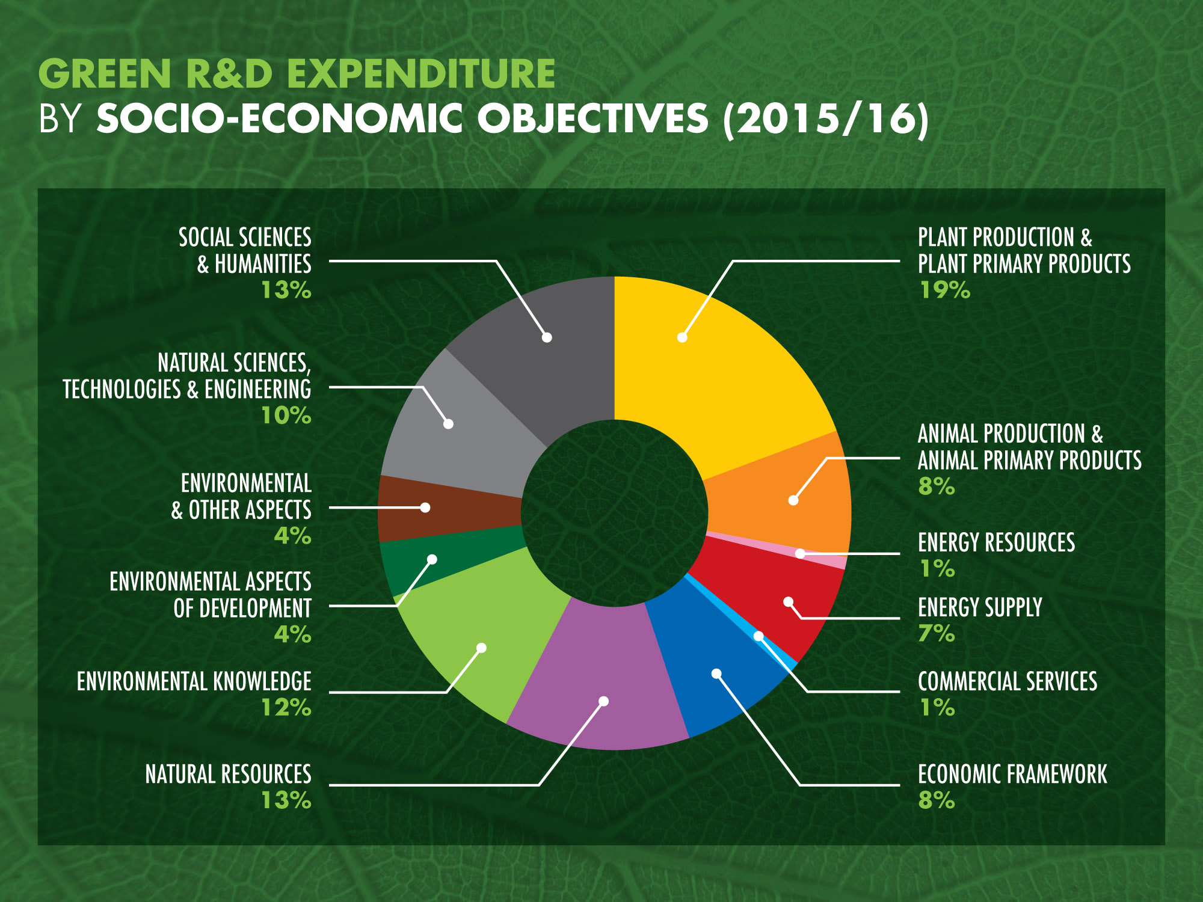

Slide 49
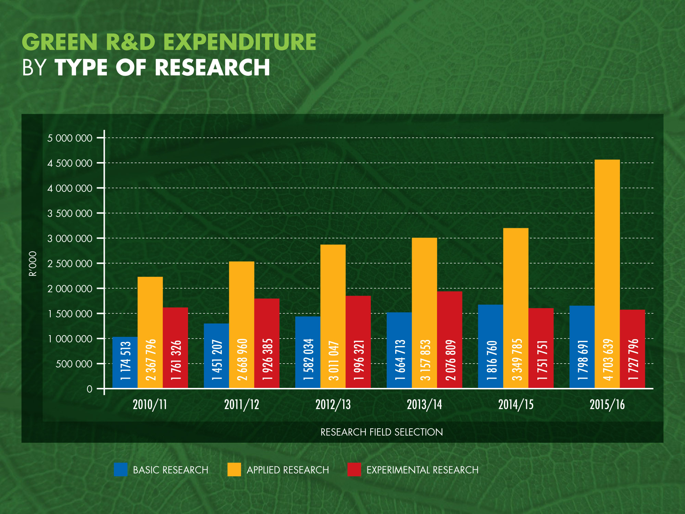

Slide 50
Summary of salient points
Spending priorities are: reducing poverty and inequality, increasing employment and inclusive growth
Also improving spending efficiency, government capacity and governance
Strengthening public institutions and SOEs
Structural reforms?
More emphasis on attracting private investment – “blended finance” = partnership and/or privatisation?
Education, skills development, and the development of 4IR innovation capabilities are intertwined. Optimizing capability development will require
  understanding the nature of changes to skills supply and demand, and
  resources for skills development.

Slide 51
Summary of salient points continued
As in previous years, the government must again be commended for continuing to provide the bulk of the funding of up to 80% of the cost of the national HIV response.
The transition to NHI is imperative in light of The National Development Plan’s aim to achieve a significant shift in equity, efficiency and quality of healthcare service provision by 2030
  However, constraints in fiscal space asks serious questions as to how exactly the country needs to pursue the quest for universal health care (UHC) in the short-, medium- and longer-term
While many important healthcare programmes are being implemented and scaled up, there are, in some instances, a lack of funding for large-scale prospective impact assessments, examples being the
  Integrated school health programme (ISHP), the implementation of the sugar tax, and proposed changes in tobacco control
  Investment on social drivers of HIV epidemic especially among adolescent girls and young women, but not at the expense of young boys and strengthening sexual and reproductive health among youth

Slide 52
Summary of salient points continued
The R2.5 billion allocated every year to provide extensive support to build municipal capacity is welcomed, but there is an urgent need to monitor skills capacity and its impact in all municipalities during the 25 years review of local government
The potential for employment creation in agriculture, biogas, water treatment, power generation and bio-composites offers tremendous opportunities for social and economic development.
The end

