Slide 1
Presentation to Portfolio Committee
NOVEMBER 2018
CENTRE FOR PUBLIC SERVICE INNOVATION
2nd QUARTER PERFORMANCE REPORT
(JULY 2018-SEPTEMBER 2018)

Slide 2
OVERVIEW
Executive Summary
Purpose and scope of the report
Overview of the Organisation’s 2nd Quarter Performance
Progress on 2nd Quarter Targets
HR Oversight
Interim Financial Statements for the period ending 30 September 2018

Slide 3
Executive Summary
This is a preliminary report on the organisation’s progress with regards to the achievement of the 2nd Quarter (1 July 2018 – 30 September 2018) on the organisation’s 2018/2019 Annual Performance Plan (APP).
The report has been compiled by the Executive members of the CPSI based on the analysis of the progress from the work streams.

Slide 4
Purpose and scope of the report
The monitoring and reporting of the organisation's performance against its Annual Performance Plan (APP) is a requirement as per
Section 40(d) of the Public Finance Management Act, 1999 (Act No 1 of 1999), and
National Treasury's Framework for Strategic and Annual Performance Plans (August 2010).
This 2nd Quarter Report highlights the overall performance of the organisation.

Slide 5
Overview of the Organisation’s 2nd Quarter Performance
No of Targets | 2nd Quarter Targets Achieved | 2nd Quarter Targets Not Achieved
7 | 6 | 1
During the 2nd Quarter period, the organisation had 7 targets, 6 targets (86%) were achieved and 1 target (14%) was not achieved by the end of September 2018.
Mechanisms have been put in place to ensure that the target is achieved in the 3rd quarter. This gives assurance that the planned annual target, as per the 2018/19 Annual Performance Plan will be achieved.

Slide 6
Progress on 2nd Quarter Targets
Target no | Responsible unit | Target for 2018/19 as per Annual Performance Plan (APP) | 2nd Quarter Target | Actual Achievement for the 2nd Quarter | Deviation from planned target to Actual Achievement for the 2nd Quarter | Comment/ Mechanisms to address differences in targets | Performance Rating
 | SM OCFO | 4 Quarterly financial reports submitted to MPSA, DPSA and National Treasury and non-financial reports submitted to MPSA, DPSA, DPME, and National Treasury as per required timeframes | First quarter financial report submitted to MPSA, DPSA and National Treasury and non-financial report submitted to MPSA, DPSA, DPME and National Treasury by 31 July 2018 | First quarter financial report submitted to MPSA, DPSA and National Treasury and non-financial report submitted to MPSA, DPSA, DPME and National Treasury by 31 July 2018 | None | None | Achieved
2. | OCFO | 100% Implementation of internal and external audit recommendations | Implementation report developed | Implementation report developed | None | None | Achieved
3. | R&D | Two (2) innovative solutions developed | Consultation on innovative solutions to be developed in 2019/20 | Consultation on defining challenges concluded as part of the preparations for the National Service Delivery Hackathon. 5 Challenges defined. CPSI committed to facilitating the development of the winning solutions | None | None | Achieved

Slide 7
Progress on 2nd Quarter Targets
Target no | Responsible unit | Target for 2018/19 as per Annual Performance Plan (APP) | 2nd Quarter Target | Actual Achievement for the 2nd Quarter | Deviation from planned target to Actual Achievement for the 2nd Quarter | Comment/ Mechanisms to address differences in targets | Performance Rating
4. | SSI | 330 Public sector officials and other partners capacitated | 85 Public sector officials and other partners capacitated | 64 Public Sector officials and other partners capacitated on Public Sector Innovation | None | This is a cumulative target, and it was over-achieved in Q1 whereby 110 more Public sector officials and other partners were capacitated which is more than the 85 targets set for Q2. This makes the annual target on track for full achievement | Achieved
5. | EE | Six (6) knowledge platforms hosted to unearth, demonstrate, share, encourage and award innovation in the public sector | Annual Public Sector Innovation Conference hosted | The annual conference was held on 29-30 August 2018 under the Theme- Partnering for an agile and a renewed public sector through innovation. The conference also featured two-panel discussions | None | None | Achieved

Slide 8
Progress on 2nd Quarter Targets
Target no | Responsible unit | Target for 2018/19 as per Annual Performance Plan (APP) | 2nd Quarter Target | Actual Achievement for the 2nd Quarter | Deviation from planned target to Actual Achievement for the 2nd Quarter | Comment/ Mechanisms to address differences in targets | Performance Rating
4. | SSI | 330 Public sector officials and other partners capacitated | 75 Public sector officials and other partners capacitated | 185 Public sector officials and other partners capacitated | 110 more Public sector officials and other partners capacitated | The CPSI exhibition of the mobile MMIC at public sector events attracted a lot of interest from the delegates, hence the increased number | Achieved
5. | EE | Six (6) knowledge platforms hosted to unearth, demonstrate, share, encourage and award innovation in the public sector | Public Sector Innovation Awards Programme launched | The 2018 Public Sector Innovation Awards Programme was officially launched in East London on 11th May 2018 | None | None | Achieved

Slide 9
Progress on 2nd Quarter Targets
Target no | Responsible unit | Target for 2018/19 as per Annual Performance Plan (APP) | 2nd Quarter Target | Actual Achievement for the 2nd Quarter | Deviation from planned target to Actual Achievement for the 2nd Quarter | Comment/ Mechanisms to address differences in targets | Performance Rating
6. | EE | Two (2) editions (Volume 9 Issue 1 and 2) of “Ideas that Work”: The South African Public Sector Innovation Journal published | Volume 9 Issue 1 published | Content has been sourced but not published | Delay in procuring software for the in-house designer | The edition will be published in the third quarter | Not achieved
7. | EE | Participation in two (2) SADC or International innovation programmes | Participated in one (1) SADC or International innovation programme | The CPSI co-hosted and Participated in the SADC UNPAN workshop was held on 28-29 June 2018 in Mauritius. | The workshop was held a few days before the beginning of quarter two as per availability of the host country, Mauritius | None | Achieved

Slide 10
HR OVERSIGHT
Establishment
The total number of funded posts in the CPSI is 38 of which 3 are vacant. This includes posts funded by voted appropriated funds and posts funded from donor funds (i.e. the General Budget Support Fund), which are expiring at the end of March 2019. This will pose a big challenge for the CPSI as these are very critical posts.
Employment Equity
The CPSI exceeds the minimum targets of 50 % women on SMS Level at 67.67 % (4 women) and in terms of the minimum target of 2% for disability, the CPSI is at 5.88% (2 employees)

Slide 11
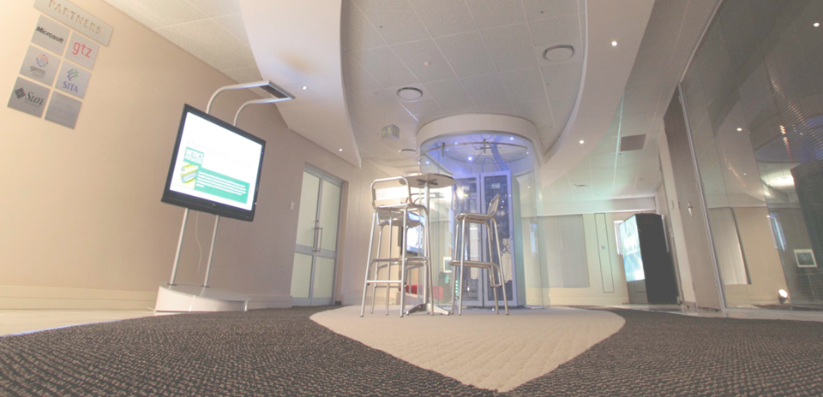
INTERIM FINANCIAL STATEMENTS FOR THE PERIOD ENDING 30 September 2018 FOR THE CPSI

Slide 12
Appropriation statement
Programme 1: Administration
The amount received in Programme 1: Administration was R9.7 million for the six months of the financial year. The spending for the same period was R8.2 million. Compensation of employees: The expenditure relating to the Executive Director post was recovered from the Department of Public Service and Administration, which resulted in savings of during the period she was acting as Director General. The vacancy of two posts on level 11 and 7 is currently filled by contract employment on a lower notch than originally budgeted for and this also contributes to the lower than anticipated spending. Goods and Services: Expenditure on traveling by the Executive Director was not incurred as projected. The printing of the Annual Performance Plan could not be finalized which resulted in the low spending on goods and services. The payment for the lease and electricity bills were only processed in the 2nd quarter, and not during the 3rd quarter as anticipated.
Programme 2: Public Sector Innovation
The amount received in Programme 2: Public Sector Innovation amounted to R8.1 million for the period 1 April 2018 to 30 September 2018. The spending for the same period was R7.3 million. The projected spending on venues and facilities is lower than anticipated.

Slide 13
Appropriation statement(continued)
Programme | 2018/19 |  |  |  | 2017/18
 | Final Appropriation R'000 | Actual Expenditure R'000 | Variance R'000 | Expenditure as % of final appropriation % | Final Appropriation R'000 | Actual Expenditure R'000
1. Administration | 19,391 | 8,246 | 11,145 | 42.5% | 18,675 | 18,327
2. Public Sector Innovation | 16,639 | 7,307 | 9,332 | 43.9% | 15,380 | 14,195
TOTAL | 36,030 | 15,553 | 20,477 | 43.2% | 34,055 | 32,522
Departmental receipts | 8 |  |  |  | 24 | -
Aid assistance | - |  |  |  | 3,407 | -
Actual amounts per Statement of Financial Performance (Total Revenue) | 36,038 |  |  |  | 37,486 | -
Add: Aid assistance |  | 971 |  |  |  | 3,287
Actual amounts per Statement of Financial Performance Expenditure |  | 16,524 |  |  |  | 35,809

Slide 14
Appropriation statement (continued)
Per Economic Classification | 2018/19 |  |  |  | 2017/18
 | Final Appropriation R'000 | Actual Expenditure R'000 | Variance R'000 | Expenditure as % of final appropriation % | Final Appropriation R'000 | Actual Expenditure R'000
Current payments | 35,776 | 15,178 | 20,598 | 42.4% | 33,421 | 32,016
Compensation of employees | 19,425 | 9,353 | 10,072 | 48.1% | 18,360 | 18,046
Goods and services | 16,351 | 5,825 | 10,526 | 35.6% | 15,061 | 13,970
Transfers and subsidies | 1 | 41 | -40 | 4100.0% | 1 | -
Households | - | 41 | -41 | 0.0% | - | -
Payments for capital assets | 253 | 334 | -81 | 132.0% | 624 | 497
Machinery and equipment | 154 | 166 | -12 | 107.8% | 525 | 497
Other machinery and equipment | 154 | 166 | -12 | 107.8% | 525 | 497
Software and other intangible assets | 99 | 168 | -69 | 169.7% | 99 | -
Payment for financial assets | - | - | - | 0.0% | 9 | 9
TOTAL | 36,030 | 15,553 | 20,477 | 43.2% | 34,055 | 32,522
Current payments | 35,776 | 15,178 | 20,598 | 42.4% | 33,421 | 32,016

Slide 15
Appropriation statement (continued)
Description | 2018/19 |  |  |  | 2017/18
 | Adjusted Appropriation R'000 | Actual Expenditure R'000 | Variance R'000 | Expenditure as % of final appropriation % | Final Appropriation R'000 | Actual Expenditure R'000
Strategic Management | 4,060 | 1,100 | 2,960 | 27.1% | 3,717 | 3,677
Corporate Resource Management | 9,166 | 4,007 | 5,159 | 43.7% | 9,116 | 8,936
Office of the Chief Financial Officer | 6,165 | 3,139 | 3,026 | 50.9% | 5,842 | 5,714
PROGRAMME 1: ADMINISTRATION | 19,391 | 8,246 | 11,145 | 42.5% | 18,675 | 18,327
Research and Development | 3,899 | 1,747 | 2,152 | 44.8% | 3,624 | 3,532
Solution Support and Incubation | 3,915 | 1,820 | 2,095 | 46.5% | 3,405 | 3,315
Enabling Environment | 8,825 | 3,740 | 5,085 | 42.4% | 8,351 | 7,348
PROGRAMME 2: PUBLIC SECTOR INNOVATION | 16,639 | 7,307 | 9,332 | 43.9% | 15,380 | 14,195
Total | 36,030 | 15,553 | 20,477 | 43.2% | 34,055 | 32,522

Slide 16
30 DAYS PAYMENTS
During the period April 2018 to September 2018 the Centre for Public Service Innovation processed 206 payments of which no payment was recorded as having exceeded 30 days
Overall Average payment days for the financial year to date is 5.15 days.

Slide 17
THANK YOU

