Slide 1
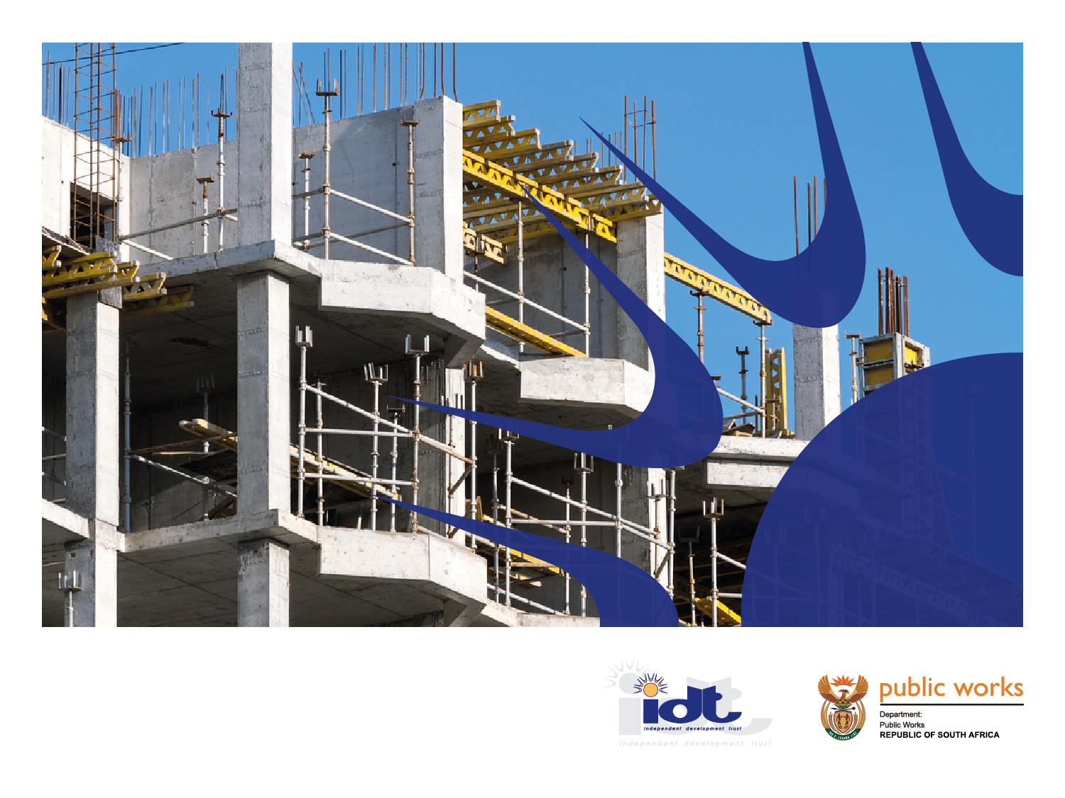
IDT ORGANIZATIONAL REDESIGN
Portfolio Committee On Public Works
Tuesday, 06 November 2018

Slide 2
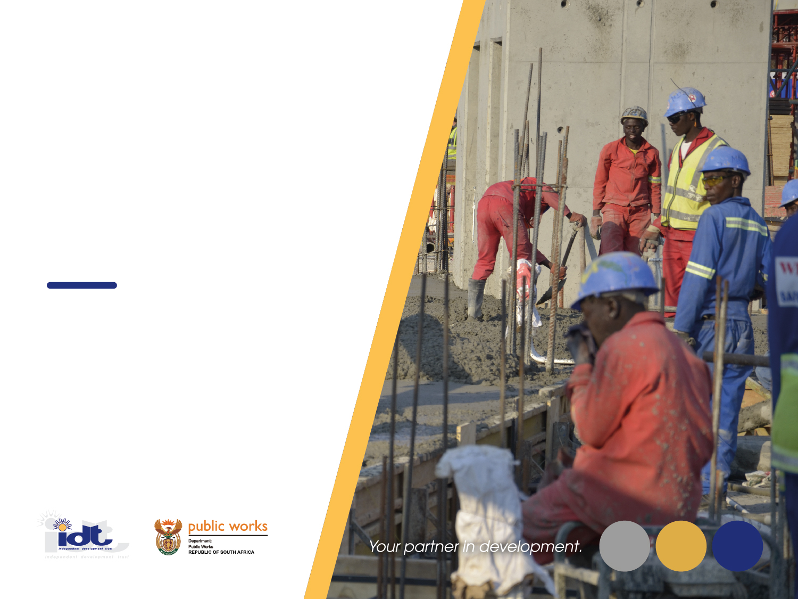
Contents
Purpose
Contextual background
The Problem Statement
2015 Turnaround Plan
2017 Repositioning and renewal process
Turnaround Strategy and Operating Model
Proposed Service Delivery Value Chain
Key turnaround measures
Key Turnaround Pillars
Organisational Development (OD)Process
Status update on the implementation of the OD process
Recommendations

Slide 3
Purpose
To present to the Public Works Portfolio Committee on the organizational repositioning and turnaround strategy for the Independent Development Trust (IDT).
Notes:
Reorganisation
Moving people and resources around in a company (the organisation) so that they produce more and better product and services.
Restructuring
Moving more resources to areas where they contribute greater value to the customer and discontinue activities that customers are not going to pay for

Slide 4
2
Contextual Background

Slide 5
Contextual Background
The Independent Development Trust (IDT) is listed as a Schedule 2, reporting to the Minister of Public Works and provides social infrastructure programme management services to government and therefore contributes to the achievement of national development goals.
The entity generates its revenue mainly from management fees derived from managing the implementation of social infrastructure projects on behalf of government.
These fees, buttressed by a growing programme portfolio and increased expenditure level, have largely served as the driver for financial sustainability of the IDT in the past financial years.
However, IDT has not managed to reach full cost recovery and attained an average of 75% recovery rate over the past 5 years. The annual budget shortfalls of an average of 25% were therefore financed through either a government grant or cash withdrawals from the capital endowment fund.

Slide 6
Operational challenges
Decline in programme portfolio and inadequate technical capacity to deliver on the current portfolio compounded IDT’s financial sustainability challenges;
The main operational challenges facing the Organisation, which necessitated the organisational development and redesign are:
  Declining business portfolio;
  Outdated business systems and inefficient processes impacting on the effectiveness of service delivery;
  Inappropriate and outdated organisational structure i.e. top heavy and not aligned to the needs of the IDT business;
  Lack of appropriate skills and technical capacity, particularly in the built environment discipline resulting in poor project management;
The unforeseen delays in the final decision regarding the future mandate and strategic role of the IDT has also contributed to the protracted transformation process of the Organisation.

Slide 7
2015 Turnaround Plan Intervention
In August 2015, in response to the operational challenges, the Board initiated a strategic intervention through a Turnaround Strategy and Plan, which focused on the following strategic pillars:
  Financial stability and viability;
  Operations and service improvement;
  Governance, compliance and financial management enforcement; and
  Organisational structure improvement and professionalism.
Notwithstanding the vigorous implementation of the Turnaround Plan, and due to resource constraints, the intended organisational turnaround has not been fully realised.

Slide 8
2017 Repositioning and renewal process
In 2017, the IDT undertook a repositioning and renewal process. This culminated in the development of the Revised Operating Model and Turnaround Plan. The new Turnaround Plan is aimed achieving the following objectives:
    Improved Delivery Capacity – delivering quality social infrastructure on time, within budget and scope;
    Improved Revenue Management – propelling the organisation towards long term sustainability; and
    Increasing Market Share – expanding operational market share.

Slide 9
Turnaround Strategy & Operation Model

Slide 10
Proposed Service Delivery Value Chain
Integrated Infrastructure Development Planning
Infrastructure Procurement Planning and Management
Project Management & Built Environment Professional Consulting Services
Research across national, provincial and local government
Cross functional/departmental planning facilitation
Infrastructure planning
Procurement planning
Procurement
Development of scope of work
Development of technical specifications and bills of quantities
Bid management process
Service provider management
Transversal contracts
Contract management
Programme and project planning
Resource allocation and management
Contracting and management
Project and programme implementation management
Quality control
Project and programme monitoring and reporting
Professional services
Contractors
Advisory services to planning departments at national, provincial and local government level
Community social facilitation and engagement
Project financial management
GIS mapping to inform planning
PPP
Programme Management
Project planning
Resource allocation and management
Contracting and management
Quality control
Monitoring and reporting
PPP
Project financial management
Capital Project Evaluation and feasibility studies
Monitoring and Evaluation and Performance Reporting

Slide 11
Key Turnaround measures
While the turnaround in its broadest context will pursue change and improvements in many areas of the IDT’s operations and governance, the following areas are regarded as key:
• Service expansion and market growth;
• Competency development and skills acquisition;
• Systems and process efficiency;
• Governance and regulatory compliance;
• Strengthening financial viability and organisational sustainability;
• Strengthening leadership and culture change;
• Collaboration and partnership building; and
• Trust, image and reputation rebuilding.

Slide 12
Key Turnaround Pillars
  Improved Revenue management
  Improving billing and collection
  Implementing cost containment
  Implementing cost recovery measures
  strengthening litigation reduction measures
  Improved Delivery Capacity
  Offer one-stop centre for infrastructure planning and delivery management.
  Utilise in-house resources instead of outsourcing as per current model (creation of Built Environment Professional Consulting service unit, BEPCS)
  Delivering social infrastructure on time, within budget and scope
  Service Expansion and Increased Market Share
  Integrated infrastructure development planning;
  Infrastructure procurement planning and management
  Infrastructure Programme Management Services; and
  Construction project management and built environment professional services

Slide 13
3
OD process implementation Status

Slide 14
The Organisational Development process
Organisational Development (OD) initiative was initiated in July 2017 as one component of the Turnaround Plan execution.
It focussed on the review of the existing organisational structure, identified skills gaps to ensure development of employees.
This process is expected to lead into the introduction of new competencies to enable the new service model, capacity adjustments and professionalization of the service offering to improve service levels and address client concerns.
The OD exercise is informed by, among others, the following principles:
Eradication of functional duplications in the regions and head office;
The Head Office to be a leaner structure with more capacity located at a delivery level;
Regions will be the delivery nodes of the IDT;
Insourcing of the built environment professional services;

Slide 15
The Organisational Development process
(Principles that informed the restructuring exercise….cont.)
Effective empowerment of regional offices to meet client needs and stakeholder expectations;
Devolving identified functions to the regional level to strengthen compliance and controls;
Demarcation of activities between Back Office and Front Office to improve efficiencies and responsiveness; and
Maintaining a healthy ratio between the administration and technical personnel.
The structure design puts emphasis on client centred service approach, operational excellence and relevance, and results based culture.

Slide 16
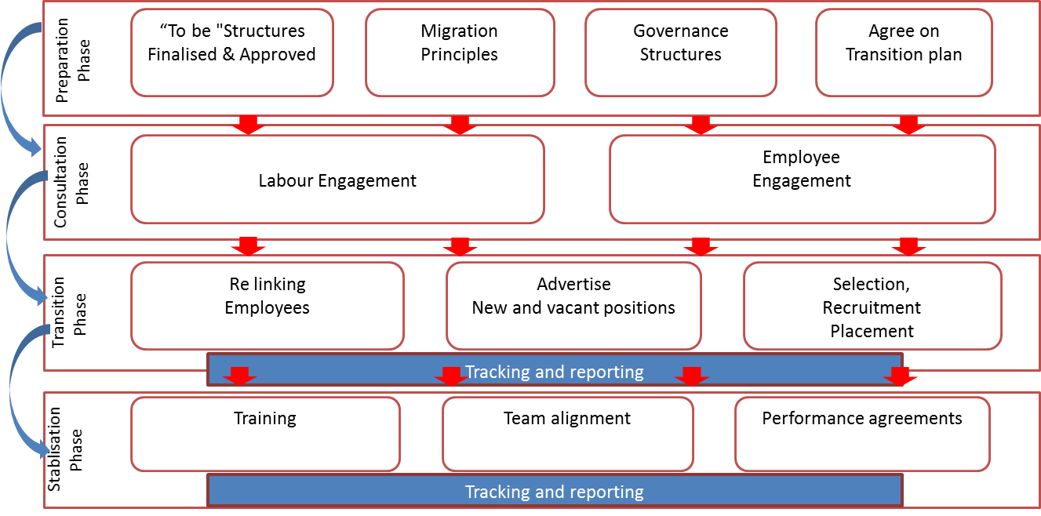
KEY REQUIREMENTS PER PHASE

Slide 17
OD process implementation Status
Implementation Process- levels 1-4:
Sub committee of board appointed to facilitate placement for Executives and General Managers;
Consultations held with 1 Executive and 8 General Managers, employees were issued with section 189; and
2 General Managers in PMSU not yet consulted
Implementation Process- levels 7-18
Consultations with NEHAWU still in progress delayed by salary negotiations
Voluntary severance package
Voluntary severance package approved at 2 weeks for every year worked for levels 7-18; and
Voluntary severance package approved at 1 week for every year worked for levels 1-6.

Slide 18
OD process implementation Status
Retrenchments:
3 retrenchments processed. Levels 3-5
Mechanism for migration of the employees to new structure:
Matching and placing principles
Advertising of positions
Employees migrated to new structure:
1 Executive was confirmed in new structure, has since resigned
4 General Managers confirmed in new structure. 1 has since resigned.
5 Senior Managers confirmed in new structure.1 has resigned
8 Managers confirmed in new structure.
3 bargaining forum level employees confirmed.

Slide 19
4
Recommendations

Slide 20
Recommendations
It is recommended that the Portfolio Committee:
Notes the IDT’s Organisational Repositioning and Turnaround Strategy; and
Notes progress made on the organisational development (OD) process; and
Supports the strategic repositioning and turnaround initiatives that are being implemented by the IDT.

Slide 21
Thank You
Independent Development Trust

