Slide 1
RESEARCH UNIT
REPORT ON THE FUTURE WORK
By
Teboho Mokoena

Slide 2
Background
The world has seen three industrial revolutions
The first, which occurred at the end of the 18th century, was characterised by mechanisation through the introduction of water and steam power, replacing cottage industries and manual labour.
The second recognised industrial revolution started in the early 20th century with the introduction of electricity and mass production, changing the scale and speed of manufacturing significantly.
From 1970, with advances in electronics and computing, the world saw a third industrial revolution characterised by increasingly optimised and automated production lines.
The fourth one is the revolution that involves a fusion of technologies that are blurring the lines between the physical, digital and biological spheres. This revolution will be driven by advances in digital systems and complimented by technologies such as artificial intelligence, automation, biotechnology, nanotechnology and communication technologies.

Slide 3
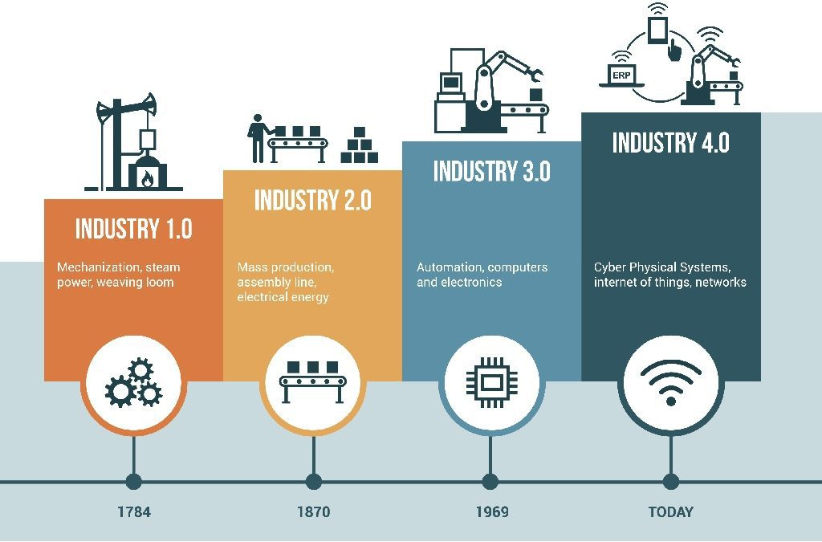
The Revolution

Slide 4
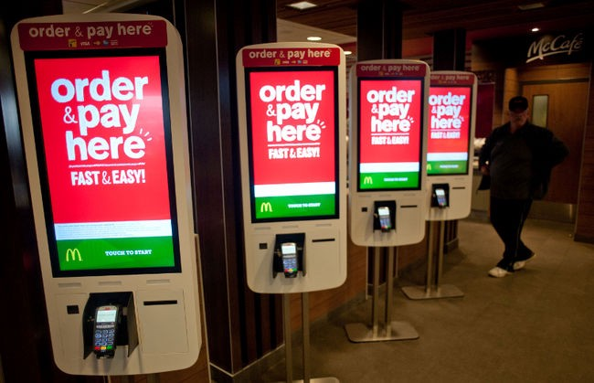
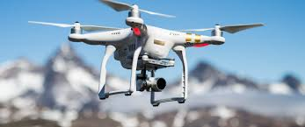
The 4th Revolution

Slide 5
How are develop economies preparing for the fourth industrial revolution?
Germany
Subsidises close-to-the-market research projects of small and medium sized companies through its Central Innovation Programme.
Established SME 4.0 competence centres throughout Germany to support companies free of charge with current know-how, e.g. on new business models, work 4.0, IT-security, 3Dprinting, logistics, as well as to provide demonstration and testing possibilities.
France
Has made a series of investments into developing skills of the unemployed and unskilled. This is done in preparation of the digital transformation of public administrations, the transformation of the agricultural sector, and the development of breakthrough innovations such as Artificial Intelligence.
South Korea
Provides fiscal support, financing and tax incentives to boost key leading businesses, including hyper-connected intelligence, smart factory, smart city, drone, and next generation automobiles, among others.
South Korea also plans to mobilize the ‘Innovative Venture Fund’ and increase tax incentives for angel investors to establish innovative start-ups and venture capital investment. In addition, to develop the skills needed for new technologies, Korea provides fiscal support to top-tier designated vocational institutions with training charges and incentives for trainees
Brics countries
India
Implemented a program of digital literacy, providing digital education and training to adults with low technological literacy skills and rural citizens.
Russia
Supports newly created industrial enterprises in priority spheres, including machinery, metal industries and pharmaceuticals, by granting concessional loans through the Industry Development Fund.
Brazil
Put into effect a program based on quick and low-cost interventions to increase productivity in industrial companies, particularly SMEs.
companies receive up to 120 hours of specialized consulting to improve the efficiency of their manufacturing processes.
Brazil also introduce a national program to support the generation of innovative enterprises prioritizing projects with social, environmental and technological impact, with measures such as targeted grants, networking and investor events, and subsidized training.
China
Implemented tax measures to support start-ups, employment, technology upgrading and innovation, such as VAT exemptions for small-scale taxpayers;
Increased deduction of R&D expenses for SMEs focusing on science and technology.
tax incentives for hiring specific categories of workers; and tax incentives for targeted groups such as university graduates and registered laid-off workers who become self-employed or set up new companies.
There are also subsidies for one year of social security contributions under certain conditions

Slide 6
Role of South African Parliament
Must design labour market institutions (e.g. minimum wages; employment protection; health and safety regulations) which encourage employers to seize the opportunities offered by technological change and globalisation, while making sure that the risks are not borne disproportionately by workers in the form of low pay, precariousness and poor working conditions.
Re-think social security systems, meaning adapting the current social security systems to the new world of work requires a fundamental paradigm shift, where entitlements are linked to individuals rather than jobs, and where they are portable from one job to the next.

Slide 7
….Role of South African Parliament
Strengthen activation frameworks to mitigate some of the inevitable adjustment costs of moving towards more globalised and technologically advanced economies by helping those workers who have been displaced by changing skills needs into a new job quickly.
Promote new forms of social dialogue which allow tailored solutions to new challenges to emerge at the firm-level, while strengthening the voice of those workers who are increasingly working independently and separated by distance, language and legal
Developed legislations that assist in preparing the youth for future jobs by equipping them with right type of skills to successfully navigate through an ever-changing technology work environment, and give all workers the opportunity to continuously maintain their skills, upskill and/or reskill throughout their working life.

Slide 8
Recommendations
Changes in the employment protection legislation must be considered
Training & Education for labour Inspectorates on the new forms of employment
Social Security systems have to be changed to reflect the new forms of jobs
Develop a tax system that caters for the new forms of jobs to ensure tax collection is maximised.
Government provide sufficient funding to tertiary education and training.

Slide 9
Conclusion
Let’s conclude with the obvious: we do not know what the jobs of the future will be. We only know that, although they may have the same names, they will be very different from current jobs.
World Economic forum report on the future of jobs and skills in Africa in preparation of the Fourth Industrial Revolution (2017), estimates that 41% of all work activities in South Africa are susceptible to automation.
This digital innovation is changing profoundly the nature of work in terms of the type of jobs being created, the skills required for these jobs and the way work is organised.
These trends are challenging traditional labour market and social policies and require new thinking to help navigate and shape the new world of work in ways to ensure a fair sharing of the benefits that these changes may bring while limiting their costs.
Labour markets will need to be made more flexible and adaptable.

Slide 10
End

