Slide 1

Briefing of the Department of Tourism on full Plan of the Oceans Economy - Coastal and Marine Tourism
Portfolio Committee on Tourism
31 October 2018

Slide 2
CONTENT | Slide Number
Background | 3
Vision Statement | 4
Nodal/Cluster approach | 5 - 6
Thematic Initiatives | 7
NODAL INITIATIVES Node 1 – Durban and Surrounds (Kwa-Zulu Natal Node 2 - Umkhanyakude including Umhlabuyalingana and surrounds (KwaZulu-Natal) Node 3 - Port St Johns to Coffee Bay (Eastern Cape) Node 4 - East London, Port Elizabeth and surrounds (Eastern Cape) Node 5 - Cape Town and surrounds (Western Cape) Node 6 –West Coast and surrounds (Northern Cape) | 10 - 11 12 13 – 15 16 -18 19 -21 22 -23
Cross Cutting initiatives | 24 – 29
Major Infrastructure projects | 30- 31
Institutional and Operational Arrangements | 32 - 33
PROGRESS Investment towards 2026 vision 2018/19 projects, implemented in partnership with government entities Community Projects Infrastructure Projects and Events Regulations and Research Development of the Indi-Atlantic Route – an example of a node | 34 35 36 37 38 39 - 45
Concluding Remarks | 46
Acronyms | 47

Slide 3
Background
Operation Phakisa, a fast results delivery programme to help implement the NDP, commenced in 2014 with 4 initial focus areas
  Marine Transport and Manufacturing activities;
  Offshore Oil and Gas Exploration;
  Aquaculture; and
  Marine Protection Services and Ocean Governance.
At the Oceans economy review workshop in 2015, two focus areas added
  Coastal and Marine Tourism (CMT); and
  Small Harbours.
The Coastal and Marine Tourism lab convened for 5 weeks (in April & May 2016) to prioritise issues and to develop solutions and action plans. Extensive post lab consultations were held with all stakeholders to prioritise initiatives
Cabinet approved the CMT Implementation Plan on 16 August 2017

Slide 4
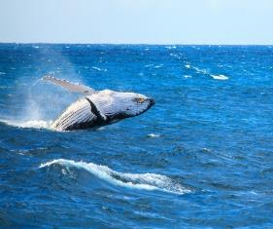
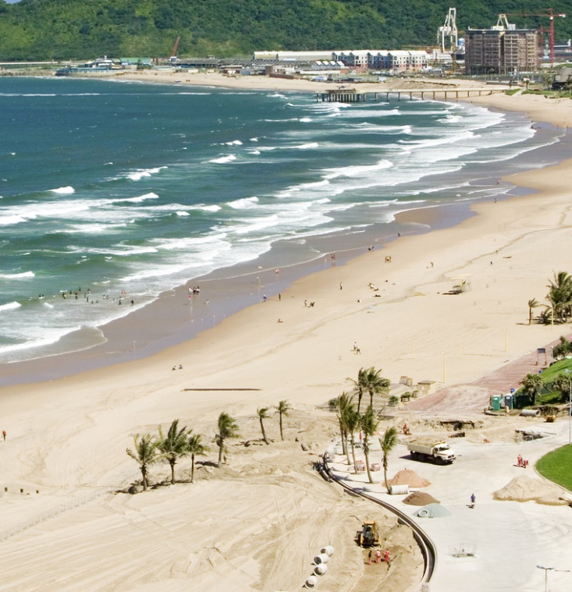
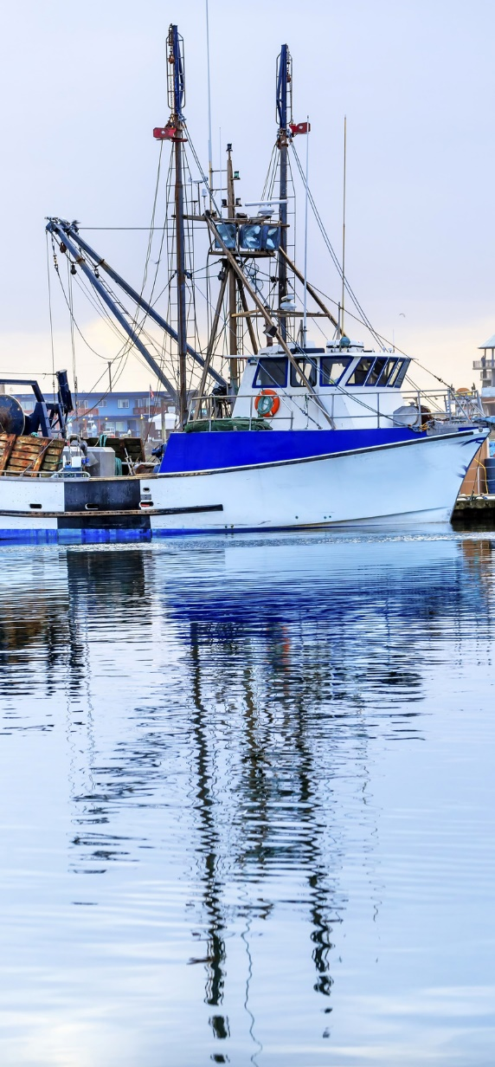
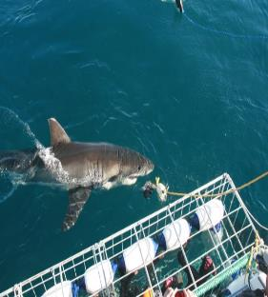
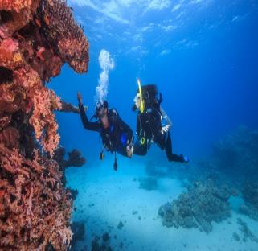
Vision Statement
Our vision is to grow a world class and sustainable coastal and marine tourism destination that leverages South Africa’s competitive advantages in nature, culture, and heritage
Estimated R21.4 billion direct contribution to GDP and approximately double the number of jobs to 116 000 by 2026.

Slide 5
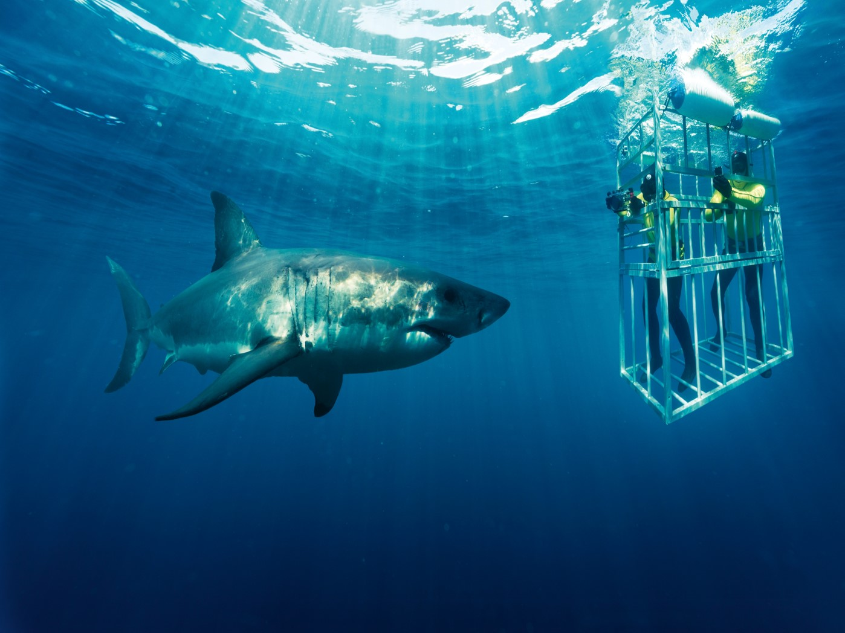
Nodal/cluster approach (1)
The CMT Implementation Plan is being implemented in nodal/cluster approach that seeks to:
prioritise destinations rather than individual tourism projects/products.
support the enhancement of the general environment in which attractions and products are located.
strengthen the linkages between attractions and improves the quality of the tourist experience within destinations.
strengthen the linkages with other areas of Operation Phakisa.

Slide 6
Nodal/cluster approach (2)
The identified nodes/clusters in the First Phase (0 - 5 years) encompass the following geographic areas:
Durban and surrounds (KwaZulu-Natal);
Umkhanyakude including Umhlabuyalingana and surrounds (KwaZulu-Natal);
Port St Johns to Coffee Bay (Eastern Cape);
East London, Port Elizabeth and surrounds (Eastern Cape);
Cape Town and surrounds (Western Cape); and
West Coast and surrounds (Northern Cape).
Additionally, a set of cross cutting initiatives will be implemented across the nodes.

Slide 7
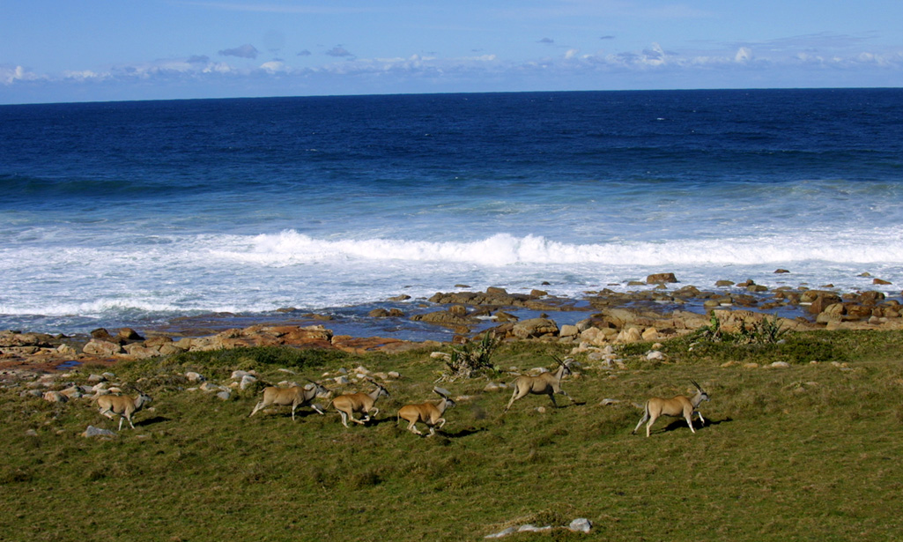
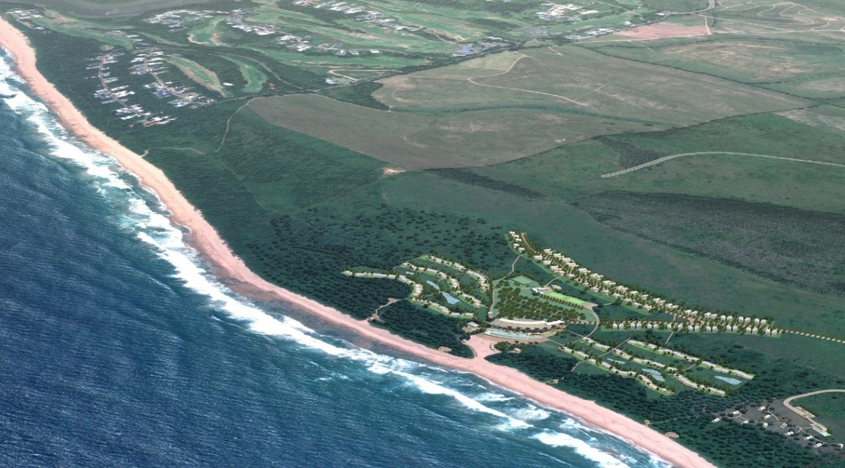
6 Thematic Initiatives
Initiatives in these nodes cover six thematic areas:
Marketing, Events and
Routes
ii) Regulations and Permitting
iii) Research and Spatial
Planning
iv) Beach Precinct
Development, Tourism
Infrastructure and Tourism
Safety
Maritime Tourism
Skills development

Slide 8
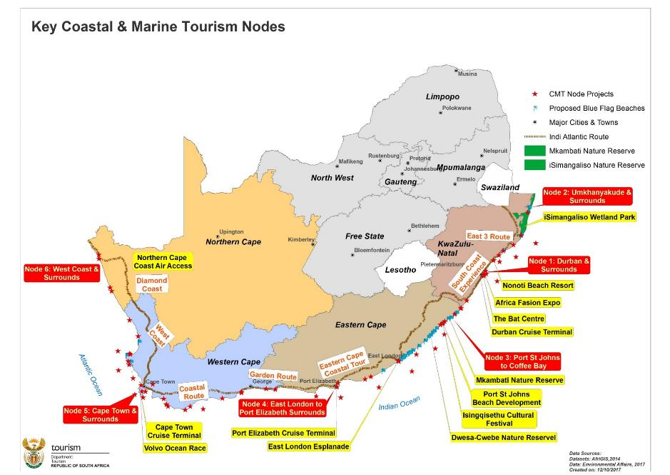
6 Thematic areas
A set of cross cutting initiatives will be implemented across the nodes, relating to the 6 thematic areas, viz.
i) Marketing, Events and Routes
ii) Regulations and Permitting
iii) Research and Spatial Planning
iv) Beach Precinct Development, Tourism Infrastructure and Tourism Safety
Maritime Tourism and
Skills development.
Priority Small Harbour Developments
NC – Port Nolloth
EC – Port St. Johns
KZN – Port Edward

Slide 9
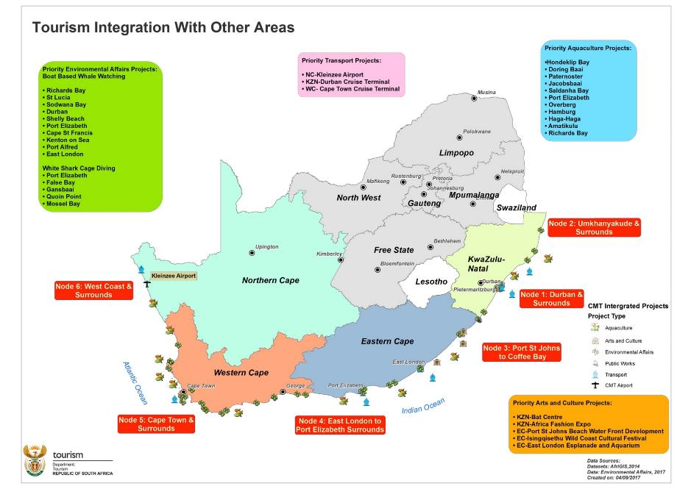

Slide 10
Province: KwaZulu-Natal
Node 1: Durban and surrounds:
INITIATIVE | OPPORTUNITY
N1.1: Durban Bat Centre Precint (Integration of tourism and creative industry on Durban Beach Front Precinct) | Improvement of infrastructure Creating access to markets for the creative industries Enterprise development Utilise available space to set up restaurants to incubate DT Chefs Programme Local supplier development (arts and craft and fashion fabric)
N1.2: Durban Cruise Terminal (Port infrastructure development) | DT Chefs, Sommeliers, Food Safety Assures trainees on board cruise ships Supply SA wine on board the ships Ground handling work by local tour operators
N1.3: Africa Fashion Expo | Mini restaurants - incubators for DT Chefs Programme Local supplier development (arts and craft and fashion fabric)

Slide 11
Province: KwaZulu-Natal
Node 1: Durban and surrounds:
INITIATIVE | OPPORTUNITY
N1.4: Unblocking legislative constraints - Nonoti Beach Resort | Enterprise development Supply fresh fish to the resort from proposed Amatikulu Aquaculture Development Zone and Mthunzini Fish Farm. Tours to the aquaculture facilities. Agricultural activities to supply fresh produce
N1.5: Boat Based Whale Watching: Durban and Shelley Beach | Increase new entrants from PDI background Deal with barriers to entry such as capital Incubate small entry operators and fast track licensing process

Slide 12
Province: KwaZulu-Natal
Node 2: Umkhanyakude / Umhlabuyalingana and surrounds
INITIATIVE | OPPORTUNITY
N2.1: iSimangaliso Wetland Park | Enterprise development: Local supplier development (fresh produce, fresh fish, linen, laundry facilities) Skills development (Chefs, Food Safety, Sommeliers, Life guards, water quality etc.)
N2.2: Bhanga Nek Community Camps | Enterprise development: Local supplier development (fresh produce, fresh fish, linen, laundry facilities) Turtle tours, recreational fishing
N2.3: Boat Based Whale Watching: Richards Bay St Lucia Sodwana Bay | Increase new entrants from PDI background Deal with barriers to entry such as capital Incubate small entry operators Fast track licensing process

Slide 13
Province: Eastern Cape
Node 3: Port St Johns to Coffee Bay
INITIATIVE | OPPORTUNITY
N3.1: Unblocking legislative constraints - Mkambati Nature Reserve | Enterprise Development Local supplier development (Fresh fish, fresh produce, community owned tourist camps, charcoal business, transport business, horse trails) Skills development
N3.2: Development of a Port St Johns - Coffee Bay Master Plan | Short- to long-term planning Diversified and enhanced tourism product offerings Quality visitor experience Customer satisfaction and inspire repeat visitation Infrastructure development, maintenance and enhancement
N3.3: Feasibility / Technical study for Port St Johns Beach Front | Infrastructure development, maintenance and enhancement Quality visitor experience Customer satisfaction and inspire repeat visitation

Slide 14
Province: Eastern Cape
Node 3: Port St Johns to Coffee Bay
INITIATIVE | OPPORTUNITY
N3.4 Port St. Johns Beach Waterfront development | Small Harbour development Port St Johns and Port Edward Tidal pool and Training facility Enterprise Development Local supplier development (arts and craft and beach front business) & Skills development (Life guards, water quality)
N3.5: Isinqqisethu Wild Coast Cultural Festival | Mini restaurants - incubators for DT Chefs Programme Local supplier development (arts and craft and fashion fabric)
N3.6: Boat Based Whale Watching: Umgazi-Umtamvuna River Kei-Mgazi River | Increase new entrants from PDI background Deal with barriers to entry such as capital Incubate small entry operators Fast track licensing process
N3.7: Dwesa-Cwebe Nature Reserve (Mbhashe) | Enterprise development: Local supplier development (fresh produce, linen, laundry facilities) Skills development (Chefs, Food Safety, Sommeliers)

Slide 15
Province: Eastern Cape
Node 3: Port St Johns to Coffee Bay
INITIATIVE | OPPORTUNITY
N3.8: Six Day Hiking Trail | Enterprise development: Local supplier development (fresh produce, fresh fish, linen, laundry facilities) Walk / hiking trails / tours
N3.9: Beach Infrastructure Upgrades | Diversified and enhanced tourism product offerings Quality visitor experience Customer satisfaction and inspire repeat visitation Infrastructure development, maintenance and enhancement

Slide 16
Province: Eastern Cape
Node 4: East London, Port Elizabeth and surrounds
INITIATIVE | OPPORTUNITY
N4.1: East London Esplanade and relocation of the Aquarium | Tidal pool Skills development (Life guards, water quality etc.) Training facility
N4.2: Port Elizabeth and East London Cruise Terminal | DT Chefs, Sommeliers, Food Safety Assures trainees on board cruise ships Supply SA wine on board the ships Tours to Addo Elephant Park (40 km from PE) Ground handling work by local tour operators

Slide 17
Province: Eastern Cape
Node 4: East London, Port Elizabeth and surrounds
INITIATIVE | OPPORTUNITY
N4.3 Addo Elephant Park | Employment / Jobs Diversified and enhanced tourism product offerings Quality visitor experience Customer satisfaction and inspire repeat visitation Infrastructure development, maintenance and enhancement
N4.4: Tsitsikama Big Tree Gateway | Employment / Jobs Diversified and enhanced tourism product offerings Quality visitor experience Customer satisfaction and inspire repeat visitation Infrastructure development, maintenance and enhancement

Slide 18
Province: Eastern Cape
Node 4: East London, Port Elizabeth and surrounds
INITIATIVE | OPPORTUNITY
N4.5: Boat Based Whale Watching: Port Elizabeth Cape St Francis Kenton on Sea Port Alfred East London | Increase new entrants from PDI background Deal with barriers to entry such as capital Incubate small entry operators Fast track licensing process
N4.6: White Shark Cage Diving: Port Elizabeth – Algoa Bay

Slide 19
Province: Western Cape
Node 5: Cape Town and surrounds
INITIATIVE | OPPORTUNITY
N5.1: Cape Town Cruise Terminal | DT Chefs, Sommeliers, Food Safety Assurers trainees on board cruise ships Supply SA wine on board the ships Ground handling work by local tour operators
N5.2: Goukamma Nature Reserve | Employment / Jobs Diversified and enhanced tourism product offerings Quality visitor experience Customer satisfaction and inspire repeat visitation Infrastructure development, maintenance and enhancement
N5.3: Khayelitsha Precinct Plan | Diversified and enhanced tourism product offerings Quality visitor experience Customer satisfaction and inspire repeat visitation

Slide 20
Province: Western Cape
Node 5: Cape Town and surrounds
INITIATIVE | OPPORTUNITY
N5.4: Khayelitsha Look Out Hill | Diversified and enhanced tourism product offerings Quality visitor experience Customer satisfaction and inspire repeat visitation Infrastructure development, maintenance and enhancement
N5.5: Monwabisi Beach | Diversified and enhanced tourism product offerings Quality visitor experience Customer satisfaction and inspire repeat visitation Infrastructure development, maintenance and enhancement

Slide 21
Province: Western Cape
Node 5: Cape Town and surrounds
INITIATIVE | OPPORTUNITY
N5.6: Boat Based Whale Watching: Cape Town, Hout Bay, Kleinbaai, Gansbaai, Amiston & Struisbaai, Hermanus, CapePoint – Kalk Bay, Mossel Bay, Knysna, Plattenberg Bay, Lamberts Bay, St Helena Bay – Sandy Point, Saldanha Bay, Stilbaai | Increase new entrants from PDI background Deal with barriers to entry such as capital Incubate small entry operators Fast track licensing process
N5.7: White Shark Cage Diving: Seal Island - False Bay, Dyer Island – Gansbaai, Quoin Rock - Quoin Point & Seal Island - Mossel Bay
N5.8: Volvo Ocean Race | Skills Development Sailing academy, SA Team for Volvo Race, School Awareness Enterprise Development (local supplier development (boat building, boat parts, refuelling) Mini restaurants - incubators for DT Chefs and Wine Programme Enterprise Development

Slide 22
Province: Northern Cape
Node 6: West Coast and surrounds
INITIATIVE | OPPORTUNITY
N6.1: Development of a Hondeklipbaai - Port Nolloth Master Plan | Medium- to long-term planning Diversified and enhanced tourism product offerings Infrastructure development, maintenance and enhancement Small Harbour development (Port Nolloth) Feasibility study on artificial lagoon
N6.2: Development of a Orange River Mouth Master Plan | Orange River Mouth activities (white water river rafting, birding, marine life and conservation, hiking and camping trails) Enterprise Development

Slide 23
Province: Northern Cape
Node 6: West Coast and surrounds
INITIATIVE | OPPORTUNITY
N6.3: Concept development for Hondeklipbaai and McDougall’s Bay Campsites | Tours to Hondeklipbaai Abalone Hatchery. Short- to long-term planning Diversified and enhanced tourism product offerings Infrastructure development, maintenance and enhancement Camping Flower tours to nearby Namaqua National Park in Hondeklipbaai
N6.4: Feasibility Study for Northern Cape coastal aviation infrastructure | Creating access for the Northern Cape coastal economy Increase tourist visitations
N6.5 Concept development for Kleinzee Beach Precinct | Tours to Farm Kleinzee (Abalone recirculating aquaculture systems) Utilise available space to set up restaurants to incubate DT Chefs Programme

Slide 24
Cross cutting initiatives (1)
CC 1: Enhance the promotion of Coastal and Marine Tourism in South Africa through coordinated marketing efforts | Develop a framework and calendar of events for marketing of CMT routes, events and attractions, including:- Indi Atlantic Route incorporating the South Coast Experience (KZN) Diamond Coast Route (Northern Cape) Coastal Route and West Coast Route (Western Cape) East 3 Route (KZN) Eastern Cape Coastal Route (EC) Garden Route (EC side)
CC 2: Beach Precinct Development, Tourism Infrastructure and Tourism Safety | Blue Flag Beach Programme – Programme is well established on 50 beaches and has commenced on 25 additional beaches Inclusion of CMT related investment projects in 3 investment promotion platforms:- Investour 2018, Gulf Region roadshow & Indaba 2018

Slide 25
Cross cutting initiatives (2)
CC 3: Regulations and Permitting | Establish an Intra - Government Permitting Forum to coordinate permit application processes and decision making for marine tourism related activities Research on governance and regulatory issues
CC 4: Research for CMT | Research/development of a framework for assessment of the economic impacts of coastal & marine tourism. Research on the governance and coordination of coastal and marine tourism.
CC 5: Skills Development | Conduct a skills audit for coastal and marine tourism; Develop a framework of existing qualifications and gaps (TVET, universities, private providers); Facilitate the establishment of centres (centres of excellence, incubation centres); Promotional material for CMT skills; Mentorship frameworks; Work placements; Skills Development Programme
CC 6: Integration with rural and agriculture related initiatives | Identify and facilitate opportunities for supply of fresh seafood to tourism initiatives by aquaculture initiatives; Identify opportunities for tours etc. to aquaculture initiatives e.g. school groups); Identify and facilitate opportunities to supply fresh produce to tourism initiatives.

Slide 26
Cross cutting initiatives (3)
Development of the Indi Atlantic Route
The Indi Atlantic Route falls under the Marketing, Events and Routes thematic area. The Route is envisioned to:
Include all towns and regions located along the South African coastline encompassing the four coastal provinces
Develop coastal areas and towns and facilitate growth and development of tourism products and services.
Identify and prioritise tourism products and incorporate them into development strategies.
Steering Committee has been established to oversee supply and demand analysis work undertaken.
The draft Demand and Supply Analysis Report and implementation plan for the proposed Indi-Atlantic Tourism Route has been circulated to stakeholders for comments. The report will be finalised by 31 December 2018

Slide 27
Cross cutting initiatives (4)
Development of Indi Atlantic Route
The outcomes / recommendations of the report focus on four key areas and are summarised as follows:
A. Supply Analysis
Tourism routes
Attractions and other infrastructure
Accessibility
Human resource development
Tourism information and signage
Tourism transport services and infrastructure
C. Marketing and Promotion
Brand image and positioning
Packaging
B. Demand Analysis
Identify the market
Size of the market
Behaviour
Spending patterns
D. Governance Issues
Route management structure
Key partners
Benchmarking with other routes i.e. Wild-Atlantic Way – Ireland, Grand Pacific Drive- Australia and the Garden Route- South Africa.

Slide 28
Cross cutting initiatives (5)
Inclusive economic growth - enterprise development to enhance transformation in coastal towns
Deal with barriers to entry such as capital and increase new entrants from PDI background as boat based whale watching and white shark cage diving operators. Assist these operators to access the Transformation fund to acquire vessels.
Currently doing needs assessments at boat launch sites to develop interventions that will create an enabling environment for these boat based whale watching and white shark cage diving operators to effectively conduct their business and attract more tourists.
Expand the Department’s current incubation programme to include boat based whale watching and white shark cage diving operators (new entrants).

Slide 29
Cross cutting initiatives (6)
Inclusive economic growth - enterprise development to enhance transformation in coastal towns
Currently engaging with Durban and Cape Town Cruise terminals to create incubation space for our Chefs to start their own mini restaurants at these terminals and at events such as Isingqisethu in the Eastern Cape.
Opportunities are being explored through the tourism value chain e.g. small businesses to supply fresh fish to the resorts such as Nonoti Beach from the proposed Amatimkulu Aquaculture Development Zone and Mthunzini Fish Farm, conduct tours to the aquaculture facilities and be local suppliers of fresh produce, community owned tourist camps, charcoal business, transport business, horse trails at the Mkambati Nature Reserve.

Slide 30

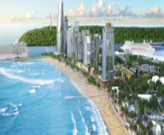
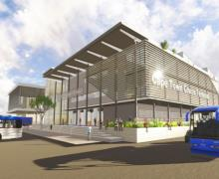
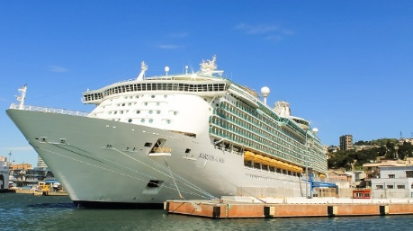
Major Infrastructure Projects
  These are major infrastructural projects that have potential to significantly contribute to the economic growth and job creation aspirations of the sector. They have clear business plans, funding secured and diverse stakeholder participation/ agreement. As a lab, we recognize these projects and have prioritized infrastructure projects that had challenges that the lab platform would unlock
Baakens Valley Precinct
Durban Point Waterfront
Cape Town Cruise Terminal
Durban Cruise Terminal
The R4 billion development will include the rehabilitation of the Baakens River which will be linked to the waterfront development. Estimated to create 3127 construction jobs and 35,000 sustainable direct jobs over a 20 year period.
The R35 billion project involves the development of luxury accommodation, tourist facilities and a cruise terminal.
The R179 million port will accommodate the current and future passenger vessel fleet. It is also envisaged that the upgraded facility will house value-added retail and hospitality services.
Aims to develop a multipurpose facility made up of conference and exhibitions venue as well include retail and entertainment facilities.

Slide 31
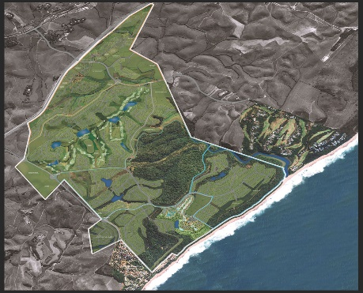
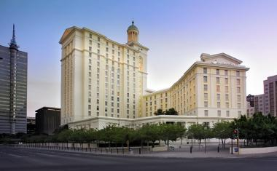


Major Infrastructure Projects (2)
  These are major infrastructural projects that have potential to significantly contribute to the economic growth and job creation aspirations of the sector. They have clear business plans, funding secured and diverse stakeholder participation/ agreement.
Blythedale Coastal Resort
Tsogo Sun Hotel Development
Cape Town
iSimangaliso accommodation mix development
R15-billion investment on the North Coast of KZN. Expected to yield 10 000 permanent jobs and an additional 110 000 indirect job opportunities over a 10-year period during the various phases of construction.
Tsogo Sun is investing about R680m in a new 500 room hotel complex in Cape Town CBD.
Forty three (43) accommodation facilities across the wetland with cabins, tented camps, lodges and self-catering units

Slide 32
  Institutional arrangements
Presidential Operation Phakisa Issue Resolution Committee
DPME / DEA (Phakisa Unit -Secretariat
Operation Phakisa Sector Ministerial Committee
Lab Coordinating Committee
DT Delivery Unit
Marketing, Events & Routes WG
Regulations & Permitting WG
Research & Spatial Planning WG
Beach Precinct Dev, Tourism Safety and Maritime Tourism WG
Skills Dev WG

Slide 33
Operational arrangements
Steering Committee - cross-departmental and agency structure led by the Tourism Minister.
Deliver and manage issue resolution and escalation processes.
  Minister (Deputy Minister as designated by the Minister)
  Director-General
  Delivery Unit (established)
  Executive representatives from partner Departments and Organisations.
Delivery Unit (DU) - link between the Department and implementation of initiatives and activities for which it is accountable.
Reports to
  Minister (Deputy Minister)
  Director-General
  Oceans Economy Secretariat (DEA) – once a month / as and when required.
  Phakisa Unit (DPME) web based reporting system every two weeks.

Slide 34
Progress (1)
Investment towards 2026 target
Performance against CMT target to create 116 000 jobs by 2026
Current government investment: R 164 345 million over 3 years
Current projected government jobs: 1 189
Current projected private sector investment: R112 722 billion
Projected private sector jobs: 71 942 full time & 153 377 part time
Investment and job figures will increase as and when more projects move into planning / implementation.

Slide 35
Progress (2)
2018/19 projects, implemented in partnership with government entities
Eastern Cape
Expansion of six day hiking trail project in Port St Johns
Feasibility study for Port St Johns Beach Front
Infrastructure upgrades and development at selected beaches
Addo Elephant Park
Tsitsikamma Big Tree Gateway
Port St Johns - Coffee Bay Master Plan
KwaZulu-Natal
Umhlabuyalingana Hospitality Skills and Tourism Business Development Programme
Bhanga Nek Community Camps
Northern Cape
Orange River Mouth Master Plan
Concept development for Hondeklipbaai and McDougall’s Bay Campsites
Feasibility Study for Northern Cape coastal aviation infrastructure
Concept development for Kleinzee Beach Precinct
Hondeklipbaai - Port Nolloth Master Plan
Western Cape
Goukamma Nature Reserve
Tourism precinct plan for Khayelitsha

Slide 36
Progress (3)
Community Projects
The land use challenges were unblocked at Mkambati Nature Reserve with DAFF in June 2017. The reserve has been in existence since 1977 and is owned by Mkambati Land Trust representing seven local communities, comprising of about 40 000 people. The Trust had their land restituted in 2002. The project involves the development of 108 bed five star lodge, made up of 15 two bedrooms and ten 4 bedroom beach lodges with an investment of R150 million. The developer is currently conducting the final survey to formally lodge the project with the Deeds Registry. Once surveyed and lodged, paperwork will be completed and building will commence.
Application with DAFF for consent to subdivide agricultural land for Nonoti Beach Resort under way. This is a concept wholly owned by the community of Nonoti which is formed by 200 households represented by the Inqaba Community Trust. The concept proposes a development of 3-4 star hotels to accommodate a total of 822 beds with sea views, swimming pools and walkways that lead to the beach, restaurants, conference facility, entertainment such as cultural activities. The development is estimated at R2.5 billion.

Slide 37
Progress (4)
Infrastructure Projects and Events
Upgrading of the East London Beachfront (Water World & Esplanade) by the Buffalo City Metro Development Agency (BCMDA) – the concept plans have been competed, town planning applications done, EIA currently underway, detailed plans to be completed by October 2018.
Relocation of the East London Aquarium by Buffalo City Metro - bid processes underway.
The Volvo Ocean Race took place on 24 November - 10 December 2017 in Cape Town.
Isingqisethu Cultural Festival took place on 10-12 November 2017 in Port St Johns.

Slide 38
Progress (5)
Regulations and Research
Boat Based Whale Watching and White Shark Cage Diving. DEA is currently conducting needs assessments at boat launch sites in order to assist the Department of Tourism ascertain required interventions at each site.
UKZN was appointed to conduct two research studies:
  Develop a framework to measure the economic impact of coastal and marine tourism in South Africa. Phase one and two of the study has been completed and phase three is under way.
  A study on the governance and coordination of coastal and marine tourism. The study has been completed and final report in place.
Draft Demand and Supply Analysis and implementation plan report for the proposed Indi-Atlantic Tourism Route has been circulated to stakeholders for comments.

Slide 39
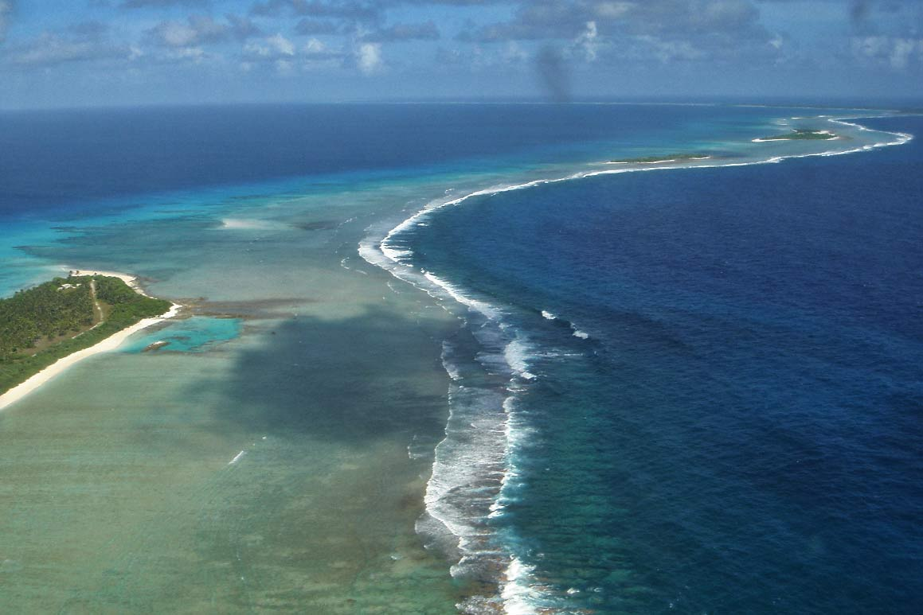
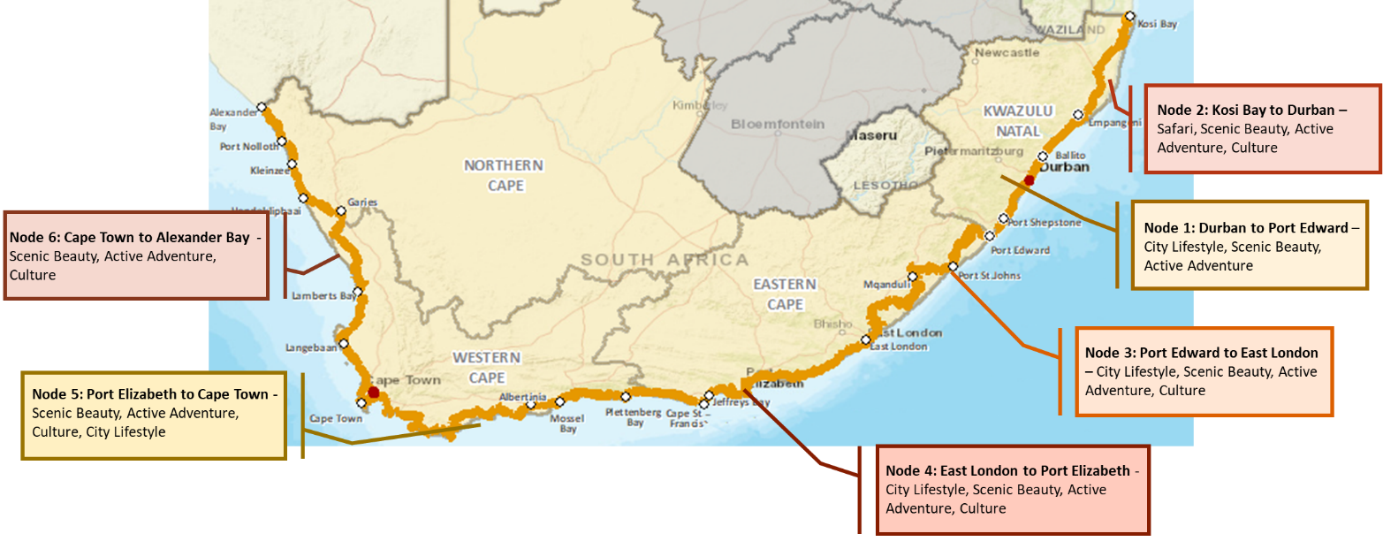
Progress (6)
Development of Indi Atlantic Route
COASTAL NODES
The Indi-Atlantic Route has adopted the following six coastal nodes as part of their development plan:

Slide 40




Progress (7)
Development of the Indi Atlantic Route – An example of NODE 1- Durban to Port Edward Demand and Supply
KWAZULU-NATAL
DURBAN
4
2 244 123 domestic overnight trips
Average length of stay: 4 nights
560 646 international arrivals
SOUTH COAST
382 776 domestic overnight trips
2 706 international arrivals
Source: StatsSA, 2017; SAT,2018; TKZN 2017

Slide 41

Progress (8)
Development of the Indi Atlantic Route – An example of NODE 1- Durban to Port Edward Demand and Supply
International Demand
R7 700 spend per trip
10
Average length of stay: 10 days
Source: StatsSA, 2017; SAT,2018; TKZN 2017

Slide 42
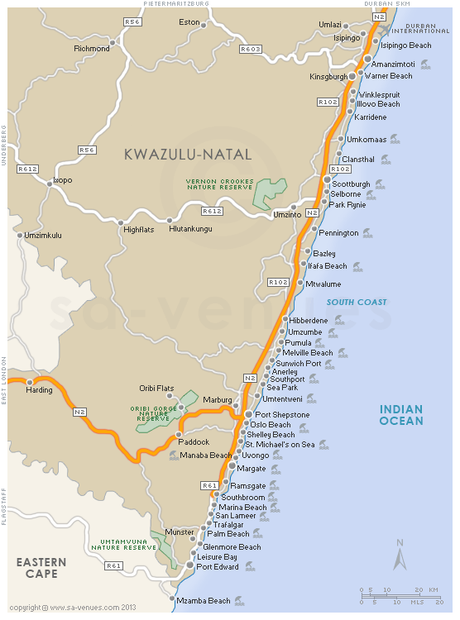
Progress (9)
Development of the Indi Atlantic Route – An example of NODE 1- Durban to Port Edward Demand and Supply
Ownership | The Ugu District Municipality owns Ugu South Coast Tourism (Pty) Ltd.
Management structure | Strategic direction is provided by the board of directors appointed by the Ugu District Municipality. The board members consist of public and private sector professionals. Municipal managers from six local municipalities and a senior official from Ugu District Municipality are members of the board of directors. The CEO is responsible for implementing strategic issues while also managing the operations of the company.
Membership status | 500+
Membership database | Ugu South Coast Tourism hosts a database.
Membership fees | Ugu SCT fees are R570 per annum.
Route status | Active
Route marketing | The route is well-marketed with a strong online and local presence. An informative website is sustained and a magazine is published to market local businesses. The route has well-maintained information offices and helpful guides. Proactive measures are taken in planning and delivering signage and information boards. The existing number of events are expanding their range of influence
SOUTHERN EXPLORER ROUTE
The Southern Explorer Route is located on the N2 and stems from Scottburgh to Port Edward and continues inland (for approximately 75 km) towards Harding.
It is located across Umdoni, Umzumbee, Ray Nkonyeni and Umuziwabentu local municipalities.

Slide 43
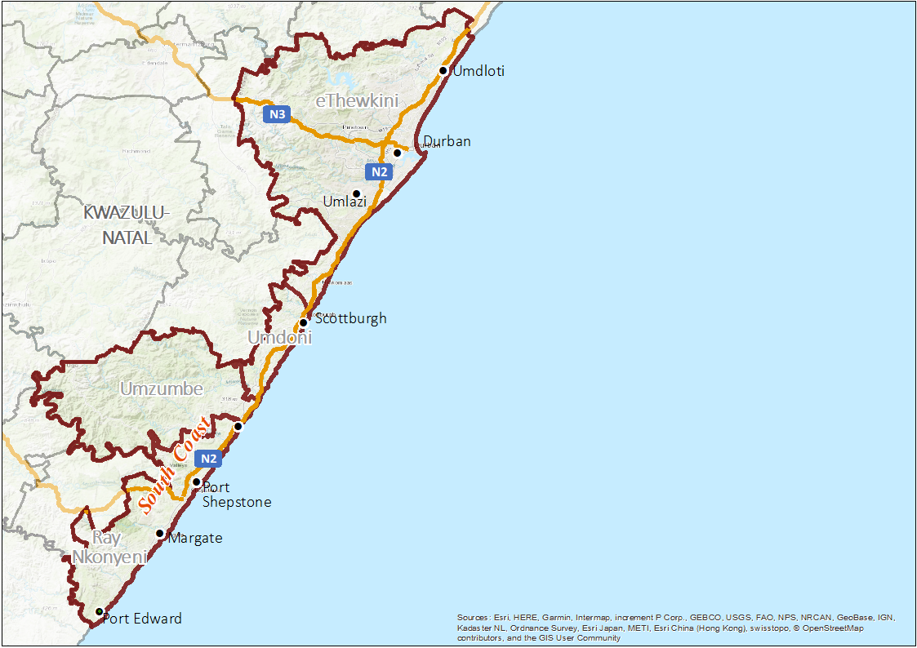
Progress (10)
Development of the Indi Atlantic Route – An example of NODE 1- Durban to Port Edward
SKILLS GAP FOR NODE 1:
Food and beverage technician
Tourist guide
Training and development specialist
Food and beverage technician
Environmental scientist
Travel consultant
Tourist guide
Training and development professional
Park ranger
Ships officer
Inbound contact centre consultant
Adventure guide
Tourism information officers
Outdoor adventure guide
Tourist guide
Training and development
Food and beverage technician
Tourism information officers
Tourists guide
Training and development professional
Environmental scientist
Inbound contact centre consultant
Ship officer
Southbroom
Food and beverage technician
Tourism information officers
Travel consultant
Outdoor adventure guide
Tourist guide
Training and development professional
Environmental scientists

Slide 44
Progress (11)
Development of the Indi Atlantic Route – An example of NODE 1- Durban to Port Edward
Focus Area | Gap | Partner(s) | Area | Intervention | Objectives | Responsibility
Product Development | Potential for cruise tourism | NDT, eThekwini Municipality | Durban Area | Development of the new cruise terminal at Durban Harbour | World class facilities and increased international exposure | Transnet
 |  | TKZN, Durban Tourism |  | Co-package experiences for cruise tourists to experience the Durban Area through 2/3 hour tours or activities | Increase the impact of cruise tourists on the economy surrounding Durban | MSC
 | Coastal product development | PHRA |  | Improvement of disability access, restaurant and bathrooms at Luthuli Museum | Upgrade of Luthuli Museum | eThekwini Municipality
 |  | Ezemvelo KZN Wildlife |  | Development of ablution facilities and information signage at Harold Johnson Nature Reserve | Upgrade Harlond Johnson Nature Reserve
 | Beach development | Local Authority | South Coast | Provide access to water at Aliwal Shoal and Protea Banks | Improvement of facilities at the diving site
 |  |  |  | Development of high-end restaurant at Aliwal Shoal and Protea Banks | Job creation at diving site
Marketing | High concentration of domestic and international tourists in Durban Area | SAT, Durban Tourism, Southern Explorer | Durban Area | Promotion of beach and leisure packages to domestic and international markets | Increase the number of tourists in South Coast | TKZN
 |  |  |  | Create incentives for young couples and families to participate in other activities around the beach | Increase spending of domestic tourists on tourism products within the coastal buffer
 |  | Southern Explorer |  | Create incentives for young couples and families to participate in other activities around the beach | Increase spending of domestic tourists on tourism products within the coastal buffer
 | Southern Explorer events | TKZN | South Coast | Leverage events marketed by Southern Explorer to create awareness of the route and to motivate attendees to explore the route | Create awareness and motive to travel for the entire Indi-Atlantic Route | Southern Explorer

Slide 45
Progress (12)
Development of the Indi Atlantic Route – An example of NODE 1- Durban to Port Edward
Focus Area | Gap | Partner(s) | Area | Intervention | Objectives | Responsibility
Marketing | Leverage Blue flag Status as a competitive advantage | TKZN | Durban Area & South Coast | Indi-Atlantic Route to position Node 1 as the Blue Flag Status Destination in South Africa | Beach Tourism as a competitive advantage for the Indi-Atlantic Route | SAT
Stakeholder Management/Fund Raising | Partnership with Ugu South Coast Tourism | Southern Explorer | South Coast | Partner with Southern Explorer to package and market the Indi-Atlantic Route | Leverage current structures and resources | TKZN
 | Tourism Information Officers product offering knowledge |  |  | Provide product exposure programmes to familiarise tourism information offices with products along the route | Improve product knowledge of tourism information offices
 |  |  |  | Provide Indi-Atlantic promotional training and guidelines for tourism information officers and tour guides along the South Coast Route | Create collaborative knowledge under tourism representatives to promote the entire Indi-Atlantic Route
Skills Development | Need for qualified and certified technicians/operators for marine tourism related activities | Department of Education | Durban Area & South Coast | Engage with operators to identified specific skills gap relating to marine tourism activities | Identification and evaluation of skills gap in marine tourism related activities | SAIMI

Slide 46
Concluding Remarks
The CMT initiatives are progressively being implemented
Monitoring and reporting takes place on a monthly basis
The Departments role is to co-ordinate reporting and facilitate progress of all the initiatives
The Implementation Plan is reviewed annually to allow for the inclusion of new initiatives
The success of CMT relies on integration and partnerships

Slide 47
Acronyms
BCMDA- Buffalo City Metro Development Agency
CMT- Coastal and Marine Tourism
DAFF- Department of Agriculture, Forestry and Fisheries
DEA- Department of Environmental Affairs
DPME- Department of Planning, Monitoring and Evaluation
DPW- Department of Public Works
DT- Department of Tourism
DU- Delivery Unit
EC- Eastern Cape
EPWP- Expanded Public Works Programme
KZN- KwaZulu-Natal
NDP- National Development Plan
PE- Port Elizabeth
PDI- Previously Disadvantaged
TNPA- Transnet National Ports Authority
WC- Western Cape
WG- Working Group

Slide 48
Thank you

