Slide 1



National Framework for the Commercialisation of Black Producers
Presentation to Portfolio Committee
30 October 2018

Slide 2
Goal
To support sustainable commercialization of black producer’s farming enterprises in agriculture, forestry and fisheries sectors.
To support enhancement of production by Black Producers through deliberate, targeted and well defined interventions.
To support inclusive growth, sustainable jobs, wealth creation, rural development and sector transformation.
To make Land Reform work!

Slide 3
Commercialization of Black Producers Framework
The approach to commercialize black producers is two fold:
The development phase for potential producers to operate at commercial level (Dynamic Business Model);
The provision of blended funding to commercialize black producers (Re-engineering of Agricultural Development Finance).

Slide 4
The Development Phase (phase 1)
    DAFF and PDAs entering into partnership with commodity organizations, SOEs (ARC, NAMC, PPECB) and Academic Institutions to support producers;
      Conduct farm and farmer needs assessments of identified producers,
      Skills and capacity building including record keeping;
      Farm planning i.e. primary and secondary commodities;
      Assistance with business plan development;
      Accreditation e.g. Global GAP or SA GAP certification and facilitation of access to markets;
      Infrastructural and input support to enable achievement of at least R500 000 turnover per annum.
    Submission of bankable business plans to Financial Institutions

Slide 5
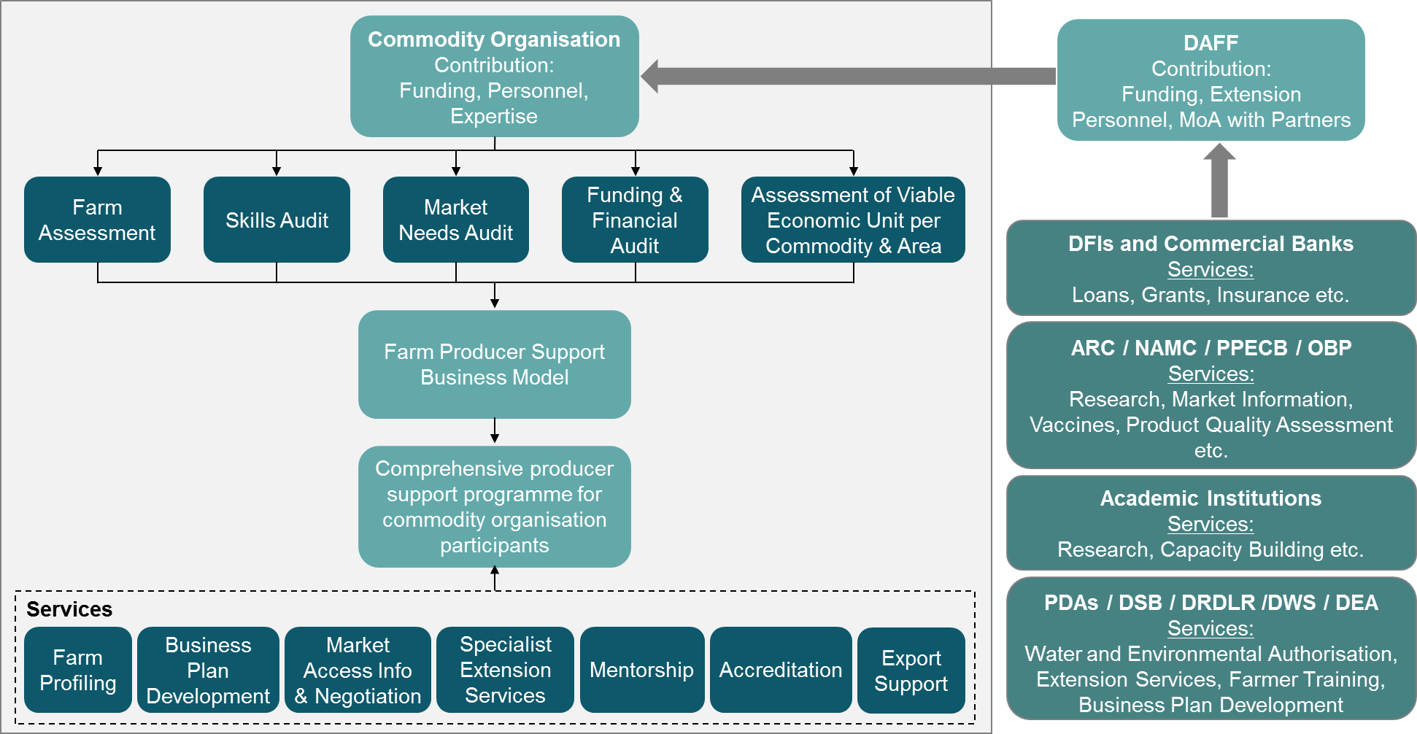
The Business Model to support farmers
Issues Addressed
Solution Design
Current government farmer support programmes have not sufficiently focused on commercializing black producers.
Current producer support is fragmented, poorly coordinated and is not comprehensive for beneficiaries.
Black producers are largely not organized and remain excluded from the mainstream agricultural value chain.
Black producers have challenges in accessing markets, finance and technical supports and to link with integrated value chains and lack the skill and capacity to be competitive.
Further challenges facing producers include poor production and market infrastructure.
The initiative is a partnership between government, commodity organisations and other stakeholders to develop and provide a commodity-specific comprehensive producer support package for each black producer participating in the initiative.
5

Slide 6
The development phase: Context
DAFF CASP conditional grants to provinces will ring-fence at least 20% of project allocation for the development of identified potential commercial producers in partnership with ARC, NAMC, PPECB and Commodity organizations;
Provinces have identified 50 potential producers to be commercialized, the lists will be updated annually;
The development include infrastructure, inputs, skilling and capacity building, record keeping, accreditation, market access, financial management, development of a bankable business plan and registration of a legal entity;
The bankable business plan is presented to the financial institution to access comprehensive blended funding.

Slide 7
Criteria used to select the 50
Agriculture Specific criteria
Forestry Specific Criteria
The farmer must have demonstrated practical knowledge and focused on a specific commodity in line with the APAP value chains and the Provincial Growth Development Plans (PGDP);
The farming enterprise has the potential to achieve R500 000 annual turn-over depending on the commodity under production;
Enterprise should preferably be within 100km radius from the identified Agri-parks Farmer Production Support Unit (FPSU) or have access to markets;
The business enterprise must have been in operation for at least 2 years;
The grower/ producer should be in their second rotation if they are in a timber production enterprise;
The grower/producer should have demonstrated practical knowledge and focused on a commodity in line with the Agricultural Policy Action Plan/ Forest sector transformation Charter Codes;
Potential to achieve an annual turnover of R 250 000 to R 500 000 per rotation if they are small growers;
Growers/producers to be within 300km radius of the mill, weigh bridge and/or processing plant;
Growers must comply to legal/ authorization and other cardinal prescripts;
Those involved in intensive production must also be considered ( Nurseries, Charcoal producers, Non-Timber Forest Products, pole producers);
Enterprises that combine forestry and alternative / complementary enterprise to promote multiple land use and associated benefits i.e. Agroforestry;
The lists of 50 identified producers per province attached

Slide 8
Status Report on development phase
Task Name | Due Date | Status
Provide a list of identified 50 producers to be commercialised per province as per defined criteria |  | Done
NAMC to provide list of commodity organizations in South Africa |  | Done
Develop criteria for prioritising commodity organisation to participate in Phase 1: Proof of Concept |  | Done
Set up and hold meetings with prioritised commodity organisation to negotiate participation in Phase 1: Proof of Concept | 31/01/2019 | Ongoing
Sign service level agreements between DAFF, PDAs and partnering prioritized commodity organizations and partnering entities. | 28/02/2019 | Ongoing
Conduct a review of producer support services which may be provided and include into the draft PCPDS. |  | Done
Get approval from National Treasury to deviate from procurement processes when enlisting the services of these identified partners to support black producers. | 31/10/2018 | Awaiting response from Treasury
Provinces allocate funding towards developed plans as produced with the partners, the plans to be submitted to DAFF National Assessment Panel. | 31/09/2018
Conduct commodity specific needs assessment of potential participating farmers and profiling of these producers | 30/04/2019
Commodity organisation and partners to develop an individual producer support implementation plan based on producer package/plans; including a bankable business plan; | to be informed by the results of the producer profiles
Execute the implementation plan
Submit bankable business plan to financing institution for comprehensive blended funding
Monitor Implementation of the business plan

Slide 9
Categories of producers and supports
Large-Scale Commercial
Smallholder Producers
Household/Subsistence Producers
Medium Scale Commercial
Blended Finance
>R20 million p/a
Blended Finance (Loans and grants) to commercialise black producers.
>R5million p/a
Tenure rights: land tenure, restitution will fit into either of the four categories
>R500 000 p/a
CASP and Ilima/Letsema still play a significant role in the development and support to these producers who will not qualify for blended funding
Existing Food security Initiatives (CASP, Ilima/Letsema, 1 ha 1 hh etc. to prepare producer to be market ready.

Slide 10
The Commercialization through Blended Funding phase
    This initiative proposed that government should develop blended financial instruments (loan and grant), administered centrally to improve access and affordability of finance by black producers and reduce reliance on grants.
    The Black Producer Commercialization Programme is the 1st blended instrument developed in partnership with DRDLR and Land Bank.
    The target is to commercialize 450 black producers over 5 year period; and
    The categorization of these producers has been done, and the commercial producers will either be small, medium or large scale commercial producers along the agriculture, forestry and fisheries value chains.

Slide 11
Blended Funding to Commercialize Black Producers
Objectives
Vision
Reduce reliance on grants
Increase access and affordability of loans by black producers
Expand the agricultural base and inject new black entrepreneurs into the sector.
Shift the demographic composition of South Africa’s commercial agriculture, forestry and fisheries. and transform the sector.
Increased meaningful participation of black producers owning and controlling the agriculture, forestry and fisheries value chains.
450 sustainable and profitable Black Commercial Producers developed across the country in the next five years.
Goal

Slide 12
Blended Funding to Commercialize Black Producers
Guiding Principles
Guiding Principles
Blended finance (grant and loan);
Focus on APAP commodities;
Focus on value chain financing;
Subsidize insurance;
Loan approval is the responsibility of financing institution;
Grant approval is the responsibility of DAFF and DRDLR, supported by DTI, DWS, DEA and National Treasury;
Steering Committee is chaired by DAFF to oversee implementation.
Promote inclusivity in the sector (women, youth, people with disabilities and farm workers)
Structuring fee, pre-financing grant (feasibility, due diligence etc.) of 1% of total grant
Project management fee of 2.5%
Black owned and managed farming enterprises that are commercially viable (100% or minimum 60% black owned).
Youth, women and People with Disability
Restitution farms / projects
Targeted beneficiaries

Slide 13

Blended Funding
Context

Slide 14
Utilization of the funds
  The Grant Funding Facility will be used by the parties to provide funding facilitation and/or grant financing to Black Commercial Producers for:
      The acquisition of primary agricultural land parcels and/or commercially viable agricultural sector value chain operating entities.
      Support existing operations for expansion in production on privately owned or land reform farms;
      Support of land development for restitution projects;
      The purchasing of capital equipment and infrastructure (“CAPEX”).
      Working capital and/or production funding facility (“Production Facility”).;
      Insurance pool provision for subsidisation of insurance cover for the applicable farmers (capped at 6% (six percent) of each total Grant Funding Facility amount).

Slide 15
Blended Funding: BPCP BF Qualifying Criteria
Economic Benefits Criteria
# | Criteria | Description | Points
1. | Equity, transformation and Inclusivity | >=60% HDI Ownership (Black, Indian or Coloured) >=40% Ownership by HDI Women / Youth/ People with disability | 1 1
2. | BBBEE | >=60% of Project will be owned by HDI groups/co-ops >= 10% of Project will be owned by employees and / or profit sharing | 1 1
3. | Personal Risk | Demonstrate significant own financial contributions to the business (relative to the means of the beneficiary and / or project size) or more than 80% of personal income will be derived from the operations funded Demonstrate significant non-financial contributions to the business i.e. Full time involvement and/or; Land ownership and/or; Water rights in place and/or; Agricultural qualification and/or skill. | 1 1
4. | Employment | >= 10% New permanent employment created >= 10% New seasonal employment created > =2 HDI employed at management level with decision making >= 6% Disabled employees | 1 1 1 1
5. | Food Security | >=10% New hectares under production OR 10% yield improvement on current production | 1
6. | Sustainable Development | Use of climate smart technologies and sustainable agricultural practices OR Use of energy from renewables | 1
7. | Localisation | Commodity to be produced will replace imports | 1
8. | Markets | Commodity produced will serve both local and export markets | 1
 | Team Potential Score |  | 14

Slide 16
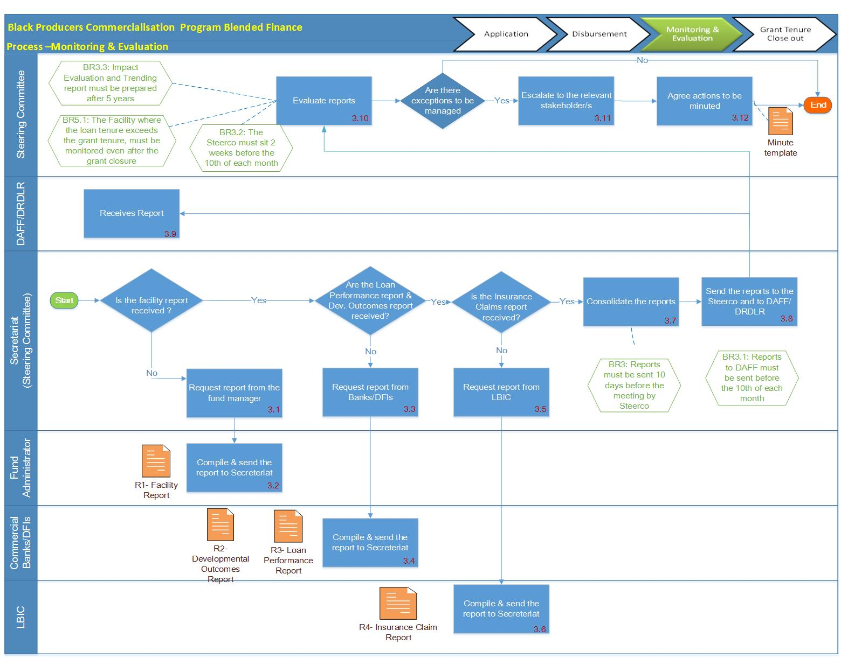
Monitoring and reporting
BPCP Steering Committee
DRDLR
Oversee the implementation of the blended funding instrument
Make recommendations to DGs on improvements
Assess reports from financing institution and Grant Fund Facility
Conduct site verification visits
Conduct site monitoring visits
Compile reports for National Treasury and Parliament
Ensure representation at FF and steering committee
Ensure adequate resources to support beneficiaries
DAFF and PDAs
Land Bank
Conduct site monitoring visits
Compile reports for National Treasury and Parliament
Assess operations of the Funding Forum
Ensure adequate technical and financial resources to support beneficiaries
Conduct site monitoring visits
Compile reports for National Treasury and Parliament
Ensure representation at steering committee
Ensure adequate resources to support beneficiaries
16

Slide 17
Status Report on Blended Funding (phase 2)
Task Name | Status
The agreement between DAFF and Land Bank was signed in March 2018 | Completed
The blended fund’s governance framework, operating manual, process maps and artefacts | Completed
The tripartite agreement between DRDLR, DAFF and Land Bank was signed end September 2018 | Completed
The Funding Forum appointments have been made by DGs of DAFF, DTI, DRDLR, DEA and NT | Completed
Funding Forum approved three applications | Ongoing
Joint marketing and communication plan to be approved by the DGs and Ministers | Awaiting approval of Ministers
Processes to support producers with specialised technical support in partnership with commodity organizations and SOEs | Ongoing
In-depth internal training in DAFF, PDAs, DRDLR, Land Bank

Slide 18
Market Access for smallholder Producers
One of the key factors to the success of smallholder producers is access to lucrative markets.
However these producers find it difficult to participate in markets because of numerous constraints and barriers, including but not limited to lack of systems to access market information, market intelligence and marketing support.
Furthermore, poor infrastructure, (road, communication and storage infrastructure), long distance to output and input markets, high transport costs and lack of technical support (e.g. training on aspects of production and marketing) hinders access to markets.
DAFF developed the Integrated Marketing Strategy to guide and streamline the implementation of marketing support programmes that are aimed at creating a conducive environment for producers and other value chain players to gain access to markets

Slide 19

Initiatives to unlock Market Access for smallholder Producers (2)
Program | Focus | Partners | Enabler
Integrated Marketing Strategy | Provide marketing information, marketing skills development, market linkages, and product safety and quality standards | DAFF PDAs NAMC PPECB | Equitable share; 20% CASP (market and business Development pillar)
Administration and issuing of negotiated market access import and export quotas and permits | Increase access to international markets | DAFF PDAs | DTI DAFF

Slide 20
Market Access for smallholder Producers (2)
Program | Focus | Partners | Enabler
Trade agreements | To enhance trade between the countries and ensure increased market access to importers and exporters. | Southern African Development Community – European Union (SADC – EU), Economic Partnership Agreement (EPA), World Trade Organisation (WTO) Marrakech Agreement and the Africa Growth and Opportunity Act (AGOA) | DAFF PDAs DTI Presidency

Slide 21
Access to EU markets by black and BBBEE compliant companies
Province | No. of Businesses | Size of Market (Quota Allocated): litres / tons
Wine (Bottled and Bulk)
Western Cape | 338 | 85 783 329
Gauteng | 1 | 60 000
Sub-Total (Wine) | 339 | 85 843 329
Fruit Juice
Western Cape | 2 | 2 800
Eastern Cape | 2 | 3 975
Limpopo | 1 | 600
Sub-Total (Fruit Juice) | 5 | 7 375
Canned and dried fruits
Western Cape | 5 | 86 703

Slide 22
Access to imports by black and BBBEE compliant companies (WTO Agreements)
Province | No. of Businesses | Size of Market (Quota Allocated): tons
Wheat
KwaZulu-Natal | 1 | 5 165
Eastern Cape | 3 | 19 839
Gauteng | 5 | 63 624
Sub-Total (Wheat) | 9 | 88 628
Maize
Western Cape | 2 | 148 528
Gauteng | 3 | 75 866
Mpumalanga | 1 | 12 805
Sub-Total (Maize) | 6 | 237 199
Tobacco
Gauteng | 1 | 6 051

Slide 23
Access to chicken imports by black and BBBEE compliant companies (AGOA)
Province | No. of HDI Businesses
KwaZulu-Natal | 4
Eastern Cape | 7
Gauteng | 24
North West | 1
Western Cape | 5
Total | 41

Slide 24
Access to local markets by smallholder producers facilitated by DAFF and PDAs in 2017/18
Province | DAFF Directorate Marketing | PDAs through CASP
Eastern Cape | 114 | 1 303
Free State | 34 | 175
Gauteng | 432 | 34
Kwazulu Natal | 45 | 4 679
Limpopo | 208 | 124
Mpumalanga | 27 | 394
Northern Cape | 28 | 962
North West | 22 | 323
Western Cape | 100 | 576
Total | 1010 | 8 572

Slide 25
Acronyms
  APAP: Agriculture Policy Action Plan
  BPCP: Black Producer Commercialization Programme
  CASP: Comprehensive Agricultural Support Programme
  DAFF: Department of Agriculture, Forestry and Fisheries
  DEA: Department of Environmental Affairs
  DRDLR: Department of Rural Development and Land Reform
  DTI: Department of Trade and Industry
  DWS: Department of Water and Sanitation
  MOU: Memorundum of Understanding
  NT: National Treasury
  PDAs: Provincial Departments of Agriculture
  TOR: Terms of Reference

Slide 26
Thank you

