Slide 1
PORTFOLIO COMMITTEE ON ENVIRONMENTAL AFFAIRS DEMAND MANAGEMENT DATE: 23 OCTOBER 2018

Slide 2
PURPOSE
Demand Management.

Slide 3
CONTEXT
Trends in rhino poaching since 2008
The Kruger National Park most affected
Rhino poaching realised as a cross border syndicated crime,
National wildlife crime reaction responses enhanced
Cooperation with neighbours (Greater Lebombo Transfrontier Conservation Area (GLTFCA) inclusive of Zimbabwe, Mozambique and South Africa) and internationally
Better understanding of dynamics of source, transit and consumer states.
Disruptions depends on understanding the demand

Slide 4
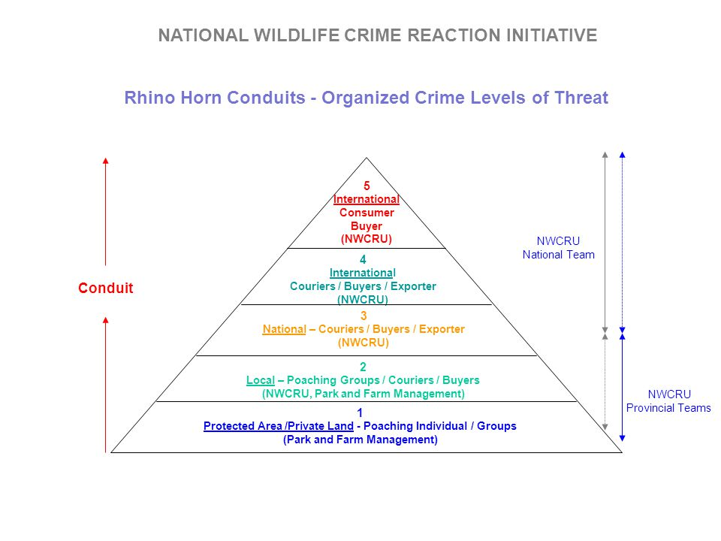
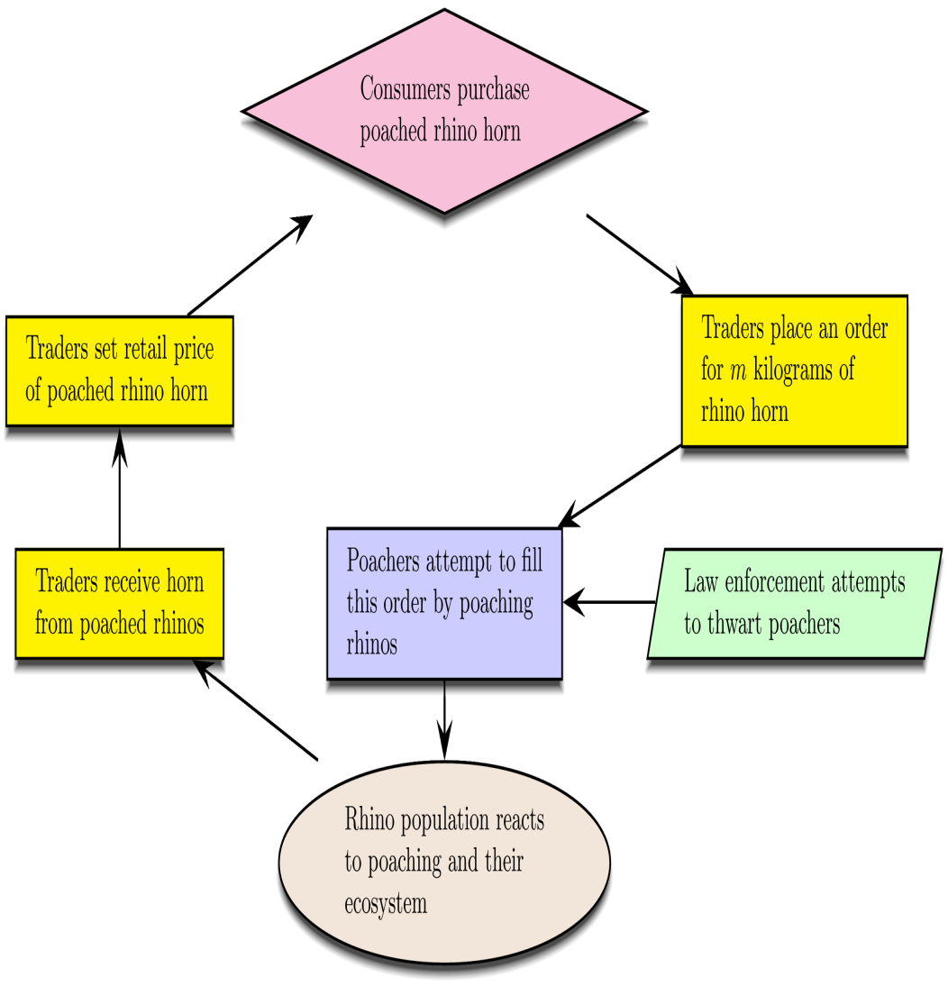
CONTEXT CONT…
The shape of the supply chain
Resource: Combating Rhino Horn Trafficking: The Need to Disrupt Criminal Networks, Timothy C. Haas Sam M. Ferreira

Slide 5
CONTEXT CONT…
Dear received expert advice on Demand Management
Rhino Issue Management (RIM):
Commissioned by the DEA, released a report in July 2013, which emanated from the national consultation process to facilitate a common understanding of the key issues related to the protection and conservation of South Africa’s rhino population. No single solution to solving the rhino problem
It provided recommendation in 4 different key areas:
Funding
Safety and Security
Conservation
Trade
The prices that “consumers” of live rhino and rhino products are prepared to pay are directly linked to their perceived value,
In the absence of any successful interventions and initiatives, the demand for rhino horn will continue to increase in years to come as a result of income and population growth in the current major consumer markets
Committee of Inquiry (COI)- advice on the possibility of proposing legal international trade in rhino horn to the 17th Conference of the Parties to the CITES, or not; and provided recommended interventions in 5 key areas:
Biological Management
Demand Management
Enforcement
Responsive Legislation
Community Empowerment
Rhino Conservation Lab

Slide 6
Demand Management
Legal and illegal trade dimensions- facilitating a legal and well-regulated trade while combating illegal trade it will be possible to supply some of the demand from legal sources and generate funds for conservation of rhino. Managing legal demand and reducing illegal demand
Information gathering - on consumer’s needs, attitudes and behaviour and on the prices currently paid for rhino horn in the illegal market.
Research
Evidence based approach to changing attitudes in consumer markets and driving down exaggerated prices of horn through a series of activities
Generating/determining Alternative Options- for addressing demand for horn and sustainable funding for conservation: irrespective of any decision on trade legalisation. The potential role of demand reduction and / or legal trade to address demand pressures
Continued interactions- with consumers and information-gathering mechanisms within known consumer and range states to better understand consumer patterns, attitudes and behaviour.
Monitoring system- to be developed and implemented to gather information relating to prices paid to poachers and the quantity of horn traded
Changing consumer behaviour- first focuses on the demand side in consumer states based on the premise that changing consumer behaviour through campaigns and the introduction of legislative restrictions and enforcement can reduce or eliminate demand for rhino horns in consumer countries
Advocacy, Education and Awareness

Slide 7
CITES Resolutions on Demand Management
Need for well-targeted, evidence-based, species-specific, country-specific demand reduction campaigns to more effectively bring about behaviour changes;
Parties urged where there is a significant market for illegally traded wildlife products to
Develop strategies to reduce the demand for illegal products of wild animals and plants through demand reduction campaigns
Enhance policy, legislation and law enforcement;
Conduct in-depth and regular research on the demand for specimens of illegally traded CITES listed species, where possible, using standard methodologies to understand the drivers and dynamics of the demand and to provide solid information for use in demand-reduction campaigns
Develop and implement well-targeted, species-specific, evidence-based campaigns by engaging key consumer groups and targeting the motivations for the demand, including the speculative nature of the demand, and develop specific messaging approaches and methods for target audiences;
Create greater awareness of the broader consequences and impacts of illegal harvest and illegal trade of wildlife and plants, particularly on wild populations and the ecosystems in which they exist, as well as raise awareness of broader impacts of wildlife trafficking on livelihoods and sustainable development; and
Strengthen legal and enforcement deterrents by creating greater awareness of laws prohibiting trade in illegal wildlife products and any associated penalties;

Slide 8
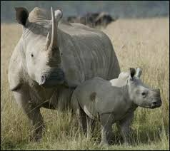
We developed work streams based on COI’s 5 pillars of rhino conservation 5 pillars of rhino conservation
1
RHINO CONSERVATION
A
B
C
D
E
Community empowerment
Responsive legislation
Security (anti-poaching and anti-trafficking)
Demand management
Management of Rhino populations
Demand Management – Managing the consumer behavior and attitude as it relates to their perception that in turn influences their need/ desire for Rhino horn; understanding the market for live rhino and rhino products

Slide 9
RHINO CONSERVATION LAB…
RESEARCH: Undertake peer reviewed research, with credible funding, on consumer markets and forms of demand and supply based on government direction and link this to demand management initiatives
INVESTIGATION: Continue and expand investigation of the strengths and risks of satisfying foreign consumer demand from within SA, alternative options for achieving this, how to increase benefits to SA, and how to disrupt illicit supply chains (e.g. trade, exporting live rhino, synthetic horn)
TARGETED MESSAGING: Develop targeted messages for a communication campaign as part of a communication strategy relating to the status and management of rhino to address incorrect perceptions that lead to speculation that drives exaggerated prices of rhino horn.
Continue to expand investigation of the potential of alternative options to satisfy foreign consumer demand from within SA, increasing benefits to SA and disrupting illicit supply chain so that we can have an understanding of the feasibility of alternative options and act accordingly

Slide 10
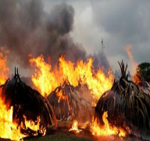
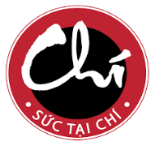
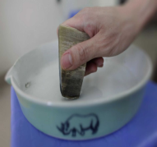
Priority research areas
Research
Undertake peer reviewed research – with neutral funding – on consumer markets and forms of demand and supply based on government direction and link this to demand management initiatives
Stockpile destruction
Consumer Markets
Campaign Success
Price of Rhino Horn
“Kenya burns vast piles of elephant tusks” – Reuters

Slide 11
Challenges
Study
Owner
Outcome
Demand for Rhino Horns in Vietnam decreases as a result of Humane Society International and Vietnam CITES Management Authority Partnership Campaign
Humane Society International
Unknown credibility
It is difficult to separate the study from the agenda of the owner
Methodology may not be accepted by all
Tendency for the research to “follow the money”
Limited access to information
Usually distributed in a targeted way focused on media as the chief consumer
No transparency to the entire data that informed the results
Government position based on a reactive process rather than a proactive one
A combination of awareness campaigns focused on demand reduction and government product bans can and do negatively influence the market for shark fins and, thus, may aid in the conservation of those shark species targeted by the trade
Wild Aid – Sharks (2014)
Rhino horn powder may contain poison that causes nausea and diarrhea (Breaking the Brand)
Lynn Johnson, a businesswoman from Melbourne, Australia
Pioneering research reveals new insights into the consumers behind rhino poaching (Sept 2013)
WWF - SA
Demand reduction for rhino horn
David Shepherd Wildlife Foundation

Slide 12
There is urgent need to undertake research on crucial questions affecting our approach to demand management
Research
The top 3 Inquiries to make will form the basis to build future research on
Rationale for Inquiry
Use of Insights
What are the profiles of different segments of buyers of rhino horn in consumer states?
To understand the underlying reasons behind purchase choices
To determine the correct sustainable approach to take in demand management
Social cultural considerations and behavior modification campaigns
Inform legislation including prohibitions and regulated market
1
What is the impact of large scale stock pile destruction on demand in consumer states?
To understand the relationship between destruction and the market forces
To determine the messaging in large scale stock pile destruction
To determine the impact on poaching in range states
Inform policy on destruction of stock piles and conservation
2
What are the successful demand management/ reduction campaign elements?
Lack of knowledge of the outcomes of campaigns
To learn best practice and lessons in messaging
To adapt in communication strategy
Make appropriate finance and auditing decisions for campaigns
3
What is the current horn price (at different points in the value chain) currently and under different scenarios
Lack of understanding of syndicate dynamics
Understanding of potential benefits of trade scenarios
Inform prosecution/ anti-trafficking operations
Provide insights for private and public trade initiatives
4

Slide 13
A targeted message is needed to change the perceptions on rhino horn in the various audiences
Requires additional information
Should be replaced
What's written
Number of rhinos
Number poached
Price of horn high
Millions of users
Rhino going extinct
What's heard
There is a product
It’s easy to get horn
There is money in it
There is a market
Price will increase!
Invest at any cost
Supply chain
Producers: On the ground poachers
Consumers:
Asian horn users
What should
be added/ written
Well managed rhino pops
Poachers caught, sentenced, assets forfeited
IPZ heavily guard, technology, dogs
Do not use illegal medicine
Rhino will not go extinct
What we want to be heard
It’s not easy to get horn
Not worth the risk
Stay out of IPZ
Sustainable legal medicine
Not a good investment

Slide 14
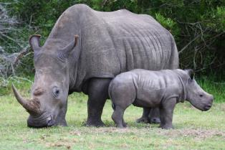
Articulating a positive future for Rhino Conservation
NOT EXTINCT
Text
South Africa saves Rhino!
South Africa Proud
RAISE THE HORN!!!
KILL RHINO?
SHAME!! SHAME!!
AWU NYUMI!
AWU NA MAHLONI!
AO SWABI!
00:00
no time for poachers
NKOSI LENAKA
FAIR HORN
Rhino capital of the World

Slide 15
Matrix used to prioritise the stakeholders to target in our messaging
Good relations
(with them)
High
TO INFORM
TO MAINTAIN
South African general population
Partners
Impact (by them or on them)
Low
High
TO RAISE AWARENESS
TO CHANGE
Consumer markets in Asia
Poachers
Community groups
Low

Slide 16
Key challenges in Demand Management
Challenges
i
Research process
Funding
Methodology
Information legitimacy
Sharing of information
Lack of diplomatic solutions
Every state is sovereign which makes it difficult to enforce in and prescribe to other countries
Implications of historical and current relationships with consumer states
Single solution approach
Prohibitions and demand reduction
No data on demand profile
Existing perceptions around high prices of rhino horn
ii
iii
iv
v

Slide 17
INTERVENTIONS

Slide 18
MAIN DESTINATION COUNTRIES (CITES TRADE)
Notes:
Member countries are called Parties
These are countries which support and enforce CITES

Slide 19
MAIN DESTINATION COUNTRIES (CITES TRADE)
Notes:
Member countries are called Parties
These are countries which support and enforce CITES

Slide 21
Partnerships
National:
Department of Environmental Affairs
South African Police Service (various units) including the Hawks
South African Revenue Service – Customs
Department of Justice including NPA
Others – FIC, SSA, DIRCO
Provincial Conservation Authorities
South African National Parks
Non-governmental Organizations eg PPF, WWF, TRAFFIC, EWT
Regional:
The African Strategy on Combating Illegal Exploitation and Illegal Trade in Wild Fauna and Flora in Africa
Law Enforcement and Anti-Poaching Strategy (LEAP) – implementation driven through the security structure of SADC
Southern African Development Community structures and through bi-lateral joint committees and MoU’s

Slide 22
Partnerships - MOUs
Memoranda of Understanding (Biodiversity, Conservation and/ or Wildlife)
Mozambique – Rhino range state, SADC member state, frontline neighbour
Botswana – Rhino range state, SADC member state, frontline neighbour
Tanzania - Rhino range state, SADC member state, frontline neighbour
Namibia - Rhino range state, SADC member state, frontline neighbour
Zimbabwe - Rhino range state, SADC member state, frontline neighbour
Kenya - Rhino range state,
Chad – Support Wildlife Conservation
Consumer and/or transit
Vietnam
Cambodia
China
Laos

Slide 23
Partnerships
International:
ICCWC partners (World Bank, CITES Secretariat, INTERPOL, UN Office on Drugs and Crime and World Customs Organization)
Donor Countries such as the US, UK, EU
Funded programmes in SA targeting wildlife crime:
GEF-UNEP Rhino Programme to enhance enforcement capabilities (DEA, UNEP, SAPS, Provincial authorities, VGL (Veterinary Genetics Lab), CSIR, WWF, EWT, PPF, ICCWC)
Rhino Protection Programme (PPF, DEA, SANParks and KZN Wildlife)
Working Together for Wildlife (WWF, DEA)

Slide 24
INITIATIVES CONT…
GREEN ARROWS - TRANSIT CITY TO BANGKOK
PURPLE ARROW – TRANSIT CITY TO VIETNAM
BLUE ARROWS – TRANSIT TO HONG KONG
ORANGE ARROW – TRANSIT TO LAOS
RED WRITING – FLIGHTS FROM TRANSIT CITY TO FINAL DESTINATION
BLACK WRITING – FLIGHTS FROM ORTIA TO TRANSIT CITY
Source: SARS Customs and NWIMU Analysis

Slide 25
INITIATIVES CONT…
GREEN ARROWS - TRANSIT CITY TO BANGKOK
PURPLE ARROW – TRANSIT CITY TO VIETNAM
BLUE ARROWS – TRANSIT TO HONG KONG
ORANGE ARROW – TRANSIT TO LAOS
RED WRITING – FLIGHTS FROM TRANSIT CITY TO FINAL DESTINATION
BLACK WRITING – FLIGHTS FROM ORTIA TO TRANSIT CITY
Source: SARS Customs and NWIMU Analysis

Slide 26
INITIATIVES CONT…
GREEN ARROWS - TRANSIT CITY TO BANGKOK
PURPLE ARROW – TRANSIT CITY TO VIETNAM
BLUE ARROWS – TRANSIT TO HONG KONG
ORANGE ARROW – TRANSIT TO LAOS
RED WRITING – FLIGHTS FROM TRANSIT CITY TO FINAL DESTINATION
BLACK WRITING – FLIGHTS FROM ORTIA TO TRANSIT CITY
Source: SARS Customs and NWIMU Analysis

Slide 27
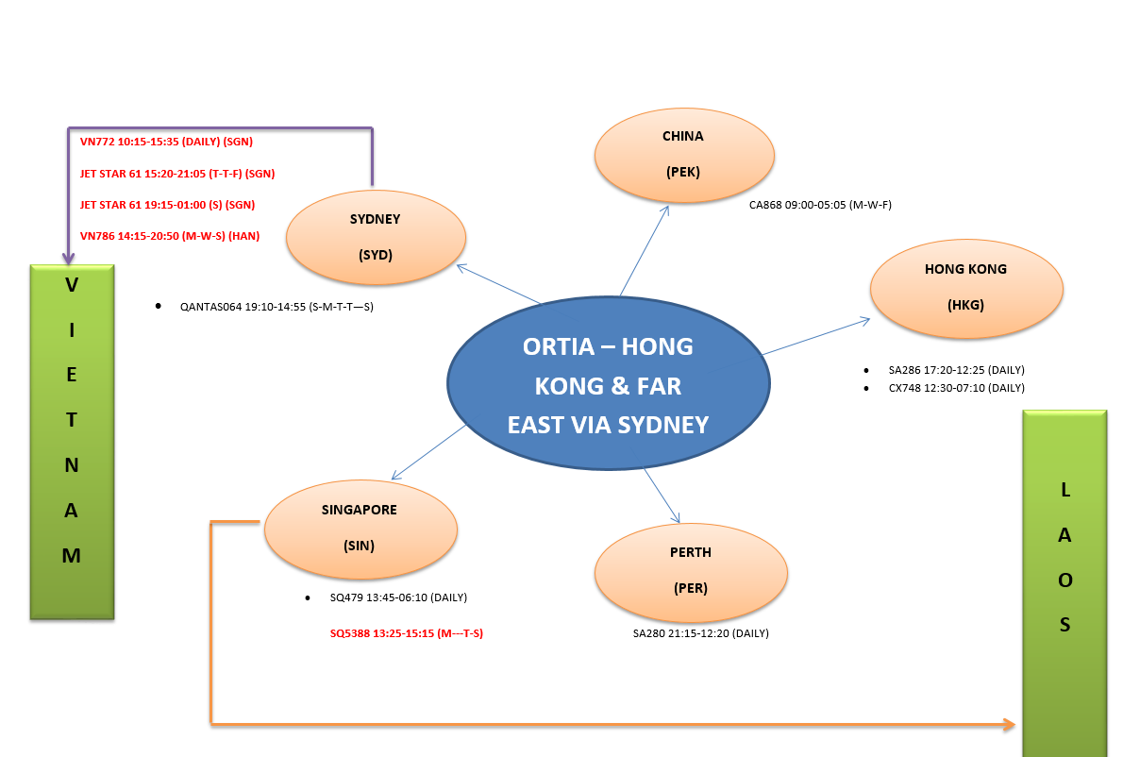
INITIATIVES CONT…
Source: SARS Customs and NWIMU Analysis

Slide 28
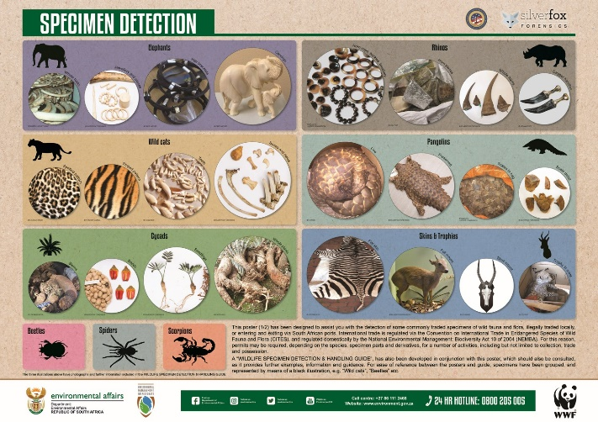
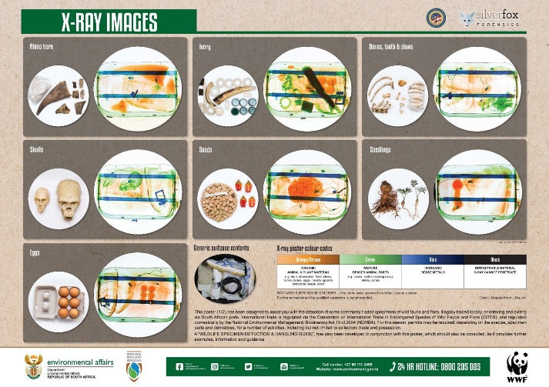
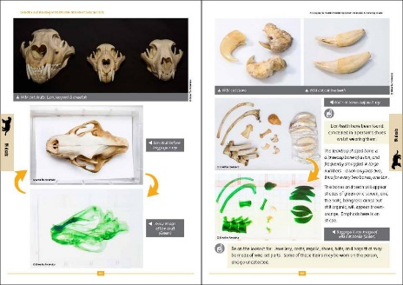
Photographic Information Booklet
Law Enforcement Awareness
Development of multimedia awareness raising material for law enforcement agencies around detection and handling of illicitly traded species in the form of:
128 page photographic rich information booklet on specimens and smuggling techniques
Awareness videos linked to booklet content
4 x commodity related posters
Awareness posters

Slide 29
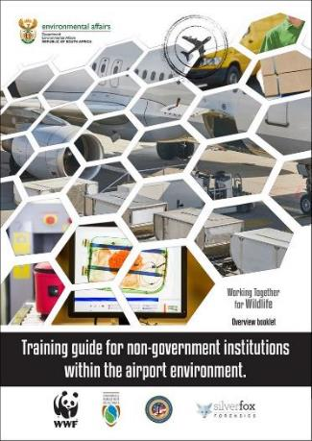
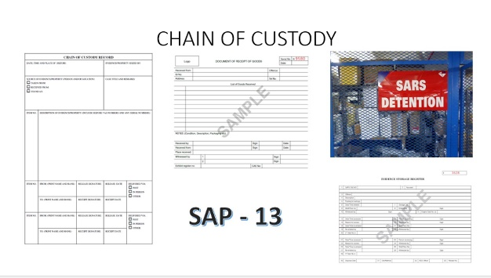
Port Operator Awareness
Awareness Booklet
Awareness Videos
Development of multi-media awareness raising material for non-governmental airport operators, such as airport security and airlines in so far:
Awareness around illicit international trade of regulated species
Detection of suspicious commodities and people
Proper communication of detected suspicious commodities and of people
Detection Training

Slide 30
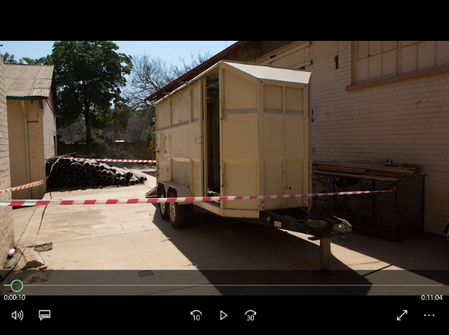
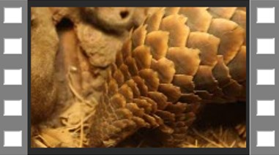
Photographic Information Booklet
Road Traffic Officer Awareness
Training Video
Development of awareness raising and training curriculum material in support of road traffic officers employed within South African Government. The material developed is in the form of:
100 page photographic rich information booklet on detection of biodiversity crimes commit while on our national roads
As well as proper procedures once detection is made.
Commodity detection video

Slide 31
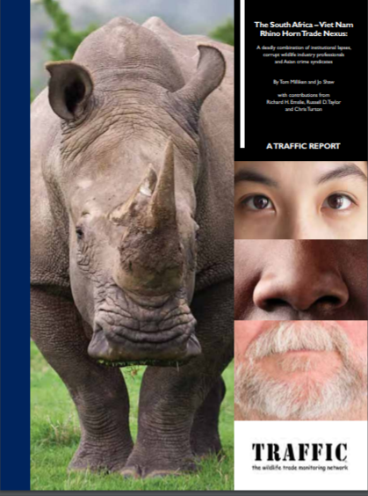
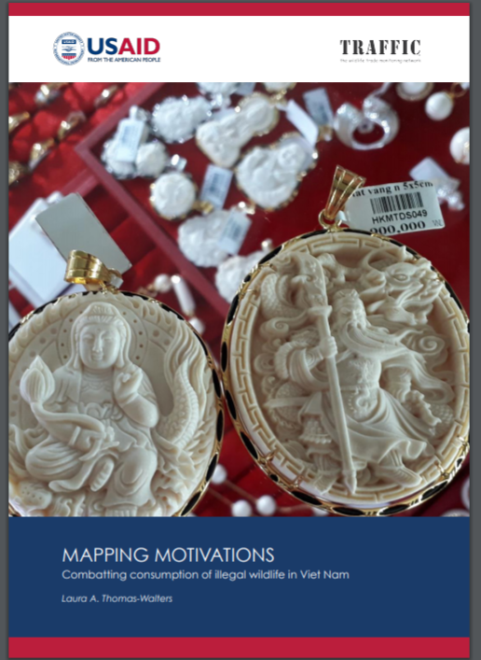
The USAID/ Traffic report summarizes the results of research regarding the motivations of consumers of endangered wildlife in Viet Nam, with a focus on rhinos, elephants, and pangolins.
The desk-based research that forms the basis of this report focused on previous consumer and other market studies with an aim of guiding the development and implementation of demand reduction and behavior change initiatives.
MAPPING MOTIVATIONS Combatting consumption of illegal wildlife in Viet Nam
The report states that it is necessary to understand the perspectives and motivations of the consumers of rhino, elephant, and pangolin products, and to engage and influence this group of people in order to change their practices and reduce demand for these wildlife products.

Slide 32
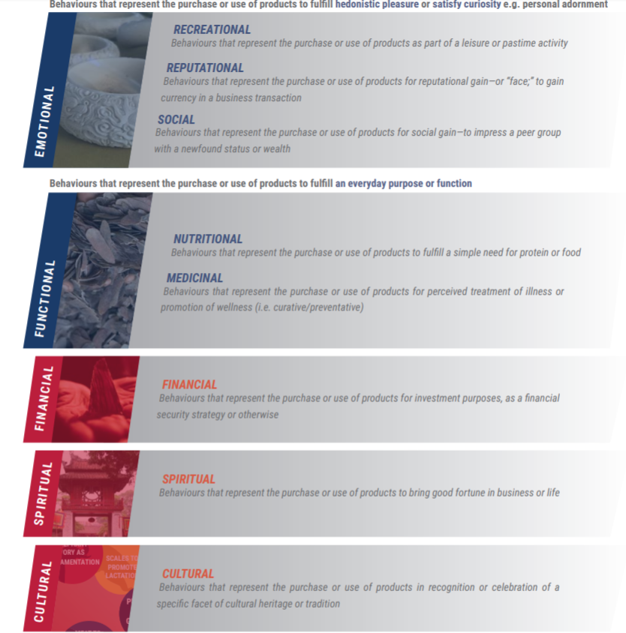
Dynamics of consumer behaviour
Notes:
Member countries are called Parties
These are countries which support and enforce CITES

Slide 33
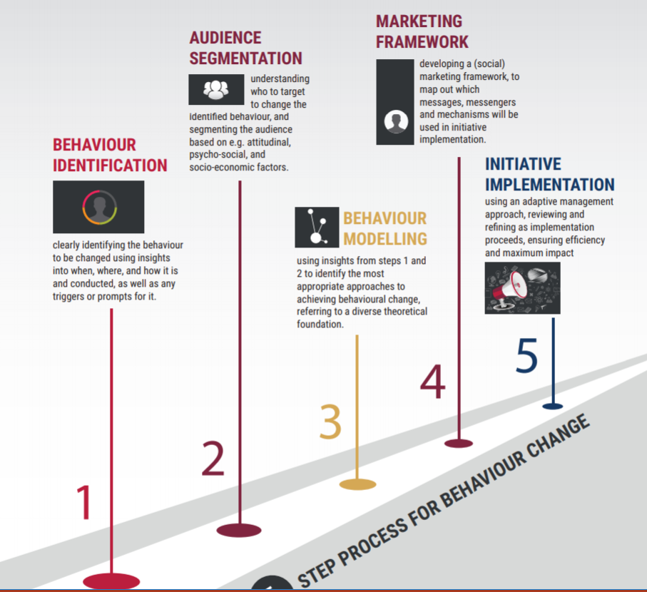
Recommendations to augment consumer behavior
Notes:
Member countries are called Parties
These are countries which support and enforce CITES

Slide 34
TRAFFIC REPORT
The report recommended actions to improve the South Africa/Viet Nam Rhino Horn Trade
Recommendations directed at South Africa:
Sustain strong high-level political will to make addressing rhino crime a non-negotiable, high-profile national priority;
Address capacity and resource constraints affecting conservation authorities at national, provincial and site levels;
Urgently design and implement a secure, national, electronic permit system for all activities related to threatened and protected species, specifically rhinos, that links to other databases on live rhino and horn stockpiles
Continue to support the implementation of mandatory registration, marking and DNA sampling of all legally-owned or held rhino horn stocks;
Develop and enact bilateral treaties to promote collaborative law enforcement action;
Ensure that appropriate penalties, which serve as an effective deterrent are given to those convicted of rhino crimes;
Investigate the option of denying those charged with outstanding rhino crime cases continued legal access to permits;
Notes:
Member countries are called Parties
These are countries which support and enforce CITES

Slide 35
TRAFFIC REPORT
Recommended actions directed at South Africa :
Improve capacity for investigations, intelligence gathering and analysis, and communication and collaboration between law enforcers at local, provincial, national and international levels
Ensure effective monitoring and regulation of sport hunting of rhinos;
Develop better regulation of professionals within the wildlife industry;
Continue to designate rhino crime cases to specific prosecutors in each province; and
Take an objective and strategic approach to assessing the long-term outcomes of any future interventions in relation to global rhino conservation objectives and trade
Tighten law enforcement activities at all ports of entry and exit from South Africa to better detect the illegal movement of rhino horn
Notes:
Member countries are called Parties
These are countries which support and enforce CITES

Slide 36
The South Africa – Viet Nam Rhino Horn Trade
Recommendations directed at Viet Nam:
Demonstrate strong political will to make rhino horn crime a national priority
Review and strengthen legislation and penalties concerning illegal rhino horn trade;
Address infractions regarding legally-imported rhino horn trophies from South Africa that have subsequently entered commercial trade;
Curtail internet advertising and trading in rhino horn;
Address the issue of “fake” rhino horns in the marketplace;
Develop and implement bilateral treaties to promote collaborative law enforcement action with South Africa and others;
Develop a strict regulatory mechanism to track legal rhino horn trophies;
Employ effective law enforcement strategies in the market place;
Commit adequate financial and human resources to fighting rhino horn crime;
Support ongoing research and monitoring;
Promote demand reduction activities; and
Undertake clinical trials and peer review research on the medicinal properties of rhino horn as a step towards promoting alternative substances
Notes:
Member countries are called Parties
These are countries which support and enforce CITES

Slide 37
CITES Standing Committee 1 - 5 October 2018 Russia Sochi
Demand-reduction strategies to combat illegal trade in CITES-listed species
Outcome
The standing committee agreed to consider draft decisions, for submission at CoP18, directing:
the Secretariat to contract a consultant to develop CITES guidance on demand-reduction strategies to combat illegal trade in CITES-listed species; and submit the draft CITES guidance on demand-reduction strategies to combat illegal trade in CITES-listed species to the SC for its consideration; and
the standing committee to review the guidance developed and make recommendations for consideration by CoP19
noted the leading role of NGO’s on demand management in consumer countries as the cost of these campaigns can be costly to range states
Notes:
Member countries are called Parties
These are countries which support and enforce CITES

Slide 38
Interventions
Focus on the air movement patterns and provide advice through the Local Authority Security Committee (LASC):
Advise operations
Establish possible transit countries and syndicate routes
Disrupt effectively
Identify key partners with which to enhance international/ diplomatic engagements
Develop recommendations on the viable routes and requirements to drive demand such as legislation for implementation
Enhance policy and legislative compliance protocols
Rhino Research Strategy framework developed prioritising the following:
The value of the horn once refined
Alternative options of refinement
Volumes of illicit trade
Tracing the duration of the action to refine

Slide 39
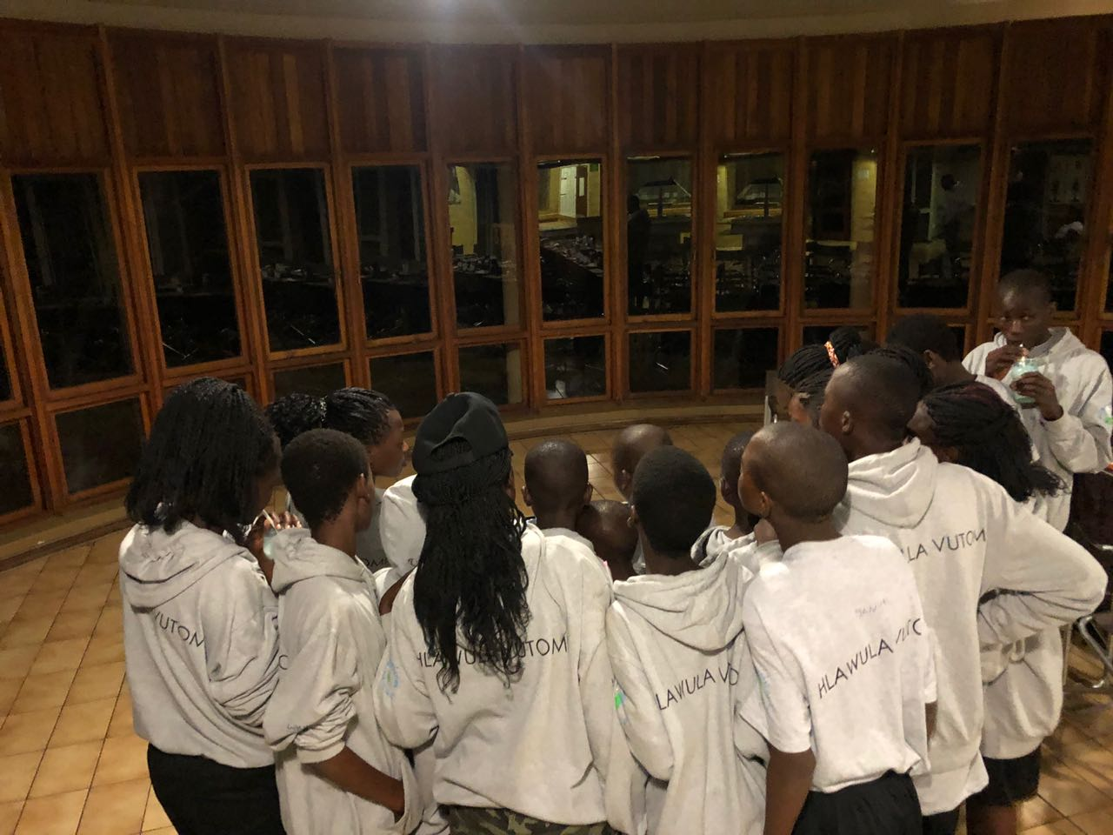
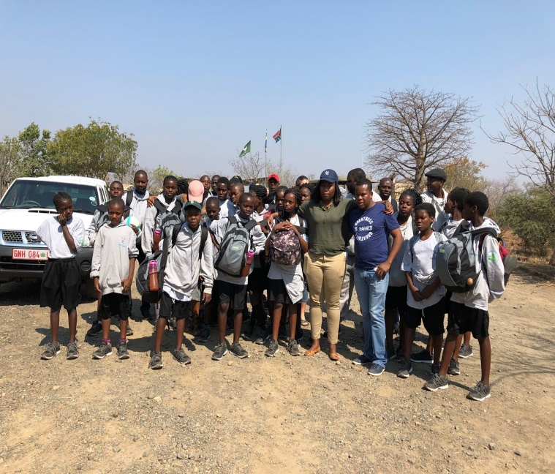
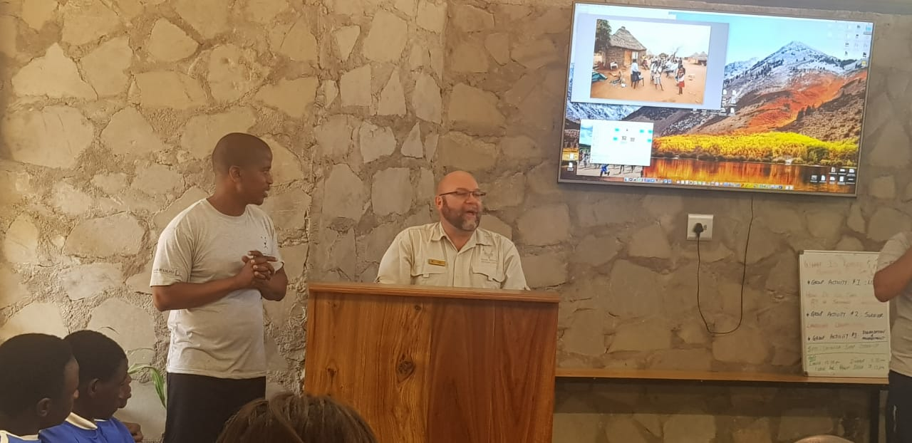
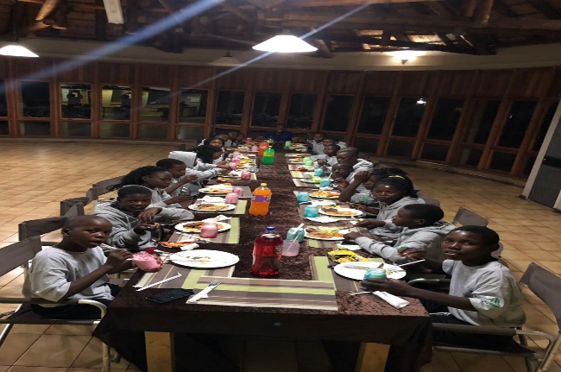
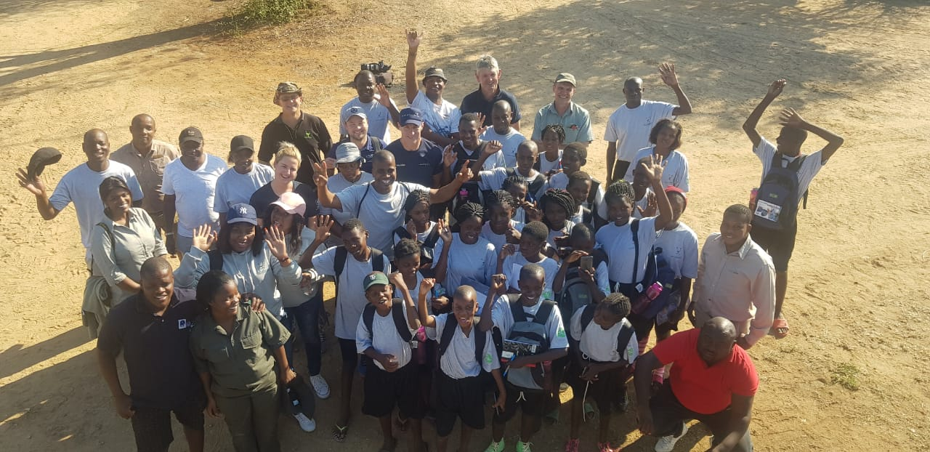
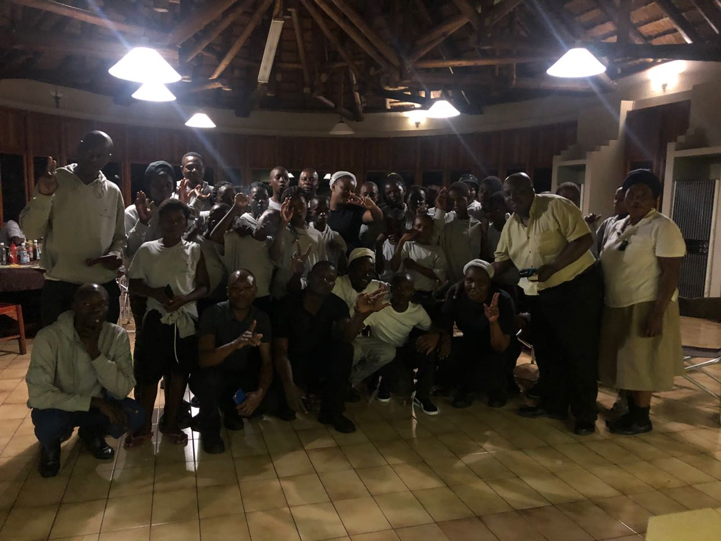
SA/ MOZ KRUGER NATIONAL PARK & LIMPOPO NATIONAL PARK YOUTH EXCHANGE PROGRAMME – AUGUST 2018

Slide 40
Conclusion
South Africa continues to undertake work on demand management
South Africa continues to address recommendations from rhino lab outcomes as interrelated interventions
Partnerships with other countries, NGOs working on the consumer side and need for more funding support- cost implications
South Africa continues to monitor international reports on demand reduction/management and these reports guides, decision making in South Africa
Notes:
Member countries are called Parties
These are countries which support and enforce CITES

