Slide 1
IRP Review Submission
Gaopalelwe Santswere
Executive Chairperson: SAYNPS
Portfolio Committee on Energy Hearings
17th October 2018
Parliament South Africa

Slide 2
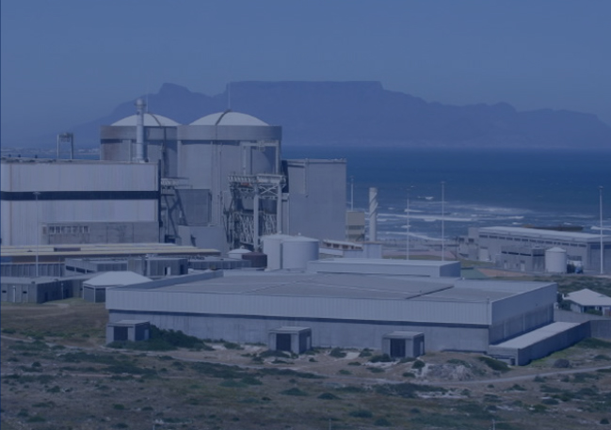
Contents
Who is SAYNPS
Executive Summary
What is Energy System Planning
Energy Modelling – What is it and what is not
German Electricity Mix 2017
Energy Plan for Myanmar 2017
Benefits of Nuclear Technology in South African Perspective
Advantages of Nuclear Power Energy in South African Perspective
Risks of No Nuclear Power IRP
Advantages of New Nuclear Build.
Conclusion

Slide 3
Who is SAYNPS
South African Young Nuclear Professionals Society (SAYNPS) was established in 2002
Membership Comprises of all Nuclear Institutions in SA. ESKOM, NNR, NECSA, DoE, Academia (NWU, SMU).
Objective: Educate and raise awareness in society esp Youth of the benefits of peaceful use of Nuclear Technology
Encourage Career choices in Nuclear Sector for University & FET Institutions students.
Advocacy & Advisory Role to Policy Makers and Implementers in determining the future of the youth of South Africa in the Nuclear Sector
Notes:
Composition of SAYNPS and all its chapters. The objective and role of the organisation amongst the working youth. Target membership
Composition of SARPA and membership. Objective and role in society.
Both non profit organisations and funded by mother companies

Slide 4
Executive summary
To Support the NDP 2030 and attract Global Investors for a Developing Country the following must happen:
  Infrastructure Development
  Investor destination for Low Production and Manufacturing Costs (Car manufacturers, Mining, Industry, etc.)
  Sustainable Job Creation (Reduce High Youth Unemployment)
  Technology that supports Greenhouse Gases (GHG) Emission Reduction
  Security of Electricity Supply through optimal cost benefit Generation Mix option
  Social Cohesion (Reduce Poverty, Eliminate Inequality and Unemployment) Socio-Economic Development.
  Skilled Workforce
  4th Industrial Revolution with No Electrical Power Disruptions.
Notes:
SA needs to be investor-friendly and Investors needs assurance for security of elec supply ,
SA is experiencing high Youth unemployment

Slide 5
WHAT IS ENERGY SYSTEM PLANNING
Preparing for an uncertain future in a comprehensive, organized and transparent manner.
Trade-offs in the optimal allocation of scarce resources between energy and non-energy sectors of the economy.
Longevity and capital-intensity of energy infrastructures.
A prerequisite for informed decision making;
  Understanding future demands developments
  Evaluating options & reviewing different ways to meet those needs
  Identifying risks and benefits
  Exploring “what id..” questions
  Investment requirements including returns (e.g. socioeconomic benefits)
  Optimal energy mix and resource allocation
  Compliance with policy constraints
  Testing the effectiveness/feasibility of policy measures
Minimizing sequential stop-gap measures.
Notes:
SA needs to be investor-friendly and Investors needs assurance for security of elec supply ,
SA is experiencing high Youth unemployment

Slide 6
Energy modelling – what is it and what is not?
Energy models create simplified images of real life energy systems by translating the essential components, structure and flow into tractable mathematical formulations (equations).
The equations represent rule-based interactions between the key energy system components.
Once calibrated to reflect the current energy system and base year energy flows, future technology and fuel or resource options (portfolio) as well as demand projections need to be added.
Forward looking is accomplished by the use of scenarios.
Different agents require different answers and thus different models or model trail (no one size fits all).
Energy modelling is an art not a science.
The information models provided is often complex and needs to be ‘interpreted/conditioned’ for use by decision makers.
Note: Energy modelling generates insights – NOT answers!!!!!!!
https://www.energy-charts.de/power.htm?source=all-sources&year=2018&week=39
Notes:
SA needs to be investor-friendly and Investors needs assurance for security of elec supply ,
SA is experiencing high Youth unemployment

Slide 7
German electricity mix 2017
Notes:
SA needs to be investor-friendly and Investors needs assurance for security of elec supply ,
SA is experiencing high Youth unemployment

Slide 8
Energy plan for Myanmar 2017
Notes:
SA needs to be investor-friendly and Investors needs assurance for security of elec supply ,
SA is experiencing high Youth unemployment

Slide 9
Benefits of nuclear technology IN sa perspective
Uses of Nuclear Technology
Careers in Nuclear Sector
Nuclear Power Generation
Nuclear Medicine
Radioisotopes Production
Research and Development, R&D
Food and Agriculture
Water Desalination – R&D Phase
Nuclear Engineers
Nuclear Scientists
Artisans
Nuclear Operators
Radiation Protection Personnel
Nuclear Inspectors
Environmentalists
Notes:
Promotes Skills development, sustainable job creation for the youth, enterprise supplier Development, Localisation
Operating the only nuclear power station in African continent (Retain the developed skills)

Slide 10
Advantages of Nuclear power energy today In sa perspective
Highly Regulated by National Nuclear Regulator - NNR (Locally) and IAEA- International Atomic Energy Agency (Internationally) helps mitigate nuclear accidents.
Nuclear Power is Safe and Reliable as Base Load Electrical Power in SA.
No Carbon (GHG) footprint thus mitigating Global Warming and Ozone Layer Degradation.
Generation III+ Plants Operates for up to 60 years.
Low Cost of generation during operation of a plant. (Koeberg has lowest operating costs among Eskom fleet).
As part of Electricity Generation mix, it ensures Diversity and Security of Supply.
Nuclear Fleet has Higher Availability and Capacity Factors among ESKOM fleet. ~90%
- Wind and Solar has 10 – 25%
Notes:
Role of the regulator is to ensure peaceful and safe use of nuclear technology and not diverted to other uses.
SA is party to non proliferation agreements.
Saving on Carbon tax.
Koeberg a cash cow
Capacity factor is the ratio of ave output of a facility to its max output and Availability factor is the ratio of the ave output of a facility to its max output
Nuclear fuel is changed every 18 months and only 1/3 is changed and rest re-configured.

Slide 11
risks of no Nuclear power energy irp 2018
Loss of Nuclear Skills in the country.
Job Losses in the Nuclear Sector.
Policy Uncertainty
SA loses its No.1 Position as Nuclear Technology leader in the Continent.
Slow Economic Growth (Knock on effects) – Investors need certainty in solid Electricity Supply.
Generation Mix cannot be guaranteed thus risk security of supply
Eskom fleet of Fossil Power Plants approaching end of life thus a challenge on Base Load.
Notes:
Koeberg has lost many experienced personnel due to uncertainty on new nuclear build.
Policy is dynamic in nature but investors need assurance of security of supply to invest in the economy (production and manufacturing).
Fossil plants approaching eol, prone to break-ups and low availability

Slide 12
Advantages of New Nuclear build
Skills Retention
Reduce Youth Unemployment.
Safe and Reliable Base Load Power.
Skills Development in the Nuclear sector.
Proven technology and skilled personnel in SA with 2 plants operating for ~30 years.
Localisation and Stimulating Local Economic Development.
Promote High Technology Industry eg, Japan, South Korea, China, France
Contribute to Science and Technology Innovation
Introduce the complete Nuclear Fuel Cycle thus increasing personnel skills (Mining, Conversion, Enrichment and Fuel Fabrication)
Notes:
Experienced personnel will not see the need to move to other countries like UAE for nuclear jobs.
SA is experiencing high youth unemployment. Youth accounts to more than half of current population.
Nuclear is special. Nuclear Personnel needs specialised training to safeguard property and environment

Slide 13
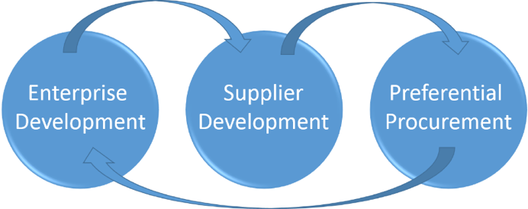
Advantages of New Nuclear build…..Continued
Supplier Development Pipeline
Notes:
The Nuclear New Build Programme will give more meaning to procurement processes and ensure that black-owned companies benefit.

Slide 14
Advantages of New Nuclear build…..Continued
Sea Water
- Nuclear Energy Generation in SA uses Sea Water for Cooling. No strain on scarce resources
Land
  1 Km² for Nuclear Plant ~ 1 000 W of electricity
  1 Km² Photovoltaics ~ 22 W of electricity
  1 Km² of Wind farm ~ 2 W of electricity
Notes:
The Nuclear New Build Programme will give more meaning to procurement processes and ensure that black-owned companies benefit.
Nuclear power plants occupy less land compared to other renewable energy sources.

Slide 15
Conclusion
  Half of Eskom coal fleet will not be in operation beyond 2030. (EOL) – Average useful life of 40 years. Half of Base Load current elec will be decommissioned.
  Natural Gas is imported and future prices cannot be guaranteed. The Cost of Gas maybe passed to the Consumer (Not Desirable).
  Base Load is necessary to stabilise the Electricity Grid. Only Coal and Nuclear can provide the Assurance.
  Useful life of Nuclear Plant is 60 years. Nuclear has High Capital Costs during Construction but Low Operating Costs and delaying the decision until beyond 2030 does not guarantee Costs will be Low.
Notes:
Coal plants produces Carbon. Carbon is payable. Nuclear makes for a best case with no GHG. Nuclear required for Base Load Power
Delaying the decision until beyond 2030 will be catastrophic as costs will be very higher. Current exchange rate is high.

Slide 16
Conclusion
Creation of Sustainable Jobs in the Nuclear Sector
Coal plants produces Carbon. Carbon Tax is payable.
Nuclear makes for a best case with no GHG. Nuclear is required for Base Load Power.
Decision to Build New Nuclear Power Plants cannot be delayed. Nuclear is necessary by 2030. IRP must include Nuclear Energy for commissioning in early 2030’s.
1000 – 1600 MW per plant in phases. (Total of 6 600 MW of Nuclear Energy)
The only way to know the true cost of nuclear energy is for Department of Energy to issue Request for Information from technology supplier and subject it to a competitive bidding process like REIPPP!
Notes:
Nuclear power plants must be built at the rate and pace that the country can afford. 1000- 1200 MW per plant.

Slide 17
PO BOX 582 I Pretoria I 0001 I Contact: Gaopalelwe Santswere
Tel: +27 12 305 3227 I Mobile +27 71 302 4674

