Slide 1
Hearings on the draft Integrated Resource Plan 2018 (IRP)
For Nuclear Industry Association of South Africa
Dr Anthonie Cilliers Pr.Eng,
Regional Coordinator AFRA-NEST
National Coordinator: SAN-NEST
Honorary Research Fellow – University of the Witwatersrand

Slide 2
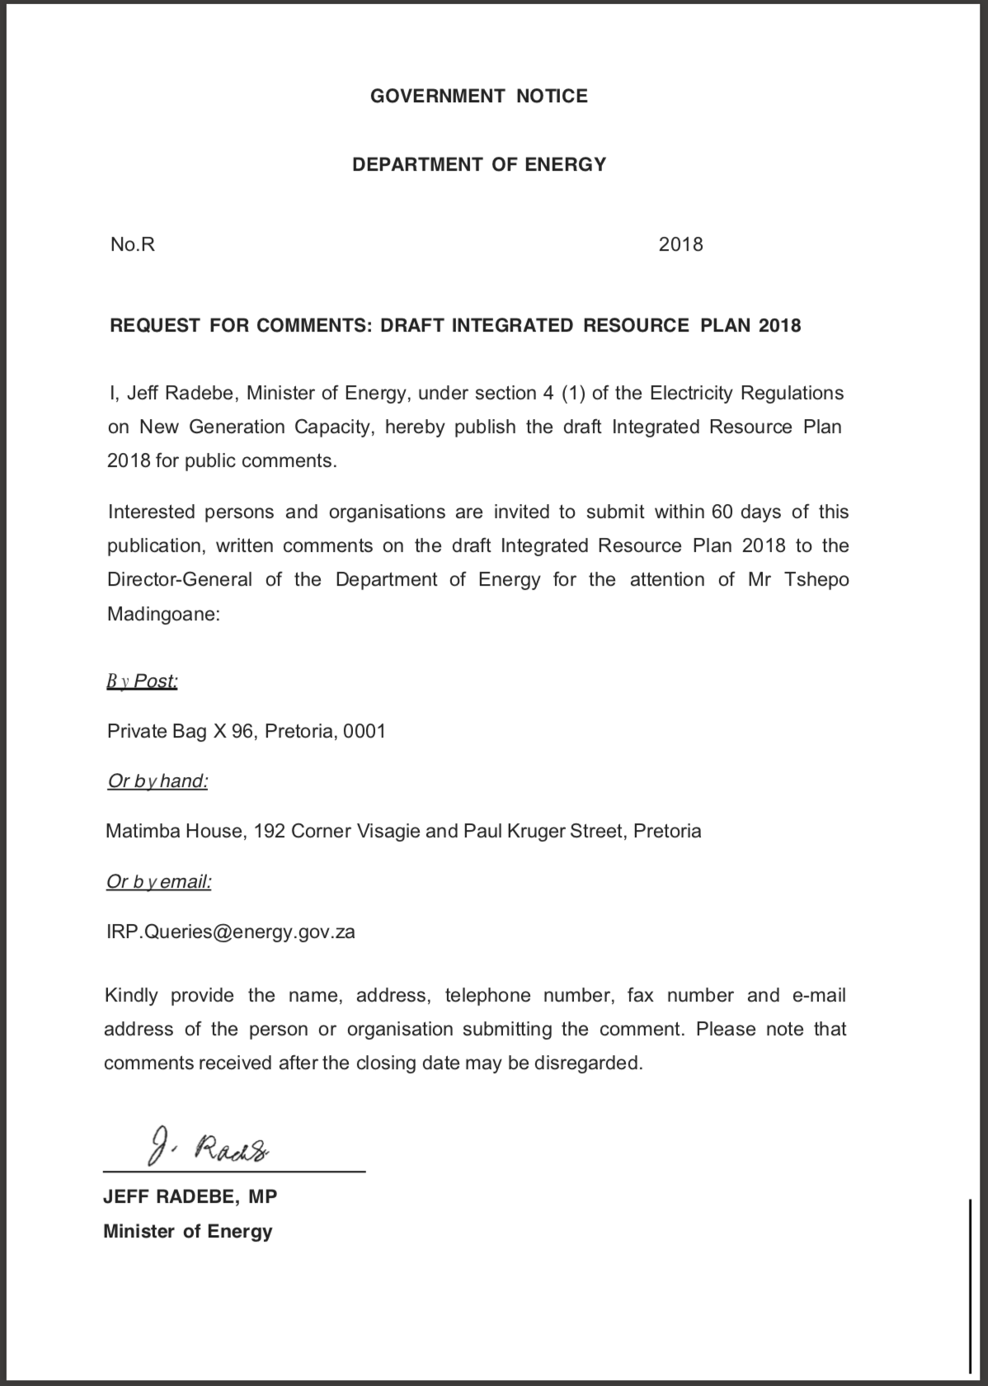
How do we address the concerns in the Draft IRP2018?
Find the base or foundation of the IRP2018
What is it trying to achieve?
Find areas we agree on.
Test the assumptions and calculations.
Is all available information included?
Will it achieve what it is setting out to achieve?
Can we assist to make it better?
What are the alternatives?

Slide 3
Find the base or foundation of the IRP2018
INTRODUCTION (page 14-15)
Paragraph 3: “In formulating its vision for the energy sector, the NDP took as point of departure the Integrated Resource Plan (IRP) 2010–2030, which was promulgated in March 2011. The IRP is an electricity infrastructure development plan based on least-cost supply and demand balance taking into account security of supply and the environment (minimize negative emissions and water usage).”
Do we agree, does it make sense?
The energy sector vision is based on supporting the National Development Plan developed to achieve a level of 7% economic growth.
It is rational to expect the final IRP to assume successful implementation of the NDP in its economic growth targets.
In the same way it would be irrational to develop an IRP based on the NDP vision and assuming this will not be implemented or achieved, as seems to be the case with the lower growth trajectories assumed in the IRP2018.

Slide 4
Find areas we agree on
INPUT PARAMETER ASSUMPTIONS (page 16)
Paragraph 2: “The comments were mostly advocating for a least-cost plan, mainly based on renewable energy (RE) and gas in accordance with the scenario presented by the Council for Scientific and Industrial Research (CSIR) at the time.”
Do we agree, does it make sense?
This seems to reveal the authors conflict: Least-cost plan should be technology neutral.
Assuming a least-cost plan based on renewable energy
Although not mutually exclusive – does not imply mutually inclusive and both requirements cannot be placed on the IRP2018 as this would require a policy adjustment.
Least-cost plan can only be implemented with all costs to the economy being available – as per the recommendations in the Draft_22/8/2018 INTEGRATED RESOURCE PLAN 2018 for further studies. These costs are not available.

Slide 5
Find areas we agree on
The term “least-cost” is used on 15 pages within the draft IRP document. However, this term is not defined and as a result the methodology to achieve the least-cost plan cannot be evaluated.
Definition
Least-cost is defined by Semantic Scholar as as: “Least-cost planning methodology (LCPM), also referred to as "least-cost planning" (LCP) is a relatively new technique used by economists for making rational decisions about investments in transport and other urban infrastructure projects. It is based on cost–benefit analysis.”
It is clear that the methodology applied in the draft IRP2018 does not meet the criteria for least-cost planning, it is not based on a cost-benefit analysis as all recommendations for further detailed studies described on page 38, are required to determine the benefits and full costs of each technology.
It appears that the developers of the least-cost utilised a “cheapest” plan rather than a least-nett-cost plan to the economy as is defined by the utilities industry.

Slide 6
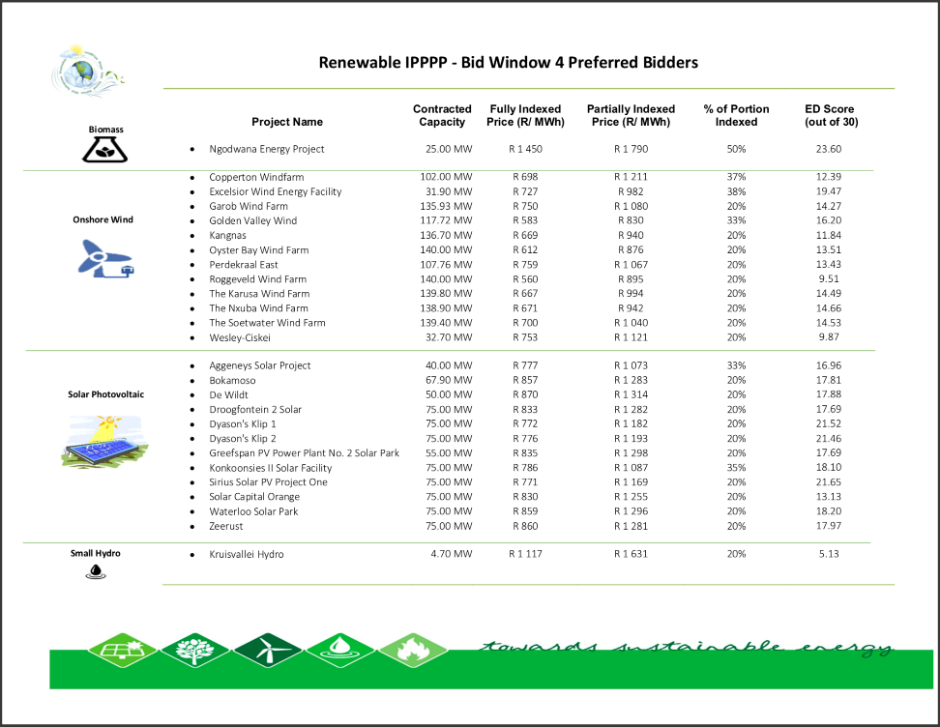
Test the assumptions and calculations – Intermittent Renewable Energy
Paragraph 6: “This IRP Update includes the costs as contained in the EPRI report, except for the following technologies: PV, wind, coal and sugar bagasse for which average actual costs achieved by the South African REIPPP were used.”
Fully indexed pricing implies that the cost will increase annually with inflation (inflation rate of 5% is assumed). A lifetime of 20 is assumed years for wind and 25 years for solar PV is assumed.

Slide 7
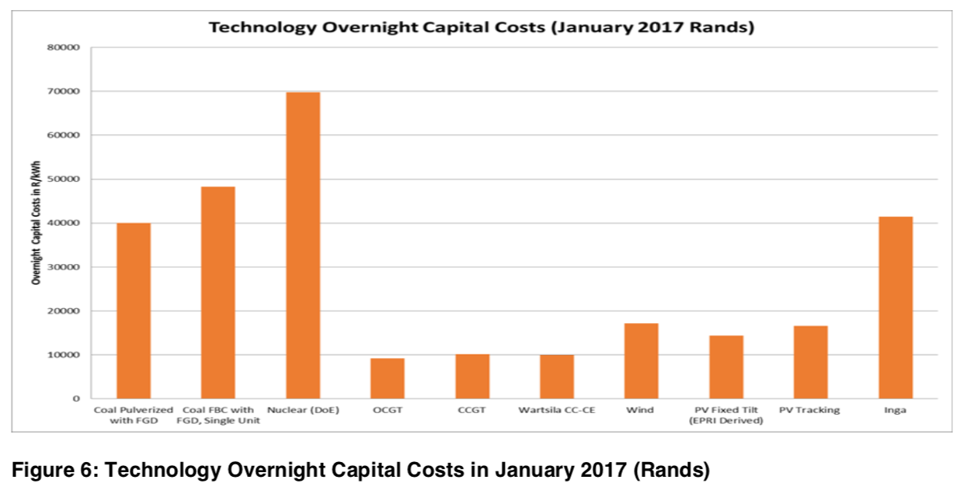
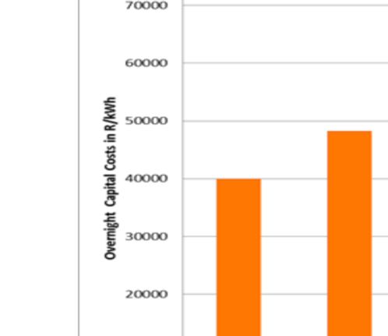
Test the assumptions and calculations - Nuclear
Page 24, paragraph 2: “Some of the technology costs, such as coal, nuclear and concentrating solar power (CSP), showed much higher costs in 2017 relative to the assumed values in the promulgated IRP 2010–2030. That was mainly due to the higher exchange rate in 2017, which impacted all technologies with the exception of some of the RE technologies as a result of learning-related reduction in costs experienced over the last few years.”
Based on these assumptions, the costs for nuclear is calculated to be:
Nuclear: R1.18 per kWh.

Slide 9
Treating cost of energy sources over time
On page 12 it is stipulated that:
“The projected unit cost of electricity by 2030 is similar for all scenarios except for market-linked gas prices, in the case of which a market-linked increase in gas prices was assumed instead of an inflation-based increase.”
This is mathematically incorrect
REIPP programme uses inflation indexed pricing,
The calculation of LCOE of other energy sources the total cost will not increase with inflation as the Capital costs is spread evenly over time.
Only the operations, maintenance and fuel cost will increase with inflation (for nuclear power this makes less than 20% of the LCOE cost).
Only the operations, Maintenance and Fuel costs (R0,21) of nuclear escalates with inflation as the Capex costs are fixed for the duration of the plant. R1,18 per kWh is perceived to be very high for nuclear energy – this is due to the specific assumptions imposed on nuclear energy. Issuing a Request for Proposals (RFP) for Nuclear Power Plants should achieve certainty in the price as well as similar cost reductions achieved by the REIPP programme.

Slide 10
How does this effect cost over time? Directly compared

Slide 11
How long will it take to recover the initial additional cost? Directly compared

Slide 12
Will it achieve what it is setting out to achieve?
“Applied policy adjustment and considerations in the final proposed plan are as follows:
Inclusion of 2500MW of hydro power in 2030 to facilitate the RSA-DRC treaty on the Inga Hydro Power Project in line with South Africa’s commitments contained in the NDP to partner with regional neighbours, The Project has the potential to energise and unlock regional industrialisation.”
With the associated risk of the 2500MW hydro RSA-DRC project and uncertainty in cost it seems irrational to include this in the pre-2030 plan. This should be replaced with a similar (low emission, dispatchable) supply.

Slide 13
Will it achieve what it is setting out to achieve?
The IRP2018 proposes the following new (not committed yet) additional capacity up to 2030:
Coal: 1000MW – R 48 000 000 000
Hydro: 2500MW – R 105 000 000 000
Solar PV: 5670 MWp – R 85 050 000 000 (1247,4MW average) 25 year life
Wind: 8100 MWp – R 137 700 000 000 (2916 MW average) 20 year life
Gas/Diesel 8100 MWp – R 81 000 000 000
Total 25 370MWp – R 453 750 000 000
The Wind-Solar-Gas combination will cost R303 750 000 000.
Equivalent Nuclear (for the Wind-Solar-Gas mix), based on the IRP2018 costs are:
Nuclear: 5076MW – R 354 122 318 000 – 60 year life
Without the requirement of burning expensive gas during times of low wind and solar. It is also very likely that costs for nuclear will be substantially lower from a competitive bidding process.

Slide 14
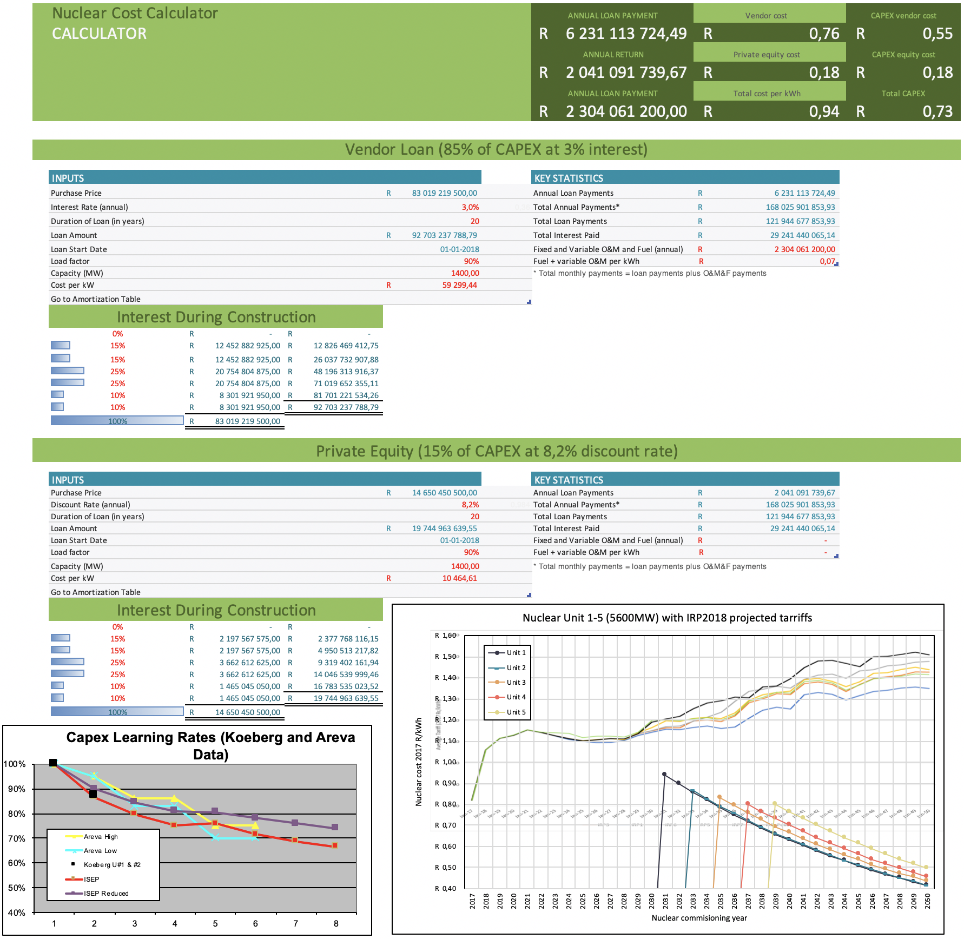

Slide 15
Economic impact of Nuclear Programmes

Slide 16
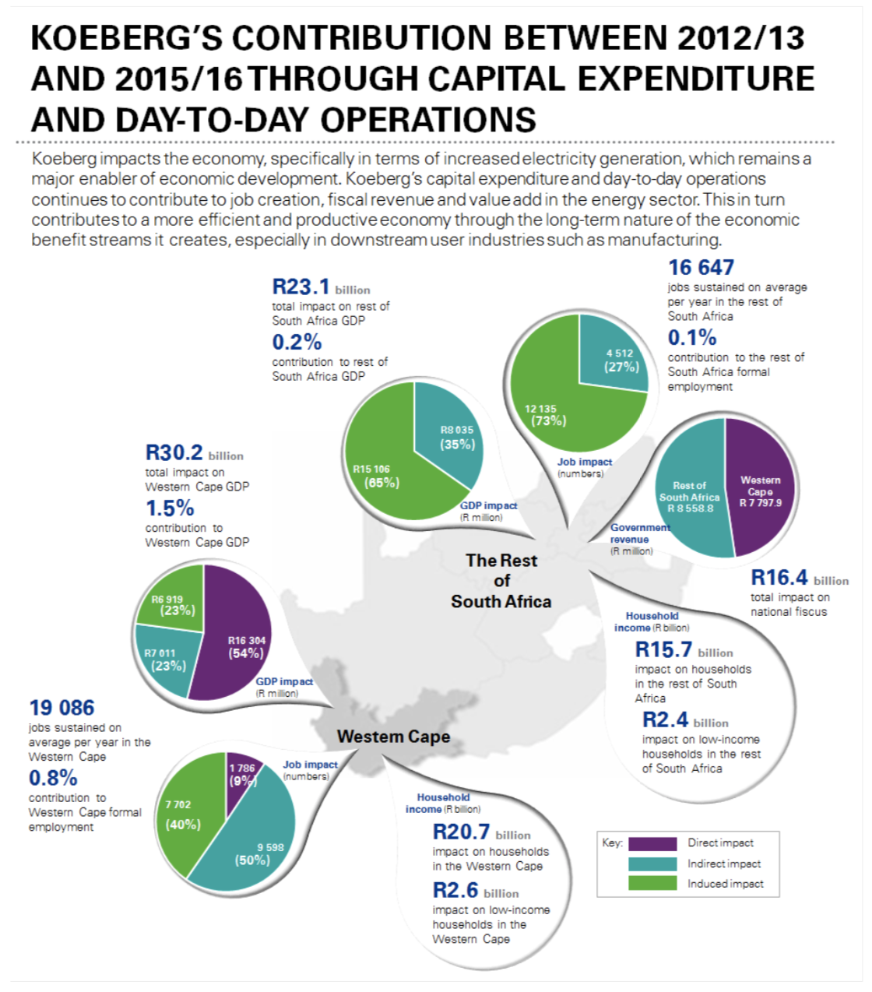

Slide 17
Findings (1/3)
The Draft_22/8/2018 INTEGRATED RESOURCE PLAN 2018 attempts to provide a number of least-cost planning scenarios based on various growth paths and policy adjustments for South Africa.
Generally, the plan fails to meet the least-cost planning objectives as it ignores all costs associated with socio-economics of various options as well as the transition costs.
It does not judge all energy sources on the same merit. It does not even attempt to do that.
Rather than being technology neutral, it appears the plan has been developed with certain policy outcomes in mind with the least-cost planning method used as a tool to achieve this.
The least-cost outcome it proposes however, has been internationally demonstrated to be uncertain, expensive and in most cases ineffective in achieving its goals – primarily that of decarbonising the electricity sector.

Slide 18
Findings (2/3)
It is notable that in depth research, in particular on the socio-economic impact of nuclear programmes has been conducted such as:
“Economic Impact of the Koeberg Nuclear Power Station”, March 2017 by Eskom.
“The economic benefits of the nuclear build for the Eastern Cape” by Coega Development Corporation.
The authors of the Draft_22/8/2018 INTEGRATED RESOURCE PLAN 2018 are seemingly unaware of these studies.
The Draft_22/8/2018 INTEGRATED RESOURCE PLAN 2018 does not compare costs between various technologies on an even playing field:
fully indexed power purchase agreement prices (for wind and solar PV)
calculated costs discounted over time for nuclear and other energy sources.
This needs to be corrected. A Request for Proposals (RFP) from nuclear vendors should be issued to determine the correct costs of nuclear.

Slide 19
Findings (4/4)
The Draft_22/8/2018 INTEGRATED RESOURCE PLAN 2018 should be redrafted to incorporate:
the information that the authors were previously unaware of,
the correct and full definition of the least-cost analysis,
Treat costing of energy sources equally.

