Slide 1
2018
Presentation on SA’s Draft IRP2018
PORTFOLIO COMMITTEE ON ENERGY(PCE)
17 October 2018
Notes:
The EIUG would like to thank the Portfolio Committee for affording us an opportunity to present our preliminary views on the draft IRP2018.
My name is Seeralan Chinaboo and I am the current Deputy Chair of the EIUG Council.

Slide 2
1. INTRODUCTION
Established in 1999, the EIUG is a voluntary, non-profit association of energy intensive consumers. Membership comprises of mining, minerals beneficiation, materials manufacturing, logistics and water industries contributing ~20% to the GDP of South Africa. The group strongly believes that energy is the engine for economic growth and development in South Africa.
While the EIUG remains technology agnostic, the country needs reliable electricity supply at the least possible cost, delivered by a build plan using technologies that offer modularity and the flexibility to match the vagaries of demand.
The EIUG thanks Minister releasing draft IRP2018 for review before final publication. We view this as the beginning of an inclusive engagement and “just transition” that the Department of Energy (DoE) commits to undertake.
EIUG commends the Department for providing the IRP update which aims to balance the objectives of ensuring security of supply, to minimise the cost of electricity, to minimise GHG emissions, and minimise water usage.
It is stated that the IRP analyses entails balancing supply and demand at least-possible cost. However; the EIUG feels that all policy adjustments connected to achieving the desired balance needs to be tested for effectiveness. It is important for DoE to prudently demonstrate cost-benefits analysis for the South African economy.
Electricity pricing and security of supply are key critical issues for the EIUG out of this IRP - we need a realistic IRP
Notes:
EIUG commends the Department for providing the IRP update which aims to balance the objectives of ensuring security of supply, to minimise the cost of electricity, to minimise GHG emissions, and minimise water usage. All these objectives are aligned to business values of our members .
It is important for DoE to prudently demonstrate cost-benefits analysis of the policy adjustment decisions made, for the South African economy.

Slide 3
CONTENTS
1. Key Planning INPUT Assumptions 1.1. Demand/GDP Growth Forecast 1.2. Plant Performance Forecast 1.3. Technology Costs
2. the Proposed Plan with policy adjustments 2.1. RE Roll-Out 2.2. Coal Roll-Out 2.3. Import Gas and Hydro Power 2.4. Embedded Generation 2.5. Eskom’s Committed Capacity and Decommissioning Plan
3. Electricity Price Path

Slide 4
1. KEY PLANNING ASSUMPTION: Demand/GDP Growth Forecast
The Method of Using Historical Data to Forecast Future Demand in a world that is changing may be fundamentally flawed
Historic data is not the answer to forecasting in a period of change. The likely future electricity consumption cannot be based purely on historic trends any longer. Extensive groundwork is required where information from every sector needs to be collected on each sector’s future requirements for electricity.
Models may still be useful for residential and commercial forecasts, but for mining and industrial forecasts more detailed information collection and analysis is required. Models may still be useful for residential and commercial forecasts, but for mining and industrial forecasts more detailed information collection and analysis is required. Specifically, in the industrial sector, driven by lumpy investment decisions or de-commissioning, regression models are less useful, and more so if similar weightings are assigned to recent and much older regression points.
It may therefore be more useful, on a more granular level, to provide for known changes in the industrial sector e.g. planned investments, closing of PGM mines, closing of smelters, long-term decline in gold mining, new own generation, etc.
Notes:
The EIUG would be willing to work with the DoE in collecting more representative data, as part of the just transition studies.

Slide 5
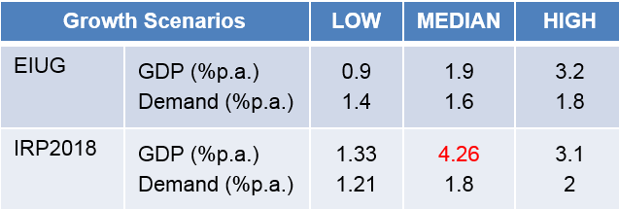
1. KEY PLANNING ASSUMPTIONS Demand/GDP Growth Forecast
The Choice of a High GDP Growth Scenario for the IRP2018 Base case is unrealistic in the short term
While indications are that the low demand growth outlook is the most likely for South Africa over short to medium term, it is concerning that in this draft IRP only the median growth scenarios (with high annual average GDP growth of 4.26%) were taken up in the comparative sensitivity analyses
It is not clear if a high GDP growth is applied in order to apply low financing costs in the model – it is typically that, the lower the GDP, the higher the financing cost as there is less certainty of full utilisation of the new capacity.
The EIUG recommends that base case (IRP1) and all scenarios should be tested against the lower GDP forecast of 1.33% and the lower demand forecast of 1.21% by 2030, in order to demonstrate robust planning that ensures that a least-regret investment decision is made for the country.
Notes:
The demand forecast for the reference case (IRP1) assumes a high economic growth scenario, at an average 4.26% GDP growth. However, South Africa’s economy is currently in a technical recession and growth prospects are marginal.

Slide 6
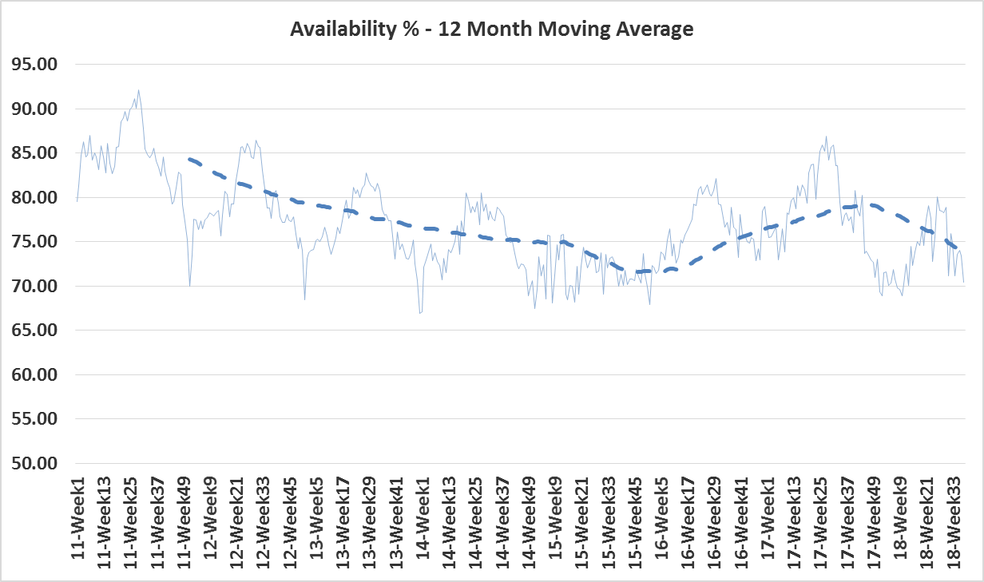
1. KEY PLANNING ASSUMPTION: Plant Performance
Eskom plant performance has been deteriorating, at 70.41% in week33
This IRP uses the medium plant performance projections compiled by Eskom that plant availability improving to ≥80% by 2021 and beyond. The EIUG is very uncertain about the short to medium term outlook of Eskom’s Plant Performance.

Slide 7
1. KEY PLANNING ASSUMPTION: Plant Performance
The Use of Medium Plant Performance Forecast in the Short Term is Unrealistic
The high planned and unplanned outages as well as outage slippages are eating away into operating reserves; Eskom is already frequently dispatching the expensive emergency reserves in order to meet the daily demands and avoid load shedding.
This coupled with the current coal shortages, poor management of coal stock levels and concomitant primary energy cost, the lack of sufficient capital investment to sustain the existing fleet, the EIUG is concerned about Eskom’s ability to cost effectively meet demand in the next 5 years – and this performance is a key input parameter into the IRP model.
The EUIG recommends that the lower plant performance projections be used for the short to medium term, in order to reflect current reality and progressively monitor/raise the performance to this IRP aspirational levels.
Notes:
The recovery from these shortages of coal alone cannot sufficiently be done in 2 to 3 years to reach a target of 80% EAF. The procurement of coal for Kusile is estimated to take more than 3 years to implement.
It will be prudent for the IRP model to allow for a lower EAF until such time when new tied collieries (such as New Largo for Kusile) are operational. Emission abatement retrofit projects will also lower the system EAF during construction in the short term.

Slide 8
1. KEY PLANNING ASSUMPTION: Technology Costs
This IRP has updated the RE cost and the outcome of which indicate clearly that a Wind, Solar PV and Gas energy mix is the least-cost option going forward.
The EIUG’s concern is that the flexibility of the current fleet to balance renewables is already becoming problematic; for example, at times Eskom has to order wind generators to spill when the coal fleet cannot be cut back deep/fast enough to make way for wind supply on the system. The problem is that we still have to pay for the wind power not delivered, according to the ‘take/pay’ PPAs. This problem will obviously grow when more RE plants achieve commercial operation. These curtailments are increasing system cost – and need to be accommodated in the just transition.
This draft IRP did not take grid stability cost into account - it defers this to a need to conduct further in-depth analysis of technical risks. Due to poor plant performance, Eskom is already experiencing high frequency control incidents
In absence of an in-depth Flexibility study, The EIUG recommends that a cost risk allowance be built in the IRP model to account for grid stability cost
Notes:
The recovery from these shortages of coal alone cannot sufficiently be done in 2 to 3 years to reach a target of 80% EAF. The procurement of coal for Kusile is estimated to take more than 3 years to implement.
It will be prudent for the IRP model to allow for a lower EAF until such time when new tied collieries (such as New Largo for Kusile) are operational. Emission abatement retrofit projects will also lower the system EAF during construction in the short term.

Slide 9
2. POLICY ADJUSTMENT: RE Roll-Out
It is shown that the unconstrained, pure least cost path would only roll-out new additional PV from 2027 and Wind from 2028 (IRP Table 7, pg 50) – DoE argues that this would create a stagnant gap that would damper the skills/capacity momentum that the IPP industry has already started. Therefore DoE made policy adjustment by applying annual build limits on RE and advanced the roll-out to 2025 in order to sustain/protect RE industry.
This decision will unfortunately have cost implications for the consumers. This IRP does not explicitly provide a cost- benefits analysis for this decision for the South African economy – it cannot be simply made for the sake of job creation and getting FDI, without sparing a thought for who will buy the power, how the transition will be managed and how the System Operator will keep the lights on.
While levelised cost of producing RE significantly declined over BW1 to BW4 expedited, the average PPA prices at which such electricity is sold to Eskom is above Eskom’s marginal cost of supply. This has a negative impact on rate payers as Eskom recovers this cost from the tariffs. The current IRP_Policy price path does not take impact of new/planned IPP PPAs pricing on Eskom’s tariffs into consideration.
The EIUG support the IPP program but “at a pace and scale which will enhance the competitiveness of the SA economy and not erode it”.
Notes:
Clarity on the way forward for the announced REIPP Small Project Programme and the promulgated Round 5 bid window projects, must be prioritised for policy certainty

Slide 10
2. POLICY ADJUSTMENT: Coal Roll-Out
The country has already made international environmental commitments; the EIUG supports that the Country must transition to a lower-carbon future. Thus it is recommended that future coal roll-outs should incorporate clean/carbon abatement technologies
The EIUG understands that there are pending legal cases on the roll-out of the 2x 500MW IPP coal in the plan, which may or may not impact on this IRP allocation; i.e. there is a risk that the plan may change.
The IRP does not explicitly provide cost-benefits analysis for the South African economy for this 2x 500MW IPP coal decision, however it is important to note that South Africa sits on vast amount of coal resources and any move away from coal should be done in a manner and within a time-frame that protects and maintains the competitiveness of our economy.
The significant move away from coal in the longer term will be disruptive to the coal value chain. Even the planned decommissioning of the old (12GW) coal power stations will negatively impact the primary energy price as well as the electricity price in the next 10 years.

Slide 11
2. THE PROPOSED PLAN: Import Gas And Hydro
What are the Exposures to Imported Gas and Hydro Power?
It is surprising that IRP provides medium to high degree of certainty to 2020-30 proposed plan, which includes import gas and hydro that still require regional negotiations, planning and programmes.
The time frame to deliver these mega projects is already constrained. Clarity on the way forward on the Gas Utilisation Master Plan (GUMP) and power procurement strategy and grid extension plans for these projects must be prioritised.
Notes:
IEP
The use market linked gas price as opposed
Risk exposure on delivery of this before/by 2030 may be too high to inflation linked based.

Slide 12
2. THE PROPOSED PLAN: Eskom’s Committed Capacity and Decommissioning
What is the Risk Exposure on the Delivery of Eskom’s Committed Capacity?
The IRP has awarded a high degree of certainty to Eskom’s completion of its build programme as well as the decommissioning plan, despite the Utility’s history of cost and time overruns.
What is the risk on the proposed plan if Medupi and Kusile are not completed on time?
Although the programme may seem currently well managed, it is possible that the emission abatement retrofit projects would impact CODs - such risk exposures should be considered/closely monitored, otherwise the least cost path may become a virtual concept.
The IRP does not consider the impact of delaying or expediting the decommissioning plan. With the already constrained time to deliver the import gas and hydro, it is a likely possibility that some plants may need to be prolonged in service.
Notes:
Commercial operation date

Slide 13
2. POLICY ADJUSTMENT: Embedded Generation
Lack of data on small-scale embedded generation market deserves attention – it is believed that this sector is spiking and 200 MW allocation in this draft IRP may be insufficient
The process for ministerial deviation approval needs to be explicitly clarified in the IRP; it is not clear whether any 1-10MW project within this allocation would still require ministerial determinations or only applicable when the allocation is exceeded, This IRP is also silent on licensing requirement. It is recommended that DoE should prioritise finalisation policy directives, rules and regulations pertaining to small scale embedded generation including wheeling and net-metering.
The EIUG recommends that there should be no limits on MW capacity on Co-Generation where waste heat is to be used. It is recommended that DoE should prioritise finalisation policy, rules and regulations pertaining to small scale embedded generation including wheeling and net-metering.
Why not increase the 1 to 10MW limit to something like 1 to 30MW – 50MW? Our studies have shown that full economies of scale are reached at ~50MW for a PV facility, ensuring the lowest possible cost of electricity in line with the objectives of the IRP.

Slide 14
3. ELECTRICITY PRICE PATH
The IRP_Policy price path is found to be misleading as it does not take a number of factors into account:
Changing power consumption patterns - Eskom already experiences extreme financial and operational challenges in managing the changing daily consumption patterns due to baseload demand reductions, compounded by poor plant availability. Eskom is struggling to consistently meet the maximum expected demand, having to dispatch expensive emergency reserves to avert load shedding.
Cost of grid stability – with increasing penetration of renewables and decommissioning of synchronous machines, would require the system operator to make some investment in managing grid inertia and frequency control
Plant decommissioning cost
The impact of IPPs PPA pricing structure at which electricity is sold to Eskom at prices above Eskom’s marginal cost of supply - this must be reviewed under the ‘just transition’ studies, as it has a negative impact on rate payers because Eskom recovers this cost from the tariffs.
Possibility of a low GDP growth
Notes:
The IRP states that Plant decommissioning cost has not been taken into account.

Slide 15
3. ELECTRICITY PRICE PATH
However, the IRP 2018 in its draft format has failed to address the current transition by delaying this to the medium term – there is no deep dive into the current ESI structural issues that are the root causes of declining demand and tariff hikes. The price path price ranges are unsustainable for mining & industry and it appears that what ESI requires to be a sustainable and profitable, is unaffordable to South Africa.
Continuing the status quo will require the customer base to fund, via unacceptably high tariffs, the inefficiencies and shortcomings of the current industry structure with potentially disastrous consequences. What is evident is the current Electricity Industry business model is not meeting the needs of South Africa.
For this IRP_Policy Price Path to enable a ‘Just Transition’, Tariff & Regulatory Reform Supporting Policies are required:
The fact that we have ended up with a financially unsustainable Eskom after tariff increases of over 353% in the last 10 years demonstrates without doubt that the current regulatory system is not effective.
Sticking diligently to the current NERSA Rate of Return methodology to give Eskom the prices they should be entitled to, without forward view on how price elasticity of demand will be dealt with is concerning.
The EIUG recommends regulation on the basis of keeping Eskom cash positive for the ‘just transition’ period as opposed to allowing Eskom to get the profits it would require to develop a strong independent balance sheet.

Slide 16
CONCLUSIONS
Despite vulnerabilities to electricity pricing, EIUG members are deeply invested in the economic well-being of this country.
We are therefore committed to working with government and other stakeholders to ensure South Africa has energy industry which provides a reliable supply of acceptable quality at competitive prices. Cost competitiveness is a key industrial enabler towards alleviation of poverty, addressing inequality and reducing unemployment in South Africa.
The EIUG supports the need for further studies to be undertaken in order to improve the IRP modelling and assumption.
The EIUG would like to thank the honourable Minister Jeff Hadebe, for approving the Short-term Incentive Electricity Pricing Policy which enables Eskom and the Regulator to consider temporary special pricing agreements for unstainable businesses.
We are looking forward to similar just transition policy work being crafted to look at the long term sustainable ESI model and tariffs, that will balance affordability for all South Africans, including industry and mining.
The EIUG trusts that the DoE will implement a systematic approach that will ensure that there is continuous improvement (and publication) of the energy plan as committed; i.e. at least every 2 years.

Slide 17
Thank You

