Slide 1
2017/18
ANNUAL REPORT PRESENTATION
PORTFOLIO COMMITTEE ON TRANSPORT (PCoT)
16th OCTOBER 2018
Presented by Sipho G. Khumalo

Slide 2
Presentation outline
The C-BRTA’s Mandate
Strategic Overview
Our Operational Environment
Performance Summary : Our Journey Thus Far
2017/18 Organisational Performance
Organisational Performance
Social Responsibility
Financial Performance 2017/18
Financial Position 2017/18
Audit Outcomes 2017/18
Concluding Remarks

Slide 3
THE C-BRTA’S MANDATE
The C-BRTA is established in terms of C-BRT Act No. 4 of 1998
The primary reason for our existence is to license commercial cross-border operators. The Act envisaged that as part of executing this mandate, we would:
Eliminate impediments that constrain the flow of passengers and freight across South African borders
Regulate competition of passenger transport operators
Liberalise market access for freight transport operators
Reduce operational constraints that have a negative impact on cross-border road transport industry
Enhance and strengthen the capacity of public sector to execute on these tasks
Build industry partnerships in order to empower the cross-border road transport industry.

Slide 4
STRATEGIC OVERVIEW
GOAL 1: Facilitate unimpeded flow of cross-border transport
GOAL 2: Strategic positioning to promote integration of the African continent
GOAL 3 : Promote safe and reliable cross-border transport
GOAL 4 : Enhance organisational performance in order to
improve sustainability
STRATEGIC OBJECTIVES
1. To introduce and implement regulated competition of cross
border movements as pertaining to cross border
movements
2. To improve compliance with road transport legislation
3. To establish and sustain strategic partnerships with
stakeholders so as to enable the Agency to achieve its
objectives
4. To proactively provide value added advisory services to the
Minister of Transport and other relevant stakeholders on
cross border matters in the transport sector
5. To proactively promote transformation and development of
the cross-border industry
6. To ensure the financial viability and sustainability of the
C-BRTA
7. To improve efficiencies in business operations
MISSION : We spearhead the unimpeded flow of Inter-State operations thereby facilitating sustainable social and economic development
VISION : The champion of free-flowing Inter-State operations
CORE VALUES - “ITREES”
Integrity, Transparency, Reliability, Efficiency, Effectiveness and Social responsibility
4
Notes:
The values, abbreviated “ITREES” are the core priorities of the Agency’s culture.
Integrity – we are professional, honest, fair and so not tolerate crime, fraud and corruption
Transparency – we are open and accountable in our interactions with our stakeholders and amongst ourselves as staff
Reliability – we are dependable, trustworthy and value our customers
Efficiency – we are innovative and passionate about performance
Effectiveness - we achieve our set goals and objectives with desired outcomes
Social responsibility – we seek to contribute towards the greater good of our country and continent by supporting social development and economic growth

Slide 5
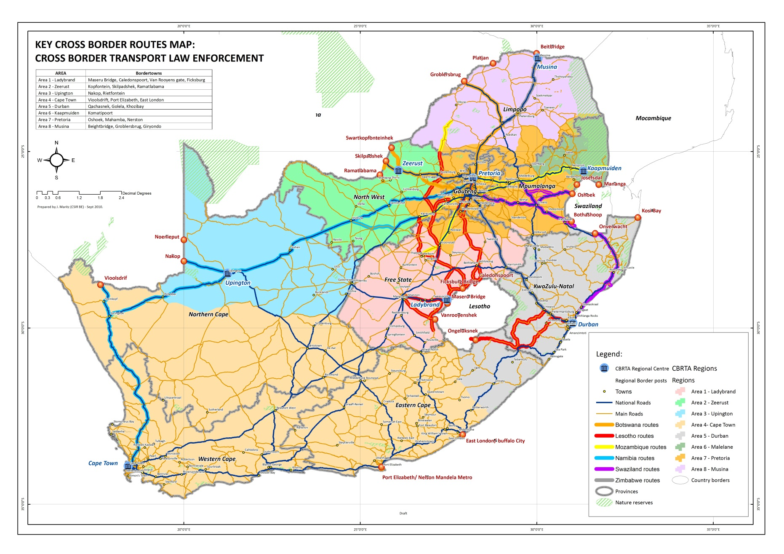
OUR OPERATING ENVIRONMENT
Notes:
There are 53 land border posts between South Africa and her immediate neighbouring countries;
Of the 53 borders 19 are designated commercial border posts;
There are 4 border posts that carry over 70% of the traffic (commercial passenger and freight vehicles) – Beitbridge, Lebombo, Maseru and Skilpadshek
These border posts are located in the busiest corridors linking South Africa to the SADC region through the North-South Corridor (N1), Trans-Kalahari Corridor, the Maputo Corridor (N4).
Key role players at border posts are:
DHA (Immigration)
Border Management Agency (management of the border-posts);
SARS (Customs);
South African Police Service (Border Police);
Agriculture, Forestry and Fisheries;
Port Health;
State Security Agency.

Slide 6
OUR OPERATIONAL ENVIRONMENT
INTERNAL ENVIRONMENT
Employment Statistics:-
- Total staff component as at 31 March 2018 was 164,
- Female represented 62% of workforce, males – 38%
- Females constituted 42% of Senior Management,
- Management maintains sound relationship with organised labour (POPCRU)
Internal Control
- Agency maintains sound and effective internal control and risk management
systems
SOCIO-ECONOMIC ENVIRONMENT
In 2017, SA ’s economic rating was put below investment grade by the rating agencies.
This implied an increased cost of doing business for the South African Operators
C-BRTA’s strategic approach – Linking Africa Plan
Domestic demand is driven by Africa’s growing population
Natural resources and primary commodities are major drivers of economic growth in Africa
C-BRTA’s strategic focus stretches beyond the SADC region,
REGIONAL ENVIRONMENT

Slide 8
2017/18 ORGANISATIONAL PERFORMANCE
92.31% of the predetermined targets set were achieved signifying a 25.64% increase compared to prior years performance .
KPI not achieved
KPI not achieved: Implemented cross border charges as an additional revenue streams Target: Consultation and development of legislative proposal on cross border charges Progress: The Agency developed a business case on “Levying of Cross Border Charges” which was consulted with various stakeholders including DoT officials, SANRAL and RAF. The business case is yet to be presented to the DoT EXCO.
8

Slide 9
ORGANISATIONAL PERFORMANCE: ACHIEVED TARGETS
NO. | KEY PERFORMANCE INDICATOR | 2017/18 ANNUAL TARGET | ACTUAL ACHIEVEMENT
1. | Developed and implemented new cross-border management system | Developed Enterprise Architecture for cross-border Management system | Enterprise Architecture and the Roadmap were completed and approved. The business case for the Integrated Cross Border Management System was also considered and approved.
2. | Developed Permit fee Regulations | Amended Draft Permit Fee Regulations | Permit fee regulations were amended and submitted to DoT for further publishing. The regulations were published by DoT for public comments on the 28th March 2018.
3. | Implemented scientific tool used by the Regulatory Committee to manage supply and demand of cross-border passenger transport | Fully implemented scientific tool | Regulatory Committee held a workshop on the refined model parameters for MAR and the tool was subsequently approved. The Regulatory Committee had since tested the tool by using it as reference during the regulatory hearings.
Notes:
Developed and implemented new cross-border management system
This achievement makes a significant milestone towards improvement in the efficiency of C-BRTA business system as the key outputs of this exercise include:-
Architecture models for the business, application, data/information, technology, integration and security layers.
The Digital Operator Services Architecture (DOSA) vision based on the Agency’s strategic goals.
An IT Roadmap for the implementation of the DOSA vision and related migration objectives.
To increase employee performance levels, the Agency introduced culture change programmes, revised C-BRTA reward program, induction and training programme.
Developed Permit Fee Regulations
The new permit tariff determination model was developed and the permit fee regulations were amended as part of the mechanisms that will assist in implementing regulated competition of cross border movements, it simultaneously serves as an approach to ensuring the financial viability and sustainability of the C-BRTA.
Implemented scientific tool used by the Regulatory Committee to manage supply and demand of cross border passenger transport
In an effort to meet its objective of introducing and implementing regulated competition of cross border movements, the Agency targeted to fully implement the Market Access Regulation (MAR) tool during 2017/18 and that was achieved. This project dates back from the 2012/13 financial whereby research was conducted to look into passenger and cross border transport patterns along the corridors leading to the border. The tool was eventually developed, piloted in 2015/16 and its impact assessed in the previous financial year

Slide 10
ORGANISATIONAL PERFORMANCE: ACHIEVED TARGETS Cont./…
NO. | KEY PERFORMANCE INDICATOR | 2017/18 ANNUAL TARGET | ACTUAL ACHIEVEMENT
4. | Developed and Implemented Operator Compliance Accreditation Scheme (OCAS) | Board approved draft legislation | The legislative proposal for the implementation of OCAS was drafted and approved by the Board. OCAS was presented to DoT’s EXCO and submission made to COTO and MinMEC.
5. | Percentage of temporary permits issued within pre-determined turnaround times | 90% of compliant applications for temporary permits processed and permits issued in front office within 1 day. 90% of compliant applications for temporary permits processed and permits issued in remote office within 2 days. | 99.42% of compliant temporary permits applications were processed and permits issued within 1 day in front office 98.15% of compliant remote temporary permits applications were processed and permits issued within 2 days
6. | Number of operator and corridor profiling reports for decision making | 4 Section 39 reports submitted to the Regulatory Committee for decision making | Four (4) Section 39 reports submitted to the Regulatory Committee for decision making
Notes:
Developed and Implemented Operator Compliance Accreditation Scheme (OCAS)
OCAS is one of the projects that was initiated for purposes of enhancing regulatory efficiency, compliance to road transport regulations, road safety, and unimpeded flow of cross-border road transport and also to reduce operational constraints faced by cross-border road transport operators. There is a lot of research that was conducted in the past few years that enabled the finalisation of the design framework. For 2017/18, focus was on developing model legislative framework for implementation of the scheme and show-casing the benefits of implementing the project to key decision makers, which is the Committee of Transport Officials (COTO), and the MINMEC.
The Agency also conducted an aassessment of road crashes involving cross-border road transport vehicles (crashes statistics, strategies to reduce accidents and the role of C-BRTA).
Percentage of temporary permits issued within pre-determined turnaround times
This initiative also proved to be very resourceful in assisting the identification of bottlenecks that often compromises the turn-around times thereby pointing at areas that require improvement. The need for reconfiguration of the CBRTS was identified as one of the exercises that would enhance the turn-around time. The reconfiguration of the CBRTS Turnaround Report functionality was since tested, assessed and implemented in order to ensure that the turnaround time of permits issued is monitored to improve services rendered to our operators. This successfully boosts achievement of the Agency’s objective of improving efficiencies in business operations.
Number of operator and corridor profiling reports for decision making
This report is developed in line with Section 39 of the C-BRT Act. It contains information related to expired permits and returned permits per vehicle type, per conveyance type, per duration and per destination. In addition to that, the report also has nature of offences detected during inspections, processing statistics and analysis of operator behaviour. This report does not only boost compliance levels to improve on road safety but contributes meaningfully towards implementation of regulated competition as pertaining to cross border movements. It is used as a reference by the Regulatory Committee as they make decisions related to permit issuance.
RTI for the 2017/18, conducted XX number of inspections representing 1% increase from the previous financial year.

Slide 11
ORGANISATIONAL PERFORMANCE: ACHIEVED TARGETS Cont./…
NO. | KEY PERFORMANCE INDICATOR | 2017/18 ANNUAL TARGET | ACTUAL ACHIEVEMENT
7. | Developed and implemented stakeholder management plan | Board approved Stakeholder Management Plan Hosted O.R. Tambo International Road Transport Indaba | The Stakeholder Management Plan was developed and approved by the Board. The Agency hosted an O.R Tambo International Road Transport Indaba and inputs from the Indaba were considered in the development of the Linking Africa Plan.
8. | Facilitated the implementation of the SADC protocol and regional agreements | Workshopped SADC protocol and regional agreement | The SADC workshop was held during the October Transport Month. The workshop agreed on the establishment of Cross Border Transport Regulators Forum to fast-track implementation of the SADC Protocol . The proposal for the establishment of the Forum was tabled at the SADC Ministers of Transport and has since been approved.
9. | Developed and implemented industry development strategy | Board approved Industry Development Strategy submitted to Minister | The Industry Development Strategy was approved by the Board and submitted to the Minister of Transport. The draft cross border road transport regulations were developed and submitted to DoT.
Notes:
Developed and implemented stakeholder management plan
One of the Agency’s goals is to be strategically positioned to promote integration of the African continent, hence a decision to adopt a robust approach to stakeholder management was taken during the strategic review in 2016/17. C-BRTA’s business success depends on the number and levels of stakeholders that it interacts, keeps and maintains excellent working relations with its partners in both private and public sectors. The achieved 2017/18 targets of developing a Stakeholder Management Plan and hosting of the O.R. Tambo International Road Transport Indaba, were basically the onset of this initiative.
In addition to that, the Agency developed a Linking Africa Plan aimed at identifying interventions that can enhance the unimpeded flow of cross-border road transport movements, intra-Africa trade, regional integration and industrialisation on the African continent.
Refinement of the Model for estimating the cost of doing business on the NSC, MDC and TKC corridors
Facilitated the implementation of the SADC protocol and regional agreements
The purpose for this indicator is to ensure that all the applicable agreements entered into with other counterparts are properly implemented and monitored. This in turn boost the Agency’s chances to succeed in its commitment to accelerate regional integration. The following was also achieved during 2017/18
Engaging member states on the implementation of SADC protocol and Regional Agreements,
Engagements with primary and secondary stakeholders,
Facilitated institutionalisation of the taxi industry through formation of various structures like JC, JRMG, Route committees and Associations
Developed and implemented industry development strategy
The Strategy is intended to drive economic transformation. This initiative had added benefits like identifying industry challenges, areas of development, stakeholders and development of interventions to address the identified challenges
in the cross-border road transport industry. This will ensure that the demographics are representative of the South African public and that previously disadvantaged individuals acquire a share of the market in order to participate in the business.

Slide 12
ORGANISATIONAL PERFORMANCE: ACHIEVED TARGETS Cont./…
NO. | KEY PERFORMANCE INDICATOR | 2017/18 ANNUAL TARGET | ACTUAL ACHIEVEMENT
10. | Number of Annual State of Cross-border operations reports (ASCBOR) submitted to the Minister and other relevant stakeholders | 1 ASCBOR report submitted to the Minister and other stakeholders | ASCBOR was developed, approved and submitted to the DoT The report is also published on the C-BRTA website for all other stakeholders.
11. | Number of country profiles developed | 2 country (Swaziland and Botswana) profiles developed | Country profiles for Swaziland and Botswana were developed during the financial year.
12. | Developed model to calculate transit and cost of delays at commercial border posts | Cross-border Flow calculator Concept document | The Cross Border Flow calculator concept document was approved by the Board.
Notes:
Number of Annual State of Cross-border operations reports (ASCBOR) submitted to the Minister and other relevant stakeholders
The value of this Report lies in its provision of advice and consolidated information to the Minister of Transport, the Department of Transport and other key stakeholders. It further articulates challenges facing the cross-border road transport sector, corridor performance indicators, developments in the trade and transport sectors, initiatives that may be implemented to address the identified challenges and action plans, and funding frameworks for the identified initiatives, amongst others.
Number of country profiles developed
The aim of Country Profile reports is to provide a consolidated platform for the dissemination of information that is useful to key stakeholders in the cross-border environment, particularly cross-border road transport operators, regulatory authorities and trading parties on a specific country of interest. It is envisaged that the reports will be resourceful to cross-border operators conducting operations between South Africa and the said countries, in terms of providing information that influence decision-making with respect to improving operations and exploring business opportunities.
Developed model to calculate transit and cost of delays at commercial border posts
The major aim of the project was to develop a Cross-Border Flow Calculator that can be used to calculate transit times and the economic impact of the delays. It is envisaged that the Calculator will provide invaluable information with respect to key drivers of transit times and related transit time durations at specific points at commercial border posts and corridors, as well as the economic impact thereof. This information will add value with respect to prioritisation of interventions at border posts and corridors as well as determination of key points within the border posts that must also be prioritised.

Slide 13
Permits issued per category
ORGANISATIONAL PERFORMANCE Cont./…
MODE | 2017/18 | 2016/17 | Increase/ (Decrease) | % Movement
Freight | 63 695 | 65 000 |  | (2%)
Buses | 2 581 | 2 011 |  | 28%
Taxi | 22 500 | 15 465 |  | 45%
Tourist | 2 853 | 2 482 |  | 15%
TOTAL | 91 629 | 84 958 |  | 8%

Slide 14
ORGANISATIONAL PERFORMANCE Cont./…
COUNTRY | 2017/18 | % Issued Per Country
Angola | 167 | 0,3%
Botswana | 8 080 | 12,7%
Democratic Republic of Congo | 5 528 | 8,7%
Lesotho | 3 198 | 5,0%
Malawi | 2 607 | 4,1%
Mozambique | 9230 | 14,5%
Namibia | 5630 | 8,8%
Swaziland | 5046 | 7,9%
Zambia | 12616 | 19,8%
Zimbabwe | 11539 | 18,1%
Cabotage | 54 | 0,1%
TOTAL | 63 695
Notes:
Statistics
Zambia highest in terms of trade at 20% represented by 11 539 permits
Zimbabwe second highest at 18% (11 539 permits)
Mozambique third highest at 14% (9 230 permits)
Botswana fourth highest at 13% (8 080)
The least is Angola which hardly at 1%

Slide 15
ORGANISATIONAL PERFORMANCE Cont./…
% of Taxi Passenger Permit Statistics Per Country
Notes:
Total Taxi Permits 22 500
Taxi permits issued to Zimbabwe highest at 43% of the total taxi permits issued ( 9 573 permits issued)
Mozambique is the second highest at 42% ( 9 461 permits issued)
Followed by Lesotho at 6% ( 1 258 permits issued)
The least permits were issued for DRC – with only 4 permits issued
Botswana 637 - 2,8%
Malawi 56 - 0,2%
Namibia 206 - 0,9%
Swaziland 1222 - 5,4%
Zambia 83 - 0,4%

Slide 16
ORGANISATIONAL PERFORMANCE Cont./…
COUNTRY | 2017/18 | % Per Country
Botswana | 156 | 6,0%
Democratic Republic of Congo | 13 | 0,5%
Lesotho | 251 | 9,7%
Malawi | 168 | 6,5%
Mozambique | 310 | 12,0%
Namibia | 64 | 2,5%
Swaziland | 167 | 6,5%
Zambia | 55 | 2,1%
Zimbabwe | 1 397 | 54,1%
Total | 2 581
Notes:
Total permits issued for BUS Operators is 2 581
Zimbabwe is highest with 54% of the total Bus permits issued – (1 397 permits issued)
Second highest is Mozambique with 310 permits – constituting 12% of total bus permit issued
Lesotho is third highest with 251 permits, constituting 10% of the total bus permits issued

Slide 17
ORGANISATIONAL PERFORMANCE Cont./…
Tourist | 2017/18 | % Per Destination
Regional | 2 793 | 98%
Cabotage | 60 | 2%
Total | 2 853
Notes:
Most of the tourism permits issued to Operators transport tourists into the region with very few doing cabotage

Slide 18
ORGANISATIONAL PERFORMANCE Cont./…
Work Activity | 2017/18 | 2016/17 | Difference | % Movement | Year-on-year movement
Vehicle Inspections | 276 227 | 272 247 | 3 980 | 1%
Prosecutions | 19 410 | 15 113 | 4 297 | 28%
Compliance Rate | 93% | 94% |  | (1%)
Notes:
1% improvement on vehicle inspection since the RTI migrated to RTMC with an improvement of 28% on prosecution.

Slide 19
SOCIAL RESPONSIBILITY
In an effort to advance youth and women empowerment, the Agency conducted career exhibitions, information workshops and seminars as follows:-
A Knowledge Seminar for the University of Johannesburg students.
A Youth Empowerment Workshop in Musina Municipality to educate youth on opportunities available within the cross-border space.
Information Sharing Seminar targeting communities around Oshoek border post was hosted in collaboration with Chief Albert Luthuli Local Municipality.
A Road Safety Education session supported by sister agencies was held with two Primary Schools in Hartebeeskop.
A campaign to attract new entrants into the cross-border market was held in Makgobistad in the North West Province.
In partnership with the National Department of Transport, a career exhibition was conducted for grade 10-12 learners in Limpopo, North West and Mpumalanga Province.

Slide 20
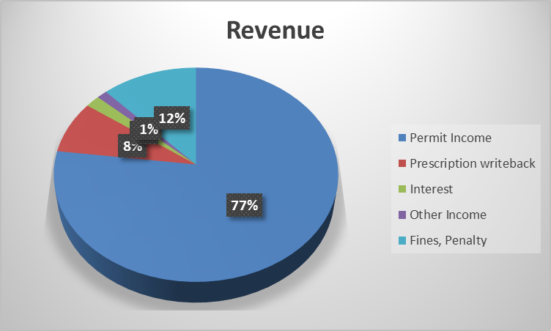
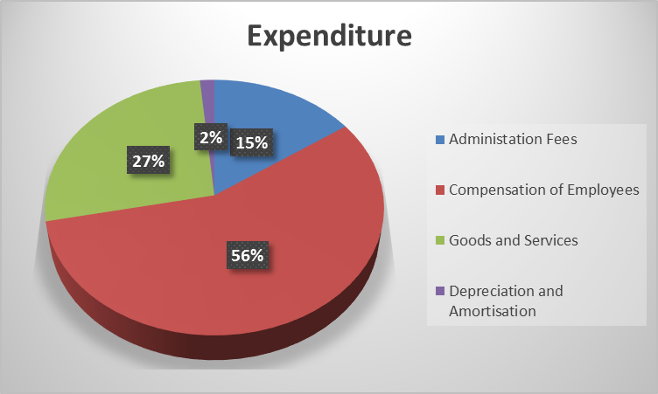
FINANCIAL PERFORMANCE 2017/2018

Slide 21
FINANCIAL PERFORMANCE 2017/2018 Cont./…
REVENUE
Permit revenue is the main funding stream and constituted 77% of the total income
There’s 1% decrease in permit revenue due to marginal decrease in the number of freight permits issued.
Penalty revenue constitutes 12% of the total income.
EXPENDITURE
Employee costs constituted 56% of the total expenditure March 2018 .
Operating expenditure constituted 27%
Financial strategy for cost saving was put in place,
Conserved cash and generated surpluses to enable the Agency to service the Operator Refund liability of R318 million as well as capital expenditure
To that effect, the Agency reported a surplus of R55 million for the year ended March 2018

Slide 22
FINANCIAL POSITION 2017/2018

Slide 23
FINANCIAL POSITION 2017/2018 Cont./…
The Agency reported a position of technical insolvency as its liabilities exceeded the assets by R124 million at year-end. This was due to the outcome of the 2011 permit tariff litigation which resulted in R318 million provision for Operator Refunds
The accumulated deficit of R124 million was reduced by 30% from the previous year as a result of the refunds that were made to the operators as at year end and the reported surplus for the year
A total of R142,8 million (from the R318 million) has been refunded to the operators as at 31 March 2018.
On 12 May 2018, the Agency applied provisions of Prescription Act, 68 of 1969, in respect of the amount previously provided for as a potential liability in the statement of financial position.

Slide 24
FINANCIAL POSITION 2017/2018 Cont./…
The effect of the application of the Prescription Act is that from the date of the application of the Act, the provisions of claims raised in the statement of financial position at 31 March 2018 for an amount of R164,021,935 will be reversed and will result in the Agency being solvent
Contingent liability relating to the court challenge on the 2014 Permit Tariff Regulations remains
There were no Irregular, Fruitless and Wasteful expenditure incurred during 2017/18 financial year

Slide 25
AUDIT OUTCOMES 2017/18
The Agency has achieved a Clean Audit for three consecutive years
2009/10 to 2011/12 Qualified Audit
2015-16
Clean Audit
2016-17
Clean Audit
2017-18 Clean Audit
2012/13 to 2014/15 Unqualified Audit

Slide 26
AUDIT OUTCOMES 2017/18 Cont./…
Conclusion on Annual Financial Statements | AFS present fairly, in all material respects, the financial position of the entity, its financial performance and cash flows for the year ended
Conclusion on pre-determined objectives | There were no material findings on the usefulness and reliability of reported performance information
Conclusion on Compliance with legislation | Internal Control No material non-compliance with applicable legislation
EMPHASIS OF MATTER | Uncertainty relating to the outcome of exceptional litigation: Court challenge on the 2014 Permit Tariffs Regulations

Slide 27
CONCLUDING REMARKS
KEY CHALLENGES FACING THE AGENCY
Permit tariff, which constitute the lifeblood of the C-BRTA have not been revised since May 2014. This exposes the Agency to untold risks, and stifle its financial position.
Litigation against the 2014 permit tariff regulations still not concluded.
The Board of the C-BRTA is not properly constituted for over 18 months now. This creates a quorum problem for the Regulatory Committee (Quasi-judicial structure established in terms of the Act to consider permit application). This exposes the Agency to the risk of litigation by operators who may want to challenge the decisions of the Committee.
The Agency will continue to work closely with and collaborate with various cross-border stakeholders in pursing its mandate of ensuring unimpeded movement of goods and people across our borders

Slide 28
I THANK YOU
Notes:
THUS SHALL NOT UNDER ESTIMATE YOUR CONTRIBUTION TO PERFORMANCE”

