Slide 1


Mitochondria Energy Company (Pty) Ltd
Fuel Cells and the IRP
16 October 2018
Private and Confidential

Slide 2
Mitochondria Energy Company (Pty) Ltd
Mitochondria Energy Company (Mito) Ltd was founded in 2012
IDC has an equity stake – 40%
Terracotta Resources (Pty) Ltd controls the balance – 60%
Terracotta is a 100% Black-owned investment vehicle, and represents the interests of several Black investors
Mashudu Ramano is the central figure

Slide 3
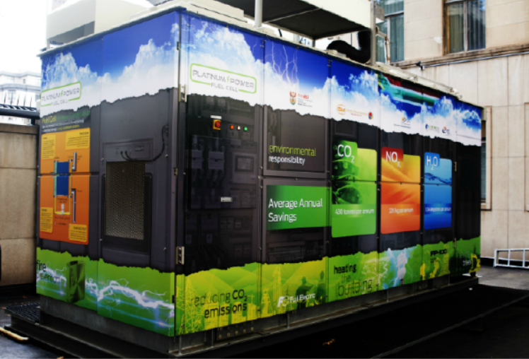
Chamber of Mines
Installation
100 kW PAFC fuel cell
Platinum based
Baseload (80/40 kW)
Critical back-up solution
Environmental Impact
  Saving 430 tons CO₂/annum
  Saving 320 kg NO_{x}/annum
  Saving 1m litres H₂O per annum
Notes:
1.38 l/kwh as per Eskom 2015 fact sheet

Slide 4
Energy Trends
Decarbonising and hydrogenating
Gas is emerging
Decentralised, distributed energy solutions will dominate
High energy price growth
Climate change drives focus on carbon
Urbanisation in Africa is driving increasing demand for energy

Slide 5
IRP
Overview

Slide 6
IRP Overview
Balanced Electrical Grid
Unbalanced Electrical Grid
Fuel Cells
Battery Storage
Hydro
Renewable Energies
Wind
Solar PV
Baseload Energy
Nuclear
Coal Fired Power Plants
CSP
Renewable Energies
Wind
Solar PV
Baseload Energy
Nuclear
Coal Fired Power Plants
CSP
Fuel Cells
Notes:
Solar and wind are not baseload power and Eskom is decommissioning baseload power. A technology is needed to overcome this issue
Many technologies exist but in the presentation we will discuss the fuel cell

Slide 7
IRP Overview
 | Coal Pulverized with FGD | Coal FBC Pulverized with CCS | Coal Pulverized with CCS | Coal IGCC | Nuclear (DoE) | OCGT | CCGT | ICE 2 MW | ICE 10 MW | Fuel Cell
Rated Capacity, MW Net | 4500 | 250 | 4500 | 644 | 1400 | 132 | 732 | 1.90 | 9.40 | 2
Total Overnight Cost, ZAR/kW (Jan 2015 Rands) | 32420.0 | 39133.0 | 62712.0 | 50327.0 | 55260 | 7472.0 | 8205.0 | 11657.0 | 12494.0 | 27140*
Lead-times and Project Schedule, years | 9.0 | 4.0 | 9.0 | 4.0 | 8 | 2.0 | 3.0 | 1.0 | 1.0 | 1.0
Phasing in capital spent (% per year) (* indicates commissioning year of 1st unit) | 2, 6, 13, 17, 17, 16, 15, 11, 3 | 10, 25, 45, 20 | 2, 6, 13, 17 *, 17, 16, 15, 11, 3 | 10, 25, 45, 20 | 5, 5, 15, 15, 20, 20, 10, 10 | 90, 10 | 40, 50, 10 | 100.00 | 100.00 | 100
Fuel Energy Content, HHV, kJ/kg | 17850.0 | 17850.0 | 17850.0 | 17850.0 | 129900000 | 39.3 | 39.3 | 39.3 | 39.3 | 39.3
Fuel Cost (R/GJ) | 25.0 | 12.5 | 25.0 | 25.0 | 7.35 | 115.5 | 115.5 | 115.5 | 115.5 | 115.5
Heat Rate (kJ/kWh) | 9812.0 | 10788.0 | 14106.0 | 9758.0 | 10657 | 11519.0 | 7395.0 | 9477.0 | 8780.0 | 5519.0
Fixed O&M Cost (R/KW/Year) | 845.0 | 568.0 | 1441.0 | 1301.0 | 885 | 147.0 | 151.0 | 386.0 | 434.0 | NA
Variable O&M Cost (R/MWh) | 73.1 | 158.2 | 134.9 | 69.0 | 34 | 2.2 | 20.0 | 64.0 | 110.1 | NA
Equivalent Availability (%) | 91.5 | 91.5 | 91.5 | 85.2 | 92 | 88.5 | 88.5 | 88.5 | 88.8 | 96
Planned Outage Rate (%) | 4.8 | 4.8 | 4.8 | 4.7 | 3 | 6.9 | 6.9 | 6.9 | 6.9 | 3.5
Unplanned Outage Rate (%) | 3.7 | 3.7 | 3.7 | 10.1 | 6 | 4.6 | 4.6 | 4.6 | 4.6 | 0.5
Typical Load Factor (%) | 85.0 | 85.0 | 85.0 | 85.0 | 90 | 8.0 | 48.0 | 48.0 | 50.0 | 90
Economic Life | 30.0 | 30.0 | 30.0 | 30.0 | 60 | 30.0 | 30.0 | 30.0 | 30.0 | 20
Water Usage (l/MWh) | 231.0 | 33.3 | 320.0 | 256.7 | 0 | 0.0 | 19.8 | 0.0 | 0.0 | 0.0
Sorbent Usage (kg/MWh) | 15.8 | 41.0 | 22.8 | 0.0 | 0 | 0.0 | 0.0 | 0.0 | 0.0 | 0
CO2 Emissions (kg/MWh) | 947.3 | 1003.0 | 136.2 | 930.0 | 0 | 574.0 | 367.0 | 491.0 | 455.0 | 225
SOx Emissions (kg/MWh) | 0.5 | 0.5 | 0.7 | 0.2 | 0 | 0.0 | 0.0 | 0.0 | 0.0 | 0
NOx Emissions (kg/MWh) | 1.9 | 0.3 | 0.4 | 0.2 | 0 | 0.3 | 0.2 | 1.3 | 0.1 | 0
Hg (kg/MWh) | 0.1 | 0.0 | 0.0 | 0.0 | 0 | 0.0 | 0.0 | 0.0 | 0.0 | 0
Particulates (kg/MWh) | 0.1 | 0.1 | 0.2 | 0.4 | 0 | 0.1 | 0.0 | 0.0 | 0.0 | 0
Department of Energy, “Integrated Resource Plan,” [Online]. Available: http://www.energy.gov.za/IRP/overview.html
Notes:
This is the IRP table to compare different technologies. We added fuel cell technologies and the items in red shows were fuel cells are superior.
In the next slides we will have a closer look at the advantages of using fuel cell

Slide 8
IRP Overview
Electrical Efficiencies
Department of Energy, “Integrated Resource Plan,” [Online]. Available: http://www.energy.gov.za/IRP/overview.html
Notes:
Fuel cell are about twice as efficient as other technologies

Slide 9
IRP Overview
Fuel Flexibility
Notes:
Fuel cells can use many different fuels

Slide 10
IRP Overview
Emission Rate
Department of Energy, “Integrated Resource Plan,” [Online]. Available: http://www.energy.gov.za/IRP/overview.html
Notes:
Fuel cells produce very little emissions compared to other technologies

Slide 11
IRP Overview
Water usage
Department of Energy, “Integrated Resource Plan,” [Online]. Available: http://www.energy.gov.za/IRP/overview.html
Notes:
Fuel cell has an unique electro-chemical process to generate power. This process produce water instead of using water for generation

Slide 12
IRP Overview
Capacity Factor
Department of Energy, “Integrated Resource Plan,” [Online]. Available: http://www.energy.gov.za/IRP/overview.html
Notes:
Capacity factor shows the availability of the technology to produce power. Fuel cells has the highest CF because of their unique electrochemical process and modularity of the system.

Slide 13
What a localised fuel cell industry can do for South Africa

Slide 14
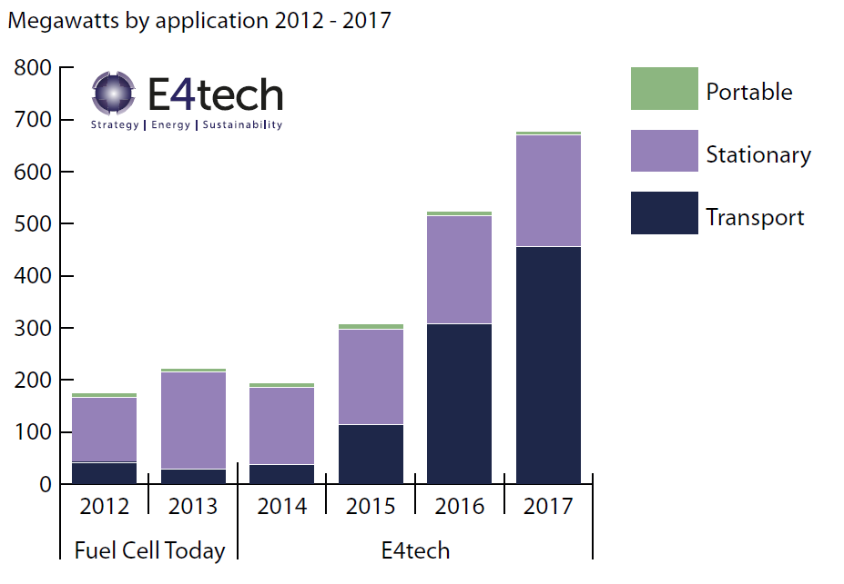
Fuel Cell Trends
Sources:
* E4tech: The Fuel Cell Industry Review 2017

Slide 15

The opportunity – Stationary fuel cells
Notes:
Establishing a local industry in the fuel cell sector:
Establishing a local industry in the fuel cell sector in South Africa will not only benefit our own energy needs but could also become a major exporting industry. Different from other established technologies (like wind and solar PV), the global fuel cell industry is still at its infancy, ESPECIALLY IN THE MARKET SEGMENT FOR LARGER STATIONARY APPLICATIONS, like standalone decentralised generation for industry. This opens the opportunity to invest in this industry and become a market leader, right here in South Africa. This will enable South Africa to generate their energy needs with technology that is owned by South Africa – decoupled from foreign imports. At the same time, we could use our procurement to lay the foundation for becoming a global leader earning valuable foreign currency for the country, and addressing the urgent need to re-industrialise our nation.
Reduce the cost of the fuel cell system
Large penetration of the market with fuel cells, especially on the African continent, is prevented solely by the high current cost of the technology. (In Europe and most of the First World, an added barrier is that they have established infrastructure and are, to some extent, locked into older technologies and paradigms). Establishing a large volume through-put facility, with off-take from SA and elsewhere on the continent, will enable us to reduce the cost of the technology to the point where we can become a global market leader in these fuel cell systems.
Local mineral beneficiation
Many minerals that form part of such components of fuel cells as electrodes and interconnect plates are mined right here in South Africa. 17% of the cost of the stack is associated with these minerals [5]. Instead of exporting our minerals and importing refined products, we could keep the whole value chain in South Africa.
Job creation
The establishment of a fuel cell industry will create many direct and indirect jobs. These include manufacturing, power generation, operation and maintenance.

Slide 16
Towards a South African fuel cell industry
Establish local production facility in the MW scale per year
Reduce the cost of fuel cell systems
Local mineral beneficiation
Job creation
Notes:
Establishing a local industry in the fuel cell sector:
Establishing a local industry in the fuel cell sector in South Africa will not only benefit our own energy needs but could also become a major exporting industry. Different from other established technologies (like wind and solar PV), the global fuel cell industry is still at its infancy, ESPECIALLY IN THE MARKET SEGMENT FOR LARGER STATIONARY APPLICATIONS, like standalone decentralised generation for industry. This opens the opportunity to invest in this industry and become a market leader, right here in South Africa. This will enable South Africa to generate their energy needs with technology that is owned by South Africa – decoupled from foreign imports. At the same time, we could use our procurement to lay the foundation for becoming a global leader earning valuable foreign currency for the country, and addressing the urgent need to re-industrialise our nation.
Reduce the cost of the fuel cell system
Large penetration of the market with fuel cells, especially on the African continent, is prevented solely by the high current cost of the technology. (In Europe and most of the First World, an added barrier is that they have established infrastructure and are, to some extent, locked into older technologies and paradigms). Establishing a large volume through-put facility, with off-take from SA and elsewhere on the continent, will enable us to reduce the cost of the technology to the point where we can become a global market leader in these fuel cell systems.
Local mineral beneficiation
Many minerals that form part of such components of fuel cells as electrodes and interconnect plates are mined right here in South Africa. 17% of the cost of the stack is associated with these minerals [5]. Instead of exporting our minerals and importing refined products, we could keep the whole value chain in South Africa.
Job creation
The establishment of a fuel cell industry will create many direct and indirect jobs. These include manufacturing, power generation, operation and maintenance.

Slide 17
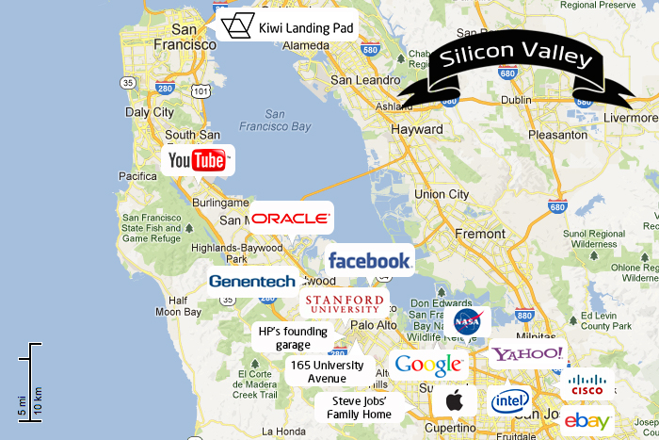
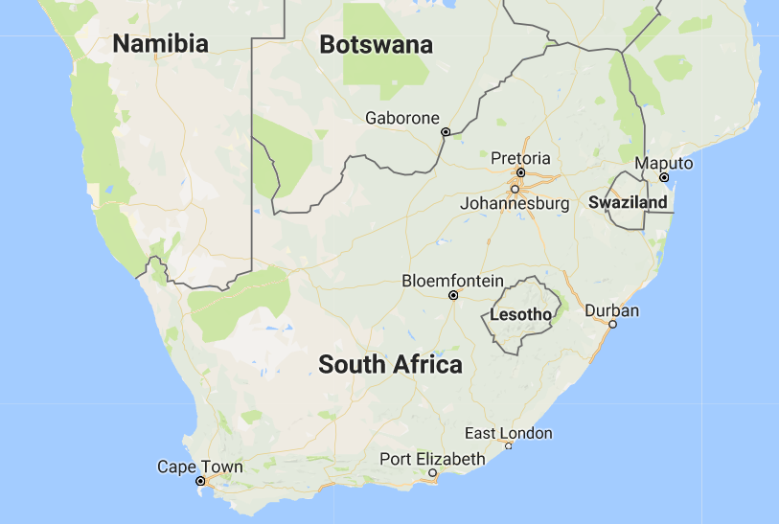
The South African Story
Silicon Valley
Fuel Cell Valley
Silicon – Semiconductors
Computer Industries
39 businesses in the “Fortune 1000”
Catalyst
  Platinum Group Metals (1^{st*})
  Zirconia (2^{nd*})
Bipolar / Interconnect plates
  Chrome (1^{st**})
  Iron (6^{th*})
Major role player in energy supply
Sources:
* U.S. Geological Survey, Mineral Commodity Summaries, January 2016
**International Chromium Development Association - ©2011

Slide 18
Fuel Cell Example
12 GW Decommissioning Coal Power Plants
Replace Eskom’s decommissioning coal fired power plants
Fuel Flexible: coal or gas
Load following capabilities - integrate with renewables
The local manufacturing facility
  Significant local employer
75% less CO2 emissions
The fuel cells will save 145 065 600 000 litres of water per year

Slide 19
Fuel Cell + Solar & Wind
Technology | Load following capabilities
Coal Fired Power Plant | NO
Fuel Cells | YES
Notes:
The fuel cell will lower its output as the solar PV generates. Thus Fuel Cell systems are FLEXIBLE baseload

Slide 20
Inside the Fuel Cells

Slide 21
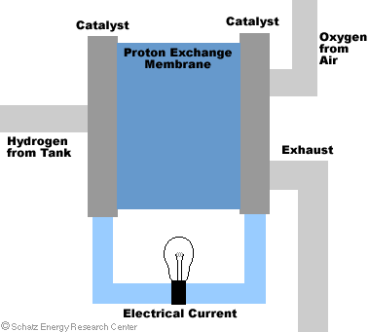
Fuel Cell Overview

Slide 22
“The electric light did not come from the continuous improvement of candles”
Oren Harari
Thank you!

Slide 23
Back-up Slides

Slide 24
Various Industries

Slide 25
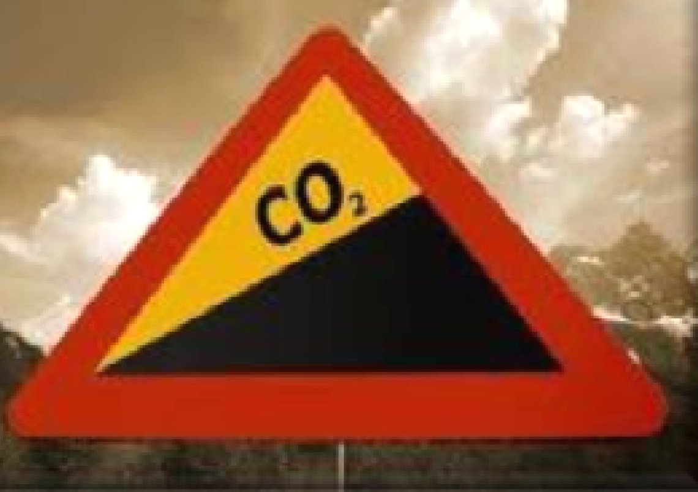
South African Energy Profile
Coal supply
  75 % of South Africa’s primary energy
  90 % of South Africa's electricity

Slide 26
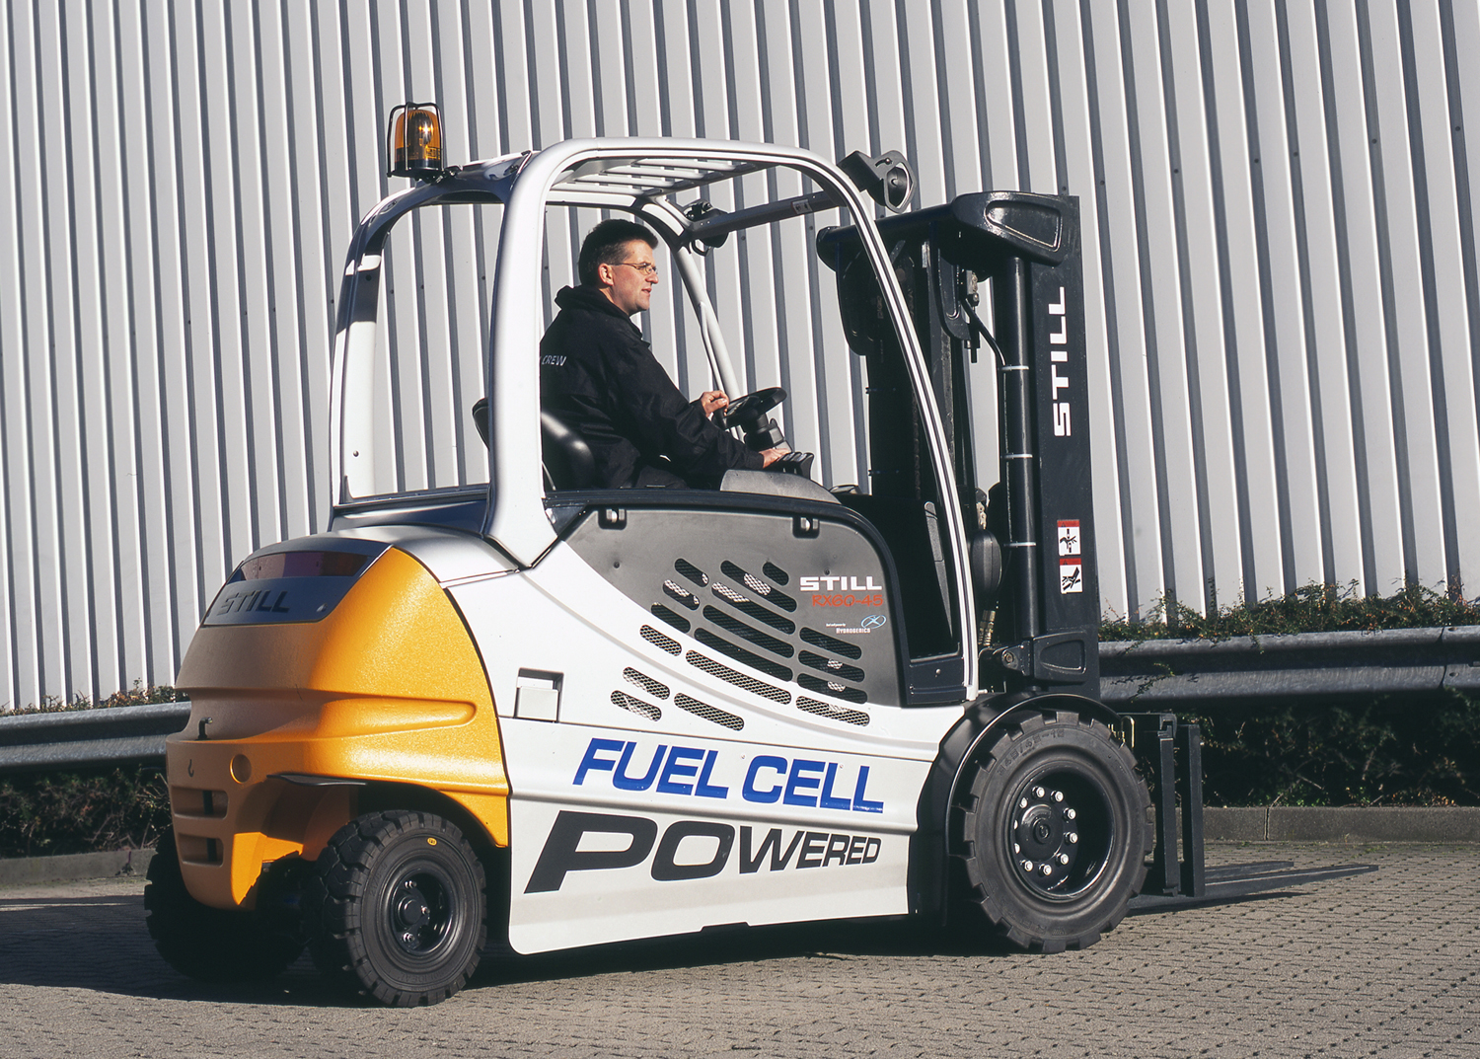

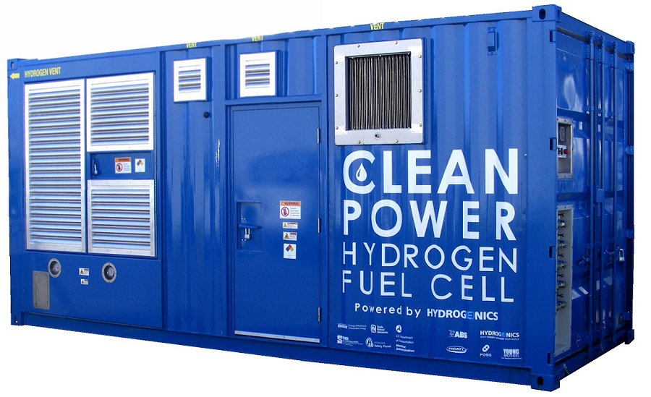
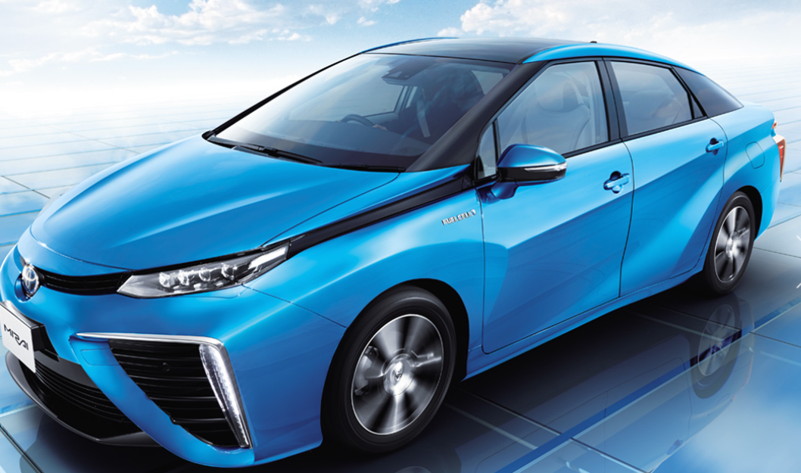
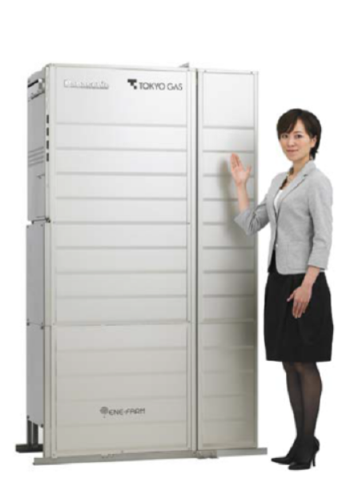
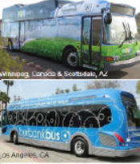
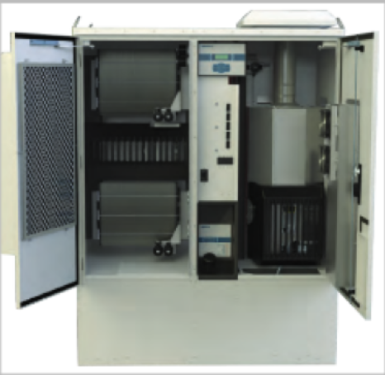
Fuel Cell Market Overview:
Global and Local
    Material Handling
    Forklifts
    6,286 units
    Baseload and Back-up Power
    Data Centers
    Telecom
    Healthcare
    Industrial
    Fuel cell Vehicles
    2020: 520 000 units
    Toyota, Mercedes-Benz, Honda, GM, Volkswagen and Hyundai
    Residential CHP
    Resi0.7-1 kW
    120 000 units
    South Africa
    100 kW Chamber of Mines
    Vodacom
    Off-grid:
      Schools
      Naledi trust- 34 Homes

Slide 27
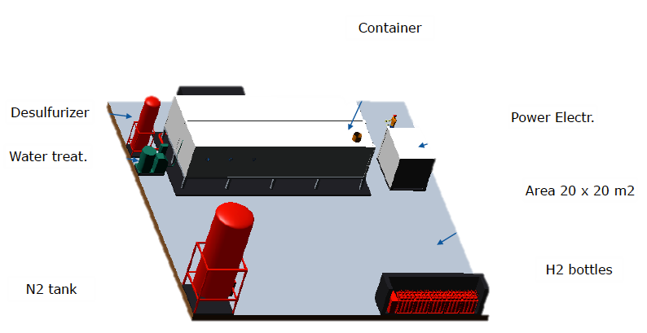
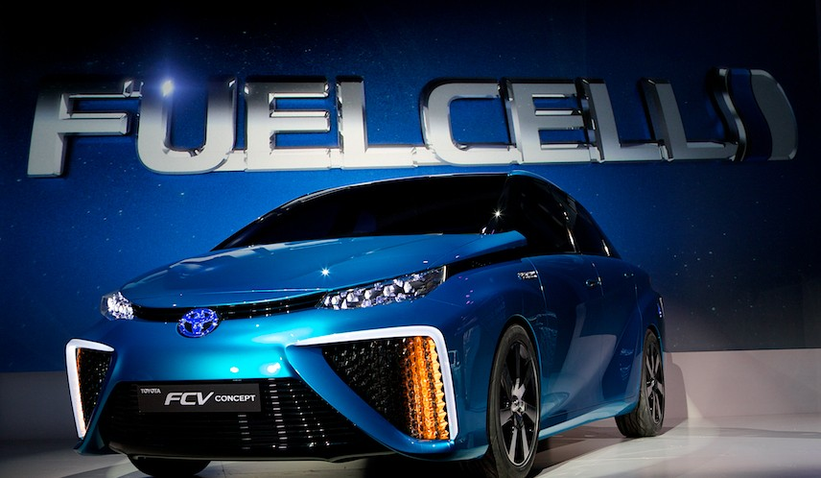
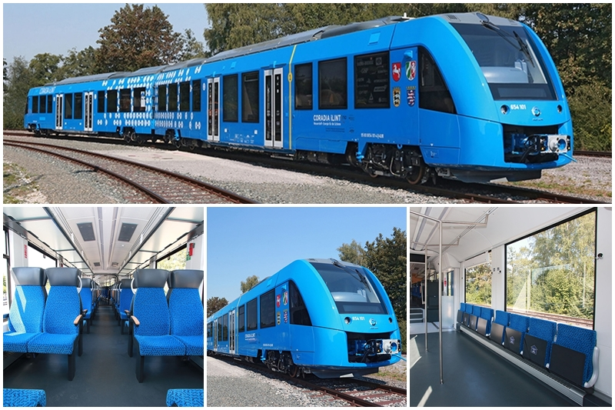
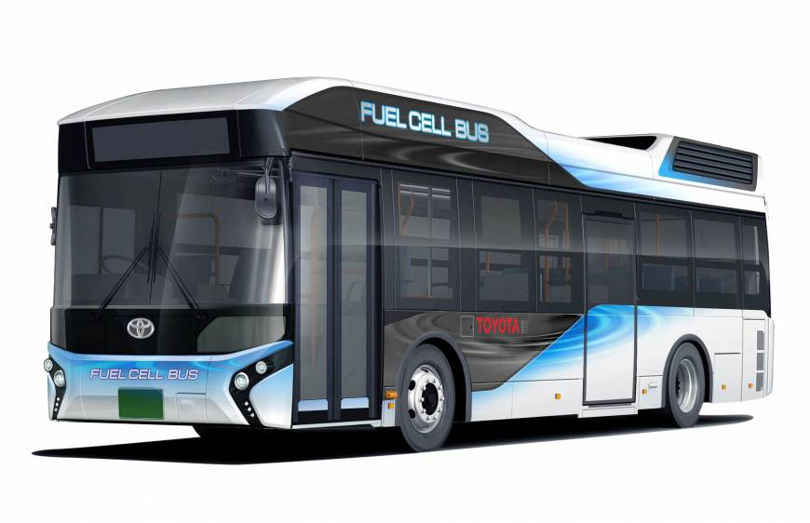
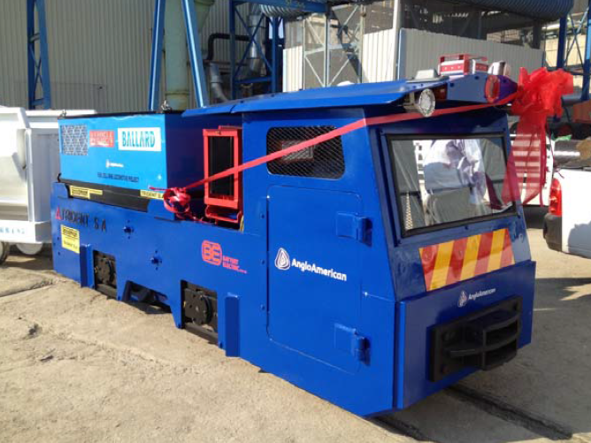
Fuel Cell Overview
 | PGM catalyst | Efficiency (%) | Temperature | Fuel | Range
PEMFC | ü | 40-60 | 40-90 | H₂ | 50 W – 5 MW
PAFC | ü | 42 | 175-205 | NG – H₂ | 100kW –10 MW
DMFC | ü | 40 | 50-120 | Methanol | 10W – 1kW
AFC | û | 60 | 1-250 | H₂ | 10W – 5 kW
MCFC | û | 45-50 | 650 | H₂ + CO | 300kW – 3MW
SOFC | û | 60 | 700-900 | H₂ + CO | 1– 2MW
Stationary Applications
Mobility Applications

Slide 28
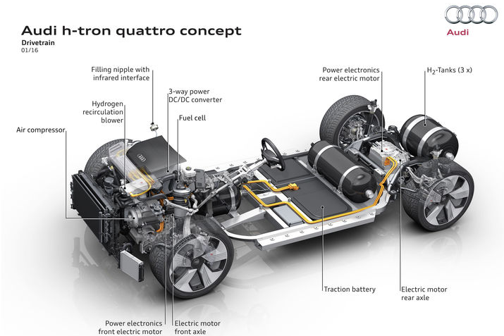
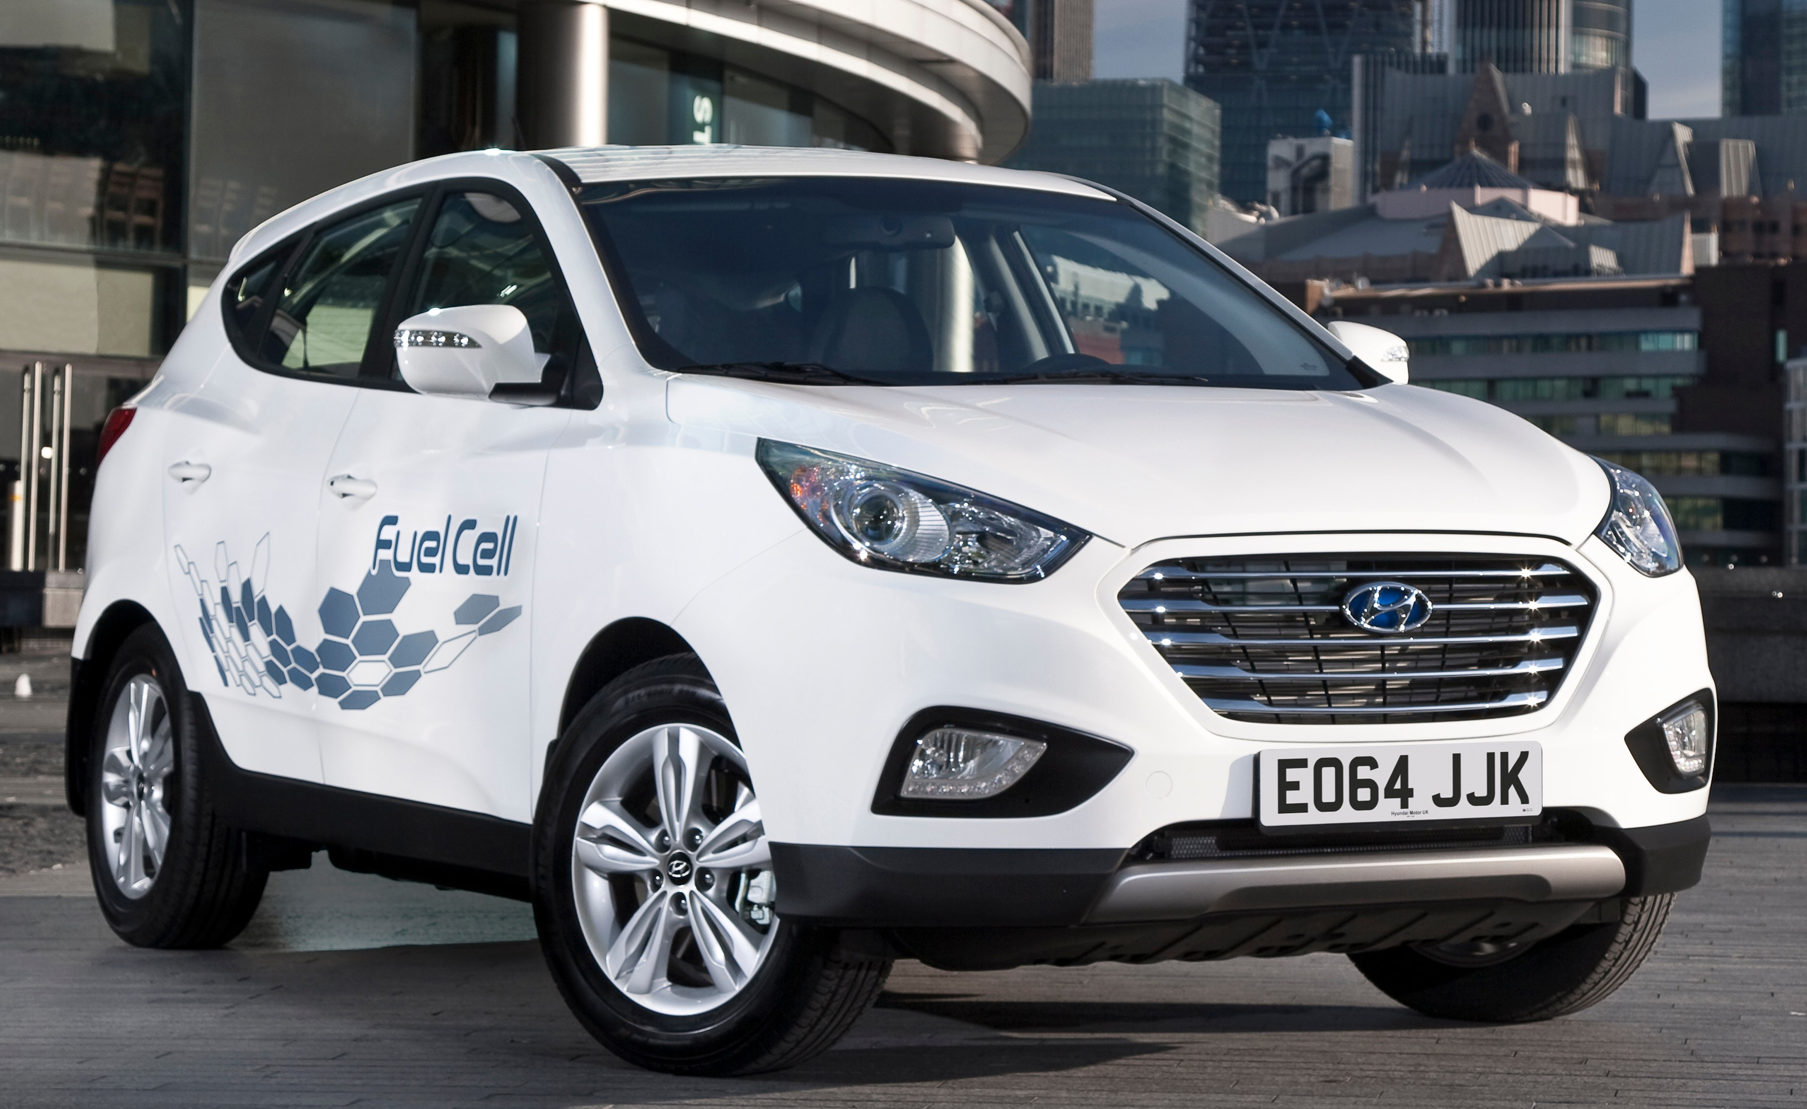
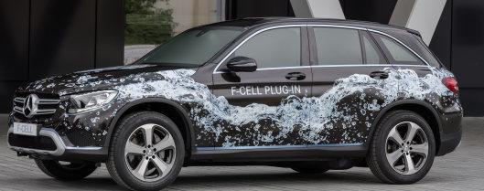
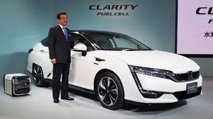
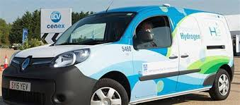
Transport - FCEV
Who is developing FCEV?
Toyota - Marai
Hyundai – iX35
Honda – Clarity
Daimler - GLC
Renault – Kangoo
GM – Equinox
Audi – h-tron Quattro

Slide 29
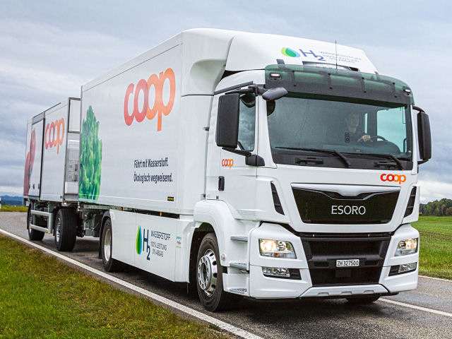
Transport - Other
Fuel Cell
Busses
Fuel Cell
Trains
Fuel Cell
Trucks

Slide 30
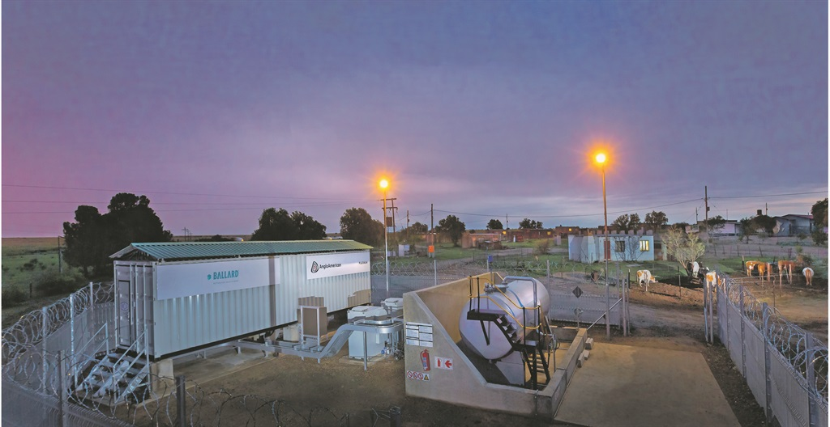
Rural Electrification
Rural Electrification – Naledi Trust, Kroonstad

Slide 31
Health Care

Slide 32
Housing Developments

Slide 33
Data Centres

Slide 34
Refineries

Slide 35
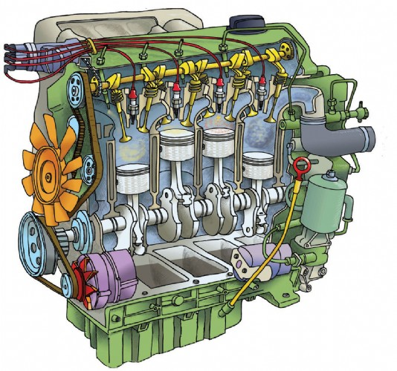
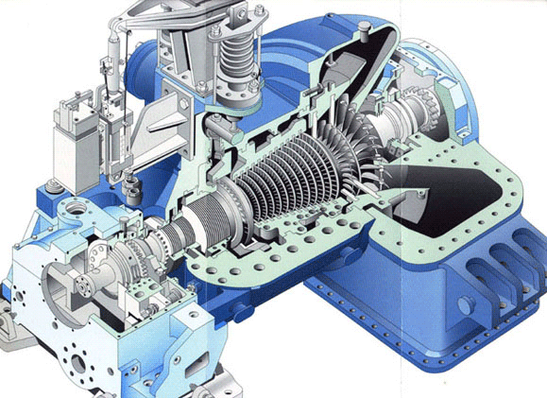
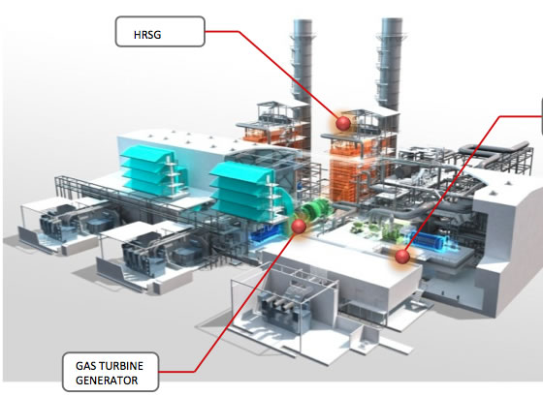
Fuel Cells vs Heat Engines
Engines
Turbines
Combined cycles
0.1 – 5 Mw_{e}
η: 33 – 45%
5 – 100 Mw_{e}
η: 27 – 40%
50 – 500 Mw_{e}
η: 50 – 60%
Chemical Energy
Heat
Mechanical Energy
Electrical Energy
Chemical Energy
Electrical Energy
FUEL CELLS ARE MORE EFFICIENT!!!

