Slide 1
Happy Khambule Greenpeace Africa hkhambule@greenpeace.org
16 October 2018

Slide 2
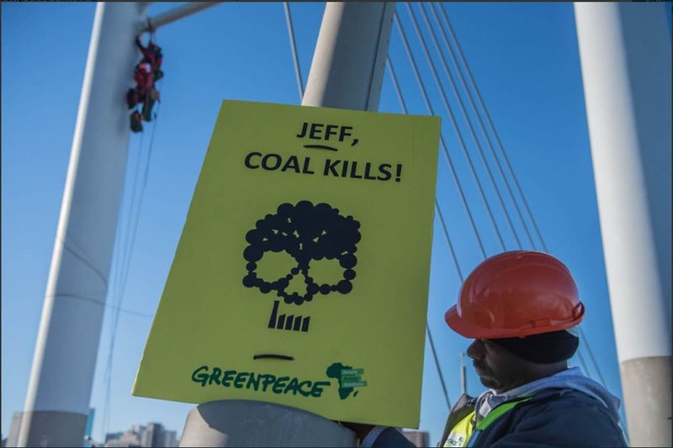
IRP Action

Slide 3
IRP action

Slide 4
Water

Slide 5
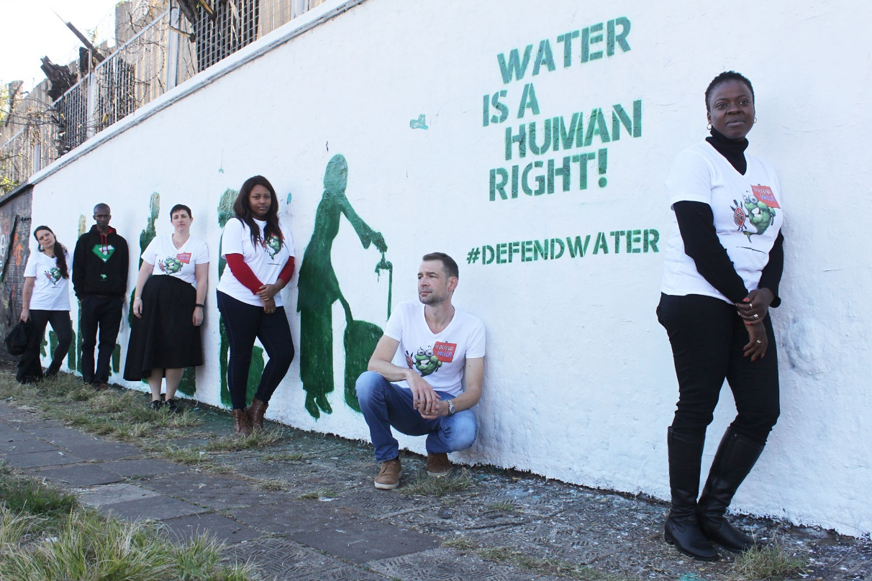
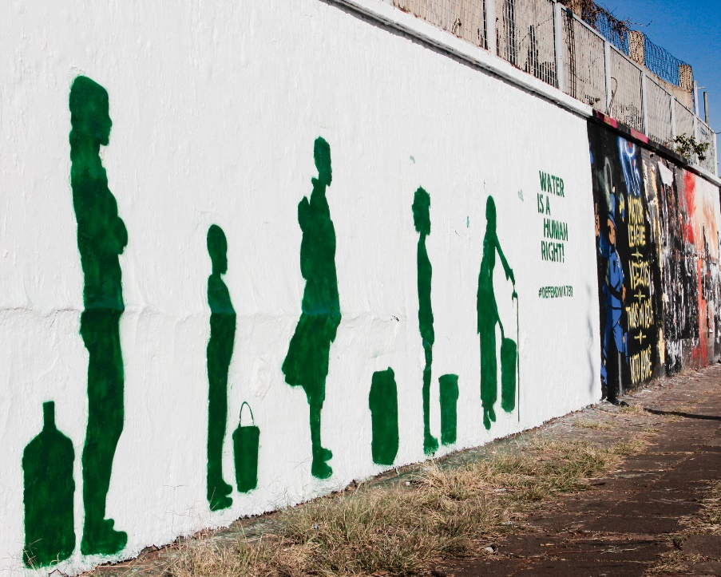
Water crisis

Slide 6
Nuclear liability

Slide 7
Nuclear liability

Slide 8
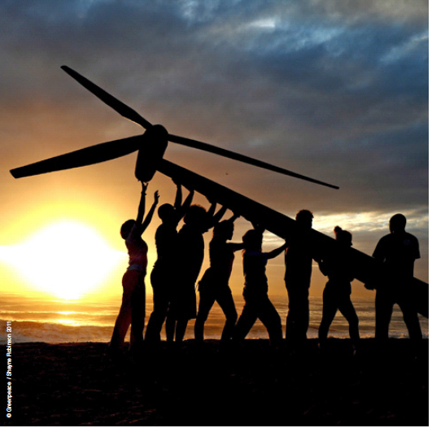
Public participation & finalisation of the IRP
Greenpeace Africa welcomes the active role that the Portfolio Committee.
We welcome the opportunity to make a submission to the Committee on the draft IRP 2018.
Support(in the form of resources and logistical assistance) community organisations to make oral submissions.
Process certainty concerning the IRP
Continued oversight role post IRP finalisation.
www.greenpeaceafrica.org

Slide 9
Climate Change
The update needs also to take the latest scientific evidence by the Intergovernmental Panel on Climate Change (IPCC) into account, which is was released on the 8th of October.
Paris Agreement
Coal (fossil fuels) in the IRP???
Climate change impacts and implications Consider that the drought resulted in escalated food prices and instability in certain areas. The resulted water scarcity meant that there was an increase in prices/tariffs that have had a negative impact on people, at the same time petrol and electricity prices have increased exponentially. South Africans are not feeling any reprieve the least parliament can do is stop activities that add to the problem, stop coal and begin the just transition to renewable energy.
www.greenpeaceafrica.org

Slide 10
Coal
Paris Agreement and NDC progression .
Path dependency. The draft IRP seeks to perpetuate the use of fossil fuels as “proven”, but which are in reality archaic, expensive, inflexible and irresponsible options for our electricity future.
Allowing the new coal plants to go ahead and continue with the construction of units 5 and 6 of Kusile, it will be disastrous for water resources, air quality, health, land and the climate .
Including new coal in the IRP is irresponsible, and puts future generations at risk. Not only should the IRP remove the 1000MW of new coal, but it should also remove Kusile units 5 and 6, which Eskom does not have the money to complete, and which will become stranded assets that the South African.
www.greenpeaceafrica.org

Slide 11
IRP and Eskom
End state
Coal
Gas & Diesel
Nuclear
RE
www.greenpeaceafrica.org

Slide 12
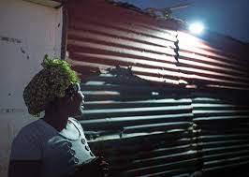
Project sunshine

Slide 13
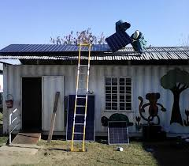
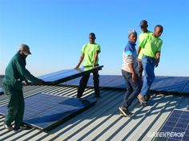
Project sunshine

Slide 14
Summary
Universal access
Process certainty
Artificial constraints on RE
IPCC and IRP emissions
Eskom’s role
www.greenpeaceafrica.org

