Slide 1

2017 – 18 Annual Report Briefing to
Portfolio Committee on Transport,
Parliament of the Republic of South Africa
14h30 – 17h00, 11 October 2018 Mr JR Chuwe: Registrar/Chief Executive Officer
Townhouse Hotel Adv MLT Bilikwana: Head: Legal & Governance
Corporation Street Ms P Moalusi: CA (SA) Chief Financial Officer
CAPE TOWN Mr BS Chaplog CA (SA) Chairperson: Audit & Risk Committee

Slide 2

Contents
CONTENTS
Assurance Certificate & Governance (Part C)
Part A : General Information
Part B : Performance Information
  Overview of RTIA’s performance
  Performance Information by Programme / Strategic Objective
  Summary of Financial Information
Part D: Human Resource Management
Part E : Financial Information
Part F : Challenges, Solutions and Conclusion

Slide 3
Preface: Certificate of Assurance
The role of the Company Secretary is:
- to ensure recordal of the Agency’s business
- provide advise to the Board and Executive management
- ensure compliance to all governance prescripts bearing on the Agency
The Agency’s Governance Framework is determined by the AARTO Act and the PFMA, further informed by the Company’s Act and the King IV Governance Code
The CoSec & Head of Legal & Governance, hereby gives assurance to Parliament that the RTIA has fully complied with all applicable governance requirements

Slide 4
Part C : Governance
Part C : Governance
Annual Report pages 100 to 118

Slide 5
Part C : Governance
  The Agency was fully constituted with a Board and operated with applicable Board Committees as follows:
  - Audit & Risk Committee
  - Technical Committee
  - HR & Remunerations Committee
  - Chairpersons’ Committee
  The Administrative arm is headed by the Registrar who sits at the apex of the Executive Committee
  The Agency also had a fully operational Management Committee

Slide 6
Part C : Governance
  Due to the intensity of the AARTO Amendment Bill process, the Agency engaged Parliament at the PCoT & NCoP on 10 occasions during the year
  Furthermore engaged 8 Provincial Legislatures for the tabling of the Amendment Bill, with the exception of the Northern Cape Legislature
  Public Hearings on the Bill were held in 6 Provinces by end of financial year
  All the governance structures have fully developed charters that regulate their operations
  The various Board Committees were chaired by Board members

Slide 7
Part C : Governance
  The Board recognised the increased number of meetings during the year, as in the preceding year, with a total of 12
  Significant challenges continued regarding the interpretation of oversight and operational responsibilities, resulting in a strain in relations
  To enhance governance, the Agency underwent a compulsory 5 year external audit quality assurance and was found satisfactory
  The Agency scored highly on the King IV good governance code
  The Risk Management Framework was updated and included Strategic risks which were overseen by the Board

Slide 8
Part C : Governance
  The Internal Audit Unit continued operating independent of management and reporting to the ARC, with the AG placing reliance on its work
  Fraud Policy and Fraud Prevention Plan was approved by the Board
  An independent anti-fraud hotline continued operating and nothing significant was reported during the year
  The Board’s term expired on 31 July 2018 and the Agency awaits the appointment of a new Board
  In the meantime, the Agency has invoked Section 49(2)(b) of the PFMA, empowering the CEO as the Accounting Authority until the new Board is appointed

Slide 9
Part A : General Information
Part A :
General Information
Annual Report pages 5 to 30

Slide 10
Part A : General Information
  Vision
A safer road user community
  Mission
  To encourage compliance with road traffic laws through procedurally fair and lawful adjudication

Slide 11
Part A : General Information
  Mandate
Encourage compliance to road traffic laws
Encourage payment of penalties
Establish effective adjudications procedures
Alleviate the burden on courts
Penalise infringers through demerit points
Reward compliant behaviour with reduction of demerit points
Establish Agency to support las enforcement
Strengthen cooperation between prosecution and law enforcement

Slide 12
Part A : General Information
  The essence of the Agency’s mandate is to effect a change in road user behaviour resulting in increased road safety

Slide 13
Part A: General Information
Applicable Legislative Mandates governing the Agency
Name of Act | Provisions
Constitution, Section 32 | Access to information
Constitution, Section 33 | Just administrative action
Constitution, Section 34 | Access to Courts
AARTO, NRTA, | Operational mandate, road traffic and transport

Slide 14
Part A: General Information
Applicable Legislative Mandates governing the Agency
Name of Act | Provisions
PAJA, 2002 | Promotion of Administrative justice
PAIA, 2000 | Promotion of Access to Information
PFMA, 1999 | Regulation of financial management
ECTA, 2000 | Regulation of electronic communications

Slide 15
Part A: General Information
Relevant Court Rulings
Litigation | Nature
Fines 4 U & Audi Johannesburg v Deputy Registrar of RTIA & Others | Review of decisions of Representations Officers
Brian Edwards v Metropolitan Municipality of Tshwane & RTIA | Compelling municipality to issue licence disk after Enforcement Orders issued
Howard Demborvsky v Minister of Transport & Others | Contesting Constitutionality of AARTO provisions & Regulations Allegations of contravening right to a fair trial enshrined in the Constitution Cancellation of Infringement Notices after election to Court

Slide 16
Part A: General Information
Status on PCoT’s Observations from the 2016/17 AR
Aspect | Status of implementation
Advised Agency to ensure SMART definition of its APP targets | Appreciated. Agency updated its KPIs to ensure alignment to SMART principles
Acknowledged the Agency’s consistent high performance with 85% rating of APP but emphasised that it expects 100% achievement going forth | Appreciated. Agency committed to continue high performance and aiming for 100% achievement from the 2018/19 APP
Expressed concern of excessive number of Board meetings | Noted. Agency endeavoured to curtail the number of meetings

Slide 17
Part A: General Information
Status on PCoT’s Observations from the 2016/17 AR
Aspect | Status of implementation
Congratulated Agency for clean audit | Appreciated. The Agency is fully committed to clean administration and good governance and always aims for clean audits
Advised the Agency to be more focussed on road safety innovations and outcome, than on revenue | Appreciated. The Agency will put more emphasis on road safety innovation and reporting on impact of its innovations
When is the Agency intending to finalise its funding model | The funding model has been finalised. Subsequent to the promulgation of the AAB, the relevant aspects would be updated

Slide 18
Part A: General Information
Status on PCoT’s Observations from the 2016/17 AR
Aspect | Status of implementation
What was the reason for the decline in the Agency’s revenue? | It is directly related to the decline in infringements issued by the Issuing Authorities. The decline is even greater for the 2017/18 period.
How does the Agency address itself to the AG’s findings? | The Agency continues to monitor and enhance its internal system of control & reports on compliance to the ARC & Board every quarter
Is the Agency’s achievement of a huge surplus not at the expense of service delivery? | No, it is not. The Agency’s surplus is related to building adequate reserves to support national rollout

Slide 19
Part A : General Information
  Performance Overview
The Agency continued with its stakeholder engagement processes in preparation for rollout
- AARTO National Task Team & Provinces
- Interfaith movement
- SABS, Public transport operators,
Continued international leverages through the Monash University Accident Research Centre & the United Nations Road Safety Collaboration (UNRSC) & further established relations with Swedish Transportation Agency

Slide 20
Part A : General Information
  Performance Overview
Obtained unqualified audit opinion
Increased revenue collection by R20 m compared to previous year
Continued to increase transport skills through empowerment & training with MUARC and Swedish Transportation Agency
RTIA maintained optimum levels of efficacy by meeting its target of adjudicating 100% of received representations within 21 days
For the year under review the Agency achieved 88% of set APP targets
Completed development of its funding model

Slide 21
Part A : General Information
  Performance Overview
Disbursed a total of R181m to various stakeholders
The Agency continued to successfully suppress numerous litigations which could have had serious implications to the Agency and key role-players

Slide 22
Part B : Performance Information
Part B : Performance Information
Annual Report pages 33 to 94

Slide 23
Part B : Performance Information
Overview of RTIA’s performance
Service delivery environment
One of South Africa's greatest challenges:
significant reduction of the road carnage!
The number of road traffic crashes and fatalities are directly proportional to:
The level of lawlessness and driver misbehaviour;
Continuous visible and efficient law enforcement;
Effective public awareness & communication programmes; and
Efficient, transparent & expeditious adjudication of road traffic violations.

Slide 24
Part B : Performance Information
Overview of RTIA’s performance
RTIA assists the various road traffic departments and Issuing Authorities to enhance effective law enforcement by:
monitoring adherence with road traffic law enforcement programmes, plans and targets;
provision of performance information on issuing authorities collected by means of the AARTO process and
The easy identification of infringements with a view to informing interventionist strategies and operational plans.

Slide 25
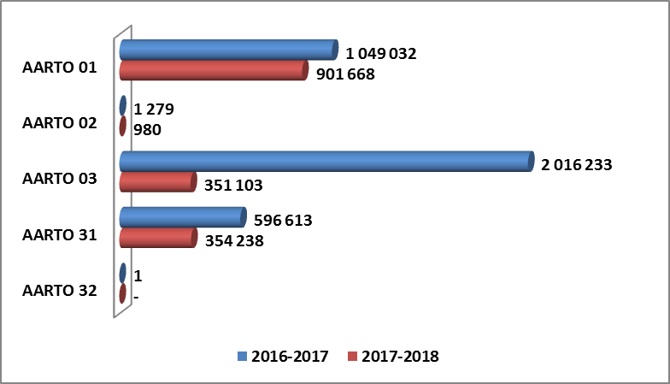
Number of Notices Captured per Type
Part B : Performance Information
2016-2017
Total = 3 663 158
2017-2018
Total = 1 607 989

Slide 26
Number of Notices Captured per Type
Part B : Performance Information
AARTO 01 - Hand written notices

Slide 27
Number of Notices Captured per Type
Part B : Performance Information
AARTO 02 - electronic notices created at the weighbridges

Slide 28
Number of Notices Captured per Type
Part B : Performance Information
AARTO 03 - Camera captured notices

Slide 29
Number of Notices Captured per Type
Part B : Performance Information
AARTO 31 - unattended vehicle

Slide 30
Number of Notices Captured per Type
Part B : Performance Information
AARTO 32 - Offences at the roadside

Slide 31
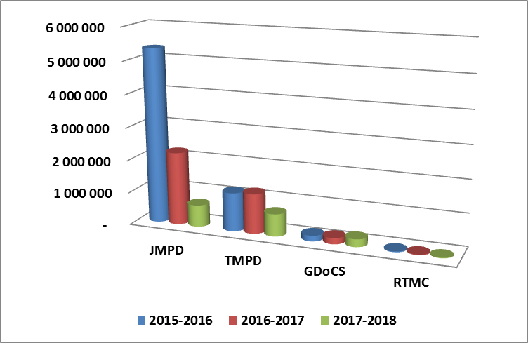
Notices Captured per Issuing Authority
Part B : Performance Information
2017-2018
Decrease for all the IA’s

Slide 32
Part B : Performance Information
Elective Options Exercised by Infringers
Available elective options are the following :
Payment of the penalty
Notification to make payment in Instalments
Submit a Representation
Nomination of the driver or person in control
Elect to be tried in court

Slide 33
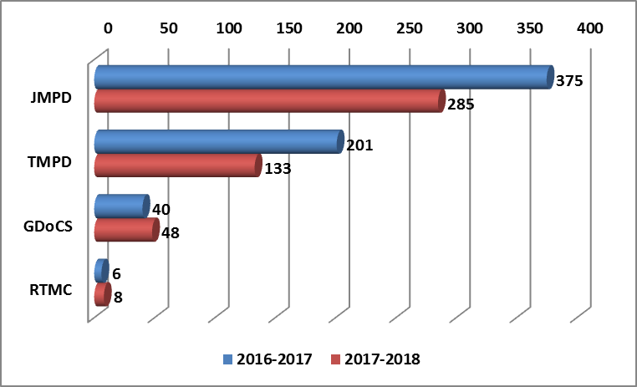
Part B : Performance Information
Number of Notification to Pay in Instalments

Slide 34
Part B : Performance Information
Number of Notification to Pay in Instalments
2016-2017 2017-2018
23.79% decrease

Slide 35
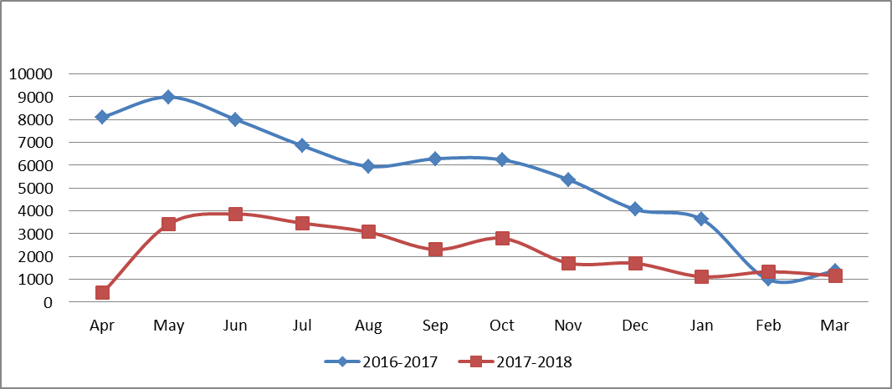
Part B : Performance Information
Nomination of drivers
2016-2017
Total 65 868
2017-2018
Total 26 376

Slide 36
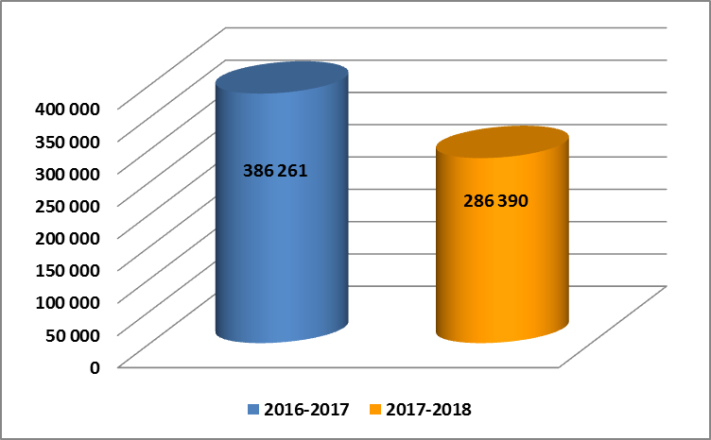
Part B : Performance Information
Elections to be tried in Court
Decrease of 25.86% in
2017-2018

Slide 37
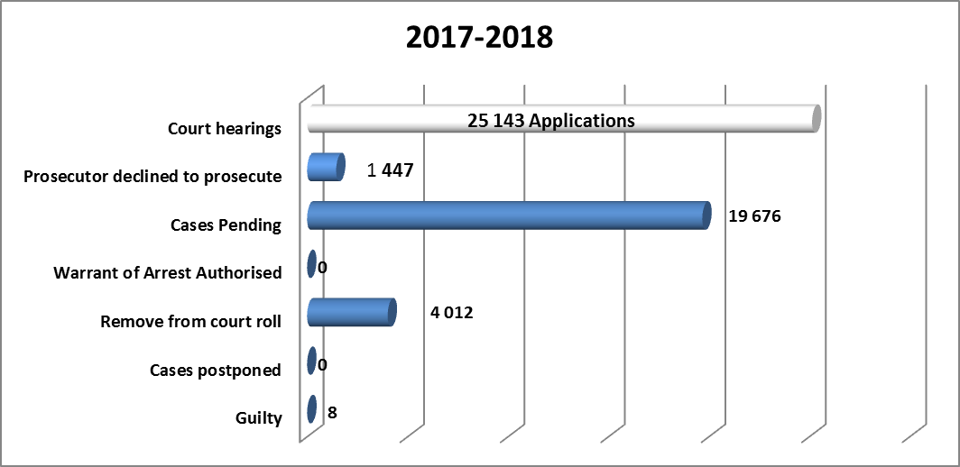
Part B : Performance Information
Matters set at court based on Elections to be tried in Court

Slide 38
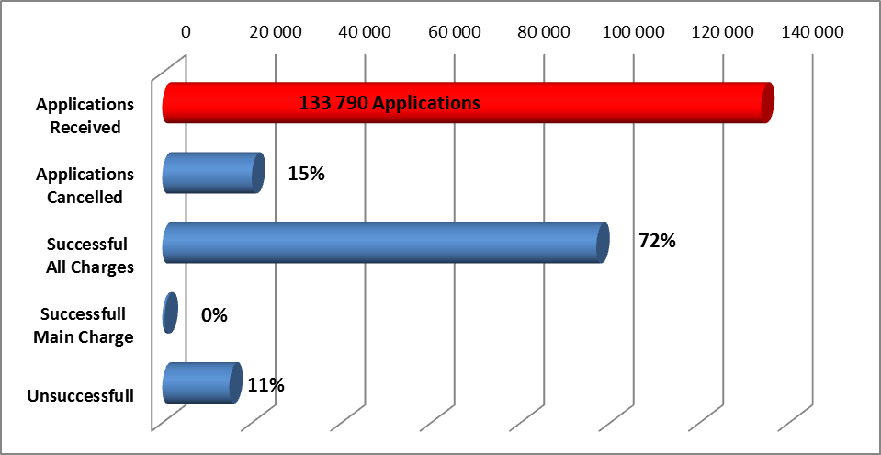
Part B : Performance Information
Adjudication of Representations 2017-2018

Slide 39
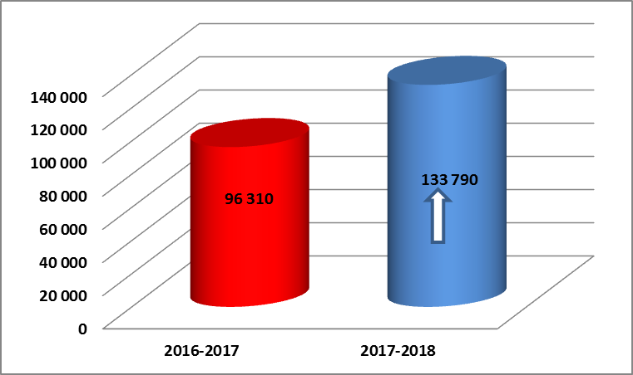
Part B : Performance Information
Adjudication of Representations 2016-2017 VS 2017-2018
38.92% increase in
2017-2018

Slide 40
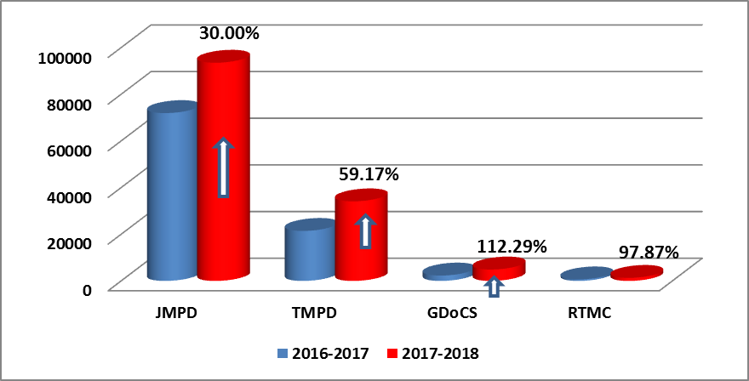
Part B : Performance Information
Submission of Representations per IAs
2017-2018
Increase for all the IA’s
JMPD: 93 502
TMPD: 34 103
GDOCS: 4 887
RTMC: 1 298

Slide 41
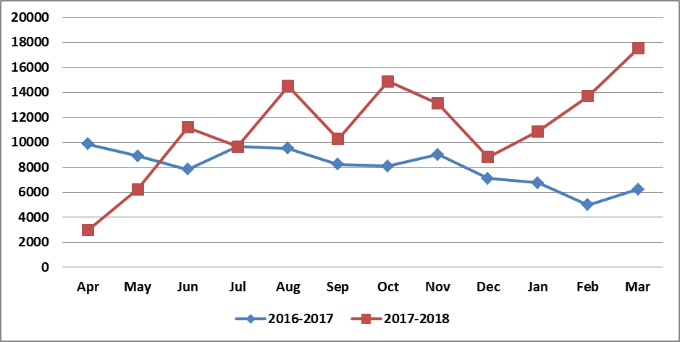
Part B : Performance Information
Adjudication of Representations 2016-2017 VS 2017-2018
Month to month comparison

Slide 42
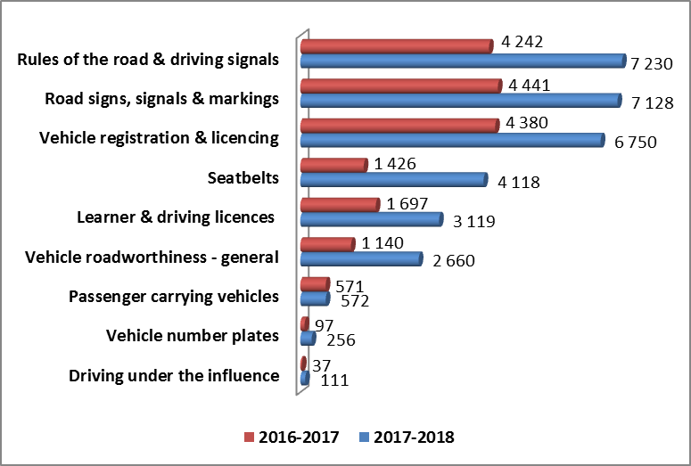
Part B : Performance Information
Some charges on which representations are based
Increase in 2017-2018

Slide 43
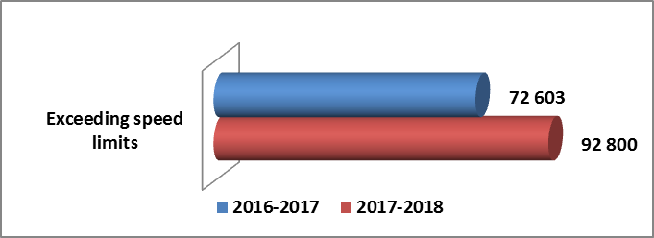
Part B : Performance Information
Cont… Some charges on which representations are based

Slide 44
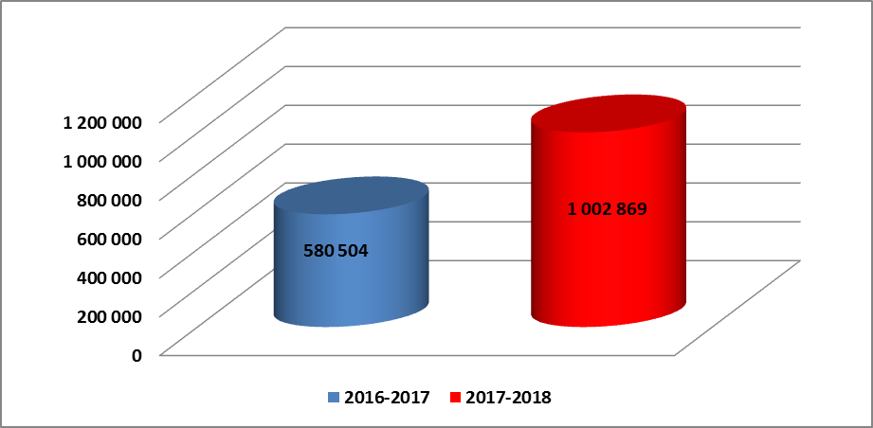
Part B : Performance Information
Courtesy Letters Issued
72.76% increase in
2017-2018

Slide 45
Part B : Performance Information
Courtesy Letters Issued
72.76% increase in
2017-2018
2017-2018
AARTO 01 = 794 800 79.25%
AARTO 02 = 635 <1%
AARTO 03 = 173 989 17.35%
AARTO 03a = 8 445 <1%
AARTO 03b = 25 000 2.49%

Slide 46
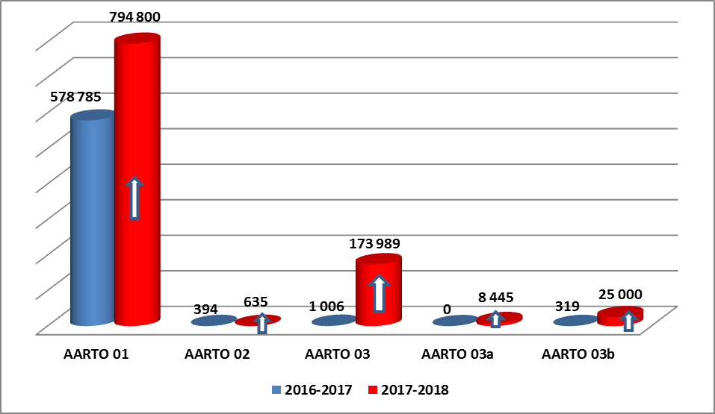
Part B : Performance Information
Courtesy Letters Issued per AARTO Type
2017-2018 increases
AARTO 01 = 37.32%
AARTO 02 = 61.17%
AARTO 03 = 17195.13%
AARTO 03a = 100%
AARTO 03b = 7736.99%

Slide 47
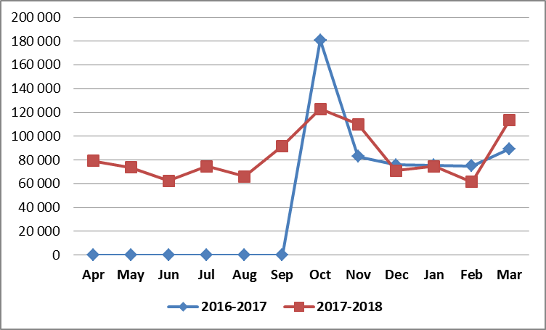
Part B : Performance Information
Courtesy Letters Issued
Month to month comparison

Slide 48
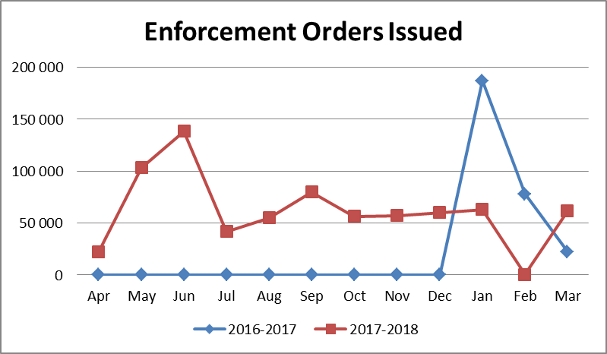
Part B : Performance Information
Enforcement Orders Issued
Month to month comparison

Slide 49
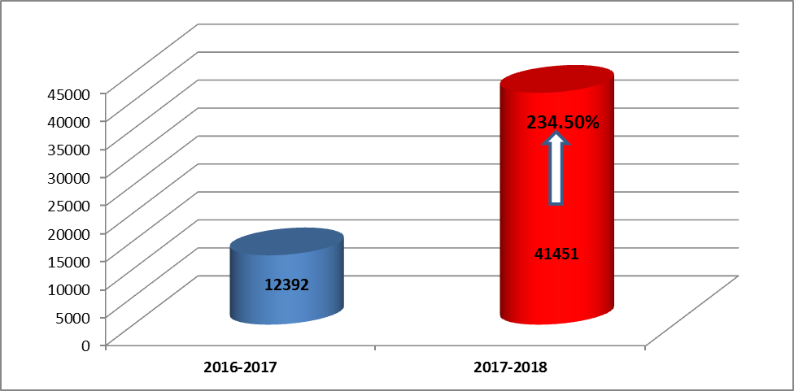
Part B : Performance Information
Revocation of Enforcement Orders Applications

Slide 50
Part B : Performance Information
Applications for Revocation of Enforcement Orders
Unsuccessful Reps

Slide 51
Part B : Performance Information
Applications for Revocation of Enforcement Orders
Successful Reps

Slide 52
Part B : Performance Information
Applications for Revocation of Enforcement Orders
Successful Vs Unsuccessful Reps
Unsuccessful Revocation of EO
Successful Revocation of EO

Slide 53
Strategic outcome orientated goals of the RTIA
Part B : Performance Information

Slide 54
Part B : Performance Information
Strategic objective 1:
Effective administration and resourcing of the Agency to deliver on its mandate

Slide 55
Part B : Performance Information
Strategic objective 1:
Effective administration and resourcing of the Agency to deliver on its mandate
Approval of ERP Model
% of Workplace Skills
Plan implemented

Slide 56
Part B : Performance Information
Strategic objective 1:
Effective administration and resourcing of the Agency to deliver on its mandate
Approval of ERP Model
% of Workplace Skills
Plan implemented
100%

Slide 57
Part B : Performance Information
Strategic objective 1:
Effective administration and resourcing of the Agency to deliver on its mandate
Approval of ERP Model
% of Workplace Skills
Plan implemented
100%
100%

Slide 58
Part B : Performance Information
Strategic objective 1:
Effective administration and resourcing of the Agency to deliver on its mandate
100%
Approval of ERP Model
% of Workplace Skills
Plan implemented
100%
100%

Slide 59
Part B : Performance Information
Strategic objective 2:
Discourage the contravention of road traffic laws

Slide 60
Part B : Performance Information
Strategic objective 2:
Discourage the contravention of road traffic laws
% of received representations adjudicated within 21 days
Develop alternative
funding model to ensure
Agency sustainability

Slide 61
Part B : Performance Information
Strategic objective 2:
Discourage the contravention of road traffic laws
% of received representations adjudicated within 21 days
Develop alternative
funding model to ensure
Agency sustainability
100%

Slide 62
Part B : Performance Information
Strategic objective 2:
Discourage the contravention of road traffic laws
% of received representations adjudicated within 21 days
Develop alternative
funding model to ensure
Agency sustainability
100%
100%

Slide 63
Part B : Performance Information
Strategic objective 2:
Discourage the contravention of road traffic laws
100%
% of received representations adjudicated within 21 days
Develop alternative
funding model to ensure
Agency sustainability
100%
100%

Slide 64
Part B : Performance Information
Strategic objective 3:
Co-ordinate and facilitate readiness for national implementation of AARTO

Slide 65
Part B : Performance Information
Strategic objective 3:
Co-ordinate and facilitate readiness for national implementation of AARTO
Dissemination of AARTO
Information to IA’s
% of IA’s readiness for AARTO
Roll Out in 2017/18

Slide 66
Part B : Performance Information
Strategic objective 3:
Co-ordinate and facilitate readiness for national implementation of AARTO
Dissemination of AARTO
Information to IA’s
100%
% of IA’s readiness for AARTO
Roll Out in 2017/18

Slide 67
Part B : Performance Information
Strategic objective 3:
Co-ordinate and facilitate readiness for national implementation of AARTO
Dissemination of AARTO
Information to IA’s
100%
% of IA’s readiness for AARTO
Roll Out in 2017/18
100%

Slide 68
Part B : Performance Information
Strategic objective 3:
Co-ordinate and facilitate readiness for national implementation of AARTO
100%
Dissemination of AARTO
Information to IA’s
100%
% of IA’s readiness for AARTO
Roll Out in 2017/18
100%

Slide 69
Part B : Performance Information
Strategic objective 4:
Influence change in road user behaviour

Slide 70
Part B : Performance Information
Strategic objective 4:
Influence change in road user behaviour
Number of campaigns
implemented to influence
change in road user behaviour
Service outlets established

Slide 71
Part B : Performance Information
Strategic objective 4:
Influence change in road user behaviour
Number of campaigns
implemented to influence
change in road user behaviour
100%
Service outlets established

Slide 72
Part B : Performance Information
Strategic objective 4:
Influence change in road user behaviour
Number of campaigns
implemented to influence
change in road user behaviour
0%
100%
Service outlets established

Slide 73
Part B : Performance Information
Strategic objective 4:
Influence change in road user behaviour
50%
Number of campaigns
implemented to influence
change in road user behaviour
0%
100%
Service outlets established

Slide 74
Part B : Performance Information
Overall Agency Performance
Overall Agency Performance
Strategic Objective 1
100%
Strategic Objective 2
100%
Strategic Objective 3
100%
Strategic Objective 4
50%

Slide 75
Part B : Performance Information
Overall Agency Performance
Overall Agency Performance
87.5%
Strategic Objective 1
100%
Strategic Objective 2
100%
Strategic Objective 3
100%
Strategic Objective 4
50%

Slide 76
Part D : Human Resource Management
Part D : Human Resources
Annual Report pages 121 to 128

Slide 77
Part D : Human Resource Management
  The Board approved a new organisational structure
  The Agency prioritised the learning & development of staff
  5 employee were exposed to specialised Road Safety training through MUARC and Swedish Transport Agency
  A two dimensional bursary scheme was implemented, with both an internal and external focus
  An internship scheme was implemented and 20 young graduates provided with core skills to increase their employability

Slide 78
Part D : Human Resource Management
  The performance management framework was implemented for the second year to track , encourage and reward outstanding employee performance
  Employee attrition remained low at 5, with 1 death, 1 termination and 3 resignations
  A recognition agreement was signed with a second labour union which became the majority representative union
  A key challenge remains ability to attract representative employment equity candidates

Slide 79
Part E : Financial Information
Part E : Annual Financial Statements
Financial Statements 131 to 177

Slide 80
Part E : Financial Information
Audited | 2017/18 | 2016/17 | Movement
Revenue | 183 732 656 | 150 998 187 | 21.68%
Infringement fees | 166 036 656 | 140 906 187 | 17.83%
MTEF Grant | 17 696 000 | 10 092 000 | 75.35%
Other Income | 10 300 | 151 291 | -93.19%
Expenses | (222 706 877) | (144 973 644) | 53.62%
Net Finance Income | 8 656 396 | 9 929 552 | -12.82%
Surplus/(Deficit) from for the period | (30 307 525) | 16 105 386

Slide 81
Part E : Financial Information
Audited | 2017/18 | Restated 2016/17 | Movement
Assets
Non- Current Assets | 4 834 417 | 6 768 490 | -28.57%
Current assets | 223 873 336 | 256 968 114 | -12.88%
Total Assets | 228 707 753 | 263 736 604 | -13.28%
Net Assets | 96 854 310 | 194 685 046 | -50.25%
Current Liabilities | 131 853 443 | 69 041 814 | +90.98%
Total net assets and liabilities | 228 707 753 | 263 736 604 | -13.28%

Slide 82
Part E : Financial Information
Infringement fees have increased by 17.83% from the prior period. The infringement revenue is still below expectation as a result of the non-issuance of camera-generated notices by the Issuing authorities.
The significant increase in operating expenses is due to the education and awareness campaigns. The agency heeded the call of the Public Protector & the Shareholder to improve on education and awareness of AARTO in line with the Agency’s core mandate.
By the end of 2017/18 the Agency had realised a deficit mainly due to suppressed revenue brought by a 56% decline in infringement notices from Issuing Authorities.
Current and non-current assets declined during the financial year as the Agency reduced spending on assets as the staff numbers remained stable over the financial year.

Slide 83
Part E : Financial Information
Current liabilities increased significantly due to the request by National Treasury for the Agency to surrender the prior year surplus up to R69million. This surplus is raised as a payable due to National Treasury should the Agency’s request to retain it be finally denied.
The Agency’s cash reserves are still available to settle this debt with National Treasury should the appeal process be unsuccessful.
The Agency has faced several challenges in the 2017/18 financial year, the diminished law enforcement activity by Issuing Authorities and the declining economic performance of the country continue to put the Agency under tremendous pressure.

Slide 84
Part E : Financial Information
Despite the deficit for the year, the Agency remains a going concern into the foreseeable future, this is noted in the strong financial position reported at year end. The total assets reported are in excess of the liabilities by 1.7:1.
A current ratio of 1.7:1 means the Agency has healthy liquidity and is still in a strong position to settle any debts as they become due.
The Agency is in a strong solvent position with a solvency ratio of 0.57% meaning that the Agency’s total debt only makes up 0.57% of its total assets. Any number above 1 would be a cause for concern.
Stakeholder engagements continue to be the core activity in preparation for AARTO roll-out readiness towards the successful implementation of AARTO nationwide.

Slide 85
Part E : Financial Information
Budget to Actual analysis
Expenditure | Actual | Budget | Difference
Revenue | 183 732 656 | 387 923 000 | (204 190 344)
Personnel Cost | 82 216 347 | 151 300 496 | 69 084 149
Operating Expenses | 98 405 910 | 153 335 959 | 54 930 049
Postage | 33 417 924 | 83 286 546 | 49 868 622
Total Expenditure | 214 040 181 | 387 923 001 | 173 882 820

Slide 86
Part E : Financial Information
Despite the deficit realised in the statement of financial performance for 2017/18, the Agency still spent below budget.
The Agency continues to spend carefully in anticipation of AARTO National roll-out to ensure there are enough reserves in place.
During the 2017/18 audit the AGSA raised irregular expenditure for goods procured on an approved deviation.
The Agency went on an approved deviation to purchase goods directly from a large wholesaler in order to eliminate commission costs and mark-ups. Savings were also realised by the Agency in this regard due to discounts.
The Agency has made significant strides in improving its financial management, while ensuring cost containment measures are strictly adhered to where possible.

Slide 87
Part E : Financial Information
Name | 2017/2018 | 2016/2017
AARTO assets due from:
AARTO Net Assets | 13 145 233 | 12 827 702
Other collecting agents | 7 430 549 | 6 030 782
RTMC | 1 084 094 | 1 084 094
RTIA | 882 260 | 882 260
TMPD | 1 816 326 | 892 256
JMPD | 8 733 595 | 503 201
Total | 33 092 058 | 22 220 295
AARTO liabilities due to Issuing Authorities:
GDOC | 2 846 232 | 1 648 088
RTMC | 327 133 | 341 206
RTIA | 29 918 693 | 20 231 001
Total | 33 092 058 | 22 220 295

Slide 88
Part E : Financial Information
AARTO Performance
The AARTO accounts are subjected to an audit by the AGSA. This year’s audit was carried out as part of the overall Agency audit.
The audit of the AARTO accounts ensures that the Agency remains accountable to key AARTO stakeholders and allows the municipalities to obtain assurance over the AARTO accounts.
The Agency continued to service the AARTO stakeholders in terms of its legislated mandate.

Slide 89
Part E : Financial Information
Part E : Audit Report
Part of Annual Financial Statements on pages 131 to 177

Slide 90
Part E : Financial Information
Audit Committee Report
The Audit & Risk Committee was fully and properly constituted for the year under review
Complied with all its responsibilities in the PFMA and Treasury Regulations
Confirms the effectiveness of the Agency’s internal controls
Confirms the assurance given to the Board & Shareholder about the business of the Agency and its healthy financial status
Confirms that it evaluated the Agency’s financial statements and satisfied itself about its accuracy
Concurs with and recommends that the Shareholder accepts the audited financial statements and opinion of the Auditor General

Slide 91
Part E : Financial Information
Auditors Report
AG has issued unqualified audit opinion for the 2017/18 reporting period, that the financial statements are fairly presented in all material respects.
This is the 7th consecutive year that the Agency receives the highest audit opinion (unqualified or clean opinion)
In line with the AG’s responsibility to report material findings of non-compliance with key legislation, the AG has reported that the Agency has for the year under review complied with all the relevant legislation
The Agency did not incur any fruitless expenditure for the year under review.
Only one instance of irregular expenditure noted (approved deviation)

Slide 92
Part E : Performance Information
Summary of audit conclusions
The following is a summary of the AG’s conclusions on the usefulness and reliability of the reported performance information individually:
Selected objective | Usefulness | Reliability
Objective 1: 1 Discourage the contravention of road traffic laws | Unqualified | Adverse
Objective 2: Co-ordinate and facilitate readiness for national implementation of AARTO | Unqualified | Unqualified
Objective 3: Influence change in road user behaviour | Unqualified | Unqualified

Slide 93
 | Financial statements |  | Performance reporting |  | Compliance with legislation
 | Current year | Prior year | Current year | Prior year | Current year | Prior year
Leadership
Overall movement from previous assessment
Provide effective leadership based on a culture of honesty, ethical business practices and good governance, and protecting and enhancing the best interests of the entity
Exercise oversight responsibility regarding financial and performance reporting and compliance as well as related internal controls

Slide 94
 | Financial statements |  | Performance reporting |  |  | Compliance with legislation
 | Current year | Prior year | Current year |  | Prior year | Current year | Prior year
Leadership
Overall movement from previous assessment
Implement effective human resource management to ensure that adequate and sufficiently skilled resources are in place and that performance is monitored
Establish and communicate policies and procedures to enable and support the understanding and execution of internal control objectives, processes and responsibilities

Slide 95
 | Financial statements |  | Performance reporting |  | Compliance with legislation
 | Current year | Prior year | Current year | Prior year | Current year | Prior year
Leadership
Overall movement from previous assessment
Develop and monitor the implementation of action plans to address internal control deficiencies
Establish and implement an information technology governance framework that supports and enables the business, delivers value and improves performance

Slide 96
 | Financial statements |  | Performance reporting |  | Compliance with legislation
 | Current year | Prior year | Current year | Prior year | Current year | Prior year
Financial and performance management
Overall movement from previous assessment
Implement proper record keeping in a timely manner to ensure that complete, relevant and accurate information is accessible and available to support financial and performance reporting
Implement controls over daily and monthly processing and reconciling transactions
Prepare regular, accurate and complete financial and performance reports that are supported and evidenced by reliable information

Slide 97
 | Financial statements |  | Performance reporting |  | Compliance with legislation
 | Current year | Prior year | Current year | Prior year | Current year | Prior year
Financial and performance management
Overall movement from previous assessment
Review and monitor compliance with applicable legislation
Design and implement formal controls over information technology systems to ensure the reliability of the systems and the availability, accuracy and protection of information |  |  |  |  | N/A

Slide 98
 | Financial statements |  | Performance reporting |  |  | Compliance with legislation
 | Current year | Prior year | Current year | Prior year |  | Current year | Prior year
Governance
Overall movement from previous assessment
Implement appropriate risk management activities to ensure that regular risk assessments, including the consideration of information technology risks and fraud prevention, are conducted and that a risk strategy to address the risks is developed and monitored
Ensure that there is an adequately resourced and functioning internal audit unit that identifies internal control deficiencies and recommends corrective action effectively

Slide 99
 | Financial statements |  | Performance reporting |  | Compliance with legislation
 | Current year | Prior year | Current year | Prior year | Current year | Prior year
Governance
Ensure that the audit committee promotes accountability and service delivery through evaluating and monitoring responses to risks and overseeing the effectiveness of the internal control environment, including financial and performance reporting and compliance with legislation

Slide 100
Part F:
Challenges, Solutions, & Conclusion

Slide 101
Part F: Challenges Experienced
Challenges | Proposed Solutions
Systems performance Deficiencies in systems interfaces (NCR – SAPO), eNaTIS Data integrity, Enhancement of business logic | Usage of the latest technological advancements for data and information processing Electronic interfaces & service of documents as per Amendment bill

Slide 102
Part F: Challenges Experienced
Challenges | Proposed Solutions
Inadequate legislative framework Legislative deficiencies impeding implementation Communication & empowerment programmes | Excellent progress of Amendment Bill Promulgation – Approved by National Assembly on 5 September 2017, now at final stages with NCoP Leveraging on mass-based community outreach & empowerment programmes, through the ED & inter-faith movement Submitted request for Cabinet approval of Declaration of a National Prayer Day for Road Safety

Slide 103
Part F: Challenges Experienced
Challenges | Proposed Solutions
Comprehensive co-ordination and stepping up of national rollout preparations Board membership expired 30 November 2017 and fluxed 31 July 2018 after 3 extensions | Regular engagements with all stakeholders (ANTT, Provinces, SAPS, IAs, public) Continuation of extensive educational and communication programmes, including electronic and print media Awaiting finalisation of new Board appointment - Section 49(2)(b) of the PFMA invoked and implemented to enhance governance

Slide 104
Part F: Challenges Experienced
Challenges | Proposed Solutions
Performance environment & mandate pursuit Staff diversity 4th Industrial Revolution, Artificial Intelligence | Entrenchment of a high performance culture Alignment of organisational structure Implementation of skills development & retention strategy Implementing targeted diverse recruitment Development of new organisational strategy, catalyst ICT infrastructure, disruptive technologies,

Slide 105
Conclusion
Parliament’s unwavering support towards the RTIA never goes unnoticed
The RTIA will repay this vote of confidence through:
  Attainment of its mandate
  Contributing towards job creation, leveraging 4IR & AI
  Contributing to increased road safety through behavioural change & rehabilitation programmes
  Prioritising road safety through commemoration of National Prayer Day for Road Safety

Slide 106
Conclusion
The RTIA wants to be at the forefront of change to leverage on game-changing ICT environmental platforms and opportunities of the 4IR and AI for enhanced road safety

Slide 107
Thank You!

