Slide 1
Presentation to the Portfolio Committee on Communications

Slide 2
Contents
1 | MDDA Mandate
2 | Legislative Environment
3 | National Development Plan
4 | Alignment with DoC
5 | Impact Study
6 | 2017/2018 Performance
7 | Human Resources
8 | Report on Audit Outcome
9 | Financial Performance

Slide 3
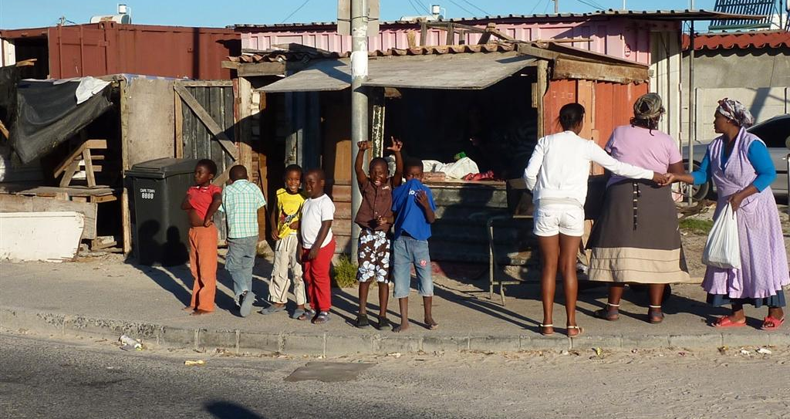
MDDA Mandate
Encourage the development of human resources and training, and capacity building, within the media industry, especially amongst HDGs
Encourage the channeling of resources to the community media sectors. Raise public awareness with regard to media development & diversity issues
Encourage ownership of, and access to, media by historically disadvantaged groups as well as by historically diminished indigenous language and cultural groups
Support initiatives which promote literacy and a culture of reading. Encourage research regarding media development & diversity

Slide 4
Legislative Environment
Electronic Communication Act no. 35 of 2005
Promotion of Administrative Justice Act.No.3 of 2000 (PAJA)
.
Public Finance Management Act No.1 of 1999 (PFMA)
The Independent Communications Authority of South Africa Act, Act no. 13 of 2000
Community Television Broadcasting Services Position Paper (2004)
White Paper on Broadcasting Policy
(1998)
Independent Communication Authority of South Africa (2015) - power to grant; renew; amend; transfer; and revoke licences
Independent Broadcasting Authority Triple Inquiry Report
(1995)

Slide 5
National Development Plan (NDP)
The NDP informs the MDDA’s Medium Term Strategic Framework (MTSF) priorities.
Outcome 12 relates to an efficient, effective and development orientated public service. This speaks to the character and nature of the MDDA as an institution and the values it should champion.
Outcome 14 relates to nation building and social cohesion as it envisions a society where South Africans will be more conscious of what they have in common than their differences. It directs the MDDA’s approach when supporting and enabling content and production elements.
Outcome 6 relates to an efficient, competitive and responsive economic infrastructure network. This highlights the role of the MDDA in assisting community media to harness the power of a rapidly changing communications environment.

Slide 6
Alignment with DoC
DoC Strategic Goal
Goal 1 - Effective and efficient strategic leadership, governance and administration
Goal 2 - A responsive communications policy regulatory environment and improved country branding
Goal 3 - Transformed communications sector
MDDA Strategic Outcome Orientated Goal
Capable and accomplished organisation in support of the delivery of the MDDA mandate by 2019
Media transformation promoted through the growth of community-based media in South Africa by 2019
Media transformation promoted through the growth of community-based media in South Africa by 2019. Body of knowledge on the community-based media sector established through focused innovation, research and development efforts by 2019

Slide 7
Impact Study
MDDA commissioned Media Monitoring Africa (MMA) to carry out an Impact Study into the MDDA with the following Brief:
Reflect and evaluate the extent to which the MDDA is responding to its mandate of community media development
Describe the impact of MDDA funded projects in terms of how they have made a difference in the communities they serve

Slide 8
Key Findings
Impact Study provided independent verification that:
MDDA has made significant impact on transforming the media landscape through the number of community and small commercial media projects funded, the majority of which are still in existence.
MDDA internal challenges such as instability of leadership (Board and Executive Management vacancies) and capacity issues detract from its ability to deliver on its mandate
Greater focus is required by MDDA on partnerships and collaboration with sister entities and sector bodies crucial to strengthen the sector
MDDA needs to review approaches to raising and disbursing funds
Regulation of print media contribution?
External challenges hinder sustainability and further growth of sector
Technological changes wreaking havoc in industry mean that MDDA funding regulations outdated

Slide 9
2017/2018 Performance

Slide 10
Overall Audit Outcome
Details | 2017/18 | 2016/17 | Movement
Audit of Financial statements | Unqualified | Unqualified | Unchanged
Findings on compliance with laws and regulations | Yes | Yes | Unchanged
Details | 2017/18 | 2016/17 | Movement
Audit of predetermined objectives (AOPOs)
Programme 2: Grant and seed funding | Qualified | Qualified | Unchanged
Programme 4: Capacity building | Unqualified | Unqualified | Unchanged

Slide 11
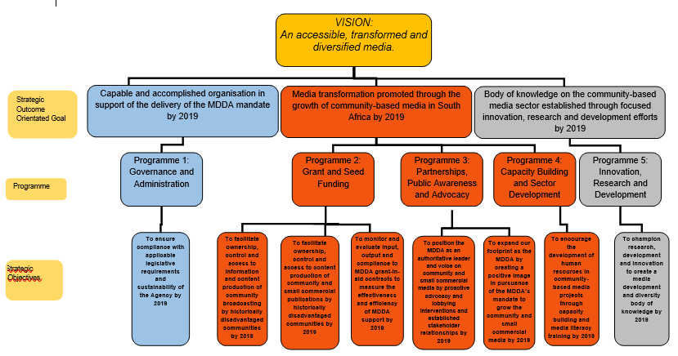
MDDA Strategy Map

Slide 12
2017/2018 Performance
MDDA achieved targets for 20 (45%) of 44 Key Performance Indicators (KPIs)
Targets for 24 KPIs (55%) were not achieved mainly due to the Board being unable to form a quorum for a significant part of the year

Slide 13
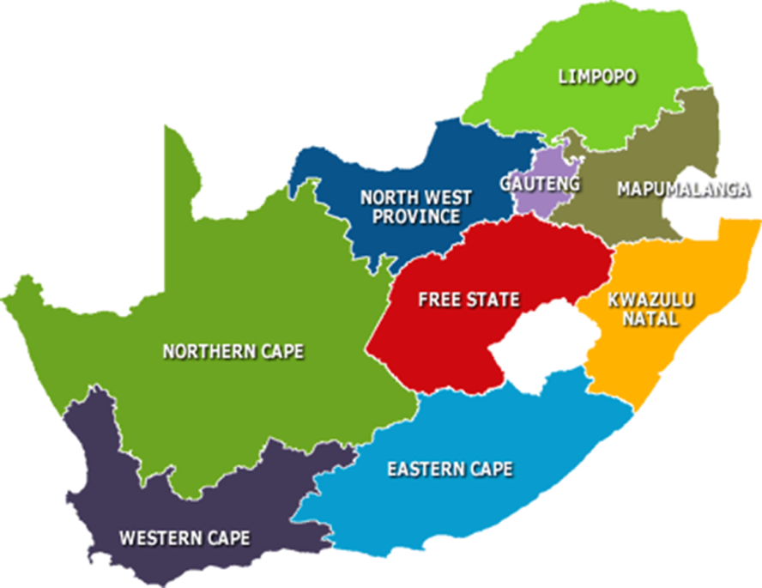
Achievements – Media Diversity
R69 million disbursed to qualifying projects:
Funding approved for 8 community broadcast projects (R 17,534,015).
Funding approved for 5 Small Commercial projects (R4,238,214) and 1 community print project (R700,000), including enabling projects to go digital.
104 direct jobs created from community broadcast projects funded.
Funding approvals restricted by due to Board not quorating for most part of the year
Projects approved for 2017/2018
2
1
3
2
2
1
1
2
Projects approved to date
32
16
24
2
9
34
16
29
27

Slide 14
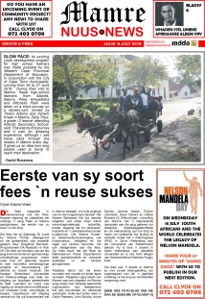
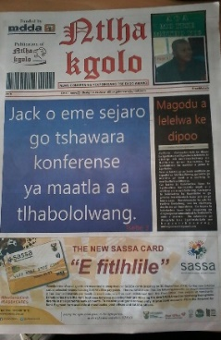
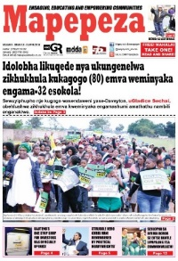
Print & Digital Media Projects funded
Print project | Location | Amount Approved | Publishing language
Kleva Nkeva Online | Eastern Cape (OR Tambo) | R935,979 | isiXhosa, English | Community project
Mamre News | Western Cape (Cape Town) | R700,000 | English, Afrikaans | Small Commercial – free monthly publication
Ntllhakgolo News | Northern Cape (Francis Baard) | R819,135 | Setswana, isiXhosa | Small Commercial – A3 monthly newspaper
The Youth Voice | Mpumalanga (Ehlanzeni) | R765,000 | SiSwati, Xitsonga, Sepulane, English, Afrikaans | Small Commercial – targeting youth and schools
SMME News | KwaZulu-Natal (Ilembe) | R810,500 | isiZulu, English | Small Commercial – supports capacity building for SMMEs in rural, semi-rural and township environments
Mapepeza | Gauteng (Sedibeng) | R907,600 | isiZulu, Sesotho, English | Small Commercial – free weekly newspaper
8
5
12

Slide 15
Community Radio Stations funded
Station | Location | Amount Approved | Broadcast Language
Musina FM | Limpopo (Vhembe) | R2,561,600 | Tshivenda, Sepedi, Xitsonga, Afrikaans, English | Radio is platform to bring many cultures Musina together
Vuwani CR | Limpopo (Vhembe) | R2,477,600 | Tshivenda, Xitsonga, English | Targets youth
Ndlambe FM | Eastern Cape (Sarah Bartman) | R2,654,600 | isiXhosa, English, Afrikaans | Area where unemployment is a huge challenge
Rise FM | Mpumalanga (Ehlanzeni) | R2,622,600 | Sepulana, isiSwati, Xitsonga, English | Targets whole community and all ages
Ugu Youth Radio | KwaZulu-Natal (Ugu) | R2,280,600 | isiZulu, isiXhosa, English | Youth
Ga Rankuwa CR | Gauteng (Tshwane) | R2,393,195 | Setswana, English | Student community
Poort FM | Gauteng (Tshwane) | R71,820 | Afrikaans | Shares platform with Mams FM to service Eersterus community
Diamond FM | North West (Dr Kenneth Kaunda) | R2,472,000 | Setswana, Sesotho, English, Afrikaans | Started broadcasting via internet streaming in early 2017

Slide 16
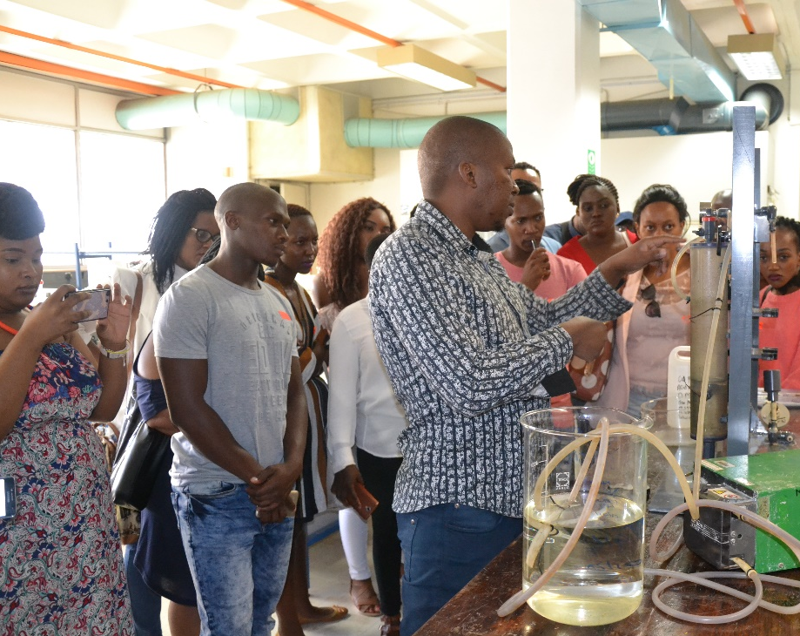
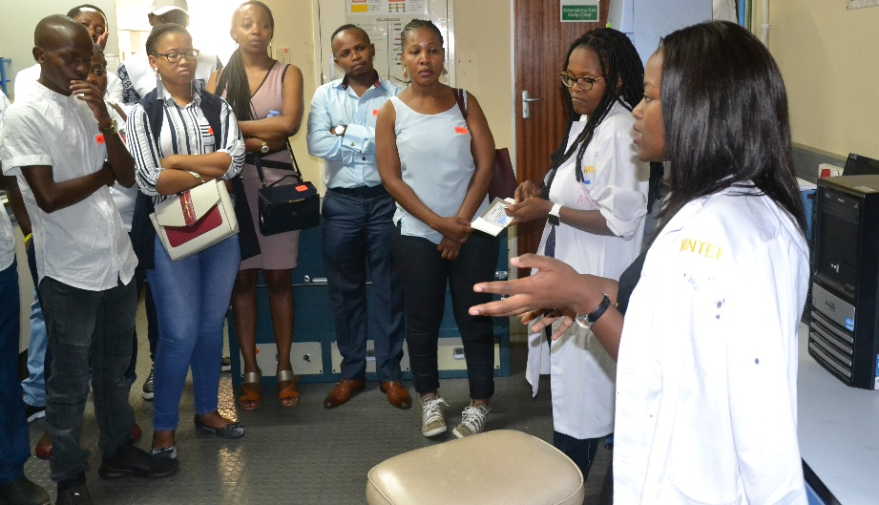
Sector Capacity Building
MDDA and SAASTA (South African Agency for Science & Technology Advancement) MoU: 47 interns were placed at community projects to develop reporting on science matters. (Non-financial support)
Ten community media practitioners attended the IAJ(Institute of Advanced Journalism) Reporting on Race and Migration Conference and were simultaneously trained on how to write and package Migration stories. (R114,180)
Grantee Orientation Workshop - contract commitment reporting. (R480,000)

Slide 17
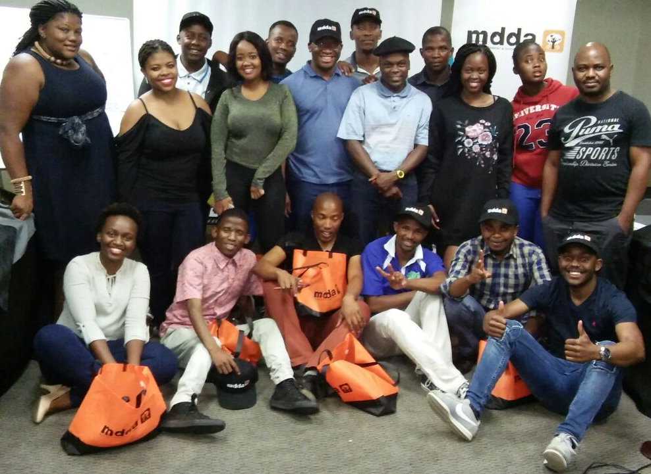
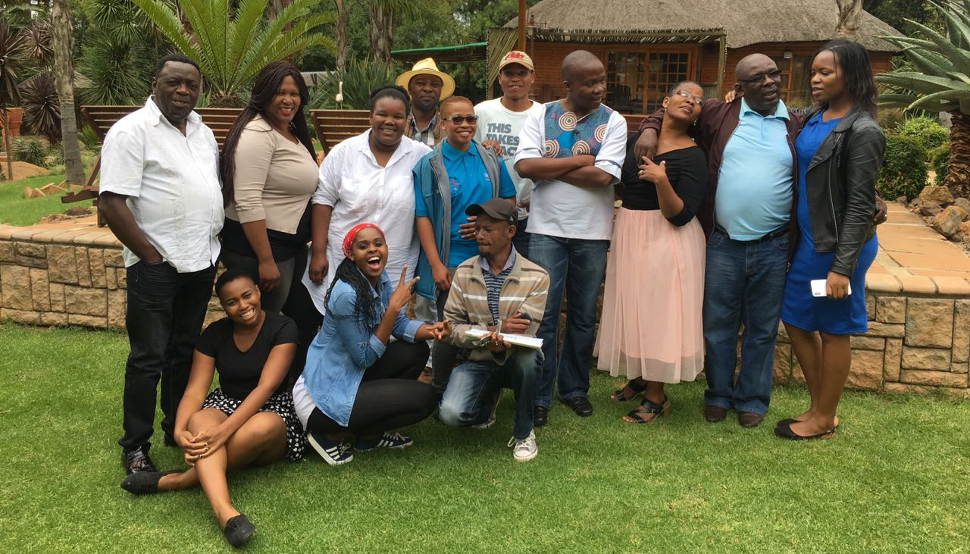
Sector Capacity Building/Research
41 print and broadcast journalists attended Stigma and Discrimination and Reduction Training workshops held in three provinces and run by the MDDA, in partnership with the Soul City Institute for Social Justice. Community media were selected from areas where HIV and tuberculosis (TB) are heavily concentrated. (R30,000)
Research commissioned into Glass Ceiling – Gender in South African Media Houses (R960,000)

Slide 18
Performance – Programme 1 Governance and Administration
1.1. Human Resources Management
Indicator | Target | Actual | Variance | Reason for Variance | Corrective Action
Number of employees trained as per Personal Development Plans | 17 | 15 | -2 | Training programmes were delayed in Q1 for completion of personnel development/ competency assessments. | Training in line with the Personal Development Plans is on track in 2018/2019.
Number of interns recruited | 5 | 5 | 0 | Achieved

Slide 19
Performance – Programme 1
1.2. Legal and Regulatory Affairs
Indicator | Target | Actual | Variance | Reason for Variance | Corrective Action
Number of compliance registers produced | 4 | 1 | -3 | Capacity constraints in the Legal unit and the Board being unable to form a quorum for much of the year restricted achievement of the target. | Vacancies in the Company Secretary’s office have been filled.
One month turn around lead time for contract vetting and approval . | 1 month | 3 months | 2 months | In addition to capacity constraints in the Legal unit, no new projects were approved in Q1, 2 and 4, due to the Board being unable to form a quorum, making it difficult to measure achievement of the target. | Vacancies in the Company Secretary’s office have been filled.
Number of MDDA policies reviewed and updated by end of quarter | 26 | 0 | -26 | Reviews and approvals of all policy reviews were deferred for new board members to familiarise themselves with the MDDA. | Review of MDDA policies has indicated significant gaps in the suite as well as a number of policies requiring considerable revision. A complete overhaul of the suite of policies is being initiated.

Slide 20
Performance - Programme 1
1.3. Financial Administration, Risk and Internal Audit
Indicator | Target | Actual | Variance | Reason for Variance | Corrective Action
Number of procurement plans submitted to National Treasury before 1 April | 1 | 1 | 0 | Achieved
Unqualified audit opinion | 1 | 1 | 0 | Achieved
Quarterly reports approved by Accounting Authority within one month of end of quarter | 4 | 4 | 0 | Achieved
Number of reviewed and updated risk management policies, frameworks and strategies | 1 | 0 | -1 | The policy, strategy and framework are pending Board approval as a result of the Board being unable to form a quorum. | Reviewed and updated documents for 2018/2019 will be submitted for approval to the Board, which is now quorating.
Number of annual strategic risk assessments conducted in April of the financial year | 1 | 1 | 0 | Achieved
Number of approved fraud and corruption prevention and awareness plans in place | 1 | 1 | 0 | Achieved
Number of approved annual internal audit plans approved by Audit and Risk Committee 1 month before internal audit cycle | 1 | 1 | 0 | Achieved
Number of risk based internal audit reports | 8 | 14 | +6 | Achieved

Slide 21
Performance – Programme 1
1.4. Information Management & Technology
Indicator | Target | Actual | Variance | Reason for Variance
Number of reviewed IT strategies approved by IT Steering Committee within 1st quarter of financial year | 1 | 1 | 0 | Achieved
Number of approved reviewed Business Continuity and Disaster Recovery Plans approved by IT Steering Committee within 1st quarter of financial year | 1 | 1 | 0 | Achieved
Quarterly assessment of upgraded and maintained ICT Infrastructure and Software completed within one month of quarter end | 4 | 4 | 0 | Achieved
Number of approved IT external projects supported and reported on within one month of quarter end | 5 | 7 | +2 | Achieved

Slide 22
Performance – Programme 2 Grant and Seed Funding
2.1. Community Broadcast Media
Indicator | Target | Actual | Variance | Reason for Variance | Corrective Action
Number of community radio stations approved by the Board for first time funding | 12 | 6 | -6 | Target not achieved due to the Board not being able to form a quorum at its meetings in Q1 and Q4. | The outstanding project approvals were rolled over to 2018/2019.
Number of community radio stations approved by the Board for strengthening | 10 | 2 | -8
Number of community TV supported for strengthening | 3 | 0 | -3 | Target not achieved as no requests from Community TV stations. | MDDA will approach the sector to identify where assistance can be provided.
Number of direct jobs created in community broadcast sector | 100 | 104 | +4 | Achieved
Social engagement strategy Implemented for communities using broadcast platform | 1 | 0 | -1 | Target not achieved as the project was temporarily suspended due to concerns by ICASA over moratorium on issuing of new licences and the need to review strategy in light of various stakeholder interests. The project is being reinstated. | The project is being reinstated. (October 2018)

Slide 23
Performance – Programme 2
2.2. Print & Digital Media
Indicator | Target | Actual | Variance | Reason for Variance | Corrective Action
Number of Small Commercial Media projects approved by the Board for first time funding | 4 | 3 | -1 | Target not achieved due to the Board not being able to form a quorum at its meetings in Q1 and Q4. | The outstanding project approvals were rolled over to 2018/2019.
Number of Small Commercial Media projects approved by the Board for strengthening | 4 | 2 | -2
Number of Community Print projects approved by the Board for first time funding | 2 | 0 | -2
Number of Community Print projects approved by the Board for strengthening | 2 | 1 | -1
Number of projects approved for online presence | 12 | 3 | -9
2.3. Monitoring & Evaluation
Indicator | Target | Actual | Variance | Reason for Variance
Number of monitoring reports produced | 80 | 80 | 0 | Achieved
Number of evaluation reports produced | 35 | 35 | 0

Slide 24
Performance - Programme 3
3.1. Strategic Programmes
Indicator | Target | Actual | Variance | Reason for Variance | Corrective Action
Reviewed Community Media digital migration strategy approved by Board in last quarter of each year | 1 | 0 | -1 | Target not achieved due to capacity constraints. | Posts are anticipated to be filled in 2018/2019 enabling development of strategy.
Stakeholder engagement policy and plan developed and implemented | 1 | 0 | -1 | Target not achieved due to Board not being able to form a quorum. | Reviewed documents will be submitted for Board approval in 2018/2019.
3.2. MDDA Brand Building
Indicator | Target | Actual | Variance | Reason for Variance | Corrective Action
Communications plan reviewed and approved by Communications Committee by end of 1st quarter of financial year | 1 | 0 | -1 | Target not achieved due to Board not being able to form a quorum. | Reviewed documents will be submitted for Board approval in 2018/2019.
Number of newsletters produced | 4 | 4 | 0 | Achieved
Annual Report produced | 1 | 1 | 0 | Achieved
Number of outreach programmes | 16 | 16 | 0 | Achieved
Number of publicity campaigns implemented | 1 | 1 | 0 | Achieved
Number of media awards hosted | 1 | 0 | -1 | Board decision in 2015/2016 to cancel further media awards pending outcomes of Media Awards and Impact Study. | A working party will be established in 2018/2019 to consider alternatives.

Slide 25
Performance – Programme 4: Capacity Building and Sector Development
Indicator | Target | Actual | Variance | Reason for Variance | Corrective Action
Number of partnership agreements with accredited learning and training institutions | 4 | 2 | -2 | Target not achieved due to capacity constraints, resulting from vacancies, within the unit. | Recruitment of Strategy Director is expected to be finalised shortly and Research Manager position has been filled.
Number of MoUs signed with partners that enhance our projects’ environment | 2 | 2 | 0 | Achieved
Number of training interventions such as Learning Forum, Grantee Orientation Workshop, etc. | 6 | 5 | -1 | Target not achieved due to capacity constraints, resulting from vacancies, within the unit. | Recruitment of Strategy Director is expected to be finalised shortly and Research Manager position has been filled.
Number of media literacy workshops conducted | 1 | 0 | -1 | Target not achieved as media literacy workshop structure requires review, but has not yet been finalised. This was largely due to capacity constraints in the unit.
Number of media exchange programmes | 1 | 0 | -1

Slide 26
Performance - Programme 5 Innovation, Research and Development
Indicator | Target | Actual | Variance | Reason for Variance | Corrective Action
Quarterly reports on updates to Content Hub produced 1 month after each quarter end | 4 | 2 | -1 | Target not achieved due to capacity constraints, resulting from vacancies within the unit. | Recruitment of Strategy Director is expected to be finalised shortly and Research Manager position has been filled.
Number of Research projects commissioned | 2 | 1 | -1

Slide 27
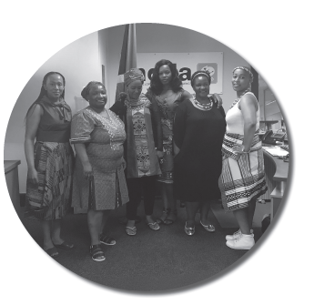
Human Resources

Slide 28
Personnel Information – Summary as of 31 March 2018
Total post establishment | 39 funded posts
Number of posts filled at end of financial year | 26
Number of funded vacant posts | 13
Vacant posts | Office of the CEO/Company Secretary | 4 posts
 | Projects | 2 posts
 | Finance | 2 post
 | Human Resources and Corporate Affairs | 0 posts
 | Internal Audit | 1 post
 | Risk Management | 1 post
 | Communications | 1 post
 | Strategy, Monitoring and Evaluation | 2 posts

Slide 29
Personnel Information – Summary as of 1 October 2018
39 funded posts |  |  | Position | Status
Filled | 29
Vacant | 10
Vacant posts | Office of CEO | 2 | CEO Knowledge Mgt Co-ordinator
 | Projects | 2 | Projects Director Digital Co-ordinator | Position Advertised Recent resignation
 | Finance | 1 | Finance Mgr | Recruitment in process
 | HR & Corp Affairs | 1 | HR & Corp Affairs Mgr | Recent resignation - position advertised
 | Internal Audit | 1 | IA Manager | Offer to be made in October
 | Risk Management | 1 | Risk Specialist | Offer to be made in October
 | Comms | 1 | Travel & Events Co-ordinator | Position to be rescoped
 | Strategy, M&E | 1 | Strategy & M&E Director | Position advertised

Slide 30
Report on Audit Outcome

Slide 31
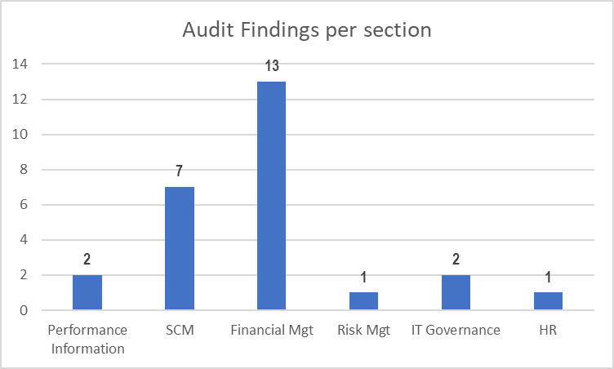
Audit Report Highlights per Section
There were 26 findings for 2017/2018

Slide 32
Key Audit Improvement Areas
Assurance Provider | Areas of improvement
ACEO | Improved record management system is needed to be implemented to ensure timeous submission of documents for audit.
CFO | The compliance with supply chain management (SCM) regulations and impact of non-compliance identified. Continuous engagements with National Treasury required on new Circulars and impact thereof . Audit action plan has been implemented and is being monitored on a monthly basis.
Company Secretary | Ensure compliance with National Treasury regulations on contract management.
HR & Corp Affairs Manager | Vacancies in key positions and instability in the environment. Improvement of Human Resources practices and adherence to policies and best practice is required
Communications Manager | Performance information target setting and technical indicator definitions to be revisited to ensure compliance with National Treasury guidelines.

Slide 33
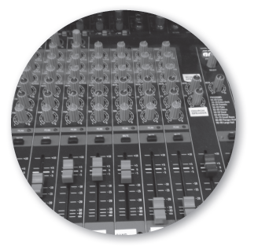
Financial Performance

Slide 34
Statement of Financial Performance
DESCRIPTION | 31 March 2018 (R’000) | 31 March 2017 (R’000)
REVENUE | 83 555 | 74 245
Government grants and subsidies | 30 005 | 23 814
Revenue from non-exchange transactions – Broadcast funders | 48 257 | 45 615
Interest received | 5 293 | 4 816
EXPENDITURE | (82 344) | (87 168)
Employee related costs | (16 258) | (13 174)
Grant cost expenditure | (46 830) | (57 744)
Other operating expenditure | (19 256) | (16 250)
(DEFICIT) SURPLUS | 1 211 | (12 923)
Deficit is a result of improved disbursement to projects from prior years and is funded by Accumulated Surplus.
Notes:
Insert the issue of the investment policy to be approved so that we are able to demonstrate a plan to reinvest in viable schemes

Slide 35
Use of Consultants -2017/2018
Description | Section | Amount
Internal Audit Co-sourcing Services | Internal Audit | R1 434 178
Human Resource Services | Placements | R206 119
Legal Services | Company Secretary | R2 065 000
Finance | Financial services | R1 148 568
Communications and branding | Annual report | R168 893
Grand Total |  | R5 022 758

Slide 36
Financial Matters – 2017/2018
Irregular expenditure – 2017/2018
A total of R3,2m of irregular expenditure was incurred in the 2017/2018 financial year.
This was mainly attributed to changes in the National Treasury changes in the procurement process through introduction of the Central Supplier Database.
Consequence Management - Measures have been implemented to ensure a parallel process of supplier evaluations is implemented. Disciplinary action will be taken if employee is found to be responsible.
Fruitless & wasteful expenditure – 2017/2018
MDDA incurred R82 000 fruitless and wasteful expenditure in the 2017/2018 financial year . Measures have been put in place to recover amounts that are deemed recoverable from the respective employees.
Contingent Liabilities & Litigations – 2017/2018
There was a legal dispute between MDDA and Joburg Post in respect of the funding agreement signed between the two parties . The financial exposure was R384 600 depending on the outcome of the dispute. The case is currently being heard by the courts.

