Slide 1
11 October 2018
CSIR 2017/18 ANNUAL REPORT PRESENTATION
TO THE PARLIAMENT PORTFOLIO COMMITTEE ON SCIENCE AND TECHNOLOGY

Slide 2
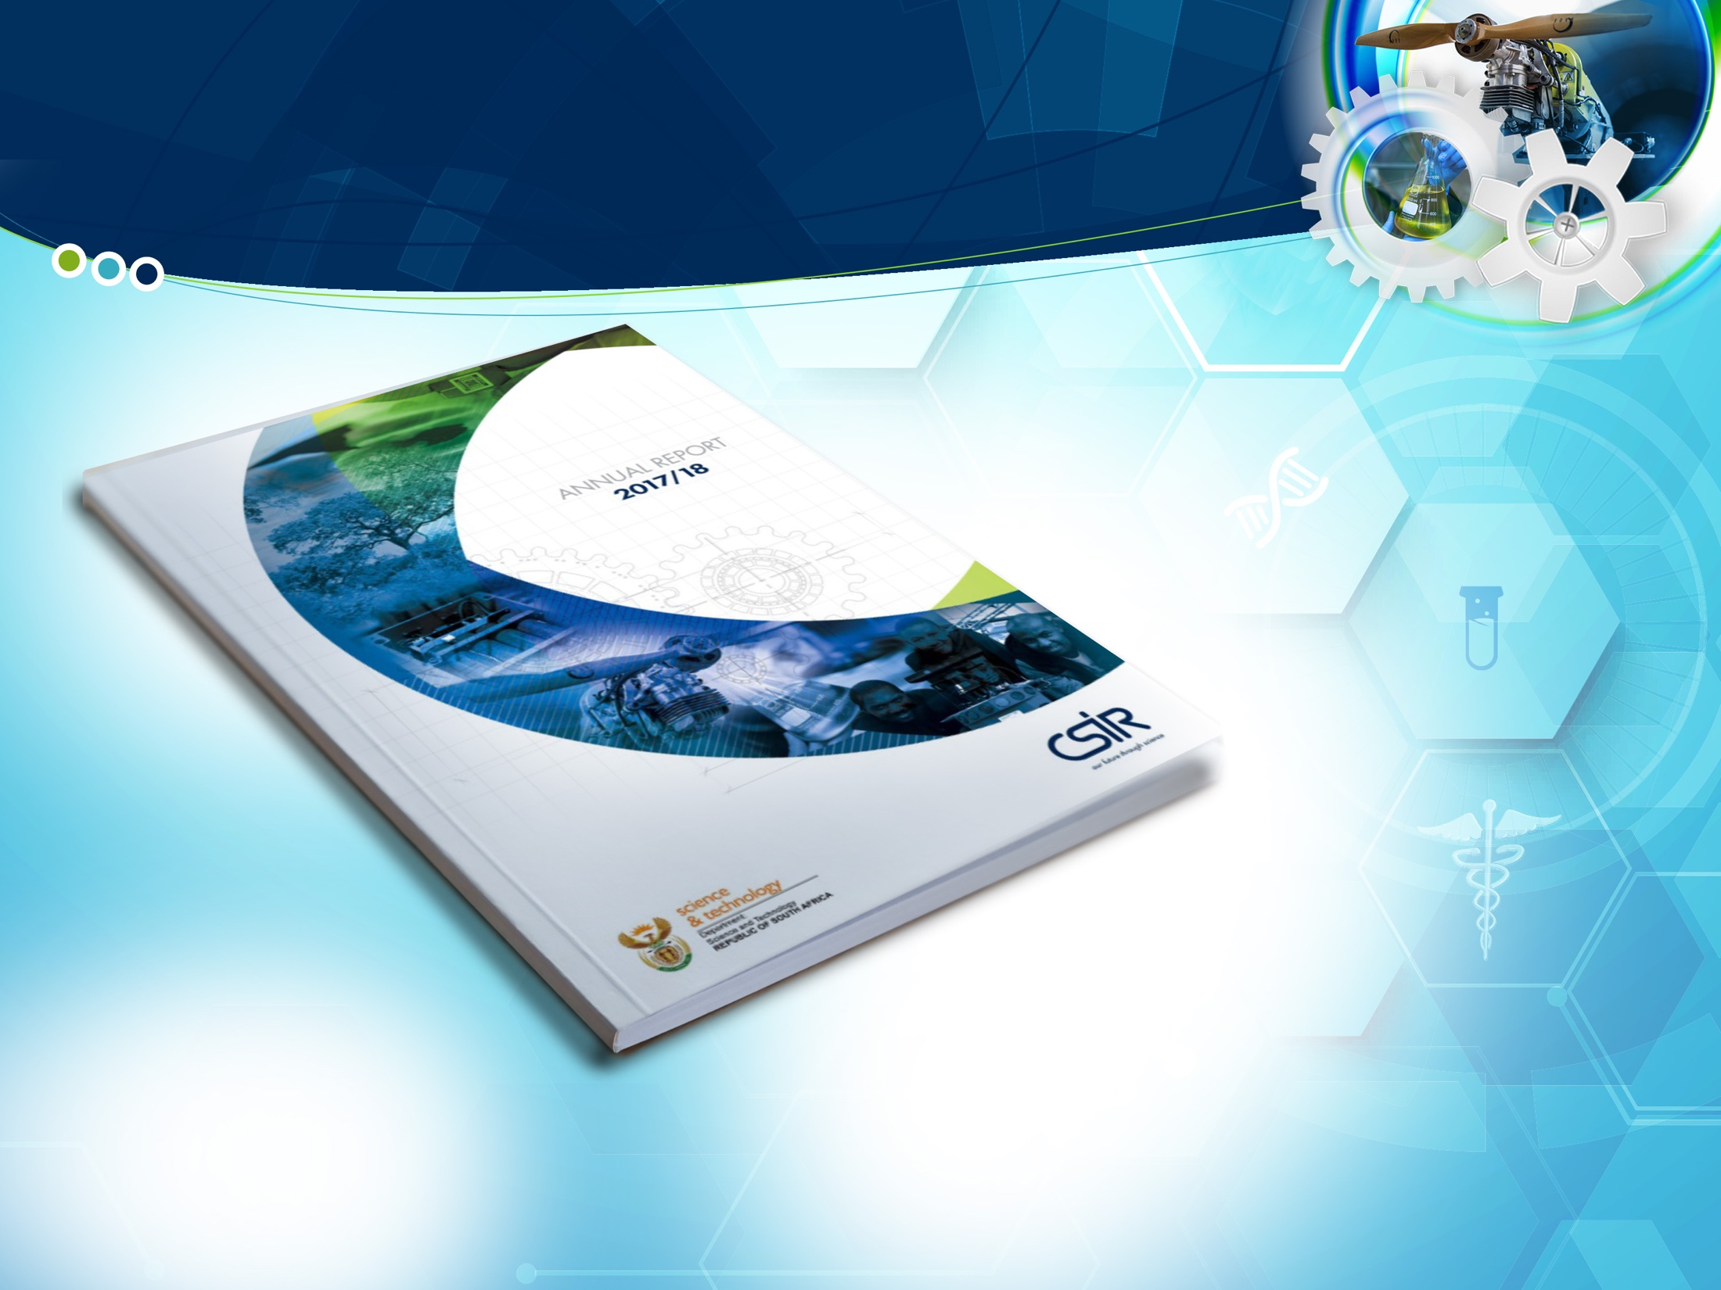
Contents
Chairman’s overview > The CSIR mandate > The CSIR at a glance
Strategic objectives > Key performance indicators > Highlights

Slide 3
Chairman’s overview
Repositioning the CSIR as an industry-focused institution
Fundamental scientific research remains key in our quest to alleviate unemployment, poverty and inequality
Engaging with our stakeholders to understand and address their needs
Establishing partnerships to help maximise our cross-disciplinary expertise, accelerate innovation and develop technological solutions
Received a clean audit report from the Auditor-General
Progress in addressing SET base growth and national challenges
Supporting Campus Master Plan as an instrumental initiative for infrastructure renewal

Slide 4

The CSIR mandate
^{CSIR MANDATE}
“The objects of the CSIR are, through directed and particularly multi-disciplinary research and technological innovation, to foster, in the national interest and in fields which in its opinion should receive preference, industrial and scientific development, either by itself or in co-operation with principals from the private or public sectors, and thereby to contribute to the improvement of the quality of life of the people of the Republic, and to perform any other functions that may be assigned to the CSIR by or under this Act.”
(Scientific Research Council Act 46 of 1988, amended by Act 71 of 1990)

Slide 5




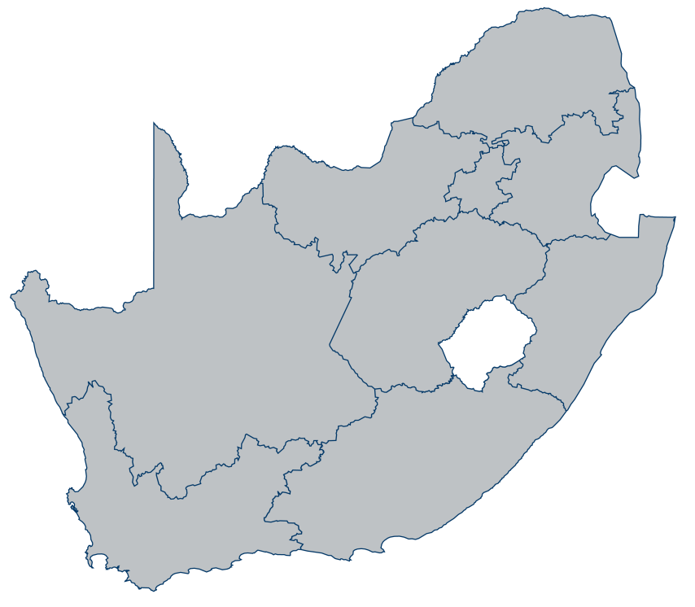





The CSIR at a glance
The CSIR is a science council, classified as a national government business enterprise.
IN NUMBERS:
73
years
1945 - 2018
Total staff base: 2 619
SET base: 1 850
Black South Africans: 1 139 (59%)
Female South Africans: 674 (35%)
Staff with PhDs: 348
Staff with M-qualifications: 631
Pipeline development: 725
Johannesburg
Pretoria
Durban
Publication equivalents: 546
Journal articles: 317
New patents: 19
New technology demonstrators: 60
Cape Town
Stellenbosch
Port Elizabeth
Total income: R 2 506 m
Contract income: R1 771 m
Royalty and licence income: R4.61 m
Total investment in HCD: + R150 m

Slide 6
Strategic objectives
Build and transform human capital | A highly skilled, diverse skills workforce Declining national economic outlook – declining CSIR income – budget constraints to recruit and appoint A young workforce also means a mobile workforce
Conduct high-quality and relevant research and technological innovation to foster industrial and scientific development | R&D with national impact Responding to priorities of government, provinces and metros A call to amplify CSIR contribution to industrial development
Maintain a financially sustainable and well-governed organisation | Maintain the CSIR legacy of good corporate governance and operate in a sustainable manner Financially constrained fiscal environment Operating in an increasingly challenging and complex regulatory environment

Slide 7

Project Synapse
Connecting innovation to industry

Slide 8
Key performance
indicators

Slide 9
Key performance indicators at a glance
SCIENTIFIC AND TECHNICAL
Strategic objective | Key performance indicator | 2017/18 Target | 2017/18 Actual
Perform relevant research and development | Publication equivalents | ≥ 500 | 546
 | Journal articles | ≥ 310 | 317
 | New technology demonstrators | ≥ 40 | 60
 | New patents granted | ≥ 15 | 19
 | Contract R&D income | ≥ R2 128 m | R1 771 m
 | Royalty and licence income | ≥ R5.17 m | R4.6 m
Notes:
. After a period of constant growth since FY10, CSIR’s income has begun to decrease rapidly from FY16 to FY18.
Total income exhibited constant growth between FY10 and FY16 of 2%¹ CAGR
This was largely driven by an increase in public sector income, despite decreasing income from private sector, international sources, the parliamentary grant as well as licensing and royalties
Total income declined significantly between FY16 and FY18 of -8%¹ CAGR
Income decreased significantly from the public sector as a result of several factors, including
Declining spend from the South African public sector on science and technology activities
The redirection of National Expenditure to higher education institutions
Increased legislative constraints on CSIR (and other SOEs²), hampering its ability to strategically secure public sector contracts, without the need to award such contracts through public tendering processes
The decrease in income was driven by a further reduction in income from licensing and royalties, a marginal decrease from the private sector
Despite a reduction in total income, international income exhibited positive growth

Slide 10
Key performance indicators at a glance
LEARNING AND GROWTH
Strategic objective | Key performance indicator | 2017/18 Target | 2017/18 Actual
Build and transform human capital | Total size of SET base | 2 100 | 1 850
 | % of black South Africans in SET base | ≥ 61 | 59
 | % of female South Africans in SET base | ≥ 37 | 35
 | % of SET base with Doctorates | ≥ 20 | 17
 | % of Chief Researchers who are black | 9.09 | 9.52
 | % of Chief Researchers who are female | 18 | 19
 | % of Principal Researchers who are black | 22 | 26
 | % of Principal Researchers who are female | 19 | 19

Slide 11
Key performance indicators at a glance
FINANCIAL AND GOVERNANCE
Strategic objective | Key performance indicator | 2017/18 Target | 2017/18 Actual
Maintain financial sustainability and good governance | Total income | R2 863 m | R2 504 m
 | Investment in property, plant and equipment | ≥ R103 m | R144 m
 | Net profit/(loss) | R64 m | (R14 m)
 | B-BBEE rating | Level 2 contributor | Level 3 contributor
 | Disabling injury frequency rate | < 0.2 | 0.11
Notes:
. After a period of constant growth since FY10, CSIR’s income has begun to decrease rapidly from FY16 to FY18.
Total income exhibited constant growth between FY10 and FY16 of 2%¹ CAGR
This was largely driven by an increase in public sector income, despite decreasing income from private sector, international sources, the parliamentary grant as well as licensing and royalties
Total income declined significantly between FY16 and FY18 of -8%¹ CAGR
Income decreased significantly from the public sector as a result of several factors, including
Declining spend from the South African public sector on science and technology activities
The redirection of National Expenditure to higher education institutions
Increased legislative constraints on CSIR (and other SOEs²), hampering its ability to strategically secure public sector contracts, without the need to award such contracts through public tendering processes
The decrease in income was driven by a further reduction in income from licensing and royalties, a marginal decrease from the private sector
Despite a reduction in total income, international income exhibited positive growth

Slide 12





Highlights
Build and transform human capital
Financial sustainability and governance
Research to foster industrial development
Research to foster scientific development
Health and safety
Broad-Based Black Economic Empowerment
Infrastructure renewal and development

Slide 13
Build and transform human capital
164
105
97
369
Renew
the SET base:
Pipeline indicators
Undergrads and Hons
on CSIR bursaries
Master’s
studentships
Doctoral
studentships
Postgraduates on DST Interbursary
77
96
87
54
Transform
the SET base: Pipeline
indicators
Female
CSIR bursary holders (47%)
African
CSIR bursary holders (59%)
African females CSIR studentships (46%)
African females CSIR internships (55%)
182
3
240
Develop
the SET base
Promotions
Promotions
to chief researchers
Principal researchers

Slide 14
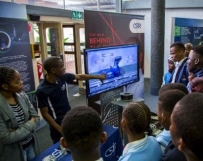
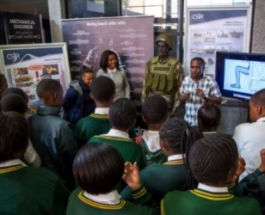
Build and transform human capital
45
Successfully partnered with sector education training authorities (SETAs) to address youth unemployment, among others, the Media, Information and Communication Technologies (MICT) SETA
Qualified, unemployed youths trained with MICT-SETA
13
Developed new apprenticeships with Manufacturing, Engineering and Related Services Sector SETA for the 4th industrial revolution: maintenance of solar photovoltaic systems and vehicle maintenance in informal settlements
Employment offers to MICT-SETA interns
200k
Engaged next generation of researchers through outreach programme: Sasol TechnoX, Science Tube, Scifest, CSIR Career Day
Young people reached

Slide 15





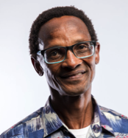
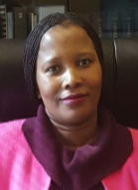
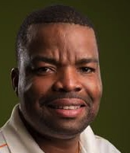

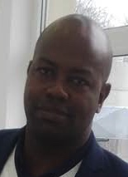
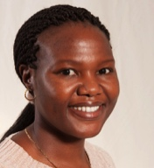

Accelerated Researcher Development Programme
Programme objective
Targeted support and funding for accelerated development of promising black South African researchers with the aim of growing the CSIR chief researcher cohort.
Programme intent
Provide systematic and resource-based support to allow rapid career development:
Infrastructure
Studentships
Training
Travel and exposure
Ring-fenced research funding
Progress to date
Invested R10m in seven promising researchers (black South Africans, three female) in 2017/18 and a further six have been identified for support in 2018/19.
Dr Sisa Pityana
Dr Gugu Mhlongo
Dr Abel Ramoelo
Dr Vhahangwele Masindi
Dr David Motaung
Dr Patience Mthunzi-Kufa
Dr Remegia Modibenia

Slide 16
Financial and governance
Income sources
Public sector
Private sector
Royalties and licensing
Parliamentary grant
International
Total CAGR
CAGR
+2%
-8%
FY10-FY16
FY16-FY18
2,100
2,014
4
-15.4%
-11.4%
2,000
1,821
1,839
1,885
114
1,917
4
1,900
1,753
1,734
1,745
13
12
150
7
132
117
1,800
11
9
10
166
175
135
1,707
3
-6.1%
+4.6%
1,700
166
161
133
130
125
1,600
173
163
136
130
1,500
158
193
552
-2.9%
-0.8%
1,400
553
1,300
596
604
1,200
636
576
588
550
-2.4%
-0.2%
1,100
615
1,000
900
800
700
1,212
600
1,107
+7.6%
-13.9%
500
855
891
921
994
899
400
781
756
300
200
100
0
FY10
FY11
FY12
FY13
FY14
FY15
FY16
FY17
FY18
Notes:
. After a period of constant growth since FY10, CSIR’s income has begun to decrease rapidly from FY16 to FY18.
Total income exhibited constant growth between FY10 and FY16 of 2%¹ CAGR
This was largely driven by an increase in public sector income, despite decreasing income from private sector, international sources, the parliamentary grant as well as licensing and royalties
Total income declined significantly between FY16 and FY18 of -8%¹ CAGR
Income decreased significantly from the public sector as a result of several factors, including
Declining spend from the South African public sector on science and technology activities
The redirection of National Expenditure to higher education institutions
Increased legislative constraints on CSIR (and other SOEs²), hampering its ability to strategically secure public sector contracts, without the need to award such contracts through public tendering processes
The decrease in income was driven by a further reduction in income from licensing and royalties, a marginal decrease from the private sector
Despite a reduction in total income, international income exhibited positive growth

Slide 17
Financial and governance
Total income showed constant growth between FY10 and FY16; this was largely driven by an increase in public sector income
CSIR’s contract income has declined sharply from FY16 – FY18 primarily due to a decrease in public sector income to the CSIR
Income decreased significantly from the public sector as a result of MOAs with CSIR no longer supported by National Treasury as a way of contracting between the CSIR and government departments and other state-owned entities; tender processes are now required
CSIR’s share of contract income from the private sector is relatively low (10%)

Slide 18
Financial and governance
In 2017/18 the CSIR was not profitable mainly due to the rapid decline in public sector revenue and a high manpower cost base
Remedial action
Extensive cost containment measures have been implemented to respond to the declining income
A review process is currently underway for all non-sustainable operating units
Improvements to internal processes have been implemented over income declaration, customer contracting and work at risk

Slide 19
Financial and governance
Audit report matters
The CSIR maintained its clean audit status in that it received an unqualified opinion with no material findings
The CSIR is currently a going concern despite the loss in the current year
Heightened awareness on the increase in irregular expenditure due to increased governance processes that have been implemented. Consequence management is in progress
The Annual Financial Statements disclosed a prior-period error relating to revenue overstated in FY17 that was corrected

Slide 20
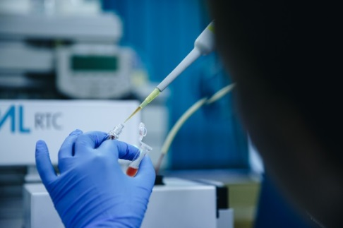
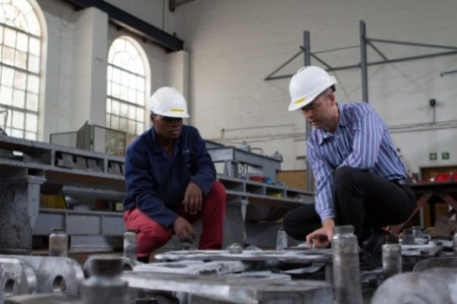
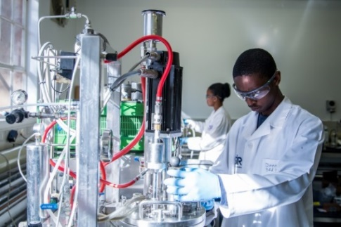
Health and safety
A renewed emphasis on safety
Target for Disabling Injury Frequency Rate met and exceeded
Goal remains: Zero harm, zero disabling injuries and zero fatalities
Occupational Health and Safety Assessment Series 18001 certification maintained for another year
  Review of occupational health and safety management systems
  Revised and improved occupational health and safety management system
  10-Point Heath and Safety Improvement Plan
Improved governance structures and leadership
  Newly constituted CSIR Safety, Health and Environmental Leadership Committee, chaired by the CEO
  Improved accountability for Executive Directors, portfolio heads and senior managers at regional sites

Slide 21
Broad-Based Black Economic Empowerment
Achieved a Level 3 B-BBEE status against a Level 2 target
Additional measures put in place to ensure regaining of Level 2 status
The CSIR still measures up well against similar institutions and universities, predominantly scoring Level 7 or lower, with the Agricultural Research Council performing on par by achieving Level 3
Focus areas include:
  Targeted preferential procurement focusing on qualifying small enterprises and 51% black-owned enterprises
  Targeted recruitment programmes areas reflective of the national demographic
Considering the development of a recruitment and skills development plan targeted at qualifying disabled individuals subject to infrastructure requirements

Slide 22
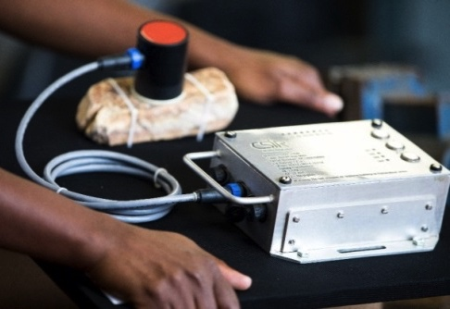
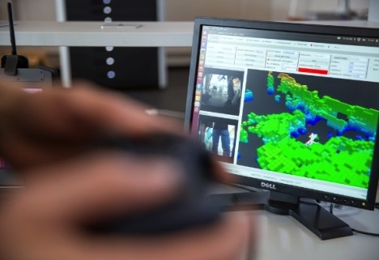
Research to foster industrial development
Slurry detection
A Canadian mine is doing field trials of a CSIR technology to detect sedimentation in slurry pipelines
CSIR system detects heavy particles that settle at the bottom of pipelines, causing blockages
Rock stability monitor
Developed a compact battery-operated device to monitor rock-mass for micro-seismicity
Optimises safe re-entry after hazardous events
Multi-robot mapping
Use of multiple autonomous robots to map large areas that are hard to reach or hazardous
Work on software continues prior to field trials
Helping Transnet monitor locomotive condition
The CSIR and Transnet are developing a system to monitor the condition of locomotives
Transnet will be able to implement predictive maintenance and detect rail infrastructure defects

Slide 23
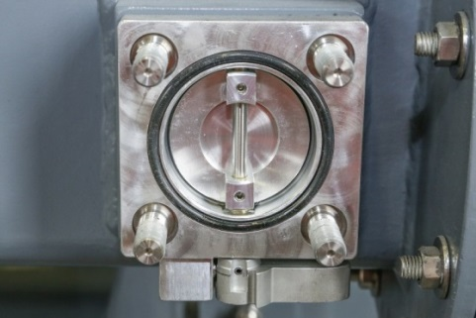
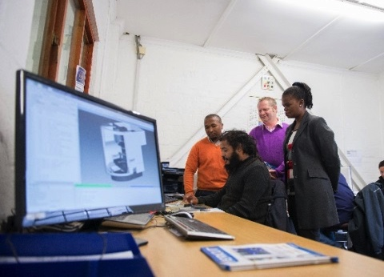
Research to foster industrial development
Supporting valve localisation
TLIU helped Paltechnologies (Pty) Ltd to develop valves used in high-voltage transformers
Eskom had experienced problems with leaking imported valves
Industry 4.0 practices for a local aerospace supplier
AISI helped Daliff Precision Engineering to implement real-time monitoring of all its machines
Measured and improved preparedness for implementation of product lifecycle management
New manufacturing process for waveguides
AISI helped NewSpace Systems to print waveguides in 3D in titanium and aluminium alloys and developed a post-processing method to reduce surface roughness and improve conductivity

Slide 24
Research to foster industrial development
Diabetes-detecting chip
Developed and patented a diabetes breath analyser, an alternative to the finger-prick blood test for detecting high blood sugar levels
A micro-nanochip detects acetone, a by-product of high blood sugar levels
Biodegradable plastics from agricultural waste
Developed a fully biodegradable plastic material from agricultural waste by-products and biopolymers
The material has been tested and validated as per international norms and standards
Web-based tools to monitor the ocean
Developed an early-warning tool to monitor and assess the risk of harmful algal blooms on the west and south coasts
Developed an interactive flood risk viewer to visualise the predicted extent of coastal flooding for disaster managers, insurance companies and house owners

Slide 25

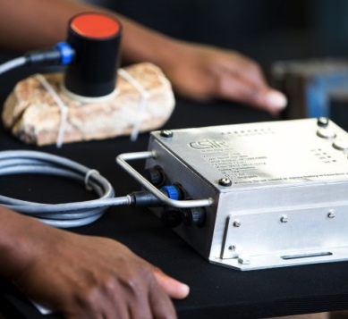
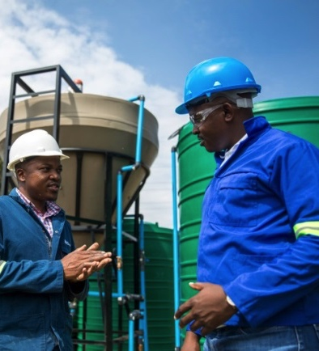
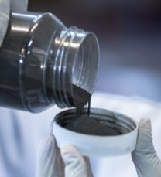
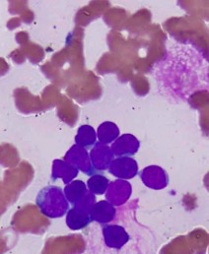

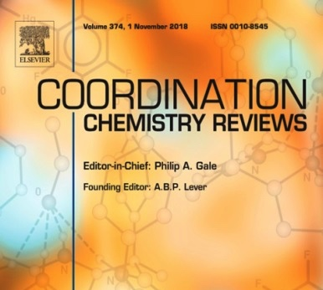
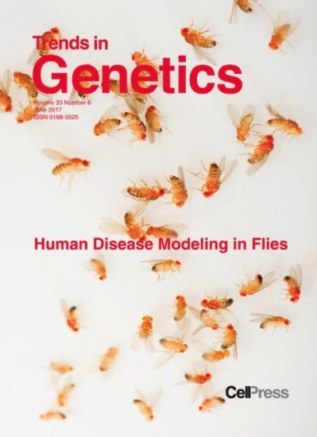
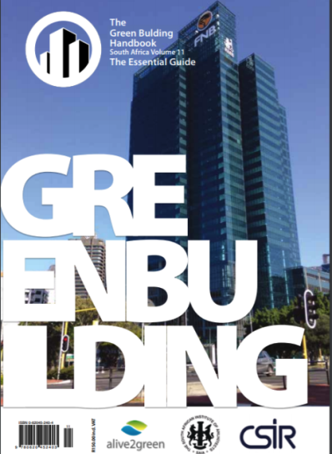

Research to foster scientific development
PATENTS: A LEAD INDICATOR OF INNOVATION
Determining the integrity of a rock mass:
Canada
Removal of phosphates from municipal effluents: Australia
Producing crystal-line titanium powder: Europe, Russia, Ukraine, Kazakhstan, USA
System for the analysis of blood samples:
China
JOURNAL ARTICLES, BOOKS: CONTRIBUTING TO THE KNOWLEDGE BASE
Review on the current practices and efforts toward pilot-scale production of metal-organic frameworks
Enhancer-derived IncRNAs regulate genome architecture: fact or fiction?
The Green Building Handbook, Volume 11
Highly efficient inactivation of bacteria found in drinking water using chitosan-bentonite composites

Slide 26
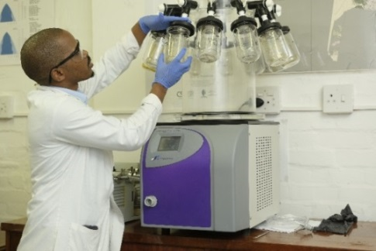
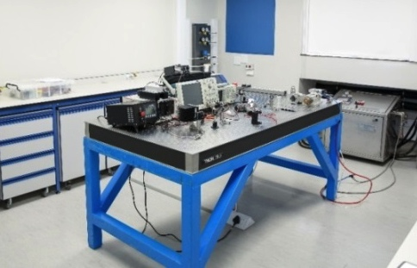
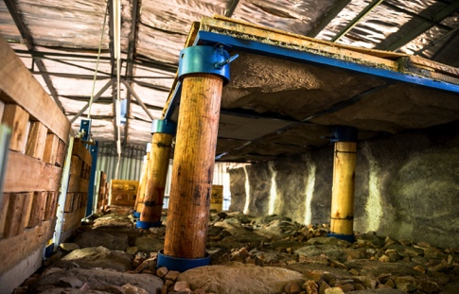
Infrastructure renewal and development
Biorefinery: New facility for biomass waste
A R37.5 million Biorefinery Industry Development Facility launched to extract maximum value from biomass waste
Facilities for prototyping, upscaling, pilot manufacture, testing
Focus on forestry, extracting high-value chemicals
Photonics: Growing SA’s photonics industry
A photonics prototyping facility that acts as a photonics technology accelerator to be launched this year
Two seed projects: extracting surface and sub-dermal fingerprints and laser range-finder for the archery industry
The Mandela Mining Precinct
Coordinates research activities toward the revitalisation of mining – safer, more efficient mining
Facilities include a research hub for researchers, equipment manufacturers and mining companies to collaborate and will include innovative mining simulation centre
Set to be launched 14 September 2018

Slide 27
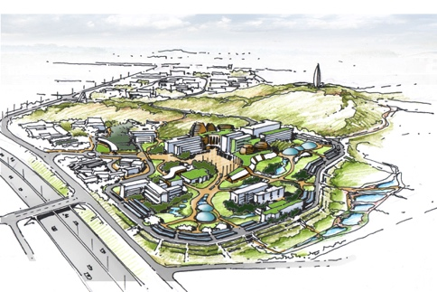
The Campus Master Plan
Established Campus Planning and Development Office
Stakeholder engagement
Engaged with the National Treasury, DST, Minister of Science and Technology, the NRF and several Parliament Portfolio Committees
Project preparation completed
Developed implementation roadmap/five-year operational plan
Completed market and pre-feasibility studies for key priority projects
Prioritised the implementation of the Gateway to Science and Innovation Centre
Funding campaign for priority projects underway
Successful initial investor interaction to test investor appetite
Submitted National Treasury large infrastructure bid to secure funding
Grant proposals to dti Critical Infrastructure Program and the
DBSA Green Fund
PPP process for residential development and EAC programme underway

Slide 28
Thank you

