Slide 1


Slide 2
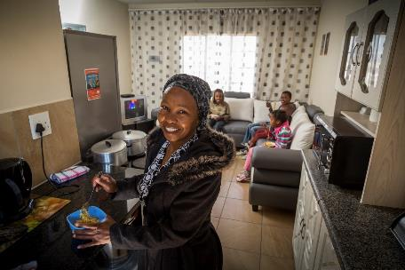
Contents
Theme of the Report
Vision, Mission, Mandate
Values
Legislative and other mandates
Strategic Goals
Programmes
Structure, incumbents and vacancies
Council composition
Foreword by the Chairperson
CEO’s Overview
Highlights of the period
Non-financial performance
Financial performance
2017/18 Audit Opinion

Slide 3

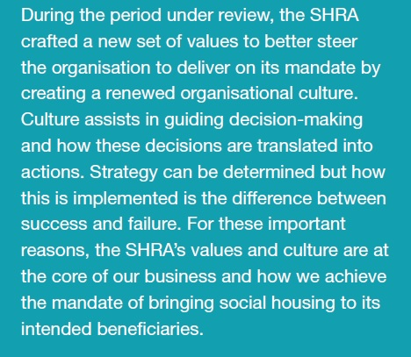
Theme of the Report

Slide 4
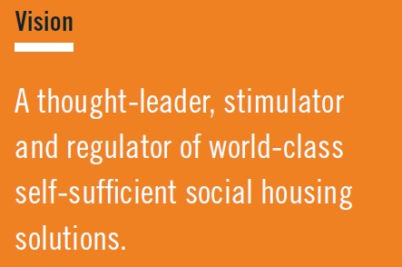
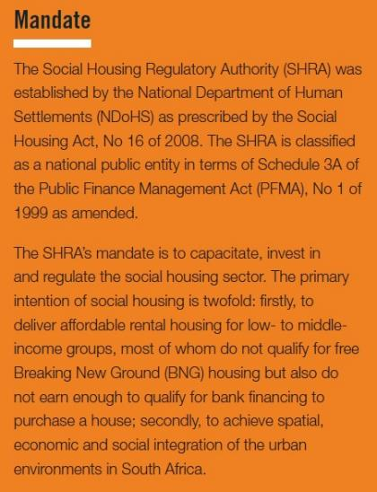
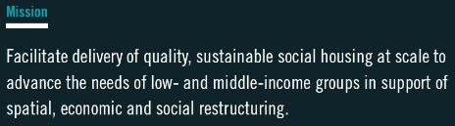
Vision, Mission and Mandate

Slide 5
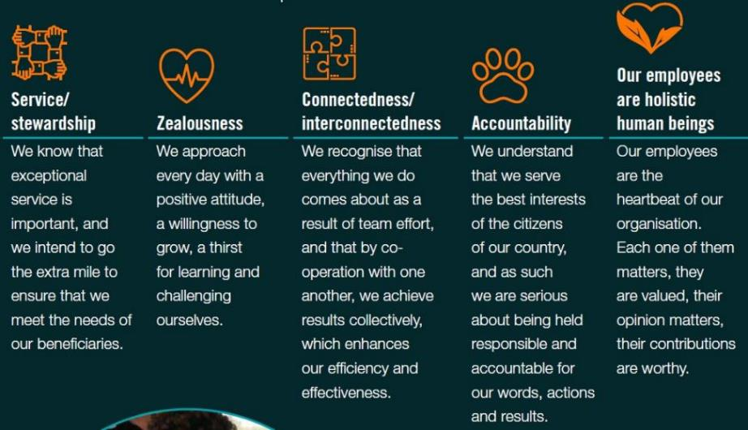
Values

Slide 6
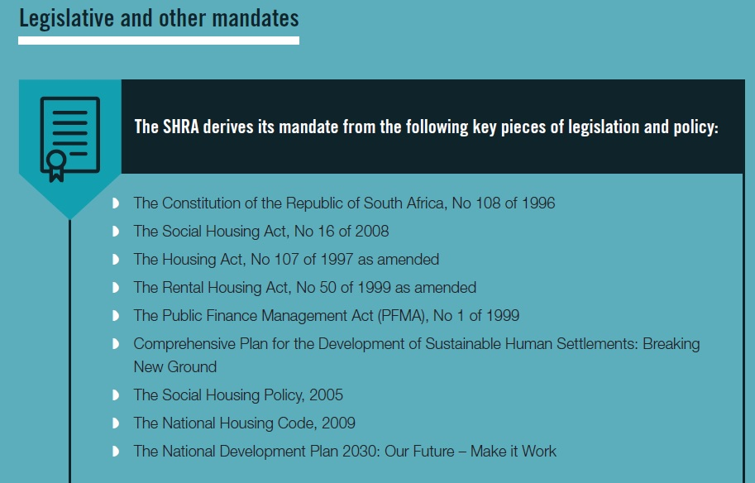

Slide 7
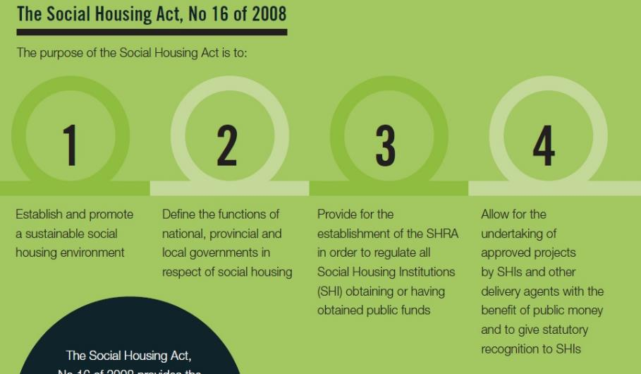
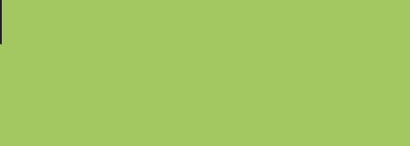

Slide 8
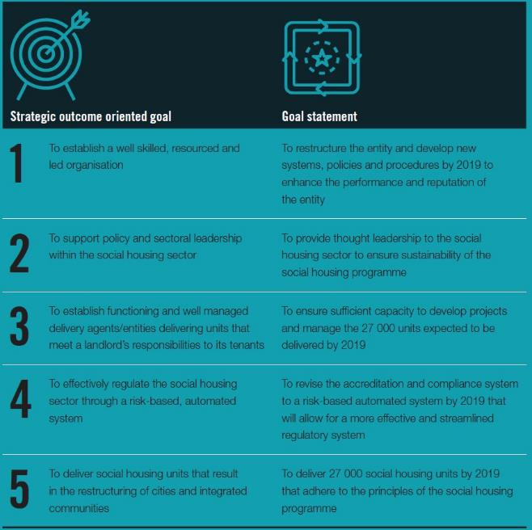

Slide 9
SHRA Programmes
Administration Programme
Compliance, Accreditation and Regulation Programme (CAR)
Sector Development and Transformation Programme (SDT)
Project Development and Funding (PDF)

Slide 10
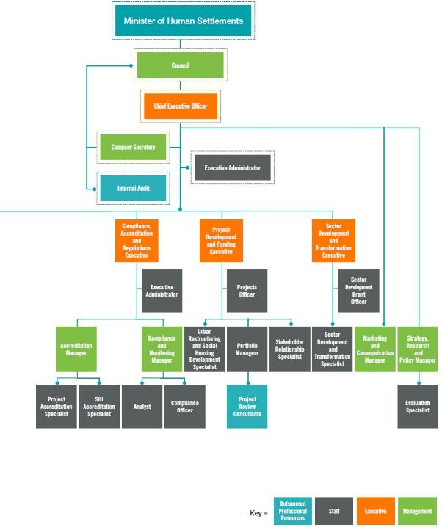
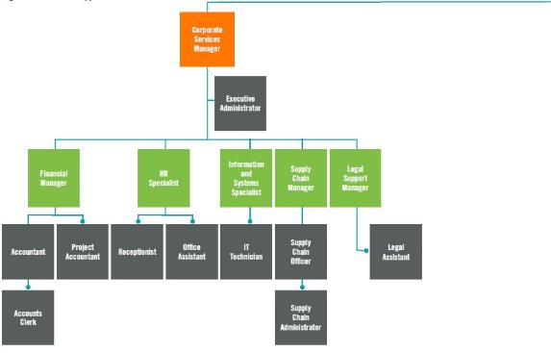
Structure of the Entity

Slide 11
SHRA Structure and incumbents
 | Designation | SHRA Incumbent
1 | Chief Executive Officer | Rory Gallocher
2 | Corporate Services Manager | Alice Puoane
3 | Project Development & Funding Executive | Lebowa Letsoalo
4 | Sector Development & Transformation Executive | Dewalt Koekemoer
5 | Compliance, Accreditation and Regulations Executive | Khulile Boqwana
6 | Executive Administrator: CEO | Alice Mogale
7 | Executive Administrator: CSM | Carol Hlatswayo
8 | Document Management Officer | Caroline Motloung
9 | Finance Manager | Vusi Fakudze
10 | Accountant | Deloshnie Govender
11 | Accounts Clerk | Ayesha Nkosi
12 | Information and System Specialist | Yusuf Badooda
13 | IT Technician | Priyen Vallabh
14 | HR Specialist | Barbara Du Plooy
15 | Facilities and Logistics Officer | Mandlakayise Mochoko
16 | Receptionist | Phindile Moche
17 | Legal Support Manager | Tebogo Mogosoana
18 | Legal Assistant – Acting Company Secretary | Matshidiso Molefe

Slide 12
SHRA Structure and incumbents
 | Designation | SHRA Incumbent
19 | Supply Chain Officer – Acting SC Manager | Oral Ndove
20 | Supply Chain Officer | Eunice E Mampheu
21 | Supply Chain Administrator | Vongani D Mahatlane
22 | Supply Chain Administrator | Katlego L Panana
23 | Grant Officer | Keitumetse Masuku
24 | Sector Development & Transformation Specialist | John H Mofokeng
25 | Project Officer | Gayathri Appalsamy
26 | Portfolio Manager | Thabo C Mafona
27 | Portfolio Manager | Kgabo Mpyana
28 | Executive Administrator: CAR | Caroline Moses
29 | Accreditation Manager | Gianni Vecchio
30 | Project Accreditation Specialist | Tokelo Shalang
31 | SHI Accreditation Specialist | Palesa Dibe
32 | Compliance Manager | Florence T Maleka
33 | Compliance Officer | Ahwatief Baderoen
34 | Analyst | Rheena Hansrajh
35 | Marketing and Communications Manager | Lesego Kagiso
36 | Strategy, Research and Policy Manager | Gillian Mackay
37 | Evaluation Specialist | Vincent Chauke

Slide 13
Vacancies within the SHRA
1 | Company Secretary
2 | HR Officer
3 | Supply Chain Manager
4 | Sector Development and Transformation Specialist
5 | Portfolio Manager x 2
6 | SHI Accreditation Specialist
7 | Compliance Officer x 2
8 | Marketing and Communication Officer
9 | Research Specialist
10 | Urban Restructuring Specialist
11 | Stakeholder Relationship Specialist

Slide 14
Current Board Members and Remaining Term of Office
 | Board Members | Appointment date | End of Term date
1 | Mr Zolile Ngcakani (Chairperson) | 18 March 2018 | 17 March 2021
2 | Ms Nambitha Ntshongwana (Deputy Chairperson) | 1 July 2018 | 30 June 2021
3 | Ms Kelikile Kwinana | 18 March 2018 | 17 March 2021
4 | Mr Shadrack Ganda | 18 March 2018 | 17 March 2021
5 | Mr Manye Moroka | 18 March 2018 | 17 March 2021
6 | Mr Itumeleng Kotsoane | 18 March 2018 | 17 March 2021
7 | Mr Phakamile Ximiya | 18 March 2018 | 17 March 2021
8 | Mr Igshaan Higgins | 18 March 2018 | 17 March 2021
9 | Adv. Mandla Mdludlu | 18 March 2018 | 17 March 2021
10 | Mr Moses Chikane | 18 March 2018 | 17 March 2021
11 | Mr Mbasa Mxenge | 18 March 2018 | 17 March 2021
12 | Mr Sebatha Kone | 1 July 2018 | 30 June 2021

Slide 15
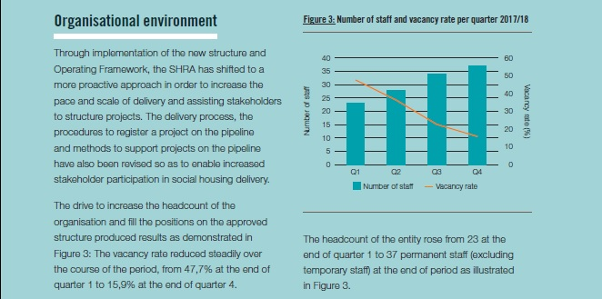
SHRA Vacancy Rate

Slide 16
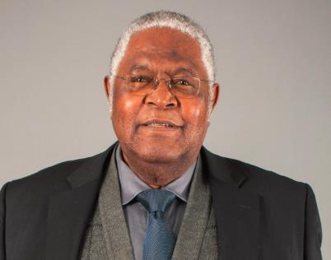
Foreword by the Chairperson
The SHRA, collectively, formulated the new values for the entity in the period under review.
The last three financial years have seen immense change within the entity; a series of interventions were instituted.
These interventions have resulted in significant improvement in the entity’s financial and non-financial performance resulting in the Minister lifting the Administration in July 2017.
Key policy changes in period under review: increase of the Restructuring Capital Grant quantum and the increase of the income bands for qualifying households.
The work of the SHRA requires collaboration between all three spheres of government and the private sector.

Slide 17
Chief Executive Officer’s Overview
SHRA achieved an unqualified audit opinion for 2017/18
Improvements in expenditure of capital grants
Improvements in non-financial performance – 78%
Rigorous recruitment drive in 2017/18
Implemented series of OD interventions
3 519 social housing units delivered
32 046 social housing units under regulation
11 684 units have been delivered thus far within the MTSF period of 2014 – 2019.

Slide 18

Highlights OF THE PERIOD
Annual Report 2017/18

Slide 19
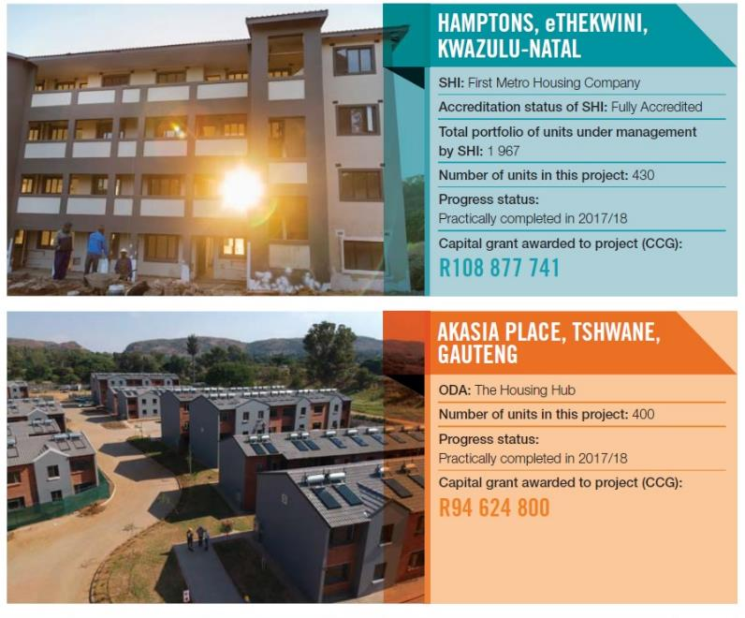

Slide 20
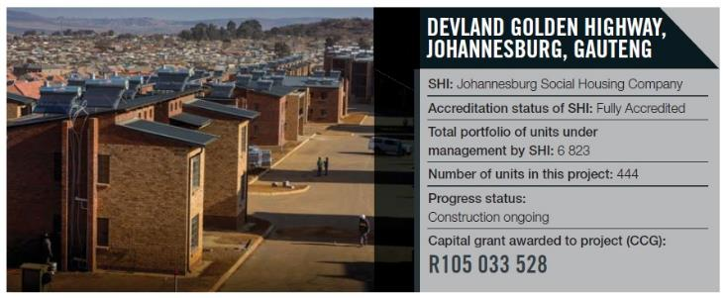
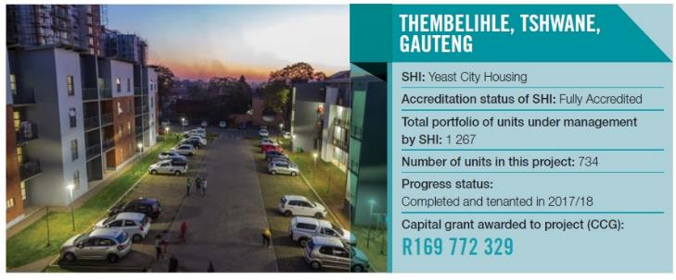

Slide 21
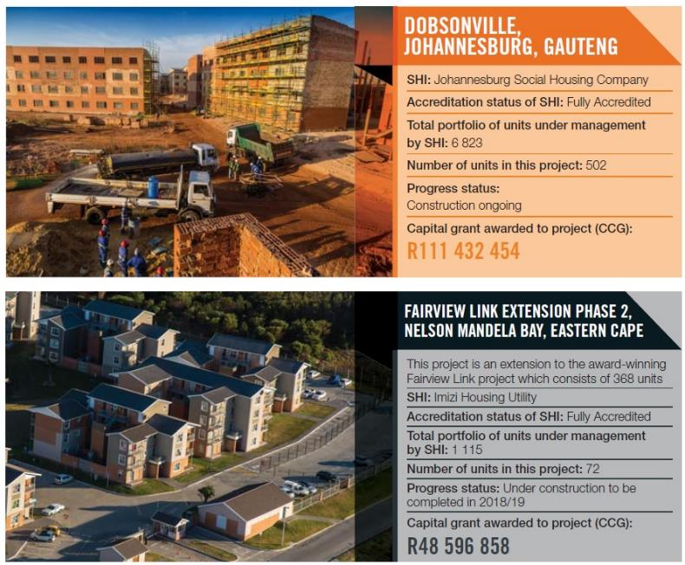

Slide 22
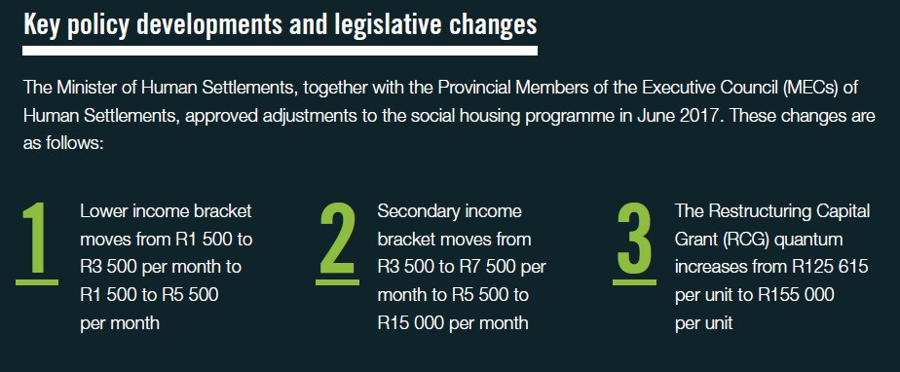

Slide 23
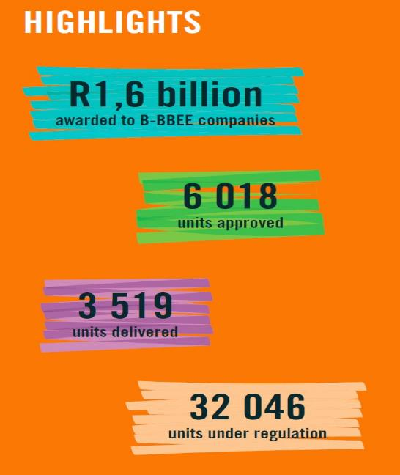
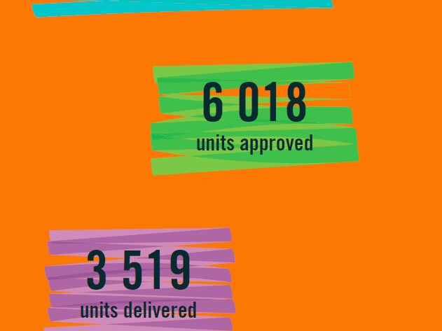

Slide 24
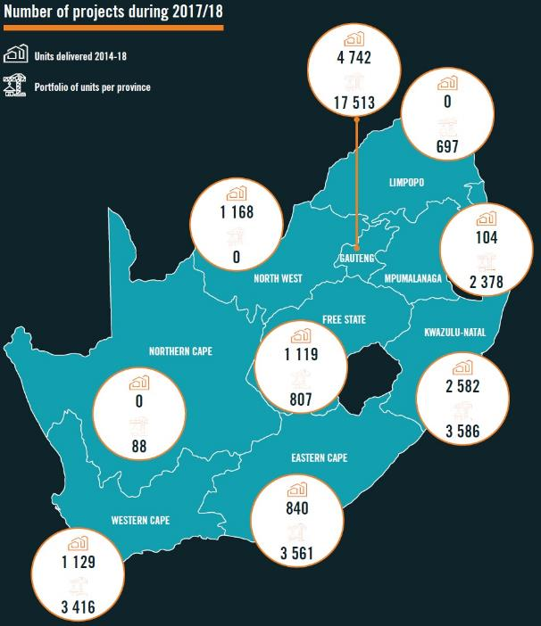
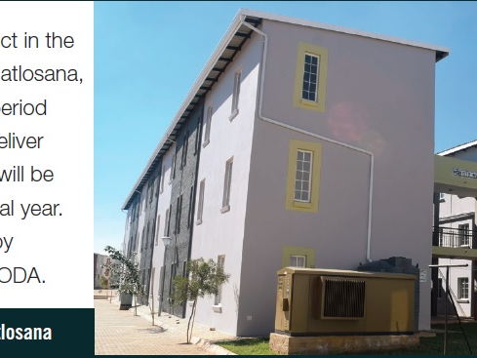

Slide 25
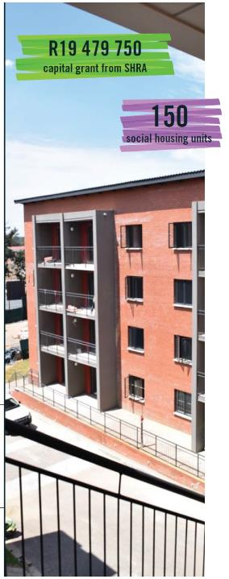
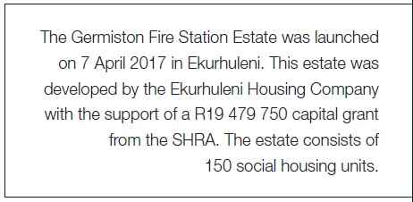
Project Launches

Slide 26


Slide 27
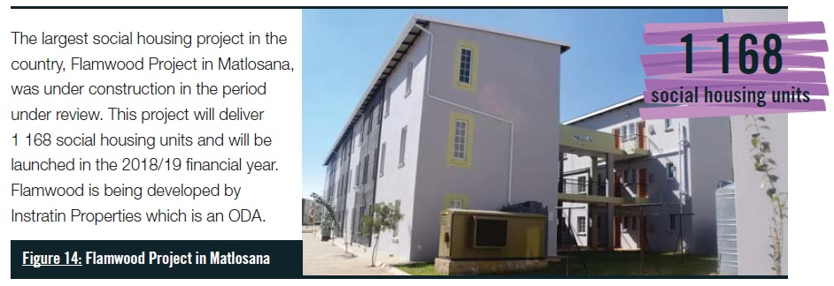
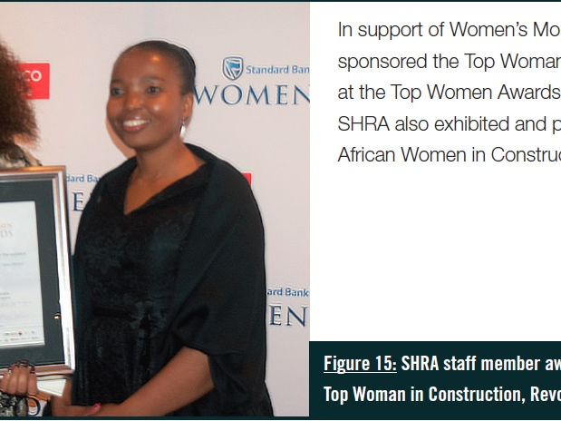
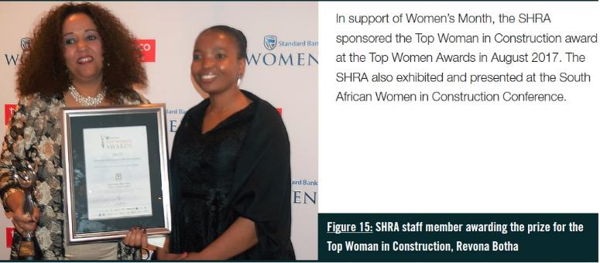

Slide 28
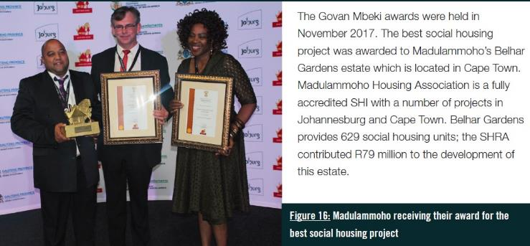

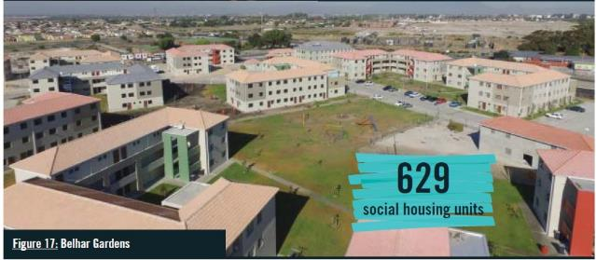

Slide 29
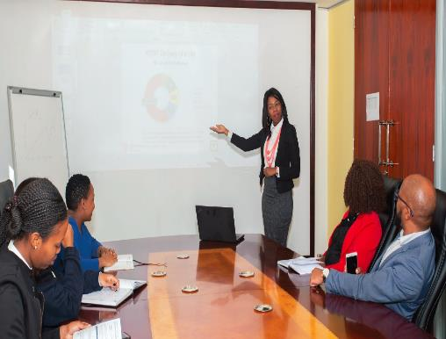
NON-FINANCIAL PERFORMANCE
Annual Report 2017/18

Slide 30
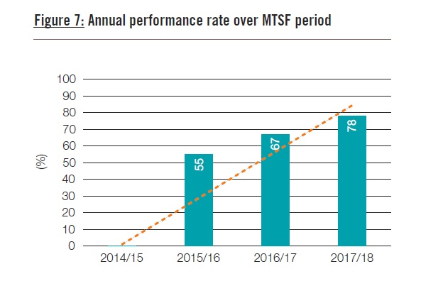

Slide 31
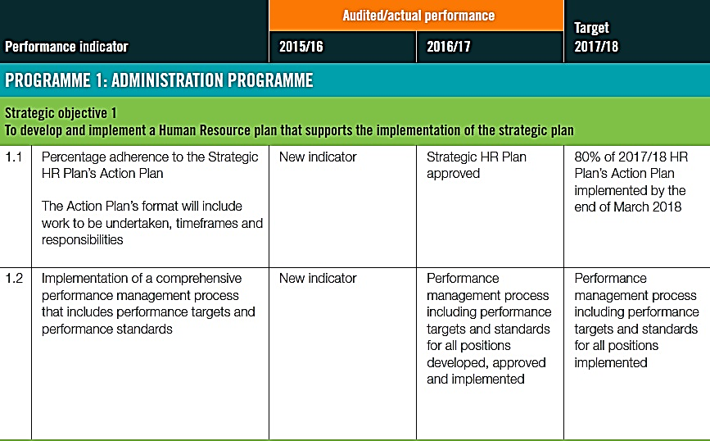
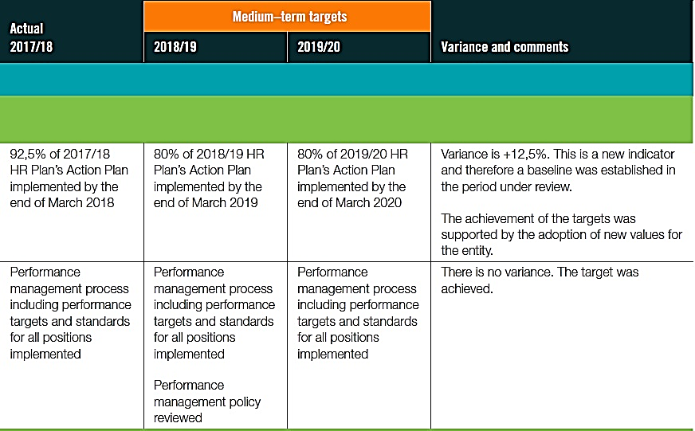

Slide 32
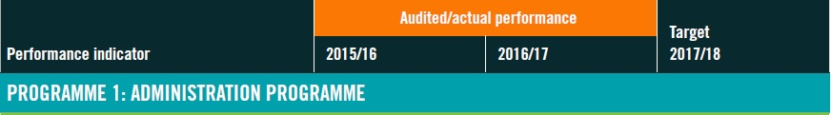

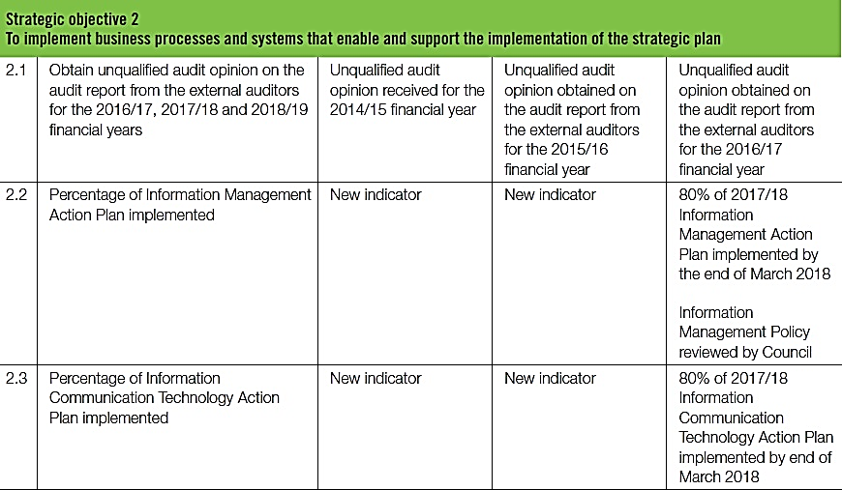
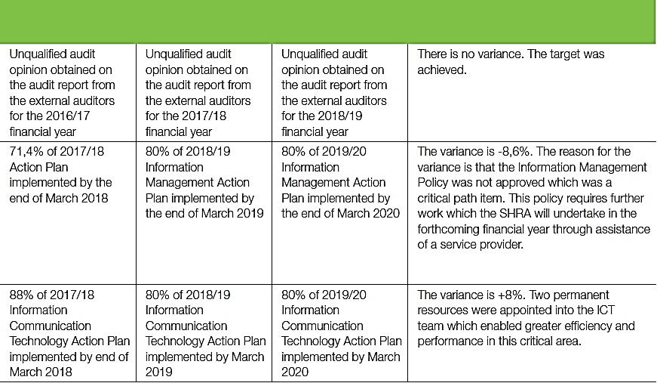

Slide 33
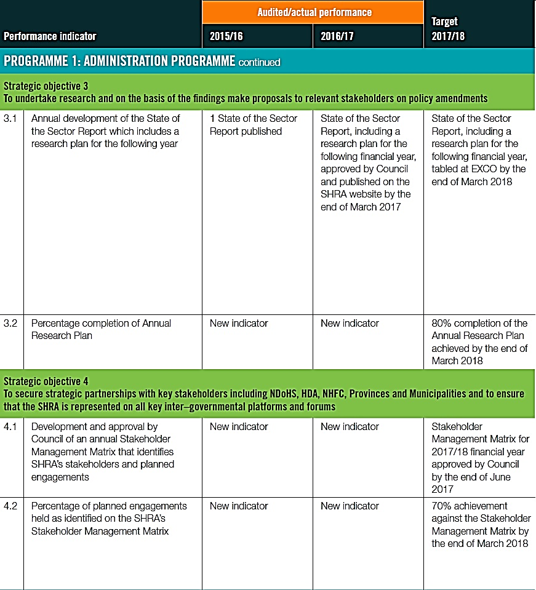
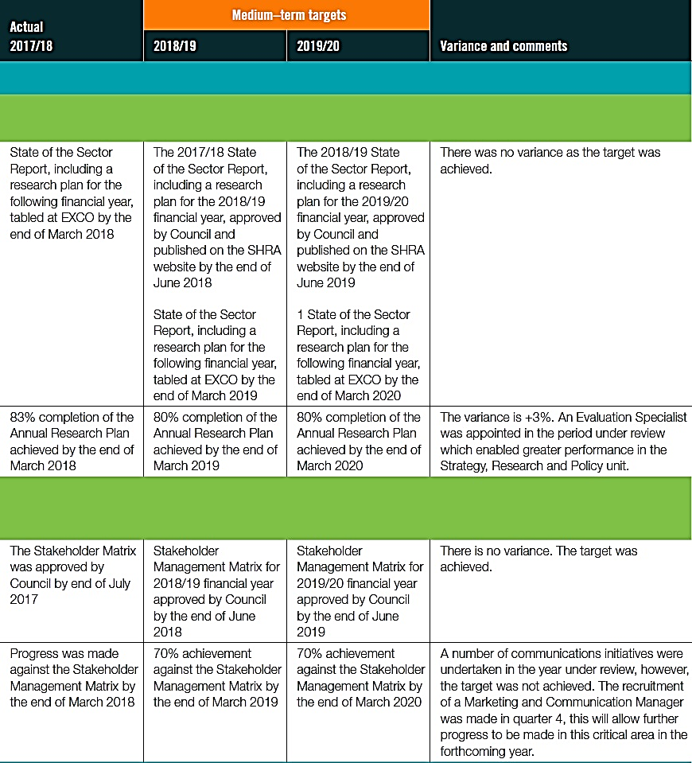

Slide 34
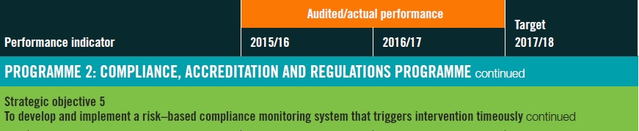
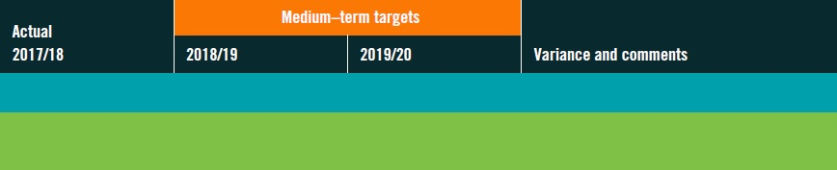
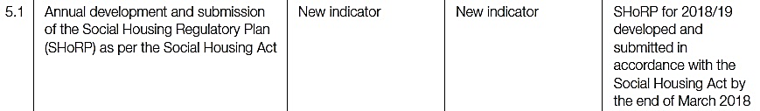
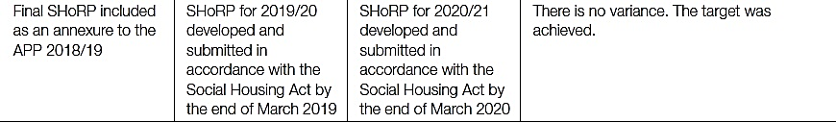
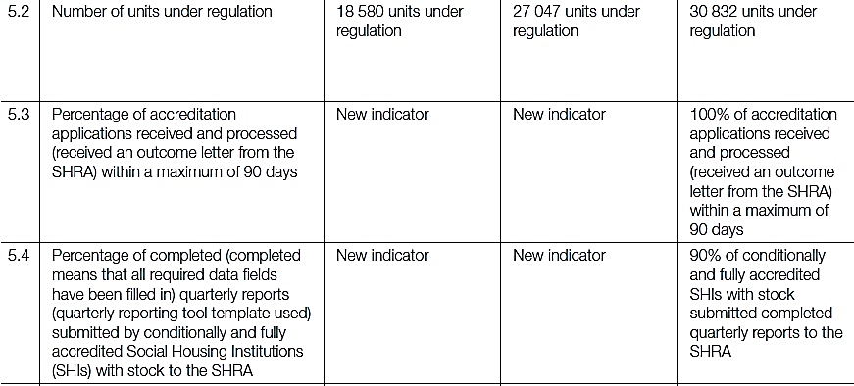
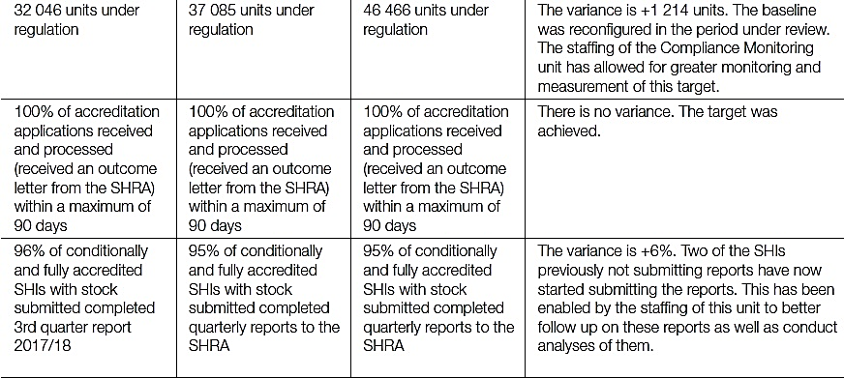

Slide 35
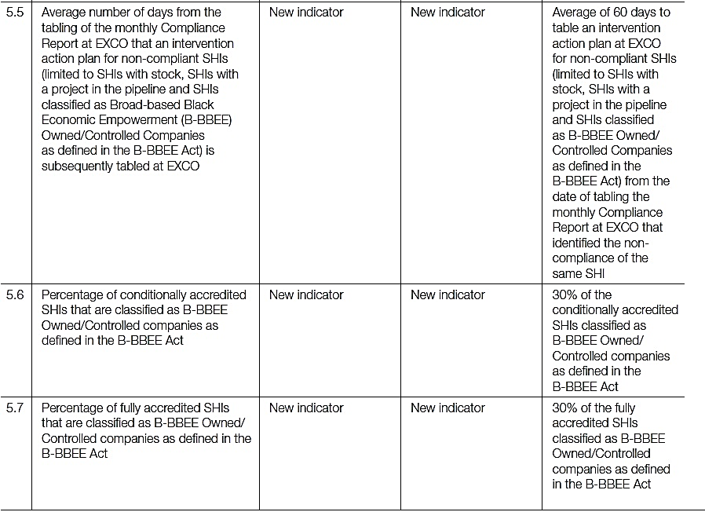
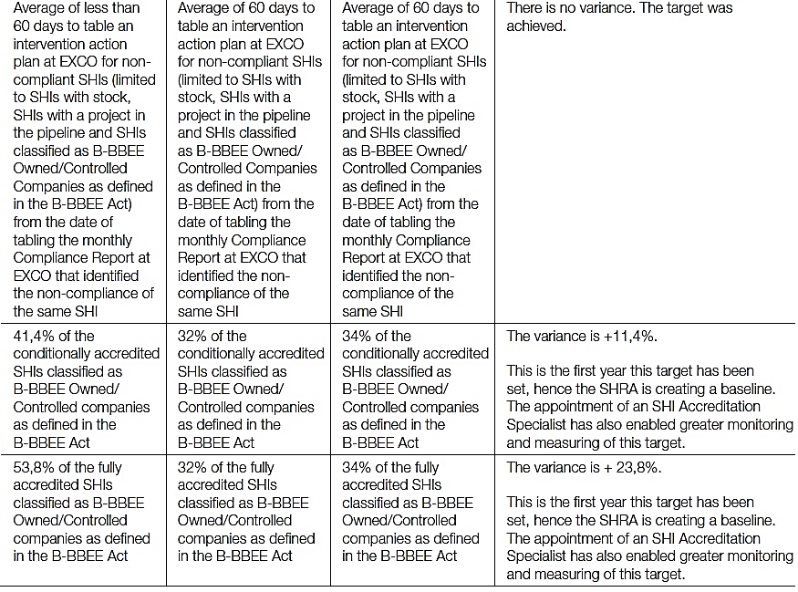

Slide 36
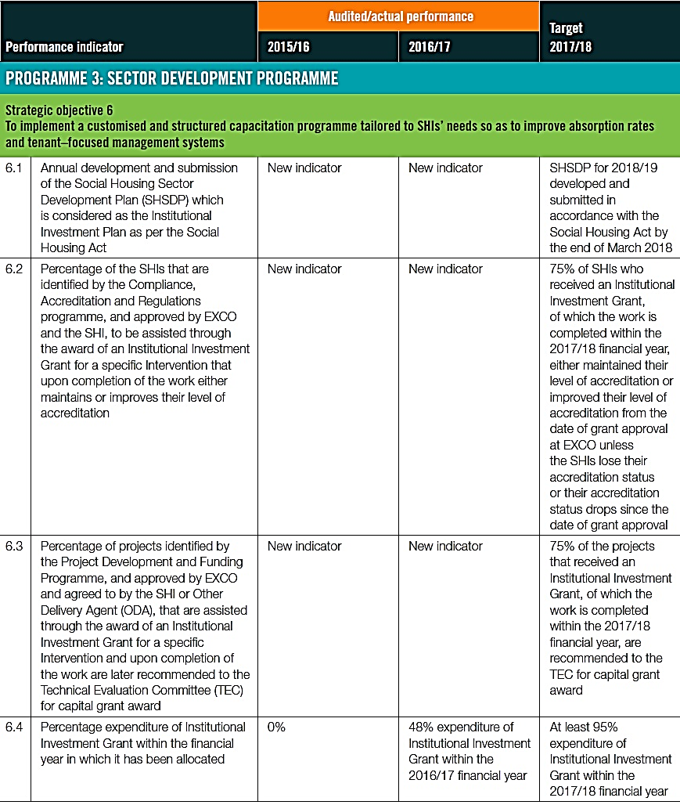
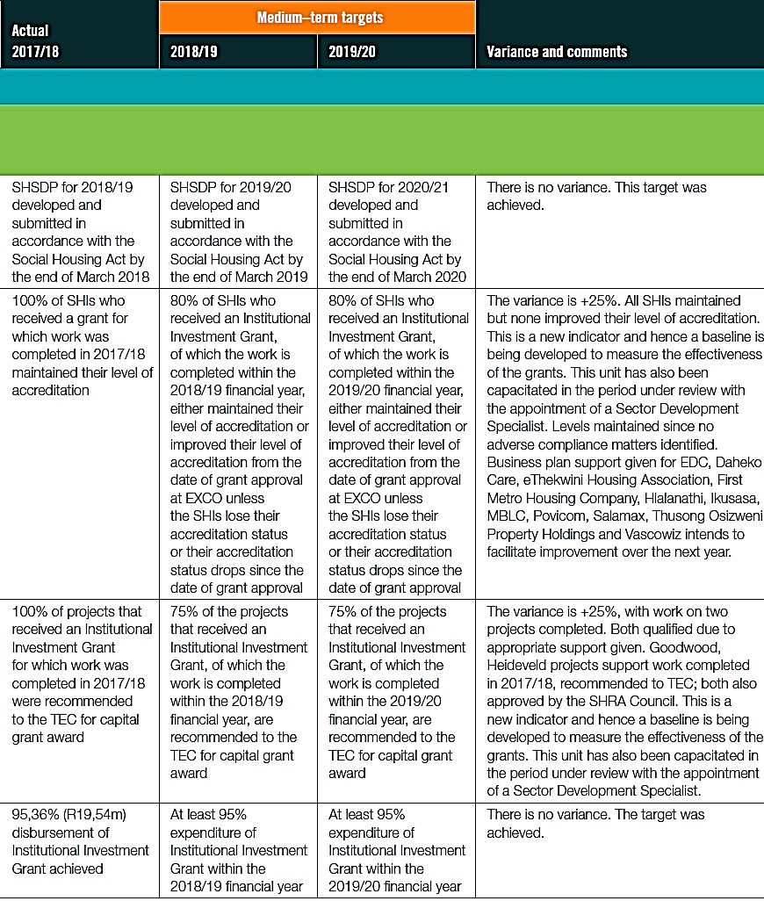

Slide 37
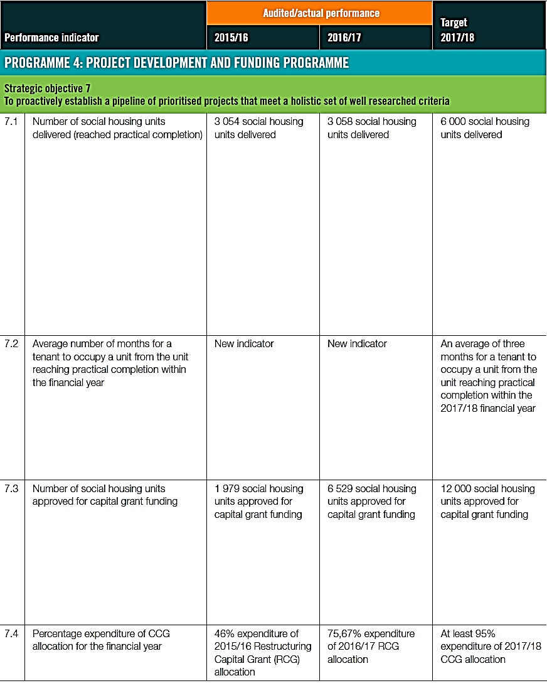


Slide 38



Slide 39
FINANCIAL PERFORMANCE
Annual Report 2017/18

Slide 40


Slide 41


Slide 42


Slide 43


Slide 44
2017/18 Audit Opinion
Audit Opinion | Unqualified
Emphasis of matter | None
Compliance with Legislation | Material misstatement on the financial statements which was corrected
Predetermined objectives | No material findings
Fruitless and wasteful expenditure | No instances
Irregular Expenditure | No instances

Slide 45
THANK YOU

