Slide 1
SASA POSITION ON THE NEW SUGAR TARIFF Presentation to the PPC on Trade and Industry 10 October 2018
Notes:
Portia to introduce SASA Delegation

Slide 2
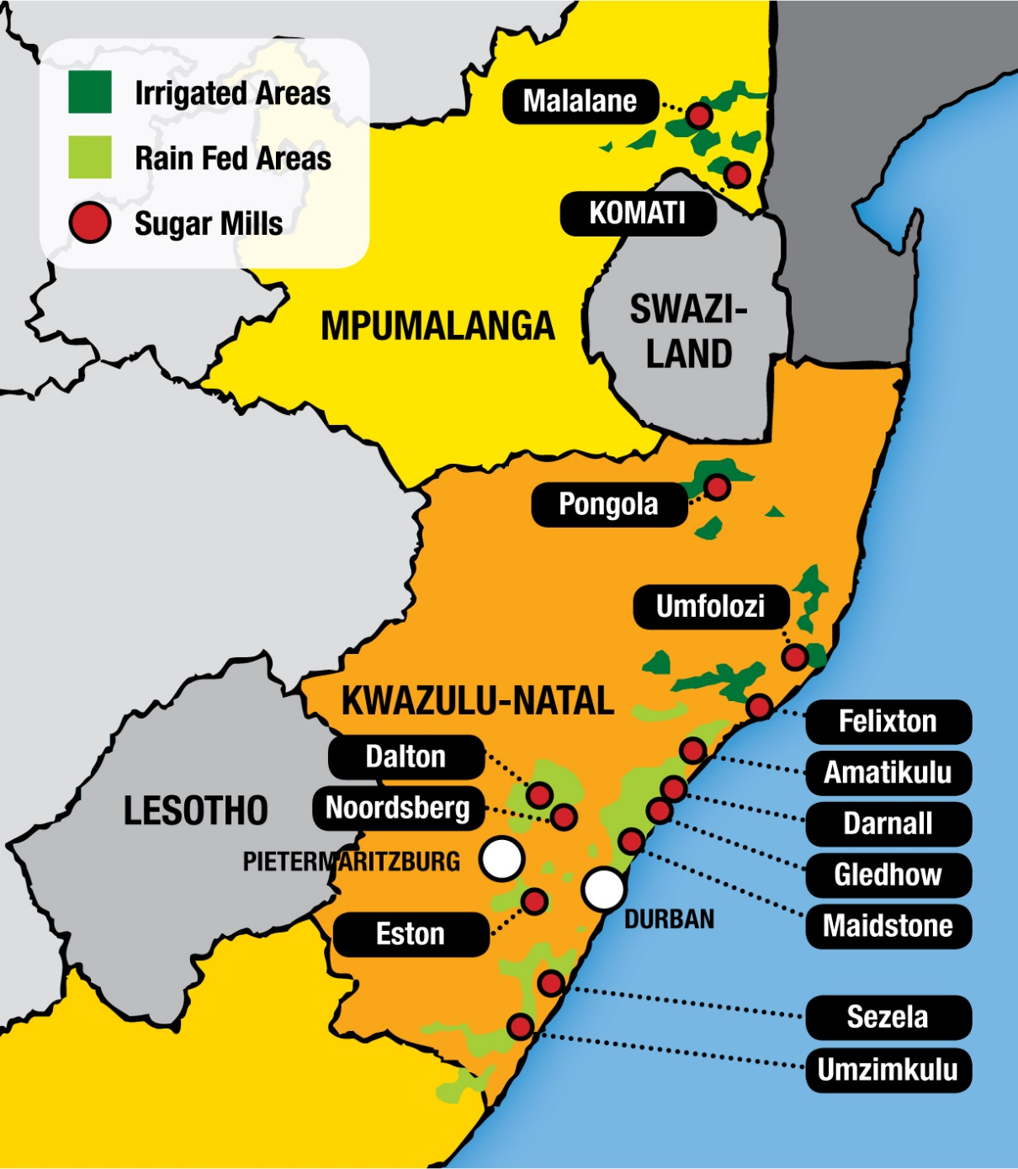
SOUTH AFRICAN SUGAR INDUSTRY
Key Industry Variables
Number of sugarcane farmers | 22 500
Area under Cane | 365 000
No of Sugar Mills | 14
Direct jobs | 85 000
Indirect jobs | 350 000
Contribution to GDP | R16 billion
1 000 hectares = 133 permanent + 210 seasonal jobs
Since 2013/2014, 5 831 jobs have been lost

Slide 3
The need for protection
World sugar market is highly distorted
World Price is a dumped price
It has no relation to the cost of production
Extensive government support and subsidies
In the form of direct support, export schemes, diversification
All sugar producing countries protect their local industries
Mozambique has a DBRP of $932 for refined sugar
Import licensing in many other African sugar industries

Slide 4
Level of protection requested Dollar Based Reference Price (DBRP) mechanism
SASA requested a DBRP of $856
Basis cost of SA’n sugar production
Return on investment
Policy cost – cost of exporting surplus production
Taking into account ITAC’s recent inclusion of the REER adj. to the R/$ exchange rate
ITAC granted a DBRP of $680
6 year av. of distorted World Price
Application of a distortion factor
Continued application of REER in the import duty formula

Slide 5
The DBRP and the import duty calculation
ITAC
ruling
What we asked for
no REER
R704/ton
a 15% discount for importers

Slide 6
Industry position on the outcome of the sugar tariff review by ITAC
SASA’s analysis of the sugar tariff review and outcome:
The objective of providing sustainable support to the local industry has not been achieved
The new import duty will be ineffective in protecting the industry over the next 3 years – a shrinkage of the industry is most likely
The sustainability of the sugar industry remains in the balance
There is an urgent need to review the basis on which protection from world sugar imports is afforded to the local industry

Slide 7
Impact of ITAC’s revised import duty for sugar
In the next 12 months:
Some measure of relief to loss-making operations for some farmers and millers
Majority of sugarcane farmers and millers will remain under significant financial pressure
Reduced investments on farms and mills
All 14 mills likely to remain under-utilised
In the 3 years’ time:
Area under cane likely to reduce by 40 000 ha
More than 5 000 black small-scale farmers likely to exit the industry
Sugar production likely to decrease by 240 000 tons
Very likely closure of 1 or 2 sugar mills – reduction in exposure to export market
Job losses could be 9 500 direct and 39 000 indirect jobs
Notes:
The intention of the next 3 slides is to establish the existence of distortion in the world market, with the following key points
RSA is one of the most economical producers of sugar IN SPITE of agro-climatic, topographical and scale challenges
No 5 price is a futures price, and bears no relation to cost of production
World prices are influenced by fundamental as well as macro-dynamics, and are increasingly heavily influenced by speculators
As the biggest traders of world market sugar, the exchange rate impacts of the Brazilian Real have a marked impact on the No 5 price
By comparison, South African sugar pricing is a result of a squeeze between increasing production costs and price suppression due to insufficient protection
This will answer QUESTION H (“What have been the (world) price trends of sugar over the last 3 years and their impact on the price of sugar (in RSA))”
Speaker Notes:
South Africans produce sugar in unique conditions. In spite of being one within the top 20 producers globally in terms of low cost, the South African production of 2.3 million tons bears little relation to the massive scale of Brazil (more than 80 million tons capacity, with roughly half of this production to ethanol), India (25 million tons) and China (12 million tons). These large producer countries also enjoy significant incentives and subsidies to protect their local industries, and promote surplus production and exports below their production costs.
In particular, Brazil’s conducive agro-climatic environment (soils, water, topography) allow for very high yields per hectare. In addition, government policies make it possible for production to be largely mechanised. Comparing field costs of growing cane, South Africa’s largely manual agricultural practises cost on average 37% more per ton (over the last 5 years) than Brazil. And in 2015/2016, this cost differential grew to more than 80% as a result of reduced mechanisation costs in Brazil linked to the falling oil price.

Slide 8
Independent analysis by the Bureau for Food and Agricultural Policy (BFAP)

Slide 9
SA Sugar Industry is globally competitive
Industry appreciates the difficult balancing act ITAC has to undertake
Protecting the sugar industry
Protecting the downstream users and consumer
South African sugar industry remains globally competitive
Under normal weather conditions - ranks in the top 15 of the lowest cost producers out of 135 sugar industries world wide
Industry is a significant socio-economic contributor to our economy

Slide 10
Concluding remarks
Current protection methodology may be flawed
Based on historic distorted world sugar pricing
Application of a subjective distortion factor
Discounting of the import duty – by application of the REER
There is a need to review the basis for the protection of the sugar industry
Industry to engage with key stakeholders to find a way forward
Short-term solutions that would sustain the industry in the next 3 years
Remove the REER from the import duty formula
Explore other protection measures applicable to dumped imports
Notes:
Speaker Notes:
Protection at below our local cost of production has resulted in price suppression.
In the South African context, sugar pricing (the industry’s notional price used for the calculation of the recoverable value of cane is used as a proxy) tends to be squeezed between a need to cover increasing costs of production, and the ever-present threat of world market imports. As a result, and evidenced by the confidential information supplied to ITAC, profitability is increasingly compromised. In recent months, the industry has been forced to increase pricing to recover massively escalated costs as a result of drought. But it must be noted that the industry’s inability to increase pricing before the impacts of drought were felt were already making the industry unsustainable.

