Slide 1

2017/18 Annual Report Presentation, to The Portfolio Committee on Basic Education
10 October 2018

Slide 2
PRESENTATION OUTLINE
Introduction
Legislative Background and Service Delivery Environment
Audited Financial Statements 2017/18
Programme Performance:
  Programme 1: Registration
  Programme 2: Ethics
  Programme 3: CPTD Management System
  Programme 4: Professional Standards
  Programme 5: Policy and Research
Concluding Remarks

Slide 3
LEGISLATIVE BACKGROUND AND SERVICE DELIVERY ENVIRONMENT

Slide 4
SA National Development Plan: VISION 2030
PROFESSIONAL STANDARDS AND QUALITY CPD PROVISIONING
“Attention should be given to the Continuing Professional Development of teachers and promotion of Professional Standards. Bodies such as the South African Council for Educators and specialist subject associations need to play a greater role in this”.
PROFESSIONAL CERTIFICATION / RE-CERTIFICATION
“Investigate introducing professional certification. Newly qualified teachers would need to demonstrate certain competencies before they are employed in schools, and after that they would be offered preliminary or probationary certification, to be finalised based on demonstrated competence”.
“The professional certification of all teachers would need to be renewed periodically (for example, every five years), serving as an incentive for teachers to undertake Continuous Professional Development”.
Quality Assurance of PD Programmes and Providers, and ensuring that teachers earn PD Points from these programmes
Monitoring and Evaluation: Quality and Relevance of PD provisioning, uptake by educators, and “impact / effect” in the system

Slide 5
LEGISLATIVE AND OTHER MANDATES
Medium Term Strategic Framework 2014 – 2019
OUTPUT NO:1
-Improved quality of teaching and learning through Development, supply and effective utilisation of teachers
Towards the Realisation to Schooling 2030
DBE Action Plan to 2019
GOAL NO: 16
Improve the professionalism, teaching skills, subject knowledge and computer literacy of teachers throughout their entire careers.
DBE Programme 3
Teachers, Human Resource and Institutional Development
SACE Act no.31 of 2000 as amended by the BELA Act no.65 of 2011
Register Educators
Manage a system for continuing professional development for all teachers
Professional Ethics
Professional Practice Standards

Slide 6

The primary outcome of the Plan is to improve the quality of teacher education and development in order to improve the quality of teachers and teaching.
It addresses the career of a teacher through a number of phases from recruitment through to retirement:
Recruitment of potential teachers.
Preparation of new teachers.
Induction into the world of work.
Career-long (continuing) professional learning and development.
2. SACE has an important quality management role to play in promoting and supporting the system for identifying and addressing teacher development needs.
SACE responsibilities in this regard include ensuring that:
the providers of teacher development programmes are fully approved by SACE;
the professional development courses available for teachers are endorsed by SACE; and
can lead to the accrual of Professional Development (PD) points on successful completion.
3
3. Development of the teacher knowledge and practice standards.

Slide 7
LEGISLATIVE AND OTHER MANDATES…
NPFTED (2007)
Section 53: “the South African Council for Educators (SACE), as the professional body for professional educators, will have the overall responsibility for the implementation, management and quality assurance of the CPTD system. SACE will be provided with the necessary resources and support to undertake that role”
NQF Act no.67 of 2008
Professional Bodies Recognition by SAQA
Section 29: “A statutory or non-statutory body of expert practitioners in an occupational field must apply in the manner prescribed by the SAQA in terms of section 13(1)(i)(i) to be recognised as a professional body in terms of this Act”
Development and Registration of the Professional Designation on the NQF
Section 30: “A professional body that is recognised in terms of section 29 must apply to the SAQA, in the manner determined by the SAQA in terms of section 13(1)(i)(ii), to register a professional designation on the NQF”.
Cooperation with other QCs
Section 28: Despite the provisions of any other Act, a professional body must co-operate with the relevant QCs in respect of qualifications and quality assurance in its occupational field.

Slide 8
AUDITED FINANCIAL STATEMENTS 2017/18

Slide 9
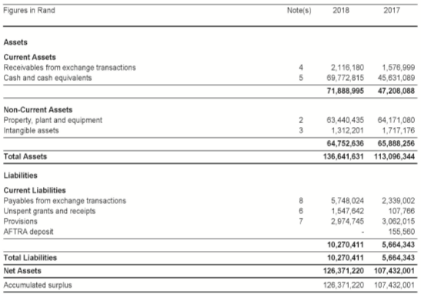
Statement of Financial Position

Slide 10
Notes: Financial Position
Total assets increased by 21% -
        Retained surplus
        Increase in subscription/cash equivalents
Non current assets remained unchanged
        No acquisition of material capital assets
Current liabilities increase of 81%
        Unspent grant
        Travel and accommodation account
Accumulated surplus of 18%
        Increased subscription / Provincial Building Reserve Fund
Financial position of SACE is positive.

Slide 11
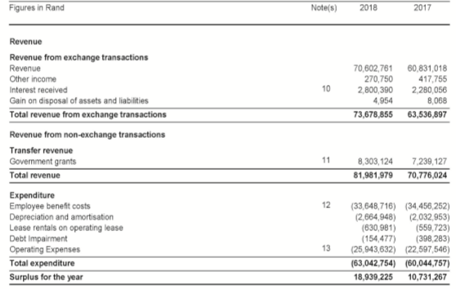
Statement of Financial Performance

Slide 12
Notes: Financial Performance
Revenue from Operating Transactions increased by 16%
            Increase of subscriptions.
Increase of 15% on CPTD subsidy spending
Total Revenue increase of 16%
Personnel Expenditure decreased by 2%
        Four Senior positions remained vacant pending the Job Evaluation process.
Operating Expenditure increased by 15%
Total Expenditure increased by 5%
        Operating cost.
Surplus of R19 million
        Approval was obtained towards improving ICT infrastructure and increasing client provincial contact points.

Slide 13
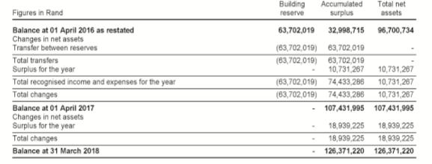
Statement of Changes in net assets

Slide 14
Notes: Changes in Assets
Total Net Assets increased by 18%
    Retained surplus
    Increased subscription
No acquisition of material Non-current Assets.

Slide 15
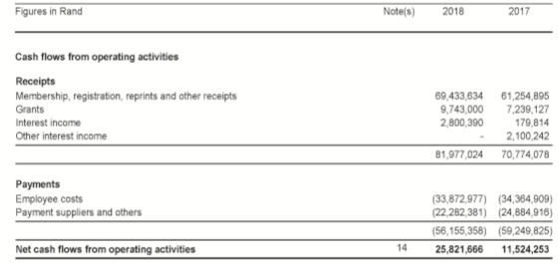
Statement of Cash flow

Slide 16
Notes: Cash Flow
Cash inflow into SACE increased by 16%
        Increase in subscription
Net cash flows increased by 124% - increase in payments.
AFTRA deposits were temporarily held in SACE account while AFTRA was in a process of opening its account facilities.
Net increase in cash and cash equivalents.
        Surplus
Cash and Cash equivalents on the 31st March 2017 was R69.8 mil – necessary approval was obtained for operational use.

Slide 17
Auditors Report
Few misstatements of information were identified and corrected on the spot;
SACE received an Unqualified Audit opinion for 2017/18.

Slide 18
PROGRAMME PERFORMANCE

Slide 19
PROGRAMME 1 - REGISTRATION OF TEACHERS
Must determine minimum criteria and procedures for registration or provisional registration;
Must consider and decide on any application for registration or provisional registration;
Must keep a register of the names of all persons who are registered or provisionally registered;
Must determine:
  The form and contents of the registers and certificates to be kept, maintained or
  issued in terms of this Act,
  The periods within which they must be reviewed and the manner in which alterations
  thereto may be effected; and
May prescribe the period of validity of the registration or provisional registration.

Slide 20
KEY PERFORMANCE INDICATOR | PLANNED TARGET 2017/2018 | ACTUAL ACHIEVEMENT 2017/2018 | DEVIATION FROM PLANNED TARGET TO ACTUAL ACHIEVEMENT 2017/2018
Number of new registered educators | 25 000 | 34 087 | + 9 087
Number of registration documents updated | 40 000 | 45 454 | + 5 454
Vetting and verification | 65 000 | 62 339 | - 2661

Slide 21
PROGRAMME 1: REGISTRATION…
Overall Programme 1 performed very well, especially with regard to the Registration of new teachers and the updating of the provisional and conditional registration documents.
New Teacher Registration refers to the process of registering with Council for the first time in terms the following categories:
TYPE OF REGISTRATION | DESCRIPTION
Full Registration | Qualified practicing unregistered teachers and newly qualified teachers who have never registered as student teachers in their third and final years of study.
Provisional Registration | Student teachers who are registering with Council for the first time and could not meet the requirements as they were still studying towards a teaching qualification.
Conditional Registration | Academically qualified and professionally unqualified people, whose registration is tied to a school or specific subject/s.
Foreign Registration | Foreign nationals registering with Council for the first time. Their registration status gets renewed every year.

Slide 22
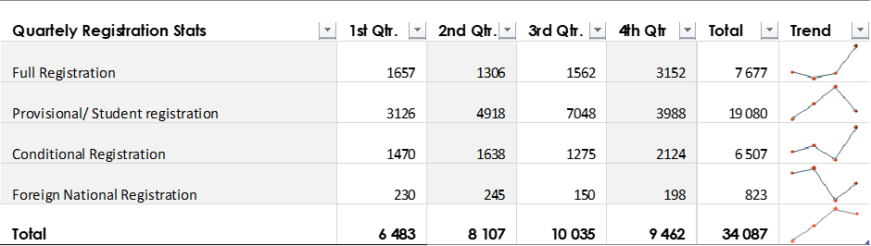
PROGRAMME 1: REGISTRATION (New Registration)…
55.97% of the new registrations come from the Higher Education Institutions – Student Teachers. This number dropped slightly by 1 339 as compared to 2016/17.
19.08% newly registered academically qualified and professionally unqualified teachers are given three years conditional registration and are required to complete their PGCE within that period.
The number of newly registered foreign nationals increased slightly from 720 in 2016/17 to 823 in 2017/18.

Slide 23
PROGRAMME 1: REGISTRATION…
Updating Registration Status
TYPE OF REGISTRATION | DESCRIPTION
Provisional to Full Registration | Newly qualified teachers who were initially accorded a provisional registration and their status gets changed upon submission of outstanding documents.
Provisional Extensions – Student Educators | Provisionally registered student educators who extend their registration status because they are still studying. An extension is provided upon submission of current proof that they are still studying and are currently enrolled at a Higher Education Institution.
Conditional Extension | Conditional Extension is given to persons who are academically qualified but professionally unqualified, and have not yet completed their PGCE as a requirement to obtain full registration and are employed at a school.
Foreign Nationals | Registered foreign nationals who come to seek extensions on their registration status either because their registration period of validity has expired, changed schools or have now acquired new passports or even residential status.

Slide 24
PROGRAMME 1: REGISTRATION …
Newly qualified teachers moving from provisional to full registration status are in the majority (51.00%)
Numbers of conditional updates remain high (5 630), indicating that the requirement to study for PGCE within the three years is not adhered to, to a certain extent.
Additionally, the employment and keeping of academically qualified and professionally underqualified people in the system is continuing. New renewal or update measures are put in place to curb this.

Slide 25
PROGRAMME 1: REGISTRATION (Vetting and Verification)…
62 339 applicants were vetted and verified in various ways during the period under review.
These numbers were not processed against the Department of Justice and Constitutional Development’s National Register of Sexual Offenders and Department of Social Development’s National Child Protection Register during the period under review because of:
  Finalization of the role of SACE in the actual verification and vetting processes against the SACE Act, section 125 of the Children’s Act, and section 147 of the Criminal Law (Sexual Offences and Related Matters) Act as Amended;
  The finalization of the identified logistical arrangements and usability of the National Register for Sexual Offenders;
  Research, legal opinion and advice, developed concept document that will inform the policy and criteria on professional suitability to practice in the teaching profession; and
  Consultative process in the profession as directed by Council.

Slide 26
PROGRAMME 1: REGISTRATION (Vetting and Verification)…
The processing of the 62 339 was done against the following:
  Mandatory individual written declaration,
  SACE internal processes in terms of the reported misconduct cases;
  Police Clearance and SAQA Qualification Evaluation and Verification documents prior to the finalisation of the foreign educators’ registration process. The issued clearance certificate is verified on the SAPS website upon submission to check its authenticity.
  The Department of Home Affairs assisted SACE with the verification of foreign educators’ travel documents;
  MOU with the Higher Education Institutions in terms of SACE receiving bulk qualification results and issuing the registration certificates at the graduation ceremony as part of welcoming the student teachers into the profession.
  A pilot study on this work has been successful with the Central University of Technology in Bloemfontein. Data has been received from the University of Kwazulu-Natal as well.
  The SACE staff that are responsible for processing the registration qualifications, have been trained on how to identify features of both genuine and fraudulent qualifications, hence a total of 18 educators were arrested for fraudulent qualifications by the Hawks in the SACE building.
  These people are flagged on the SACE registration system to avoid them attempting to register with the Council in the future. In cases where the staff is in doubt, universities are contacted for verification purposes.

Slide 27
VETTING AND VERIFICATION RECURING STICKY ISSUES AND MITIGATING PROCESSES
Implementation of the Police Clearance Certificate – 1st January 2019
Concerns raised by the teachers and teacher unions
  SACE viewed as being punitive and against the teachers;
  Hanging to the old historical offenses;
  Classification of offenses in terms of the ones that will bar applicants from being registered and others;
  Duplication in terms of police clearance, Child Protection Register, and Sexual Offenders Register
  Double payment - SACE levy and Police Clearance certificate fees.
All teacher unions, DBE, DHET, TVET Colleges, employers (Provincial Education Departments, SGB Associations, Independent Schools Associations), Higher Education Institutions, Education Deans Forum, and other stakeholders have been informed and engaged accordingly on these matters.
Advocacy and communication to the teachers has also been done.
Online systems are in place to verify the authenticity of the submitted police clearance certificate on the spot. This has already been tested against the submissions made by the foreign educators.
Fitness-to-Teach Policy and Committee has been established to deal with boarder-line cases that deserve to be heard prior to approval or disapproval of registration.

Slide 28
VETTING AND VERIFICATION RECURING STICKY ISSUES AND MITIGATING PROCESSES…
National Child Protection Register
Section 125 of the Children’s Act does not include SACE and its officials in the categories of persons who may be granted automatic or discretionary access to the Register.
SACE is therefore not lawfully entitled to access any part of the National Child Protection Register until there is an amendment of the Act.
However, the Act provides that any person has the right, upon presentation of sufficient proof of his or her identity, to establish whether or not his or her own name appears in Part A or Part B of the Register, and if so, the reasons why his or her name was entered in the Register.
DSD does not have automated systems for purposes of data sharing and as a result this will also affect the registration turn around time.
Ongoing Trilateral between SACE, DBE and DSD on this matter.
The Act was written with the employers and child caring, adoption and schools facilities, and individuals in mind and not professional councils. Hence the emphasis is on employers getting access to the register and not professional councils.
Submission made to the Registrar as part of the Child Protection Register Amendment processes.
POSSIBLE SOLUTIONS
Finalisation and implementation of the Protocol on the reporting of cases by the Provincial Education Departments and vetting and verification processes. The signatories will be the DBE, SACE, DSD, DOJC, SAPS and others.
Amendment of the Children’s Act by DSD to afford SACE direct access to the National Child Protection Register.

Slide 29











PARTIES TO THE PROTOCOL / MEMORANDUM
Including DSD, DOJC, SAPS

Slide 30
VETTING AND VERIFICATION RECURING STICKY ISSUES AND MITIGATING PROCESSES…
National Register for Sexual Offenders
The National Register for Sex Offenders is not yet operational. This can be verified by reference to the website of the Department of Justice and Constitutional Development which itself records that the issuing of clearance certificates for the verifying of individuals for any purpose in respect of the National Register for Sex Offenders is not yet operational.
While trilateral is happening between SACE, DBE and DoJC, the implementation implications by SACE will be examined.
Vetting of the Practising Registered Teachers and Verification of Qualifications
The vetting and verification of the practising registered teachers could only be done when the process of re-certification is finalised by Council and introduced into the teaching profession.
However, prior consultations and engagements with the teacher unions and teachers are critical to deal, for example, with applications for enforcing the Children’s Act and Criminal Law (Sexual Offenses) Act retrospectively and possible destabilisation of the schooling system.

Slide 31
PROGRAMME 2: ETHICS
Key Functions:
To uphold the image of the teaching profession by review of the Code of professional Ethics periodically,
To investigate complaints of improper conduct against educators,
To institute disciplinary hearings at the behest of the Council where evidence of a breach of the of the Code of Professional Ethics for educators has been found, and

Slide 32
KEY PERFORMANCE INDICATOR | PLANNED TARGET 2017/2018 | ACTUAL ACHIEVEMENT 2017/2018 | DEVIATION FROM PLANNED TARGET TO ACTUAL ACHIEVEMENT 2017/2018
Number of beneficiaries to be apprised of the code of Professional Ethics, i.e. Educators, parents, and officials | 10 000 | 7 715 (77.15%) | 2 285
The Number of concluded cases as measured against the number of cases received for the year | Actual Number of Cases Received 500 | 509 | + 9
 | Actual number finalized | 327 (64.25%) | - 182 (35.75%)

Slide 33
PROGRAMME 2….
Programme 2’s performance improved from all red (2016/17) to all amber status in 2017/18 financial year.
64.25% (327 out of 509) were finalised as follows:
301 cases finalised without actual Hearing | 233 Advisory Letters were issued to educators
 | 04 Mediated upon
 | 06 cases were withdrawn before a hearing could be conducted
 | 38 cases closed in line with the Ethics committee’s direction and permission or at the request of the complainant.
 | 20 cases referred to the DBE, SAPS, and ELRC
26 Cases finalised through hearings | 05 cases - Educators struck off indefinitely
 | 01 case - Educators struck off but may re-apply after a certain period
 | 18 cases - Educators struck off but striking off suspended for a certain period, including fines.
 | 02 cases - Educators found not guilt

Slide 34
PROGRAMME 2 : Ethics….
While the programme had a carry-over of 182 (35.75%) cases into the 2018/19 financial year, it is important to note that it has simultaneously worked on the 509 2017/18 cases plus the 248 carried over into the 2017/18 financial year from the 2016/17.
The 2016/17 cases were processed as follows by the 31st March 2018:
Total number of cases carried over from 2016/17 to 2017/18 | 248
Total number of carried over cases finalized as at 31st March 2018 | 126 (50.80%)
Total number of outstanding cases (from 2016/17) still being processed to finality as at 31 March 2018. | 122 (49.19%)

Slide 35
PROGRAMME 2: ETHICS…
Types of Incidences Received | Numbers
Corporal Punishment and Assault | 253
Verbal Abuse, Victimization, Harassment, Defamation and intimidation | 87
Sexual Misconduct /(sexual relations/rape/love relations with learners) | 78
Unprofessional. Conduct, Use of improper language, Alcohol Abuse, Absenteeism, Insubordination | 75
Fraud, Theft, Financial mismanagement | 37
Negligence | 10
Racism | 9
Murder, attempted murder, intimidation | 0
No. Jurisdiction | 11
TOTAL | 560

Slide 36
PROGRAMME 2: ETHICS (Status of all cases according to the financial years, as at the 30th September 2018)
Activity | 2016/17 | 2017/18 | 2018/19 (Current)
Cases carried over from previous financial years (Excluding 2018/19) | 248 | 182 | 312
Total number of finalized cases | 202 (81.45%) | 147 (82.58%) | 173 (55.44%)
Status of outstanding cases still being processed | 46 have been investigated and Disciplinary hearings are underway. | 35 have been investigated, and disciplinary hearings are underway. | 118 have been investigated and disciplinary hearings are underway. 21 have been scheduled for investigations.

Slide 37
PROGRAMME 2: ETHICS
Internal capacity has been enhanced through the creation of five (5) additional posts – Legal and Ethics Officers to deal with the entire case management chain, from investigation to hearings.
Working closely with the Department of Social Development in terms of feeding information into Part A of the National Child Protection Register. In line with this, a total of 24 names of teachers who are unfit to work with children have been submitted to the DSD for inclusion into Part A of the Register.
A number of advocacy and communication activities were held to promote the Code of Professional Ethics to the educators, communities and the public at large.

Slide 38
CPTD MANAGEMENT SYSTEM

Slide 39
CPTD MANAGEMENT SYSTEM
The SACE Act dictates that Council must manage a system for the promotion of continuing professional development for all educators in schools;
Programme Purpose
The programme is responsible for managing and promoting the continuing professional development; of
Teachers, additionally, the programme is being phased in in terms of orientating and signing up teachers; to
Participate in the CPTD management system and earn 150 points in 3-year cycles and approval of service providers;
Providers and endorsement of all PD programmes that are presented to teachers.
Key Functions:
• Orientate and sign-up teachers;
• Approve providers;
• Endorse professional development activities;
• Monitor professional development uptake by educators;

Slide 40
PERFORMANCE INDICATORS | TARGET FOR 2017/2018 AS PER APP (31 MARCH 2018) | ANNUAL ACTUAL OUTPUT VALIDATED | DEVIATION FROM PLANNED TARGET TO ACTUAL ACHIEVEMENT 2017/2018
Number of educators orientated and signed-up for participation in the CPTD system. | 80 000 PL 1 Educators | 74 022 (92.53%) PL1 Educators | 5 978 (7.47%)
Percentage of signed up teachers who engage in three types of Professional Development (PD) Activities: Type 1: Self-Initiated PD activities Type 2: School Initiated PD Activities Type 3: Externally Initiated PD Activities | Type 1: 65% (106 340) Type 2: 55% (89 980) Type 3: 40% (65 440) | Type 1: 32% (52 352) Type 2: 30% (49 570) Type 3: 12.3% (20 123) | Type 1 : - 33% (53 988) Type 2 : 24.7% (40 409) Type 3 : -27.7% (45 317)
Percentage of signed up educators who meet the minimum requirement of 150 CPTD points over the three-year cycle. (Disaggregated by Cohort-Principals, Deputy Principals, HODs and PL1 educators | 70% (23352 of 33360) all Signed up Principals & Deputy Principals (Cohort 1: 2014-16) meet the minimum requirement of 150 CPTD points | 1 163 (4.9%) Signed up Principals & Deputy Principals (Cohort 1: 2014-16) met the minimum requirement of 150 CPTD points. | - 22 189 (95, 01%)
EDUCATORS’ SIGN-UP FOR PARTICIPATION IN THE CPTD SYSTEM, AND REPORTING OF THEIR PARTICIPATION IN VARIOUS PROFESSIONAL DEVELOPMENT ACTIVITIES AND REFLECTION ON THE EFFECT OF THAT PARTICIPATION ON TEACHING AND LEARNING

Slide 41
PERFORMANCE INDICATORS | TARGET FOR 2017/2018 AS PER APP (31 MARCH 2018) | ANNUAL ACTUAL OUTPUT VALIDATED | DEVIATION FROM PLANNED TARGET TO ACTUAL ACHIEVEMENT 2017/2018
Number of Approved Professional Development Providers subjected to quality assurance by SACE in a financial year | 130 | 130 | -
Number of new Professional Development Providers Processed in the quarter of submission (in terms of approved status, not approved status, rejected and in process) | 120 new provider applications processed in a year | 164 | + 44
Number of new Professional Development Activities Processed in the quarter of submission (in terms of endorsed status, not-endorsed status, rejected and in process) | 600 new Professional Development Activities Processed in the year | 1 526 | + 926
Quality Assurance of the Provisioning of Professional Development, to the Educators, by various Providers

Slide 42
PROGRAMME 3: CPTD SYSTEM
The first three indicators of Programme 3 focus on the following:
  Educators’ sign-up for participation in the CPTD system;
  Monitoring educators’ uptake in three types of professional development. The success of this indicator is dependent largely on the signed-up educators as well as schools, employers and providers, reporting to SACE, participation of educators in the three types of professional development activities; and
  Educators meeting the 150 required minimum professional development points, that is dependent on two factors: (a) participation in three types of professional development activities through the SACE Approved Providers / employers and SACE Endorsed professional development activities and programmes, and (b) the reporting of participation in the three types of PD activities by educators themselves, schools, employers and providers.
The success of the two indicators (except the sign-up one) is dependent largely on the external factors and finalisation of the process of linking the CPTD system with re-certification.
74 022 (92.53%) PL1 Educators out of 80 000 signed up during the financial year. As at 30th September 2018, overall, 333 734 (77.01%) out of 433 320 educators signed up for participation in the CPTD system.
Significant improvement has been registered through the Limpopo and Kwazulu-Natal provinces, with the support of the EMIS system.

Slide 43
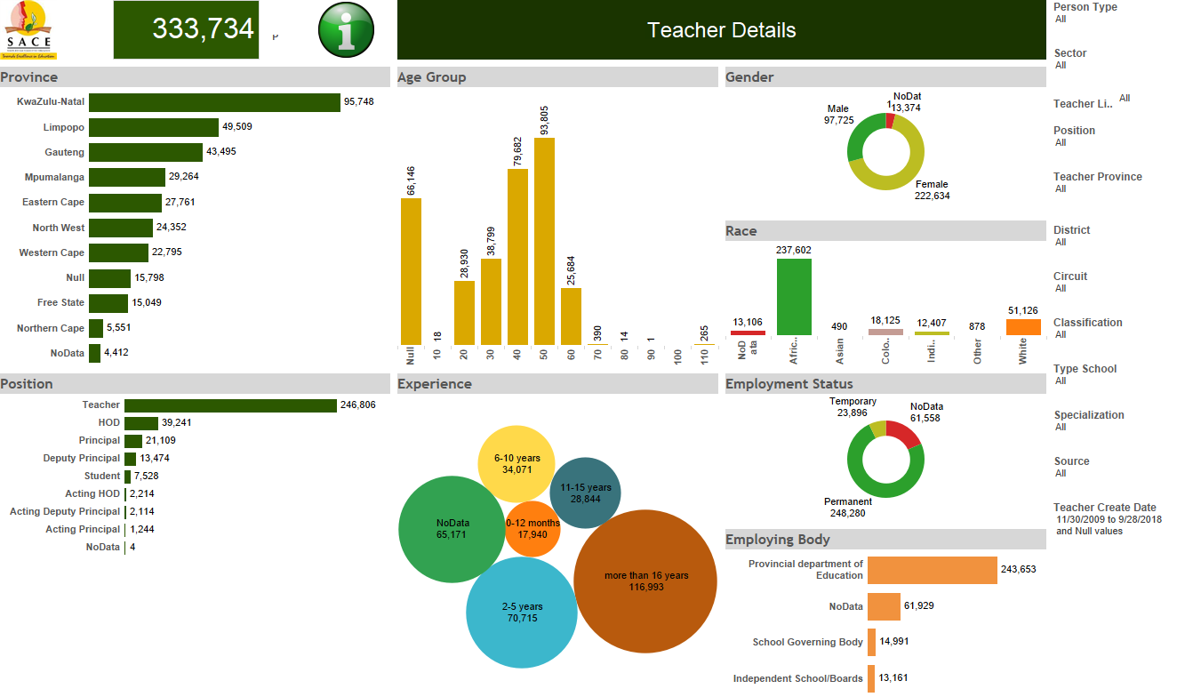
CPTD Sign-up as at the 30th September 2018

Slide 44
PROGRAMME 3: CPTD SYSTEM
While output on the sign-up for participation in the CPTD system has improved significantly in the last four years of implementing the CPTD system as well as the period under review, the effect on participation in the three types of professional development on teaching and learning is yet to be seen.
This had a negative bearing on the indicator that monitored the number of principals and deputies meeting the minimum requirements of 150 PD Points.
Notwithstanding this, lessons could be drawn from the 1163 principals and deputies who met the three year CPTD cycle requirements.
The three indicators on the approval of providers, endorsement of the activities and onsite quality assurance of endorsed activities performed very well.
This could be attributed to the support provided to the six Provincial Education Departments by SACE, on programme and material development in line with its endorsement criteria.

Slide 45
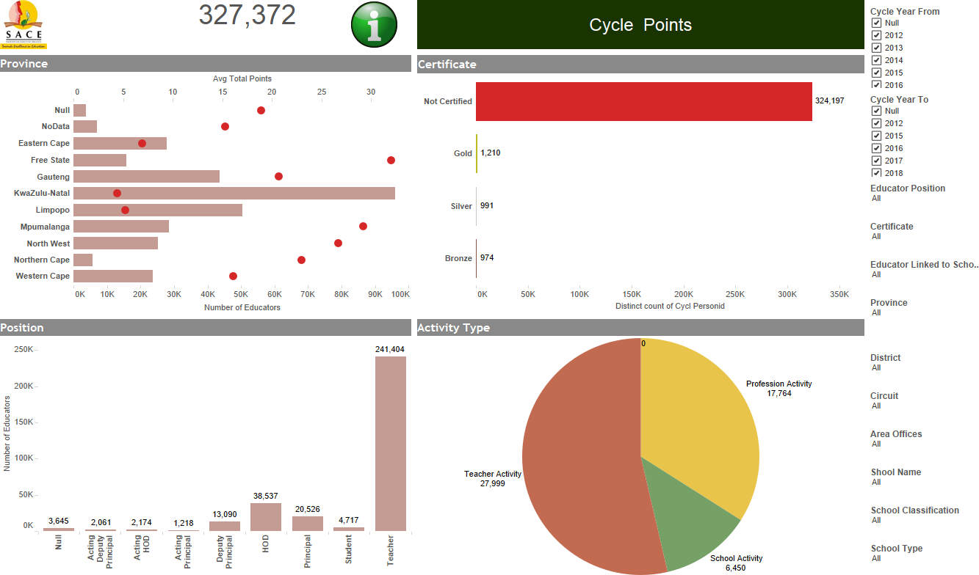

Slide 46
PROFESSIONAL STANDARDS

Slide 47
PROGRAMME 4: PROFESSIONAL STANDARDS
Key functions:
Develop standards in the following areas:
  - Entry into the teaching profession from admission to full registration,
  - IPET and CPTD programme content, and
  - Professional practice.
Award teacher designation.

Slide 48
PROGRAMME 4: PROFESSIONAL STANDARDS
The draft Professional Teaching Standards Framework and the actual standards have been produced and consulted on widely through the Teachers, Teacher Unions, Higher Education Institutions, Provincial Education Departments, DHET, DBE, Education Deans Forum, Independent Schools Associations and other stakeholders.
The standards are ready for final approval by council in November 2018 and gazetting before the 2018/19 financial year.
The will ensure that the professional standards inform all teacher education and development stages - from pre-service teaching practice through in-service (continuing development).
They will also inform all teacher education and development stages, from pre-service through in-service continuing development.
The roll-out and implementation of the professional standards will start with the provisional registration and induction of newly-qualified teachers, prior to the awarding of full registration status.
They will then be phased-in for the practising educators .

Slide 49
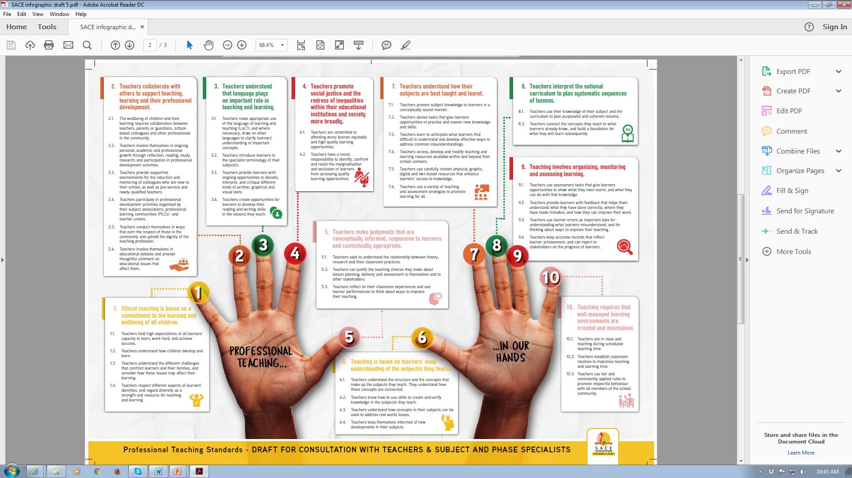

Slide 50

SACE’s Professional Teaching Standards
The Standards are grouped into 10 clusters
Two connected strands:
Professional teachers build communities
1-4
Professional teachers enable learning
5-6

Slide 51
STAKEHOLDER ENGAGEMENTS AND CONSULTATIONS
DBE
9 x PEDs
TRILATERAL
( SACE, DBE and DHET)
DHET
9 X PTEDC
Independent Schools Sector
NAISA (8 Associations)
ADvTech and Curro
PROFESSIONALISATION PATH (INCLUDING PROFESSINOAL TEACHING STANDARDS
24 X HEIs
4 X Independent HEIs
EDF
SAPA National
9 X SAPA
SGBs
7 X SGB Associations
SAQA
CHE, QCTO and Umalusi
5 National Teacher Unions
5 X 9 Provincial Teacher Unions
6 345 Teachers CPTD Weekend Seminars
TVET and CETC Colleges
ELRC
9 X PELRC

Slide 52
RESEARCH

Slide 53
PROGRAMME 5: RESEARCH
Key Functions:
Advising the Minister of Basic and Higher Education, Council and the public on Professional Development matters;
Develop and implement professional standards and designations including an induction methodology;
Provide ongoing support to all the SACE Divisions and Committees in terms of policy and research matters;
Conceptualize and undertake research on professional matters for purposes of informing SACE programmes, Council decisions, educational policy, advising the Minister of Education, Council and the profession;
Produce policy and research publications/ reports and disseminate research findings through various communications channels;
Establish and manage the SACE resource center.

Slide 54
RESEARCH ACTIVITIES
Research Projects Done
Report: Research trends analysis of a 5-year review study on disciplinary cases reported to SACE from 2013 to 2017;
Report:How can special schools use their expertise relating to specific disabilities to support ordinary schools including children with similar needs (i.e. special schools as resource centres) drawing from global examples;
Report: The role of institutional networks in the professional registration of teachers in South Africa;
Pilot Report from SAQA on Data Matching: Redefining the SACE Registration Scope;
Final Report : A qualitative study on factors and conditions facilitating and contributing to sexual relationships with learners in schools.

Slide 55
RESEARCH ACTIVITIES
2 Teacher Seminars and Conferences held;
Policy Briefs
  Low participation rates on the implementation of the CPTD Management System;
  Factors and environment that enhances sexual misdemeanours between learners and teachers.

Slide 56
FOR NOTING
SAFETY IN SCHOOLS..
SACE Contribution

Slide 57
WHAT ARE WE DOING - SCHOOL VIOLENCE
As the custodian and voice of the teaching profession, SACE has a responsibility to build and protect the profession and teachers as the nation’s greatest assets, in particular
Professionalise the teaching profession across the Teacher Education and Development Continuum
Professional Standards – Foregrounds Ethical Teaching, promotion of social justice and redressing of inequalities in schools and societies, professional teachers builds societies and the nation
Endorsement of Quality Fit-for-Purpose Professional Programmes that are responsive to issues around school violence and positive discipline
Training of the Code of Professional Ethics, especially section 3 that deals with a relationship between a teacher and a leader – setting of professional boundaries
Collaborating with teacher unions on gender-based school violence sessions
Research on cases reported to SACE – trends analysis (2008 – 2012 and 2013 – 2017), Factors that enhances sexual misdemeanour in schools
School Violence
Physical Assault
Sexual Abuse
Verbal Abuse
Teacher-on-Learner
Teacher-on-Teacher
Learner-on-Teacher
Teacher-on-Parents

Slide 58
Teachers’ Rights, Responsibilities, and Safety Programme, Handbook and Policy
Literature Review and Conceptualisation (October – December 2018)
The Right to Education means the Right to Safe Teaching and Learning Environment
Locate within Teacher Professionalisation
Engagements and Informing the Conceptualisation Process (January – March 2019)
9 x Provincial Focus Group Sessions with Teachers
Round-Table / Seminar to table the Draft Handbook
OUTPUT (April 2019 Onwards…)
Teachers’ Rights, Responsibilities and Safety Handbook
Advice to the Minister on Teachers’ Rights, Responsibilities and Safety National Policy
Official Launch cum Indaba in December 2018
Webinars and Face-to-Face CPD on the Handbook and SACE Endorsed Positive Discipline , Incorporate into Initial Teacher Education

Slide 59
TEACHERS FEELING DISEMPOWERED, AND HELPLESS CURRENTLY
Shift away from the compliance-mode of training teachers on the Code of Professional Ethics to:
  Value-based Code of Professional Ethics Programme that take into account
  Philosophical and Ethical Consideration Issues;
  - Re-building and strengthening Teachers’ Professional Identity and Pride.
Shift away from alternative discipline measures TO positive and restorative discipline.
Revive and Strengthen the Code of Professional Ethics Handbook

Slide 60
WHAT DO WE NEED?
Political will and support in and out of the teaching profession to implement and enforce the relevant legislation.
Recognition that the education system is dealing with Generation Z that is different from the millennials.
This is the generation that live and breathe technology, Wi-Fi, data. This is also a generation that is exposed to drugs, substance abuse, sexual activities and teenage pregnancy, and ill-discipline at a very early stage as well.
Because schools are microcosm of the society, all these issues replicate themselves and bring complexity, unsafe teaching environment, low teacher morale and burnout in schools.
Enhanced Institutional Arrangements and Institutional Networks.

Slide 61
Appreciation to the:
Portfolio Committee on Basic Education for critical feedback and guidance that contributed in strengthening the governance and functioning of SACE;
Minister, DG and the DBE officials enhance support and collaboration on a number of activities with an ultimate goal of improving the quality of teaching and learning in the country;
Stakeholders for working collaboratively with us in taking the teaching profession forward; and
Our teachers who ensure that SACE has the resources to deliver on its mandate accordingly.
THANK YOU

