Slide 1
Rural Housing Loan Fund
PARLIAMENTARY PORTFOLIO COMMITTEE ON HUMAN SETTLEMENTS
PRESENTATION OF THE 2017/18 ANNUAL REPORT
10 OCTOBER 2018

Slide 2
Outline
RHLF Mandate & Business Model
Market conditions prevailing during the current MTSF
Performance against Predetermined Outcomes
Performance Against MTSF and other Government Priority Programmes
Audited Financial Statements (Annual Report 2017/2018)
Governance and Audit Outcomes
Winding up of RHLF, post transferring of business to NHFC per Donation Agreement

Slide 3
Mandate and Core Business
Households access to housing finance
Facilitate access to incremental housing finance for low income households in rural areas.
Rural areas
Communal land, rural towns and small towns
Monthly Income
Maximum R15 000
Focus on borrowers earning under R3 500

Slide 4
Business model
Intermediaries
Carry credit risk, but RHLF conducts risk reviews annually (credit & mandate)
Wholesale Lending
Wholesale funds to retail intermediaries
Must be repaid to RHLF for further lending—critical for sustainable delivery on the mandate
Types: Commercial and Community based organisations
Lend to borrowers

Slide 5
RHLF Pricing Policy: making loans affordable
Rate charged to retail borrowers | Rate charged by the Rural Housing Loan Fund
REPO +≥ 25 % | Prime + 4%
REPO + ≥ 23-24.9 % | Prime + 3%
REPO + ≥ 21-22.9 % | Prime + 2%
REPO + ≥ 19-20.9 % | Prime + 1%
REPO + ≥ 17-18.9 % | Prime %
REPO + ≤ 16.9% | Prime – 1.5%
Community based organisations are charged Prime MINUS 2.5%
RHLF prices on development goals, not risk
Repo=6.50%
Prime=10%

Slide 6
Market Conditions 2015-2018

Slide 7
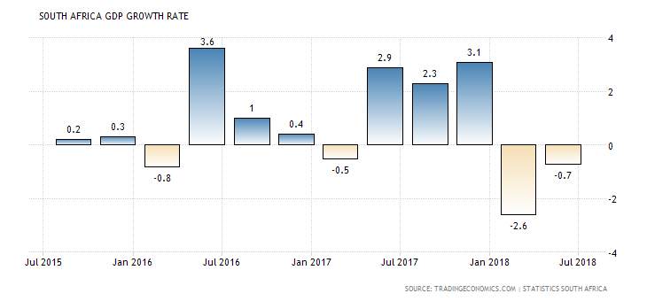
South Africa GDP Growth Rate
Growth of the economy has remained subdued during the current term of government
Economy is currently in technical recession, following contraction in the first 2 quarters of the year

Slide 8
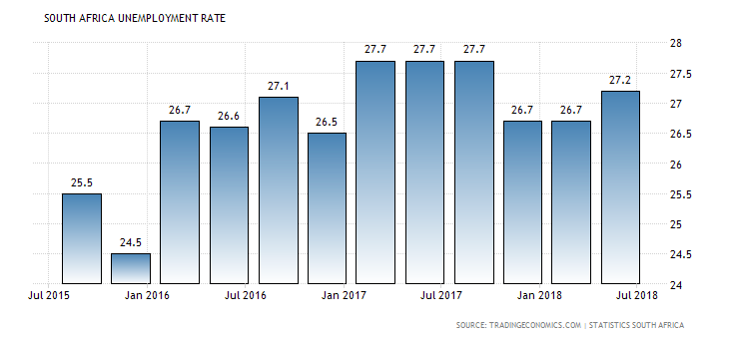
South Africa Unemployment Rate
Unemployment has remained stubbornly high during the term of government
Slow economic growth and structural factors contribute to the challenge of addressing high unemployment
Result is high dependency ratio—few people working and many mouths to feed

Slide 9
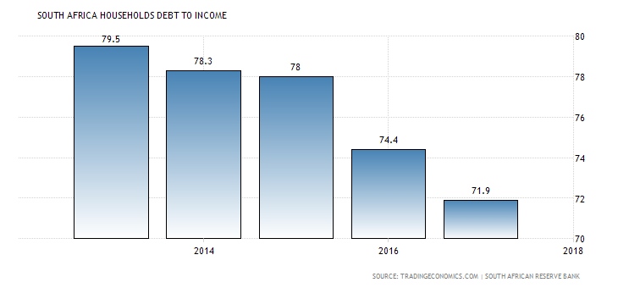
South Africa Households Debt to Income
Was at all time high at 86.4% in 2008, but has been declining
Fell to 71.9% in 2017, and reduced further to 70.9% in Q1 of 2018
Slightly increased to 71.3% in Q2 of 2018

Slide 10
Performance against Predetermined Objectives in APP 2017/18

Slide 11
Stakeholder perspective
Number of loans delivered were below the set target due to
tough market conditions—high unemployment as a result of slow economic growth
low affordability levels as shown in high rejection rates by our intermediaries
All other indicator targets were exceeded

Slide 12
Business process perspective
Disbursements were below target (89%) as a result of the poor economic conditions.
More verification visits at borrower level were conducted than budgeted and gives assurance of compliance with development mandate as shown in stakeholder perspective.

Slide 13
Financial Perspective: Capital Preservation
Expenses were below budget, partly because of delay in implementation of Voucher Programme and managing costs in general
Surplus slightly above budget due to lower than expected provisions

Slide 14
Learning and Growth Perspective
RHLF has a policy of recruiting interns where possible
9 of the 17 current employees joined as interns
High budget for training to ensure our employees develop in order to enhance capacity to deliver on the mandate & entity’s commitment to skills development of its employees in general

Slide 15
Performance against MTSF Targets and other Government Priorities

Slide 16
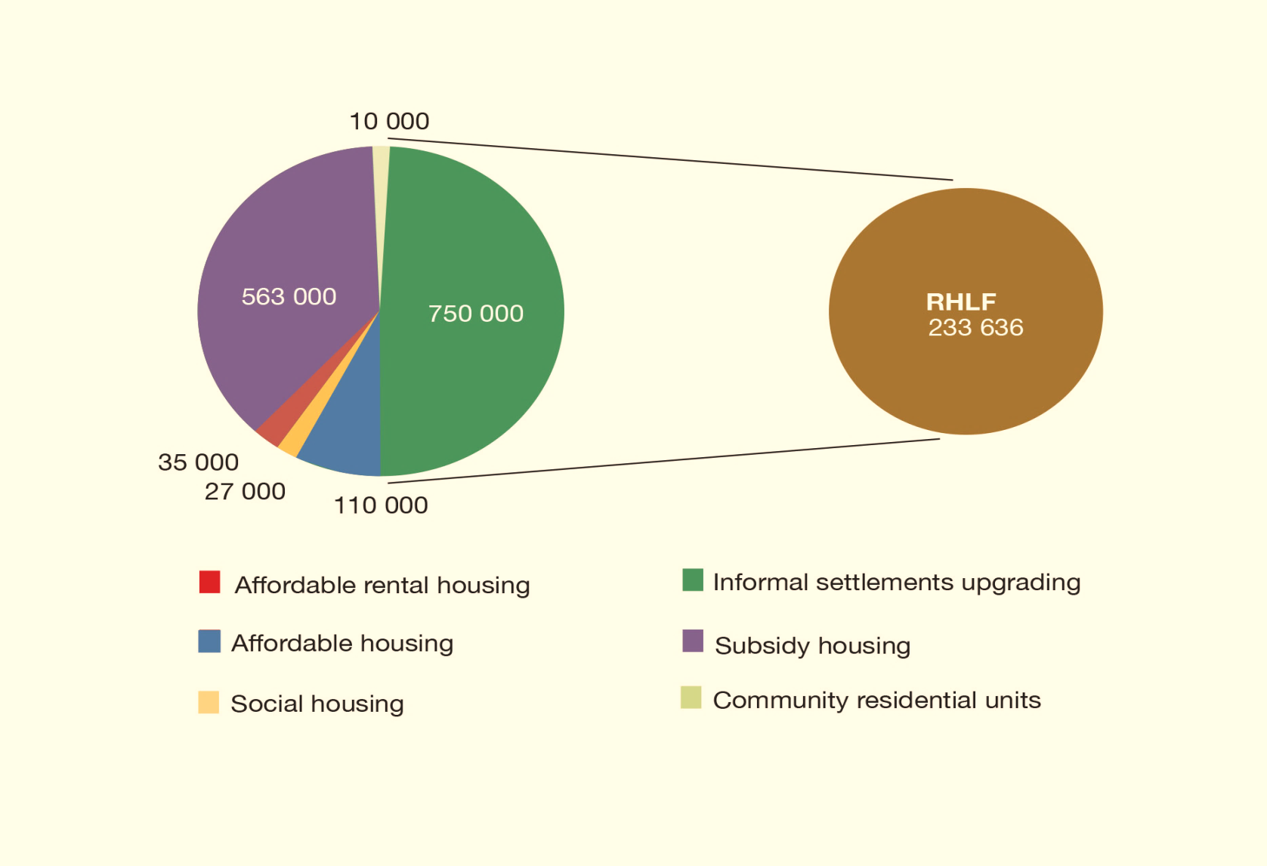
MINISTER’S COMMITMENT AND RHLF CONTRIBUTION (2014-2019 MTSF Targets)
Minister’s commitment = 1 495 000 housing opportunities
RHLF commitment = 233 636 housing opportunities

Slide 17
Performance against MTSF Target
MTSF target = 233 636 housing opportunities
Performance at end of Q1 2018/19 = 75.4% (176 208)
Consequence of poor market conditions that have prevailed during the current MTSF period

Slide 18
Profile of borrowers who benefit from RHLF Funding: Last five years, including 4 years of MTSF
UPSHOT
Majority of loans accessed by women, much higher than 30% target
Majority of loans are accessed by the borrowers in the lowest income bracket—mainly women pensioners in rural areas at much affordable interest rate

Slide 19
Provincial distribution of loans

Slide 20
Loans granted in Priority Rural Nodes
192 157 loans, valued at just over R888 million have been granted in rural nodes since 2005/06 financial year
Demand for loans come from:
Low income categories of the RHLF target market, including pensioners
Professionals building bigger and decent houses because they live and work on communal land (mortgage not an option)
RHLF funding support building materials suppliers, retain jobs in rural nodes, and contribute to local economic development

Slide 21
Loans delivered in line with the Special Presidential Package for Mining Towns
Housing loans and value delivered in both mining towns and labour sending areas prioritised in the Special Presidential Package
Started tracking loans in 2014/15 financial year

Slide 22
Audited Financial Statement 2017/18 Annual Report

Slide 23
Income Statement

Slide 24
Balance sheet

Slide 25
Cash flow

Slide 26
Governance Audit & Outcomes of 2016/17 and 2017/18 Financial Years & Governance

Slide 27
Board and committees
The Minister of Human Settlements re-appointed the current members of the Board effective April 2016 and their term of office is until the dissolution of the company after RHLF business is transferred to NHFC to implement first phase of DFI consolidation
MOI provides for 8 Non-executive directors
Three Vacancies—not filled since 2014 because of pending DFI consolidation

Slide 28
Audit outcomes: 2017/18 & 2016/17 FYs
Independent Auditor’s Report | 2017/18 Outcome | Previous year: 2016/17 Outcome
Audit opinion of financial statements | Clean | Clean
Predetermined Objectives | No material findings on usefulness and reliability of the reported performance information | No material findings on usefulness and reliability of the reported performance information
Compliance and legislation | Did not identify any instances of material non-compliance | Did not identify any instances of material non-compliance

Slide 29
Winding up of RHLF

Slide 30
Process to wind up Rural Housing Loan Fund NPC
RHLF is now a Division of NHFC as per Donation Agreement, effective 1 October 2018 (implementation of Phase 1 of consolidation)
In terms of Schedule 1 of the Companies Act an NPC can only donate assets when being wound up
Prepare financial statements for Audit
Have financial statements audited
Have RHLF Audit and Risk Committee approve audited financial statements
RHLF Board approves financial statements
RHLF Board passes resolution to wind up company
Lodge winding up resolution with CIPC

