Slide 1
PORTFOLIO COMMITTEE BRIEFING: OFFICE OF THE VALUER-GENERAL 10 OCTOBER 2018

Slide 2
FINANCIAL REPORT

Slide 3
AUDITOR GENERAL : 2017/18 AUDIT OUTCOME 2015/16- 2017/18 TIMELINE
2015/16
OVG reported as part of the Deeds Registration Account
The OVG was audited as a separate entity for the first time in 2017/18

Slide 5
SIGNIFICANT ACCOUNTING POLICIES
Financial Statements are prepared in accordance with effective Standards of Generally Accepted Accounting Practice (GRAP).
The audited annual financial statements have been prepared on an accrual basis of accounting and incorporated the historical cost conventions as the basis of measurement except where specified otherwise.
The annual financial statements have been prepared on the expectation that the entity will continue to operate as a going concern for at least the next 12 months.
Management has made and disclosed estimates and assumption that affect the amounts represented in the annual financial statements and related disclosures

Slide 8
CHIEF EXECUTIVE OFFICER’S OVERVIEW
The Office of the Valuer-General (OVG) was established through the Property Valuation Act No. 17 of 2014 (PVA). The PVA became effective from the 1st of August 2015. The VG, who is also the Chief Executive Officer (CEO) and Accounting Authority (AA) of the OVG, has spent time getting the OVG off the ground and creating an organisation as envisaged in the Public Finance Management Act (PFMA), the PVA and in the spirit of chapter six of the National Development Plan (NDP). This is therefore, the first formal annual report to be prepared by the OVG.
The overwhelming majority of the valuations conducted for the Land Reform programme was conducted by valuers in private practice, reviewed and quality assured by the OVG. The OVG intends to progressively rely less on private valuers and create its own internal capacity in carrying out its mandate.
With the initial “start-up” capacity that the OVG was granted, it began to operate as an entity supported by the Office of the Chief Registrar of Deeds (OCRD). This support was provided in so far as the corporate functions of Finance, Supply Chain Management (SCM) and Human Resource Management (HRM) were concerned. This placed considerable pressure on the OCRD resources.

Slide 9
CHIEF EXECUTIVE OFFICER’S OVERVIEW
The OVG is in the process of putting into place its own SCM, Operational, HR, Finance and other policies along with standard operating procedures, as well as delegations of authority. These will be implemented once the OVG operates without support from the OCRD.
As it stands the OVG has established healthy relationships with the Department of Rural Development and Land Reform (DRDLR) as well as the National Treasury in so far as its funding is concerned. Sufficient funding, given the start-up nature of the OVG was provided during the year under review as well as the rest of the Medium-Term Expenditure Framework (MTEF) period. This is an on-going relationship that we will endeavour to strengthen over the years lying ahead. The OVG received a budget of R64,8 mil in the 2017/18 financial year.

Slide 10
PART B: PERFORMANCE INFORMATION
The Office of the Valuer-General (OVG) did not have an Annual Performance Plan (APP) for the year under review as it was still in its formative stage. Performance information will be reported against the 2018/19 – 2022-23 strategic plan and the 2018/19 APP which have been tabled in Parliament.
Below are the highlights of the unaudited performance of the OVG::
Establishment of a programme on land reform valuations in collaboration with the South African Council for the Property Valuers Profession (SACPVP) and the University of Cape Town (UCT)
In partnership with the OVG, the University of Cape Town (Faculty of Engineering and Built Environment) is offering a Continuous Professional Development course on “Valuation for Land Reform and Expropriation”. This course is designed to equip property Valuers with advanced skills regarding the valuation of properties to be acquired by the State under the provisions of the Property Valuation Act (PVA)_ and the envisaged Expropriation Act. The course is both theoretical and practical, providing a range of skills required for the determination of value as defined in the PVA and of ‘just and equitable’ compensation, as prescribed in the Constitution and the envisaged “new” Expropriation Act.
The OVG has made this course compulsory for all property Valuers in private practice, who would like to be on the panel of Valuers for the OVG.

Slide 11
PART B: PERFORMANCE INFORMATION
2. Training of Valuers
The Office of the Valuer-General has 10 professional Valuers , including the Valuer-General (VG) who have been trained to ensure that they are competent in conducting valuations in line with the requirements of the Valuation for Land Reform and Expropriation as well as applying the 5 factors accordingly in terms of the PVA.
The Valuation for Land Reform and Expropriation Course/training was offered on the below mentioned dates:
August 2016;
November 2016;
May 2017;
July 2017; and
July 2018.
3. Support for DRDLR based on work that is provided to the OVG
The OVG started doing valuations in August 2016 with only 4 professional Valuers including the VG. It has recently appointed 6 new Valuers in June 2018 to ensure that the issuing of valuation certificates for land reform purposes is fact tracked;
The OVG has helped Land Redistribution and Development (LRD) Branch to meet its targets in the financial year 2017/18;
The OVG continues to support DRDLR branches (Restitution, LRD, Land Tenure and Property management) with their requests for valuation reports; and
Other government department’s such as Public Works and Water and Sanitation have also approached the OVG to prepare valuation reports on their behalf.

Slide 12
PART B: PERFORMANCE INFORMATION
4. Office set-up
Development of Regulations
The OVG developed draft regulations in line with the Property Valuation Act, No. 17 of 2014. These regulations provide the criteria, procedures and standard guidelines for the valuation of properties identified for land reform, acquisition and disposal purposes;
The OVG published the PVA Regulations in line with the Property Valuation Act, No. 17 of 2014. The Regulations were published in the Government Gazette No: 37792 on the 21st April 2017;
The OVG has been conducting various workshops with critical stakeholders. Amongst those engaged were professional valuers, academics, government departments and institutions. The rationale behind such a broader consultation on draft regulations was to eliminate any potential risk and threats during the implementation phase. The consultation with regards to the regulations has therefore been handled in a very sensitive manner in order to eliminate any unintended economic consequences; and
Public comments were received from different stakeholders and they were consolidated and the final refinement was completed on 3 September 2018. The regulations are in a process of being finalized for the Honourable Minister’s scrutiny and approval.
Engagements with the Department of Public Works: Office accommodation
The OVG has secured office accommodation through the Department of Public Works (DPW) and moved into its new building/ office 267 Lilian Ngoyi Street, 3rd floor Praetor Forum Building in Pretoria in April 2018.
Business Operating Model
A project that informed the business operating model as well as the internal control system of the OVG was commissioned and commenced in October 2016. This project intended to produce:
A comprehensive long term strategy document; (Complete)
A comprehensive long term funding model; (Complete)
Defined client engagement processes; (On-going)
Defined information technology requirements to support business processes; (On-going)
Defined human resources capability requirements to support business processes; (Complete-Awaiting sign-off)
Defined infrastructure requirements to house business services; (On-going)
Organizational Structure (Complete)
A set of financial policies, systems, procedures, forms and delegations of authority; (Complete) and
A set of comprehensive human resources management policies, procedures, forms and delegations of authority (Complete)

Slide 13
2018/2019 QUARTERLY PERFORMANCE INFORMATION

Slide 14
QUARTER 1

Slide 15
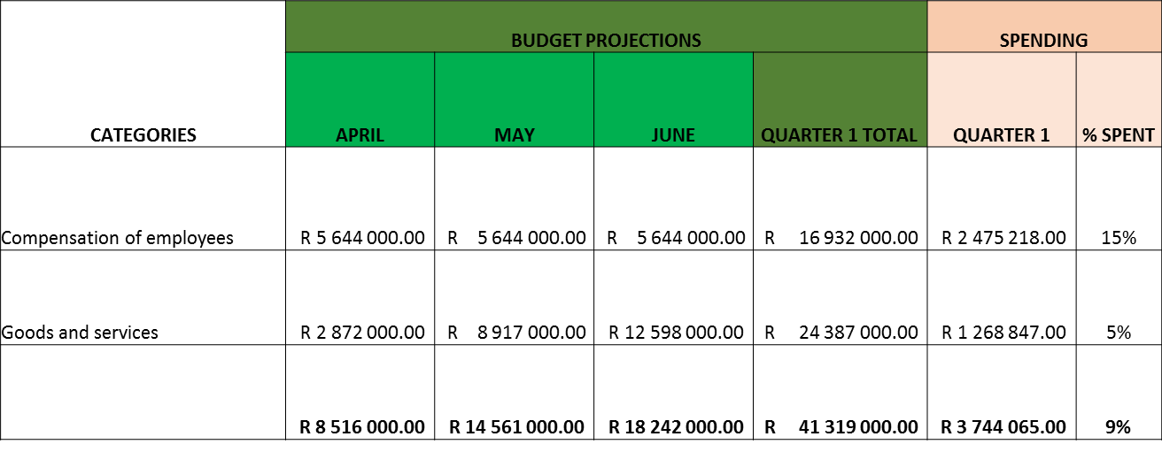
QUARTER 1 FINANCIAL PERFORMANCE

Slide 16
2018/19 QUARTER 1 PERFORMANCE
INDICATOR | QUARTER 1 TARGET AS PER APP | ACHIEVED | VARIANCE
Number of completed valuations, expressed as a percentage of total number of valuations for land reform referred by the department to the OVG for the period per the agreed annual plan | 100% 229 Restitution valuations 23 Land Redistribution and Development valuations | 139% 312 Restitution valuations 38 Land Redistribution and Development valuations | Some valuations that we conducted on Q4 of the previous year were quality assured and finalised in Q1
Criteria, procedures and guidelines determined to standardise valuation practices for land reform valuations, cumulative progress per plan to be approved by VG | Research on development commenced | Not Achieved | Research on development could not commence as a deviation on the appointment of a provider was finalised on 26/06/2018 due to procurement delays. The appointment of a provider could only be finalised on the 23/07/2018. The Annual target is on track for achievement.
Completion of the "determination of the business operating model and establishment of internal controls" project | 25% | 50% | Some deliverables were signed off in Q1
Performance information has been independently verified

Slide 17
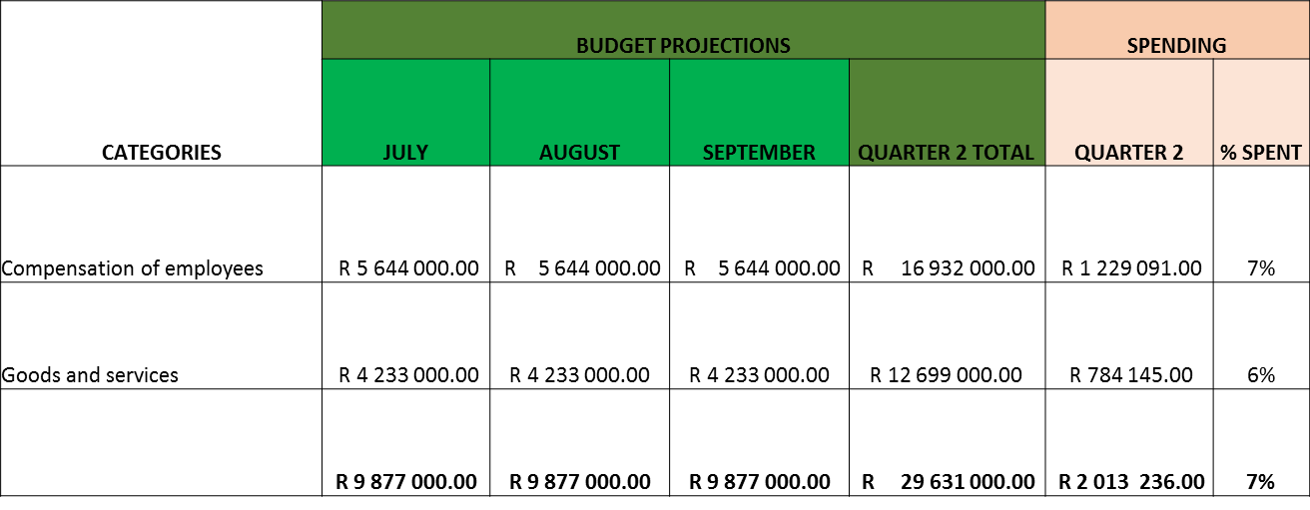
2018/19 QUARTER 2 FINANCIAL PERFORMANCE

Slide 18
2018/19 QUARTER 2 PERFORMANCE
INDICATOR | QUARTER 2 TARGET AS PER APP | ACHIEVED | VARIANCE
Number of completed valuations, expressed as a percentage of total number of valuations for land reform referred by the department to the OVG for the period per the agreed annual plan | 100% of quarterly target per agreed plan 357 Restitution valuations 54 Land Redistribution and Development valuations | 101% 362 Restituion valuations 55 Land Redistribution and Development Valuations | N/A
Criteria, procedures and guidelines determined to standardise valuation practices for land reform valuations, cumulative progress per plan to be approved by VG | Development 50% complete | Development 100% complete | N/A
Completion of the "determination of the business operating model and establishment of internal controls" project | 50% | 50% | N/A

Slide 19
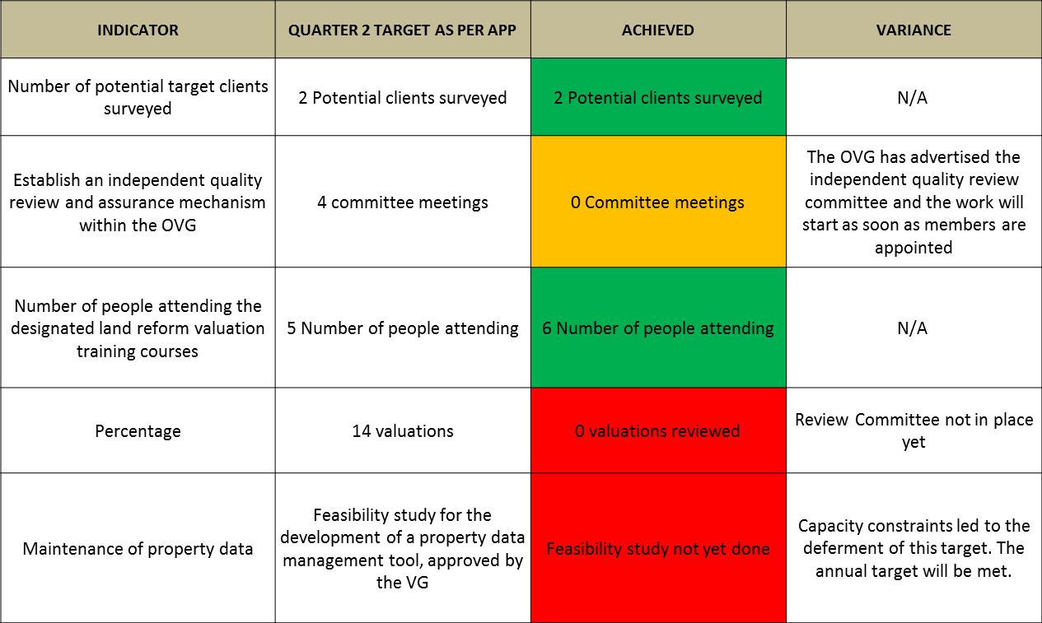
2018/19 QUARTER 2 PERFORMANCE

Slide 20
Management Report
The office of the OVG did not have any investigations in terms of chapter 10 of the PFMA
The OVG did not request for the budget realignment for 2019/20 and 2020/21. Only a request to an inflation linked increase (6%)for 2021/21. The budget realignment will be considered during the finalisation of the new budget cycle.
The OVG has submitted a request to retain R57,7 million unspent funds for the 2017/18 financial year. The office is awaiting a response from the National Treasury

Slide 21
RE YA LEBOHA

